Slide 1
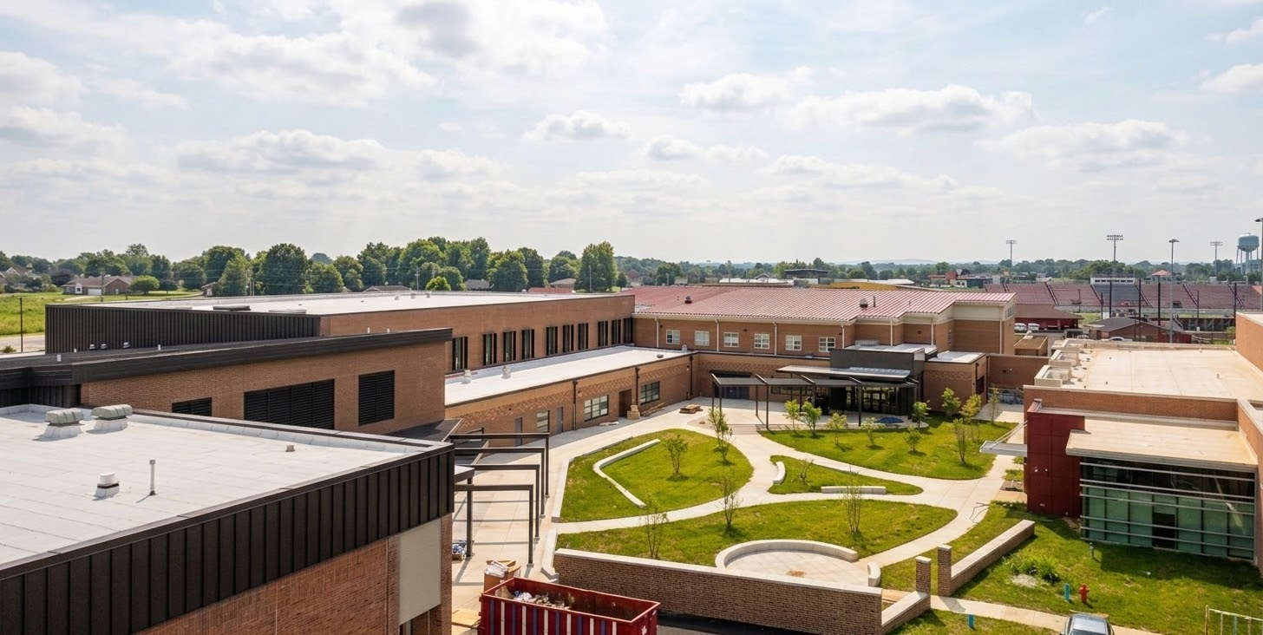


July 27th
Design & Construction Update

Slide 2
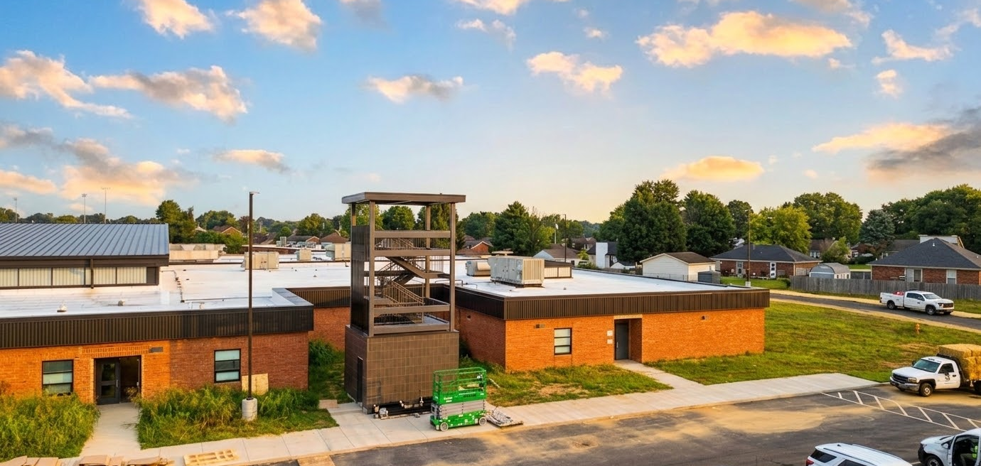

Fine Arts
Bullitt East - Construction

Slide 3
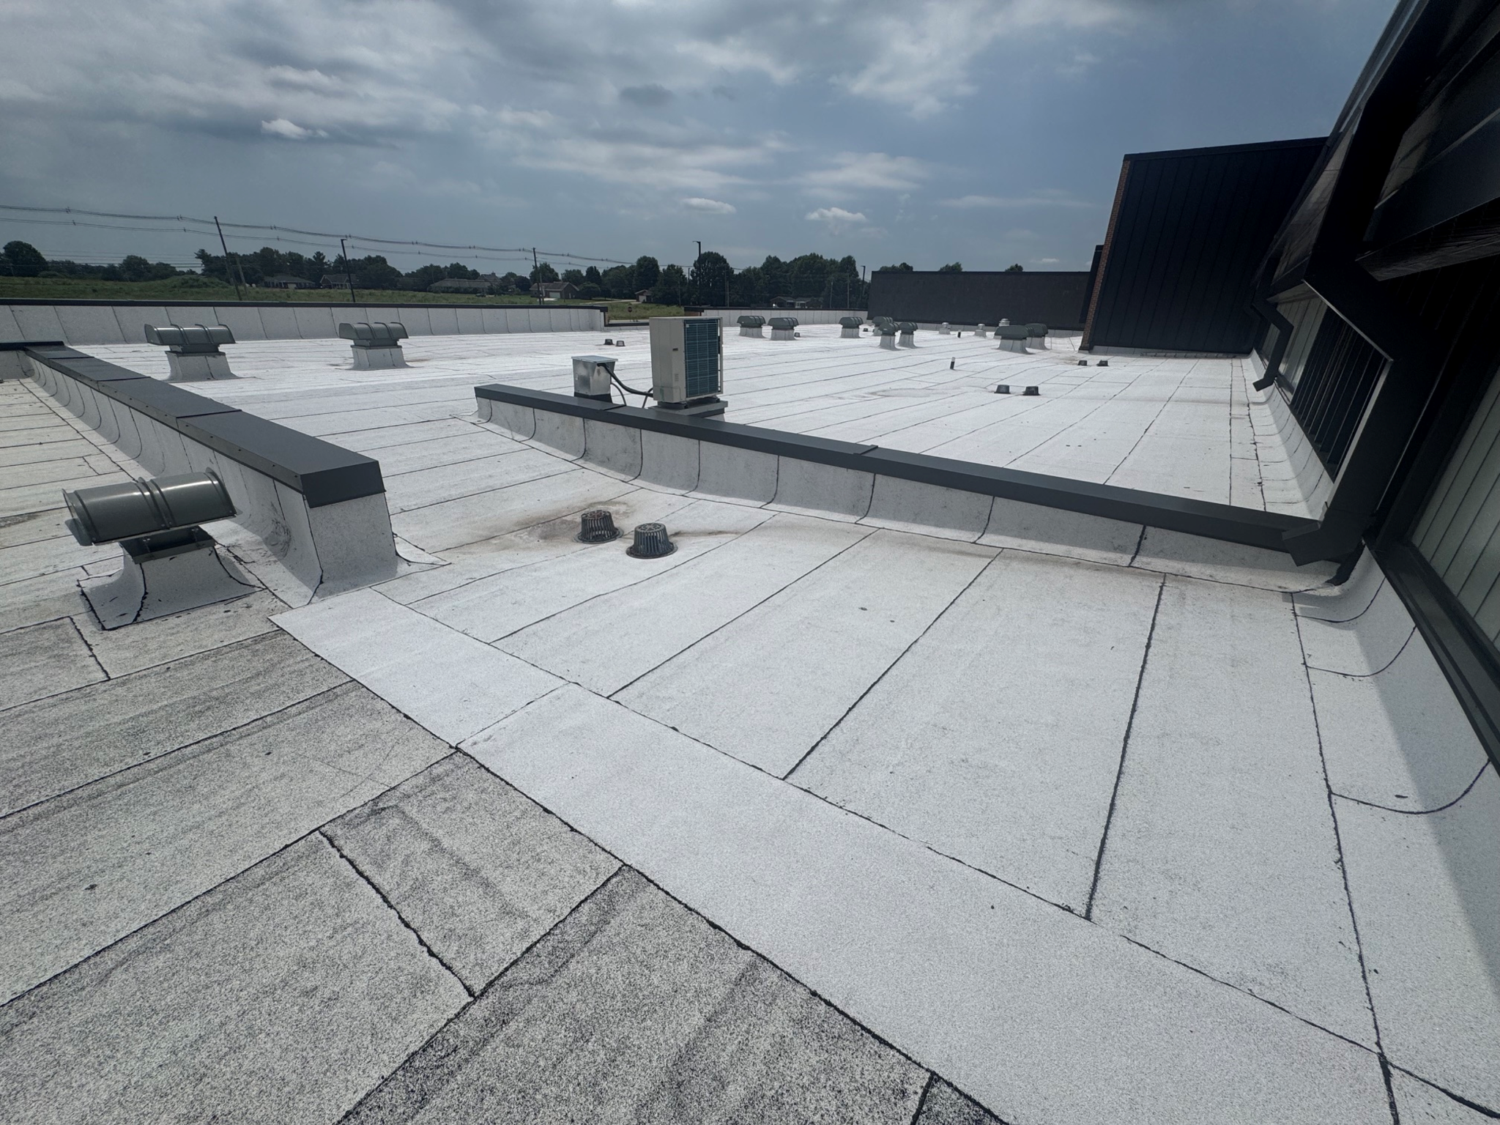
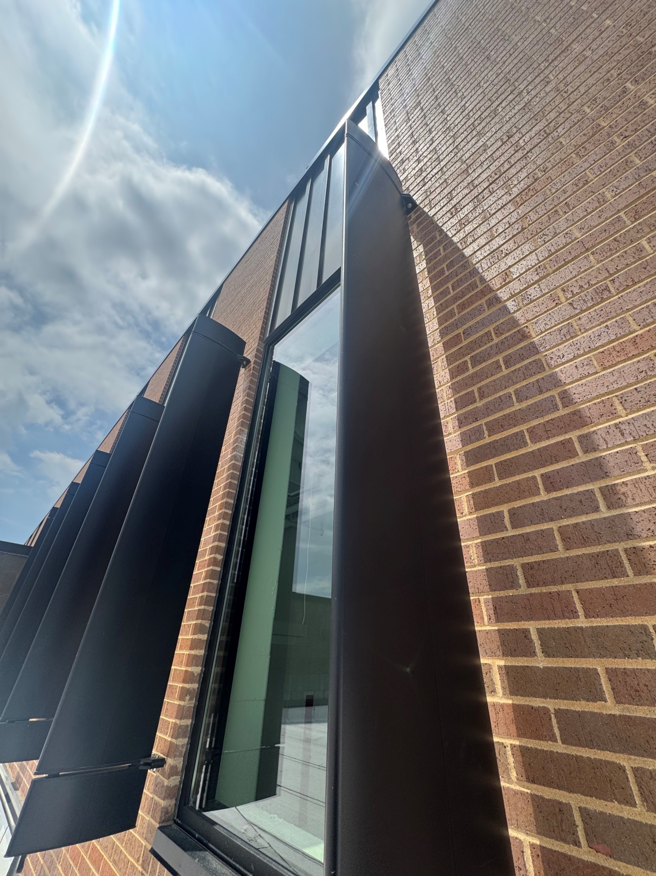
Fine Arts
Bullitt East - Construction

Slide 4
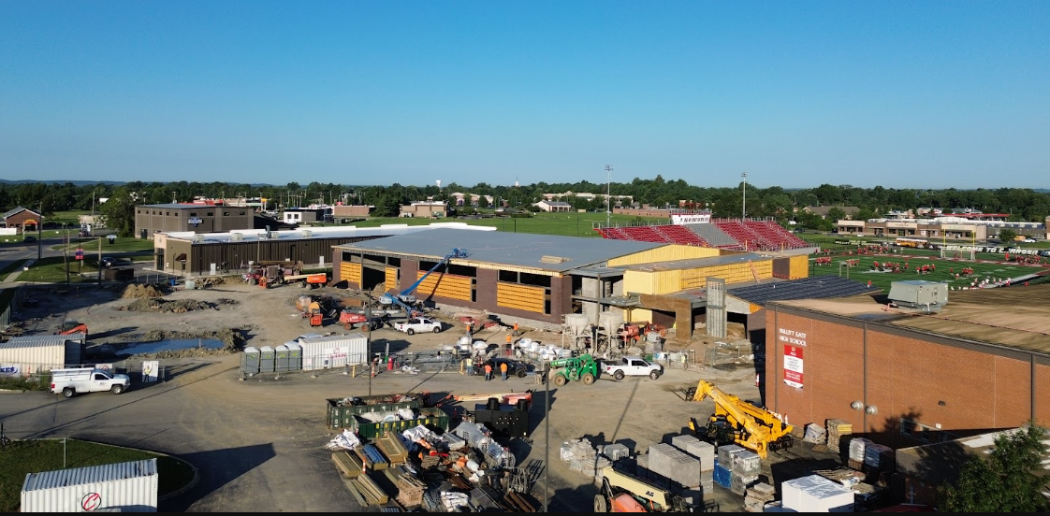
Phase 3 Athletics - Physical Science Center
Bullitt East Construction

Slide 5
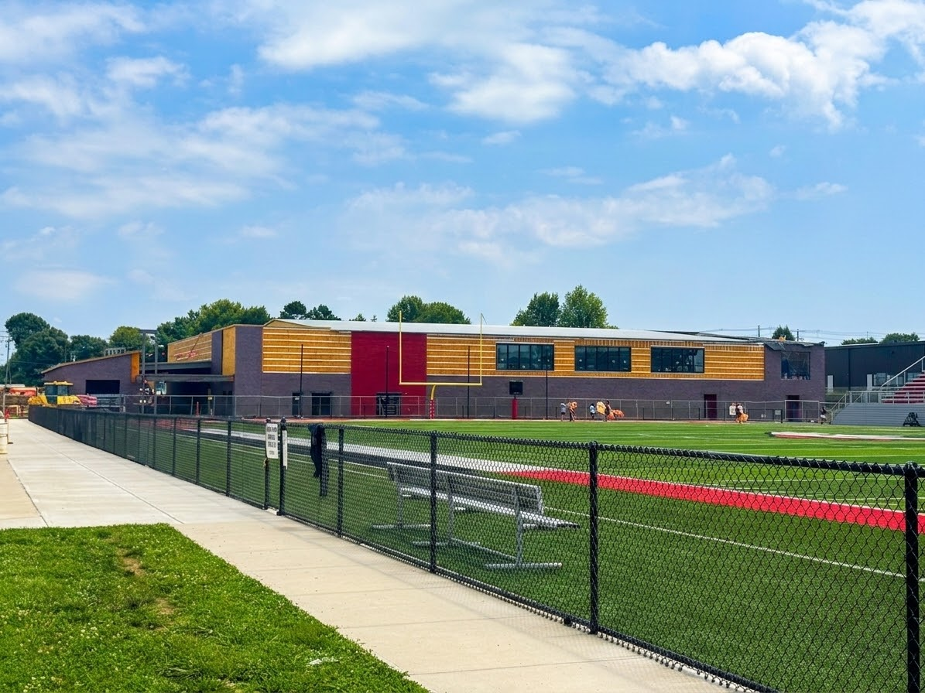
Board Consent Items - Bid Package No. 1 - Bullitt East PSC
Bullitt East PSC – BG 25-145 – Change Order #19 - Restroom Alcove $6,523.00
Exterior soffit panels and framing is being recommended at the exterior restroom alcoves at both public restrooms to provide a ceiling in lieu of leaving the area open to the floor slab.
Bullitt East PSC – BG 25-145 – Change Order #20 - Restroom Alcove $6,621.00
BCPS Leadership requested the masonry opening meant for a bell be enclosed with brick.
Phase 3 Athletics - Physical Science Center
Bullitt East Construction

Slide 6
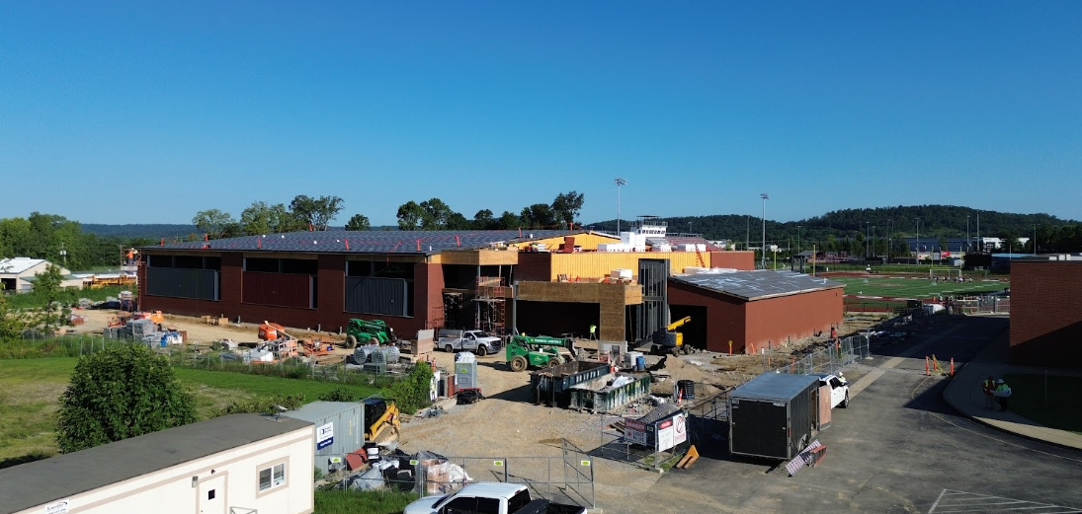

Phase 3 Athletics - Physical Science Centers
Bullitt Central Construction

Slide 7
Board Consent Items - Bid Package No. 1 - Bullitt Central PSC
Bullitt Central PSC – BG 25-145 – Change Order #18 - Exterior Water Line $19,833.00
BCPS Facilities requested the addition of a water line and exterior water yard hydrant to serve the stadium grandstands.
Bullitt Central PSC – BG 25-145 – Change Order #19 - Restroom Alcove $6,523.00
Exterior soffit panels and framing is being recommended at the exterior restroom alcoves at both public restrooms to provide a ceiling in lieu of leaving the area open to the floor slab.
Bullitt Central PSC – BG 25-145 – Change Order #20 - Restroom Alcove $6,621.00
BCPS Leadership requested the masonry opening meant for a bell be enclosed with brick.
Phase 3 Athletics - Physical Science Centers
Bullitt Central Construction

Slide 8
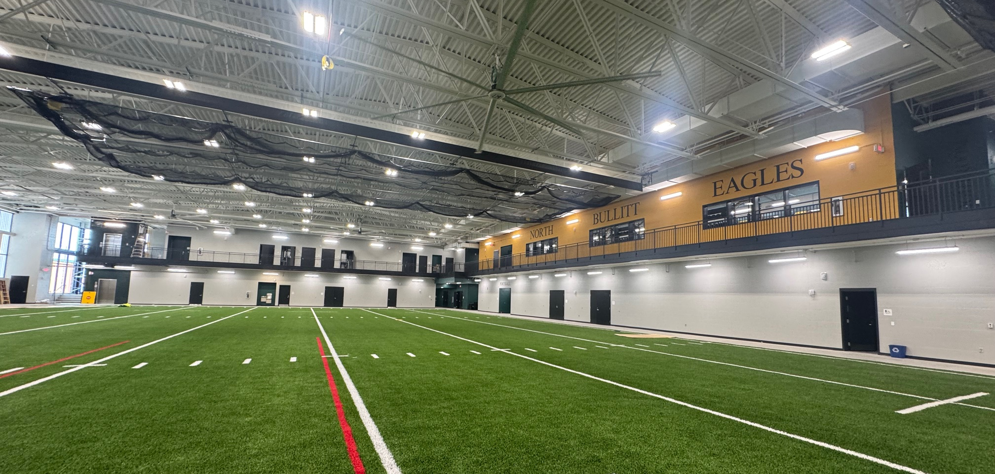

Phase 2 Athletics - Physical Science Centers
North Bullitt Construction

Slide 9
Board Consent Items - Bid Package No. 2 - North Bullitt
North Bullitt PSC – BG 24-192 – Change Order #40 - Football Locker Room Revisions - $11,149.00
The local building code official is requiring changes to the exiting plan of the football locker room. These changes include signage describing occupancy limits and door hardware revisions at the Football Locker Room. This is a local authority having jurisdiction (AHJ) requirement to obtain a final Certificate of Occupancy.
North Bullitt PSC – BG 24-192 – Change Order #41 - North Transfer Duct - $6,809.00
This Change Order includes the provision of a transfer duct at the exhaust line to step down the size where required as well as additional duct offsets to route ductwork through existing installed systems. Work can happen in sequence with scheduled construction activities and avoid delays.
Phase 2 Athletics - Physical Science Centers
North Bullitt Construction

Slide 10
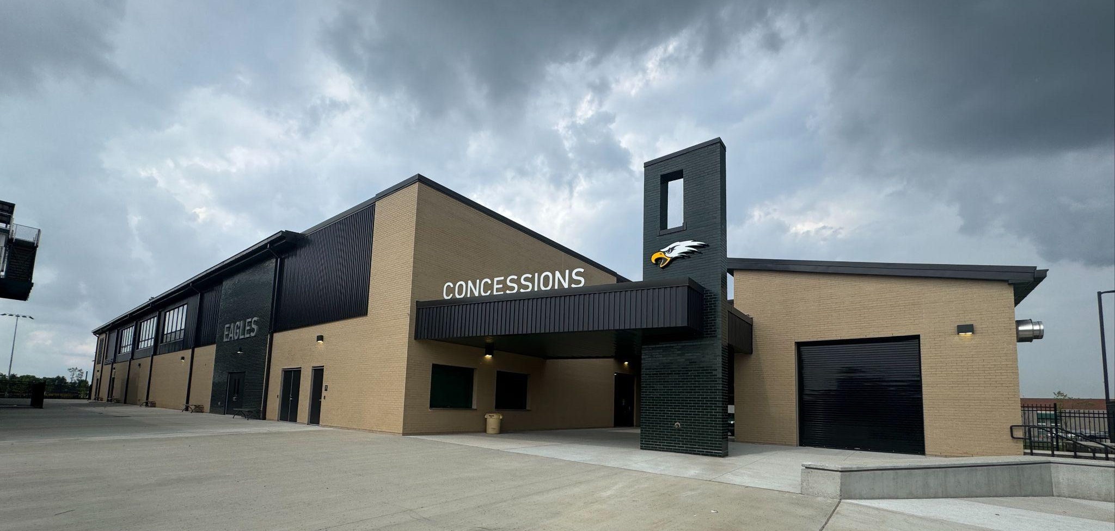
Phase 2 Athletics - Physical Science Centers
North Bullitt Construction

