Slide 1
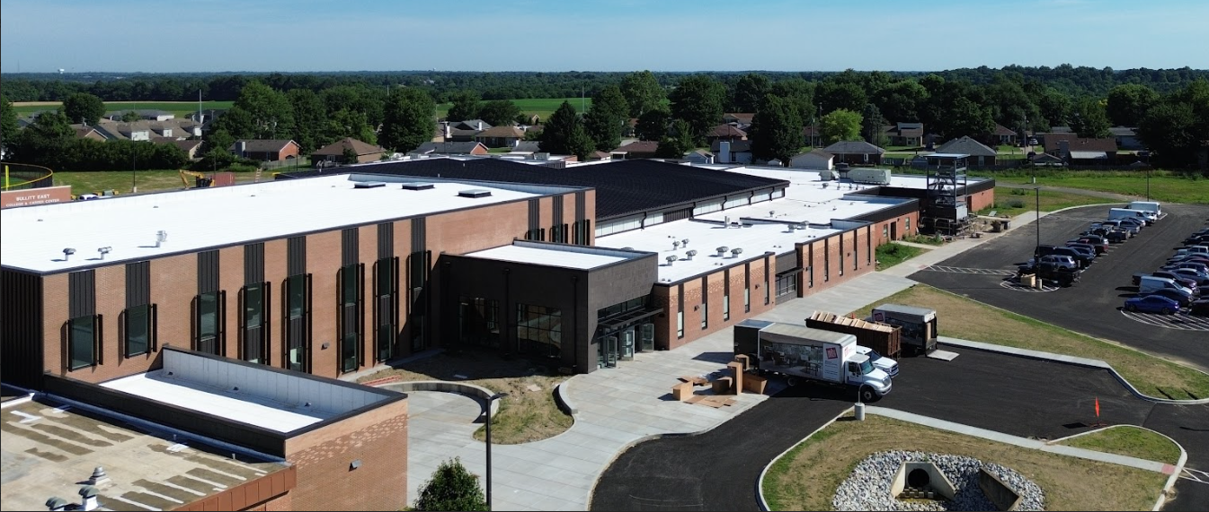


June 15th - Design & Construction Update

Slide 2


Stadium -
2022-2023
Fine Arts -
2023-2026
Baseball Softball -
2024-2025
Physical Science-
2024-2026

Slide 3
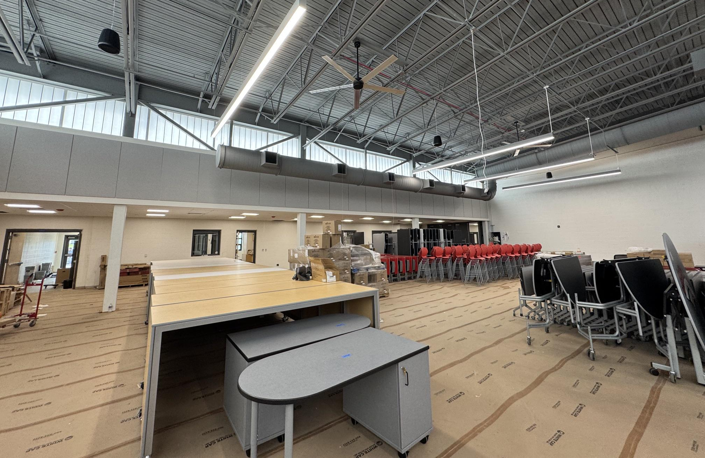
Fine Arts
Bullitt East High School - Construction

Slide 4
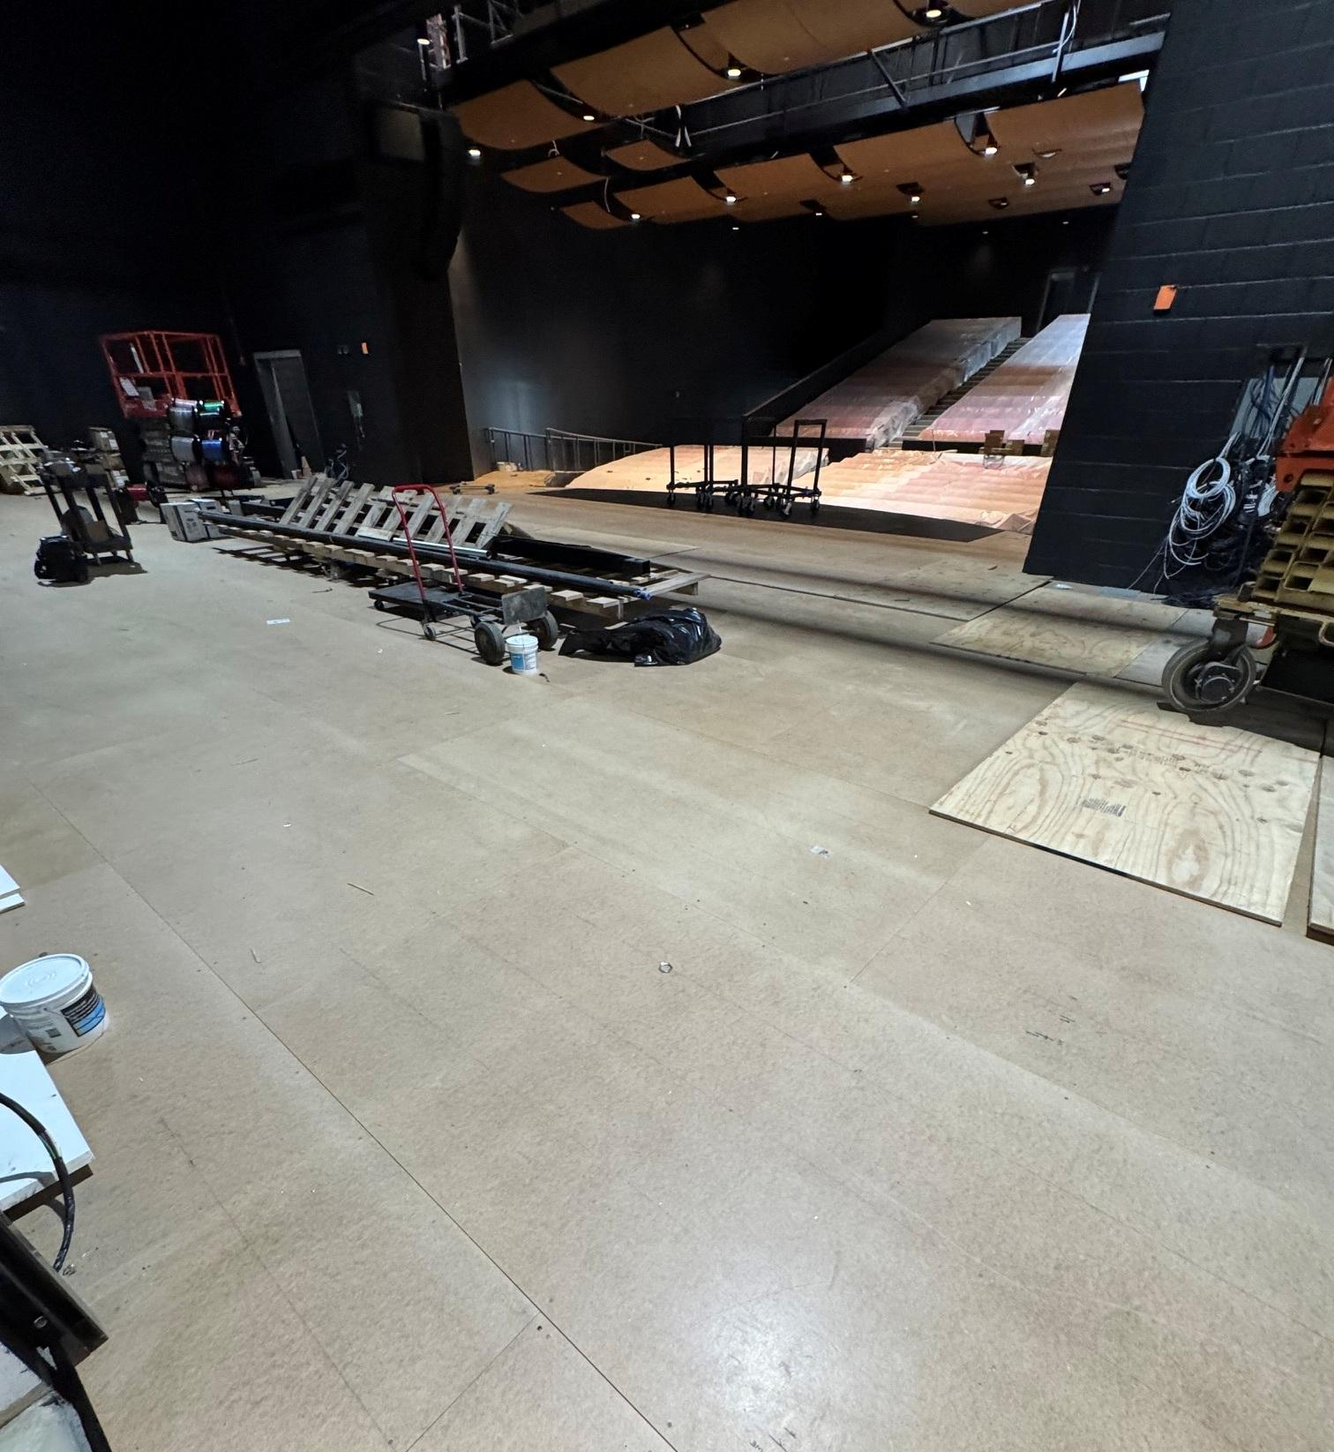
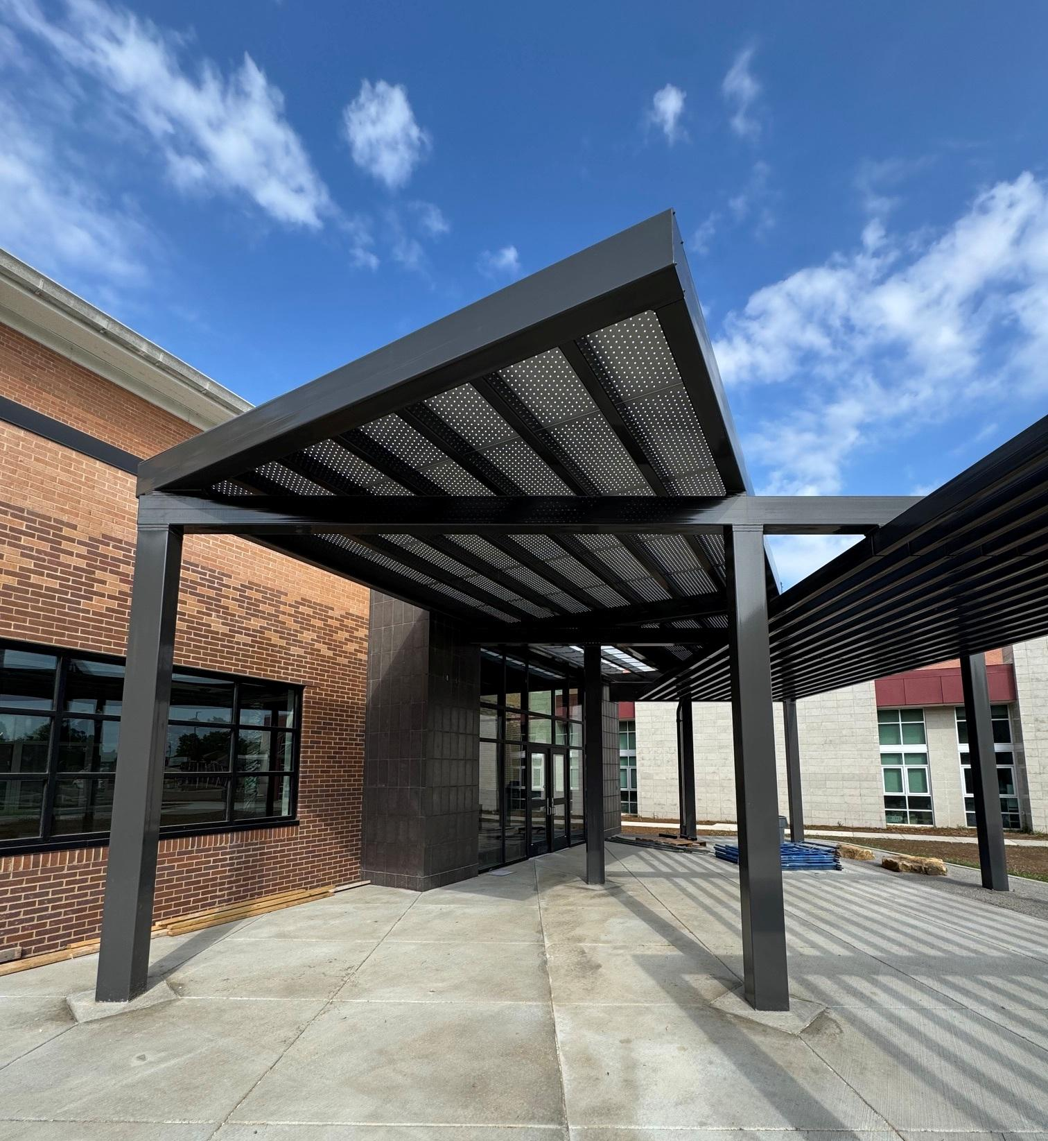
Fine Arts
Bullitt East High School - Construction

Slide 5
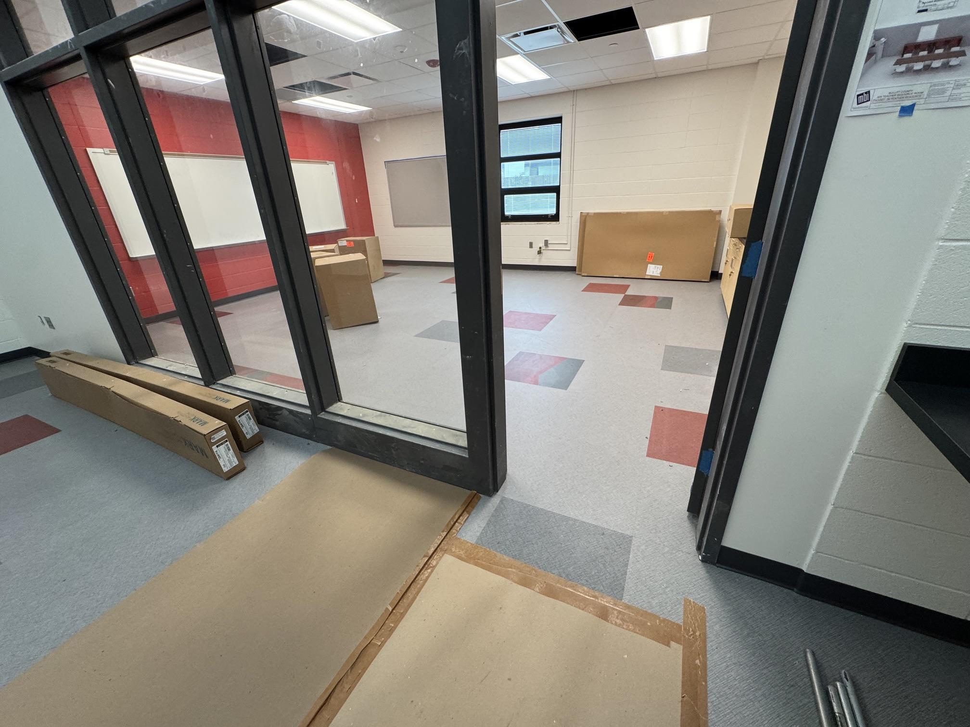
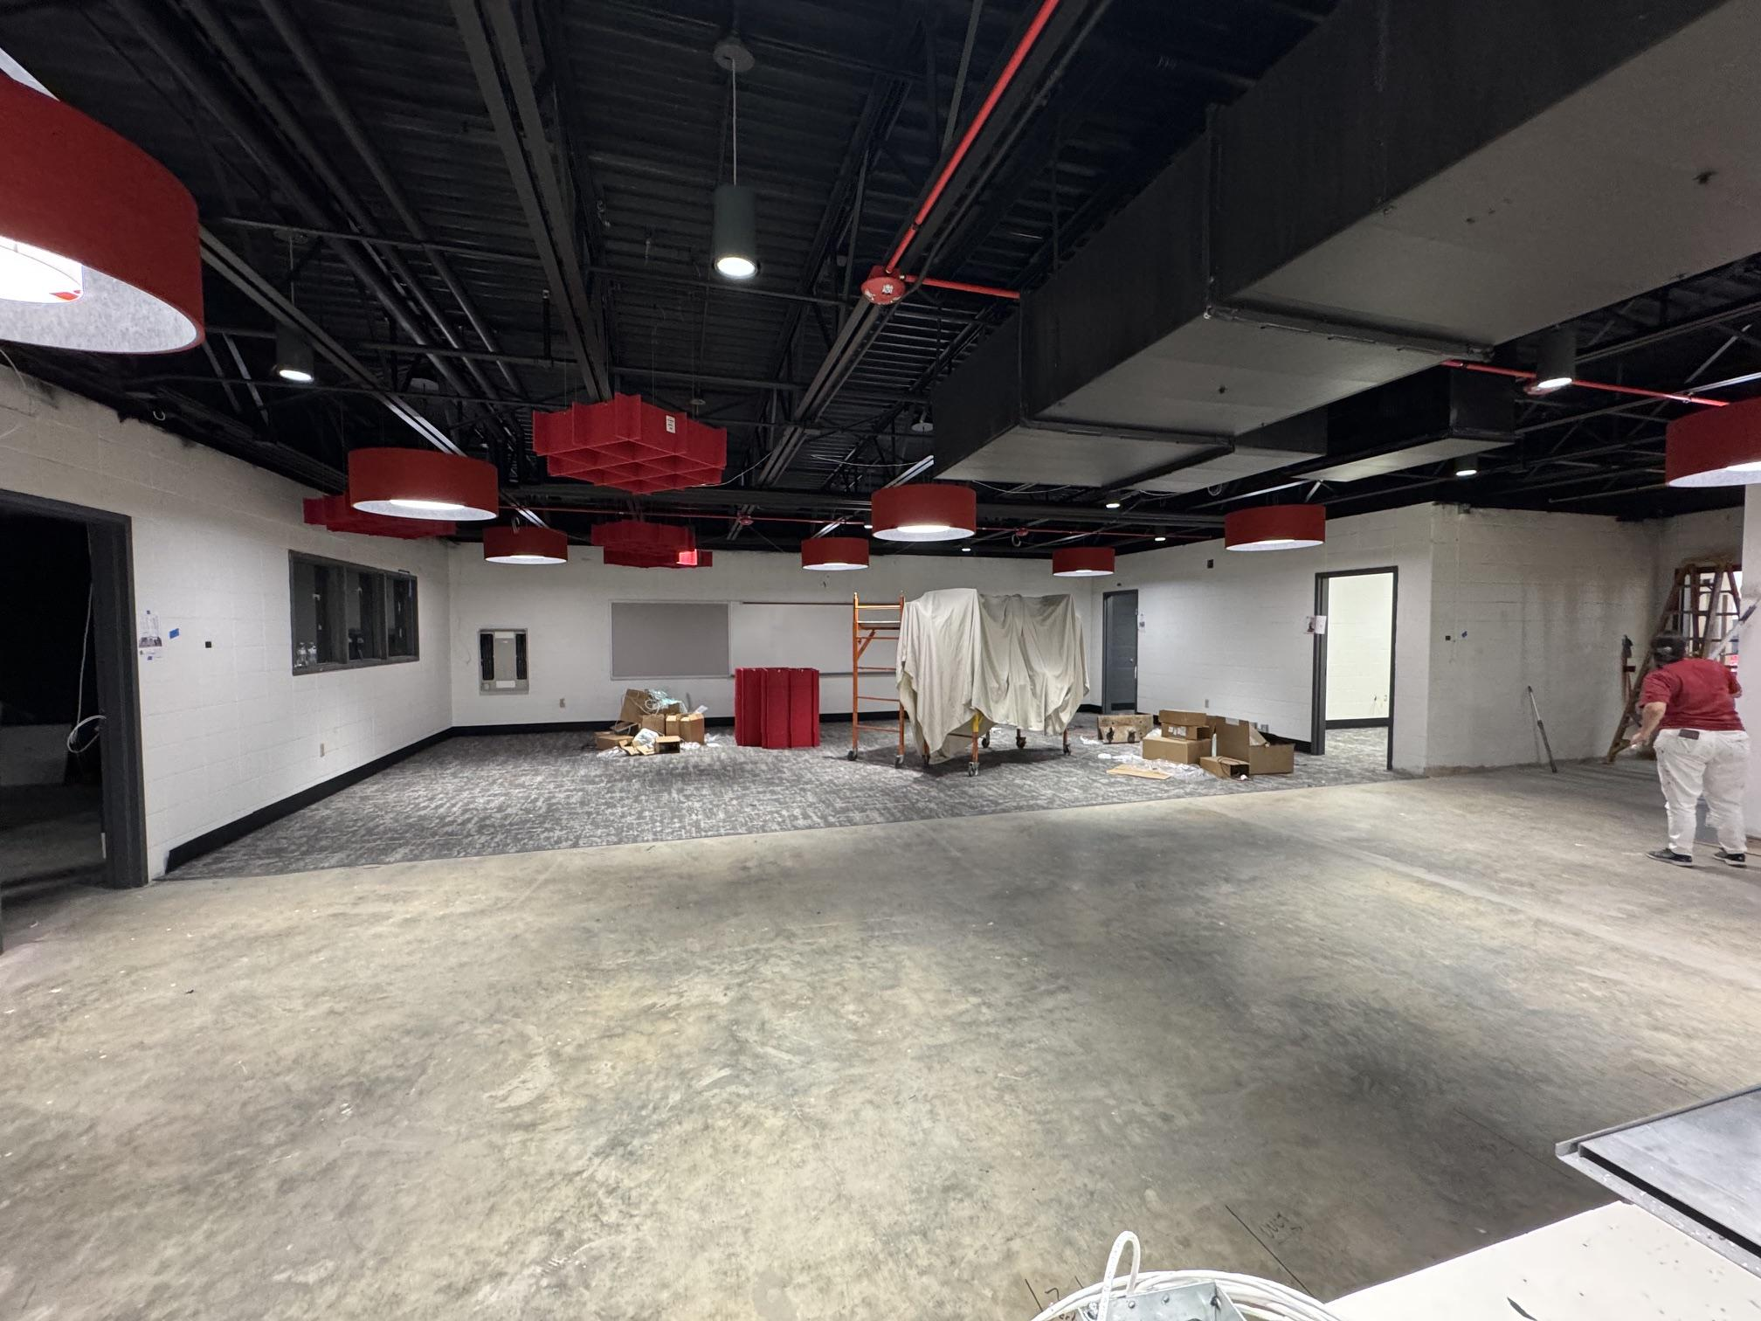
Fine Arts
Bullitt East High School - Construction

Slide 6
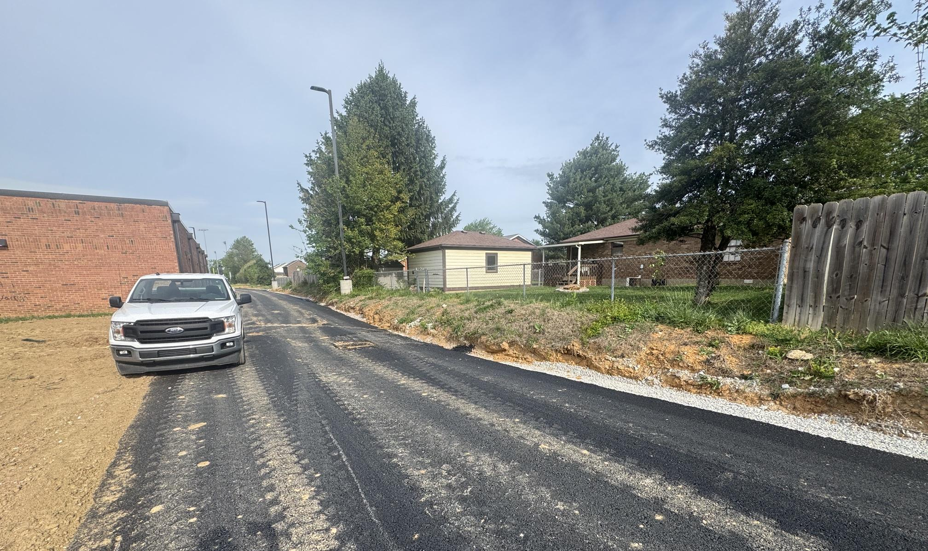
Board Consent Items - Bid Package No. 1 - Bullitt East Fine Arts
Change Order #37 - Retaining Wall - $48,496.58
Due to the grades on the adjacent properties at the new access road behind the school, it is recommended a pre-cast concrete retaining wall be added. Work can commence with trades already mobilized on site in sequence with the construction schedule.
Fine Arts
Bullitt East High School - Construction

Slide 7
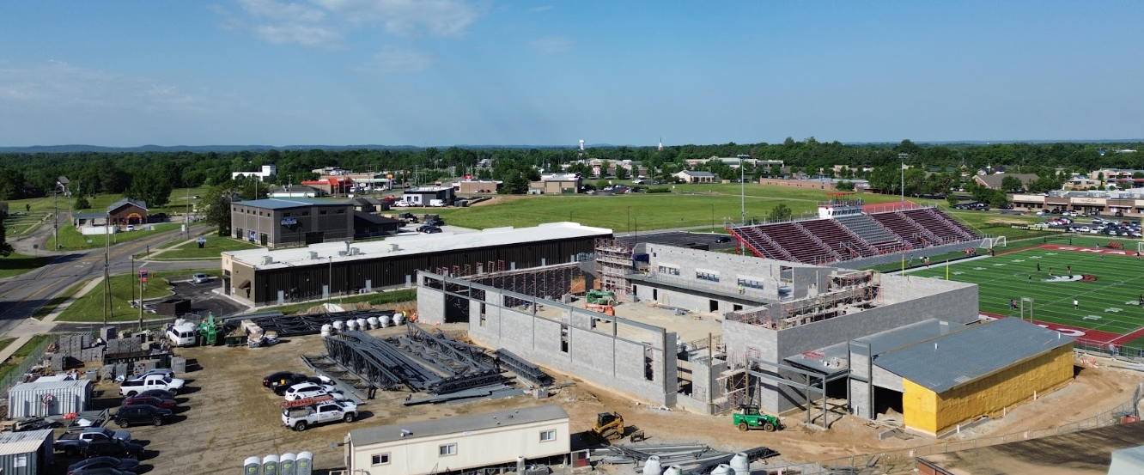
Phase 3 Athletics - Physical Science Centers
Bullitt Central & Bullitt East - Construction

Slide 8
Board Consent Items - Bid Package No. 1 - Bullitt East PSC
Bullitt East PSC – BG 25-145 – Change Order #17 - Elevator Cab Flooring and Lifeline Beam $5,258.00
This Change Order covers the cost of an additional steel lifeline beam that is required by current elevator code. Also, work includes provision of a laminate floor finish at the interior of the elevator cab.
Bullitt East PSC – BG 25-145 – Change Order #18 - Lighting Changes - $20,219.00
BCPS Facilities requested additional lights be added at the locker room stalls, mop sink, shower stalls and PE locker room doorways. This also accounts for light location revisions relative to duct rerouting.
Physical Science Center
Bullitt East High School - Construction

Slide 9
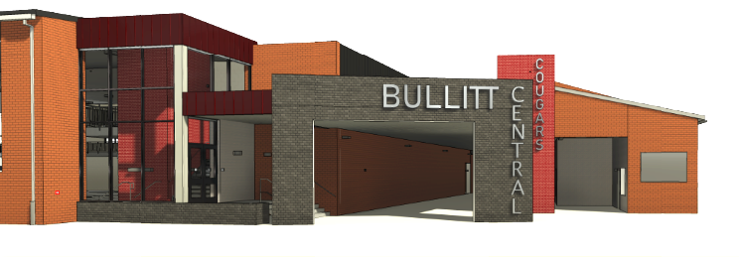

Phase 3 Athletics - Physical Science Centers
Bullitt Central Construction

Slide 10
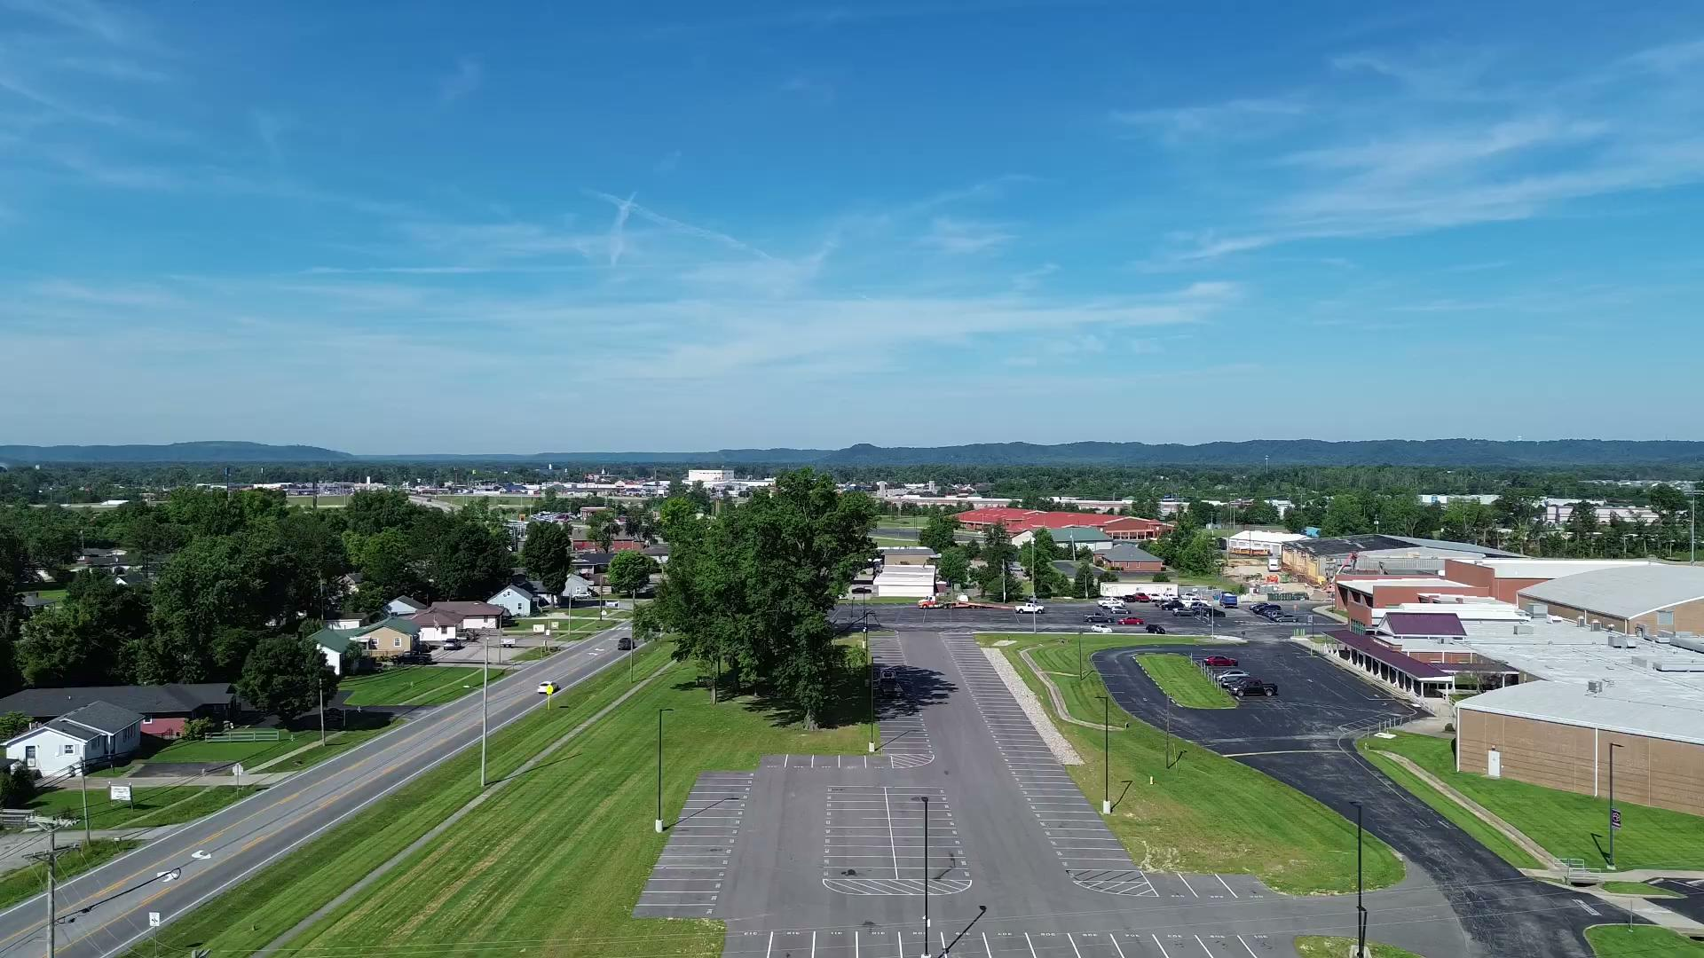
Stadium -
2022-2023
Baseball Softball -
2024-2025
Physical Science-
2024-2026

Slide 11
Board Consent Items - Bid Package No. 1 - Bullitt Central PSC
Bullitt Central PSC – BG 25-145 – Change Order #16- Elevator Cab Flooring and Lifeline Beam $5,258.00
This Change Order covers the cost of an additional steel lifeline beam that is required by current elevator code. Also, work includes provision of a laminate floor finish at the interior of the elevator cab.
Bullitt Central PSC – BG 25-145 – Change Order #17 - Lighting Changes - $20,219.00
BCPS Facilities requested additional lights be added at the locker room stalls, mop sink, shower stalls and PE locker room doorways. This also accounts for light location revisions relative to duct rerouting.
Physical Science Center
Bullitt Central High School - Construction

Slide 12
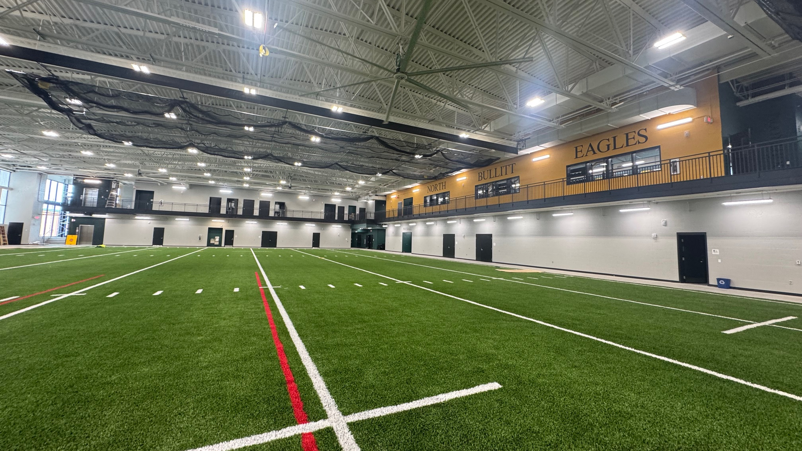


Phase 2 Athletics
NBHS Physical Science Center

Slide 13
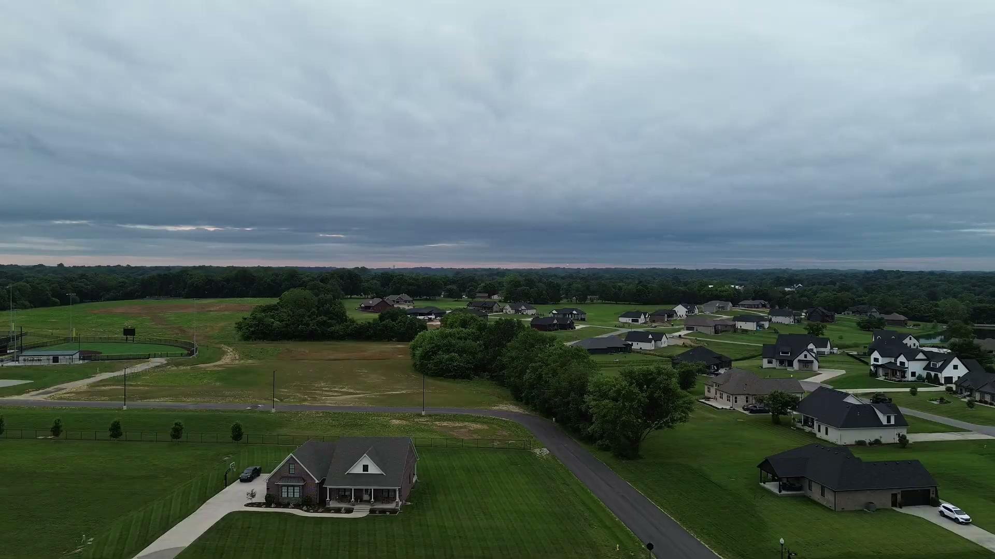
Stadium -
2022-2023
Baseball Softball -
2024-2025
Physical Science-
2024-2026
Phase 2 Athletics
NBHS Physical Science Center

Slide 14
Board Consent Items - Bid Package No. 2 - North Bullitt
North Bullitt PSC – BG 24-192 – Change Order #38 - AV Changes - $6,121.00
BCPS Technology requested an AV panel be moved from the practice field space into the AV closet. This work covers relocation of equipment and associated wall patch and paint.
North Bullitt PSC – BG 24-192 – Change Order #39 - Ductwork Revisions - $160,590.00
BCPS Leadership requests the duct routing in the PE locker rooms be revised to increase height of the ducts in the interior spaces. To achieve this, ductwork is being relocated to the practice field area to pull it out of the PE rooms to gain more height and will be changed in shape to achieve additional height. Work affects all trades. Based on built construction, the Design Team and Construction teams will be performing work to confirm final duct sizes as a design/build exercise that could affect this cost on a time and material basis if additional duct transitions are needed to avoid building infrastructure or achieve additional height.
Phase 2 Athletics
NBHS Physical Science Center

Slide 15
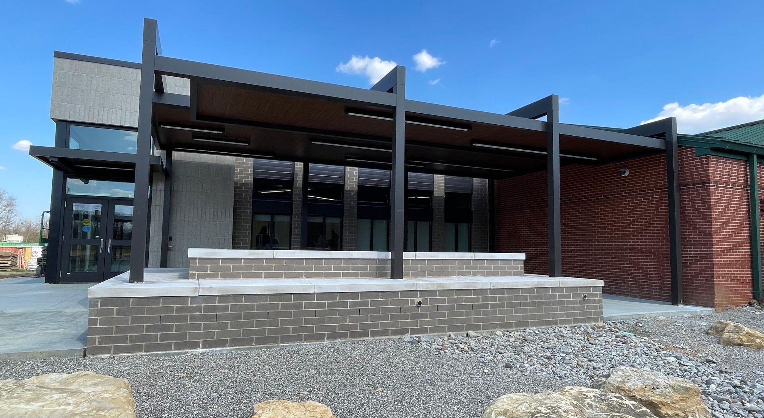

Bernheim Middle School - Close Out

Slide 16
Board Consent Items - Bid Package No. 2 - North Bullitt
Bernheim DPO Reconciliation DPO Reconciliation Credit for unbilled materials including the following:
  DPO 09 – 24901707 – Mills Supply - $0.27
BG-4 and Substantial Completion
Attached paperwork is listed below with action items noted for each:
BG 23-051 - Bernheim - BP1 - Calhoun - BG-4 - for Board Signature
  BG 23-051 - Bernheim - BP1 - Calhoun - Substantial Completion - for Board Signature
BG 23-051 - Bernheim - BP2 - Trane - BG-4 - for Board Signature
  BG 23-051 - Bernheim - BP2 - Trane - Substantial Completion - for Board Signature
BG 23-051 - Bernheim - BP3 - Business Cabling - BG-4 - for Board Signature
  BG 23-051 - Bernheim - BP3 - Business Cabling - Substantial Completion - for Board Signature
Verbiage for Board Memo:
BG-4’s and Substantial Completion Certificates for three bid packages associated with the Bernheim Middle School project are attached for Board Review and Signature.
Bernheim Middle School - Close Out

