Slide 1
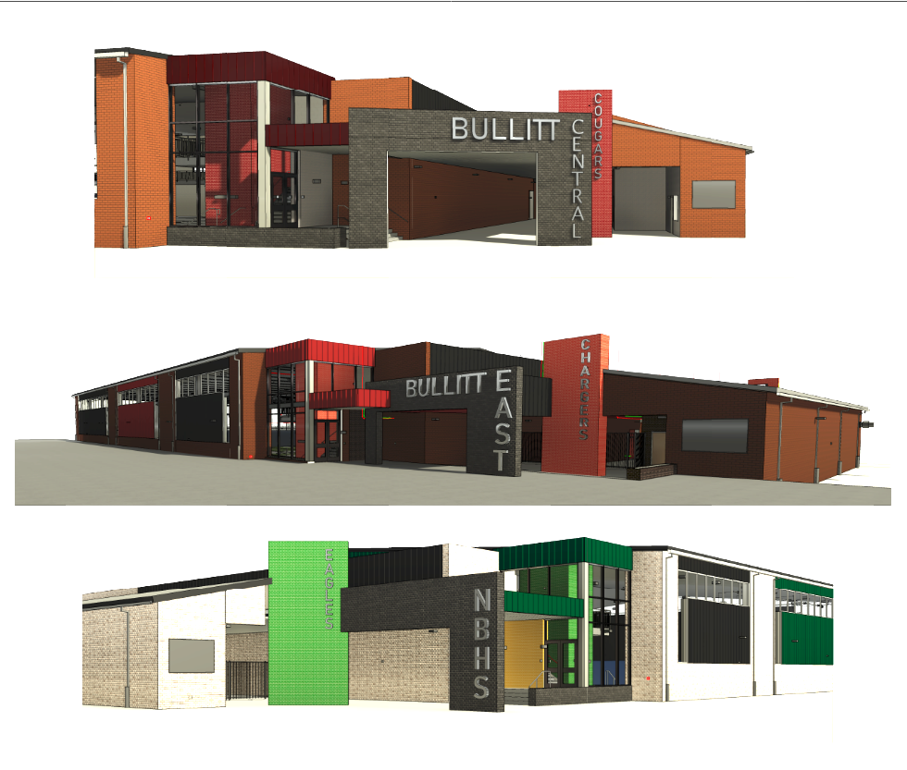




Phase 3 Athletics - Physical Science Centers
Bullitt Central & Bullitt East - Construction

Slide 2
Board Consent Items - Bid Package No. 1 - Bullitt Central PSC
Change Order 14 – Ductwork Revisions - $25,128.00
BCPS Leadership requests the duct routing in the PE locker rooms be revised to increase height of the ducts in the interior spaces. To achieve this, ductwork is being relocated to the practice field area to pull it out of the PE rooms to gain more height. The costs are priced under to separate cost documents due to revisions to the design once contractors could confirm duct heights in the field. Two COR’s result in the total Change Order cost.
Change Order 15 – Geothermal Water Treatment & Wall Heater Add - $94,253.00
BCPS Facilities requested the addition of an "EZ Water Treatment" system to maintain the geothermal system at the facility. Also included in this change order is the addition of an electric wall heater that maintains the temperature in the geothermal pump room per the recommendation of the commissioning engineer. Work can happen in sequence with trades on site.
Phase 3 Athletics - Physical Science Centers
Bullitt Central & Bullitt East - Construction

Slide 3
Board Consent Items - Bid Package No. 1 - Bullitt East PSC
Change Order 15 – Ductwork Revisions - $22,350.00
BCPS Leadership requests the duct routing in the PE locker rooms be revised to increase height of the ducts in the interior spaces. To achieve this, ductwork is being relocated to the practice field area to pull it out of the PE rooms to gain more height. The costs are priced under to separate cost documents due to revisions to the design once contractors could confirm duct heights in the field. Two COR’s result in the total Change Order cost.
Change Order 16 – Geothermal Water Treatment & Wall Heater Add - $94,253.00
BCPS Facilities requested the addition of an "EZ Water Treatment" system to maintain the geothermal system at the facility. Also included in this change order is the addition of an electric wall heater that maintains the temperature in the geothermal pump room per the recommendation of the commissioning engineer. Work can happen in sequence with trades on site.
Phase 3 Athletics - Physical Science Centers
Bullitt Central & Bullitt East - Construction

Slide 4
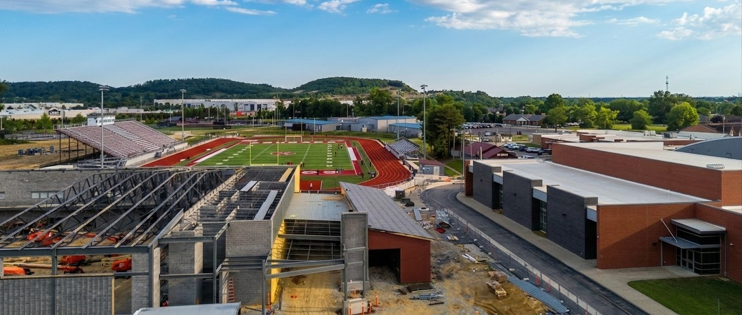
Phase 3 Athletics - Physical Science Centers
Bullitt Central & Bullitt East - Construction

