Slide 1
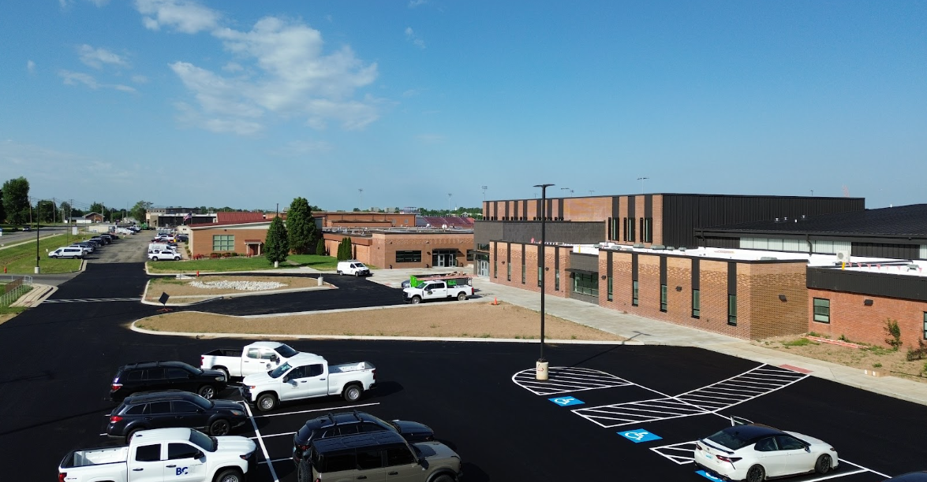



May 18th - Design & Construction

Slide 2
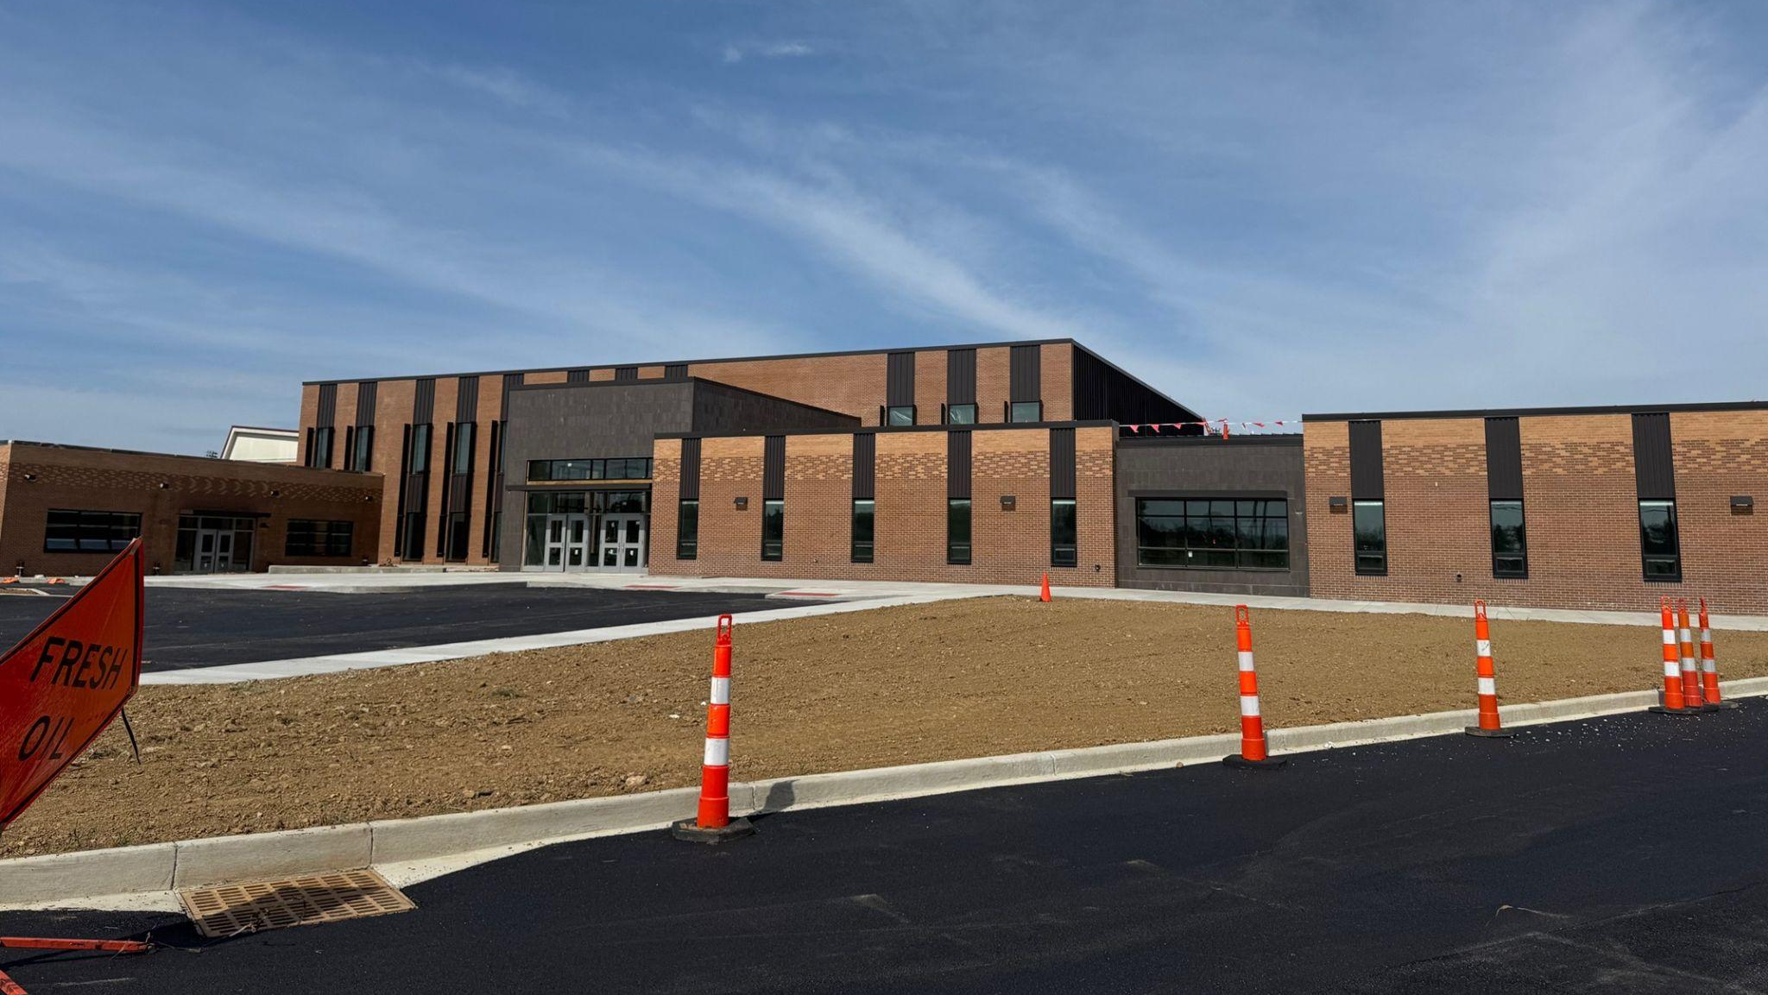

Fine Arts
Bullitt East High School - Construction

Slide 3
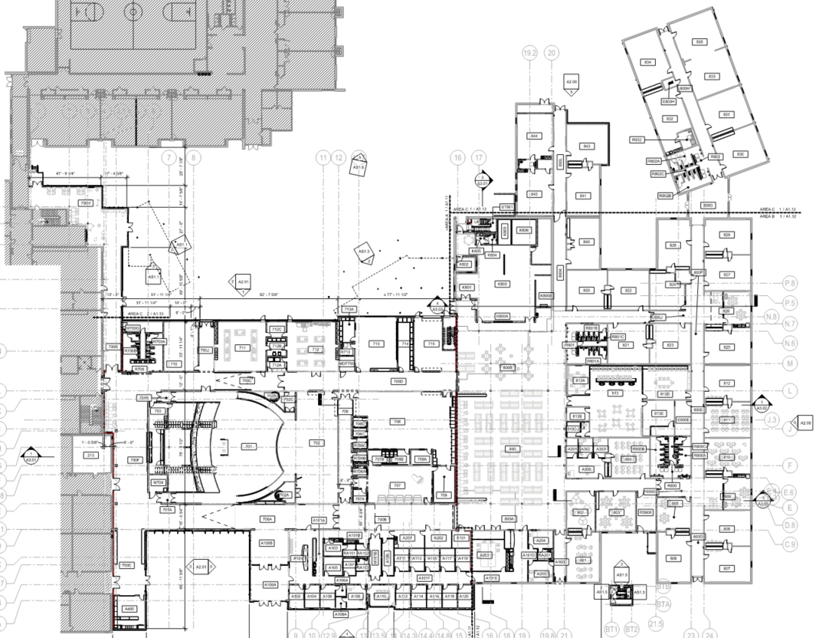
Area B
Construction Timeframe:
June 1 - Furniture
July 1 -
Turn Over to BEHS
Break Out Area
Courtyard
Area C
Area A
School Store
Band Tower
Bullitt East High School Construction

Slide 4
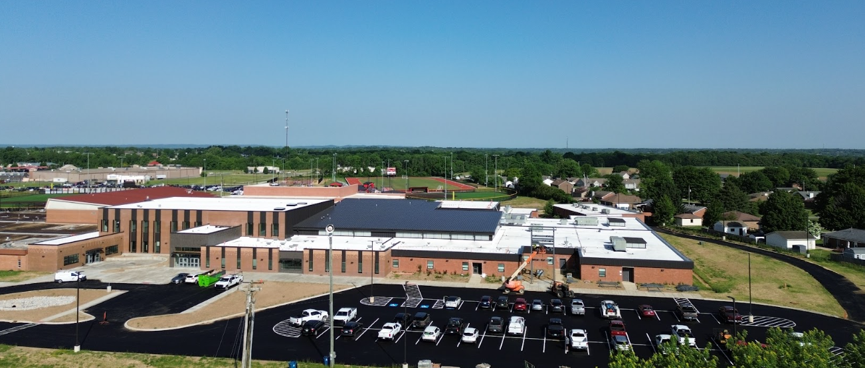
Fine Arts
Bullitt East High School - Construction

Slide 5
Board Consent Items - Bid Package No. 1 - Bullitt East Fine Arts
Change Order #34 - DPO GS Acoustics - Value Correction - Net Zero Change
This Change Order corrects the value of the GS Acoustics DPO and deducts the value from the EH Construction General Contract. This is a net-zero change.
Change Order #35 - Dock Bumpers - $1,073.98
The general contractor recommends, and BCPS Facilities agrees, with the addition of three dock bumpers at the cast-in-place concrete wall at the exterior loading dock. These bumpers will help protect the finish of the wall. Work can be done in sequence with trades on site.
Change Order #36 - Painted Revisions - $19,225.86
BEHS Administration requested a color change on classroom accent walls and a painted ceiling the digital media photography space.
Fine Arts
Bullitt East High School - Construction

Slide 6
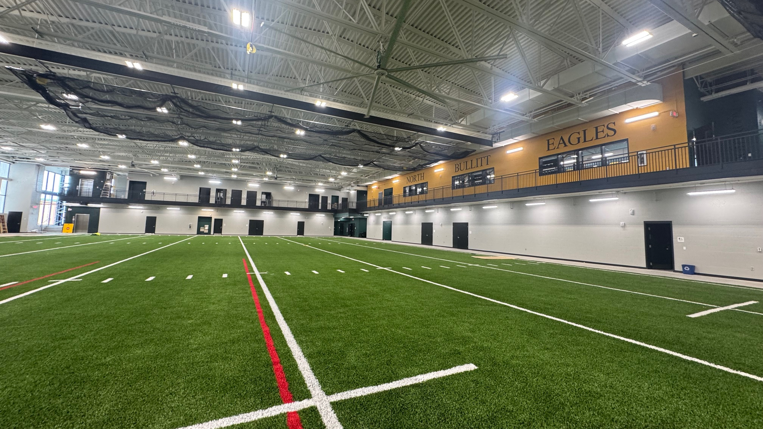

Phase 2 Athletics
NBHS Physical Science Center

Slide 7
UPDATE - Bid Package No. 2 - North Bullitt
Anticipated Inspections and Change Order Work
  Substantial Completion Meeting occurred on March 26th with Contractor.
  Substantial Completion Date Established as March 18th and May 15th is final Completion Date based on work cited, below, added via Change Order.
  Work Remaining -
    Cable Tray installation for Data Cabling - Material Delay - Starting Now
    Tennis Court Lighting - All Sites - Complete - Inspecting Sites after work was complete.
Phase 2 Athletics
NBHS Physical Science Center

Slide 8
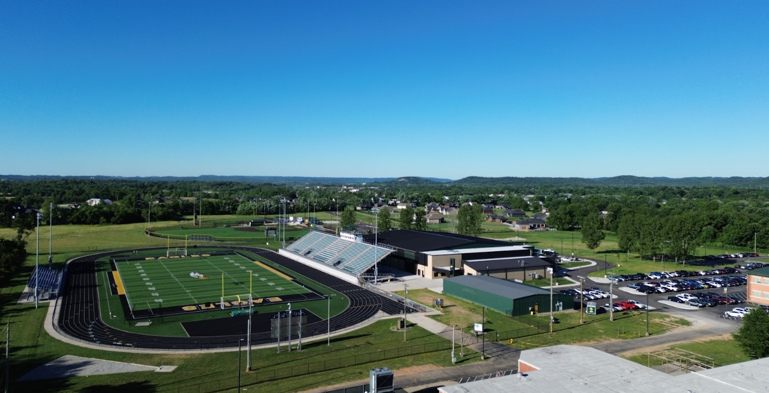
Board Consent Items - Bid Package No. 2 - North Bullitt
Change Order 07 – Access Controls DPO ADD - $12,147.59
BCPS Facilities requested the addition of Door Access Controls at the Weight Room and Two PE Locker Rooms. This is specifically for the DPO Materials Change Order to the Schiller DPO for the added Door Hardware. Calhoun’s GC contract was approved June 19th, 2025.
Phase 2 Athletics
NBHS Physical Science Center

Slide 9
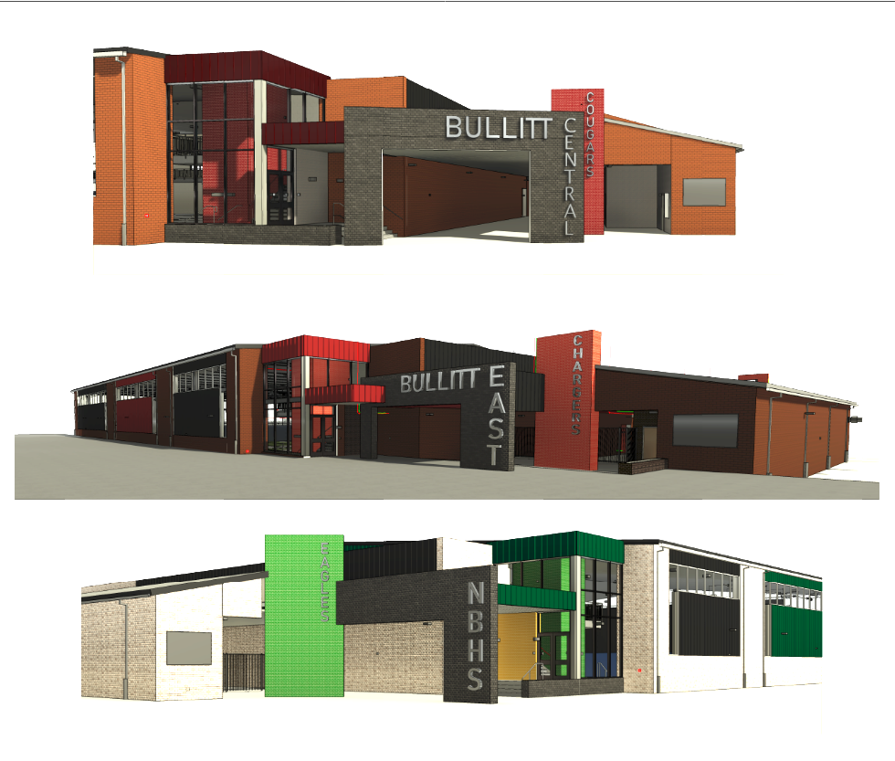

Phase 3 Athletics - Physical Science Centers
Bullitt Central & Bullitt East - Construction

Slide 10
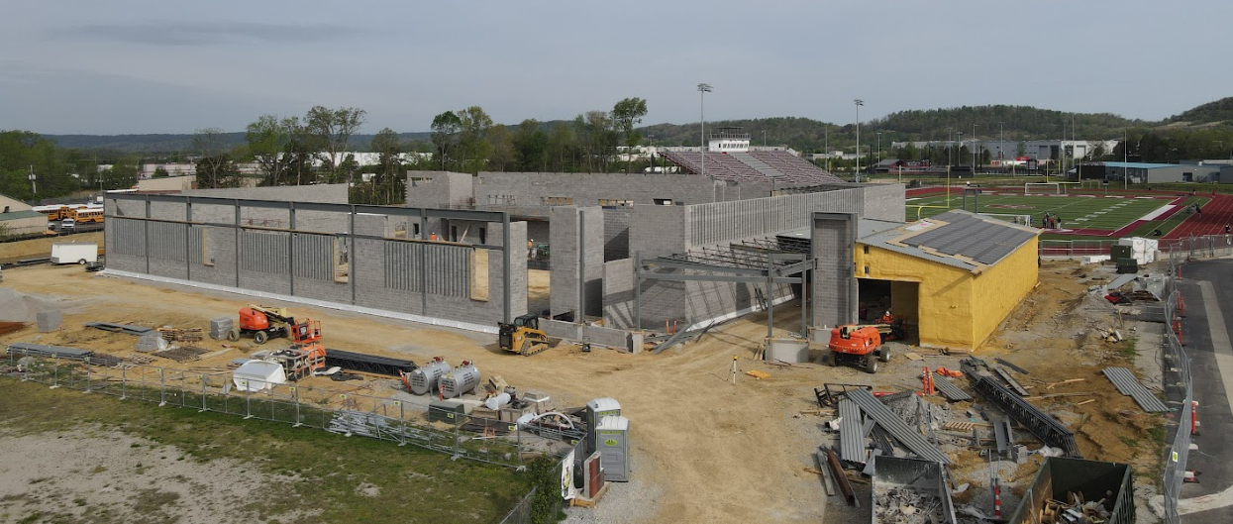
Phase 3 Athletics - Physical Science Centers
Bullitt Central & Bullitt East - Construction

Slide 11
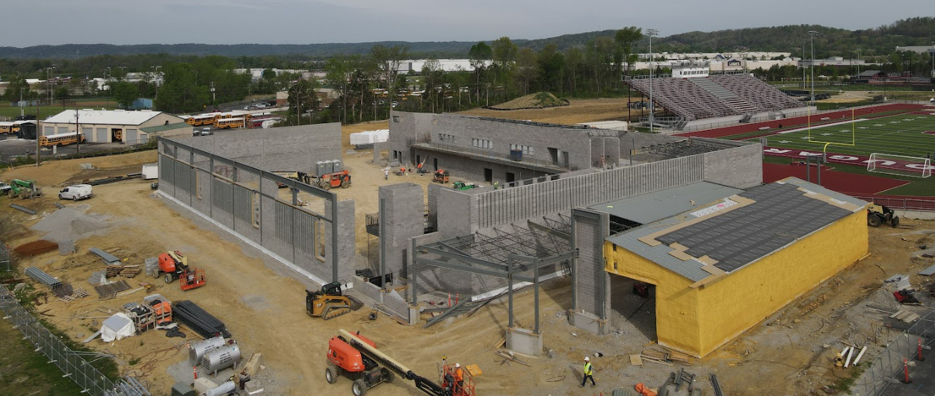
Phase 3 Athletics - Physical Science Centers
Bullitt Central & Bullitt East - Construction

Slide 12
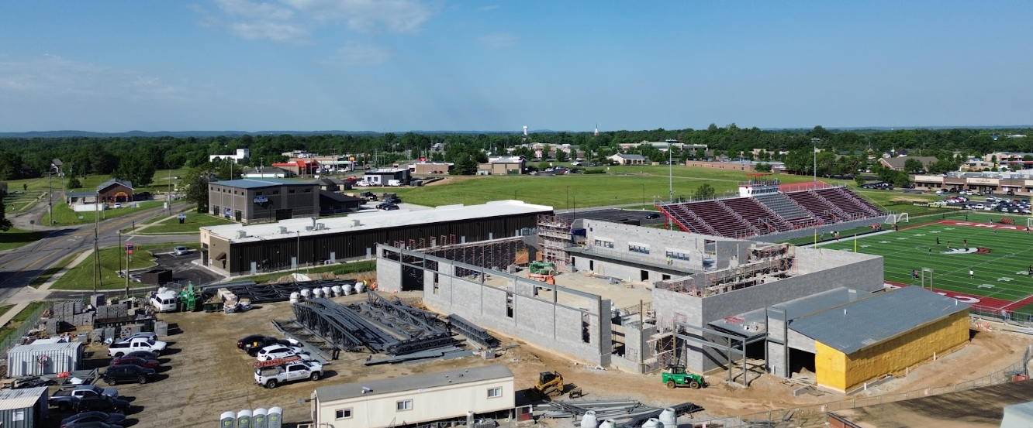
Phase 3 Athletics - Physical Science Centers
Bullitt Central & Bullitt East - Construction

Slide 13
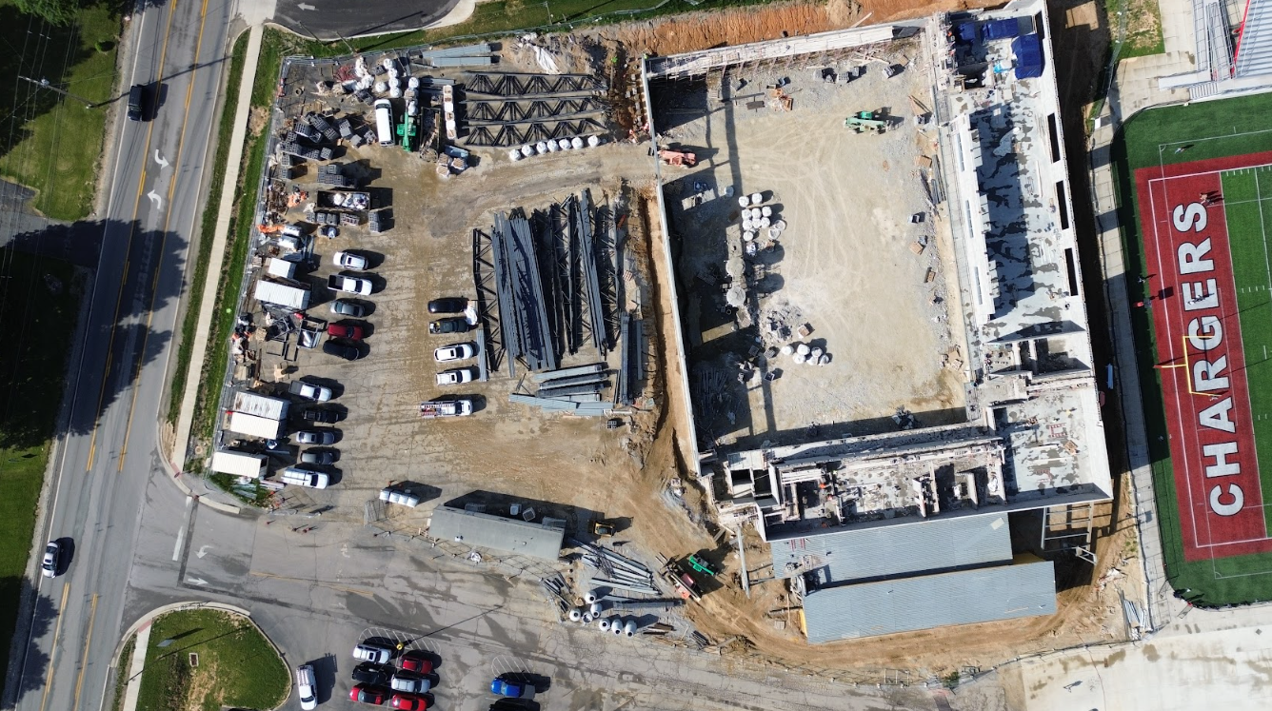
Phase 3 Athletics - Physical Science Centers
Bullitt Central & Bullitt East - Construction

Slide 14
Phase 3 Athletics - Physical Science Centers
Bullitt Central & Bullitt East - Construction

