Slide 1












TCMS

Slide 2

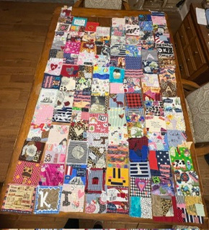


8TH GRADE SOCIAL STUDIES
Students in Ms. Stevenson’s classes are wrapping up a Todd County heritage project that is also connected to the Kentucky Academic Standards.

Slide 3





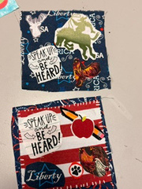
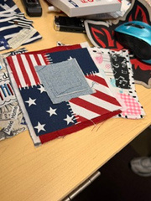
8TH GRADE SOCIAL STUDIES

Slide 4
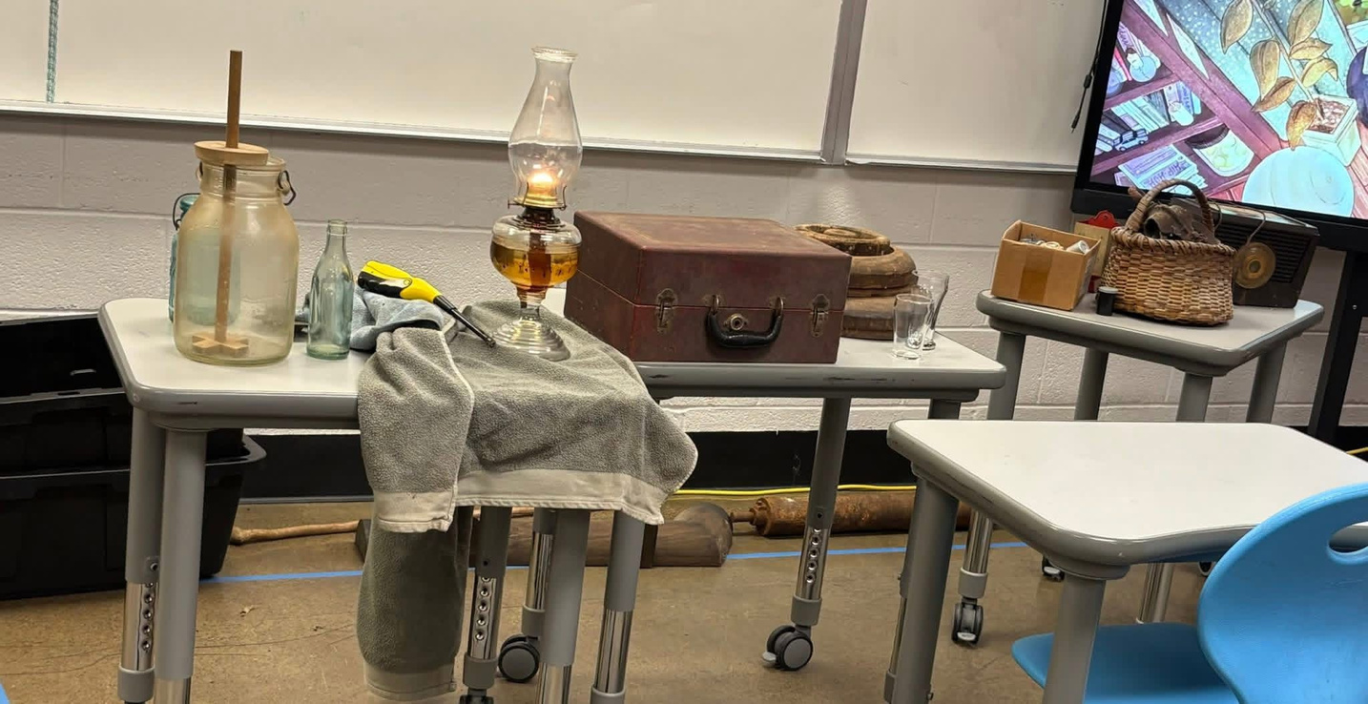
8TH GRADE SOCIAL STUDIES

Slide 5
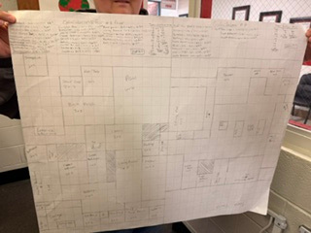
7TH GRADE MATH

