Slide 1

Attendance and Enrollment
Review
DPP- Kyle French

Slide 2
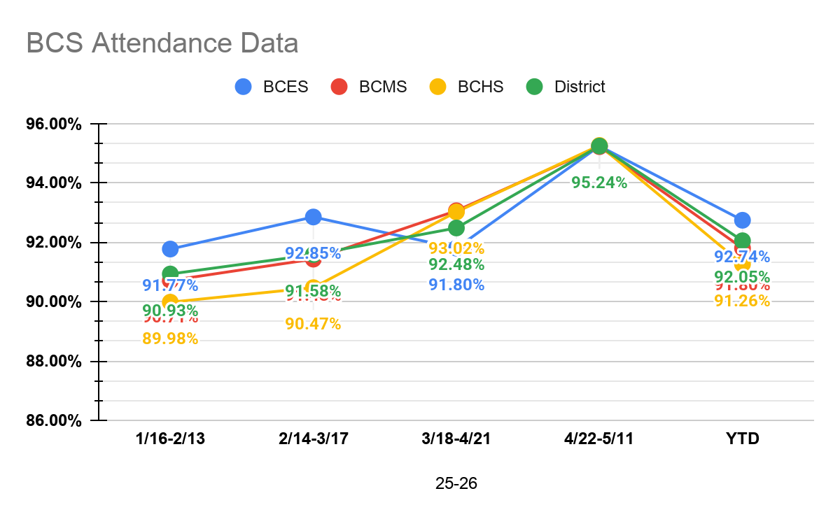
Attendance Rates
25-26 School Year | 1/16-2/13 | 2/14-3/17 | 3/18-4/21 | 4/22-5/11 | YTD
BCES | 91.77% | 92.85% | 91.80% | 95.24% | 92.74%
BCMS | 90.71% | 91.43% | 93.06% | 95.22% | 91.80%
BCHS | 89.98% | 90.47% | 93.02% | 95.26% | 91.26%
District | 90.93% | 91.58% | 92.48% | 95.24% | 92.05%
Section
Section
12

Slide 3
Enrollment Data
Section
Section
12
Enrollment Data | 21-22 | 22-23 | 23-24 | 24-25 | 25-26
Month 1 | 1057 | 1030 | 957 | 926 | 891
Month 2 | 1052 | 1038 | 959 | 924 | 891
Month 3 | 1036 | 1030 | 958 | 928 | 896
Month 4 | 1022 | 1031 | 959 | 919 | 892
Month 5 | 1021 | 1033 | 964 | 925 | 893
Month 6 | 1023 | 1035 | 968 | 932 | 886
Month 7 | 1022 | 1020 | 963 | 918 | 888
Month 8 | 1020 | 1020 | 957 | 917 | 888
Month 9 | 1016 | 1019 | 953 | 912 | 886
Month 10 | 1 Day- 1016 | 4 Days- 1019 | 2 Days- 951 | 1 Day- 912

