Slide 1


Maryville Elementary Turnaround Plan
Principal: Jamie Wyman | School Year: 2026–2027
MOTIVATE. EMPOWER.SUCCEED
MES...a family growing together in a safe, loving place to empower our students for success.

Slide 2
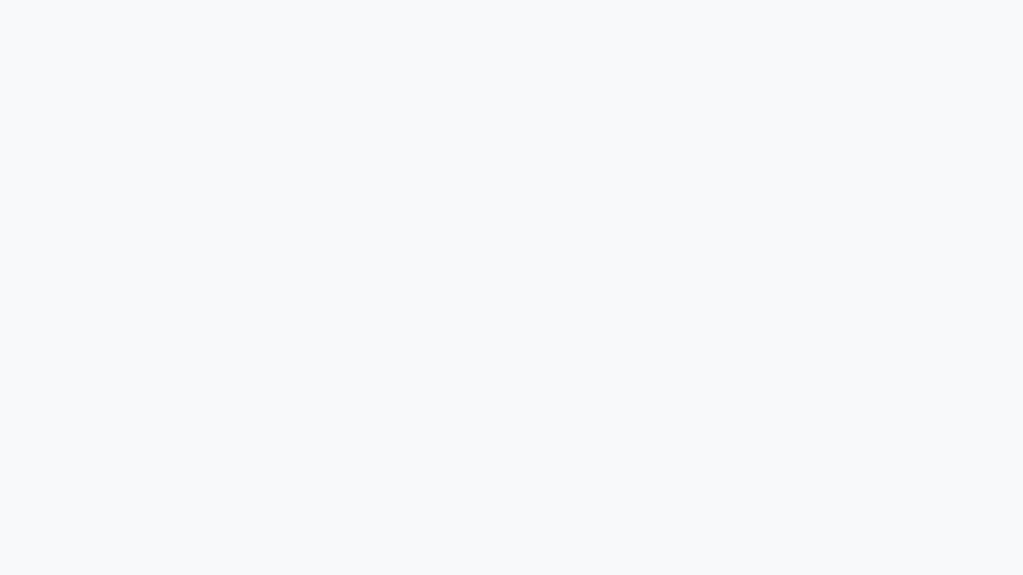
Improvement Priorities
IP #1
Implement and monitor an authentic school-wide continuous improvement process using data and feedback to guide instruction, strengthen student academic outcomes and sustain a culture of growth for all stakeholders.
IP #2
Ensure all students engage in rigorous, learner-centered instruction aligned to KAS by strategically planning, implementing and monitoring clear instructional expectations to ensure students’ academic needs are met

Slide 3
Needs Assessment
Key Findings:
Reading and math outcomes are not where we want them to be
Too many students are performing below grade level
Gaps persist for students with disabilities
We have the culture to lead this work
Reading and math are the most heavily weighted indicators in Kentucky’s accountability system, making this work critical to our overall success.

Slide 4
Focus Areas
menu_book
Strong Tier 1 Instruction
(Reading & Math)
bar_chart
Using Data to Drive Instruction
diversity_3
Positive School Climate & Student Support
These priorities are consistent across all parts of our plan and guide our daily work.

Slide 5
CSIP Goals
Reading Proficiency
26% → 36%
proficient/distinguished
Math Proficiency
20% → 35%
proficient/distinguished
Students with Disabilities (Reading)
9% → 20%
School Climate & Safety Index
66.8 → 70

Slide 6
How We Will Improve Instruction
We are ensuring consistent, rigorous instruction in every classroom, every day.
fact_check
Aligned to Kentucky Academic Standards
gps_fixed
Clear Learning Targets & Success Criteria
trending_up
Grade-level, Rigorous Tasks for All
record_voice_over
Students Explain Their Thinking Daily
Students will consistently engage in meaningful work, not just complete tasks.

Slide 7
Teacher Collaboration (PLCs)
Teachers will work together every week through structured PLCs:
event_note
Plan lessons aligned to standards
school
Teach and implement instruction
analytics
Study student work & results
tune
Adjust instruction based on data
This PLC/PDSA process is how we are implementing and monitoring our continuous improvement system across the school.

Slide 8
Using Data to Drive Decisions
We are building strong assessment practices:
assignment
Common assessments aligned to standards
bar_chart
Analysis of student performance by standard
search
Identification of misconceptions
speed
Immediate instructional adjustments
Assessment data will be used to adjust Tier 1 instruction, not just determine intervention.

Slide 9
Supporting Students with Disabilities
We are strengthening access to grade-level learning:
group
Co-planning between Gen Ed and SpEd teachers
layers
Instruction aligned to standards with scaffolds
trending_up
Focus on access, not lowering expectations
analytics
Targeted PLC support for student progress
Every student will have access to rigorous instruction.

Slide 10
Monitoring Progress
Weekly: PLC Level
Document PDSA cycles
Analyze student work by standard
Adjust instruction immediately
Refine small groups for mastery
Weekly: Leadership
Classroom walkthroughs
Focus: Alignment, Rigor, & Engagement
Immediate teacher feedback
Weekly: Coaching
Coach attends PLCs
Real-time feedback on data use
Support for student misconceptions
The leadership team will monitor implementation weekly and adjust supports to ensure consistency across classrooms.

Slide 11
Monitoring Progress
Monthly: Leadership
Review of:
Walkthrough trends
PLC documentation
Common assessment results
• Schoolwide strengths/gaps
• PL & support adjustments
Quarterly: Outcomes
Analysis of:
iReady & CFA data
Subgroup performance
• Progress evaluation
• Strategy refinement
What This Ensures
Weekly instruction improvement
Evidence-based decisions
Targeted & timely support
Focus on results over actions
Regular cycles of review drive continuous school improvement.

Slide 12
School Climate and Behavior
We are strengthening our learning environment:
Consistent Expectations
Schoolwide PBIS expectations
Positive Reinforcement
Patriot Pride
Explicit Teaching
Behavior expectations
SEL Focus
Social-emotional learning
This work ensures more time is spent on instruction and increases student engagement in learning.

Slide 13
What This Means for our Students
auto_stories
Engaging, Rigorous Lessons
assignment_turned_in
Clear Learning Expectations
forum
Think and Explain More
groups
Stronger Support Systems
sentiment_satisfied_alt
Safe & Positive Environment
Our focus is on student success and well-being every day.

Slide 14
Our Commitment
Focused & Intentional
Grounded in daily practice, building systems that support teachers and improve outcomes for students.
handshake
trending_up
school
We will monitor this work closely, adjust when needed, and ensure every student experiences rigorous, grade-level instruction every day.

