Slide 1
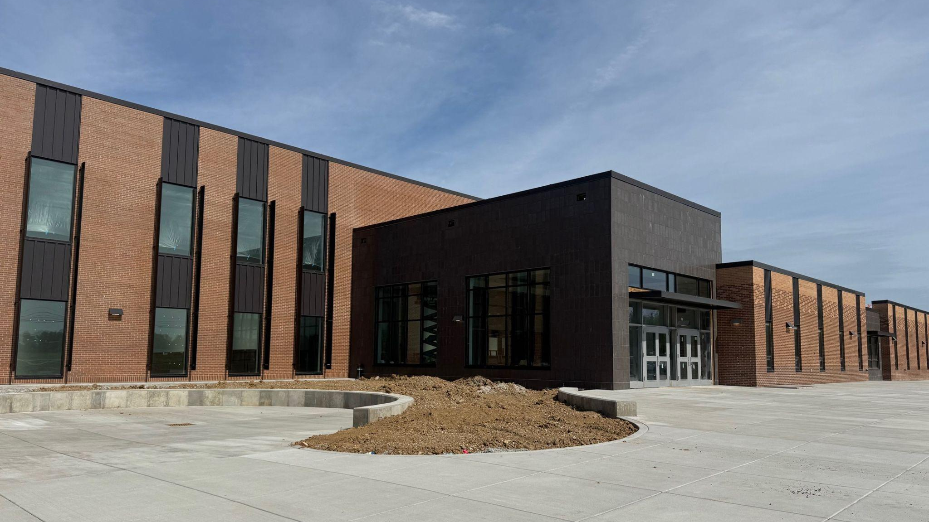


April 20th - Design and Construction

Slide 2
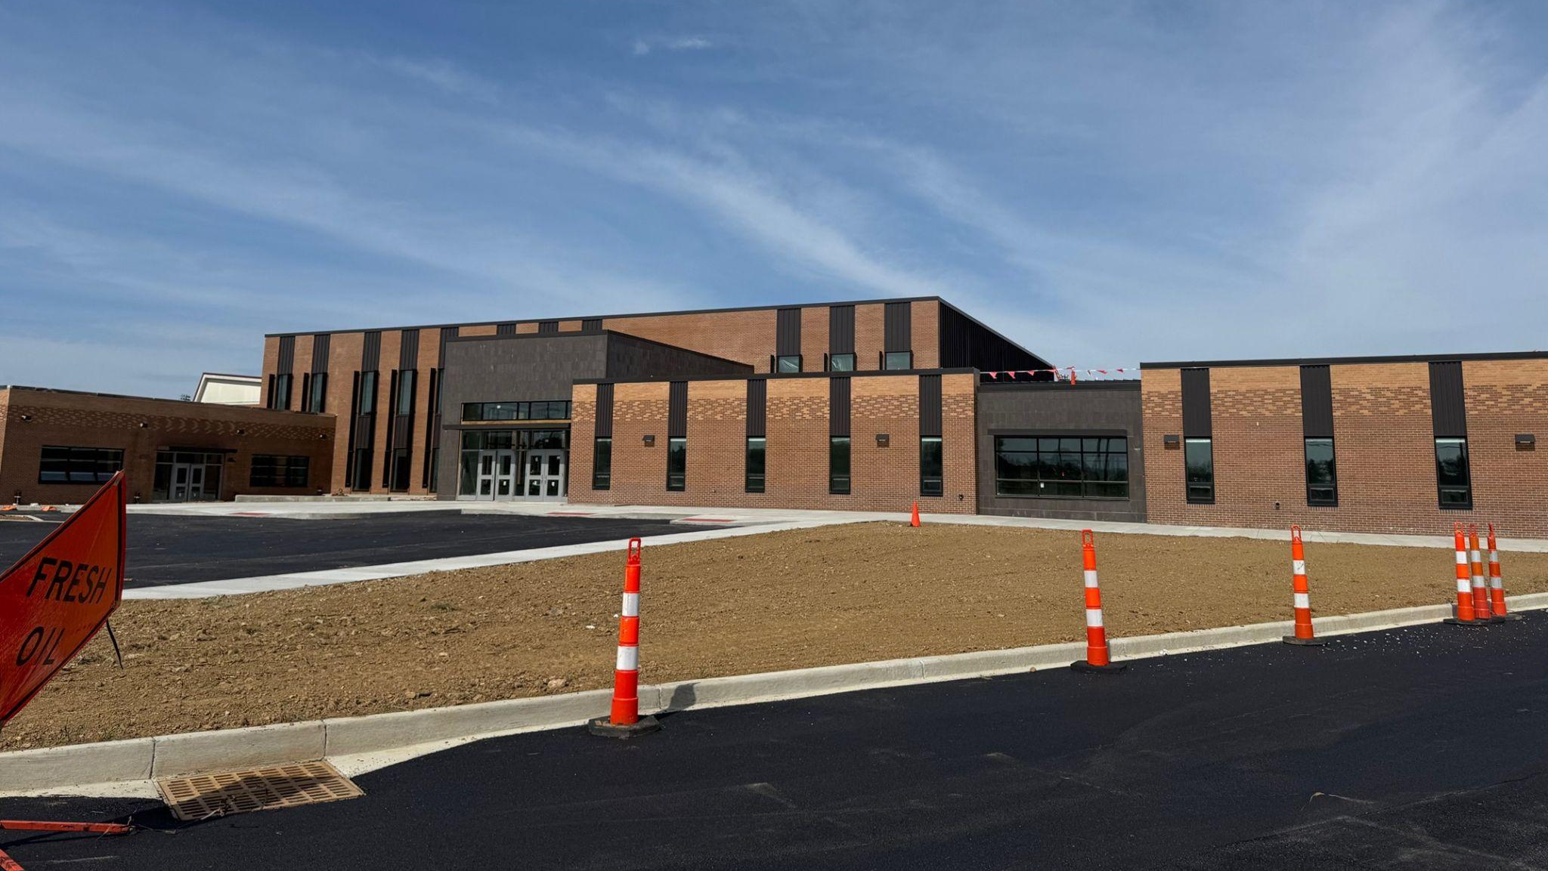


Fine Arts
Bullitt East High School - Construction

Slide 3
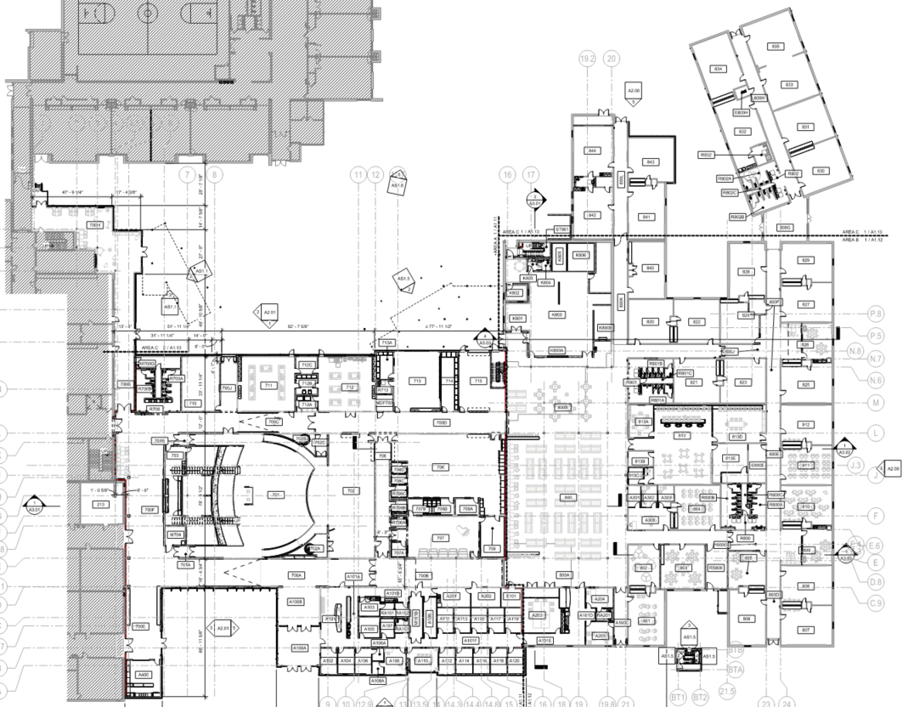
Area B
Construction Timeframe:
June 1 - Furniture
July 1 -
Turn Over to BEHS
Break Out Area
Courtyard
Area C
Area A
School Store
Band Tower
Bullitt East High School Construction

Slide 4
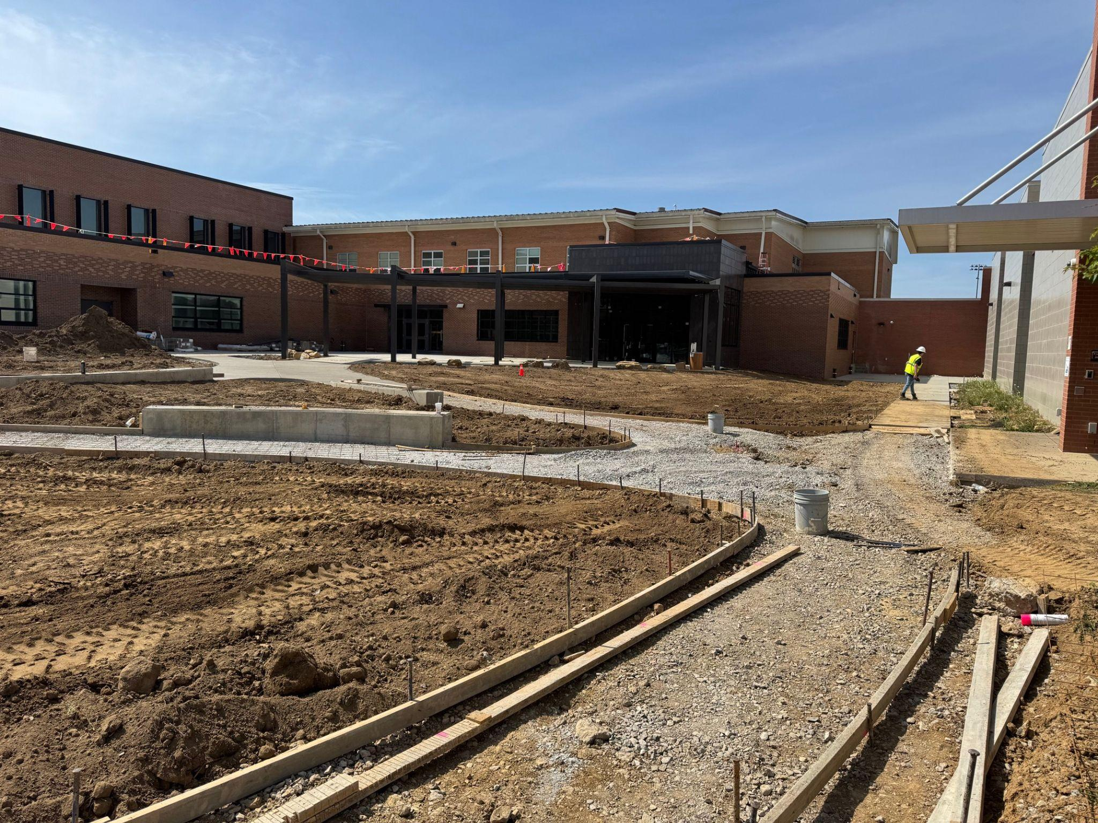
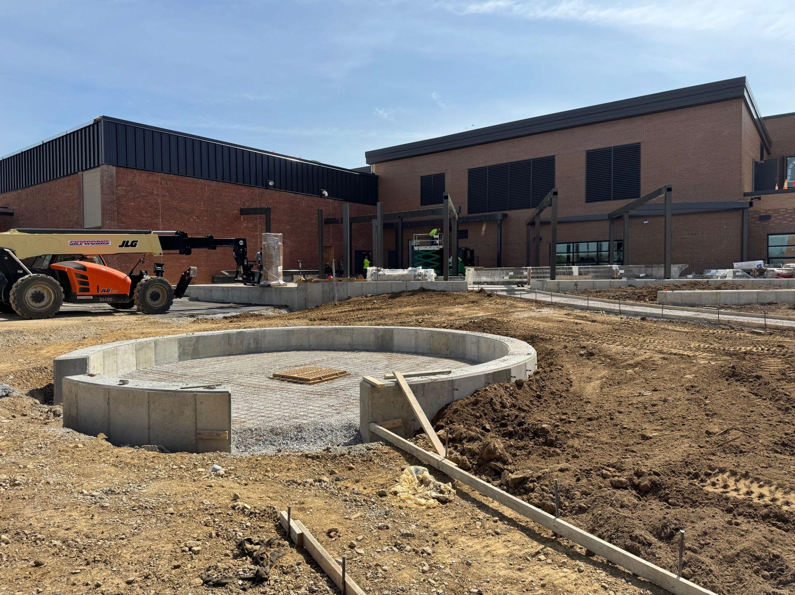
Fine Arts
Bullitt East High School - Construction

Slide 5
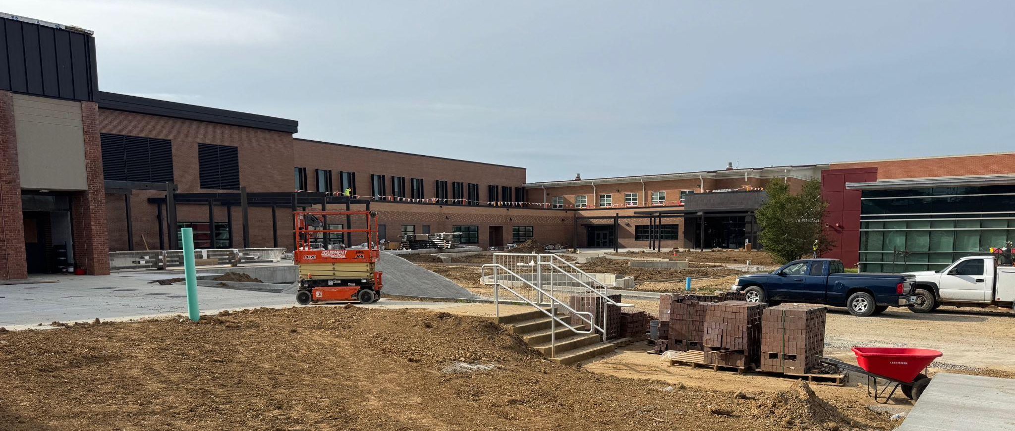
Fine Arts
Bullitt East High School - Construction

Slide 6
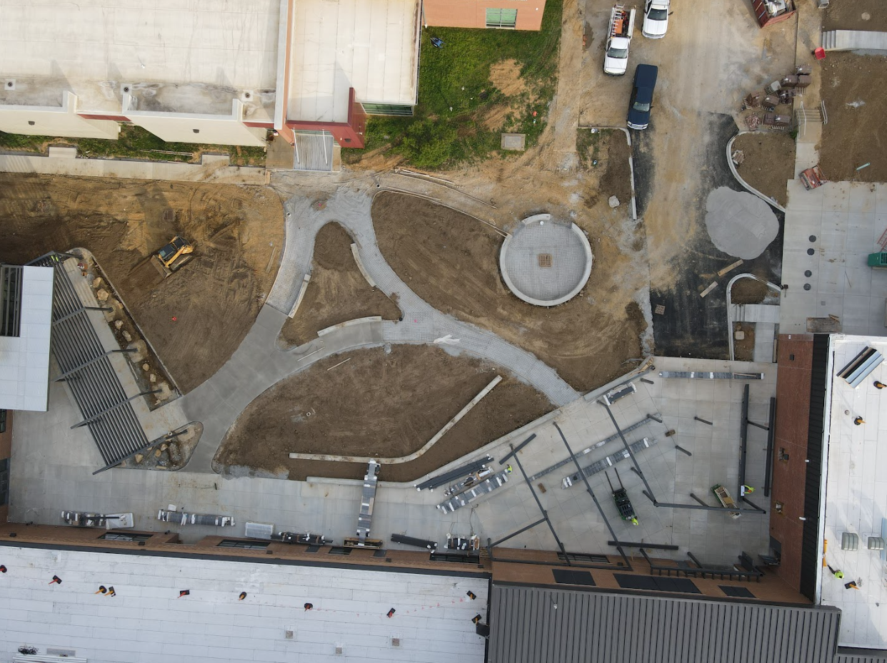
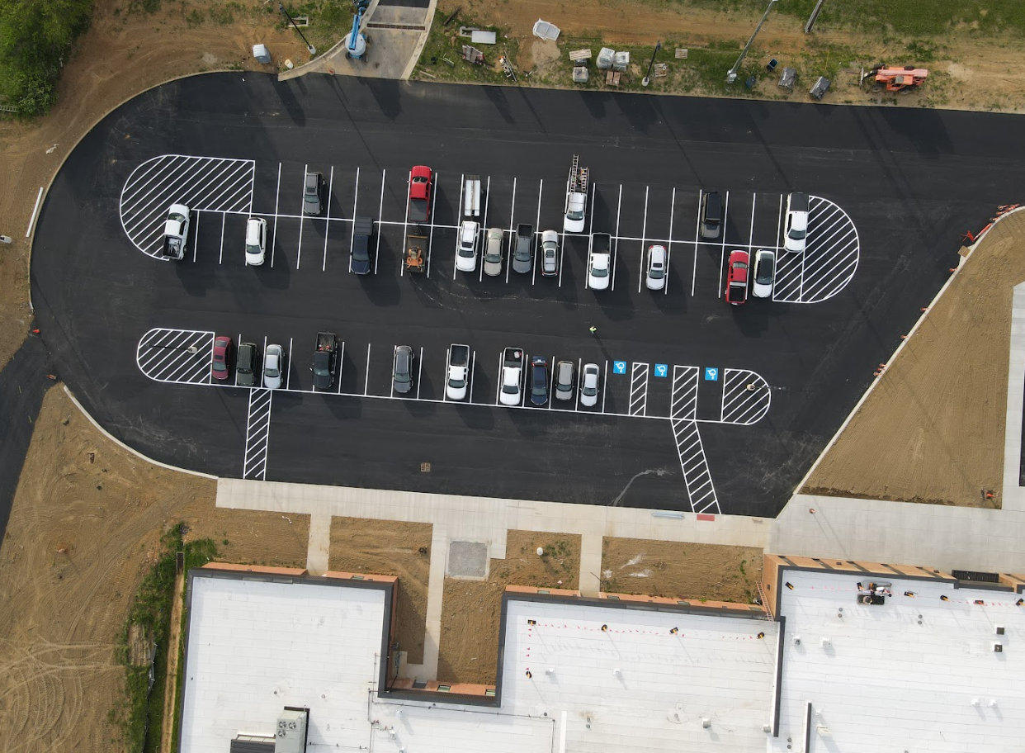
Fine Arts
Bullitt East High School - Construction

Slide 7
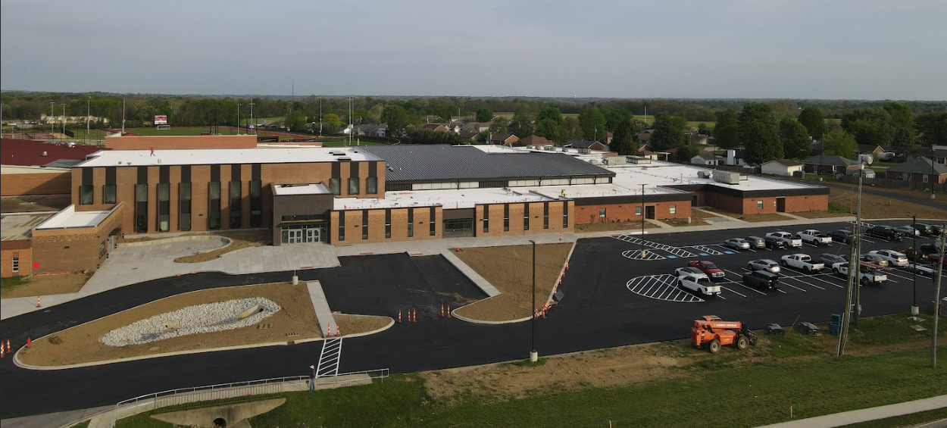
Board Consent Items - Bid Package No. 1 - Bullitt East Fine Arts
DPO Vendor Change - Duraflex to Sherwin Williams - Net Zero Change - This DPO change voids the previous DPO with Duraflex and adds a DPO with Sherwin Williams. This is a net zero change.
Fine Arts
Bullitt East High School - Construction

Slide 8
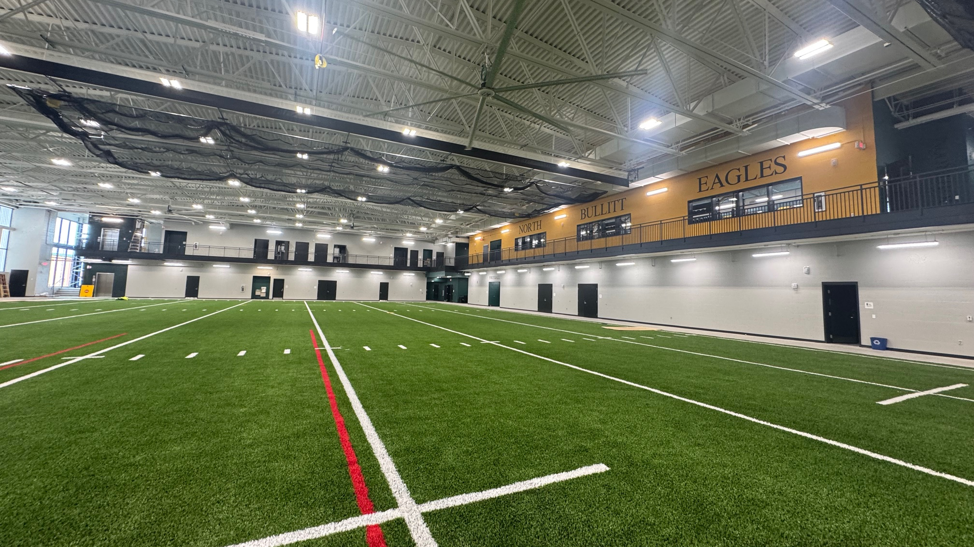

Phase 2 Athletics
NBHS Physical Science Center

Slide 9
UPDATE - Bid Package No. 2 - North Bullitt
Anticipated Inspections and Change Order Work
  Substantial Completion Meeting occurred on March 26th with Contractor.
  Substantial Completion Date Established as March 18th and May 15th is final Completion Date based on work cited, below, added via Change Order.
  Work Remaining -
    Cable Tray installation for Data Cabling - Starting Now
    Tennis Court Lighting - All Sites - Almost Complete
Phase 2 Athletics
NBHS Physical Science Center

Slide 10
Board Consent Items - Bid Package No. 2 - North Bullitt
Board Action - AIA G704 - Substantial Completion Certificate
  Phase II Athletics - Baseball/Softball Improvements
  Phase II Athletics - North Bullitt PSC
Change Order 34 – Exterior Guardrail - $10,005.00
The building inspector is requiring a 42-inch-high guardrail at the exterior landing next to the main entrance due to the height of the wall curb. This is a code compliance requirement by the authority having jurisdiction.
Change Order 35 – Unused Allowance Credits - ($97,075.10)
This is a credit for unused Construction Allowances.
Phase 2 Athletics
NBHS Physical Science Center

Slide 11
Board Consent Items - Bid Package No. 2 - North Bullitt
Change Order 36 – Additional Interior Lighting - $19,910.00
BCPS Facilities requested additional lights be added at the locker room stalls, mop sink, shower stalls, and PE locker room doorways.
Change Order 37 – Added Bulkheads and Infill - $2,838.00
Areas where walls could not go up to the roof deck due to conflicts with roof joists were infilled with stud framing and drywall finishes. This was does to compartmentalize public spaces from restrooms and shower areas.
Phase 2 Athletics
NBHS Physical Science Center

Slide 12
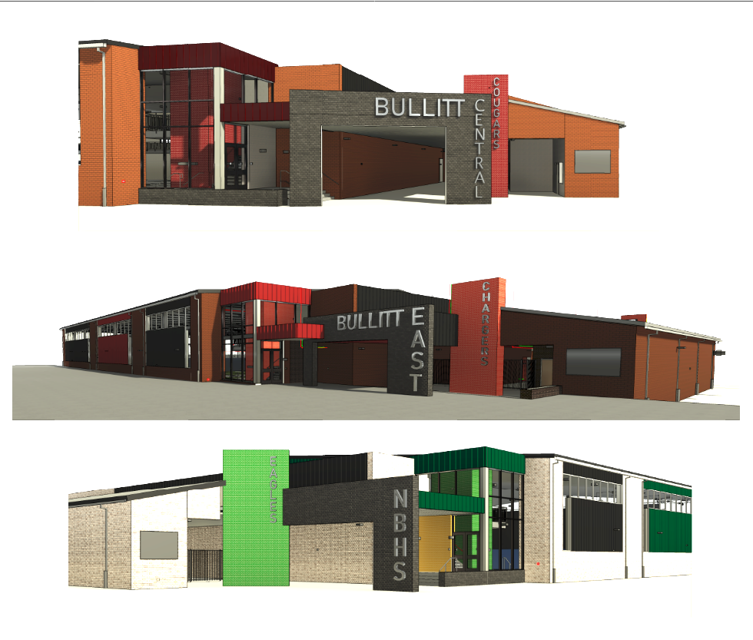

Phase 3 Athletics - Physical Science Centers
Bullitt Central & Bullitt East - Construction

Slide 13
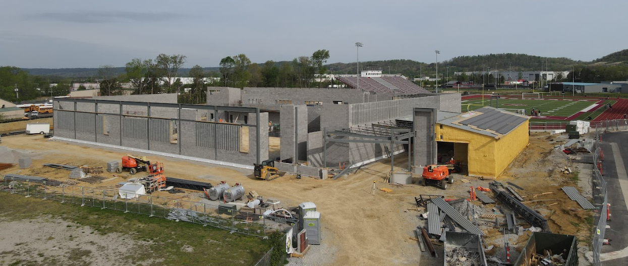
Phase 3 Athletics - Physical Science Centers
Bullitt Central & Bullitt East - Construction

Slide 14
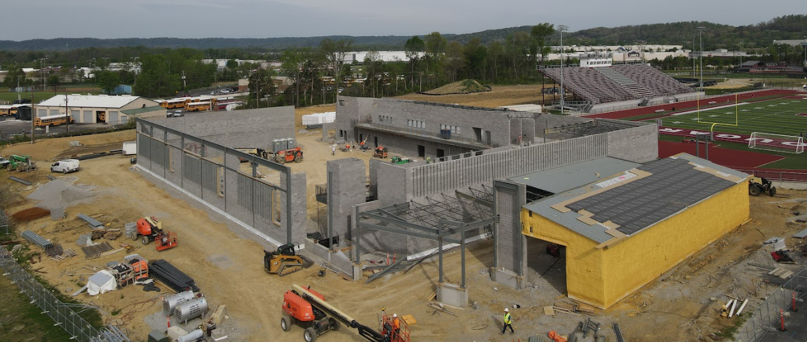
Phase 3 Athletics - Physical Science Centers
Bullitt Central & Bullitt East - Construction

Slide 15
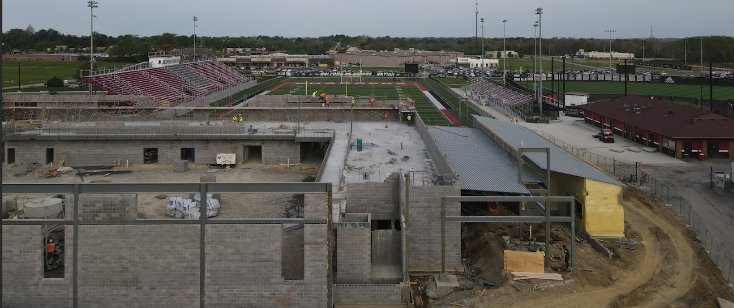
Phase 3 Athletics - Physical Science Centers
Bullitt Central & Bullitt East - Construction

Slide 16
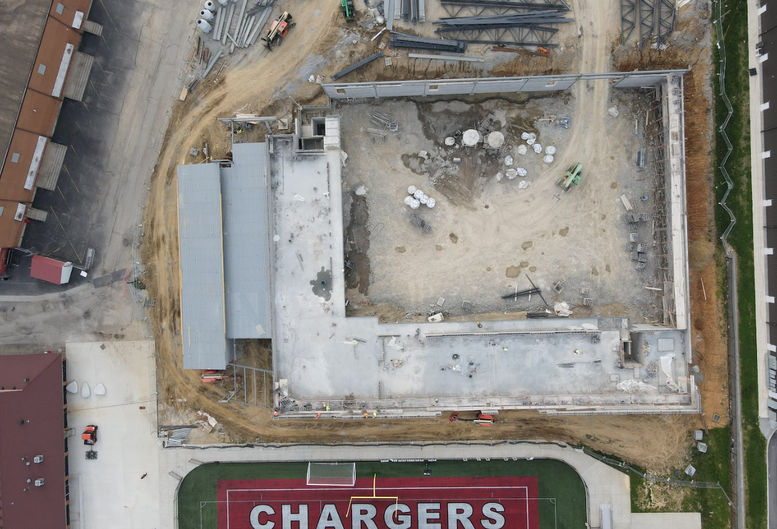
Phase 3 Athletics - Physical Science Centers
Bullitt Central & Bullitt East - Construction

Slide 17
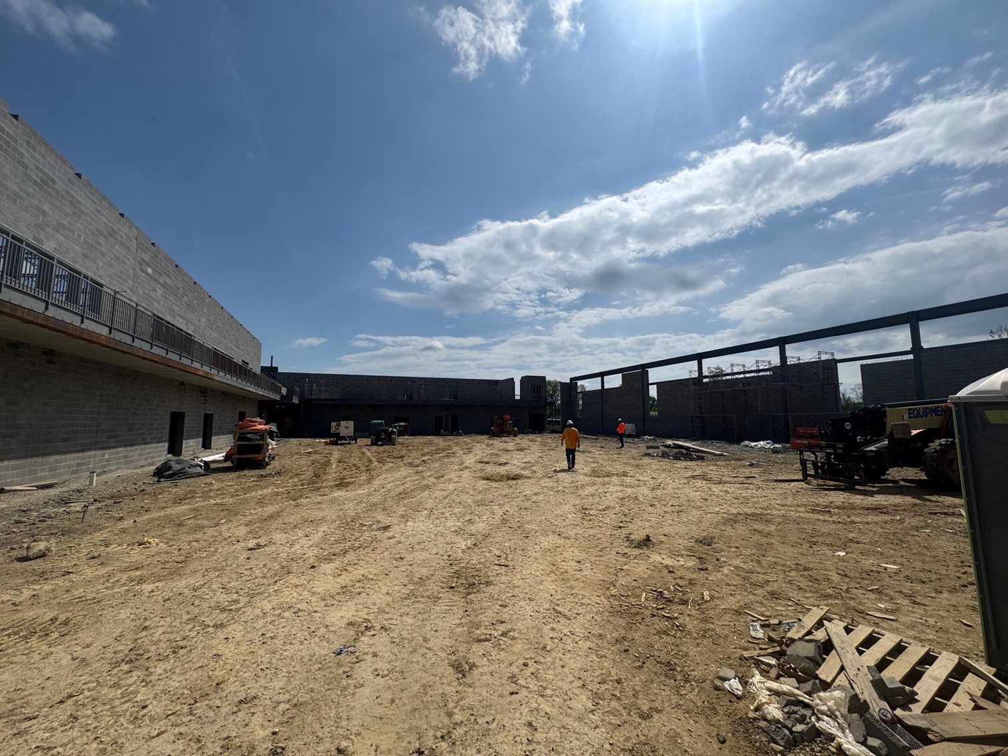
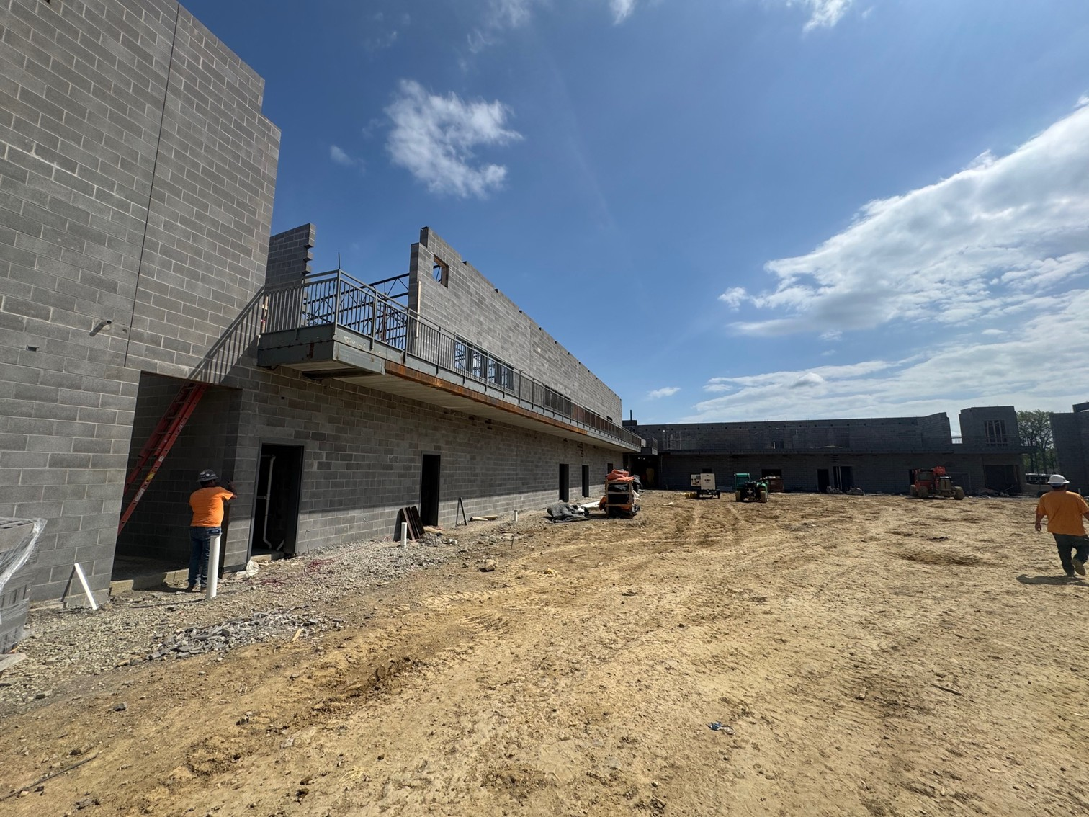
Phase 3 Athletics - Physical Science Centers
Bullitt Central & Bullitt East - Construction

Slide 18
Board Consent Items - Bid Package No. 1 - Bullitt Central and Bullitt East PSC
Bullitt East PSC & Bullitt Central PSC – BG 25-145 – Lee Building DPO – Elevator Glazed Brick Credit - ($3,900.00) - The same credit for each facility.
Brick types were changed on the elevator shaft to match the design at North's PSC.
B Sign DPO – Outdoor Back-Lit Light Credit - $ (14,637.75)
This is a material credit for lettering that was submitted as back-lit, but lighting is not required
per the drawings. This credit covers omission of the back-lit option for exterior lettering.
Phase 3 Athletics - Physical Science Centers
Bullitt Central & Bullitt East - Update

Slide 19
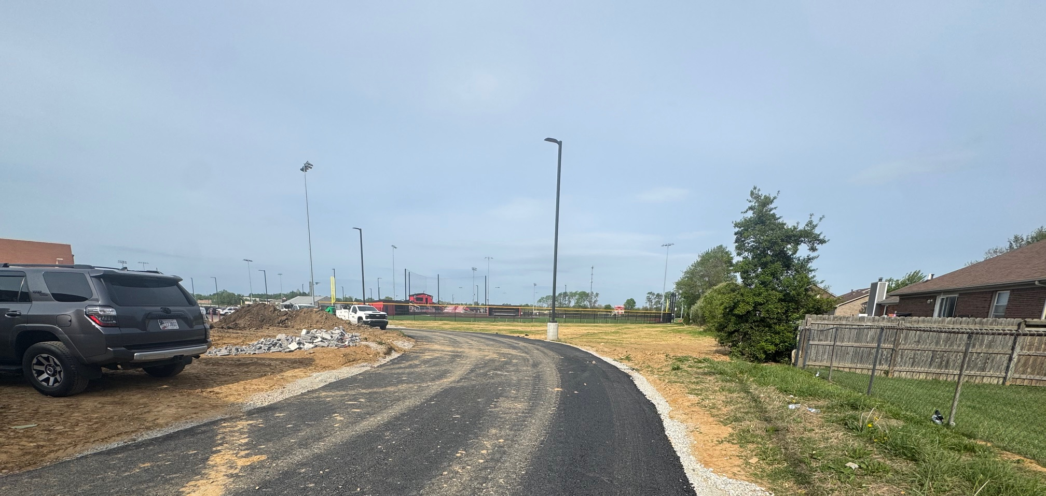
Board Consent Items - Bid Package No. 1 - Bullitt East PSC
Change Order 13 – Berm Removal and Baseball Concrete - $85,963.00
BCPS Leadership directed the constructed Berm at the Softball field to be removed by the Contractor. Contract Unit Prices were utilized to establish cost of work to haul off 2170 CY of soil fill to the location specified by BCPS.
Also, additional concrete was added at the batting tunnel area per BCPS Leadership direction.
Phase 3 Athletics - Physical Science Centers
Bullitt Central & Bullitt East - Update

Slide 20
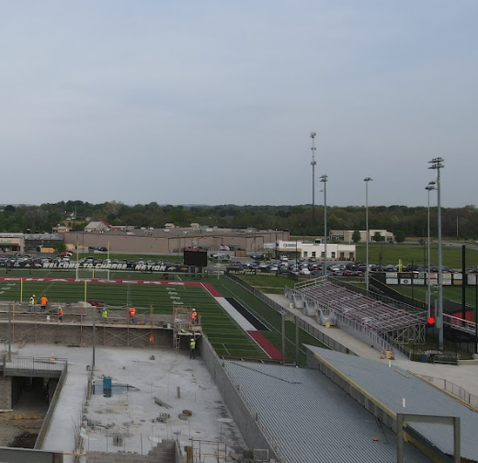
Board Consent Items - Bid Package No. 1 -
Bullitt East PSC
hange Order 14 – Stadium Lighting Additions $49,471.00
Scope for this work includes the addition of lights on the field light poles at the football stadium to provide general lighting outside of a game setting to light pathways for student access during early morning arrivals.
Work also includes two additional pathway lighting poles. Work can be performed by the electrical contractor already on site to provide work at the field house facility.
Phase 3 Athletics - Physical Science Centers
Bullitt Central & Bullitt East - Update

