Slide 1
District Local Planning Committee Orientation
Part 2
Mercer County Schools
Kentucky Department of Education
Division of District Support - District Facilities Branch
702 KAR 4:180 Planning Process

Slide 2
Welcome Back
This presentations focus is on information specific to your district and will include:
An “Overview” of your existing buildings
Your current District Facilities Plan
Projects undertaken since your last plan in June 2018
Your districts restricted funding stream
Cost of delivery of services to each of your schools
Enrollment changes since 1990
Demographic Projections

Slide 3
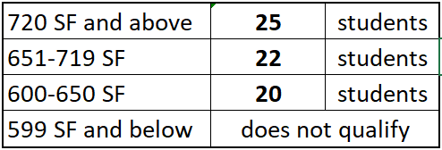
An overview of capacity calculations
Elementary School calculations
Only the standard classrooms are used when calculating student capacity
Classrooms for preschool/ kindergarten, special education, music, art, science, computer labs, etc. are not used in the capacity calculation
Since only standard classrooms are used in this calculation, it is critical that the spaces and their use be accurately noted on the building inventories
The number or students to be calculated per elementary classroom is based on the room size:

Slide 4
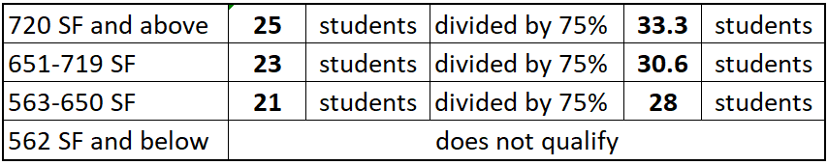
An “Overview” of capacity calculations
Middle and High School calculations
Only the standard classrooms are used when calculating student capacity.
Classrooms for special education, music, art, science, computer labs, Career and Technical Center/KY Tech Area Technology Center spaces, etc. are not used in the capacity calculation.
The number or students to be calculated per classrooms is based on the room size; note that since students are in non-standard classrooms about 25% of the time the base capacity is adjusted as shown below:

Slide 5
We will now review your current District Facilities Plan (DFP)
The information on your current District Facilities Plan (DFP) will give a good view of your needs as determined by the last LPC

Slide 6
The first part of the DFP shows:
The date your last DFP was approved by the State Board of Education
Your current district organization and proposed district organization
Then:
Your School Centers
Each school’s status as a Permanent or Transitional Center
Grades served by the facility
Enrollment at the end of the previous year vs. the building capacity

Slide 7
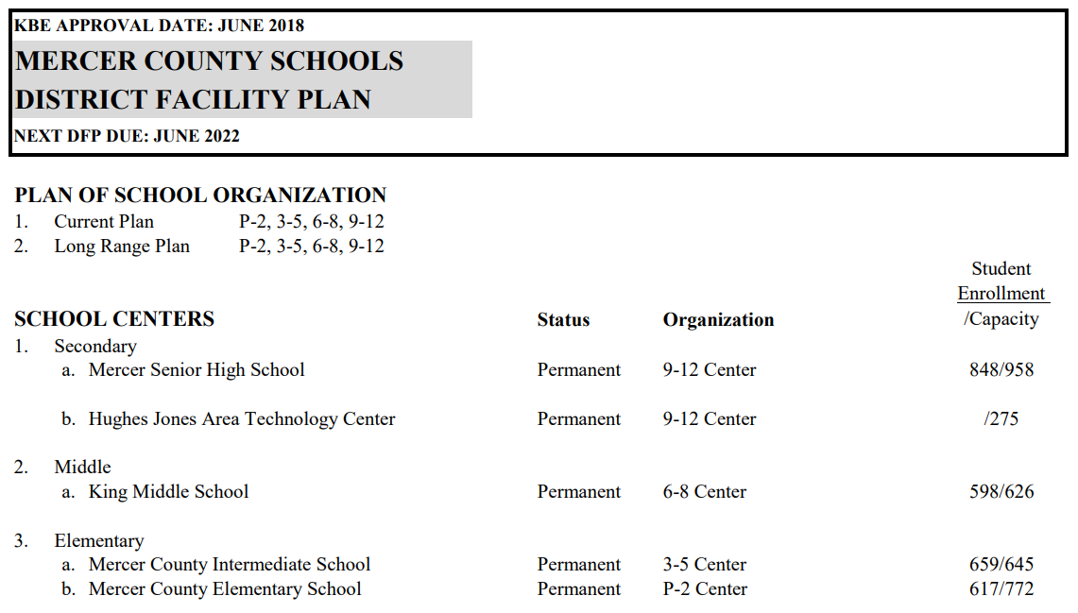
SAAR 2019 enrollment is down 3.4% from 2018 DFP student enrollment.

Slide 8
The main body of the DFP focuses on the construction identified by your LPC
Priority 1 – Work on educational facilities to be completed in the next biennium:
1a,b: New construction justified by building replacement, consolidation or growth
1c: Major renovations (see definition and exceptions) and additions
1d,e,f: KERA Strands, life safety, ADA requirements
All work in Priorities 1a through 1f are considered equal in terms of funding prioritization
Please note that due to the availability of School Security Funds and KRS 158.162 requirements, the District may choose to provide information specific to these needs qualifying to meet security requirements under Priority 1e for their new DFP. Contact DFB if you have questions on how to list this specific need.
The District lists no Priority 1 Projects in the 2018 DFP.

Slide 9
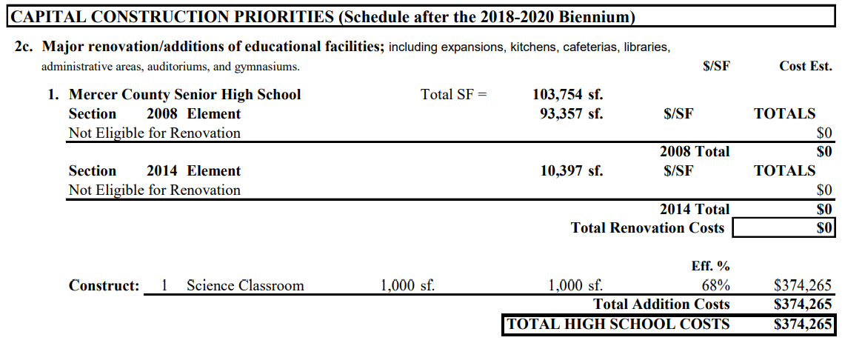
Priority 2 – Work on educational facilities to be completed after the next biennium:
2a,b: New construction justified by building replacement, consolidation or growth
2c: Major renovations (see definition and exceptions) and additions
2d,e,f: KERA Strands, life safety, ADA requirements
All work in Priorities 2a through 2f are considered equal in terms of funding prioritization

Slide 10
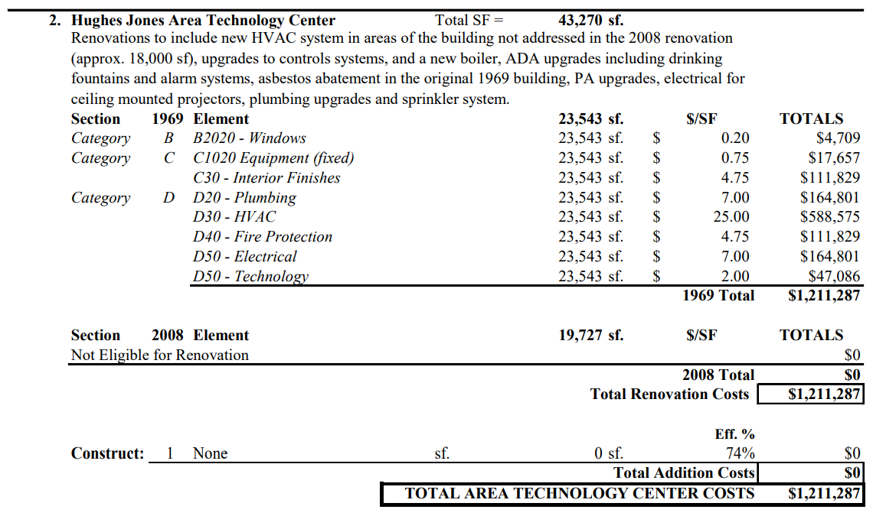
Priority 2c.2 Projects – continued

Slide 11
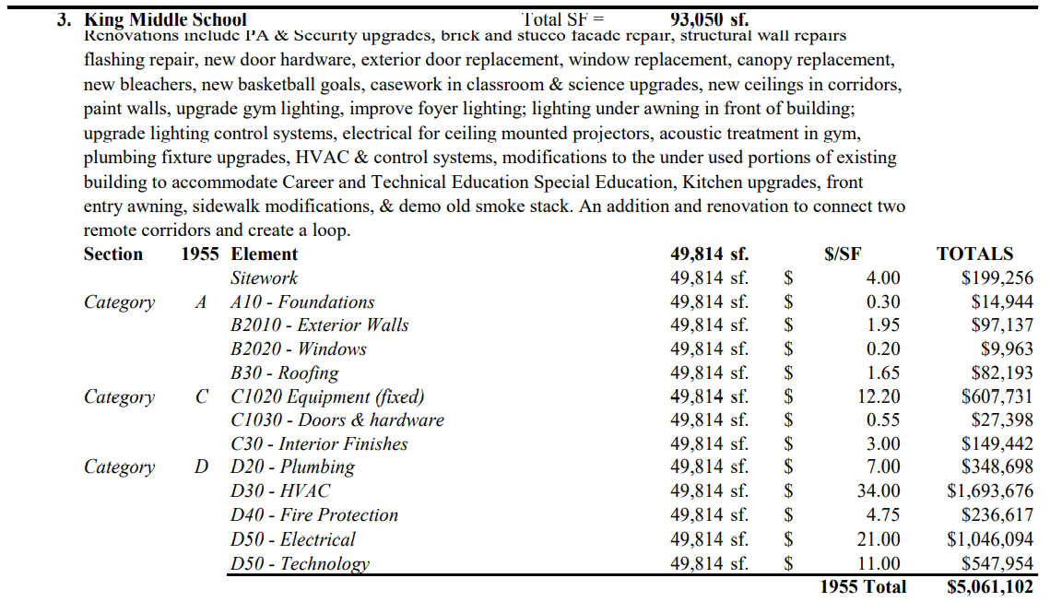
Priority 2c.3 Projects – continued

Slide 12
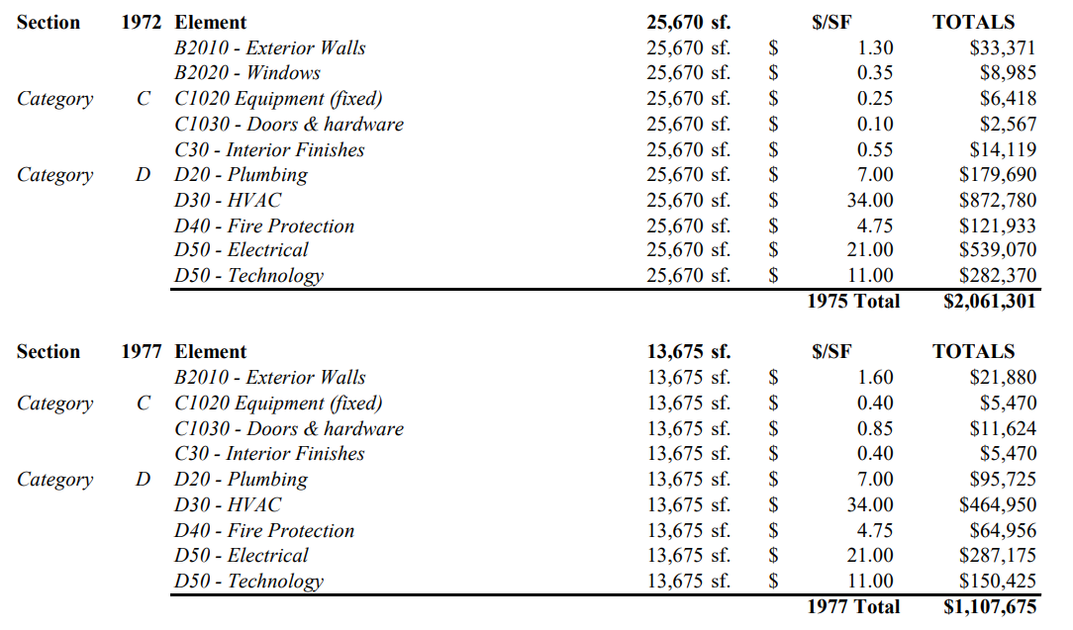
Priority 2c.3 Projects – continued

Slide 13
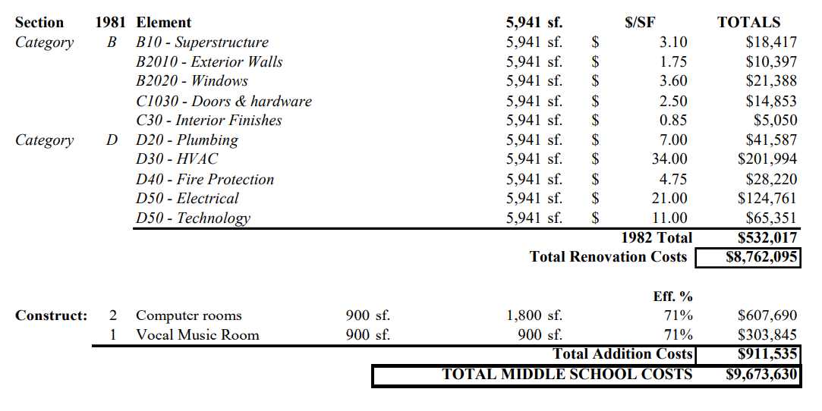
Priority 2c.3 Projects – continued

Slide 14
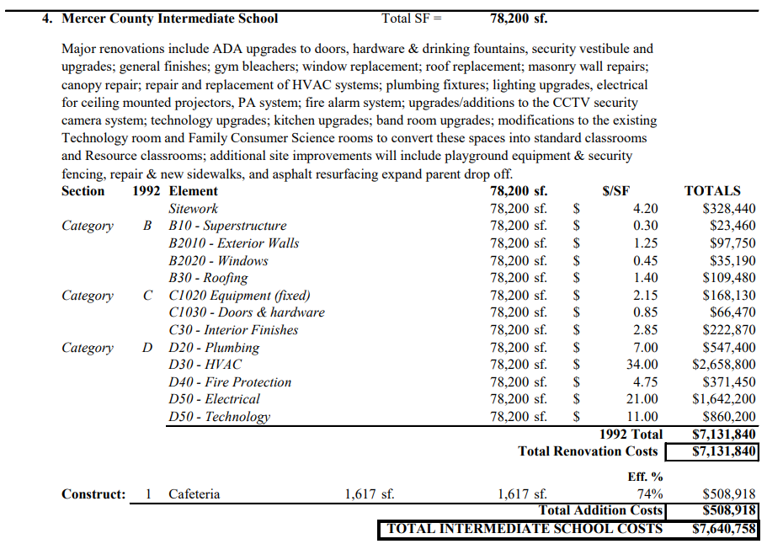
Priority 2c.4 Projects – continued

Slide 15
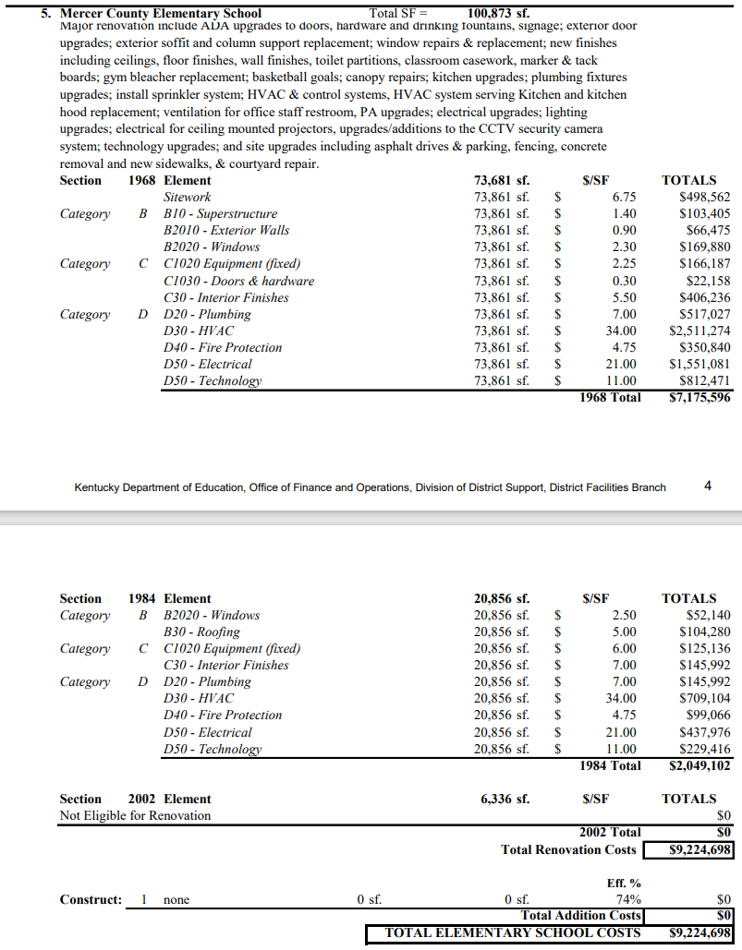
Priority 2c.5 Projects – continued

Slide 16
Priority 3 – Construction of non-educational additions or expansions (regardless of schedule) including:
Media Centers, Kitchens, Cafeterias, Gyms etc. on buildings that do not qualify for major renovation
The District lists no Priority 3 Projects in the 2018 DFP.
Priority 4 – Construction of management support areas (regardless of schedule)
Additions, renovation or new facilities including:
Central Offices, Bus Garages, Storage Buildings etc.
Priority 4 Projects start on next slide.

Slide 17
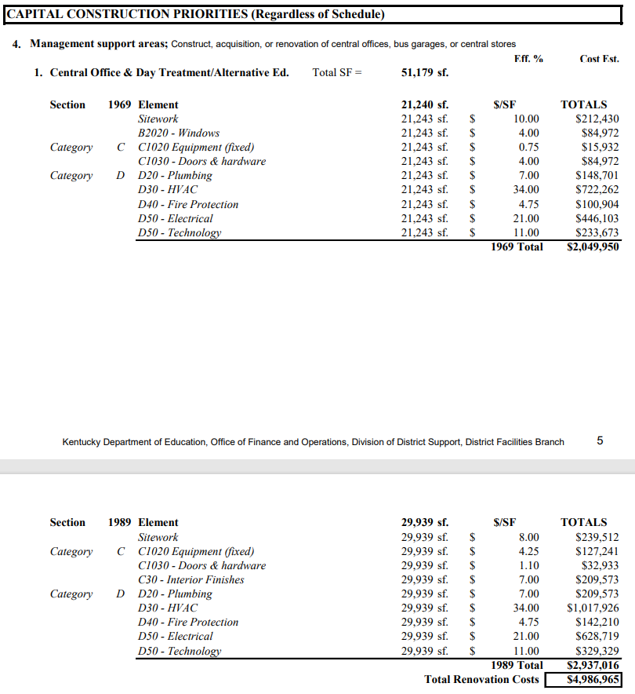
Priority 4.1 Projects – continued

Slide 18
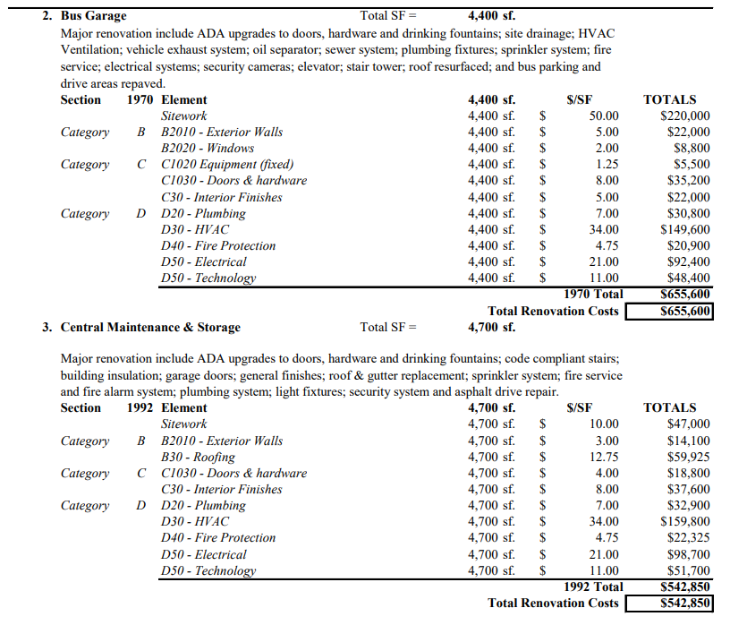
Priority 4.2 & 4.3 Projects – continued

Slide 19
Priority 4.4 Projects – continued

Slide 20
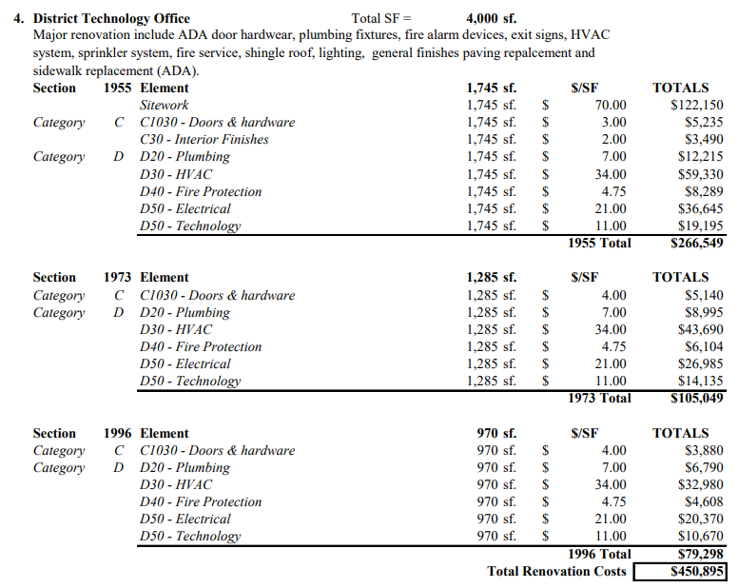
Priority 4.4 Projects – continued

Slide 21
Priorities 1-4 establish District Need:
2018 DISTRICT NEED TOTAL = $34,760,949

Slide 22
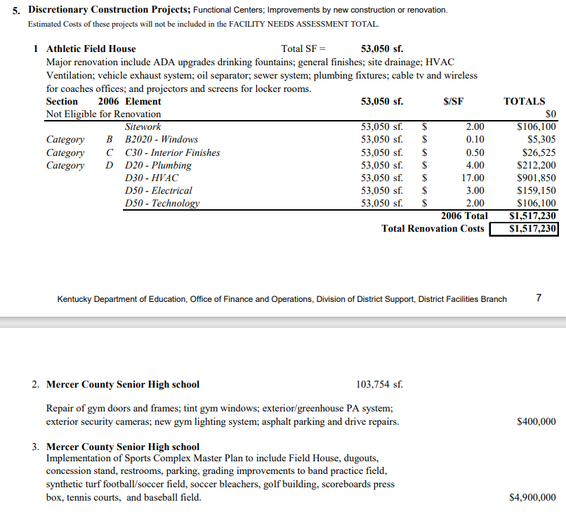
Priority 5 – Discretionary Construction Projects
Extracurricular Facilities
Buildings too new to qualify for Major Renovation
Building additions that are not justified by comparison to the Model Programs
Minor projects
These projects are not part of the FACILITY NEEDS ASSESSMENT TOTAL

Slide 23
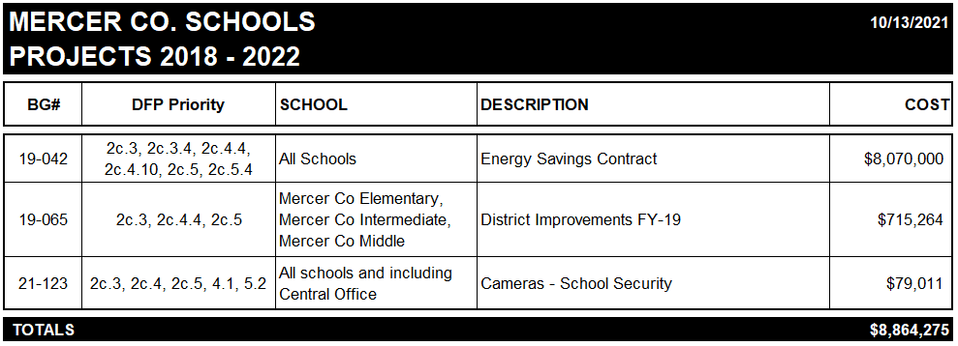
Since your last DFP your district has undertaken the following projects:

Slide 24
Restricted Funding for School Construction
Used for capital construction or major renovation; comes from multiple sources and include:
Student Population Based – KRS 157.420
Capital Outlay Funds
Property Assessment Based – KRS 157.440 (FSPK)
Building Funds and Growth levies
Facilities Support Program of KY
Qualified Needs Based – KRS 157.611
KY School Facilities Construction Commission
Urgent-Needs Grants
All the above funding sources need to be considered during the
District Facilities Planning process.

Slide 25
First and Second Funds to Consider
Student Population Based
Capital Outlay Funds
Property Assessment Based
Building Funds and Growth levies
Facilities Support Program of KY

Slide 26


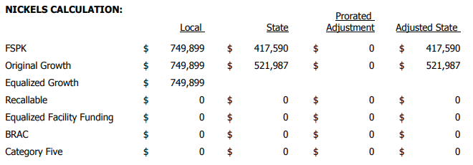
Mercer County
SEEK Calculations
2021-22 Forecast Calculations
Cap Outlay Based on AADA
FSPK Based on Assessment

Slide 27
Third Fund to Consider
Qualified Needs Based
KY School Facilities Construction Commission
Urgent-Needs Grants
The unadjusted 2017 calculated District Need (Priorities 1-4) totals $73,228,556 including projects that have been completed or underway since 2017.
This totals $20,223 per student, based on a 2019 enrollment of 3,621.

Slide 28
All funding sources need to be considered during the District Facilities Planning process.
Let’s see how they impact potential funding amounts

Slide 29
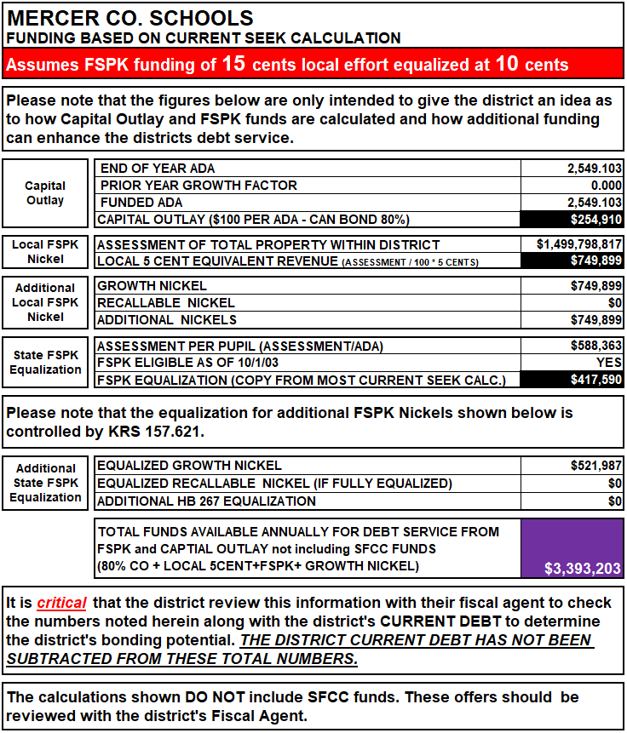
The legislature is currently not equalizing any new (recallable) nickels.

Slide 30
Cost of Delivery of Services
Student Report Cards
In addition, the LPC will want to consider the cost per pupil in each school to try to understand the forces that shape these costs

Slide 31
Cost of Delivery of Services
Many things determine the differences
The thermal envelope and energy use
Enrollment vs. capacity
The age of teaching staff
The number of free and reduced lunch students
The grade levels served
But the biggest determinant of the cost per student is the number of students served in each building

Slide 32
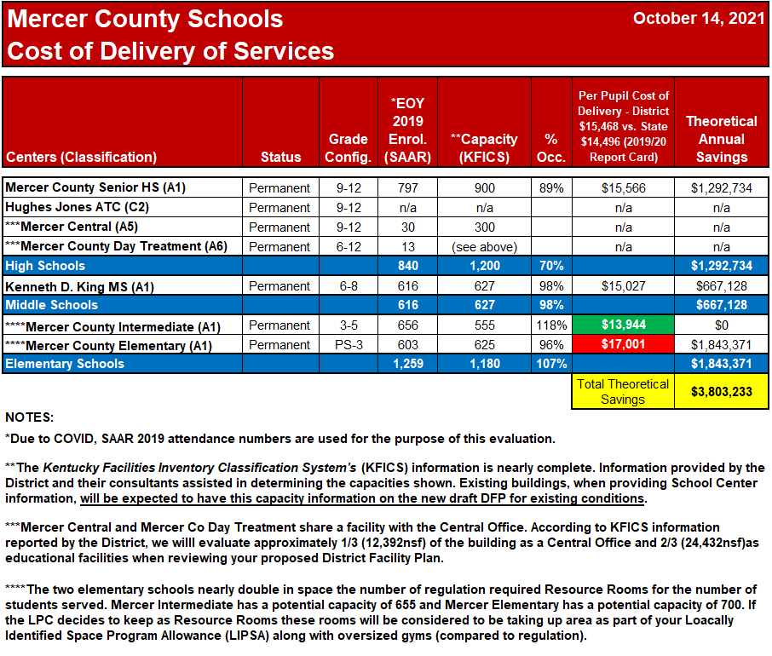
Theoretical costs indicate savings if all facilities operated at the same cost as the least expensive facility. Source Information: KY School Report Card
Use above information to complete your Plan of Organization and School Center Information on your new DFP.

Slide 33
District Enrollment Since 1990
The following chart shows actual enrollment by year, and the percentage change each year and at three, five and ten-year periods.

Slide 34
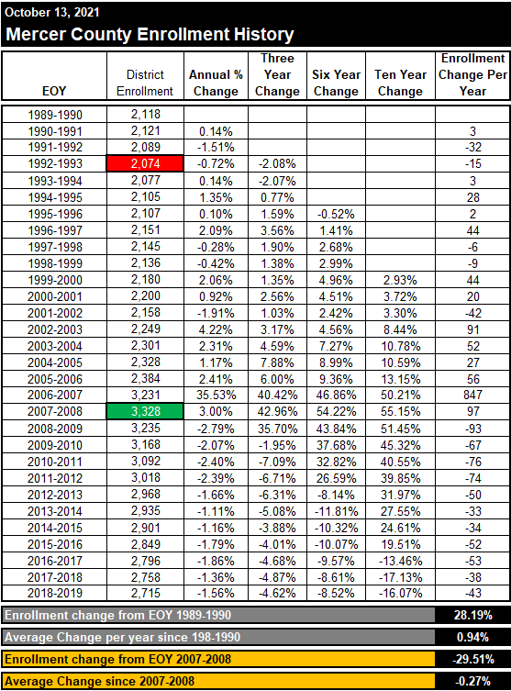

Slide 35
District Demographic Projections
The following chart shows demographic projections developed by the University of Louisville Data Center for the school aged population of your district.

Slide 36
The Mercer Co. population is projected to decrease through 2040.

Slide 37
Future Challenges for KY Schools
Lincoln Co. school enrollment has declined 9% since 1990.
Over 40% of the School Districts in the Commonwealth will experience a decline in enrollment in the next 25 years – Lincoln County will be among them.
Through 2040, the Lincoln Co. population is projected to decrease 2%; the Bluegrass ADD population will increase 18% while the Kentucky population increases 8%.
The Lincoln County student aged population is projected to decrease 10% from 2020 to 2040.
Over the same time Lincoln County is projected to increase their over 65 population by 31%.
While the working age population (20-64) in Lincoln County is projected to decrease by 9%.
How will you wisely deal with the PROJECTED student population and the funding needed to run a school system?

Slide 38
Future Challenges for KY Schools
Working together as a team with Design Professionals, School Board Members, Administrators, Legislatures and the Public to not only build schools, but to create a comprehensive planning/business model that provides equitable and adequate educational space and responds to the needs of the community.
And continues to educate students that the community is proud to support.

Slide 39



?
Questions
?
?
?
Thank you again for agreeing to be part of the Local Planning Committee for your district.
If you have any questions you may phone KDE at:
John C. Gilbert (502) 564 – 4326 x 4452
or
You can e-mail us at:
John.Gilbert@education.ky.gov

