Slide 1


Confidential
Notes:
JEN KRIMM

Slide 2

INTRODUCING
FGCS!
Notes:
JEN KRIMM: We are so thrilled to launch FGCS and to work with you to support our teachers and students. We know you are already aware of FGCS and have already approved the option of payroll deduction… thank you. We wanted to share a little bit more about FGCS today.

Slide 3
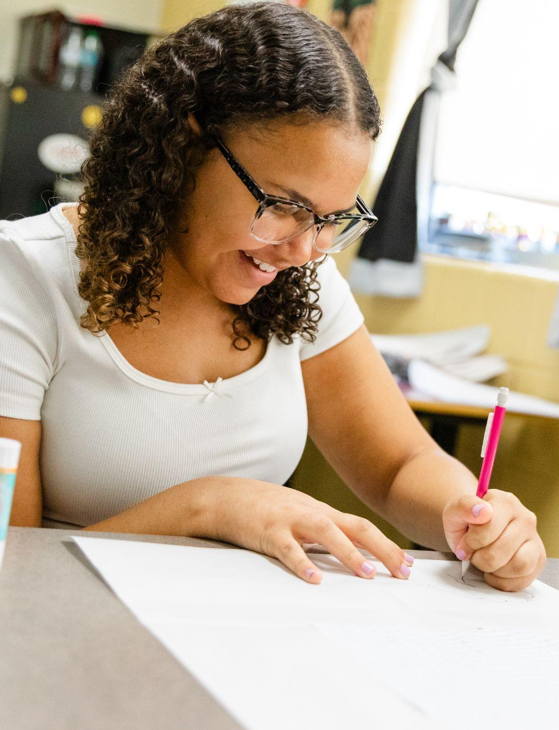

Partnering with Garrard County Schools, we envision a Garrard County where every student has access to the opportunities, resources, and support they need to succeed—in the classroom and beyond.
Notes:
PRESENTER NAME: Goal/vision

Slide 4
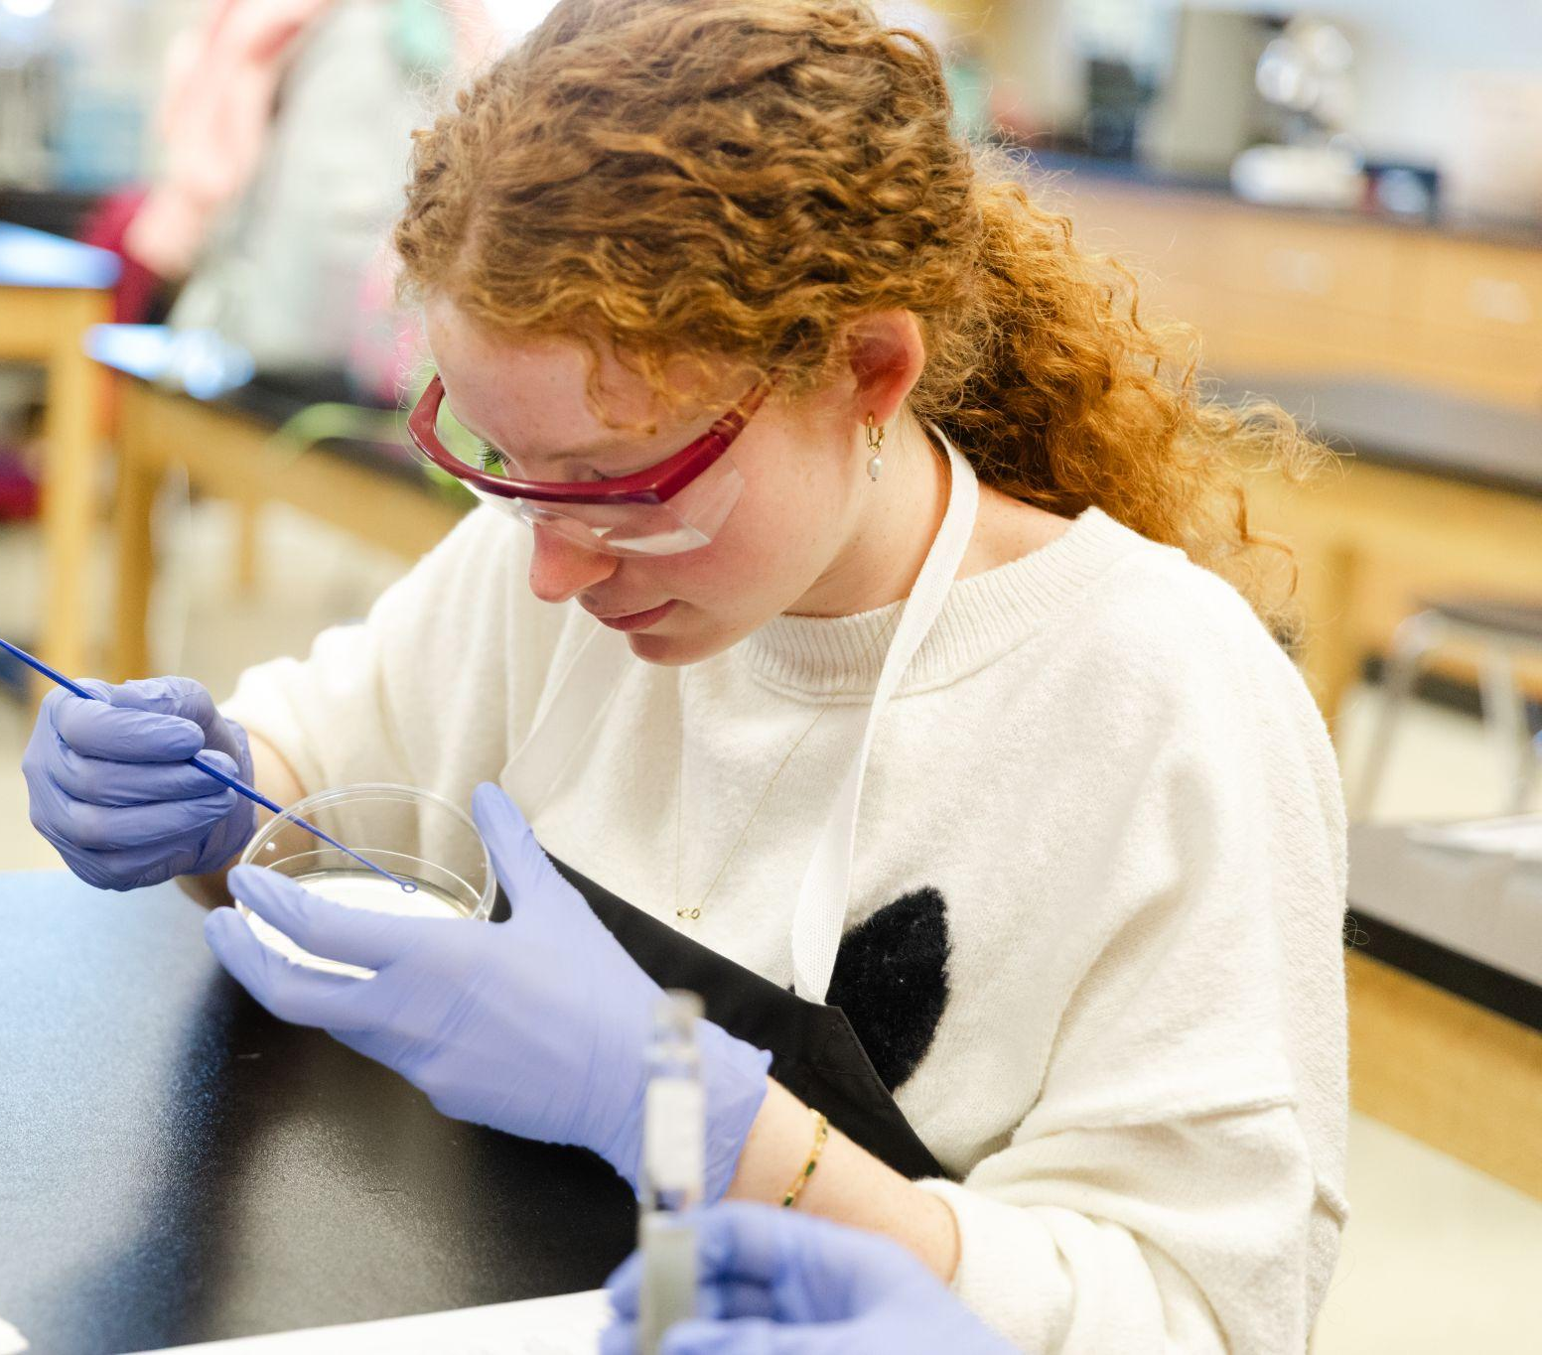
This Means…
🍎 Student Scholarships
🍎 Teacher Mini-Grants
🍎 Tech + Innovation
🍎 Training
… and More!
Notes:
PRESENTER NAME: What we hope to do

Slide 5
✅ COULD DO ✅
❌ WILL NOT DO ❌
Student Scholarships
Innovation & New Classroom Technology
Teacher Mini-Grants
Training
Etc.
Core Board of Education Functions (teacher salaries, fill gaps in school system budgets, etc.)
Fund sports teams
Large infrastructure projects
Etc.
Notes:
PRESENTER NAME: What we will do and not do (examples) Fast.

Slide 6
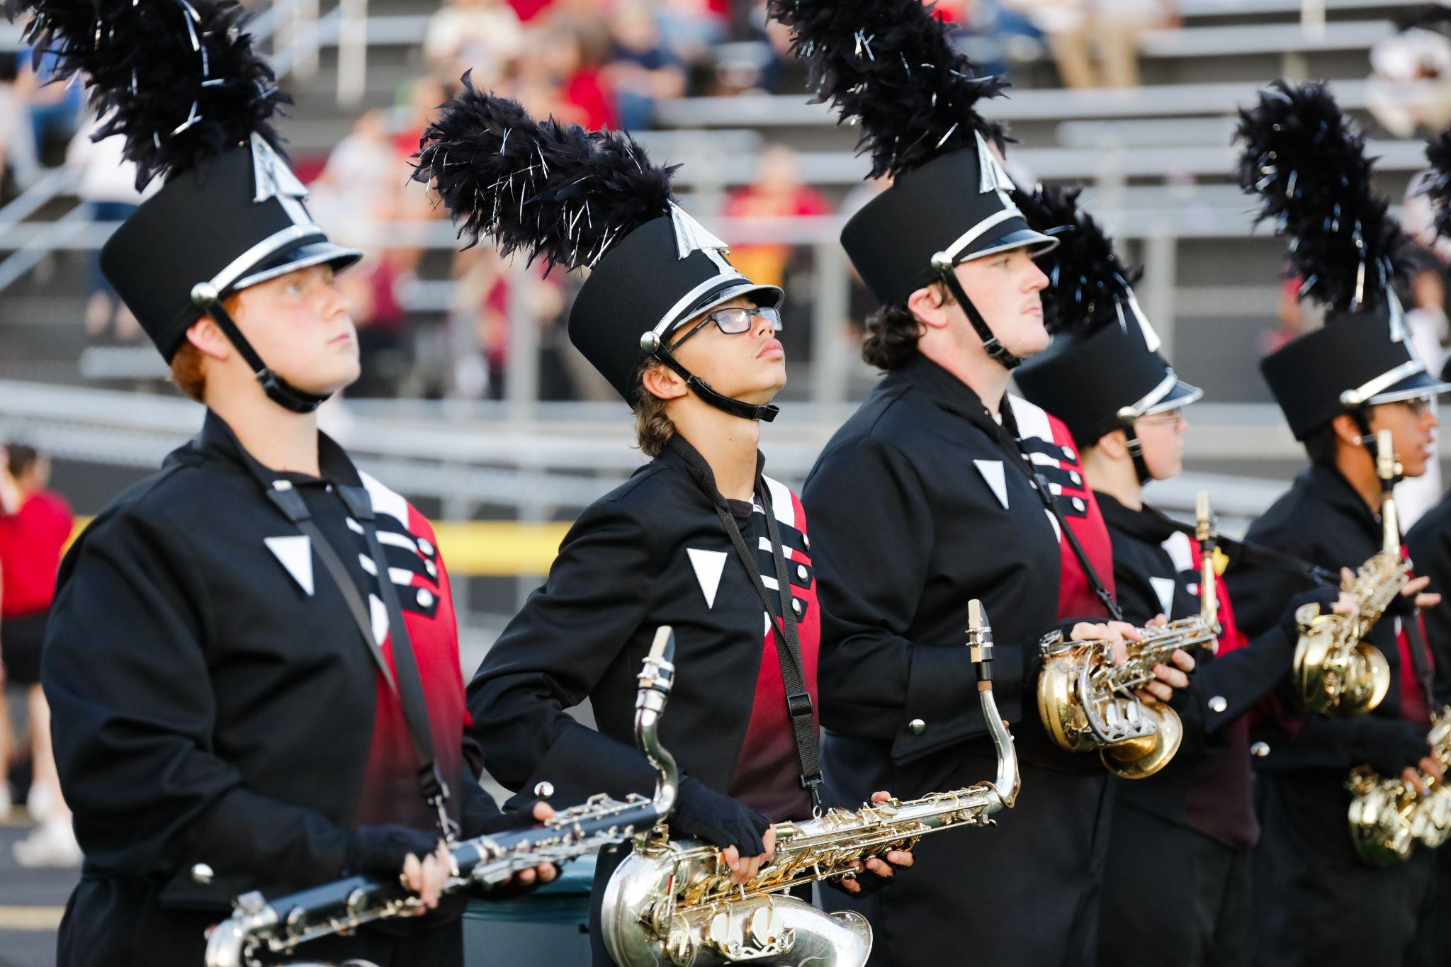
THE BOARD
Jen Krimm: Co-Founder, President
Kevin Brown: Co-Vice-President
Jeff Moss: Co-Vice-President
Melissa Erwin Taylor: Treasurer / Finance Director
Cindy Rogers: Secretary / Governance Director
Kevin Stull: Co-Founder / Board Member Ex-Officio (Non-Voting)
Eve Proffitt: Founding Benefactor and Advisor / Board Member
Michael Gaffney : Board Member
Janet Overstreet: Board Member
Nelson Rhodus: Board Member
Mary Adrianne Davis: Board Member
Kalem Grasham: Board Member
Paul McPherson: Board Member
Notes:
MARY A DAVIS: The community has come together. The Board has members of the Garrard County Schools Hall of Fame, educators, retired teachers, community members and advocates.

Slide 7

Notes:
MARY A DAVIS: FGCS is another tool in the toolbox for the Board of Education, educators, and teachers.

Slide 8
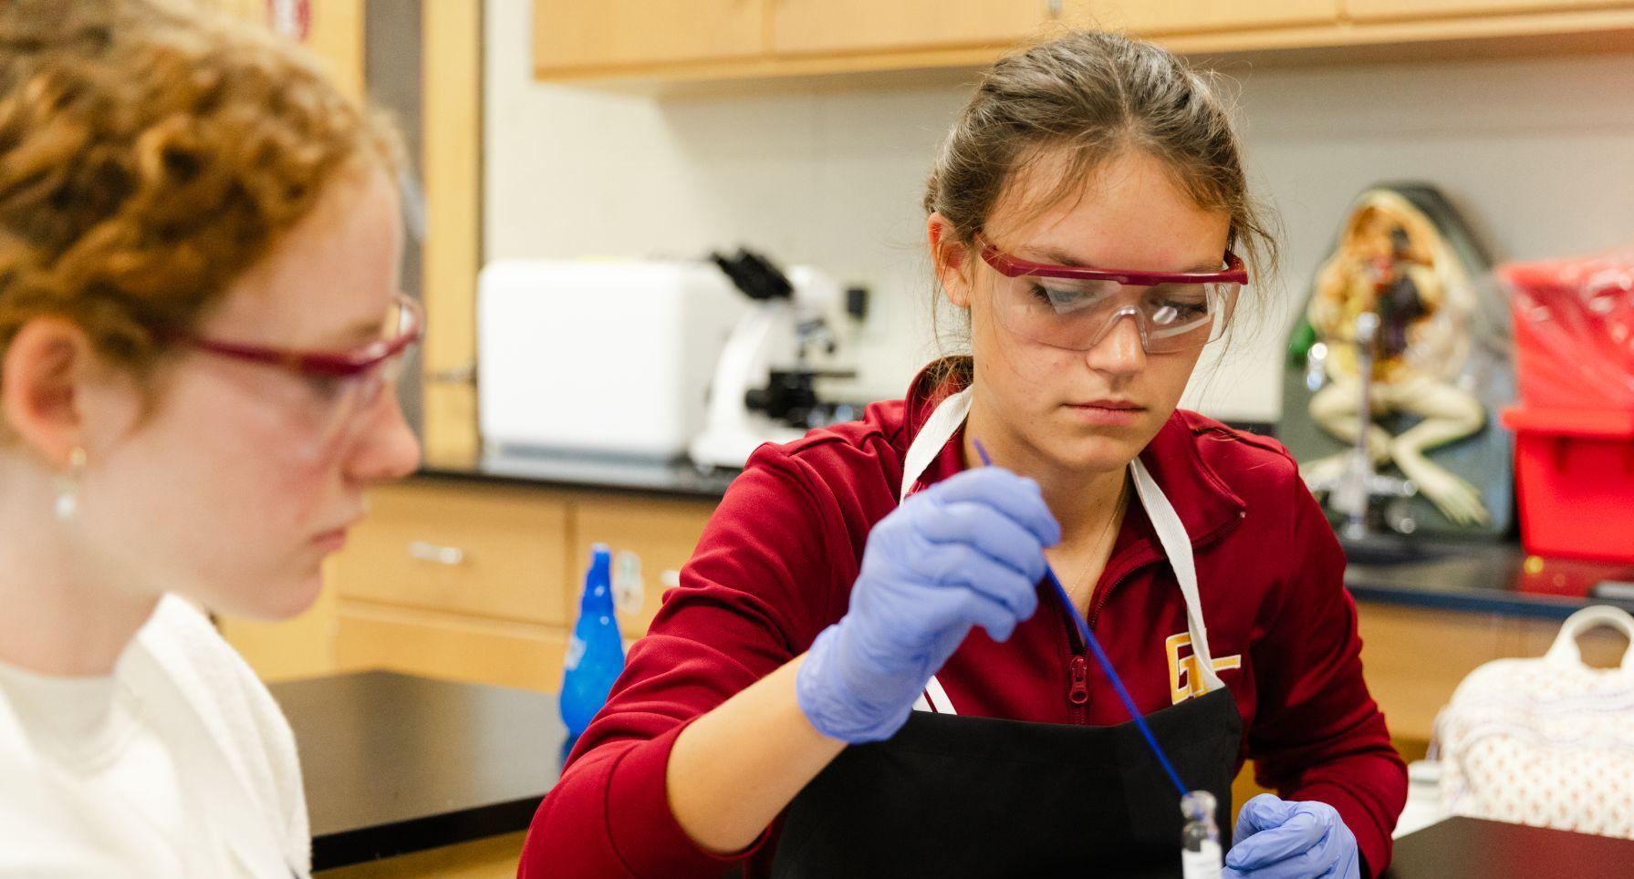
Advice?
Volunteer?
Donate?
Notes:
JEN KRIMM: We’d love to get your ideas and advice. If you have some free time, we’d love to have you volunteer. And of course, we’d love you to become a friend today!

Slide 9
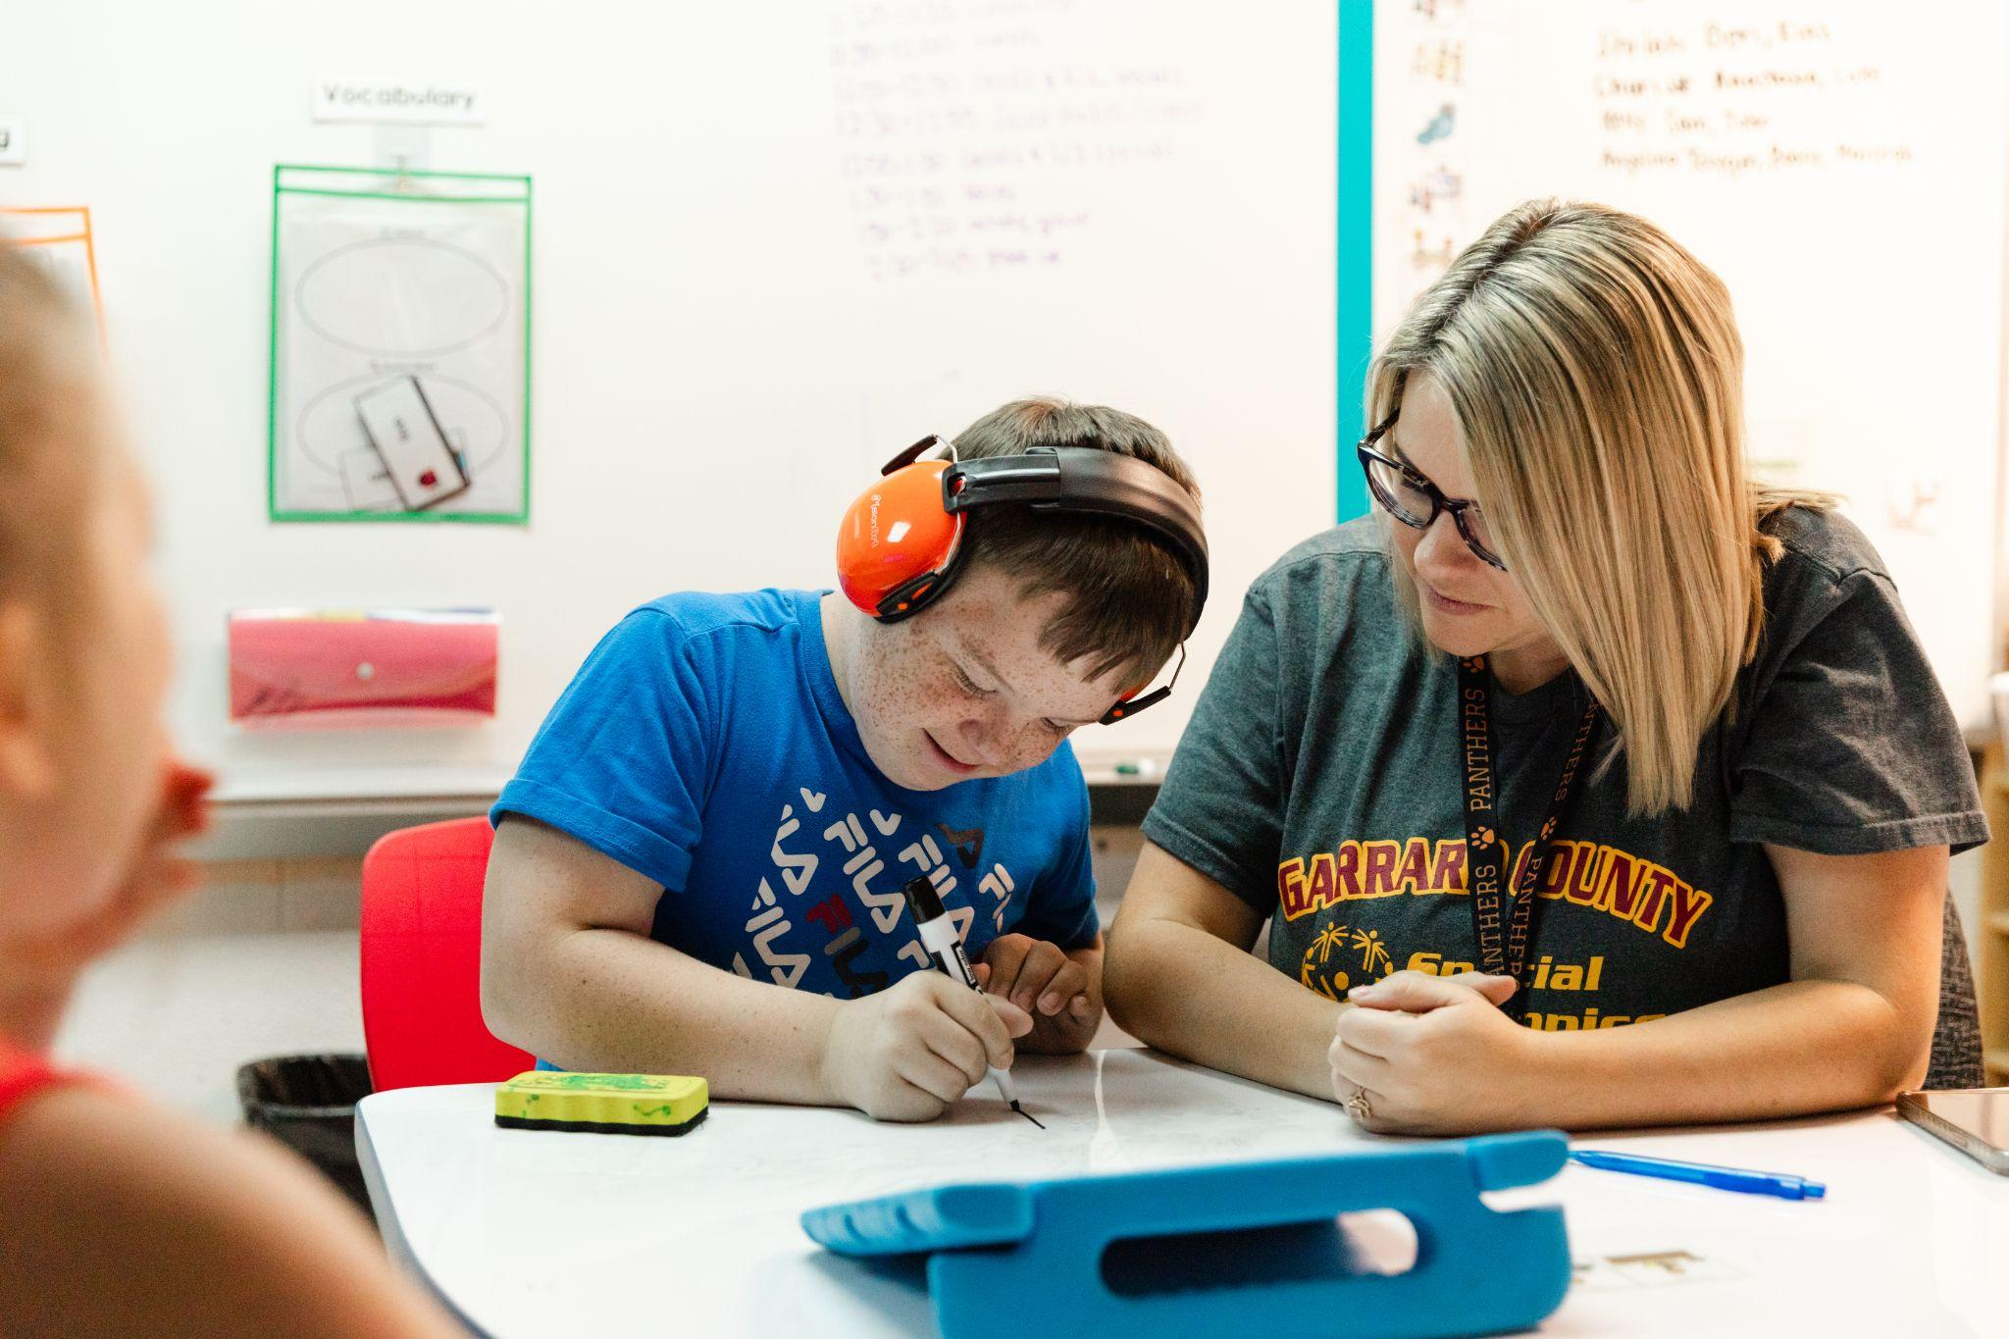
Let’s Work Together!
Notes:
JEN KRIMM: We are so excited to work together with you. FGCS is separate from the school system, but to be successful we have to work closely together… for a great cause

Slide 10
BECOME A FRIEND TODAY!
Notes:
JEN KRIMM

