Slide 1

Invitation to Bid
Sealing Parking Lots
Mercer County Schools
Invitation to Bid
general conditions of this bid.

Slide 2
Mercer County Schools
Mercer County Schools
Invitation to Bid
Grounds and Maintenance for Sealing Parking Lots
The Mercer County Board of Education invites you to submit a bid for grounds and maintenance in accordance with the detailed specifications and general conditions of this bid.
All bids need to be submitted by May 18, 2026
Please submit bids to: will.carlton@mercer.kyschools.us

Slide 3
Please “Bid” on each individual site and tabulate a total price for all sites.
Company Name: __________________________________________
Address:_________________________________________________
Phone Number:____________________________________________
MCSH
1124 Moberly Rd. $________
MCIS
1101 Moberly Rd. $________
KMS
937 Moberly Rd. $________
HARLOW $________
530 Perryville Street
TOTAL $________

Slide 4
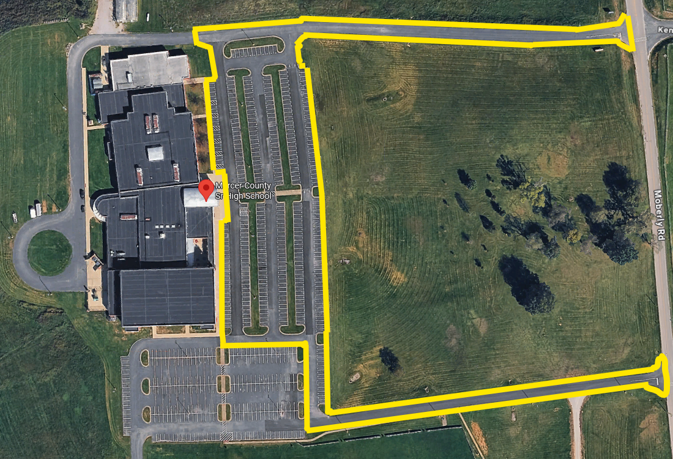
MCSH
Mercer County Senior High School
1124 Moberly Rd.
Harrodsburg, Ky 40330
Expectations:
Seal and Stripe all areas inside Yellow area.

Slide 5
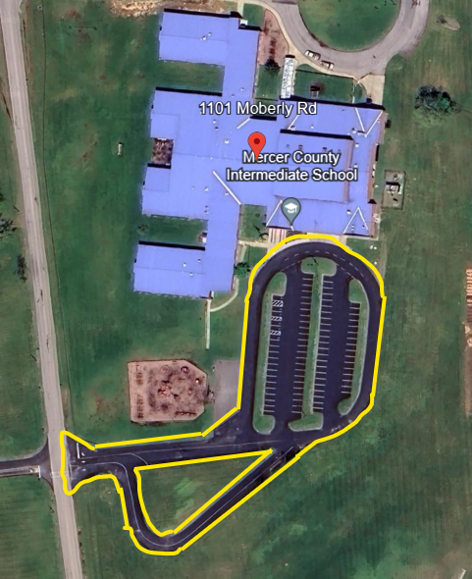
MCIS
Mercer County Intermediate School
1101 Moberly Rd.
Harrodsburg, Ky 40330
Expectations:
Seal and Stripe all areas inside Yellow area.

Slide 6
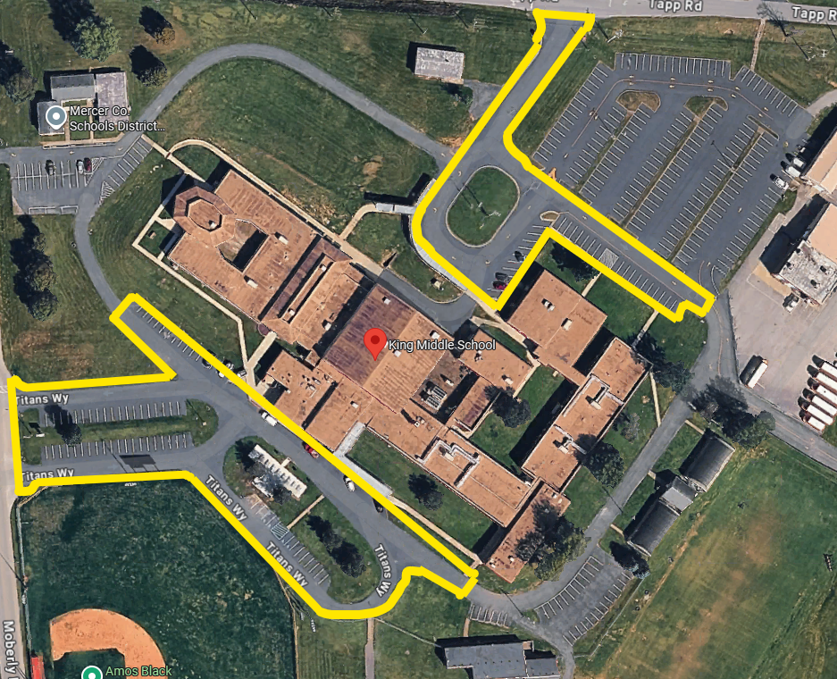
KMS
937 Moberly Rd.
Harrodsburg, Ky 40330
Expectations:
Seal and Stripe all areas inside Yellow area.

Slide 7
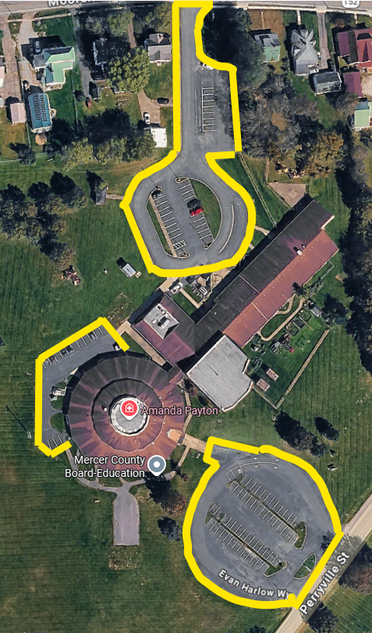
Harlow
530 Perryville Street
Harrodsburg, Ky 40330
Expectations:
Seal and Stripe all areas inside Yellow area.

