Slide 1

Attendance and Enrollment
March Review
DPP- Kyle French Created 3/9/26

Slide 2
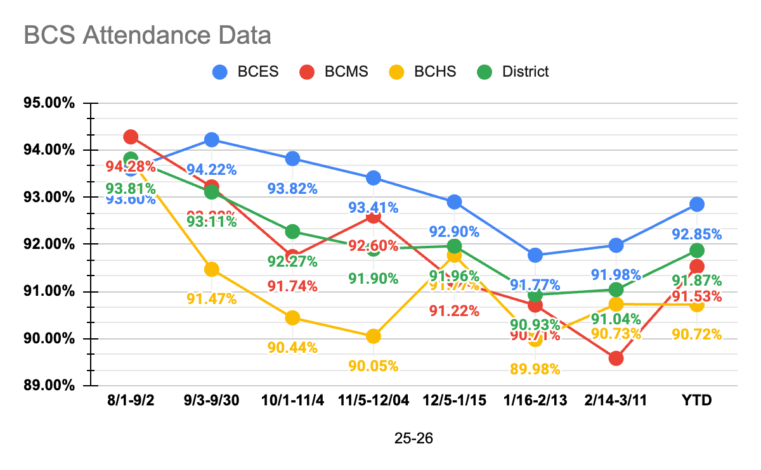
Attendance Rates
Section
25-26 School Year | 8/1-9/2 | 9/3-9/30 | 10/1-11/4 | 11/5-12/04 | 12/5-1/15 | 1/16-2/13 | 2/14-3/11 | YTD
BCES | 93.60% | 94.22% | 93.82% | 93.41% | 92.90% | 91.77% | 91.98% | 92.85%
BCMS | 94.28% | 93.22% | 91.74% | 92.60% | 91.22% | 90.71% | 89.58% | 91.53%
BCHS | 93.79% | 91.47% | 90.44% | 90.05% | 91.77% | 89.98% | 90.73% | 90.72%
District | 93.81% | 93.11% | 92.27% | 91.90% | 91.96% | 90.93% | 91.04% | 91.87%
Section
12

Slide 3
Enrollment Data
Section
Section
12
Enrollment Data | 21-22 | 22-23 | 23-24 | 24-25 | 25-26
Month 1 | 1057 | 1030 | 957 | 926 | 891
Month 2 | 1052 | 1038 | 959 | 924 | 891
Month 3 | 1036 | 1030 | 958 | 928 | 896
Month 4 | 1022 | 1031 | 959 | 919 | 892
Month 5 | 1021 | 1033 | 964 | 925 | 893
Month 6 | 1023 | 1035 | 968 | 932 | 886
Month 7 | 1022 | 1020 | 963 | 918 | 886
Month 8 | 1020 | 1020 | 957 | 917
Month 9 | 1016 | 1019 | 953 | 912
Month 10 | 1 Day- 1016 | 4 Days- 1019 | 2 Days- 951 | 1 Day- 912

