Slide 1
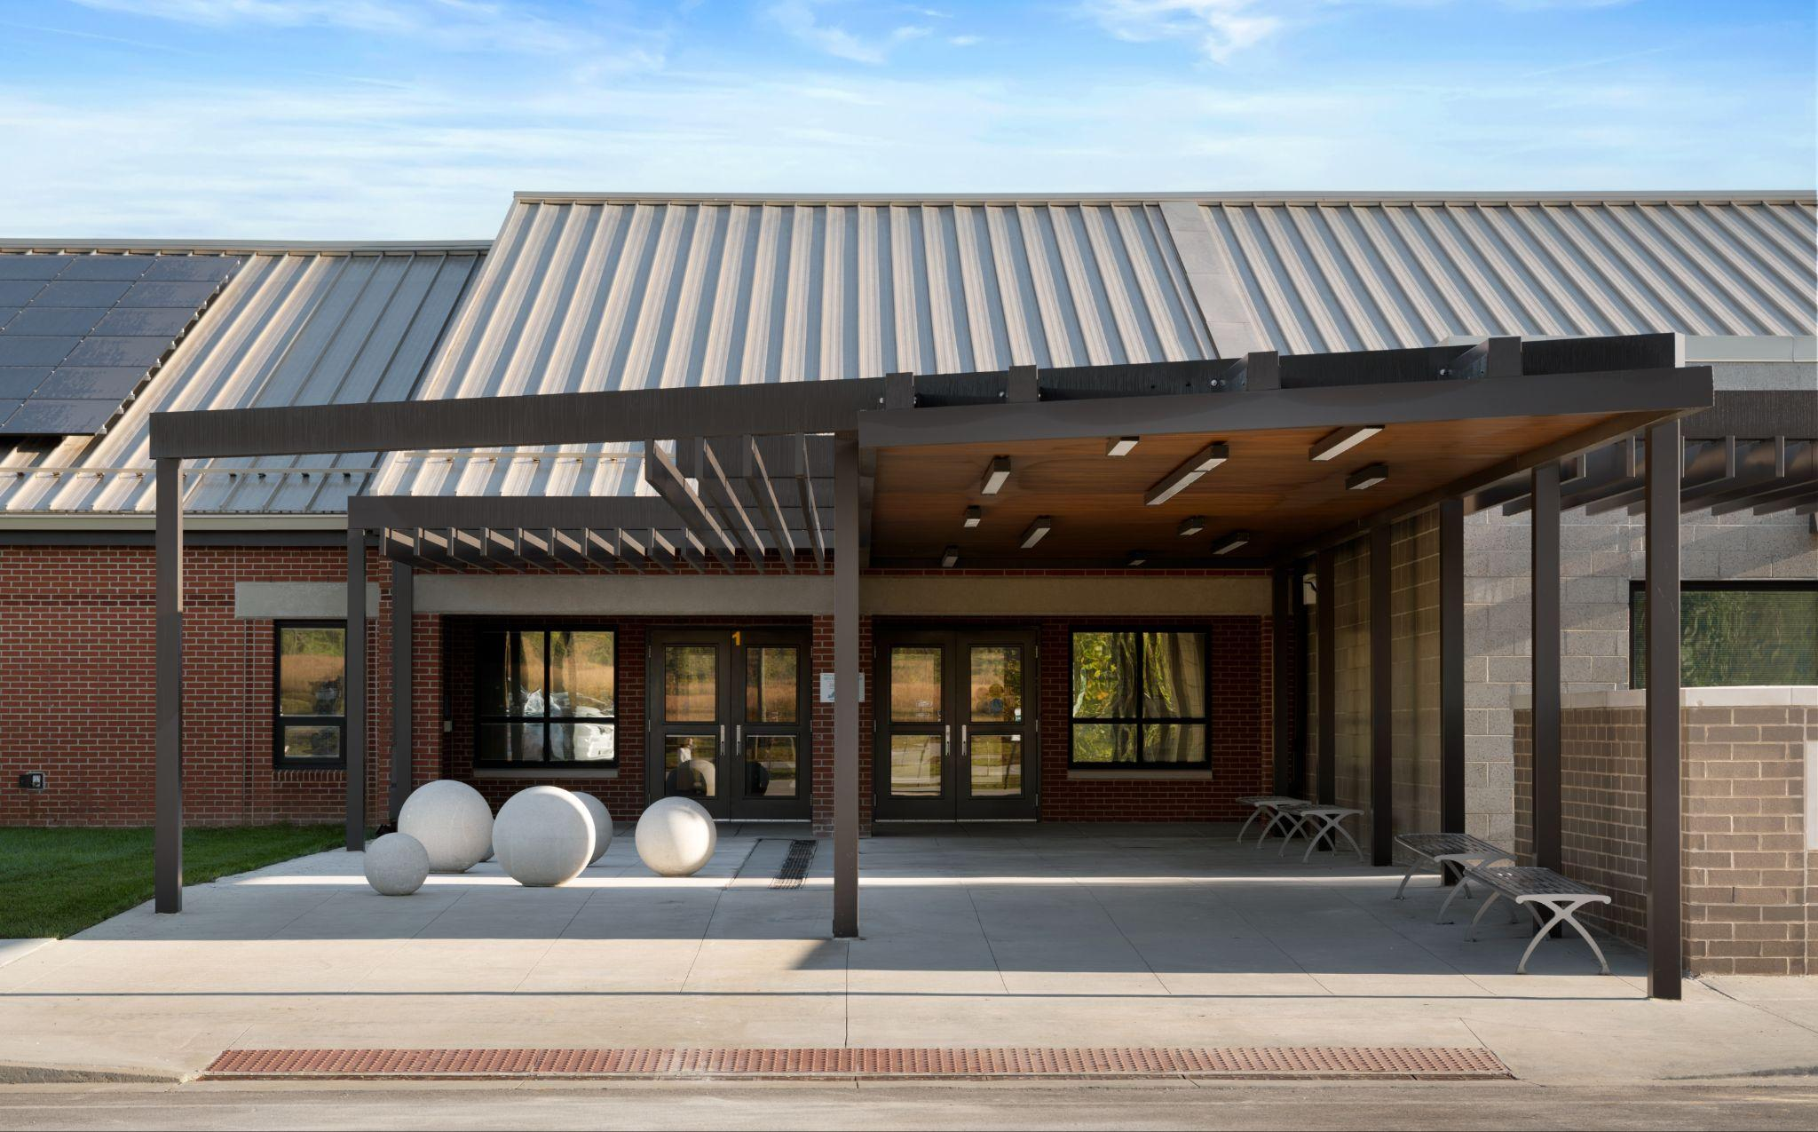


February 16th - Design and Construction

Slide 2
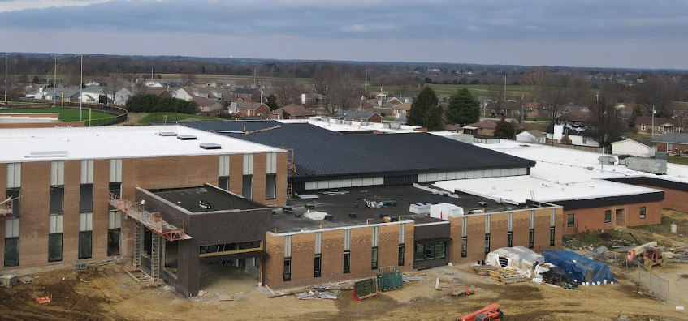

Fine Arts
Bullitt East High School - Construction

Slide 3
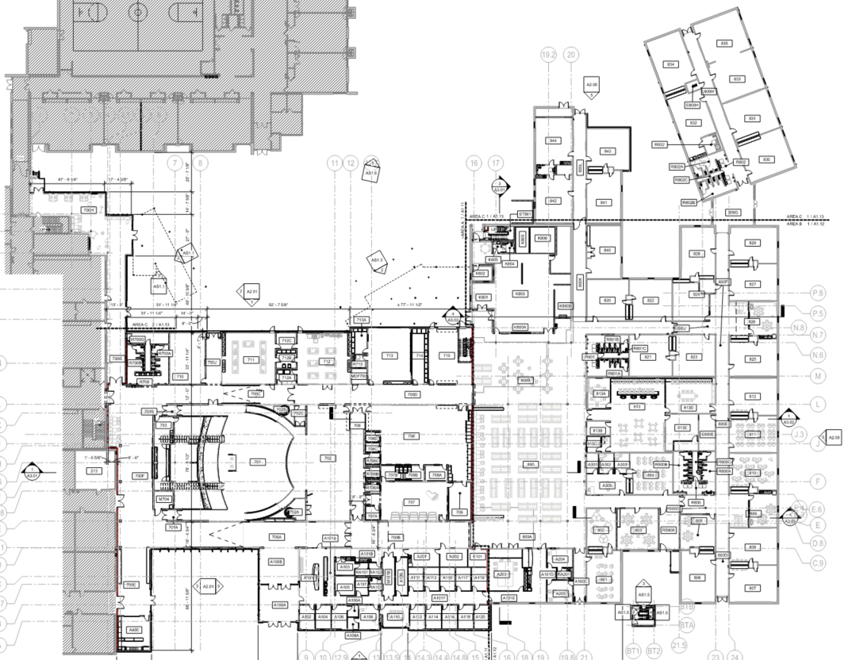
Area B
Construction Timeframe:
Anticipated Completion - June 2026
Equipment Start Up Happening, Gas is on.
Courtyard
Area C
Area A
School Store
Band Tower
Bullitt East High School Construction

Slide 4
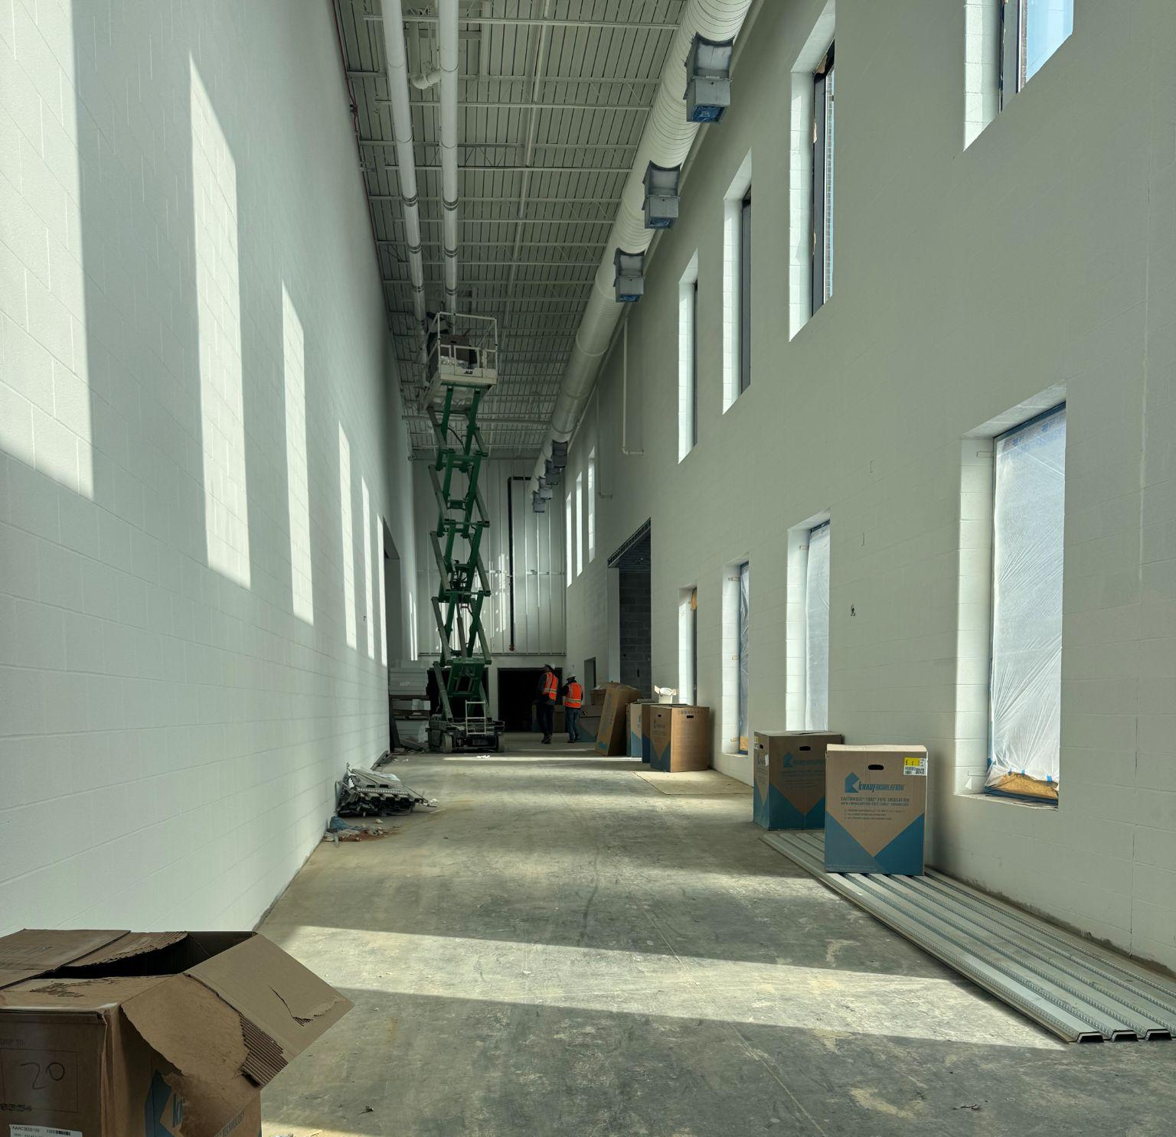
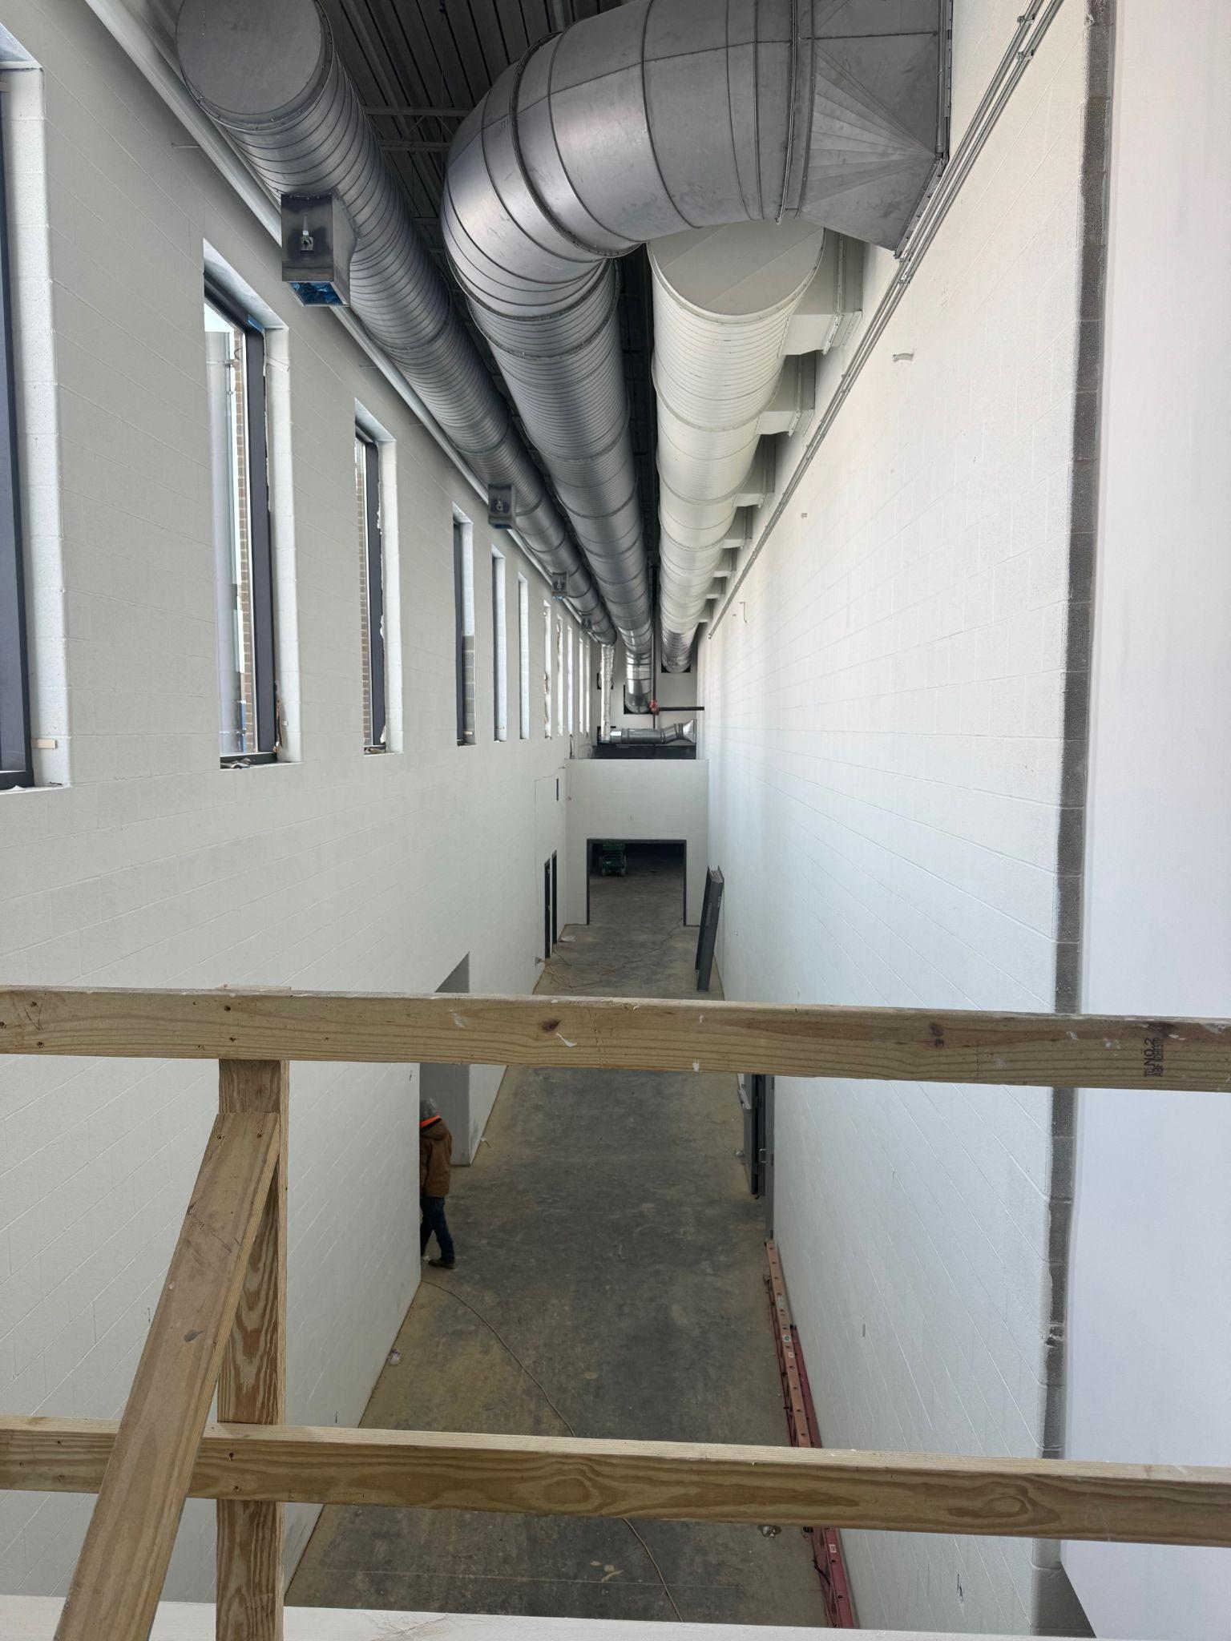
Fine Arts
Bullitt East High School - Construction

Slide 5
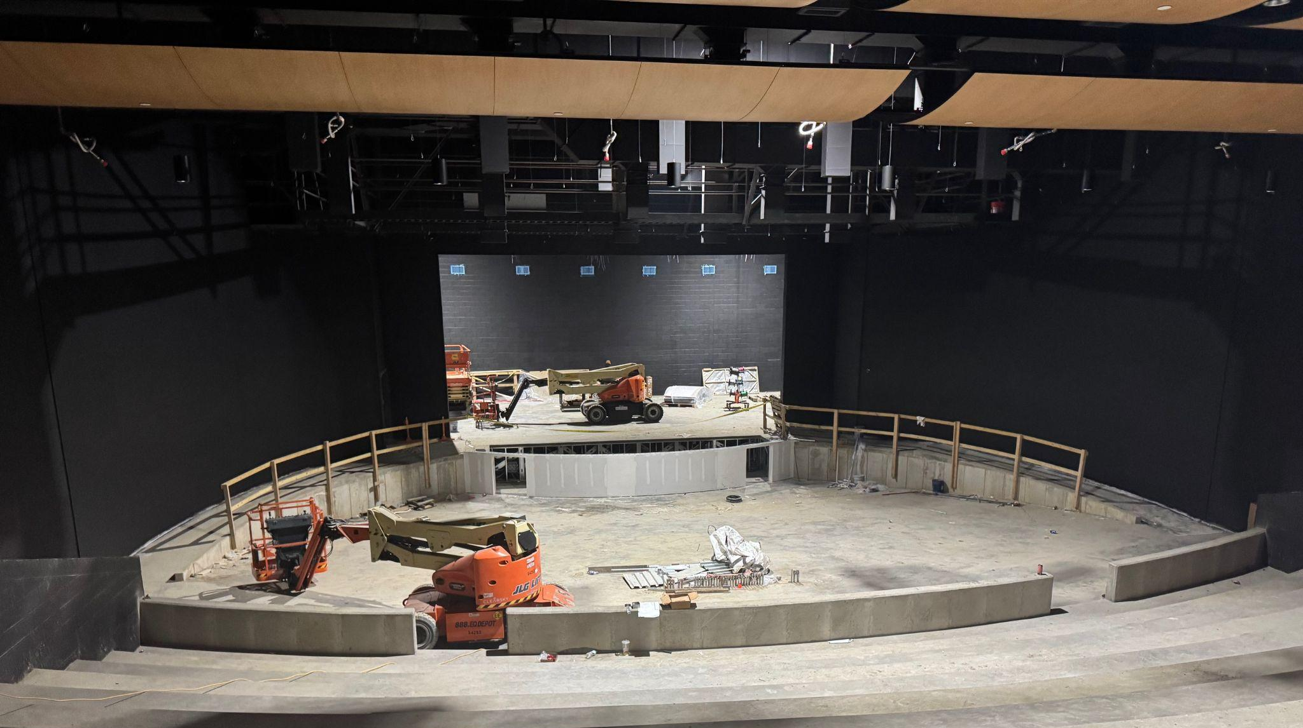
Fine Arts
Bullitt East High School - Construction

Slide 6
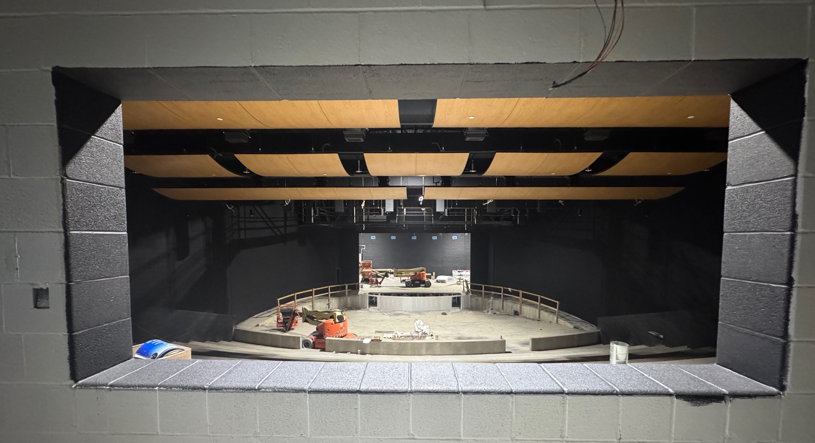
Fine Arts
Bullitt East High School - Construction

Slide 7
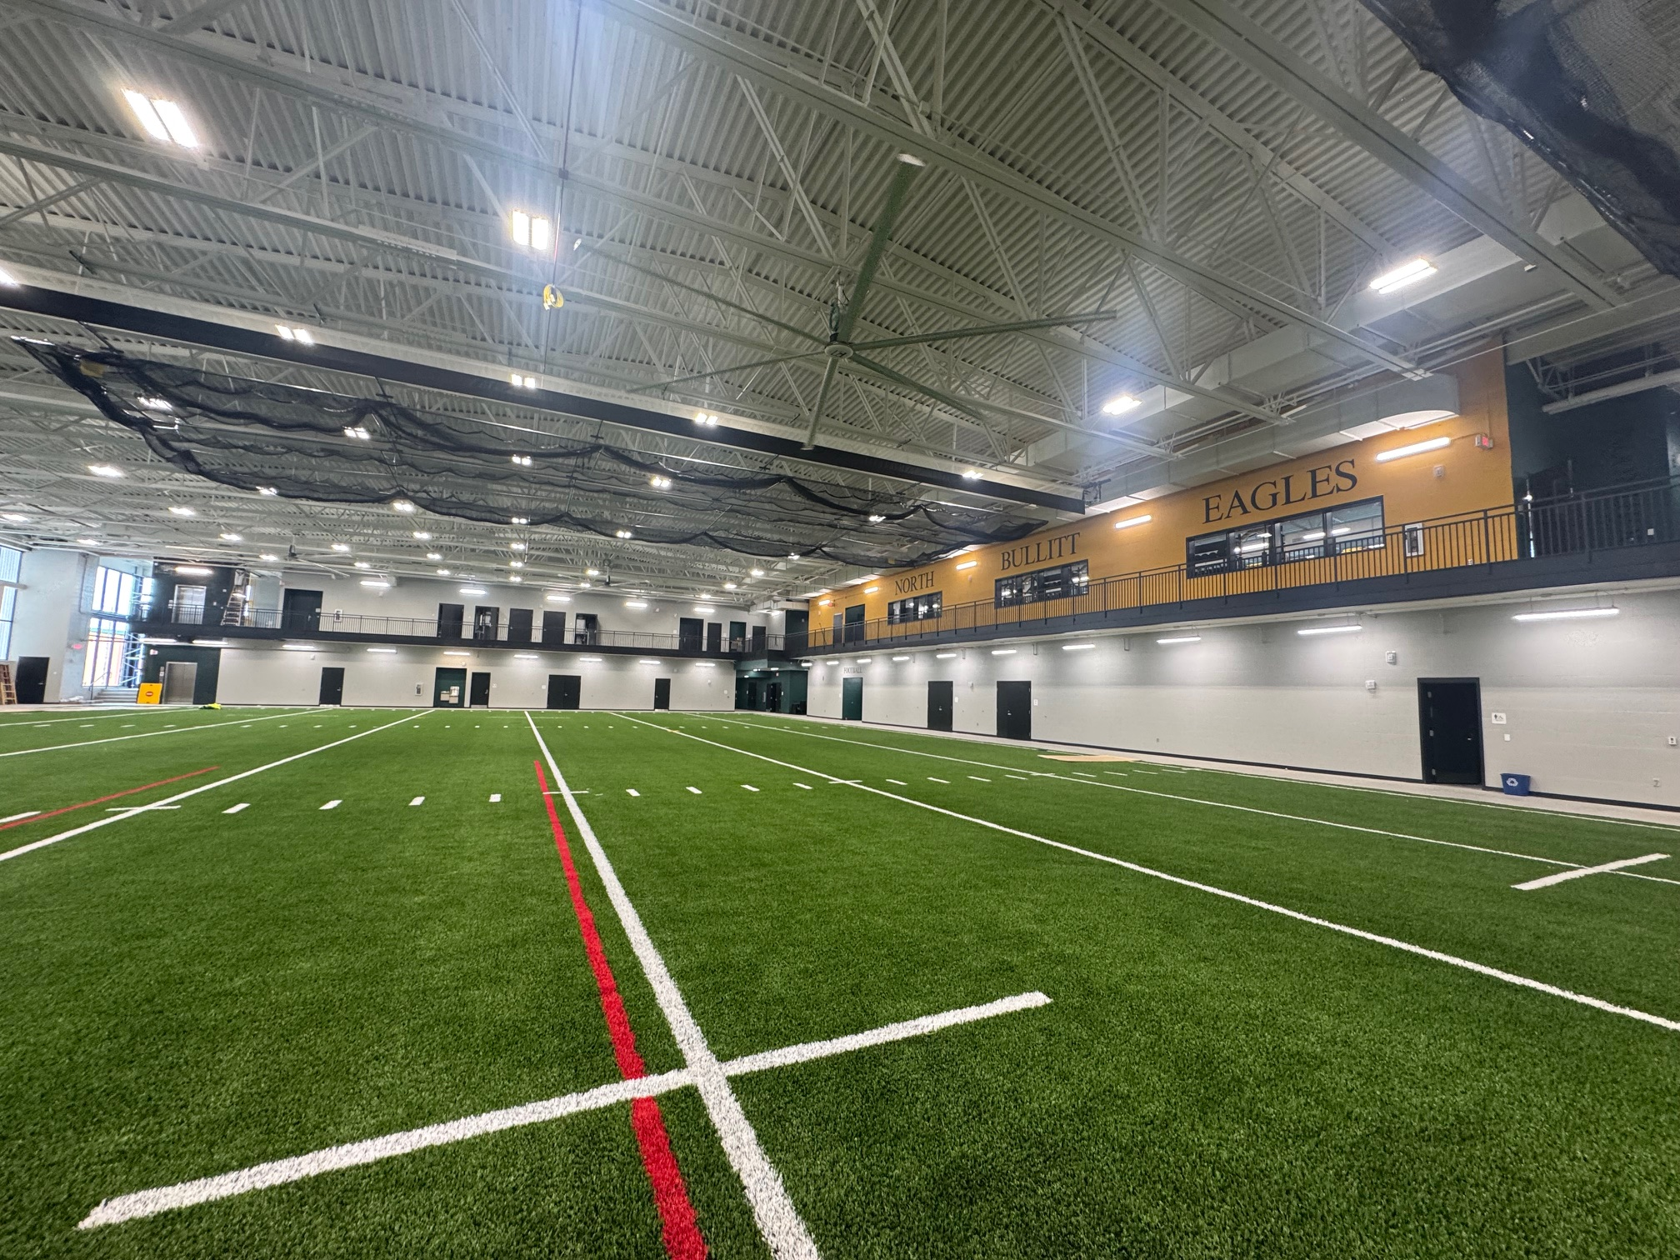

Phase 2 Athletics
NBHS Physical Science Center

Slide 8
UPDATE - Bid Package No. 2 - North Bullitt
December 12, 2025 Structural Team noticed the masonry bearing wall construction at BE/BC PSC was compromised based on in-wall plumbing work. This initial observation triggered a question relative to construction and North Bullitt’s Masonry Walls. Additional in-wall reinforcement confirmation was requested by the design team from the construction team.
December 22,2025 Architectural/MEP Punch Inspection Occurred
January 8, 2026 Temporary Certificate of Occupancy Granted – Per Inspector, building can be occupied and the following items need to be addressed within 120-Days.
  Cited Deficiencies:
    2nd Means of Egress Required by Inspector at Football Locker Room
    Guardrail at Main Entrance required by Inspector
    Pipe Rail at PE Locker room required by Inspector where ductwork is low.
January 14, 2026 On site Investigation and Analysis of the bearing walls and discontinuous reinforcement yielded a design team opinion that a redundant bearing wall has to be constructed to address the structural bearing and shear loads. Calhoun, B+K and SKA were all present during discussions and met on site on this date to review the work in place with BCPS Facilities representatives present. SKA verbally stated to BCPS Facilities at this meeting that the Design Team’s opinion is that the facility cannot be occupied until this bearing wall is built and inspected.
Phase 2 Athletics
NBHS Physical Science Center

Slide 9
UPDATE - Bid Package No. 2 - North Bullitt
Anticipated Inspections and Change Order Work
  February 16, 2026 Owner Directed Change Order Request of added Cable Tray is on Board Agenda for review.
    If this CO is approved, this adds additional time to when contractors will be in the building but does not prohibit BCPS from moving into the building as this work is not related to life safety.
  February 19, 2026 Elevator RE-Inspection Scheduled – Failed initially due to cab guardrails, OTIS is addressing at no cost to Owner/Contractor
    Cited Deficiencies:
      Safety Cab rail did not meet clearance requirements – SKA confirmed rail requirements during construction and Otis is addressing per confirmations they provided the construction and design teams.
      Incomplete Elevator does not prohibit use of the building but would limit ADA accessibility to the 2nd level.
  March 18, 2026 Potential Move-in Date
Phase 2 Athletics
NBHS Physical Science Center

Slide 10
Board Consent Items - Bid Package No. 2 - North Bullitt
Change Order 31 – Cable Tray Revisions - $82,737.00 - BCPS Technology and Leadership is requesting the addition of cable tray in lieu of J-Hooks for data cable management at the facility. This Change Order would cover a cost change for material and installation.
Phase 2 Athletics
NBHS Physical Science Center

Slide 11
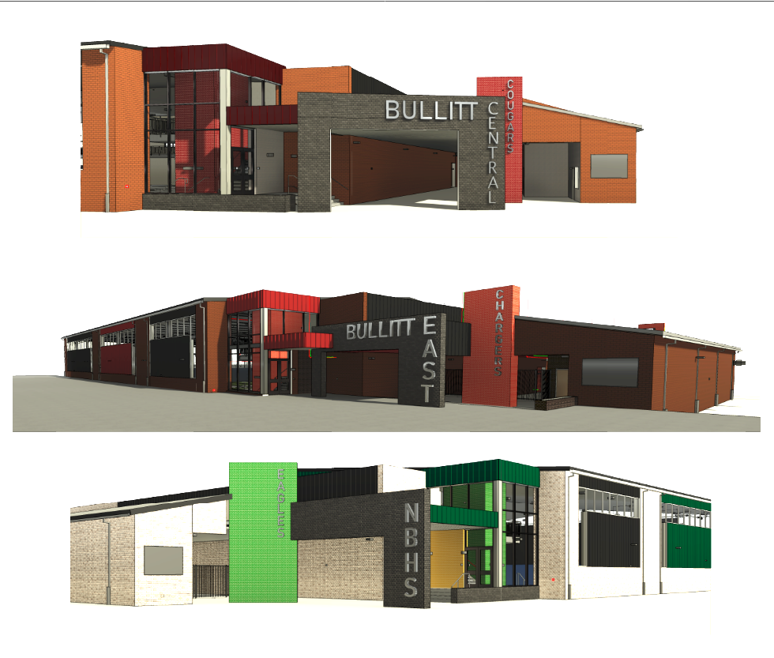

Phase 3 Athletics - Physical Science Centers
Bullitt Central & Bullitt East - Update

Slide 12
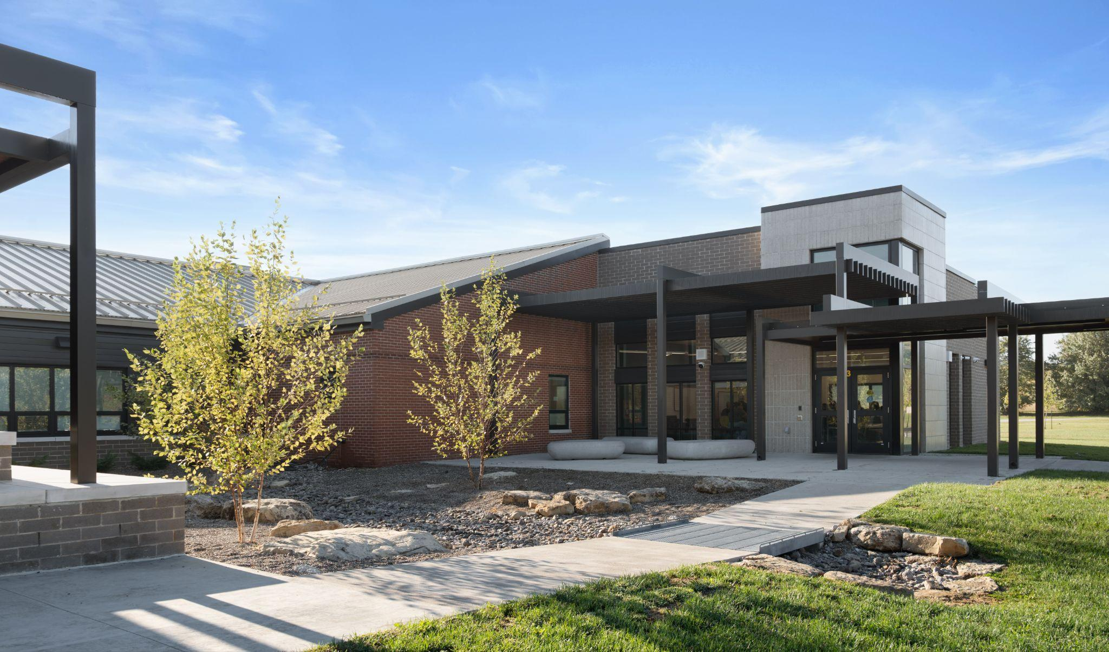
Board Consent Items - Bernheim Middle School
DPO Reconciliation Credit for unbilled materials including the following:
DPO 19 - 24903132 - Wausau Tile - $204.34
Next Board Meeting
DPO 4 – Schiller – Change Order Credit Omit Sales Tax on Administrative Request
Close-Out paperwork will follow in future board meetings.
Bernheim Project Close Out

