Slide 1
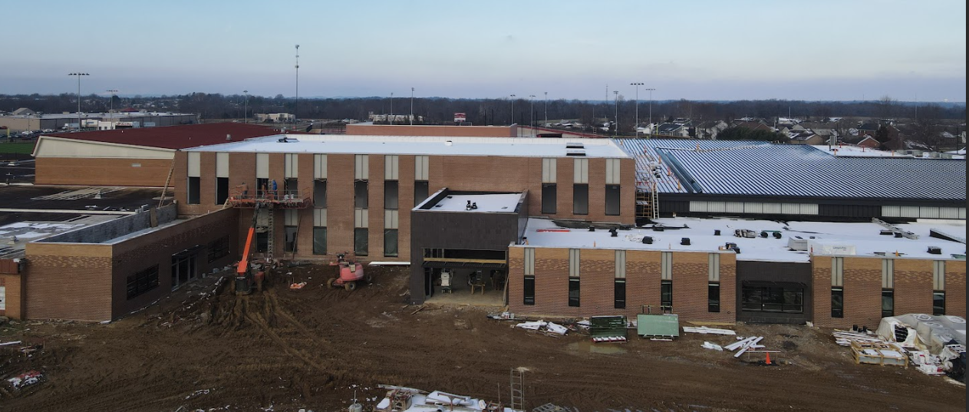


January 26th - Design and Construction Update

Slide 2
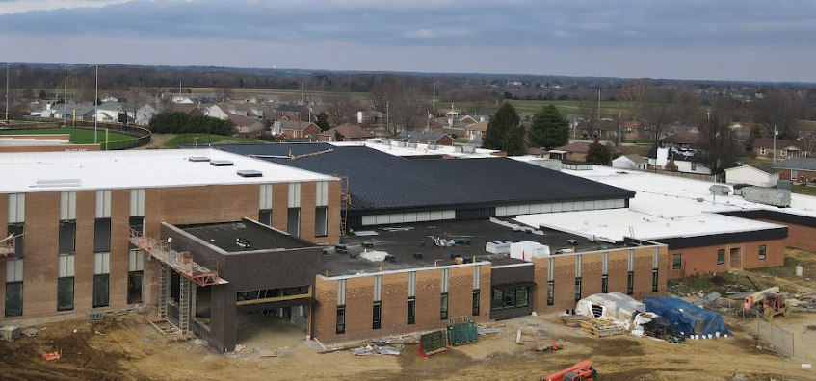

Fine Arts
Bullitt East High School - Construction

Slide 3
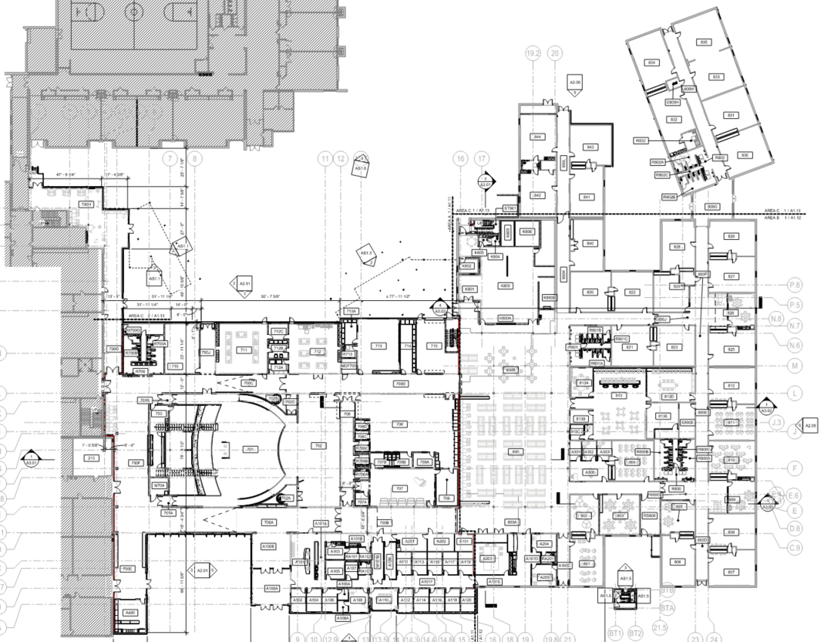
Area B
Construction Timeframe:
Anticipated Completion - June 2026
Equipment Start Up February
Under Roof
Area C - Continuing
Area A
Bullitt East High School Construction

Slide 4
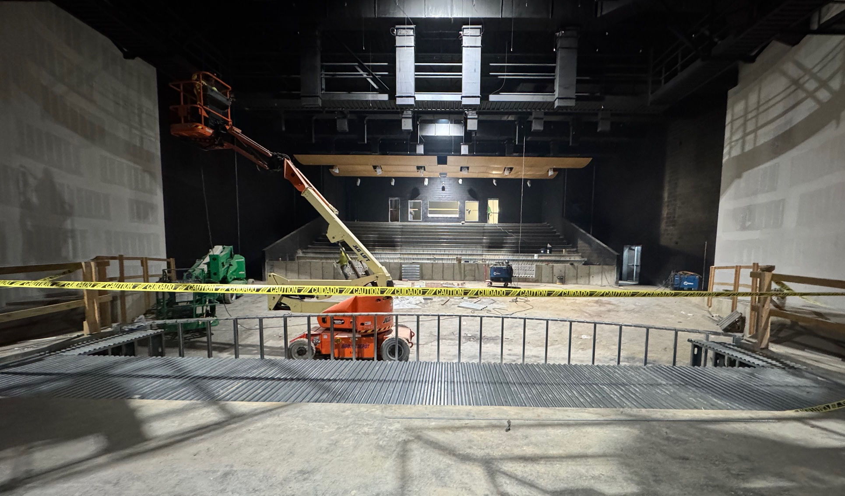
Board Consent Items - Bid Package No. 1 - Bullitt East Fine Arts
Change Order 31 - Gas Line Service Line Change - $3,276.12 - LG&E required the primary gas line be upsized based on their entire campus gas service review. As a result, the gas line sleeve that is provided by the site contractor needed to be upsized from 4" to 8". A credit is provided for the smaller line that was previously assumed.
Change Order 32 – Stage Rigging - $91,765.27- BCPS Technology/Leadership requested additional motorized stage rigging to be installed by the Contractor in sequence with the schedule. This work includes 2 additional shaft hoists and battens at the stage.
Fine Arts
Bullitt East High School - Construction

Slide 5
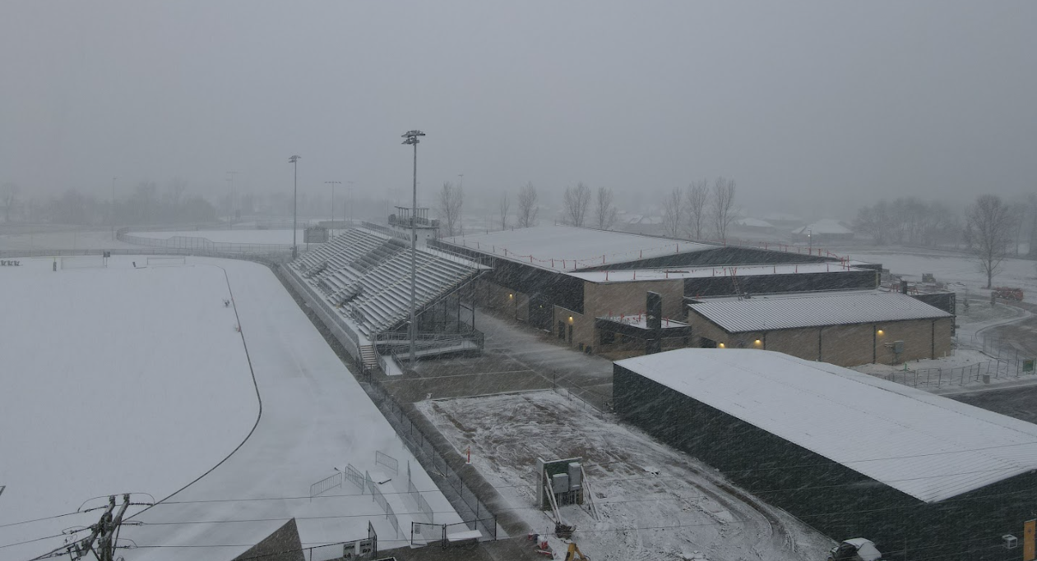

Phase 2 Athletics
NBHS Physical Science Center

Slide 6
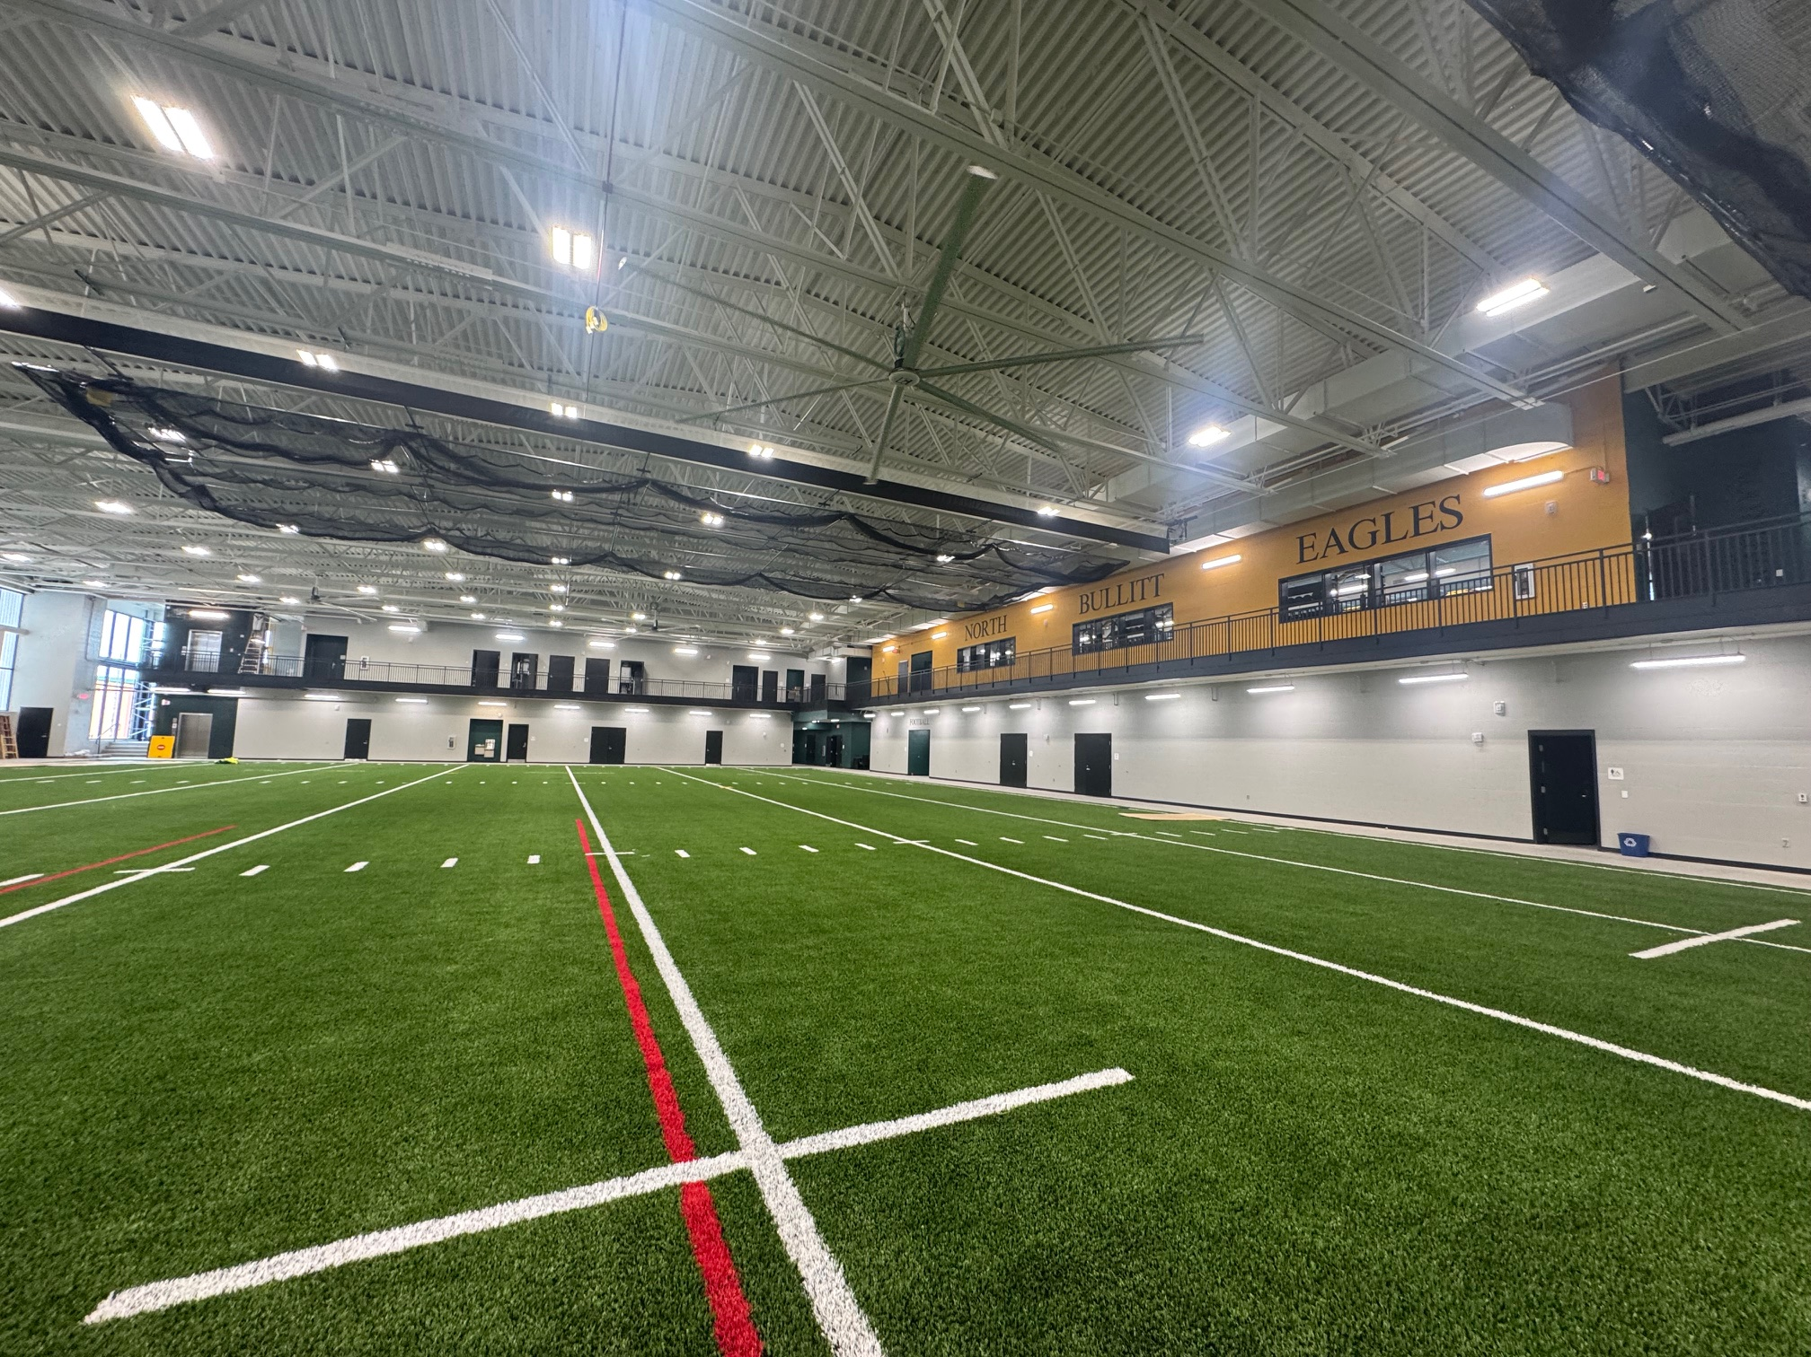
Board Consent Items - Bid Package No. 2 - North Bullitt
Change Order 30 – Tennis Court Wiring Revisions - $2,168.00 - Once submittals were issued for the Tennis Court lighting revisions by Musco (the supplier), wiring needed to be changed to accommodate the voltage. Work can happen in sequence with trades currently on site.
Phase 2 Athletics
NBHS Physical Science Center

Slide 7
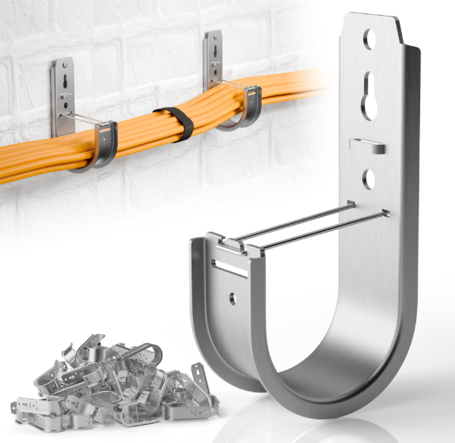
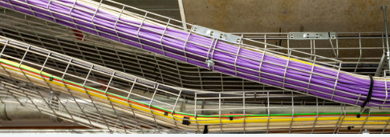

Phase III Athletics - Physical Science Centers - Bullitt East & Bullitt Central
Change Orders 08 and 10 – Weight Room Flooring ($4,013.00) labor credit + ($25,955.16) material credit (at each facility) - Weight Room flooring is being omitted and replaced with an outside vendor's flooring. This change order deducts the cost of installation of the resilient flooring originally specified and documented. There is a separate change order for the omission of flooring materials attached as a DPO Change Order for materials.
Change Orders 09 and 11 – Cable Tray Revisions $41,192.00 (at each facility) - BCPS Technology is requesting the addition of cable tray in lieu of J-Hooks for data cable management. This Change Order would cover a cost change in material and installation. Work can proceed with trades on site in sequence with construction schedules.
Phase 3 Athletics - Physical Science Centers
Construction

Slide 8
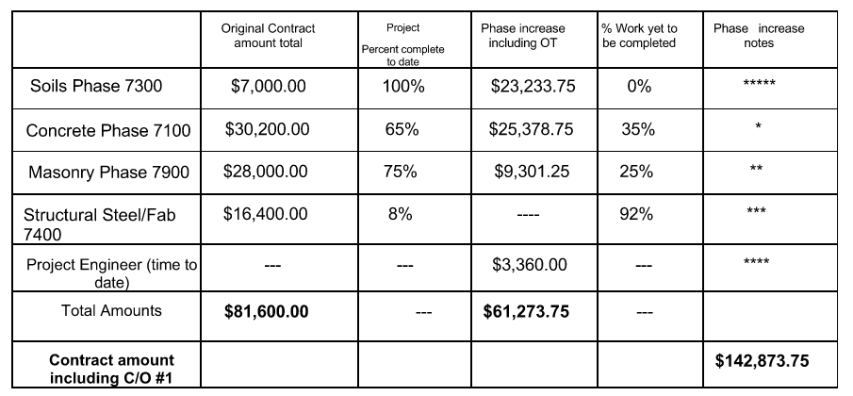
Due to the soil conditions encountered in the field at both Central and East, there has been additional site visits required by their team to analyze and report. Due to this, there is a need to increase the value of their PO.
I request this be added to the on the upcoming January Board Meeting to add this additional service change order to the board agenda. This would need to be funded via Construction Contingency due to exceeding the Post-Bond Sale BG-1 value. Per the listed probable costs below.
The original approval of the UES proposal is attached for reference. The cost ADD is $61,273.75 and includes anticipated services moving forward. Total PO value would increase to $142,873.75.
Phase 3 Athletics - Physical Science Centers
Bullitt Central & Bullitt East

