Slide 1

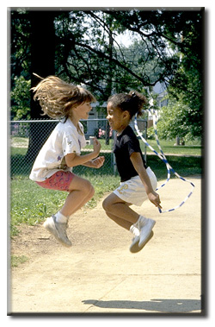

“Promoting healthy and safe behaviors among students is an important part of the fundamental mission of schools.”
School Health Index-Centers for Disease Control (CDC)
Nutrient Analysis
Averaged over the course of a week, lunch menus offered in our schools provide the following:
Bellevue Independent
School
Nutrient | Target* | Actual
Calories | 550-850 | 600-850
Sodium | <640 | <640
5 serving of fruit | 2 ½ -5 cups a week | 2 ½ -5 cups
100% whole grain | 8-12 servings | 8-12
Red & Orange vegetables | ¾ - 1 ¼ cup a week | 1 ½ cup
Protein (G) | 15 G | 32.58 G
Saturated Fat (G) | 10 % of Calories | 10 %
Dark Green Veg. | ½ cup weekly | 1 cup
School Physical Activity Environment Assessment
Program/activity
Elem
Middle
High
Nutrition & Physical Activity Report Card
2024-2025
Provide daily recess
100%
N/A
N/A
Provide at least 150 minutes of physical education per week
80%
8th grade gets 320 mins for a 1/4
As per Graduation requirement
Provide at least 225 minutes of physical education
Yes
50%
50%
The Bellevue Independent Schools are dedicated to serving nutritious meals and providing multiple physical activity opportunities as a means of helping our students reach proficiency.
Provide classroom physical activity integrated into school day
90%
NA
N/A
*Grades K-12
Provide intramural physical activity opportunities
Basketball & GOTR
100%
100%
The U.S. Department of Agriculture (USDA) prohibits discrimination against its customers, employees, and applicants for employment on the bases of race, color, national origin, age, disability, sex, gender identity, religion, reprisal, and where applicable, political beliefs, marital status, familial or parental status, sexual orientation, or if all or part of an individual's income is derived from any public assistance program, or protected genetic information in employment or in any program or activity conducted or funded by the Department. (Not all prohibited bases will apply to all programs and/or employment activities.)
If you wish to file a Civil Rights program complaint of discrimination, complete the USDA Program Discrimination Complaint Form, found online at http://www.ascr.usda.gov/complaint_filing_cust.html, or at any USDA office, or call (866) 632-9992 to request the form. You may also write a letter containing all of the information requested in the form. Send your completed complaint form or letter to us by mail at U.S. Department of Agriculture, Director, Office of Adjudication, 1400 Independence Avenue, S.W., Washington, D.C. 20250-9410, by fax (202) 690-7442 or email at program.intake@usda.gov.
Individuals who are deaf, hard of hearing or have speech disabilities may contact USDA through the Federal Relay Service at (800) 877-8339; or (800) 845-6136 (in Spanish).
USDA is an equal opportunity provider and employer.”
Offer facilities to families/
community for physical
activity opportunities
Playground at the school
Track and Tennis courts
Track and Tennis courts
The data presented above is a summary from the assessment of our physical activity environment. Both Grandview and BMHS have a certified physical education teacher on staff.
Pre-School have been instrumental in coordinating playground improvement district wide. As a result, our playgrounds are modern, safe and available to the public at large on a year-round basis.
YMCA, provides afterschool physical activity.
Classrooms introduce Go Noodle and Brain Breaks.
Average 17.5 days a month, Average 1 Rotation equal 4 days, with 200 minutes a month of P.E. on average
Physical Activity & Achievement
Schools play a crucial role in influencing physical activity behaviors. Sound curriculum, policies, and facilities create an environment encouraging students and staff to engage in a variety of physical activity opportunities. Evidence supports a correlation between SAT scores and the physical well-being of students.
Intense physical activity programs have positive effects on academic achievement , including increased concentration; improved mathematics, reading, and writing test scores; and reduced disruptive behavior.
-- Curricular Physical Activity and Academic Performance, Pediatric Exercise Science

Slide 2


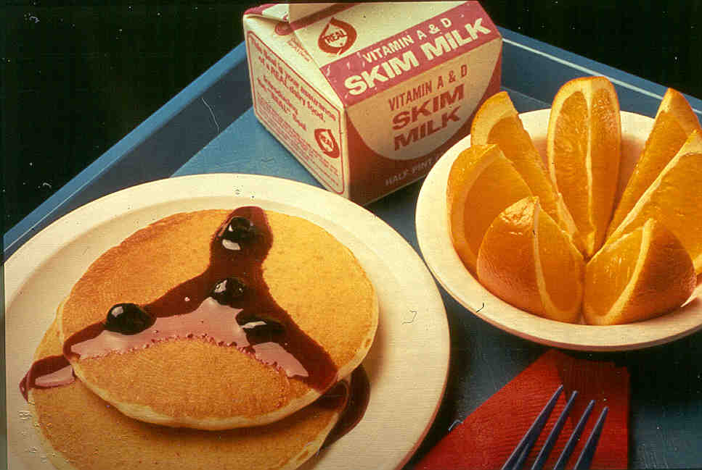
National School Lunch
The National School Lunch Program (NSLP) was conceived in 1946 as a “measure of national security to safeguard the health and well-being of the Nation’s children.” School districts receive federal reimbursement for each school lunch served that meets the United States Department of Agriculture nutrition guidelines. These guidelines promote meal quality while commodity donations help the farmer and help schools keep down meal prices.
Our lunch meals are planned on a three-week menu cycle at the elementary school and a three-week cycle at the high school Federal regulations require that we offer minimum portion sizes of meat, fruit and/or vegetable, grains/breads and fluid milk during every lunch meal service. The portion sizes are designed to meet the needs of growing children and, as a rule, we increase the sizes as the children grow older. We offer 100 % whole grains 10 -12 servings for the 9 – 12 graders, and 6-8 for K-5 grades a week and we offer fresh fruits and vegetables every day. The menu cycle provides for variety and allows us to make the most efficient use of the donated commodities, especially seasonal fresh fruits . We offer 1% white also Fat Free flavored milk as well as 100% fruit and vegetable juices.
An analysis of our lunch menus is found elsewhere in this report card. The table below provides a synopsis of the lunch program, including participation and financial data.
School Breakfast
The School Breakfast Program (SBP) was established in 1966. School districts receive federal reimbursement for each school breakfast served that meets the U.S. Department of Agriculture’s nutrition guidelines.
Studies show that children who participate in the School Breakfast Program have significantly higher standardized achievement test scores than non-participants. Children with access to school breakfast also had significantly reduced absence and tardiness rates.
“Protecting children’s health and cognitive development may be the best way to build a strong America.”
-- Dr. J. Larry Brown, Tufts University School of Nutrition
Federal Reimbursement | $ 138,629.25
# Schools Participating | 2
Total Breakfasts Served | 49,775
Average Daily Participation | 280
Breakfast Prices | Adult Price $2.50 All Students receive breakfast at no charge
We do not contract with retail establishments to provide entrée items, such as pizza and sub sandwiches. Food and beverage items that are sold as extras on the cafeteria lines or through vending machines or school stores all meet the minimum nutritional standards required by the Kentucky Board of Education. These standards are designed to limit access to items with little or no nutrient density. No sales from school stores take place until 30 minutes after the lunch period ends. Currently the only vending machine the high school is a bottled water vending machine. Smart Snacks have been sold since the rule was introduced, also know as the “Healthy, Hunger-Free Kids Act of 2010 “ another step to insure USDA nutrition standards in our school district.
Federal Reimbursement | $ 349,514.00
# Schools Participating | 2
Total Lunches Served | 78,540
Average Daily Participation | 460
Cost of Food Used | $170,521.00
# Students receiving Free Meals | All
CEP Approved | 91 %
Identified Students approved ISP | 56.70 %
Lunch Prices | Adult: $ 4.00 All students received lunch at no charge
After-School Snack Program
The After-School Snack Program allows after-school care programs with regularly scheduled activities in an organized, structured environment to provide and claim reimbursement for snacks served to school-age children. They have UMC provide them with a supper when they are having program.
A USDA study showed students who eat school meals are more likely to consume milk, meats, grain mixtures and vegetables compared to students who did not, including students who brought meals from home. Also, students who eat school meals have higher intakes of some vitamins and minerals, including calcium and Vitamin A -- nutrients that tend to be “problem nutrients” for kids.
Cost-wise, schools work very hard to make sure that school meals are a good value. Take a look at the number of items typically offered to students at lunch -- an entrée, two servings of fruits and vegetables, a bread or grain item and 8 ounces of milk. It takes a real balancing act to beat that value with a bag lunch.
--National Dairy Council
Federal Reimbursement | $14,399
Total Snacks Served | 11,900
Average Daily Participation | 103

