Slide 1

Berea Community Schools
Enrollment & Attendance Report
2025-2026 Academic Year Update

Slide 2
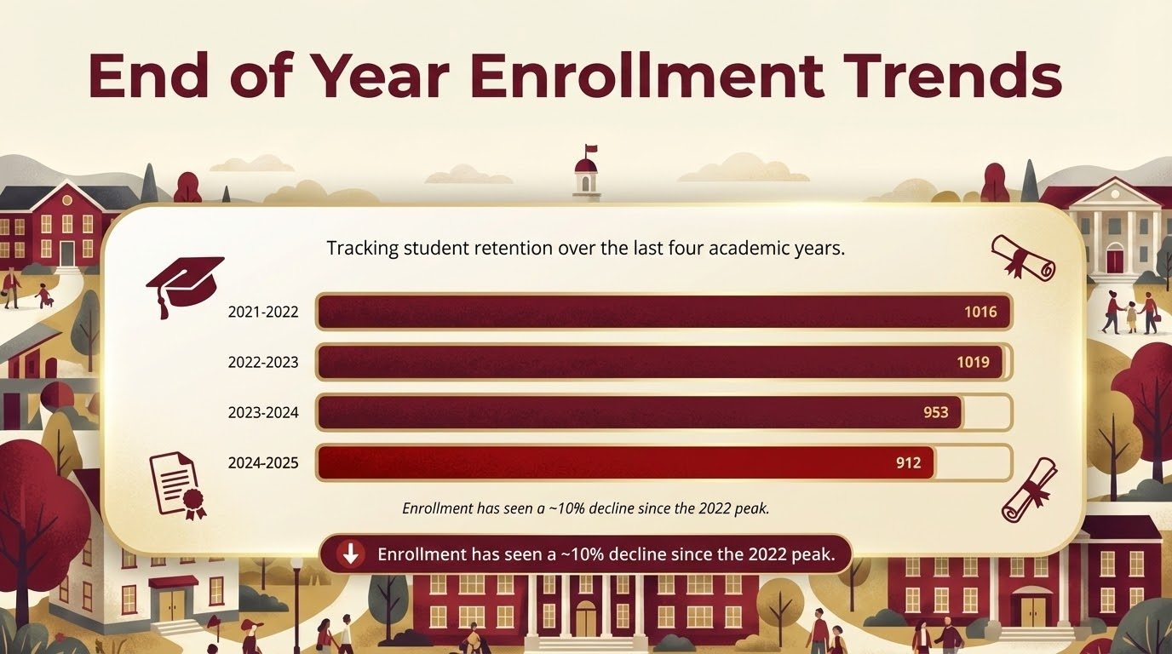

Slide 3

Monthly Enrollment Fluctuation
School Year | Month 1 | Month 5 | Month 9 (EOY) | Net Change
2024-2025 | 926 | 925 | 912 | -14
2023-2024 | 957 | 964 | 953 | -4
2022-2023 | 1030 | 1033 | 1019 | -11
2025-2026 (Current) | 891 | 889 | - | -

Slide 4
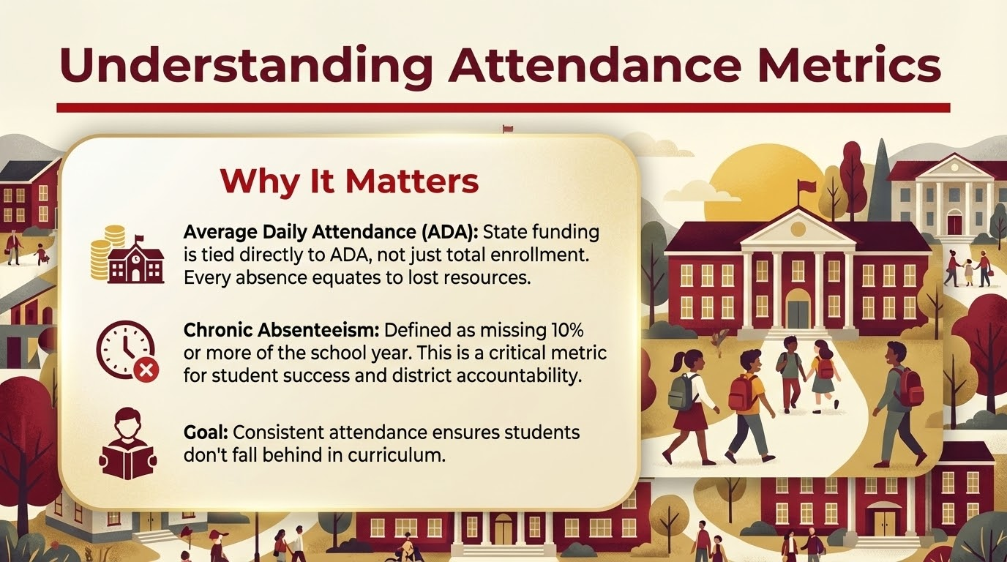
Notes:
Currently our district has 240 students considered Chronically Absent (26.29%). The elementary school has 93 students (22.57%), the middle school has 53 (25.73%), and the high school has 94 (31.86%)

Slide 5
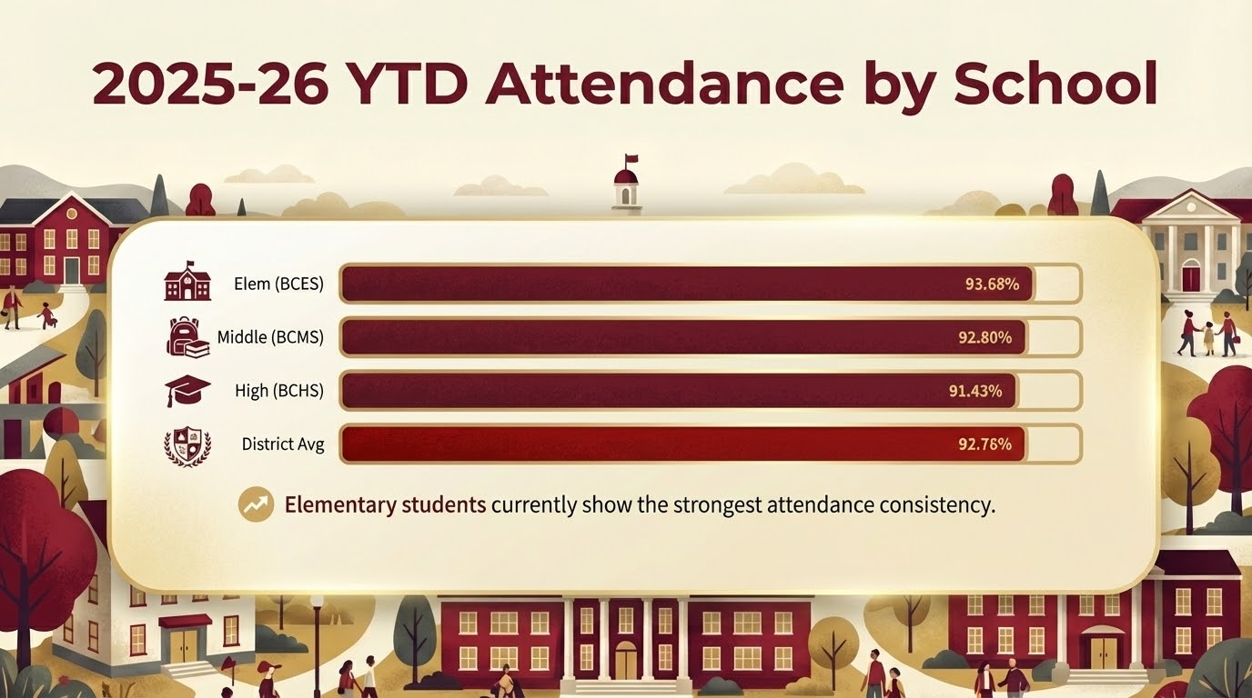

Slide 6
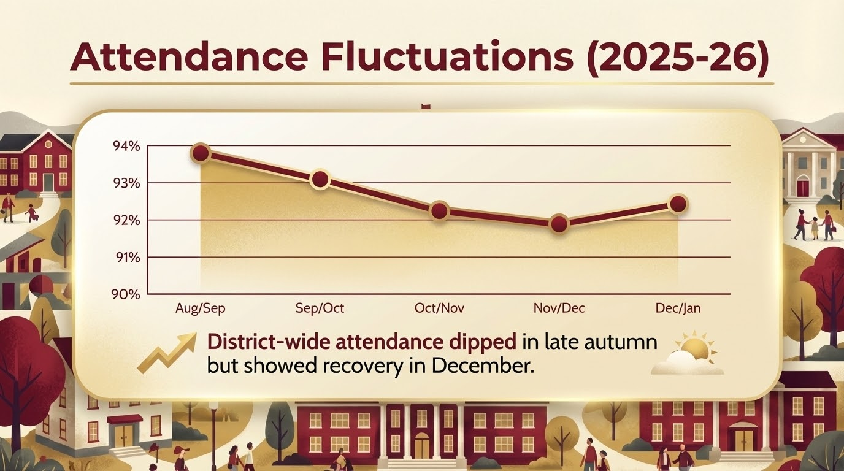

Slide 7
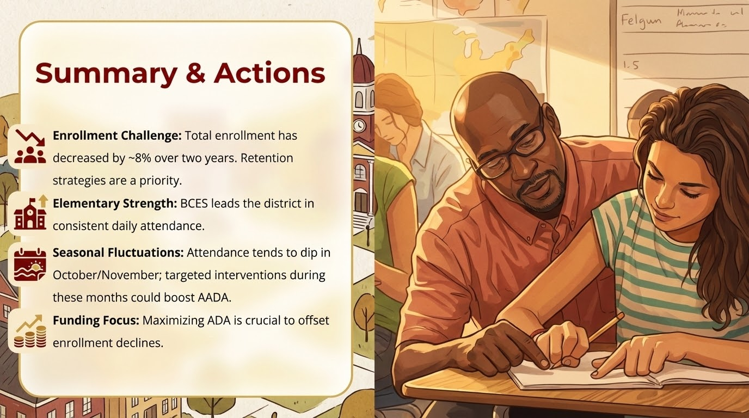

Slide 8
Questions?
Discussion & Next Steps

