Slide 1
Student Withdrawal Report
Comprehensive Analysis of Trends, Destinations, and Reasons
Fall Semester 2025 - January 2026

Slide 2


Slide 3
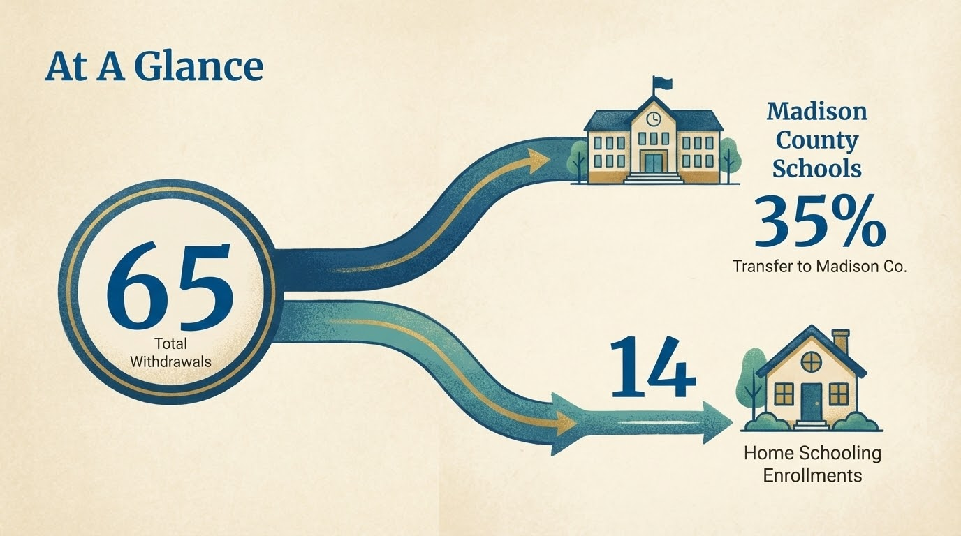

Slide 4
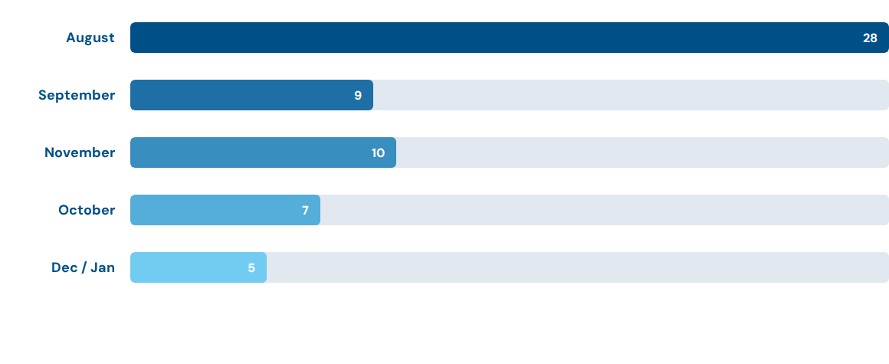
Withdrawals by Month
*August represents 43% of all withdrawals for the period.

Slide 5
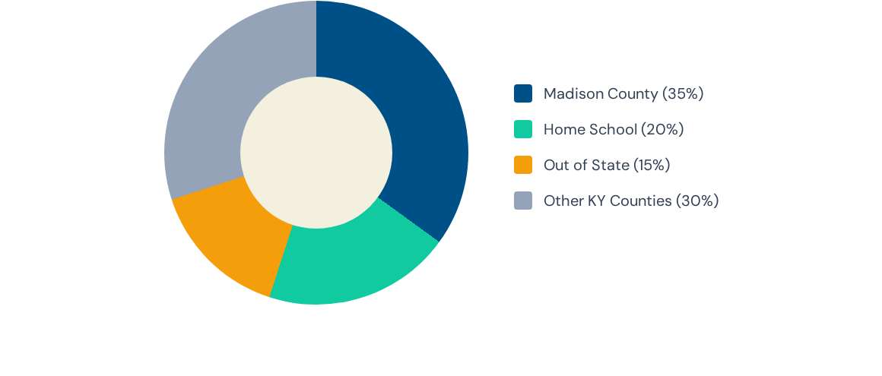
Destination Breakdown
Aside from Madison County, a significant number of students dispersed to surrounding counties including Rockcastle, Garrard, and Laurel.

Slide 6
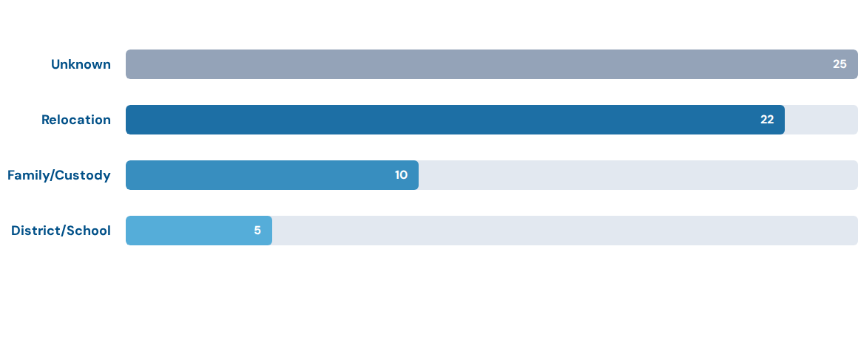
Primary Reasons for Withdrawal
"Relocation" includes moving to new counties or out of state. "Unknown" represents a significant data gap.

Slide 7


Spotlight: Home Schooling
Key Observations
Total Students: 14 students transitioned to home schooling during this period.
Timing: Distributed throughout the semester, with spikes in late September and November.
Cited Reasons: While many listed "Unknown", specific records pointed to "Attendance Issues" as a driving factor.

Slide 8




Focus: Madison County Transfers
Economic Factors
District Movement
Several records explicitly stated "Parent Got Job in MC" as the primary reason for withdrawal. Economic mobility within the region is a key driver for student population shifts.
A large portion of transfers were categorized simply as "Moved Districts." As the neighboring and largest district, Madison County naturally absorbs the highest volume of these transfers.

Slide 9

Relocation Trends
Moving to a new county or state accounts for nearly 35% of all explained withdrawals. This indicates that a significant portion of student loss is due to external family circumstances rather than internal school dissatisfaction.
Key Destinations:
•
Out of State (Virginia, Alabama, Wisconsin)
•
Rockcastle County
•
Laurel County

Slide 10





Geographic Distribution
Local Region
Extended KY
Out of State
Anderson, Rockcastle, Garrard, Jessamine, Montgomery, Boyle (Danville)
Fayette, Laurel, Pulaski, Harlan, Carroll, Jackson, Owsley
Tennessee, Alabama, Virginia, Wisconsin

Slide 11


Recommendations
Improve Data Integrity
Over 35% of records listed "Unknown" as the reason for withdrawal. Implementing a mandatory exit interview or a standardized withdrawal form with checkbox options could significantly improve data quality.

Slide 12
Q & A
Thank you for your attention.

