Slide 1
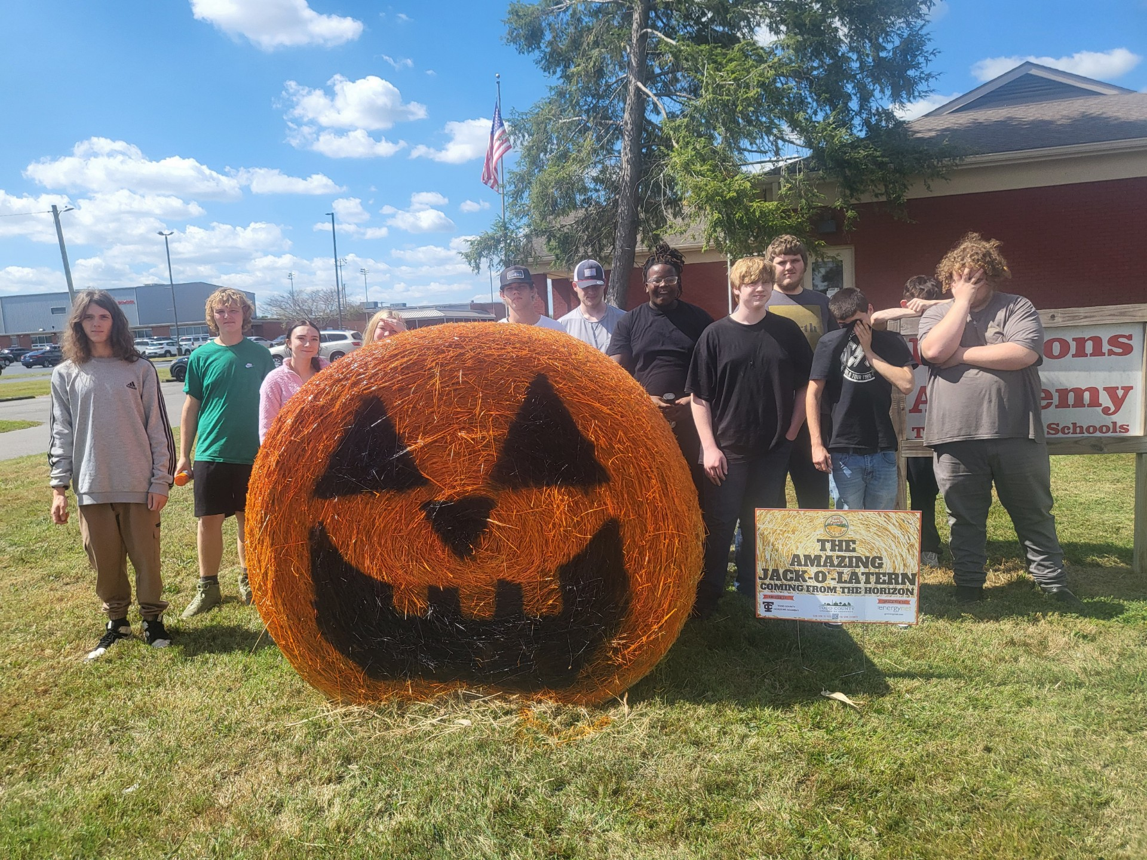
Horizons Academy
“Our goal at Horizon’s Academy is to provide students with the skillset needed to be productive citizens”

Slide 2
Programs
Day Treatment
Horizon’s Academy
Horizon’s virtual academy
Credit recovery

Slide 3
Horizons PBIS Point System
0-300 Points:
You will have to do extra work in a different room
301-350 Points:
Ice Coffee on Friday
351-400 Points
Ice Coffee
Soda on Friday
401-500 Points:
Soda on Tuesday and Friday
Ice Coffee at breakfast
extra hour of free time

Slide 4
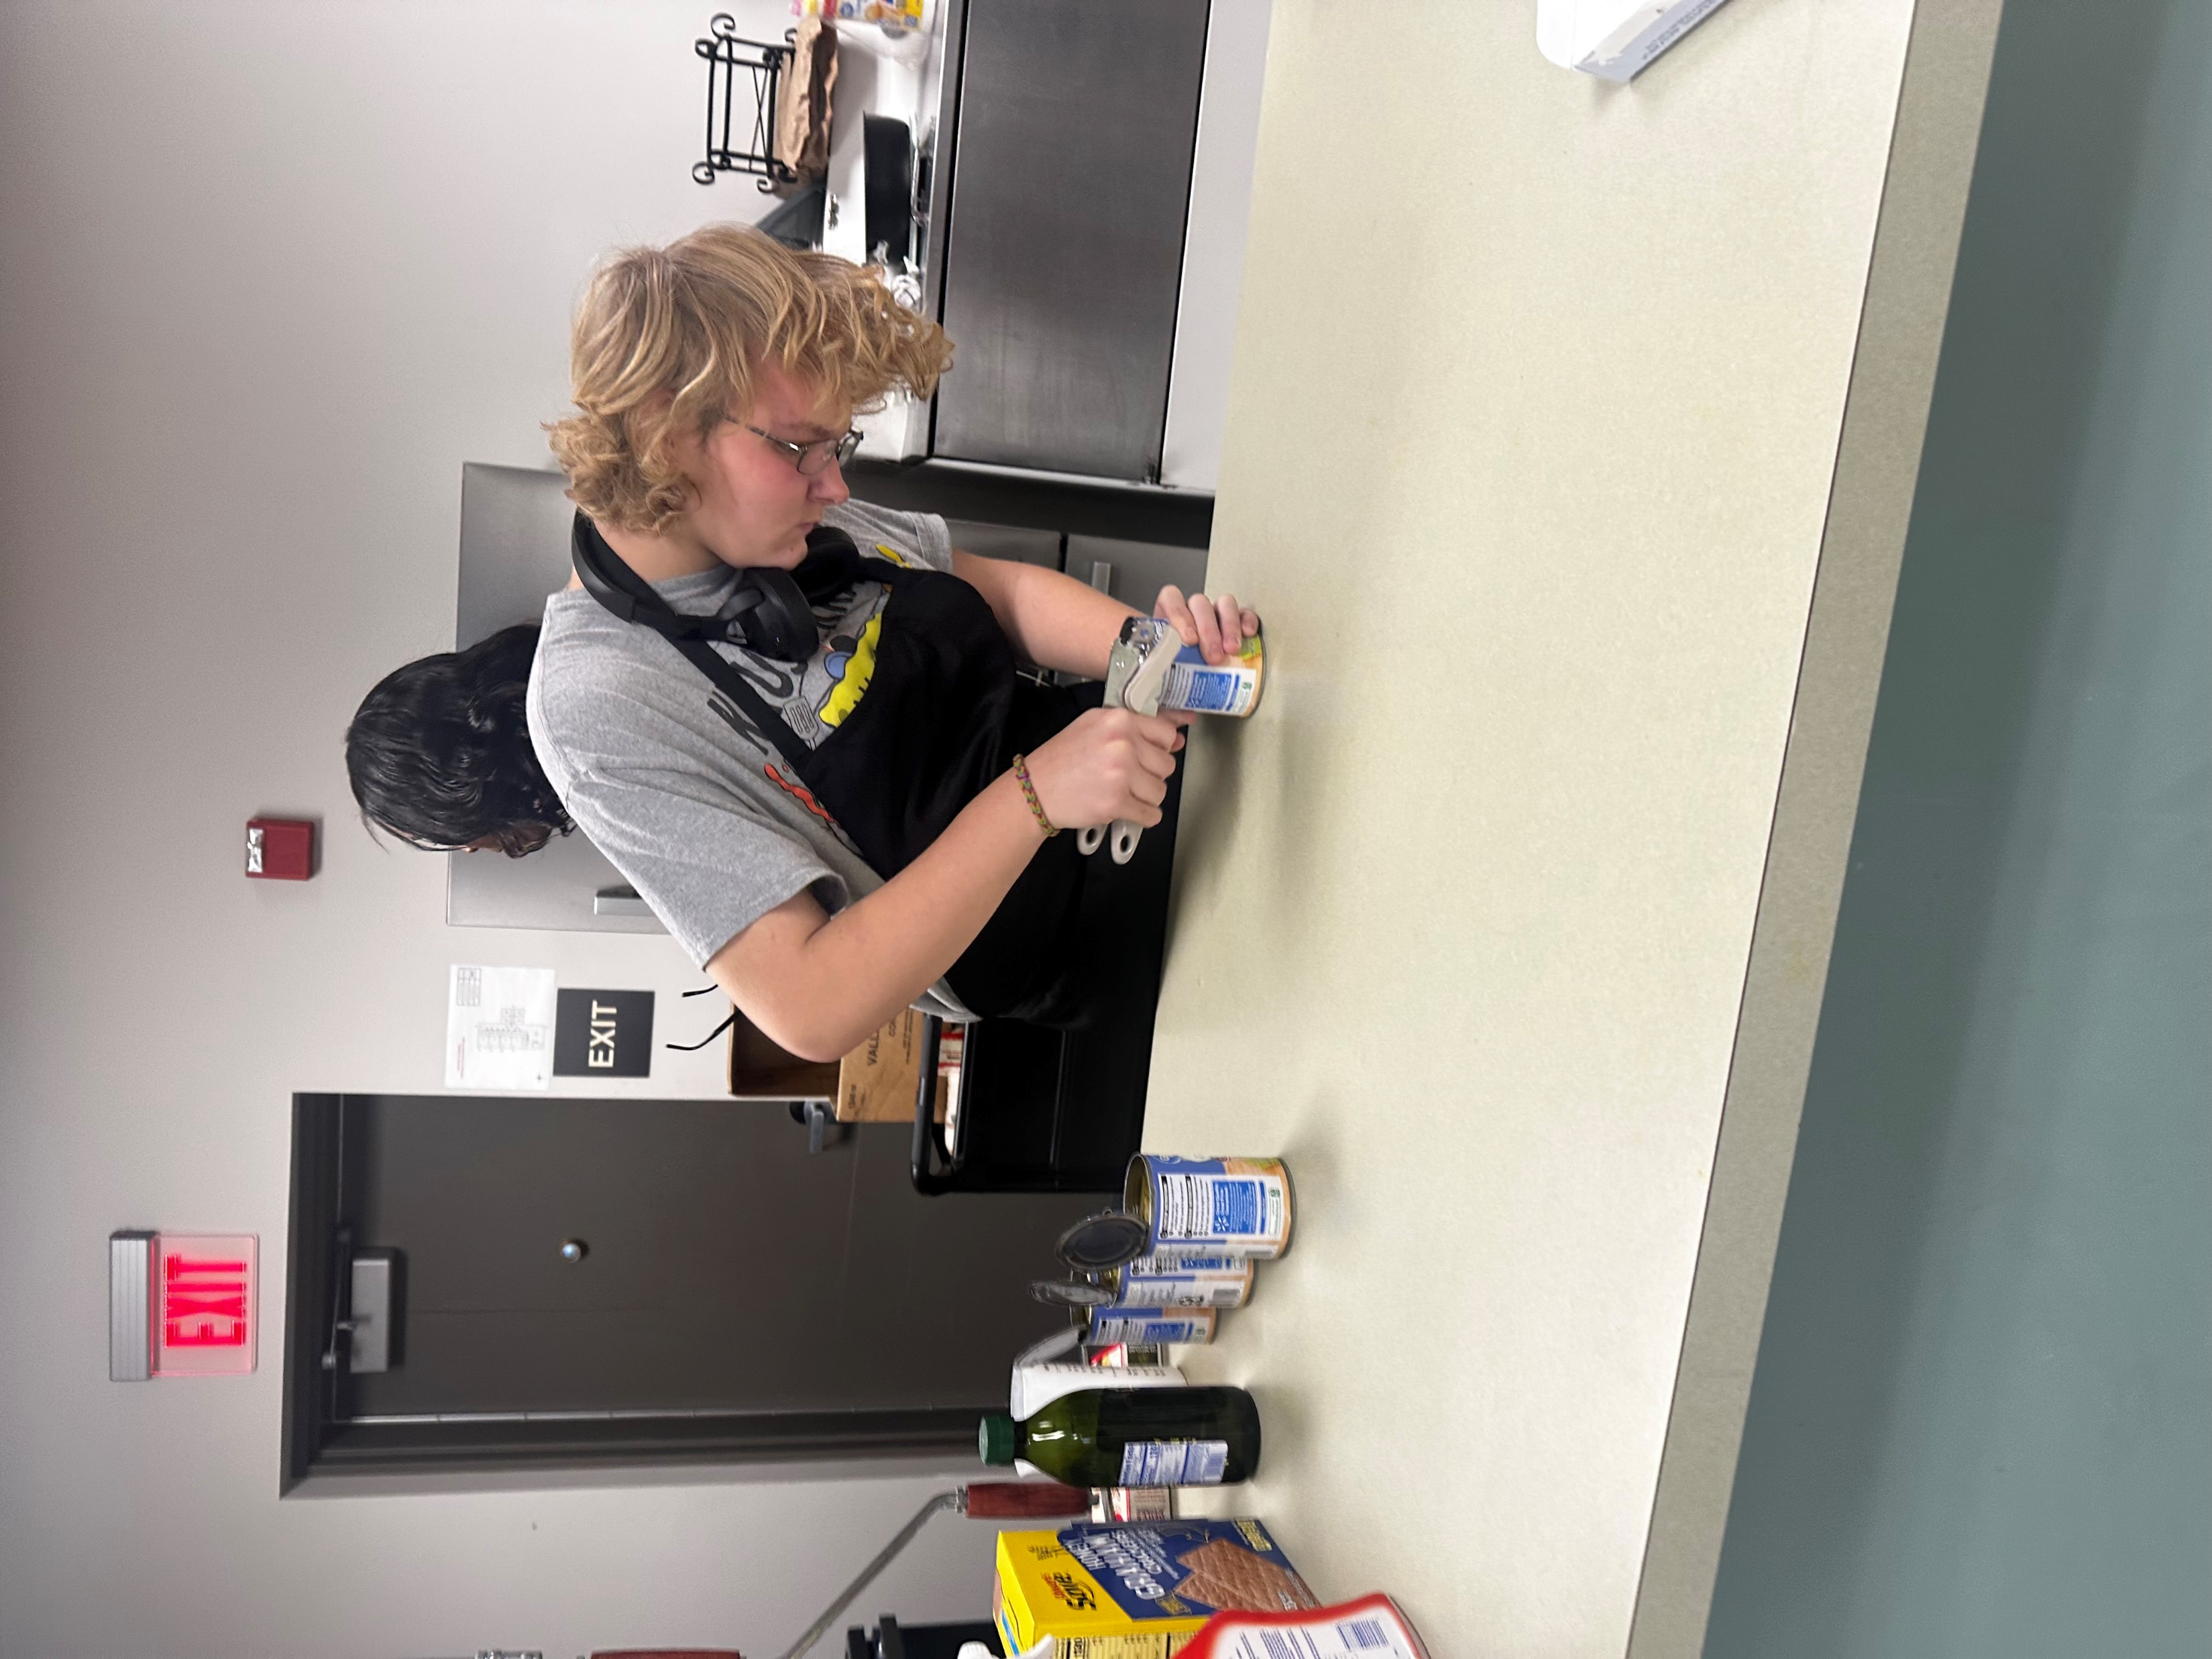
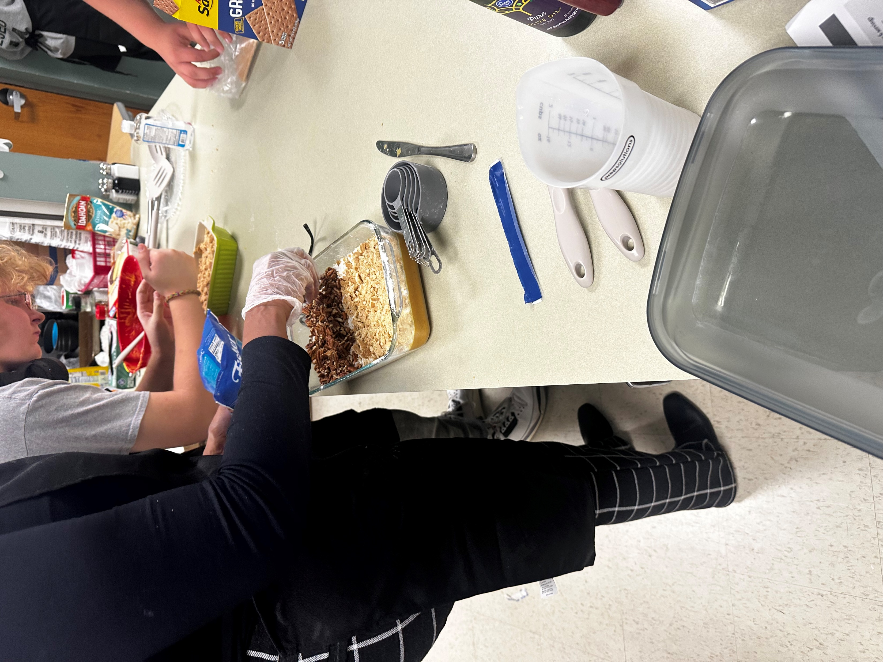
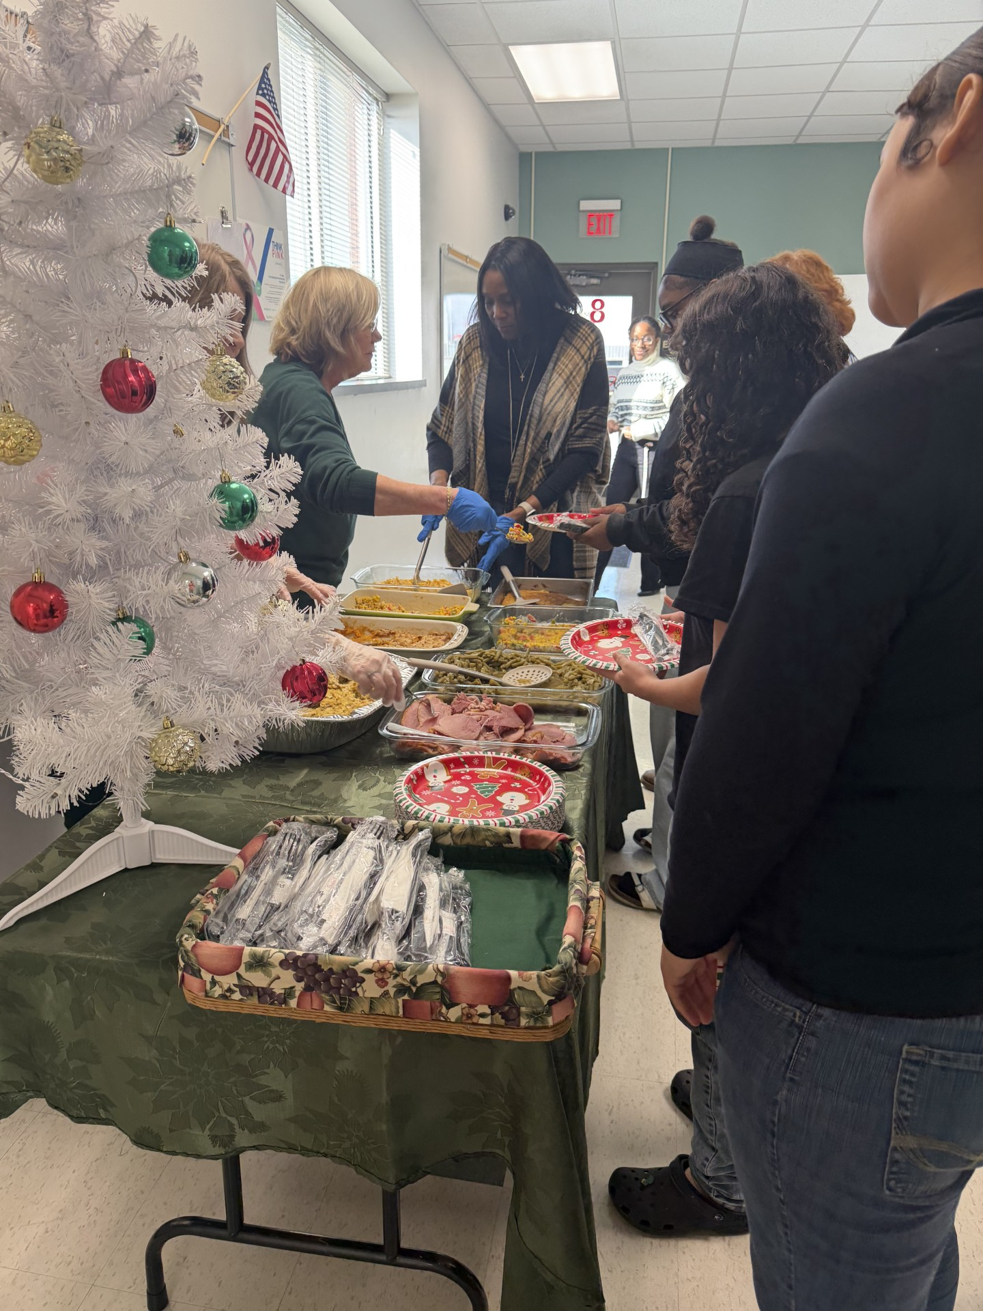
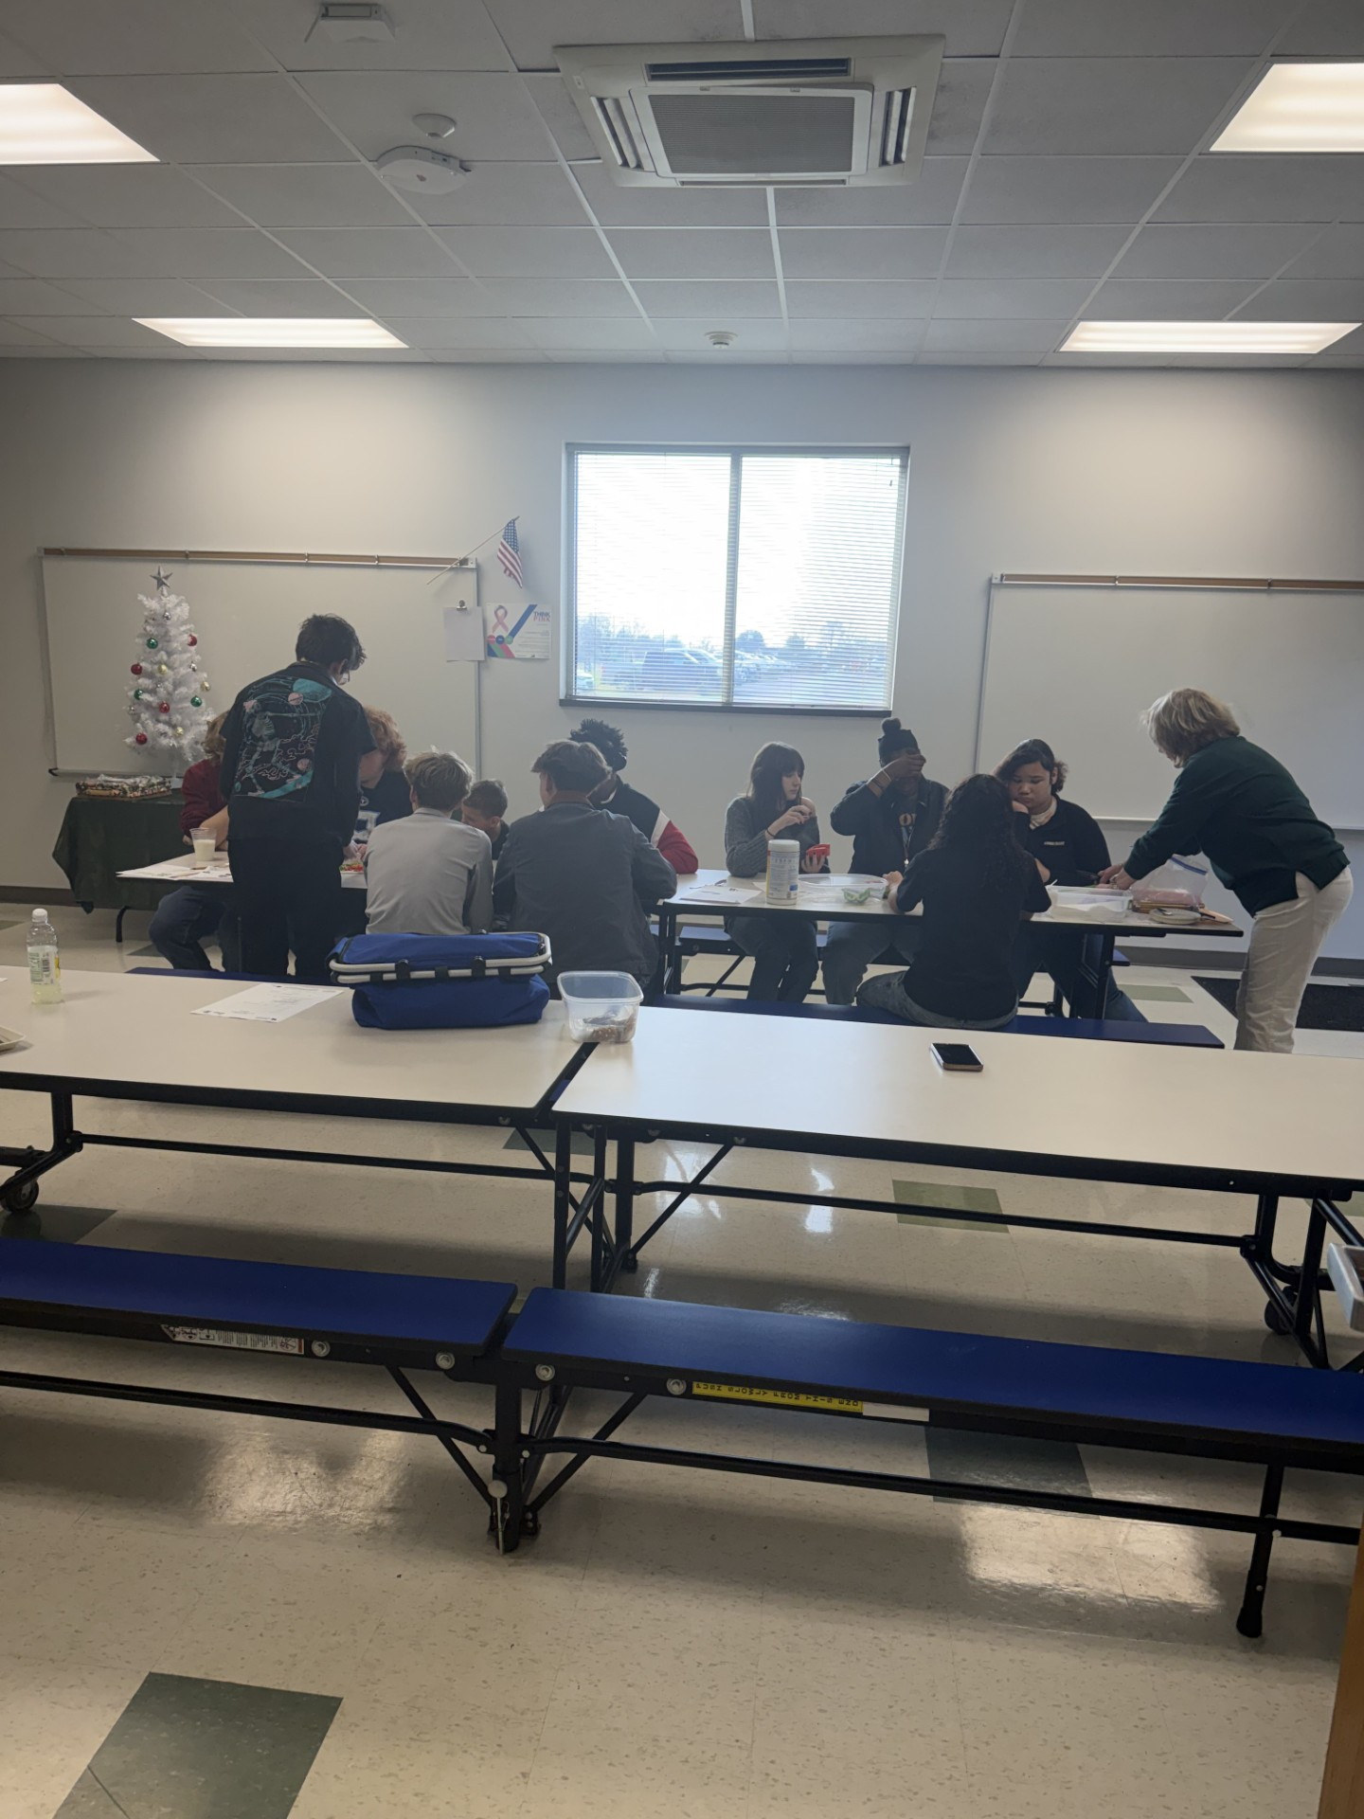
Life Skills

Slide 5
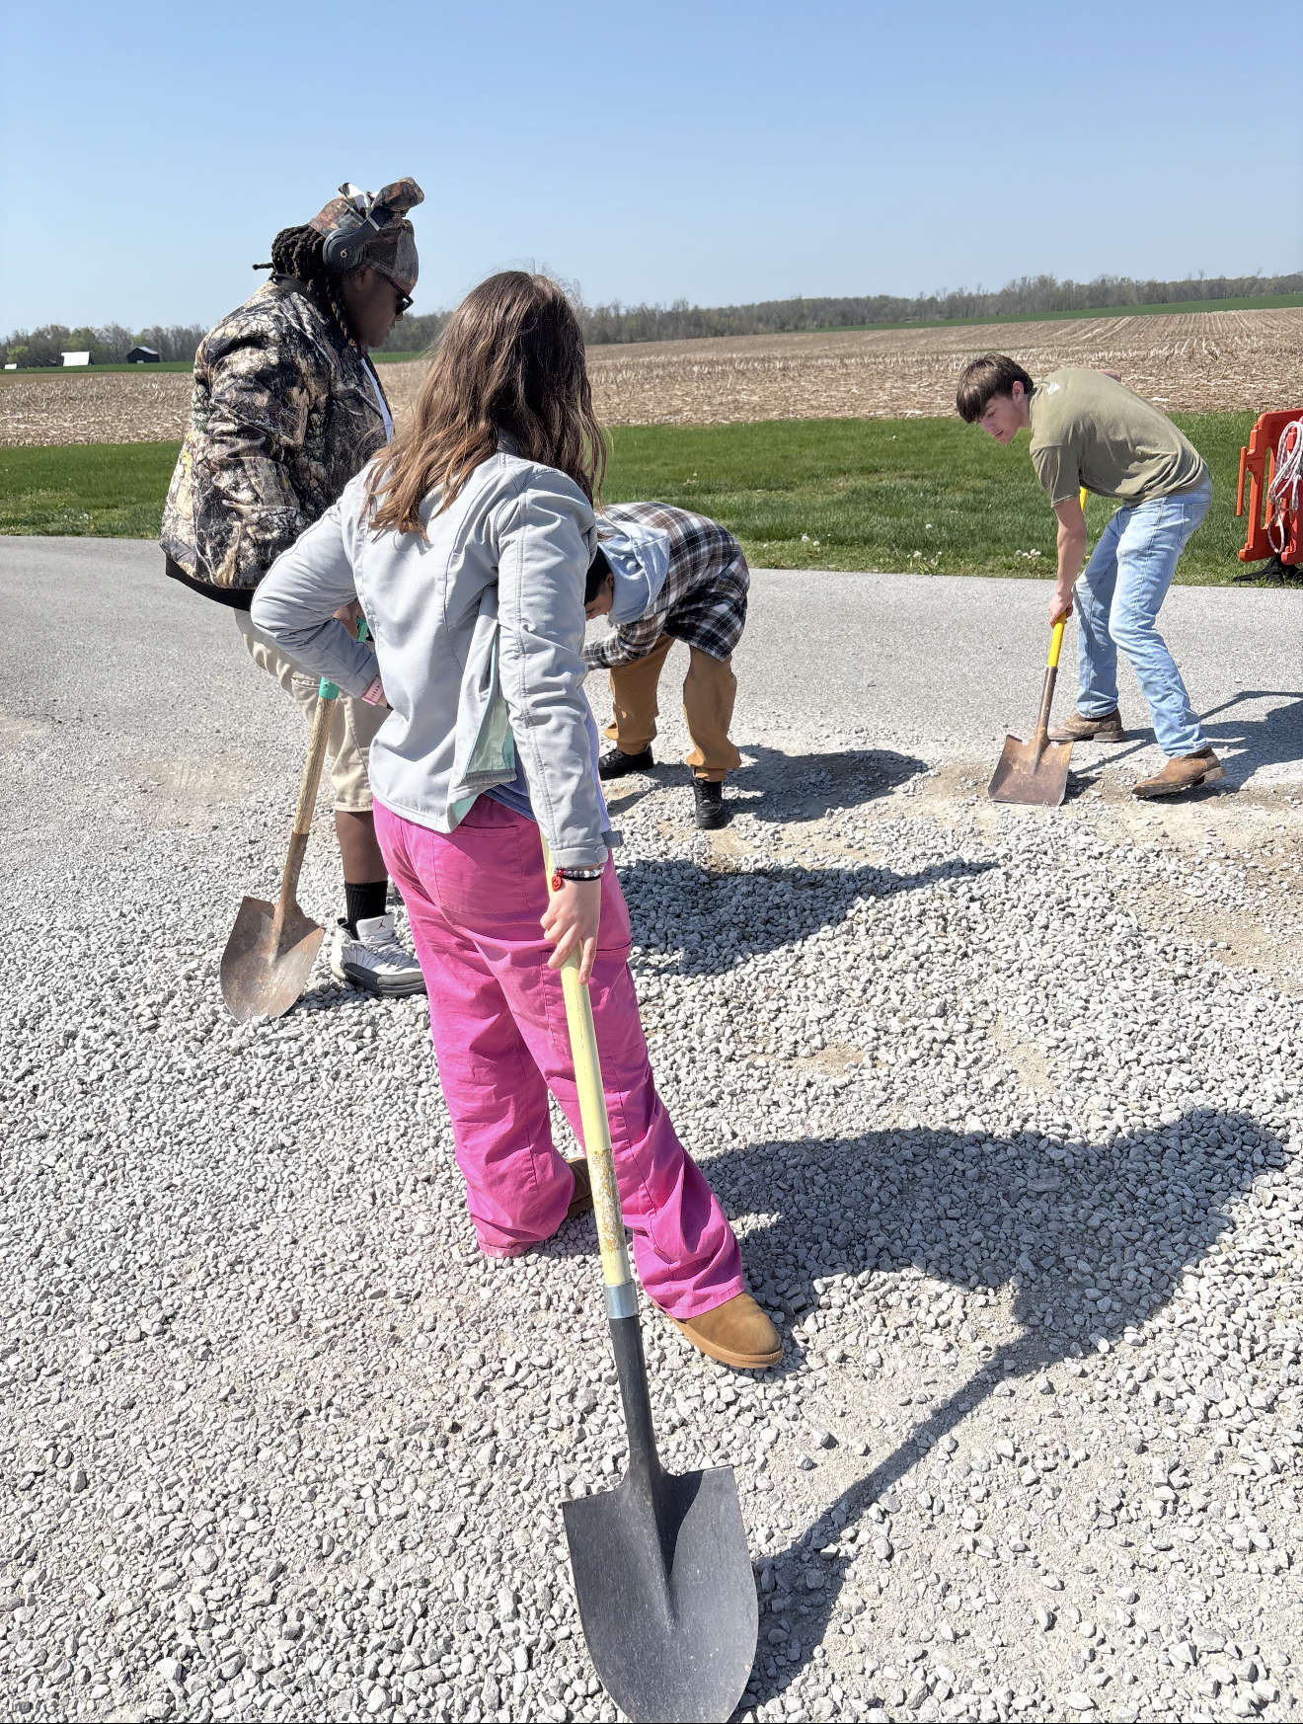
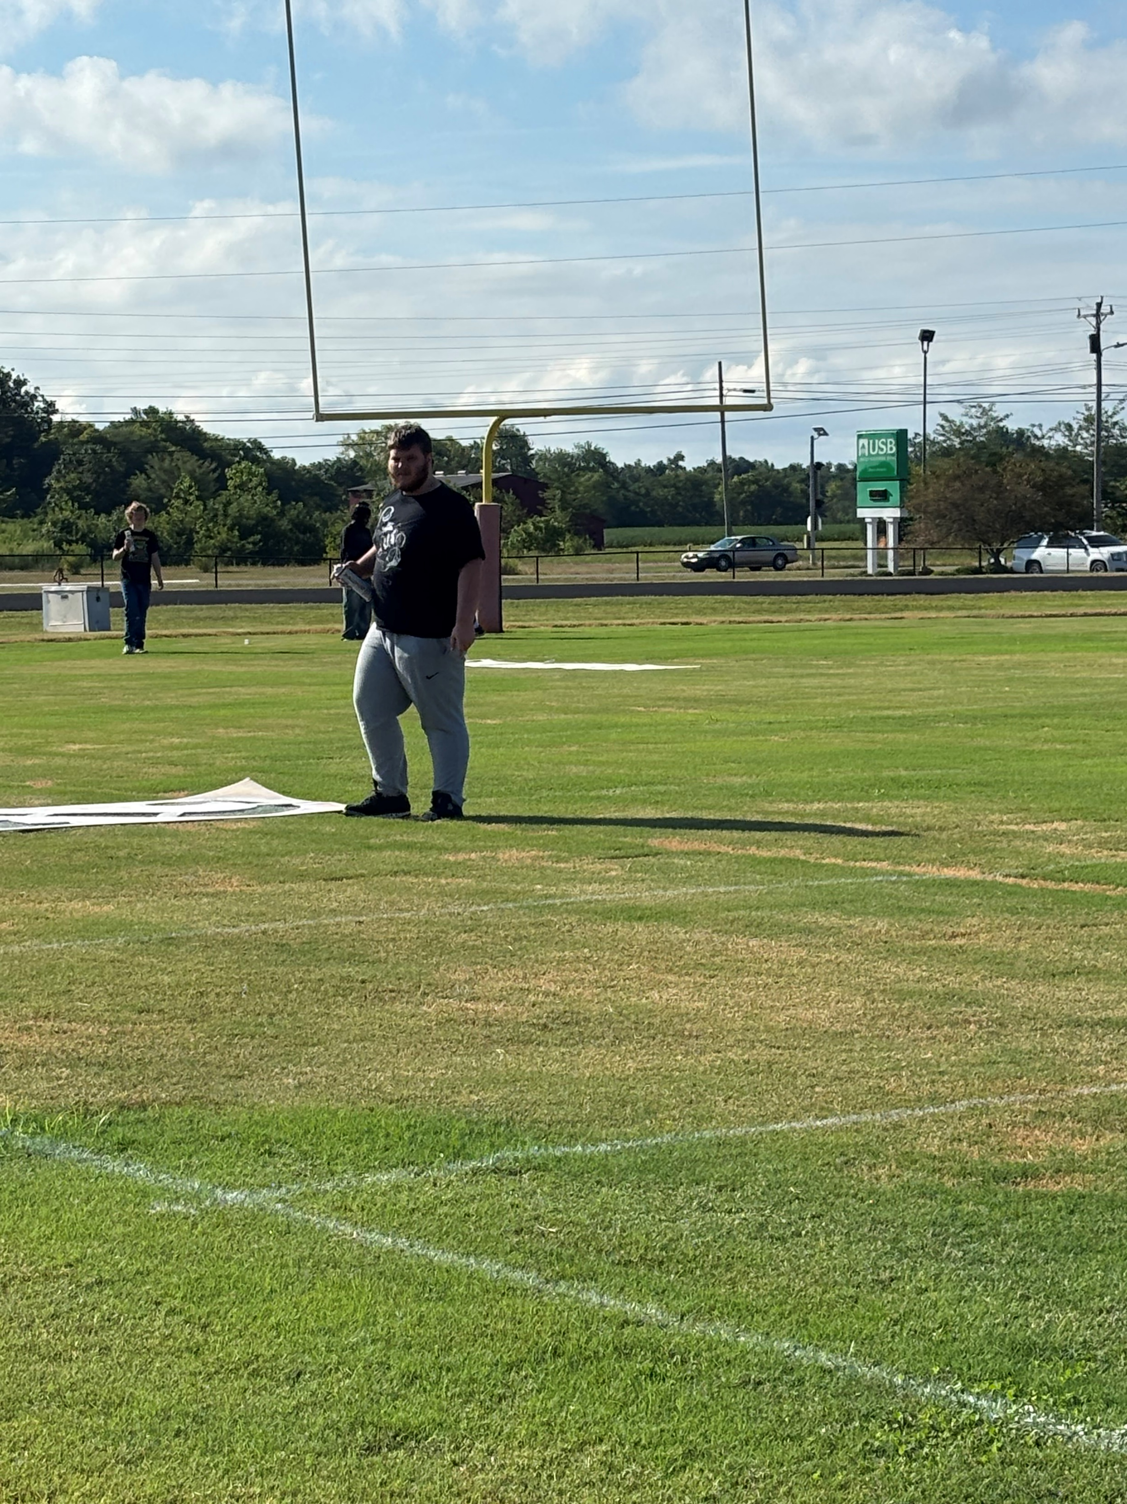
Service

Slide 6

Credit Recovery Graduates
15 students have completed the program and will graduate in May.

