Slide 1







Lancaster Elementary
Watch Us!
Notes:
Unofficial motto
Carrying on traditions at LES, but we have some exciting changes

Slide 2

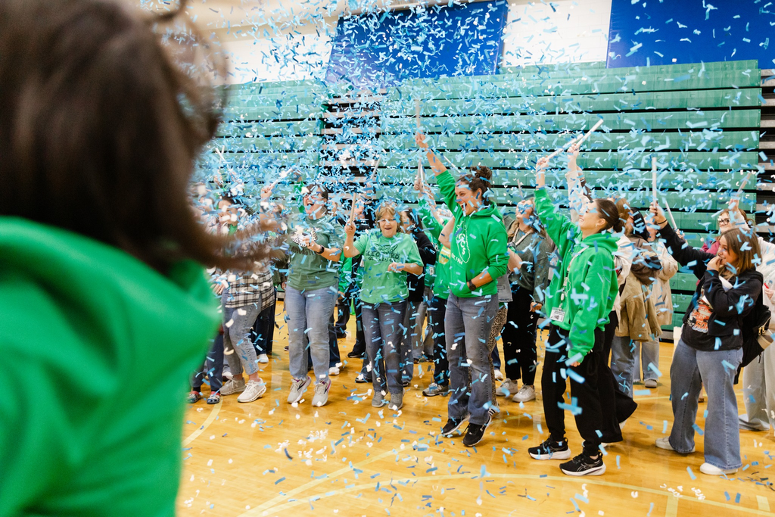

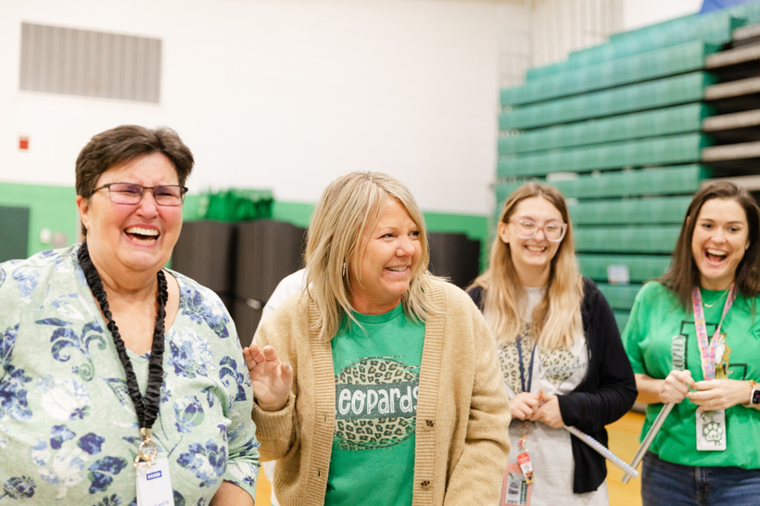
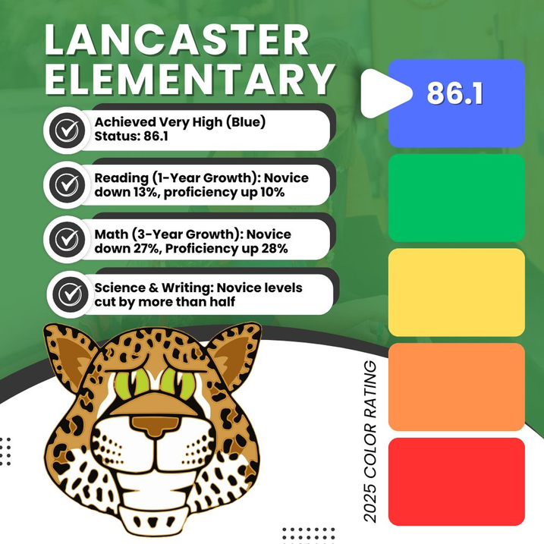


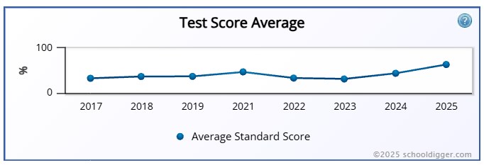
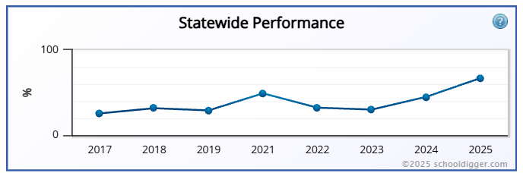
2025 KSA Results
Notes:
Increase from Orange to Yellow for the 2022-2023 school year. This brings us out of Targeted Support.

Slide 3




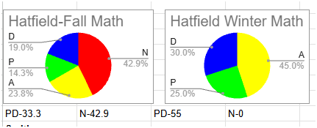

When students are not exposed to grade-level work, they are denied the opportunity to master it.

Slide 4


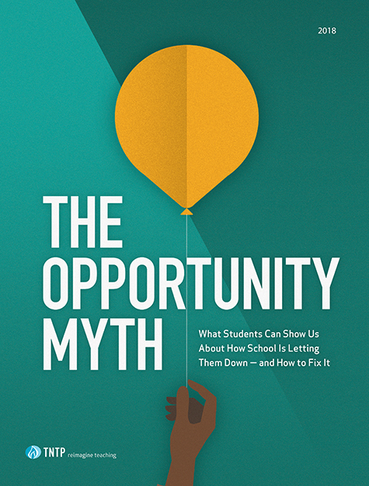
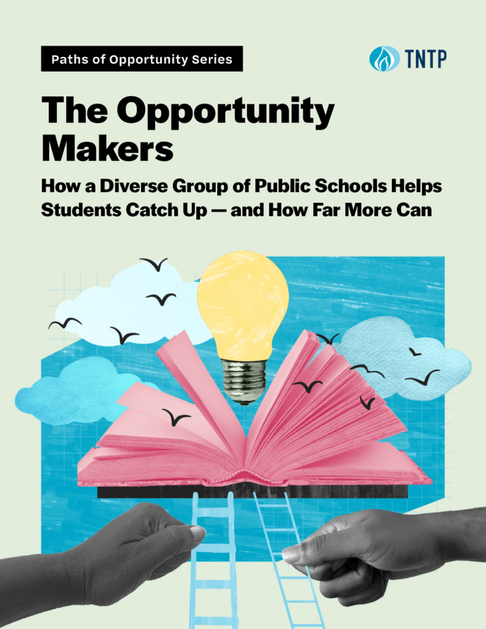


“Students spend most of their time in school without access to four key resources: grade-appropriate assignments, strong instruction, deep engagement, and teachers who hold high expectations.”
“When students who started the year behind grade level had access to stronger instruction, they closed gaps with their peers by six months.”

Slide 5
BELONGING
Trajectory-changing schools know every student deeply, and provide targeted supports that guide students to long-term grade-level success.
CONSISTENCY
Trajectory-changing schools minimize classroom variation so all students engage in grade-level work—with consistent supports and shared high expectations.
Trajectory-changing schools align curriculum, materials, interventions, and assessments around clear grade-level expectations so everyone understands their role and how the work connects.
COHERENCE
Notes:
-The Opportunity Myth- 4,000 students in five diverse school systems
- Need grade-appropriate assignments, strong instruction, deep engagement, and teachers with high expectations.
-Hattie

Slide 6
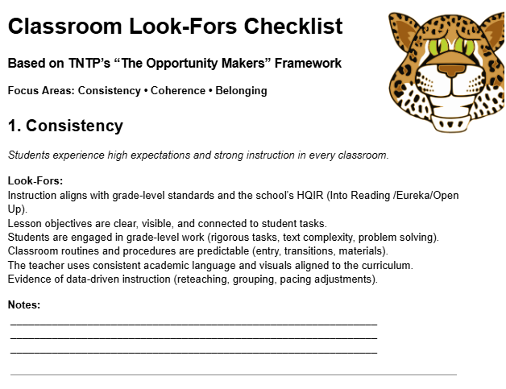


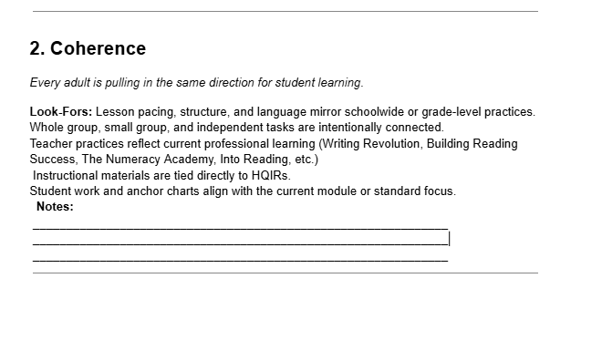
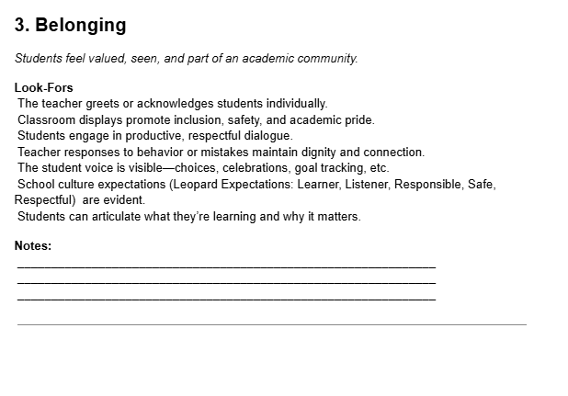
Teacher LEaders

Slide 7



Next Steps at LES
HQIR AND EVIDENCE BASED PRACTICE ALIGNMENT
CONTENT
AREA WORK
CURRICULUM BASED PROFESSIONAL LEARNING
KDE UNIT ALIGNMENT TOOLS AND RESOURCES
Notes:
Even though we saw some improvement last year, we are focused on increasing our student achievement.

