Slide 1
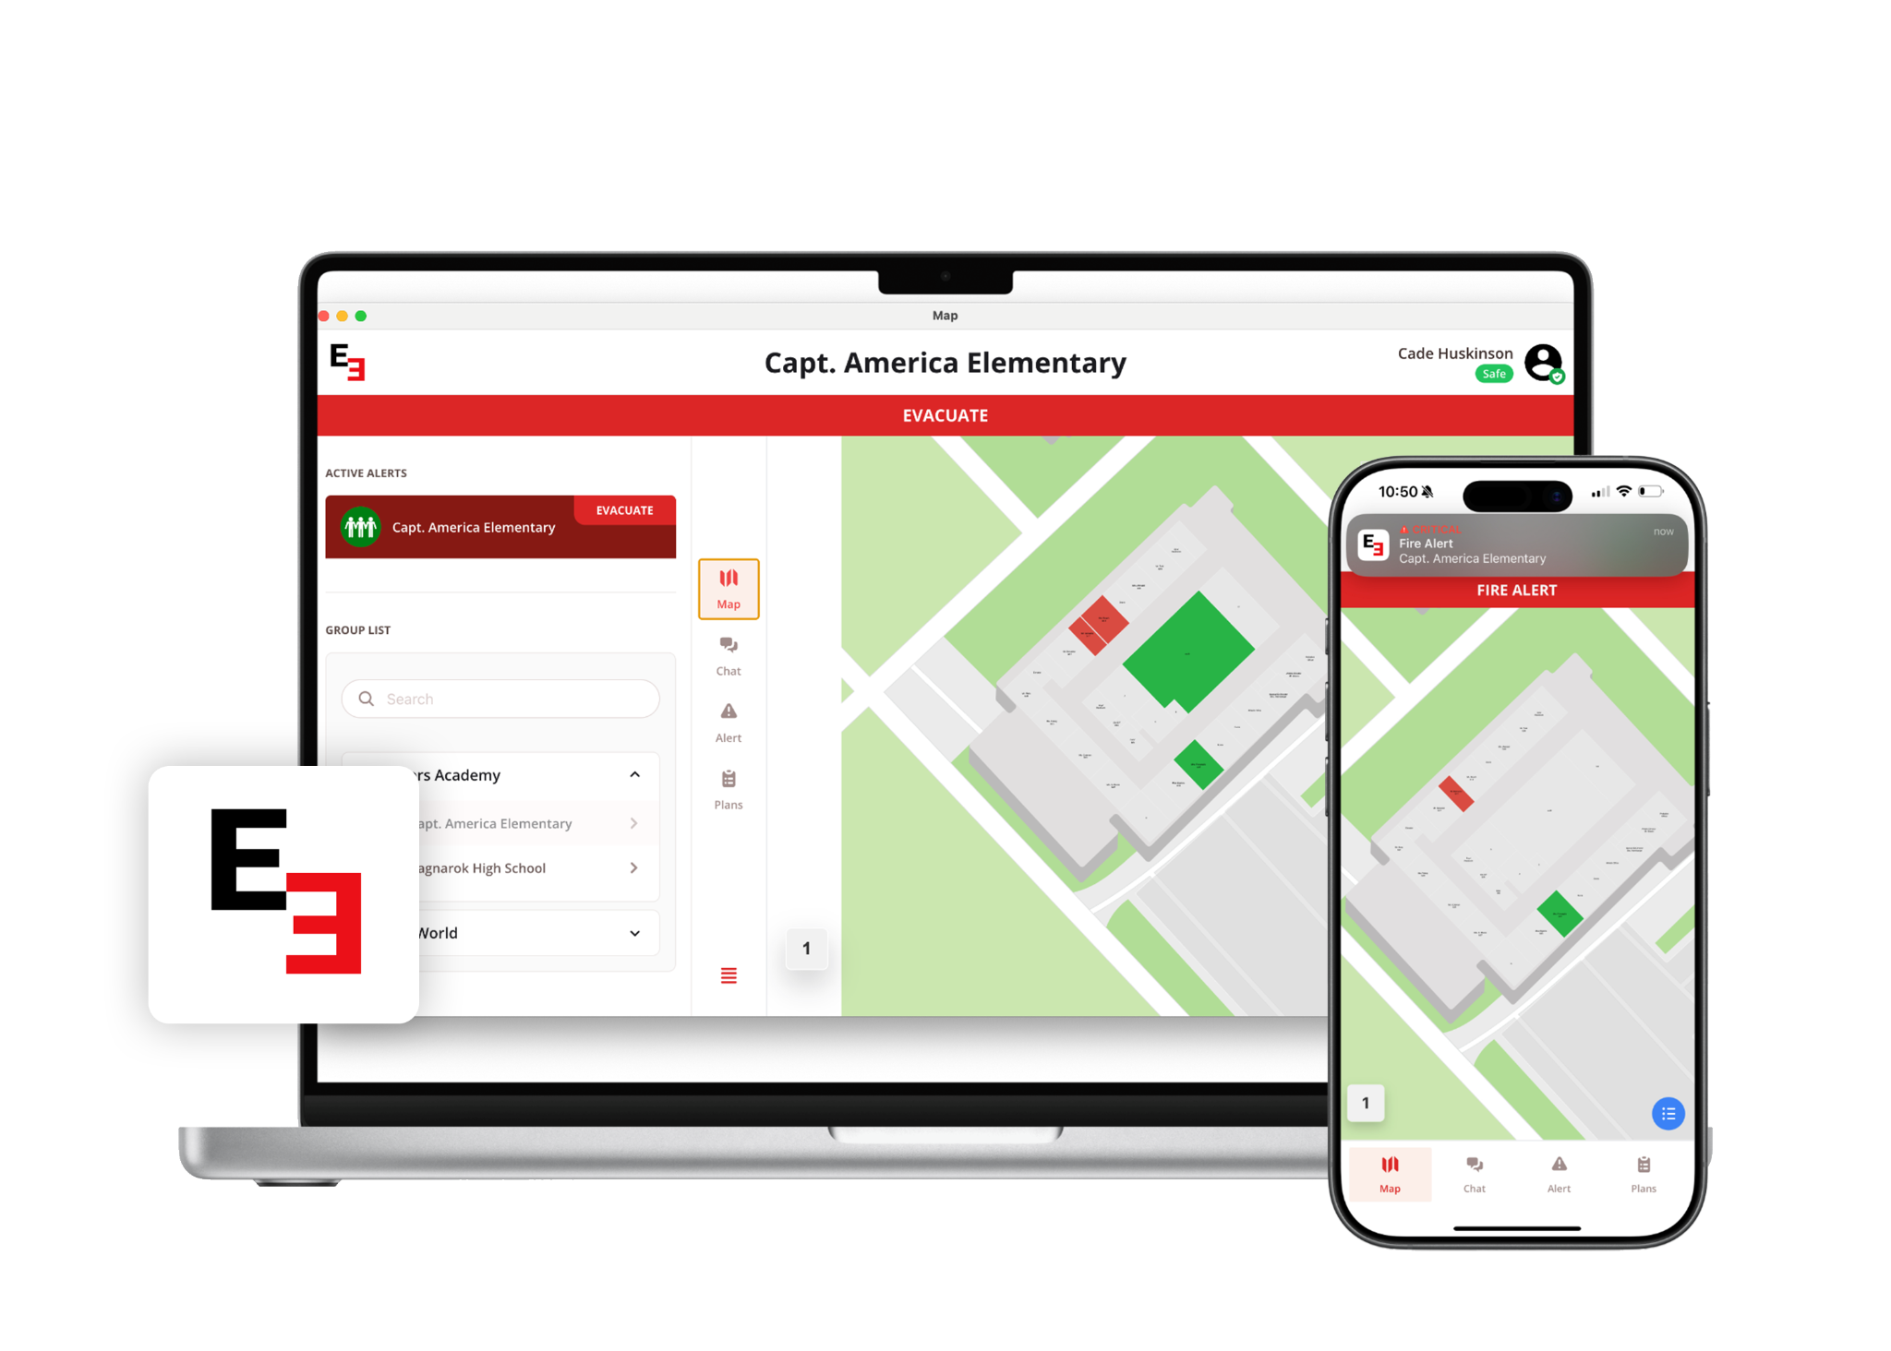

Emergent 3
Locate. Communicate. Coordinate.

Slide 2

CURRENT STATE
The harsh reality: Current emergency communication systems are failing our students and staff.
Communication breakdowns
Systems fail, PA announcements and radios go unheard, and text alerts get missed by staff and substitutes
Limited visibility during emergencies
Administrators have no real-time insight into who is safe and who needs help
First responders arrive blind
Limited information delays critical response when every second counts
Liability increases
Gaps in communication and delayed response can expose the district to legal and financial risk.
The bottom line: Communication gaps during emergencies put lives at risk and expose us to liability.

Slide 3
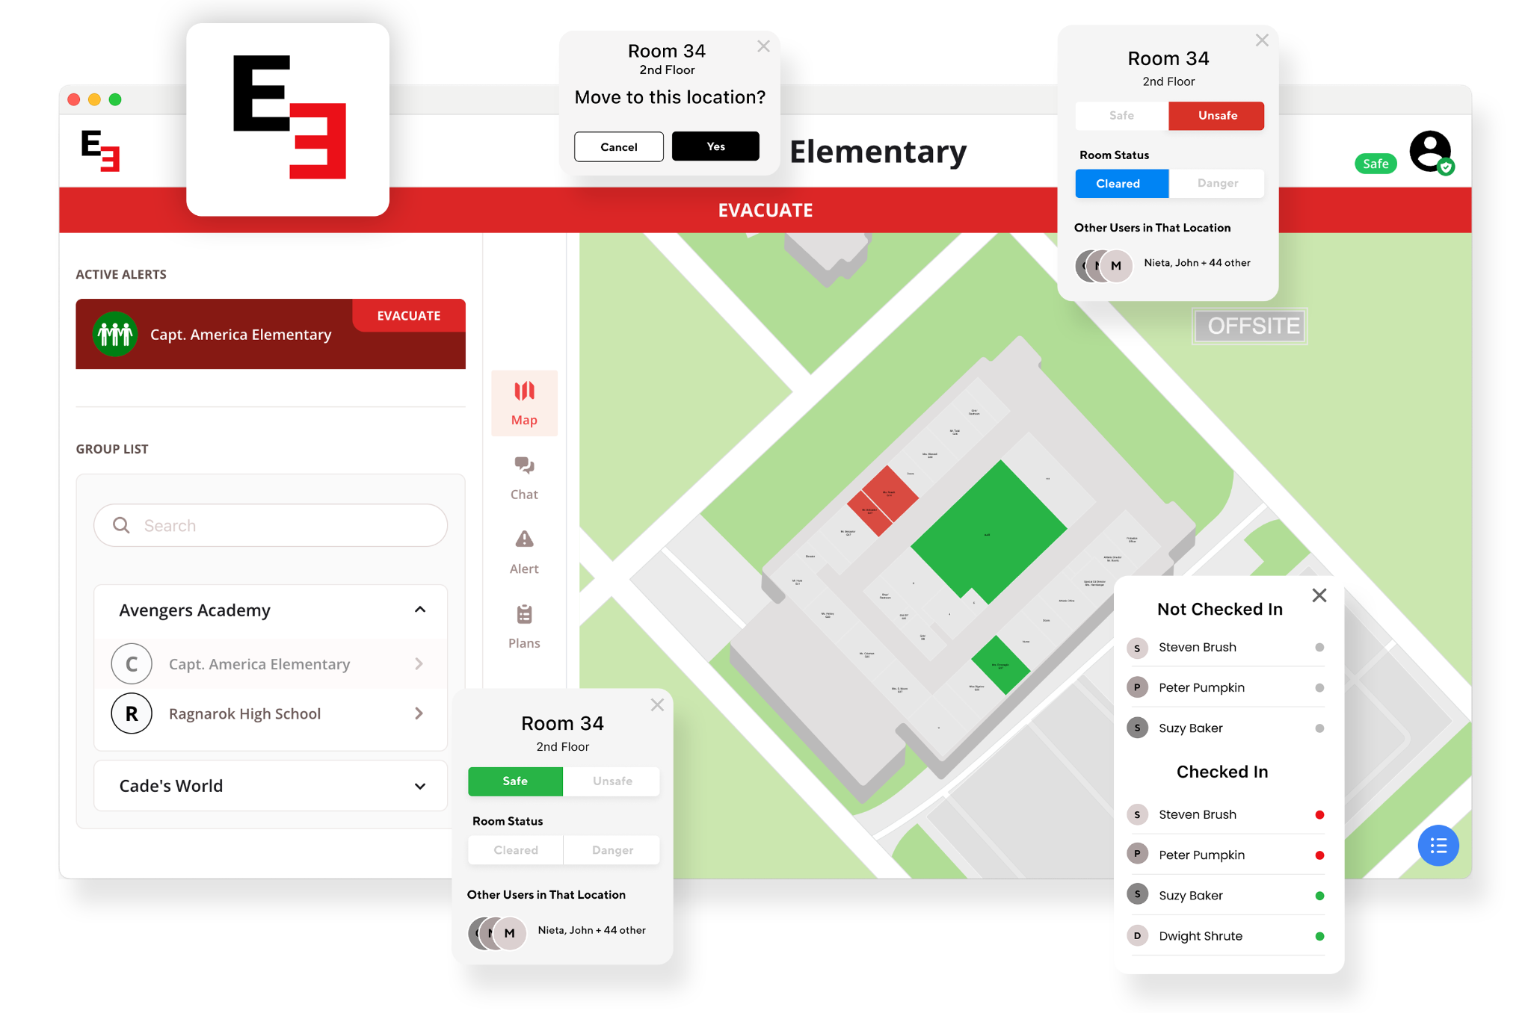
SAFETY WITH E3
E3 transforms chaos into coordinated response, turning our biggest safety vulnerabilities into our strongest protections.
Universal Instant Alerts
Send alerts to every staff member on any device, even on silent or do-not-disturb like an Amber Alert
Interactive Smart Maps
Real-time map updates allow staff to make better decisions, faster, in emergency situations
Live Staff Accountability
Staff report location and safety status, teachers submit student roll call for complete visibility in seconds
Seamless First Responder Integration
Police, fire, and dispatch receive live building data automatically
Unlimited Access
No per-device fees with E3’s unlimited users, means everyone becomes part of our safety network
E3 transforms chaos into coordinated response

Slide 4
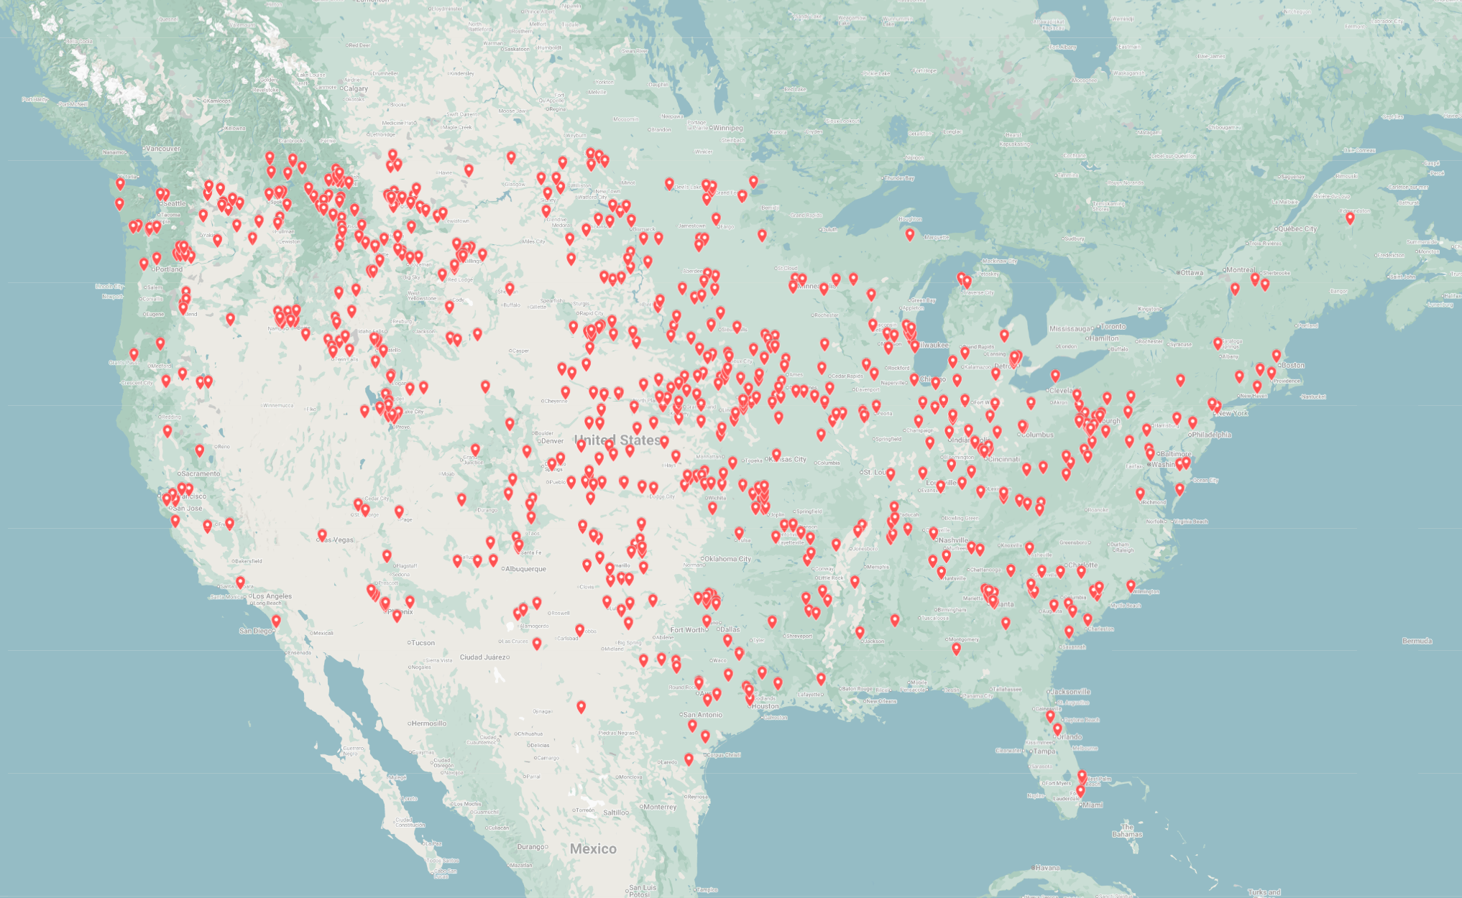
WHY SCHOOL BOARDS TRUST E3
Proven results that fit real-world constraints.
Field-tested reliability
Thousands of schools nationwide trust E3 to protect their communities
Quick onboarding
We take care of the entire onboarding process with a dedicated account manager and streamlined setup meetings over 2-3 weeks.
Budget-friendly
Purpose-built for education budgets with lower total costs than traditional hardware systems and competitors
Dependable support
Dedicated customer service teams ensure your system works flawlessly when you need it most
E3 is an essential investment in student safety, not just another technology expense.
Notes:
Elevator Pitch Script: Our board wants one thing: to know every student and staff member is safe in an emergency.
The problem is, with radios, PAs, and paper maps, we never have a clear picture. Teachers miss alerts, substitutes don’t know procedures, and first responders arrive blind. which leaves us anxious and vulnerable.
E3 solves that. Thousands of schools use it because it gives real-time situational awareness through Smart Maps. The moment an alert is triggered, we see which buildings or rooms are safe, unsafe, or cleared, and law enforcement sees the same live map before they arrive.
On top of that, E3 connects to our SIS so we can Roll Call and instantly account for every student, giving administrators a live district-wide real-time view of who’s safe and who still needs help.
The plan is simple: E3 will customize maps for our campus, staff run Role Call through the app, and everyone, from teachers to first responders, shares the same live information.
If we do nothing, we’ll keep relying on radios and paper rosters, and risk missing students or delaying response. But with E3, we’ll know exactly where the danger is, who’s safe, and that every student is accounted for — giving parents, staff, and this board true peace of mind.

Slide 5
Thank you!

