Slide 1

TODD COUNTY CENTRAL
HIGH SCHOOL
2024 - 2025 TESTING DATA

Slide 2
Overall Designations
An overall performance score combines performance on the exclusive state indicators for elementary, middle and high schools.
The ratings will be reported using a color rating system to communicate performance of schools, with Red being the lowest rating and Blue being the highest rating.
Blue
Green
Yellow
Orange
Red
Notes:
Based on weights approved by the Kentucky Board of Education (KBE).

Slide 3
State Indicators in the Accountability System
State Assessment Results in Reading and Mathematics
Graduation Rate, 4- and 5-year cohort (high school only)
State Assessment Results in Science, Social Studies and Writing
State Indicators
Post- secondary Readiness (high school only)
Quality of School Climate and Safety
English Learner Progress

Slide 4
Overall Accountability Weights
Overall Accountability Weights
 | State Assessment Results in Reading and Math | State Assessment Results in Science, Social Studies and Writing | English Learner Progress | Quality of School Climate and Safety | Post secondary Readiness | Graduation Rate (4 & 5 year cohort)
High Schools | 45 | 20 | 5 | 4 | 20 | 6
TCCHS | 47.368 | 21.053 | NA | 4.211 | 21.053 | 6.316

Slide 5
Accountability Profile and Indicator Scores and Ratings
OVERALL SCORE, OVERALL PERFORMANCE RATING (COLOR), FEDERAL CLASSIFICATIONS, INDICATOR SCORES AND RATINGS

Slide 6
Accountability Profile at Todd County Central High School
Red | Orange | Yellow | Green | Blue
School Name | Overall Performance (Color) Rating | Overall Score | CSI/TSI/ATSI | CSI/TSI/ATSI Reason
Todd County Central High School | GREEN | 75.3 | N/A | N/A

Slide 7
Indicator Details at Todd County Central High School
 | State Assessment Results in Reading/ Mathematics | State Assessment Results in Science/Social Studies/Writing | Quality of School Climate and Safety | Postsecondary Readiness | Graduation Rate
Status Level (very high to very low) | HIGH | MEDIUM | MEDIUM | MEDIUM | HIGH
Change Level (declined significantly to increased significantly) | INCREASE | SIG. INCREASE | SIG. INCREASE | INCREASE | INCREASE
Indicator Rating (red to blue) | GREEN | GREEN | GREEN | GREEN | GREEN

Slide 8
State Assessment Results
READING AND MATHEMATICS
SCIENCE, SOCIAL STUDIES AND COMBINED WRITING

Slide 9
Overall Accountable NAPD by Content Area at Todd County Central High School(2023-24 percentage of all students )
 | Novice | Apprentice | Proficient | Distinguished
Reading | 18% | 22% | 34% | 25%
Math | 27% | 30% | 36% | 7%
Science | 46% | 53% | 1% | 0
Social Studies | 36% | 35% | 25% | 4%
Combined Writing | 21% | 53% | 25% | 1%

Slide 10
Overall Accountable NAPD by Content Area at Todd County Central High School
(2024-25 percentage of all students)
 | Novice | Apprentice | Proficient | Distinguished
Reading | 21% | 21% | 38% | 20%
Math | 18% | 26% | 42% | 13%
Science | 50% | 37% | 11% | 2%
Social Studies | 39% | 27% | 22% | 11%
Combined Writing | 12% | 39% | 40% | 9%

Slide 11
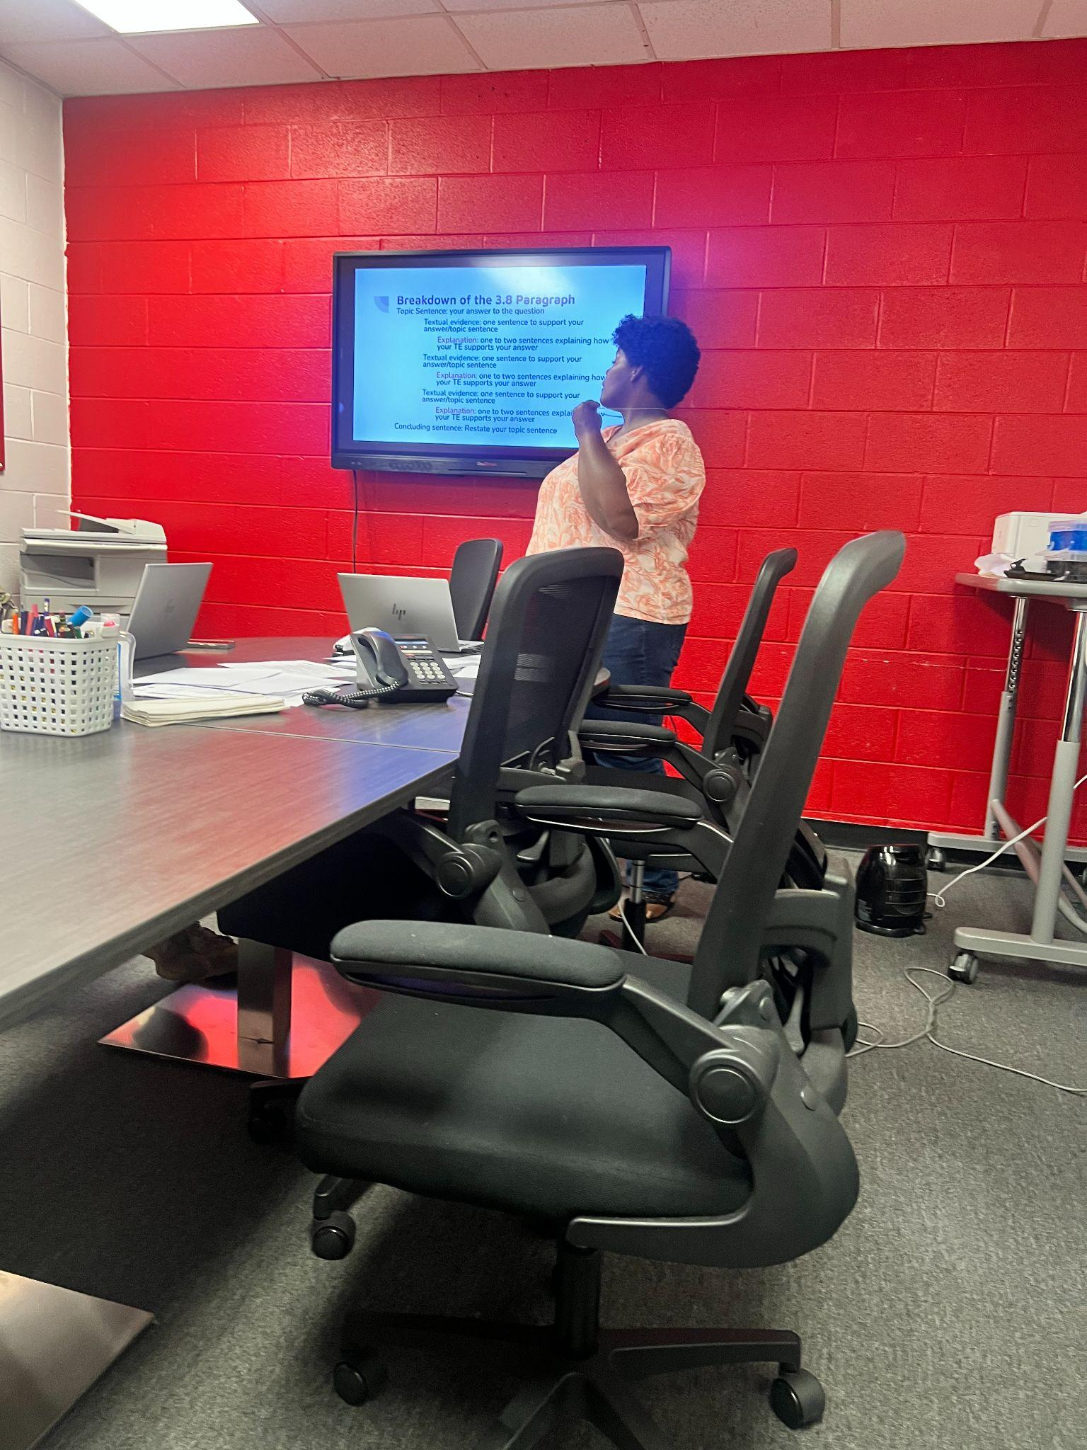
Next Continued Steps for Success:
      Advisory time IXL and Achieve 3000 for students who test
      High level curriculum in English
Common Lit.
      Math RTI during Advisory
      Read 180 for 9th and 10th grade Novice Students
      Utilize GRREC and in school PD to teachers
      Analyze MAP data for RTI classifications
      Learn from our own staff

Slide 12
Quality of School
Climate and Safety
Notes:
The QSCS Survey results are more than a participation rate.
Positively affiliated scores will generate a higher score for this indicator; negatively affiliated scores will generate a lower score for this indicator.
That score will then calculate into 4% of a school's overall performance rating for accountability.

Slide 13
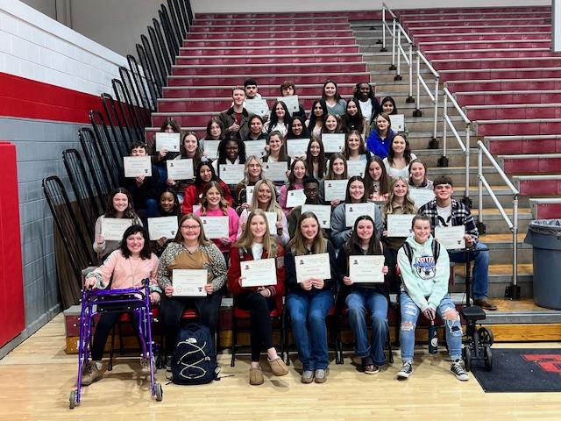
The Quality of School Climate and Safety at TCCHS
 | Climate Index | Safety Index | Indicator Score
2024 | 58.9 | 54.1 | 55.3
2025 | 66.3 | 60.7 | 68.3

Slide 14
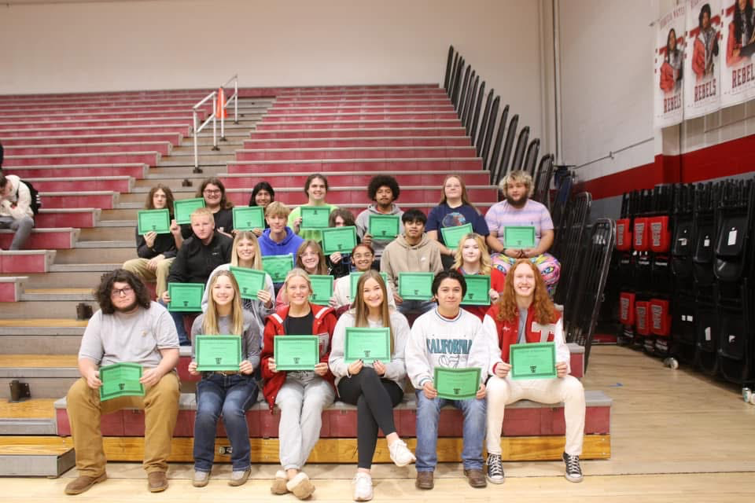
Next Steps:
      Google Survey with questions before benchmark testing and have conversations with students that keep them engaged in the school culture.
      Student/Teacher relationships
      Monthly meetings with student groups.

Slide 15

Postsecondary
Readiness

Slide 16

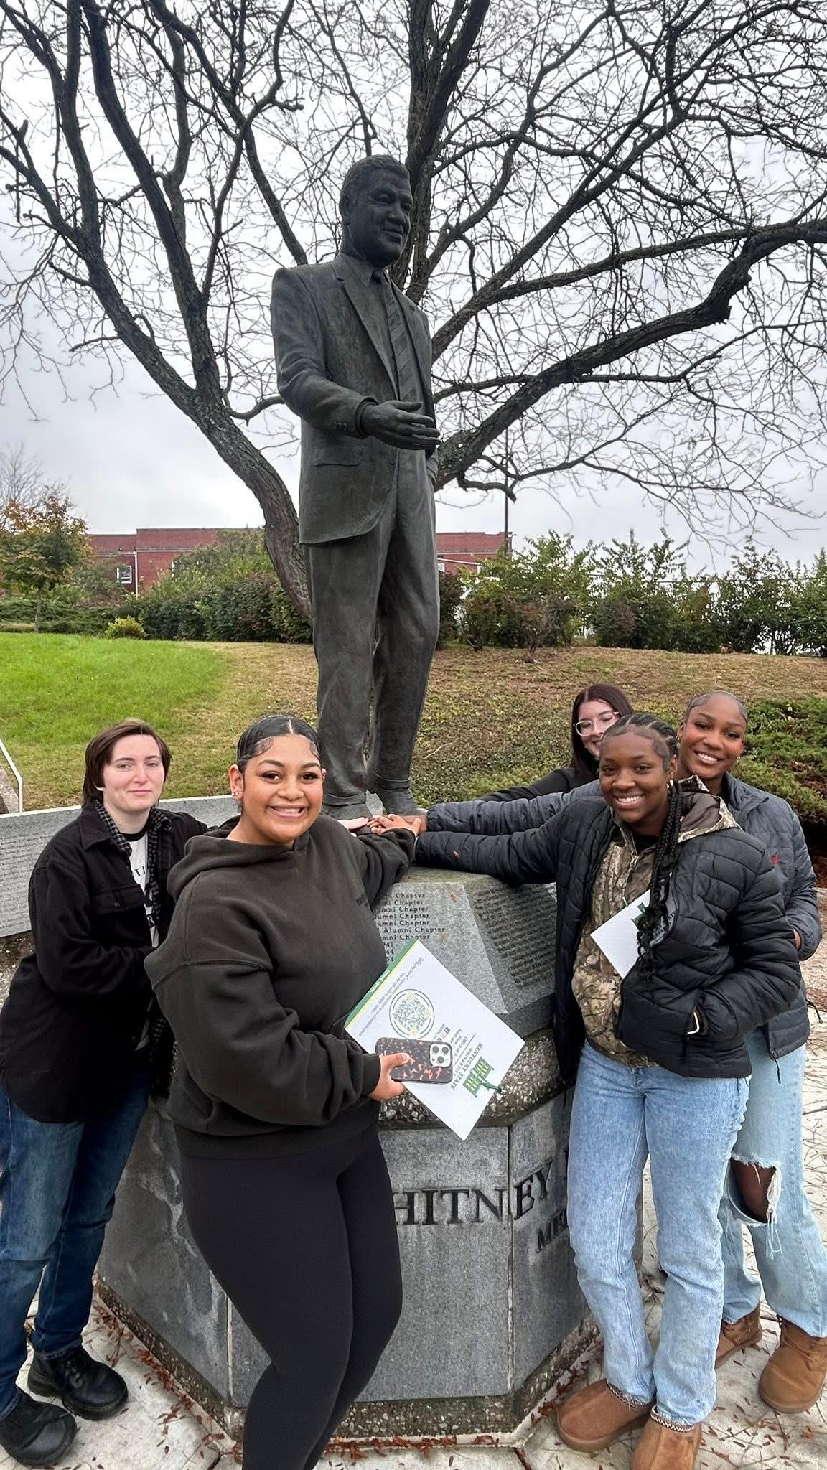
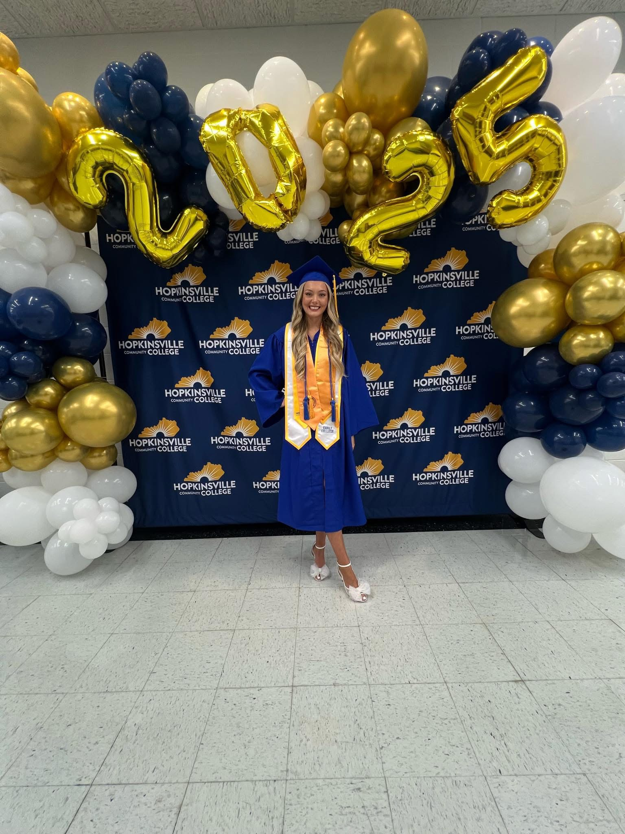
Postsecondary Readiness Counts by Student Group at Todd County Central High School
Student Group | Readiness Count | Academic Ready | Career Ready
All Students - 118 total | 91 | 61 | 65

Slide 17
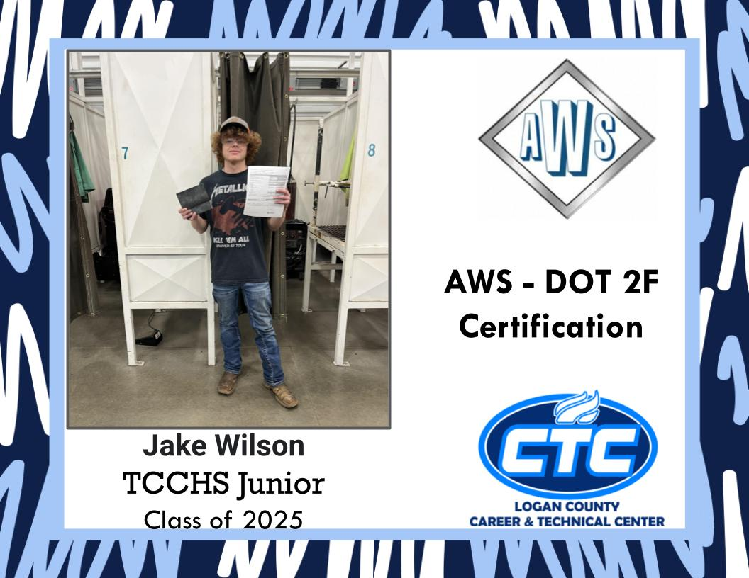
Next Steps:
      Experience-Based Work
      Scheduling students classes to complete Pathways
      College and Career Fair March
      Signing Parties

Slide 18
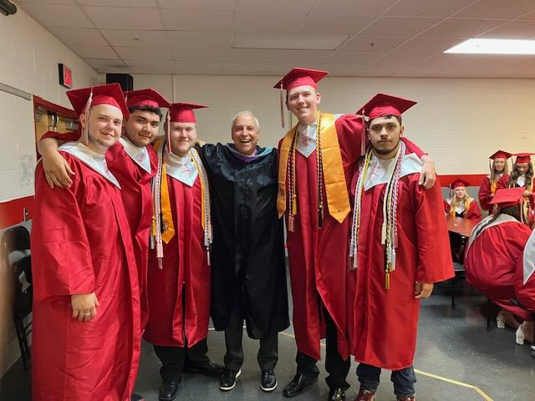
Graduation
Rate

Slide 19
Graduation Rate Trend at
Todd County Central High School
Year | 4-Year Adjusted Cohort | 5-Year Adjusted Cohort
2018 | 92.6 | 100.0
2019 | 96.3 | 95.0
2020 | 99.1 | 96.3
2021 | 95.0 | 98.1
2022 | 98.3 | 96.6
2023 | 91.7 | 98.3
2024 | 96.6 | 96.7

Slide 20

QUESTIONS ?

