Slide 1
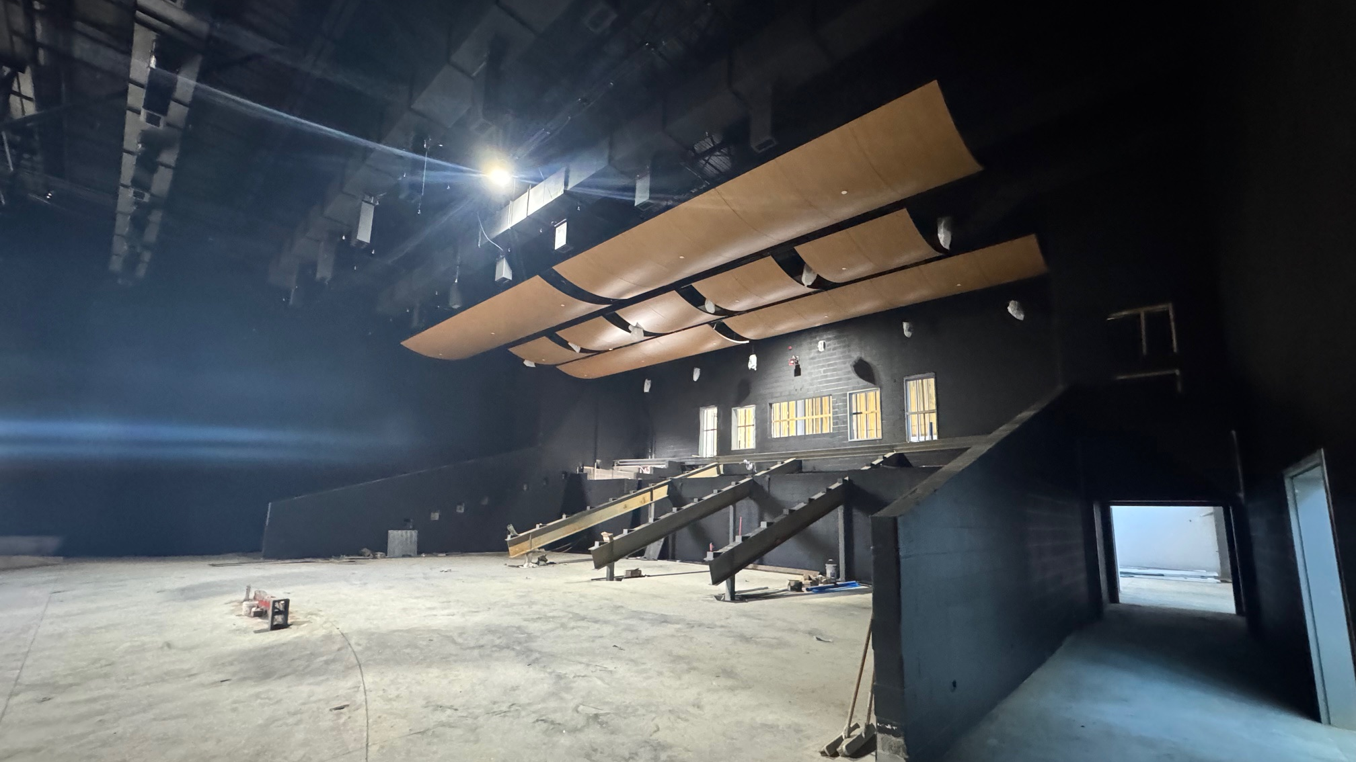



November 24th - Design and Construction Update

Slide 2
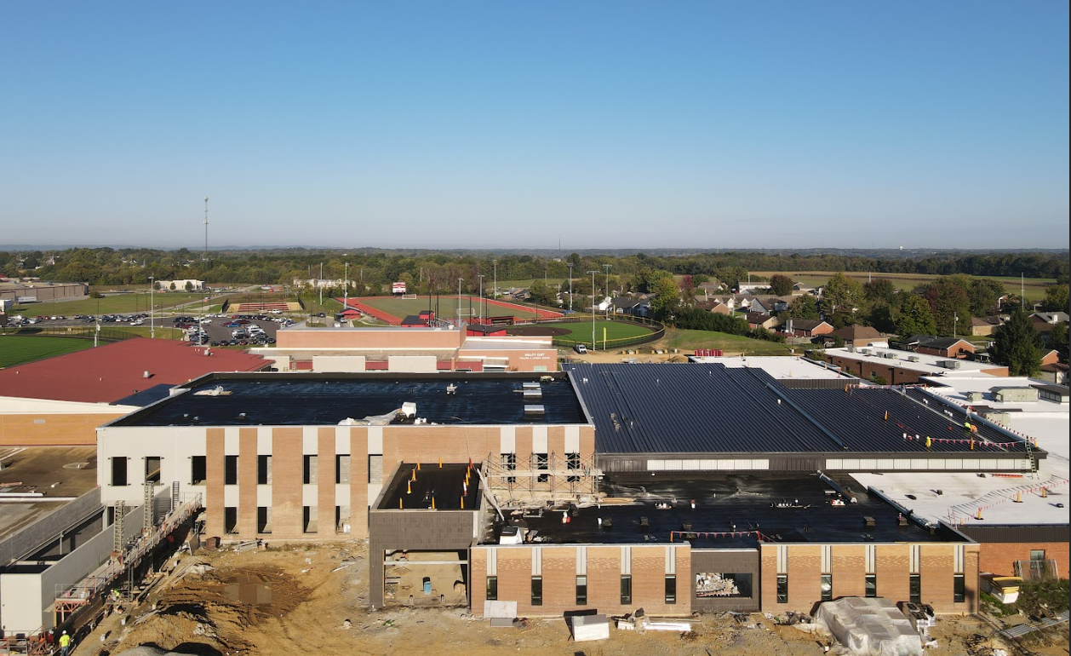

Bullitt East High School - Construction

Slide 3
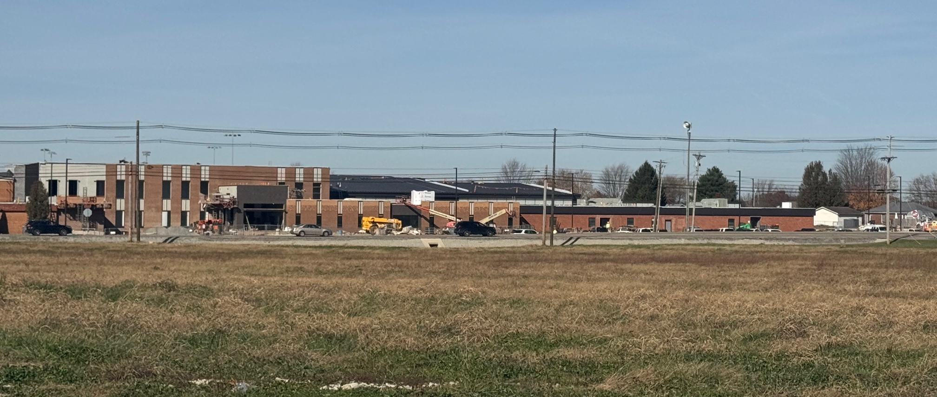
Bullitt East High School - Construction

Slide 4
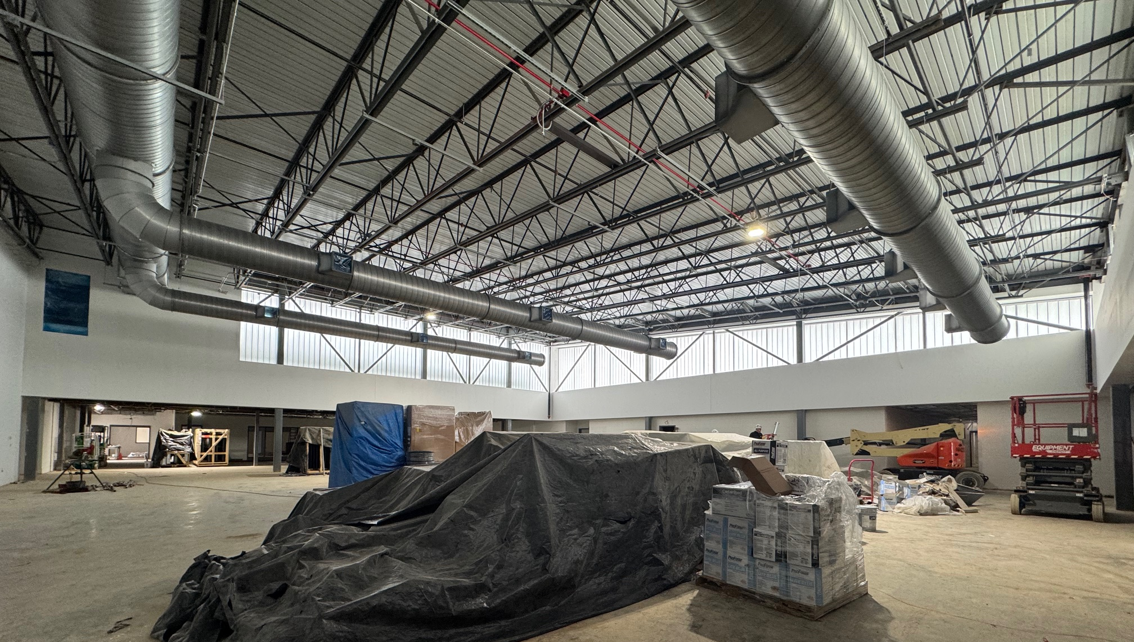
Bullitt East High School - Construction

Slide 5
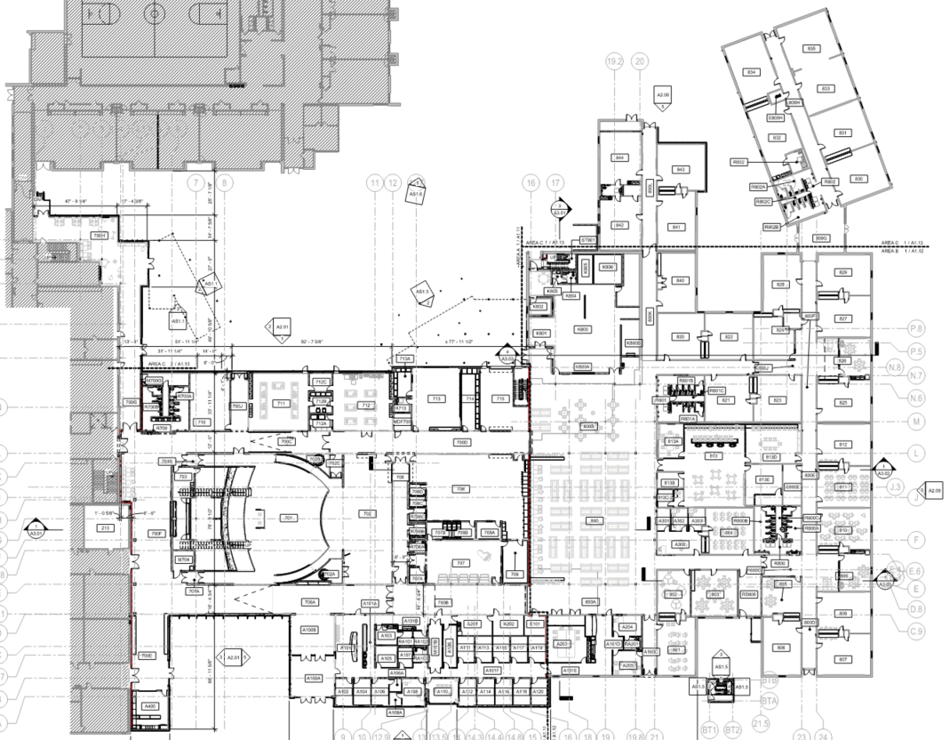
Area B
Construction Timeframe:
Anticipated Completion - May 2026
Equipment Start Up Happening December
Area C - Continuing
Area A
Bullitt East High School Construction

Slide 6

Board Consent Items - Bid Package No. 1 - Bullitt East Fine Arts
Change Order 22 - Change Order 22- Audio Enhancement – Credit to General -
This change order is a credit for Work that would have been performed/provided by the General Contractor (EH) and Electrical Contractor (KES) under the general construction contract. This Change Order is supplemented by the addition of Audio Enhancement cooperative purchase agreement scope of work as detailed by their SAP Quote #97452, dated July 9, 2025. This work will standardize this facility on the life safety upgrades established by BG 23-165. Audio Enhancement cost is $371,532.25. The A/E fee for this Change Order is based on the Audio Enhancement proposed value at 5% of construction cost to compensate for redesign of the life safety systems and coordination of the COOP agreement.
General Construction Change Order Cost: ($99,630.29) Credit
Audio Enhancement COOP Proposal - Quote #97452, dated July 9, 2025 $371,532.25
Total Cost of Improvements (Change Order + COOP) $271,901.96
Phase 2 Athletics
NBHS Physical Science Center

Slide 7
Board Consent Items - Bid Package No. 1 - Bullitt East Fine Arts
Change Order 23 - Ceiling Tile and Grid Replacement - $41,023.68 - Savings Contract with Trane. Since that time, ongoing roof leaks prior to the start of construction and the HVAC System not being operational during construction have caused the ceiling tiles to break down. Ceiling grid remains in place where possible. In addition to tile replacement, ceiling tile and grid is being replaced in three classrooms where installation of new hydronic piping would not allow ceilings to remain in place. This recommendation was discussed with the Director of Facilities and Architect during the bi-weekly progress meeting, and all agreed it was needed to yield the best result.
Change Order 24 - Site Revisions at Tennis Court and Asphalt Overlay $128,454.63 - This Change Order includes work to address two concerns, 1) The sequencing of asphalt overlays at campus parking lots and roadways and 2) add a curbed sidewalk along the access road and add storm drainage at the tennis court sidewalk. Calhoun Construction credited back the asphalt overlay in their Baseball/Softball contract and EH added it to theirs. This was done to work in sequence of completion of each contract. Work can happen with trades already on site to perform work in sequence with construction activities.
Phase 2 Athletics
NBHS Physical Science Center

Slide 8
Board Consent Items - Bid Package No. 1 - Bullitt East Fine Arts
Change Order 25 - Misc. Masonry & Framing Changes and Steel - $30,694.80 - This Change Order includes work to enclose existing roof leaders that were exposed after demolition was complete, change wing walls in the auditorium from framed to CMU and add lintel supports where required based in existing conditions.
Change Order 26 - Misc. Mechanical Changes - $48,514.04 - Due to available space at the mechanical mezzanines between Areas A and B and above ceiling areas, ductwork is being routed at the exterior roof and thermally insulated based on available space due to required routing of the hydronic lines and other equipment conduits. All exterior duct will be insulated with exterior rated insulation. Also included is duct routing to ventilate and existing outside air louver to the roof in Area C.
Phase 2 Athletics
NBHS Physical Science Center

Slide 9
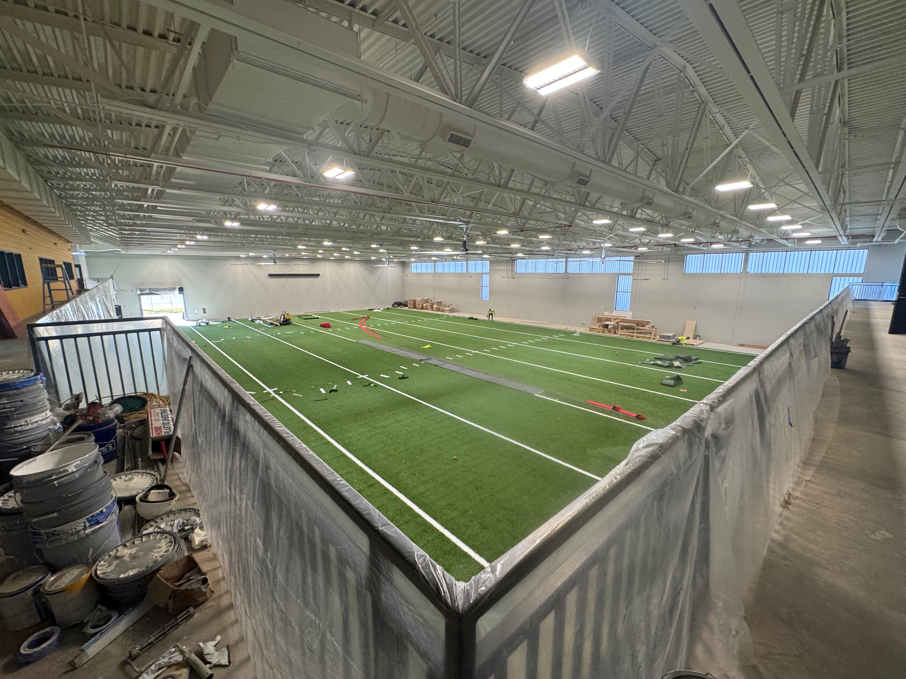
Phase 2 Athletics
NBHS Physical Science Center

Slide 10
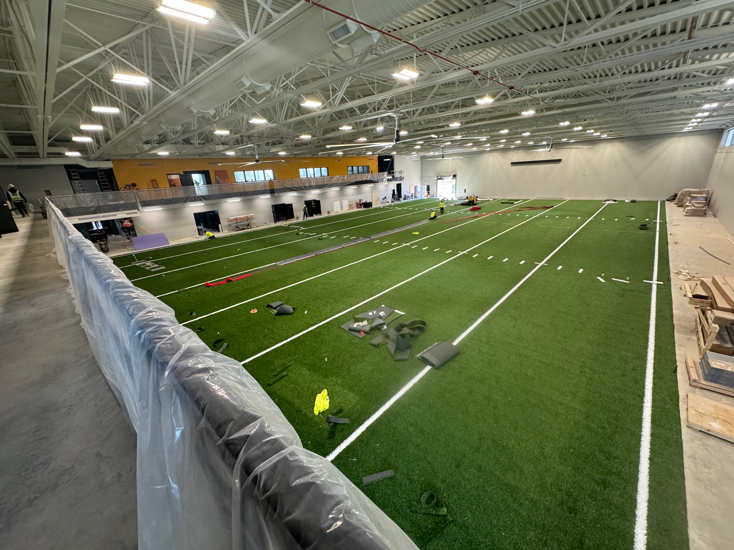
Phase 2 Athletics
NBHS Physical Science Center

Slide 11
Board Consent Items - Bid Package No. 2 - North Bullitt Physical Science Center
Change Order 24 - Whirlpool Faucet - $3,537.00 - BCPS Facilities / Construction requested the addition of a permanent wall mounted faucet in the Training Room to serve the mobile whirlpool.
Change Order 25 - Tennis Court Lighting - BCPS Leadership requested the addition of Tennis Court Lighting at all three high schools. Work in this Change Order includes cost of installation by Calhoun Construction and their subcontractors. Purchase of the lighting would be via a Sourcewell COOP agreement with Musco Lighting. A breakout of costs is below:
• $302,604.00 GC COR #42 Cost
• $86,500.00 Bullitt Central Musco Lights via Sourcewell Quote
• $86,500.00 Bullitt East Musco Lights via Sourcewell Quote
• $93,500 North Bullitt Musco Lights via Sourcewell Quote
$569,104 Total Cost
Phase 2 Athletics
NBHS Physical Science Center

Slide 12
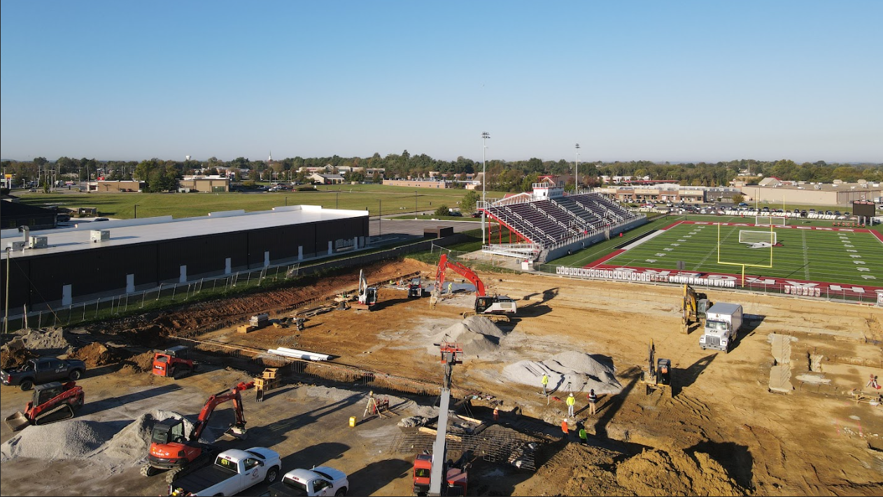
Phase 3 Athletics - Physical Science Centers
Bullitt East

Slide 13
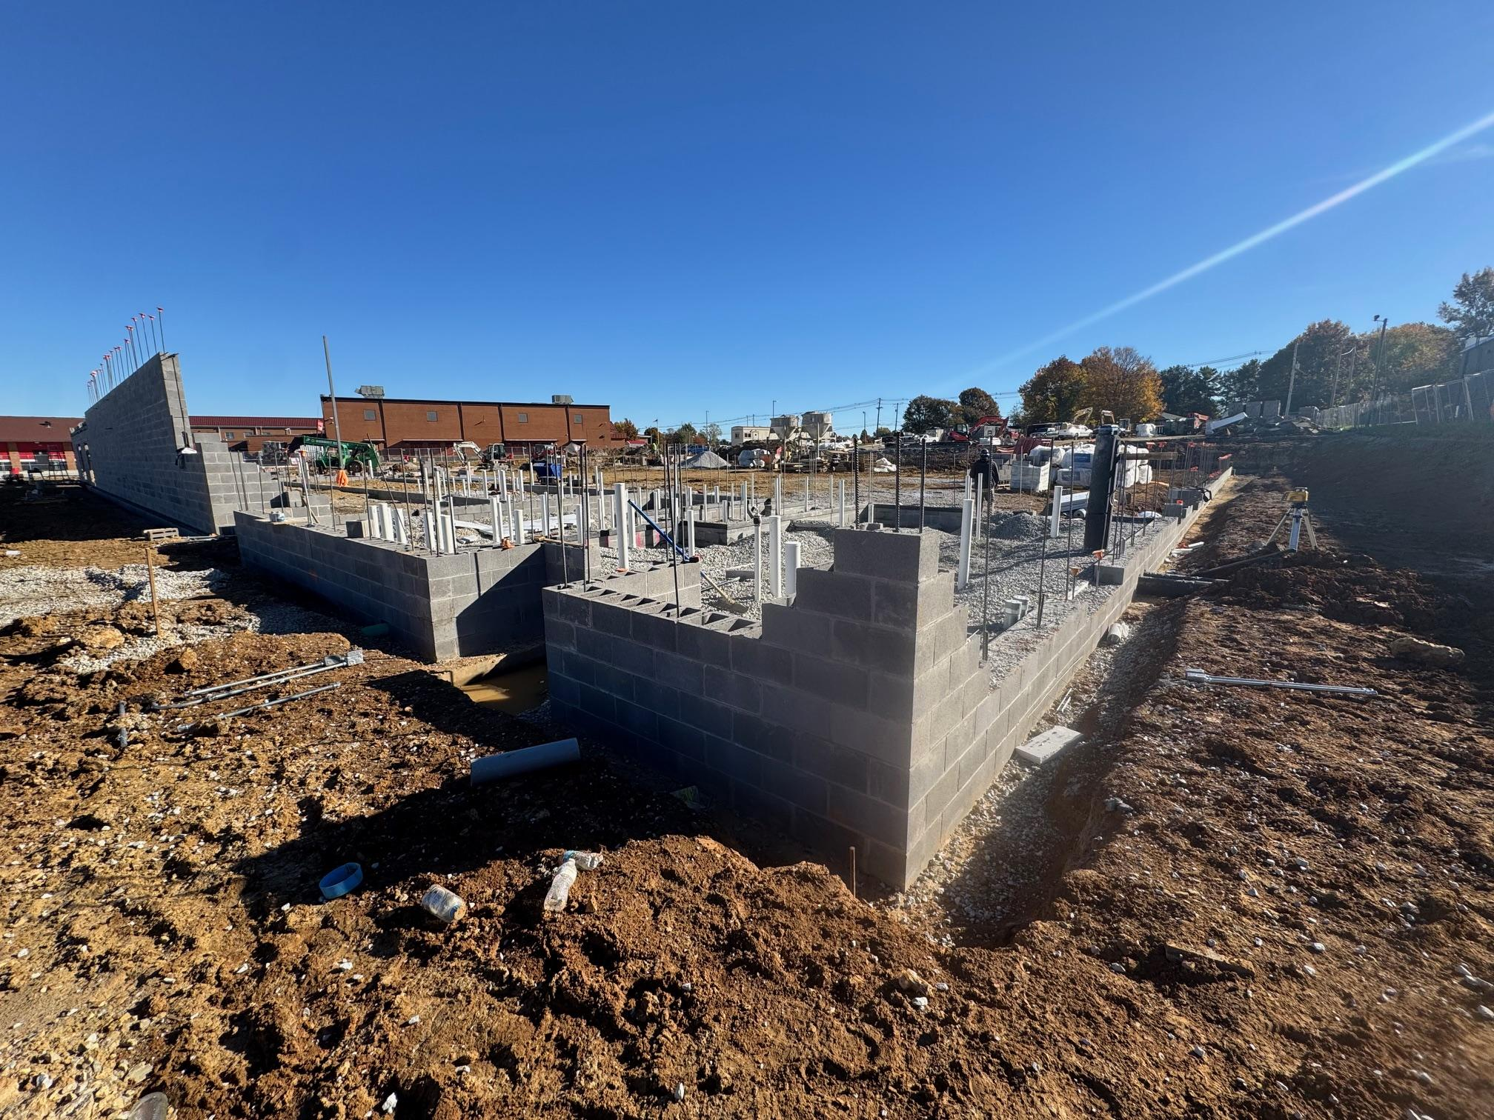
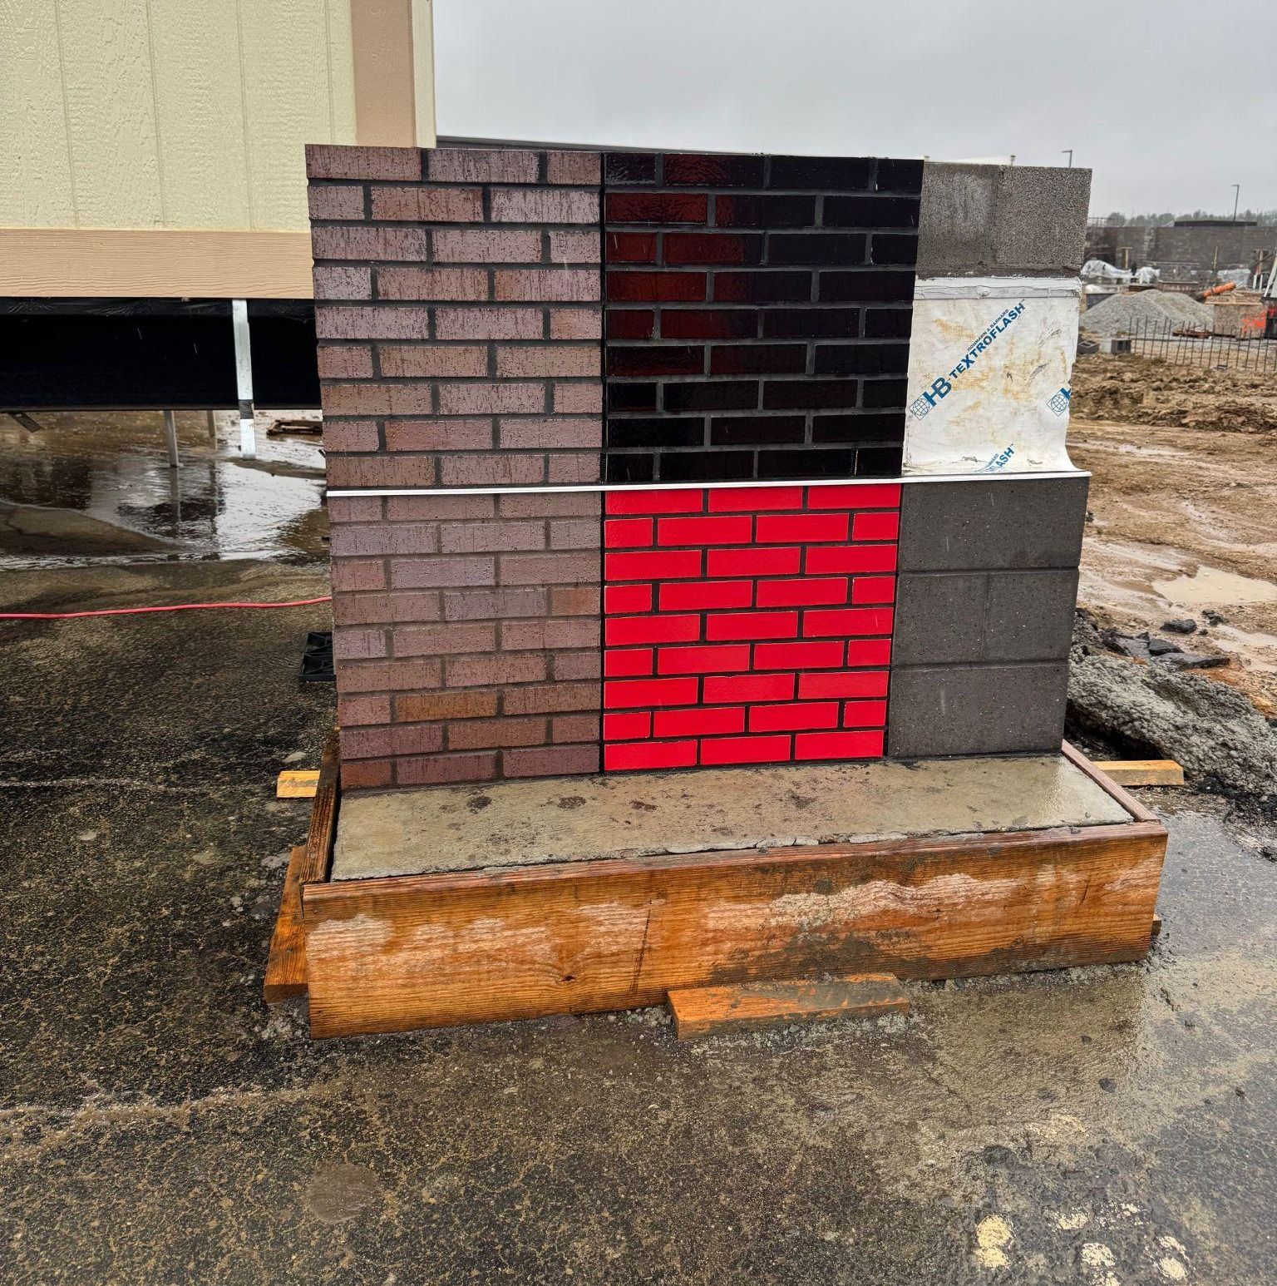
Phase 3 Athletics - Physical Science Centers
Bullitt East

Slide 14
Phase III Athletics - Physical Science Centers - Bullitt East -
Change Order 04 - Permanent Netting Poles - $10,273.65 BCPS Leadership is requesting the addition of a protective netting system in the endzone of the stadium field to deter balls from going over the fence into the construction zone. This change order includes the labor from Calhoun and their subcontractors to install the netting system that was purchased via a direct purchase order outside of this contract.
The Motz Group has been notified of this work and will monitor construction activities and remove and replace turf around the poles. Their work is estimated to be $2,000 and will work on a Time and Material Basis. Billing will be sent once actual time expended is known as a direct payment request to BCPS. The Motz Group does not have an active contract with the District to apply a change order which is why T&M is being recommended for their oversight of constructing at the existing synthetic turf stadium field. This Change Order includes a credit to offset Change Order 2 which was previously approved a temporary netting system.
Phase 3 Athletics - Physical Science Centers
Construction

Slide 15
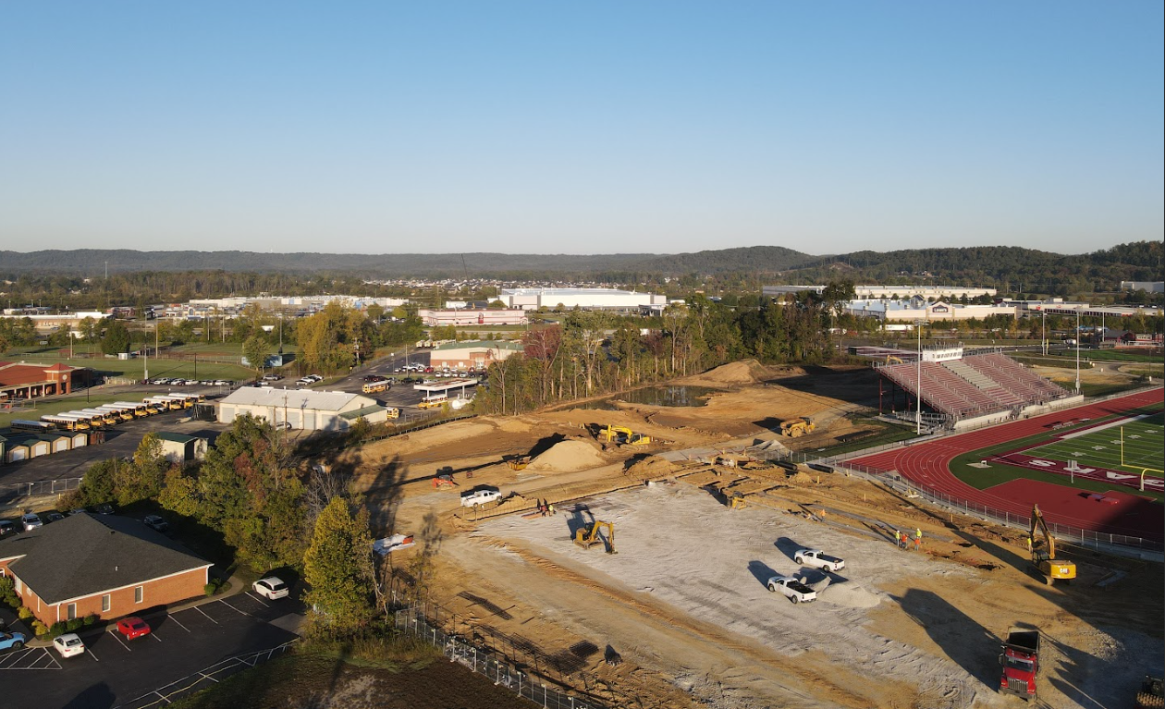
Phase 3 Athletics - Physical Science Centers
Bullitt Central

Slide 16
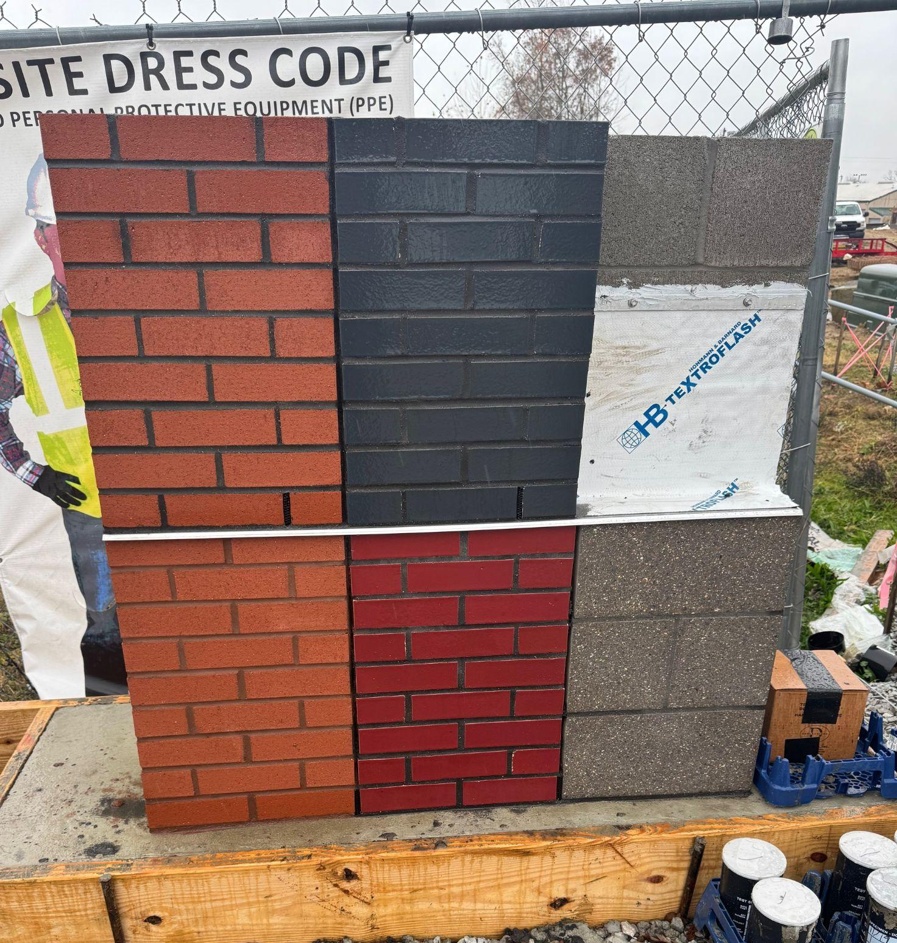
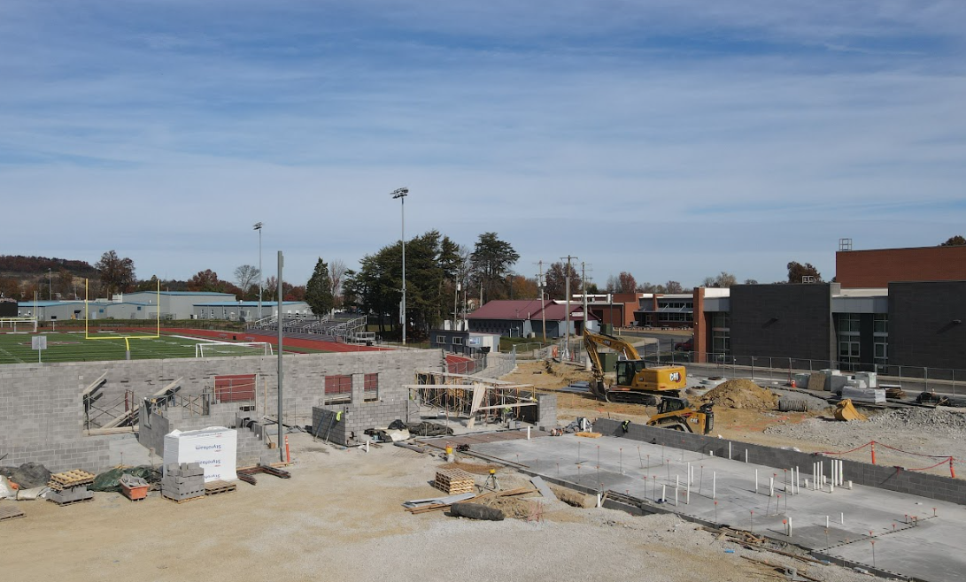
Phase 3 Athletics - Physical Science Centers
Bullitt Central

Slide 17
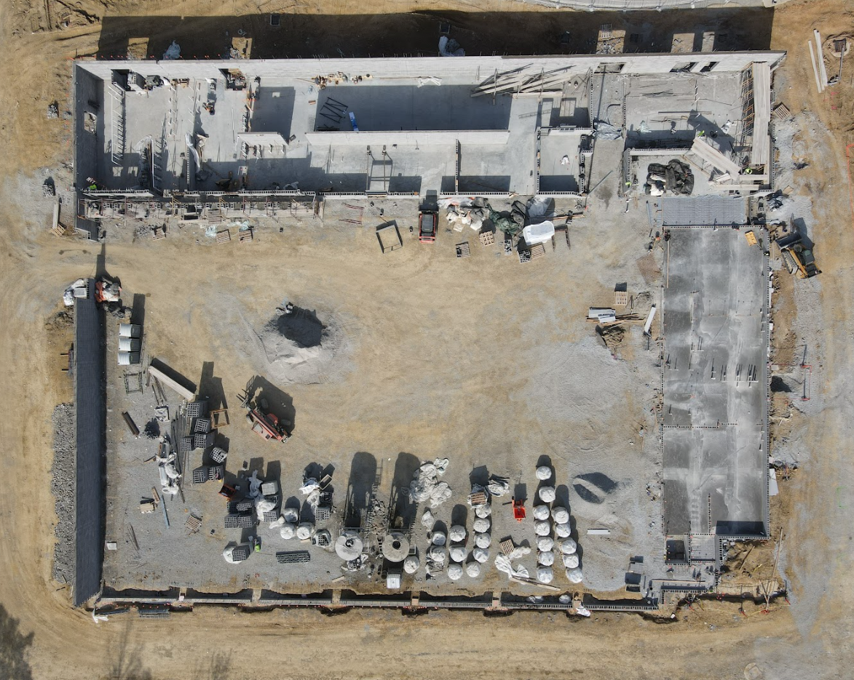
Phase 3 Athletics - Physical Science Centers
Bullitt Central

Slide 18
Bernheim Middle School
DPO Reconciliation Credit for unbilled materials including the following:
  DPO 16 – 24902055 – Core & Main - $36.46
  DPO 17 – 24902054 – Quality Stone - $0.06
  DPO 28 - 24902308 – Lee Building Products - $0.30
  DPO 29 – 24902225 – Mills Supply - $18.95
  DPO 30 – 24902221 – Quikrete - $1.00
  DPO 31 – 24902560 – Ferguson - $14.44
  DPO 34 – 24902551 – Sherwin Williams - $16,052.18
  DPO 36 – 24902821 – OVF - $1,463.03
  DPO 37 – 24902227 – Dal-Tile - $1.23
  DPO 05 – 24902554 – L&W Supply - $143,345.96
  DPO 19 - 24903132 - Wausau Tile - $204.34
  DPO 22 – 24902553 – Siskin Steel $3,411.84
Project Close Out

Slide 19
Baseball / Softball Project
DPO Reconciliation Credit for unbilled materials including the following:
  DPO 8 – 25902545 – Lee Building Products $0.78
  DPO 9 – 25902544 – Mills Supply Co. $10.76
  DPO 1 – 25902679 – Sherwin Williams $2.08
  DPO 7 – 25902680 – Garland $195.77
  DPO 17 – 25902683 – Sisken Steel $55.22
  DPO 22 – 25902707 – Ferguson $0.01
Change Order 03 – Net Zero swap for Scoreboard Trusses FACPAC Form for DPO - The value of the scoreboard truss materials were deducted from the General Contract and added to assigned Material DPO. This is a net zero change to the overall Contract Value. The change to the General Contractor’s contract was approved at the October 28, 2024, Board Meeting. The FACPAC form DPO-11 Toadvine’s DPO was not provided with that board agenda item. The FACPAC form is being presented now for board review and signature to supplement the previously approved change order.
Project Close Out

