Slide 1


GARRARD COUNTY SCHOOLS
2025 STATE ACCOUNTABILITY
DATA RELEASE, NOVEMBER 2025

Slide 2
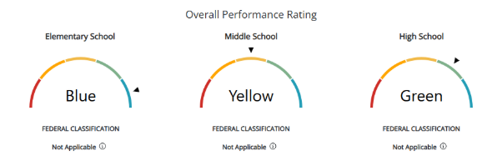
GCS DISTRICT OVERALL
GARRARD COUNTY SCHOOLS

Slide 3
GCS DISTRICT OVERALL
Elementary: 13th in KY and 2nd in CKEC
Middle: 92nd in KY 14th in CKEC
High: 74th in KY 12th in CKEC
District: 39th in KY (top 23%)
GARRARD COUNTY SCHOOLS

Slide 4
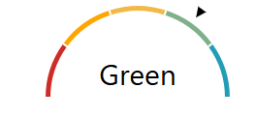
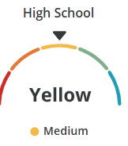
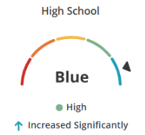
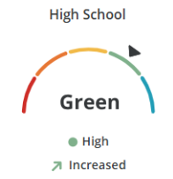
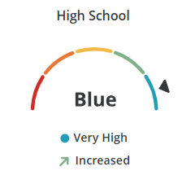
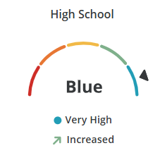
GCHS
Science,
Social Studies,
and Writing
Quality of School
Climate
and Safety
Postsecondary Readiness
Graduation
Rate
Reading & Math

Slide 5
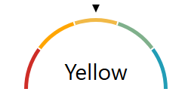
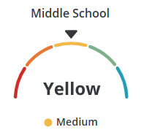
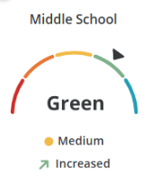
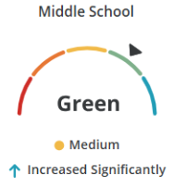
GMS
Reading & Math
Science, Social Studies,
and Writing
Quality of School Climate & Safety

Slide 6
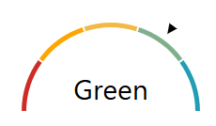
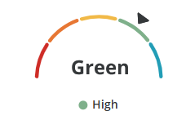
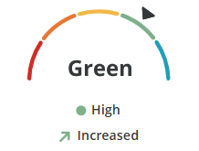
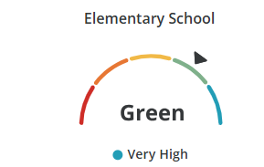
PLE
Science, Social Studies, & Writing
Quality of School Climate and Safety
Reading & Math

Slide 7
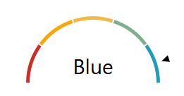
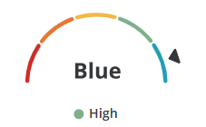
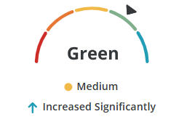
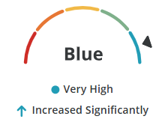
LES
Reading & Math
Science, Social Studies, & Writing
Quality of School Climate and Safety

Slide 8
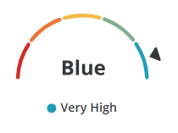
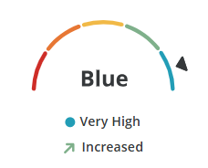
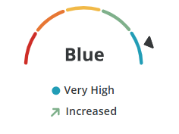
CDR
Science, Social Studies, & Writing
Quality of School Climate and Safety
Reading & Math

Slide 9
HIGHLIGHTS
  Increasing the number of students who are on grade level or above in all content areas
  10% above the state average in elementary reading proficiency
  17% above the state average in elementary math proficiency
  6% above the state average in high school science proficiency
  2% above the state average in middle school social studies proficiency
  2% above the state average in high school writing proficiency
  4% above the state average in middle school writing proficiency
  12% above the state average in elementary writing proficiency
  Increasing the number of students who demonstrate they are ready for what comes after high school: workforce, career training, college, or military
  Being 1 of 14 BLUE districts in elementary ratings (out of 172)

Slide 10
SYSTEMS AT WORK
Components in an Ideal Lesson
Walkthroughs/Learning Walks
iReady
Diagnostics
Daily Formative Assessments/Exit Slips
District Common Unit Assessments
Student Conferences
Data PLCs

Slide 11

GCS COMMITMENTS

