Slide 1
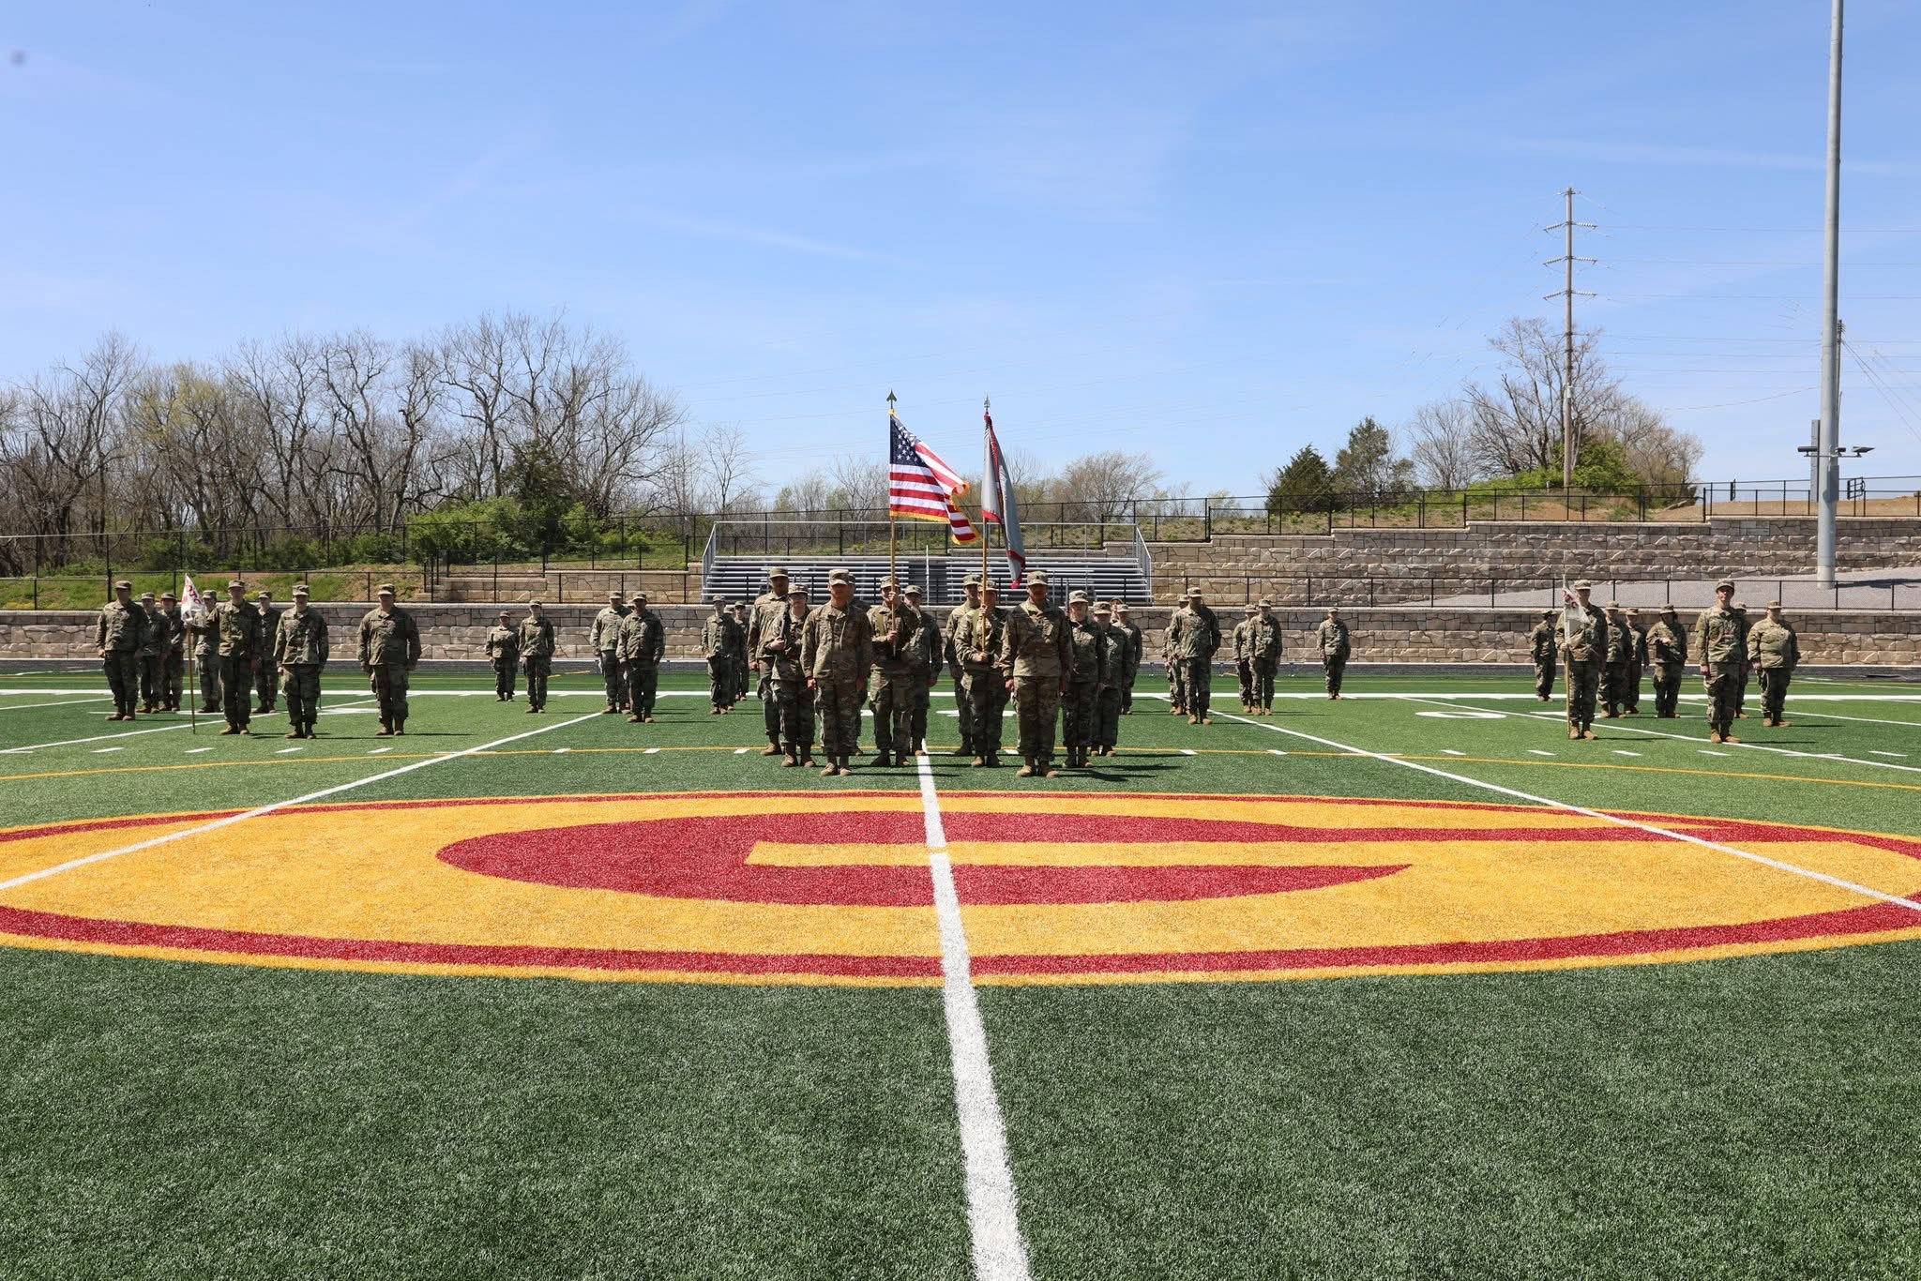
NOVEMBER
2025
JROTC UPDATE
GARRARD COUNTY HIGH SCHOOL

Slide 2
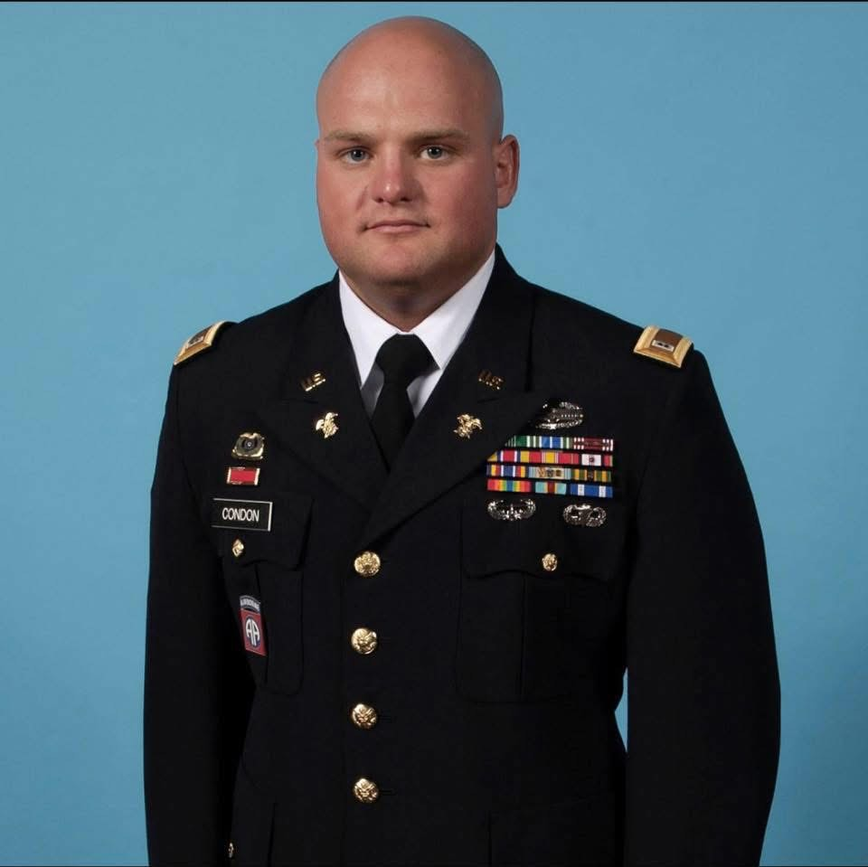
Micheal Condon II
Write a brief bio for this person.
Tell us about their role and responsibilities so your audience has an idea about the topics they’ll cover. Add that he is a GCHS Alumni,
Add a quote or extra info about their skills and capabilities.
JROTC Leader

Slide 3
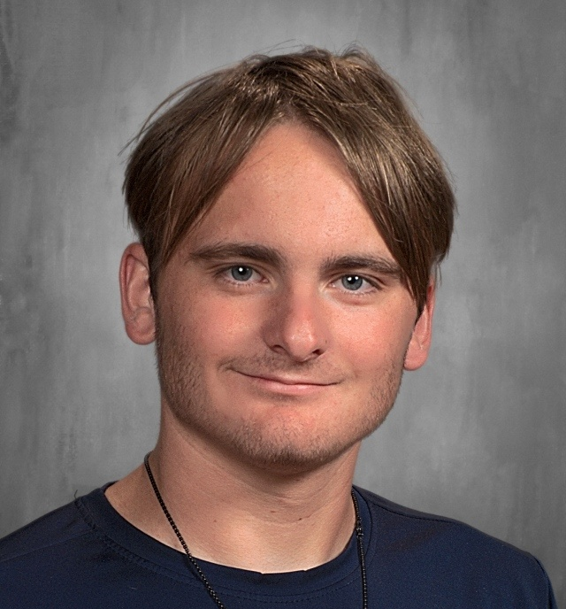
Cameron Hendren
Additional Notes;
Junior
JCLC Camp 2025 Archer Winner
JCLC Camp 2025 Land Navigation Team
Winner (New Course Record)
GCHS Varsity Soccer Player
GCHS Track & Field
Battalion Commander

Slide 4
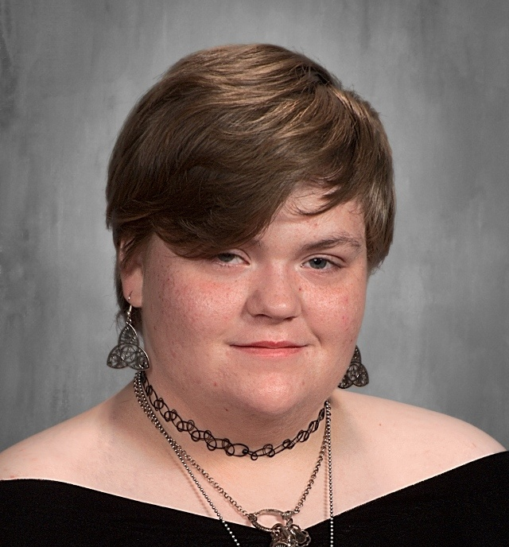
Charity Lawless
Senior
Battalion Commander Sergeant Major

Slide 5
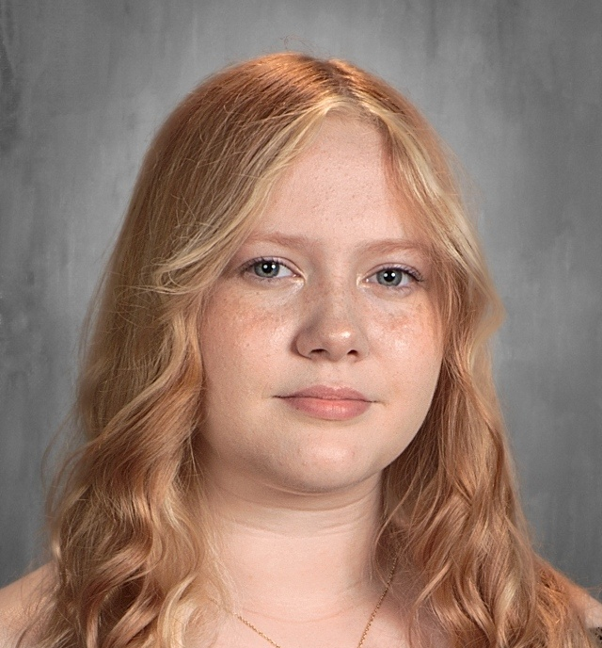
Gwendalyn Howell
Senior
Deputy Battalion Commander

Slide 6
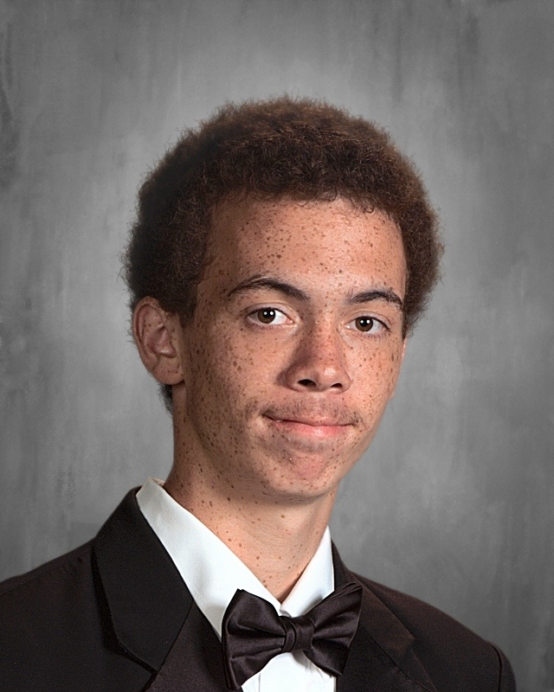
Edward Johnson
Senior
Executive Officer

Slide 7
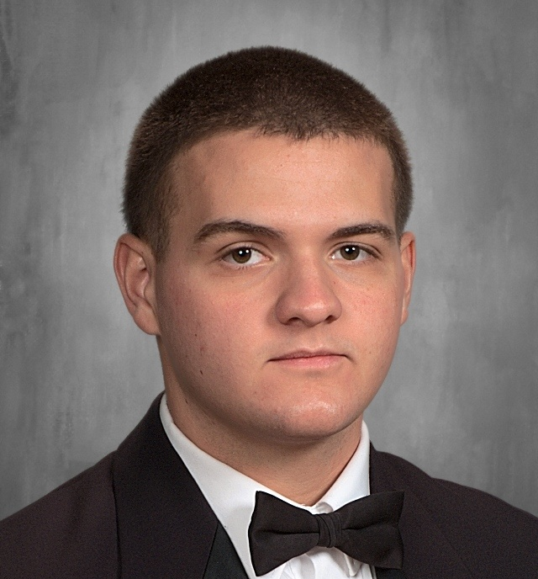
Alex Hounshell
Go to garrard gchs FB for notes. Already enlisted. Senior
S3 Officer

Slide 8
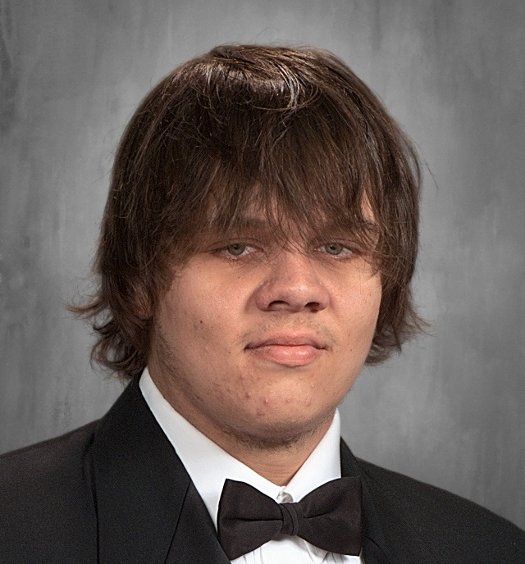
Billy Godber
Awarded JCLC Camp Cadet 2025
JCLC Archer Award 2025
JCLC Camp 2025 Land Navigation Team
Winner (New Course Record)
GCHS Varsity Football Team
Senior
Operation Sergeant Major

Slide 9
HIGHLIGHT
Motto - “Deeds not words”.
Mission - To motivate students to become better citizens.
Creed - I do not lie, cheat, or steal and will always be accountable for my actions and deeds. I will always practice good citizenship and patriotism. I will work hard to improve my mind and strengthen my body. I will seek the mantle of leadership and stand prepared to uphold the Constitution and the American way of life.
Add a statement.
This could be a quote from a project lead
or client feedback.

Slide 10
HIGHLIGHTS
230 hours which include: parking for school events, Wreath’s, Art Council, parades, KSBA, Fiscal Court, Veterans Day programs
01.
Community Service
Competitions, Cadet dinner, Summer Camp, and other trainings.
02.
Student Opportunities
Pride and service.
03.
School Culture

Slide 11
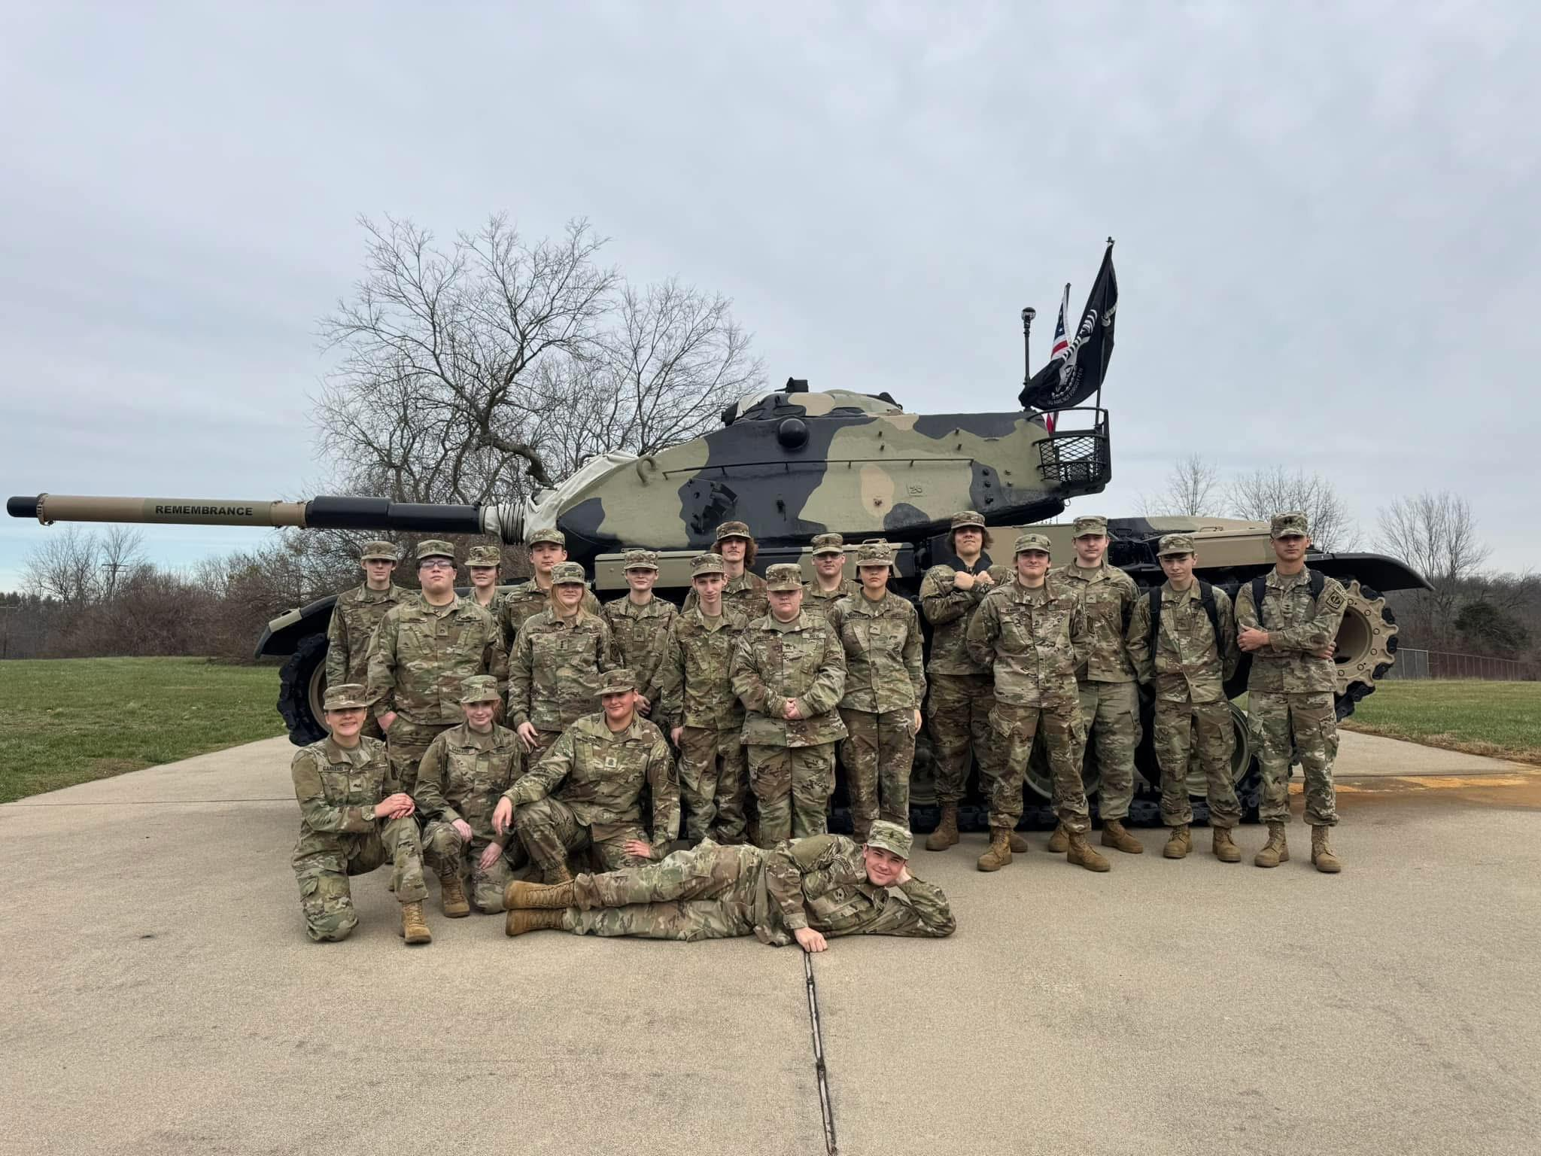
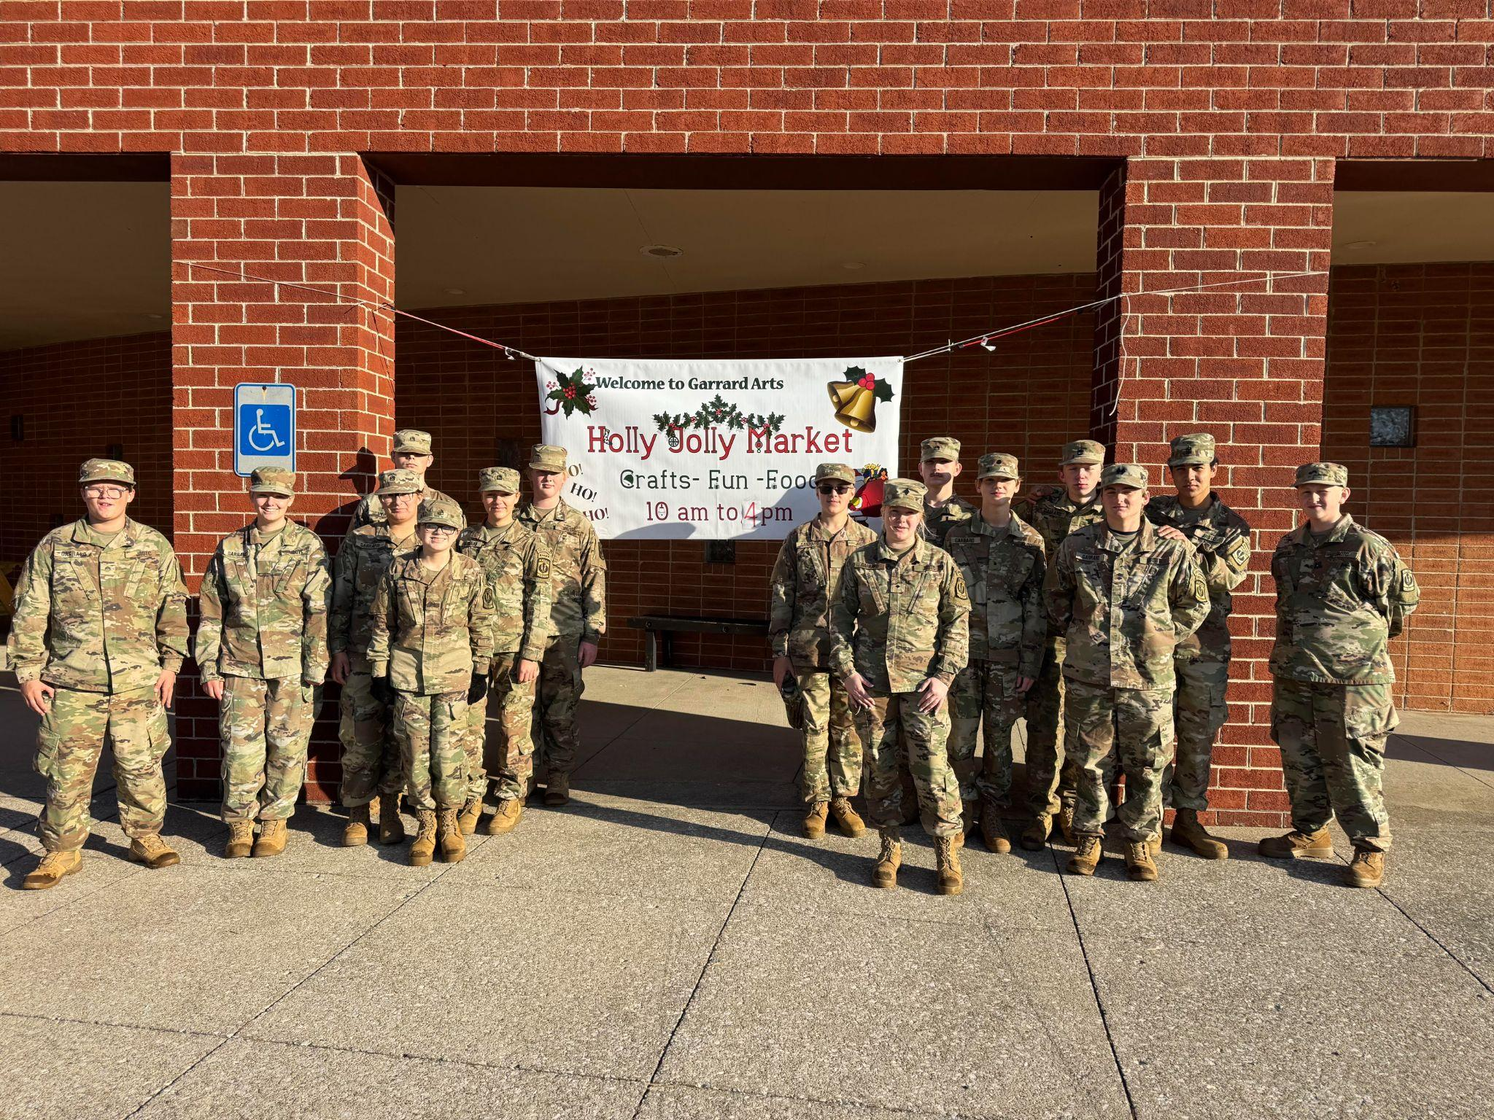
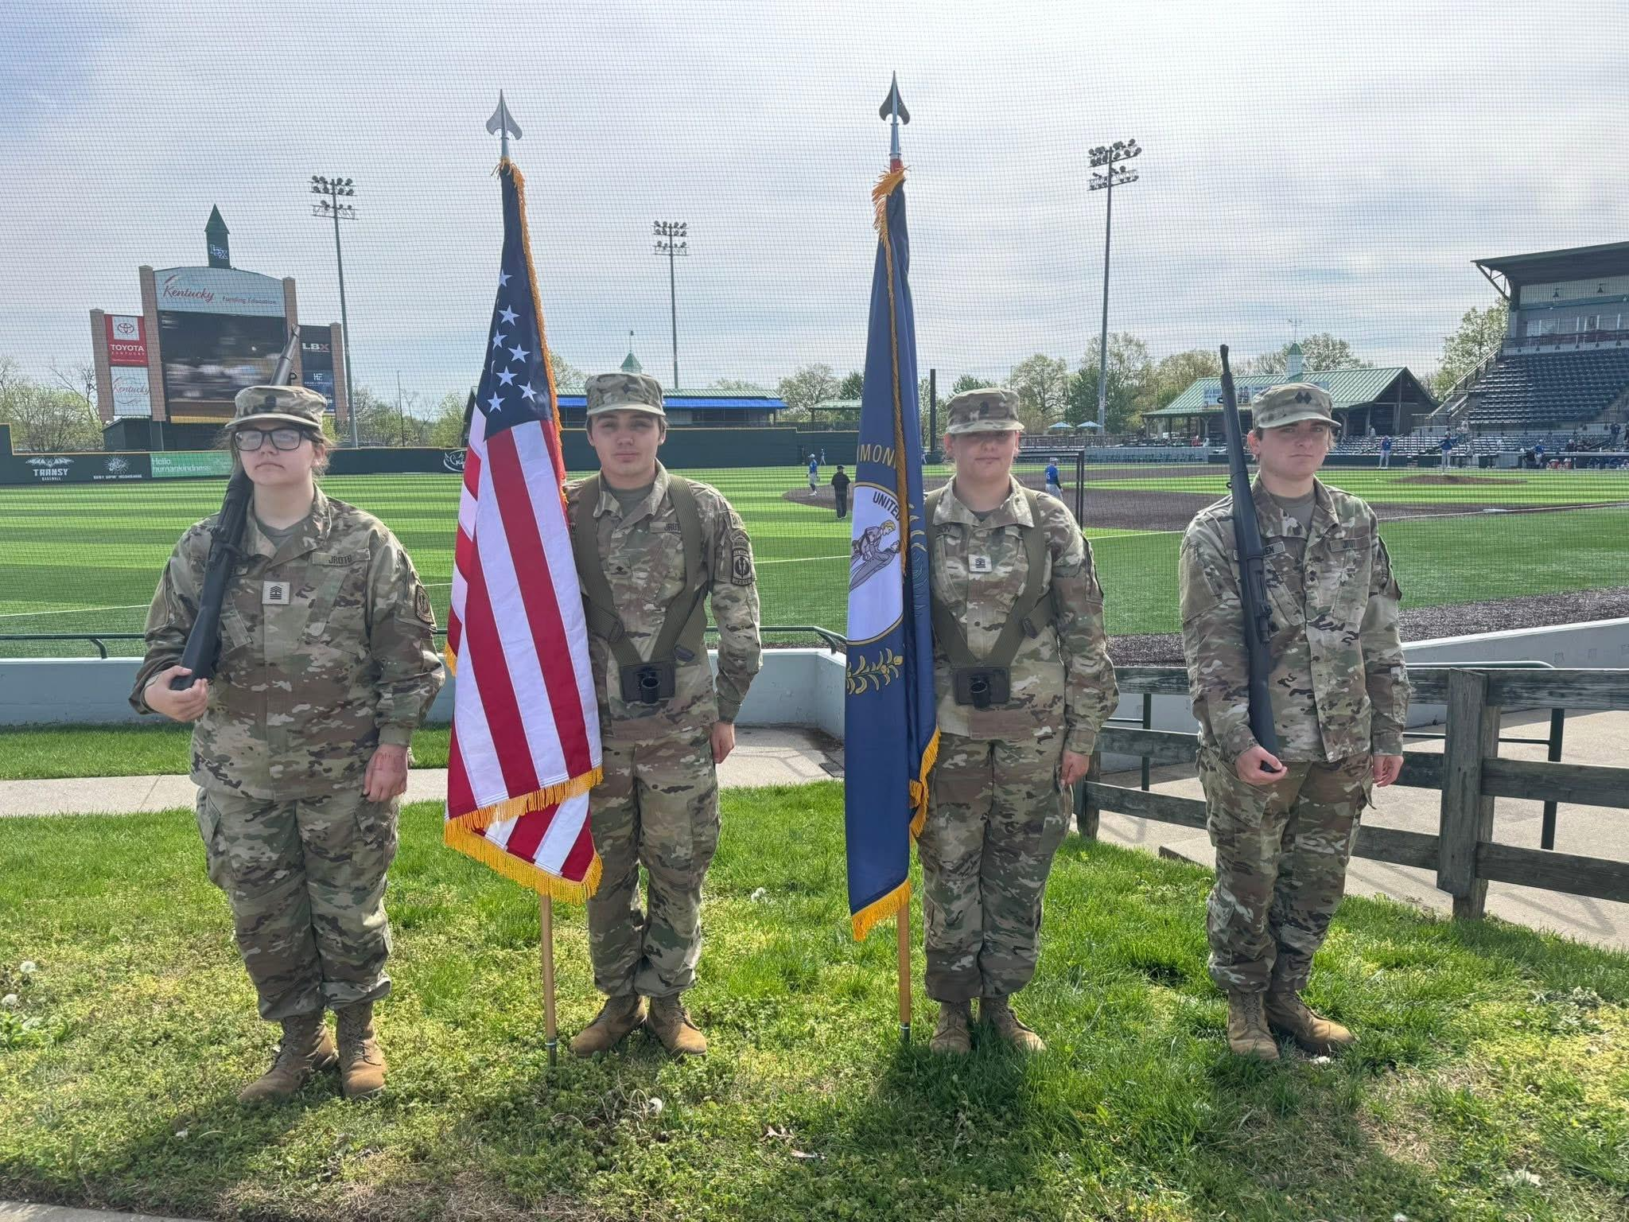
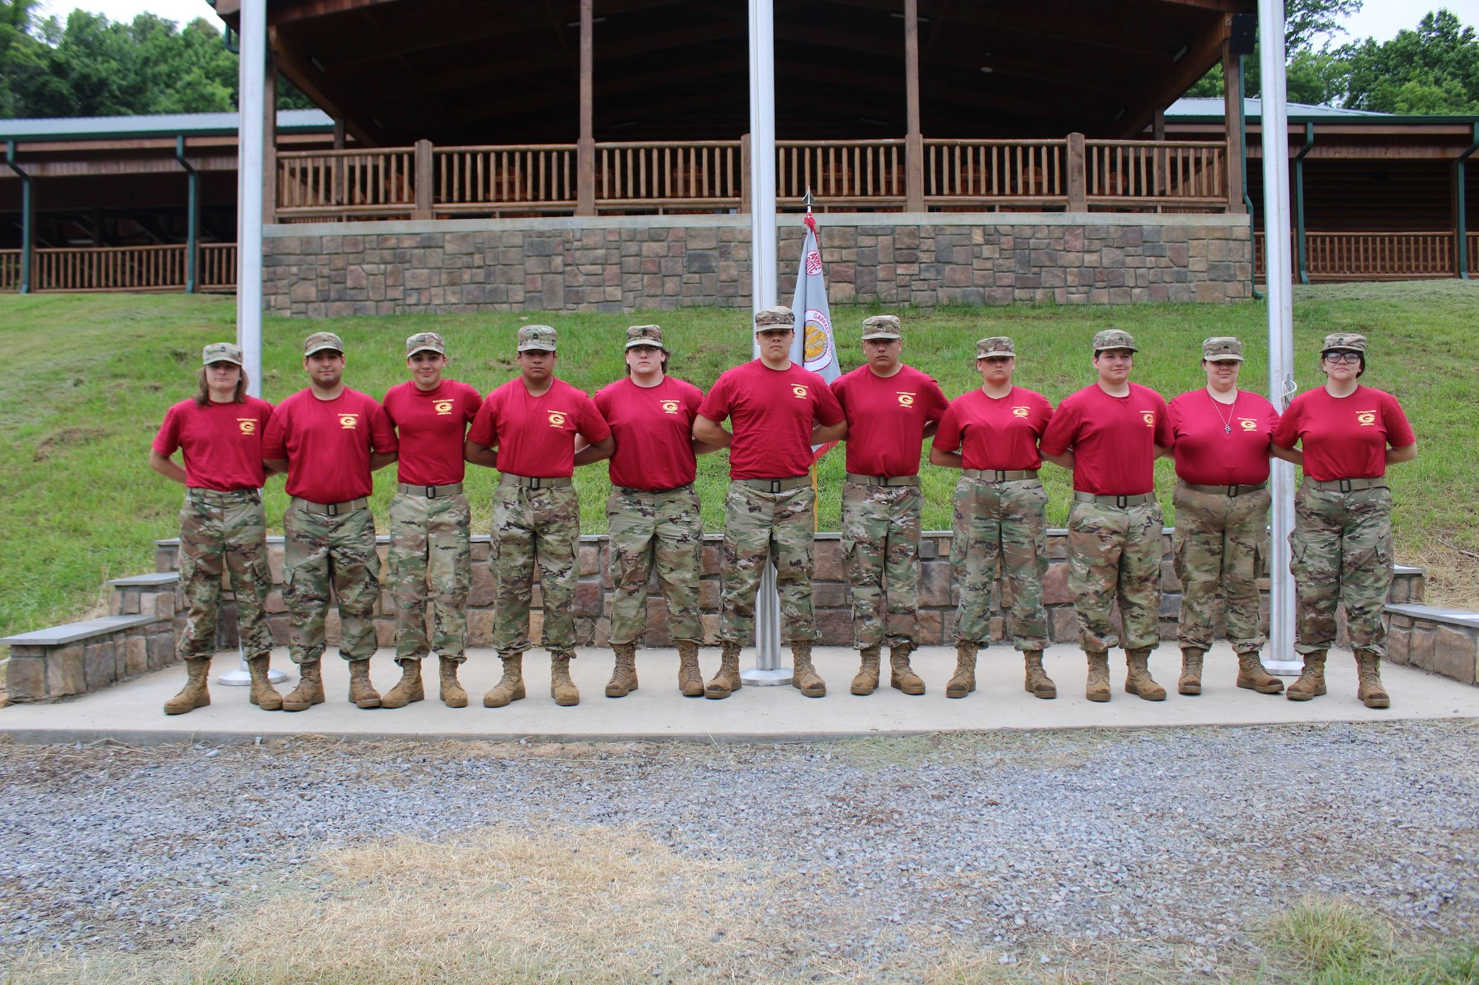
HIGHLIGHTS
HIGHLIGHT 3
Student participation 33 to 95.
HIGHLIGHT 1
Students have served 230 community hours.
HIGHLIGHT 4
HIGHLIGHT 2
Student leadership projects.
Student scored exemplary at JCLC summer camp and set new course records.

Slide 12
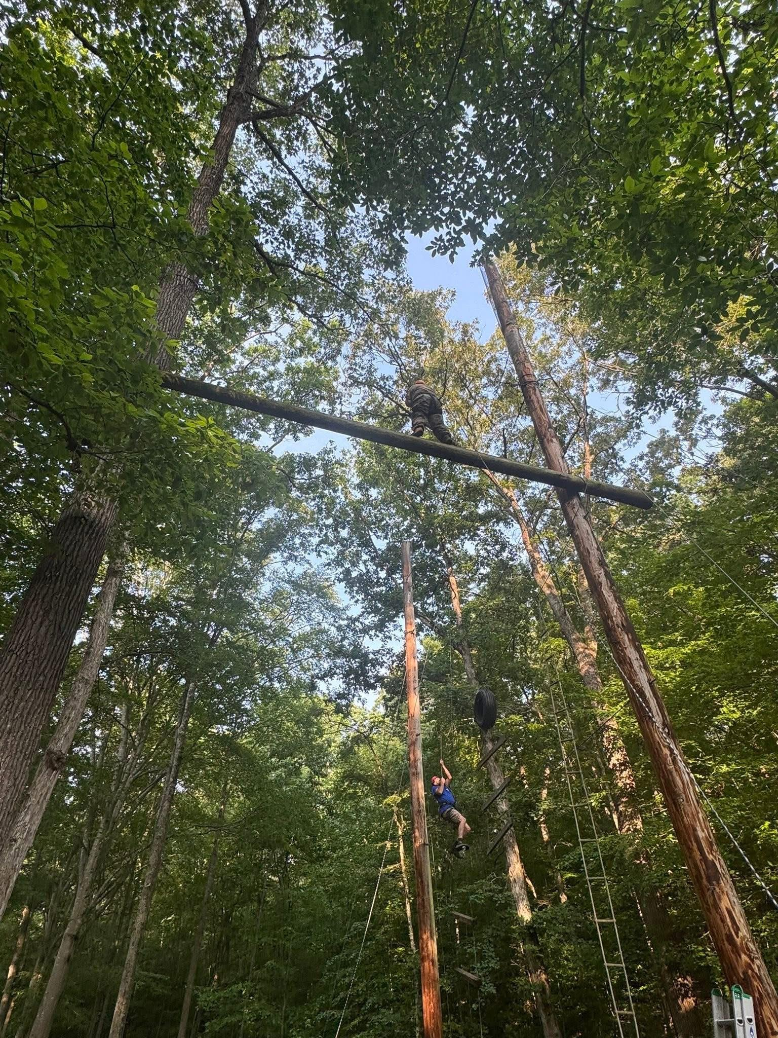
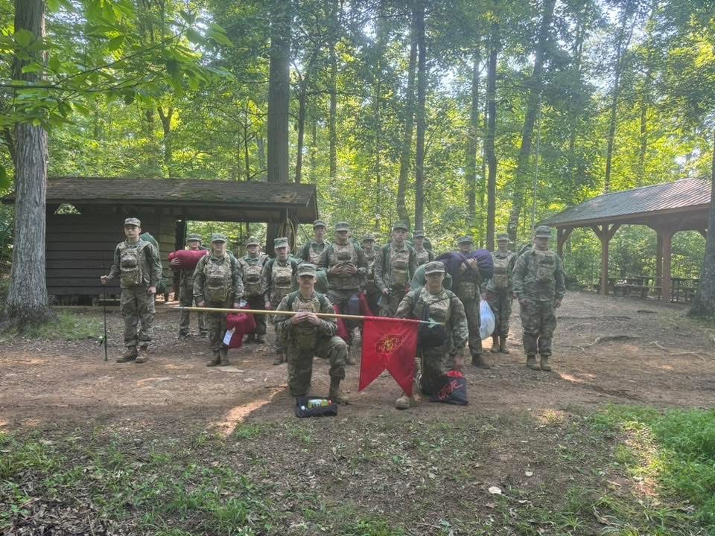
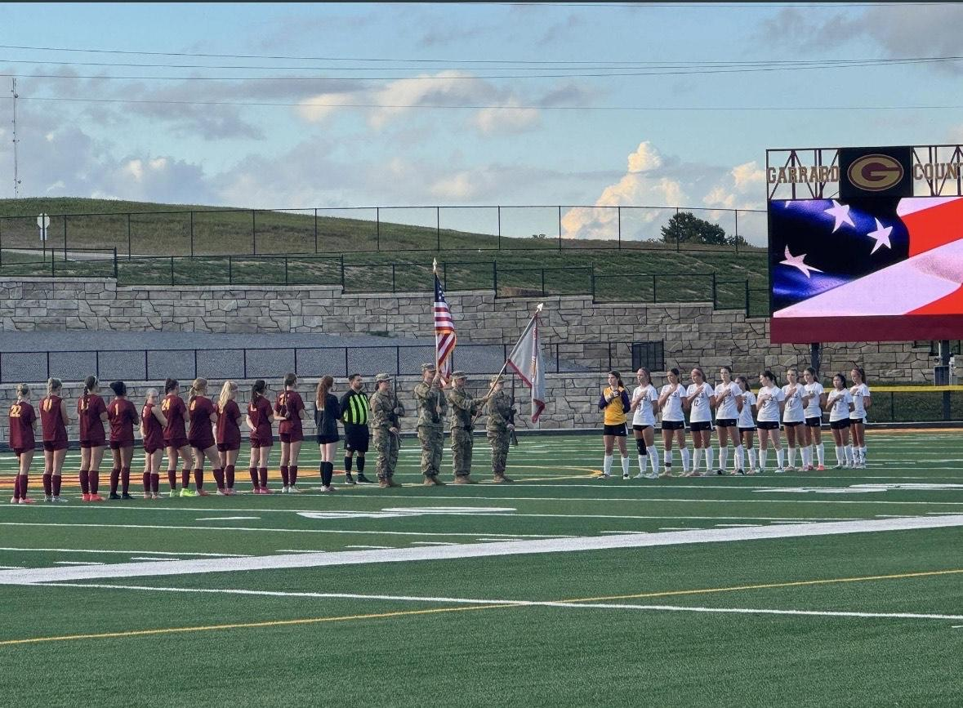
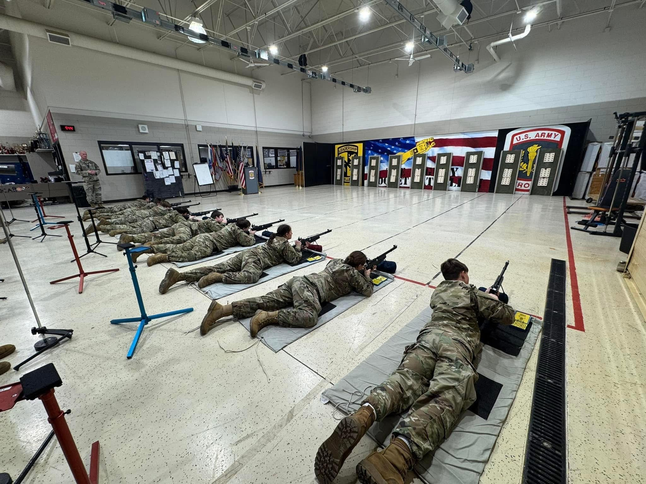
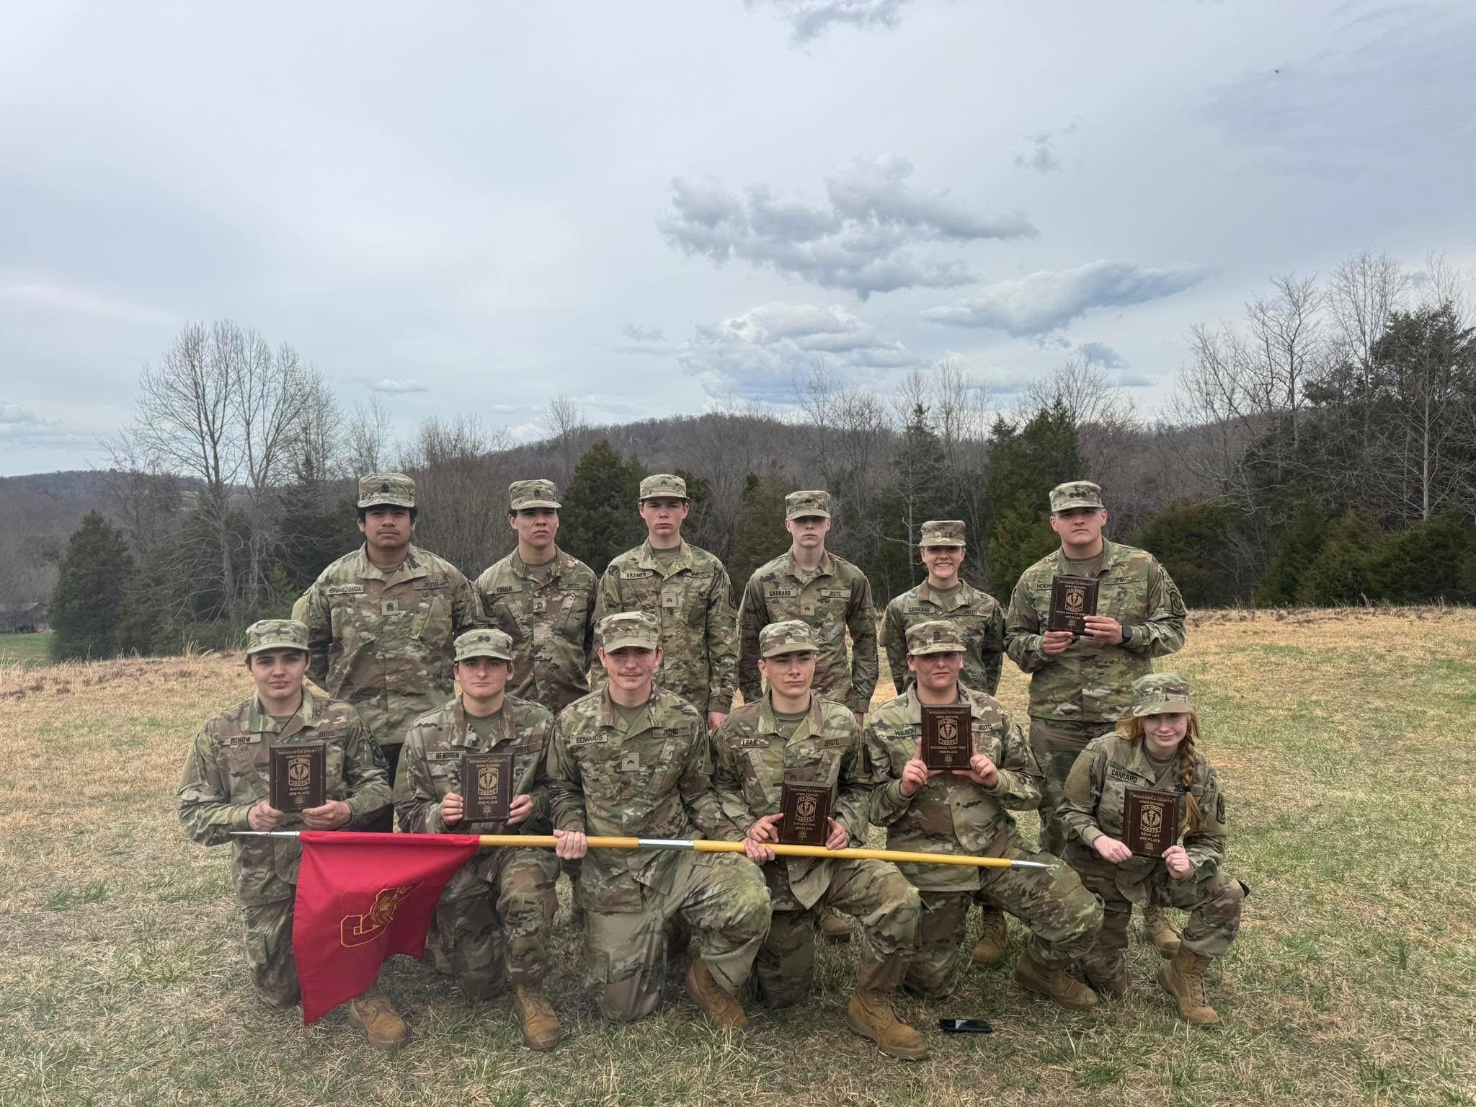
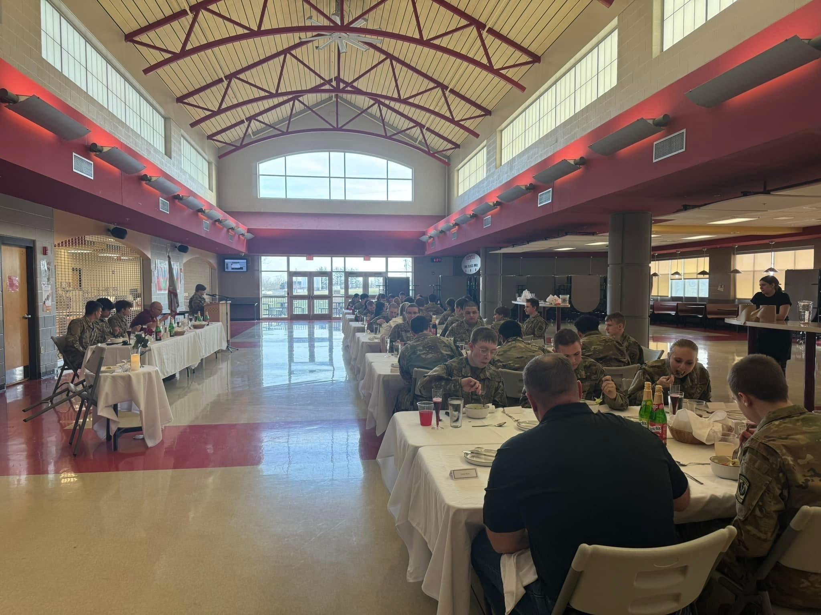
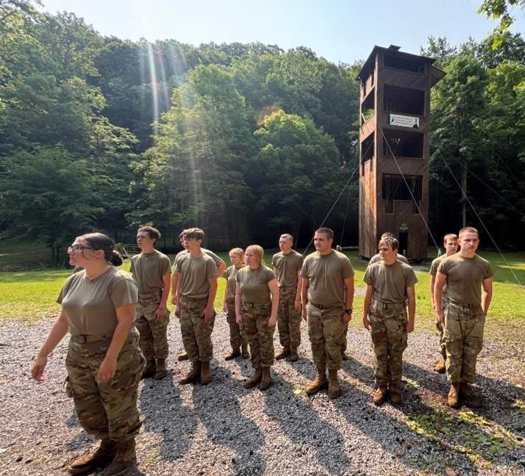
THANK YOU!

