Slide 1
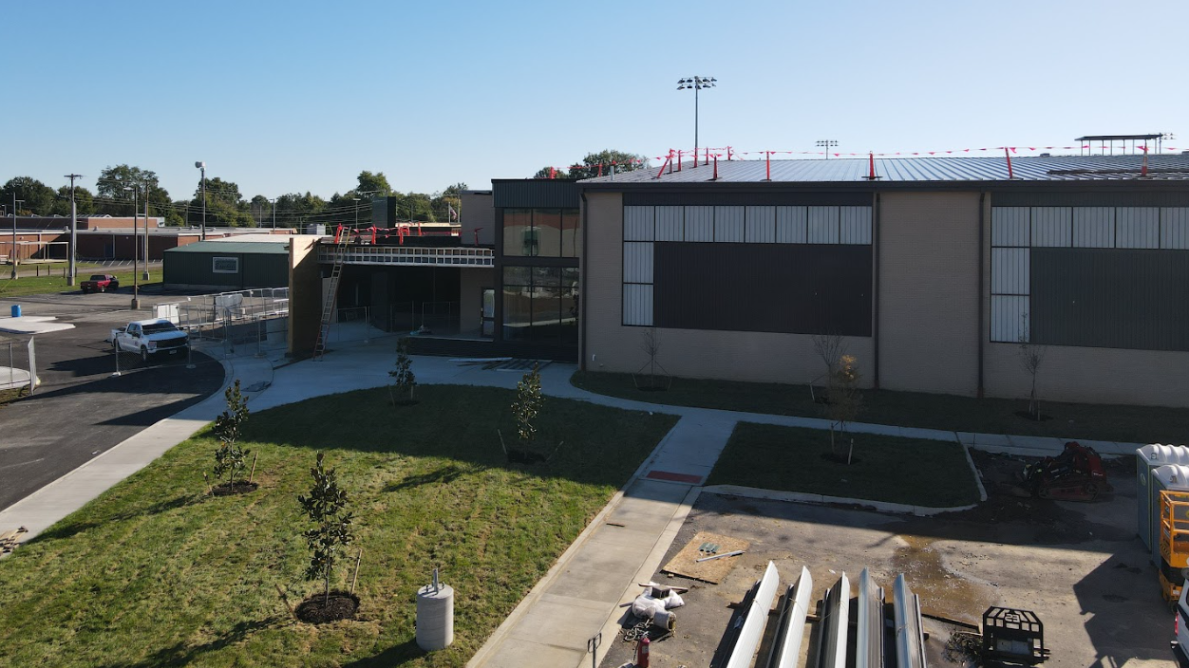


October 20th - Design and Construction Update

Slide 2
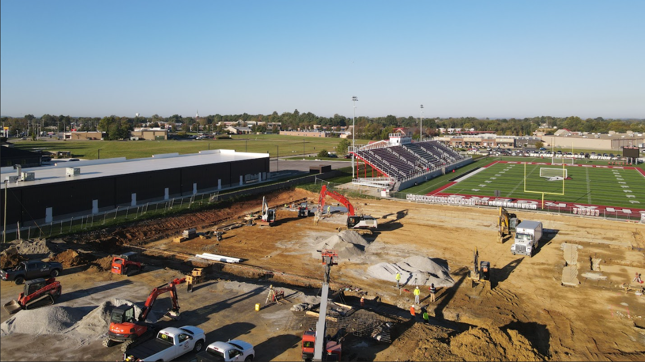


Phase 3 Athletics - Physical Science Centers
Bullitt East

Slide 3
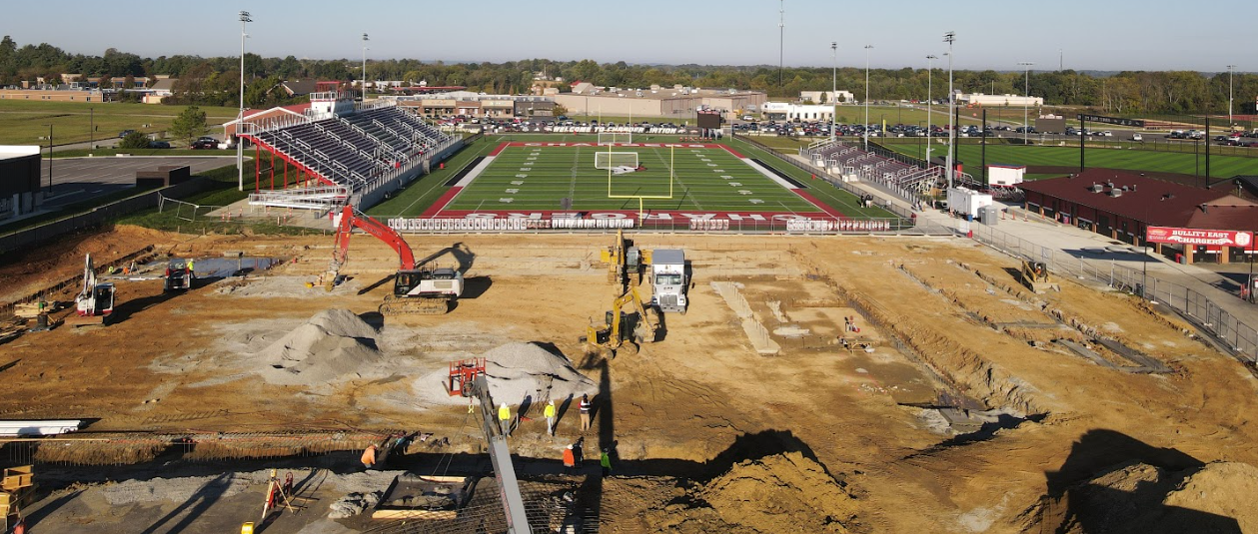
Phase 3 Athletics - Physical Science Centers
Bullitt East

Slide 4
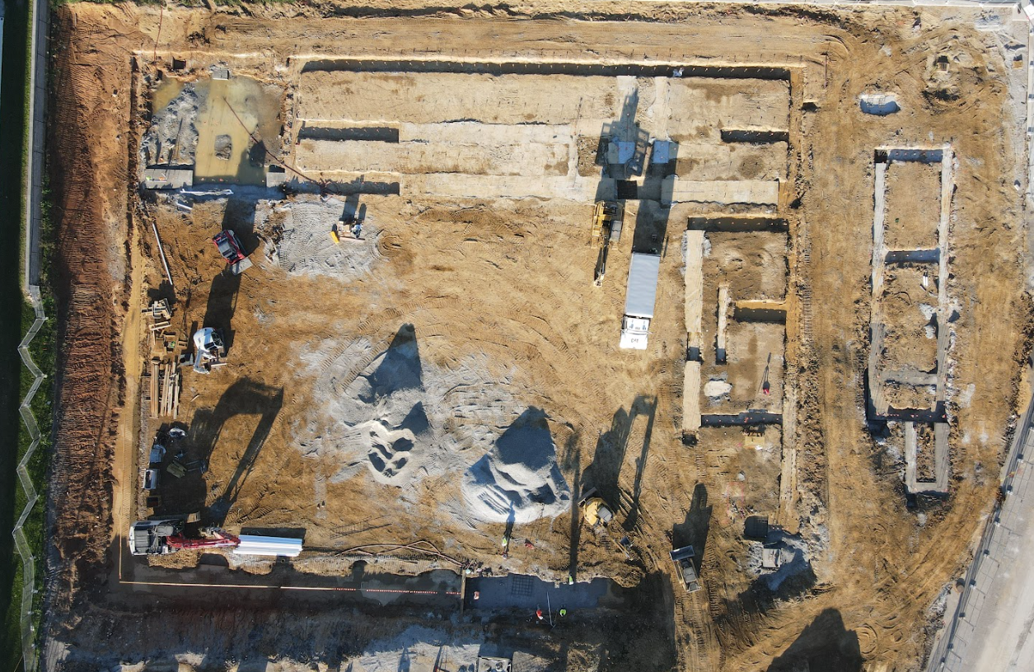
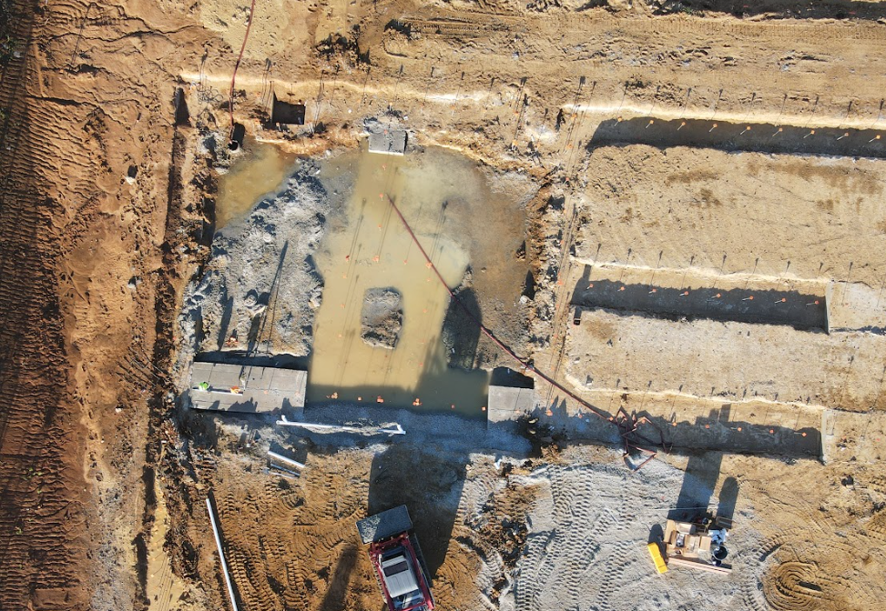
Phase 3 Athletics - Physical Science Centers
Bullitt East

Slide 5
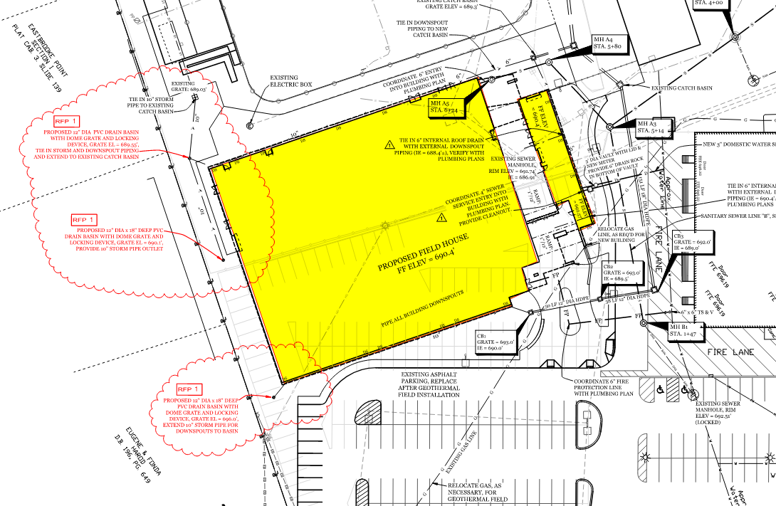
Phase III Athletics - Physical Science Centers - Bullitt East -
Change Order 03 - Added Inlets - $12,000.00 - Additional storm inlets are being recommended at the east side of the building to address storm water potential from the adjacent property.
Phase 3 Athletics - Physical Science Centers
Construction

Slide 6
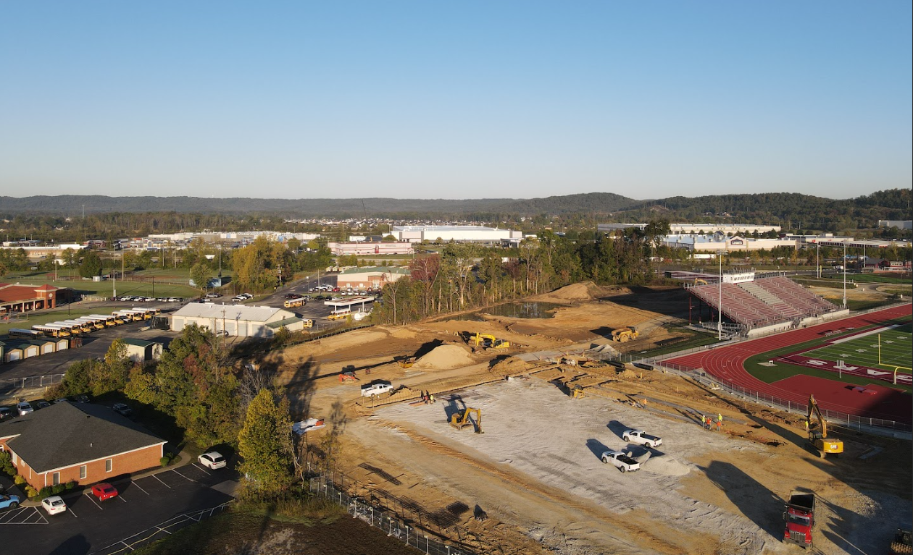
Phase 3 Athletics - Physical Science Centers
Bullitt Central

Slide 7
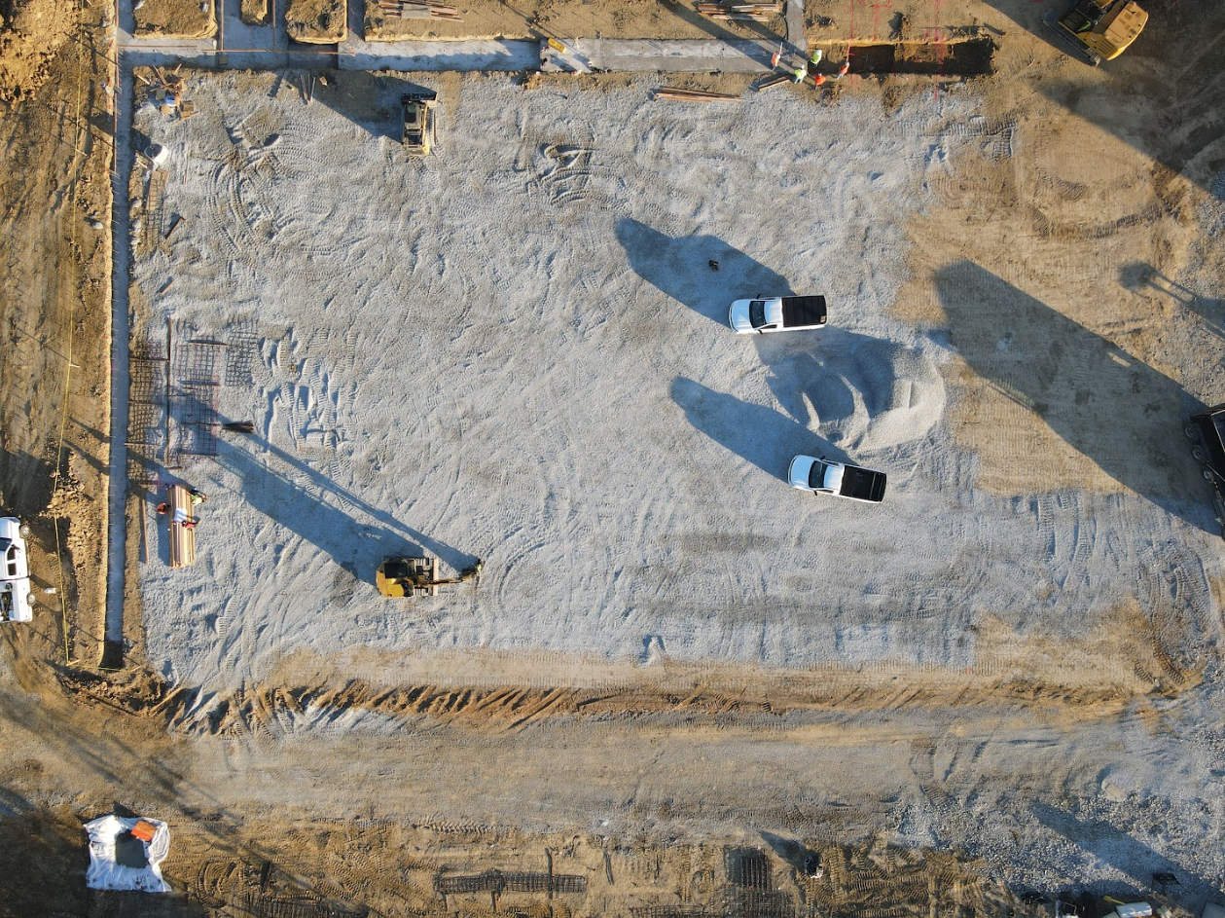
Phase 3 Athletics - Physical Science Centers
Bullitt Central

Slide 8
Phase III Athletics - Physical Science Centers- Bullitt Central -
Change Order 04 - Widening Access Road - $15,133.00 - BCPS Facilities requested the road that leads off campus be widened to better accommodate bus traffic. Work can occur in sequence with construction schedule and trades already on site. Contract unit prices are utilized for this Change Order.
Change Order 05 - Water Main Conflict - $7,115.50 - A water main that was not shown on a site survey or existing drawing had to be relocated due to a conflict with the designed storm system.
Change Order 06 - Roadway shift, Bollards - $4,944.00 - The new access road in front of facility needed to shift to make elevations work relative to the designed storm system. Additionally, two bollards are being recommended to protect a site electrical box that is 15'-0" from the edge of the new roadway.
Change Order 07 - Site Soil Remediation - $51,862.00 - This Change Order covers work to address unsuitable soils and subsurface water found below the building pad. Work was observed and quantified by the district's Special Inspector (UES) and contract unit prices were utilized. Work had to be done prior to foundations being placed.
Phase 3 Athletics - Physical Science Centers
Construction

Slide 9
Phase III Athletics - Physical Science Centers- Bullitt Central & Bullitt East - FACPAC Forms -
These change orders were presented and approved on the September 22, 2025 board meeting. However, the FACPAC forms were not available at that time. Attached please find the FACPAC forms which outline the costs of the change orders as well as the associated architect fees.
Bullitt Central PSC
BP1 - BCHS PSC - FACPAC - Change Order 01 - Fencing Swap - VOID Stephens Pipe DPO
BP1 - BCHS PSC - FACPAC - Change Order 01 - Fencing Swap
BP1 - BCHS PSC - FACPAC - Change Order 02 - Road Inlet Modifications
BP1 - BCHS PSC - FACPAC - Change Order 03 - Unsuitable Soil Overage
BP1 - BCHS PSC - FACPAC - Lee to Quikrete - Material Swap - Decrease to Lee DPO
G701-2017 - Change Order BCHS DPO Net Zero Swap - Lee to Quickrete - Rev Signed - Vendor provided their signature on this Document.
Bullitt East PSC
BP1 - BEHS PSC - FACPAC - Change Order 01 - Fencing Swap - VOID Stephens Pipe DPO
BP1 - BEHS PSC - FACPAC - Change Order 01 - Fencing Swap
BP1 - BEHS PSC - FACPAC - Change Order 02 - Temporary Netting (Note: Temporary netting will be paid through the maintenance office general fund budget.)
BP1 - BEHS PSC - FACPAC - Lee to Quikrete - Material Swap - Decrease to Lee DPO
G701-2017 - Change Order BEHS DPO Net Zero Swap - Lee to Quickrete - Rev Signed
Phase 3 Athletics - Physical Science Centers
Construction

Slide 10
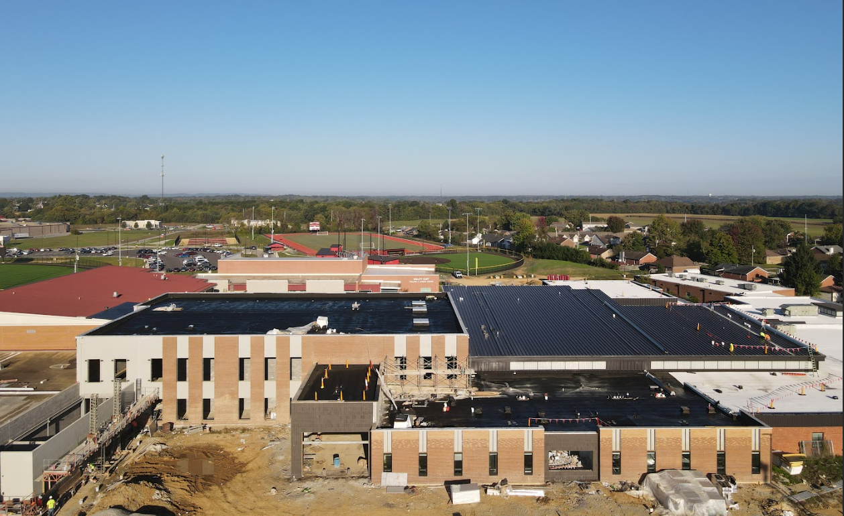
Bullitt East High School - Construction

Slide 11
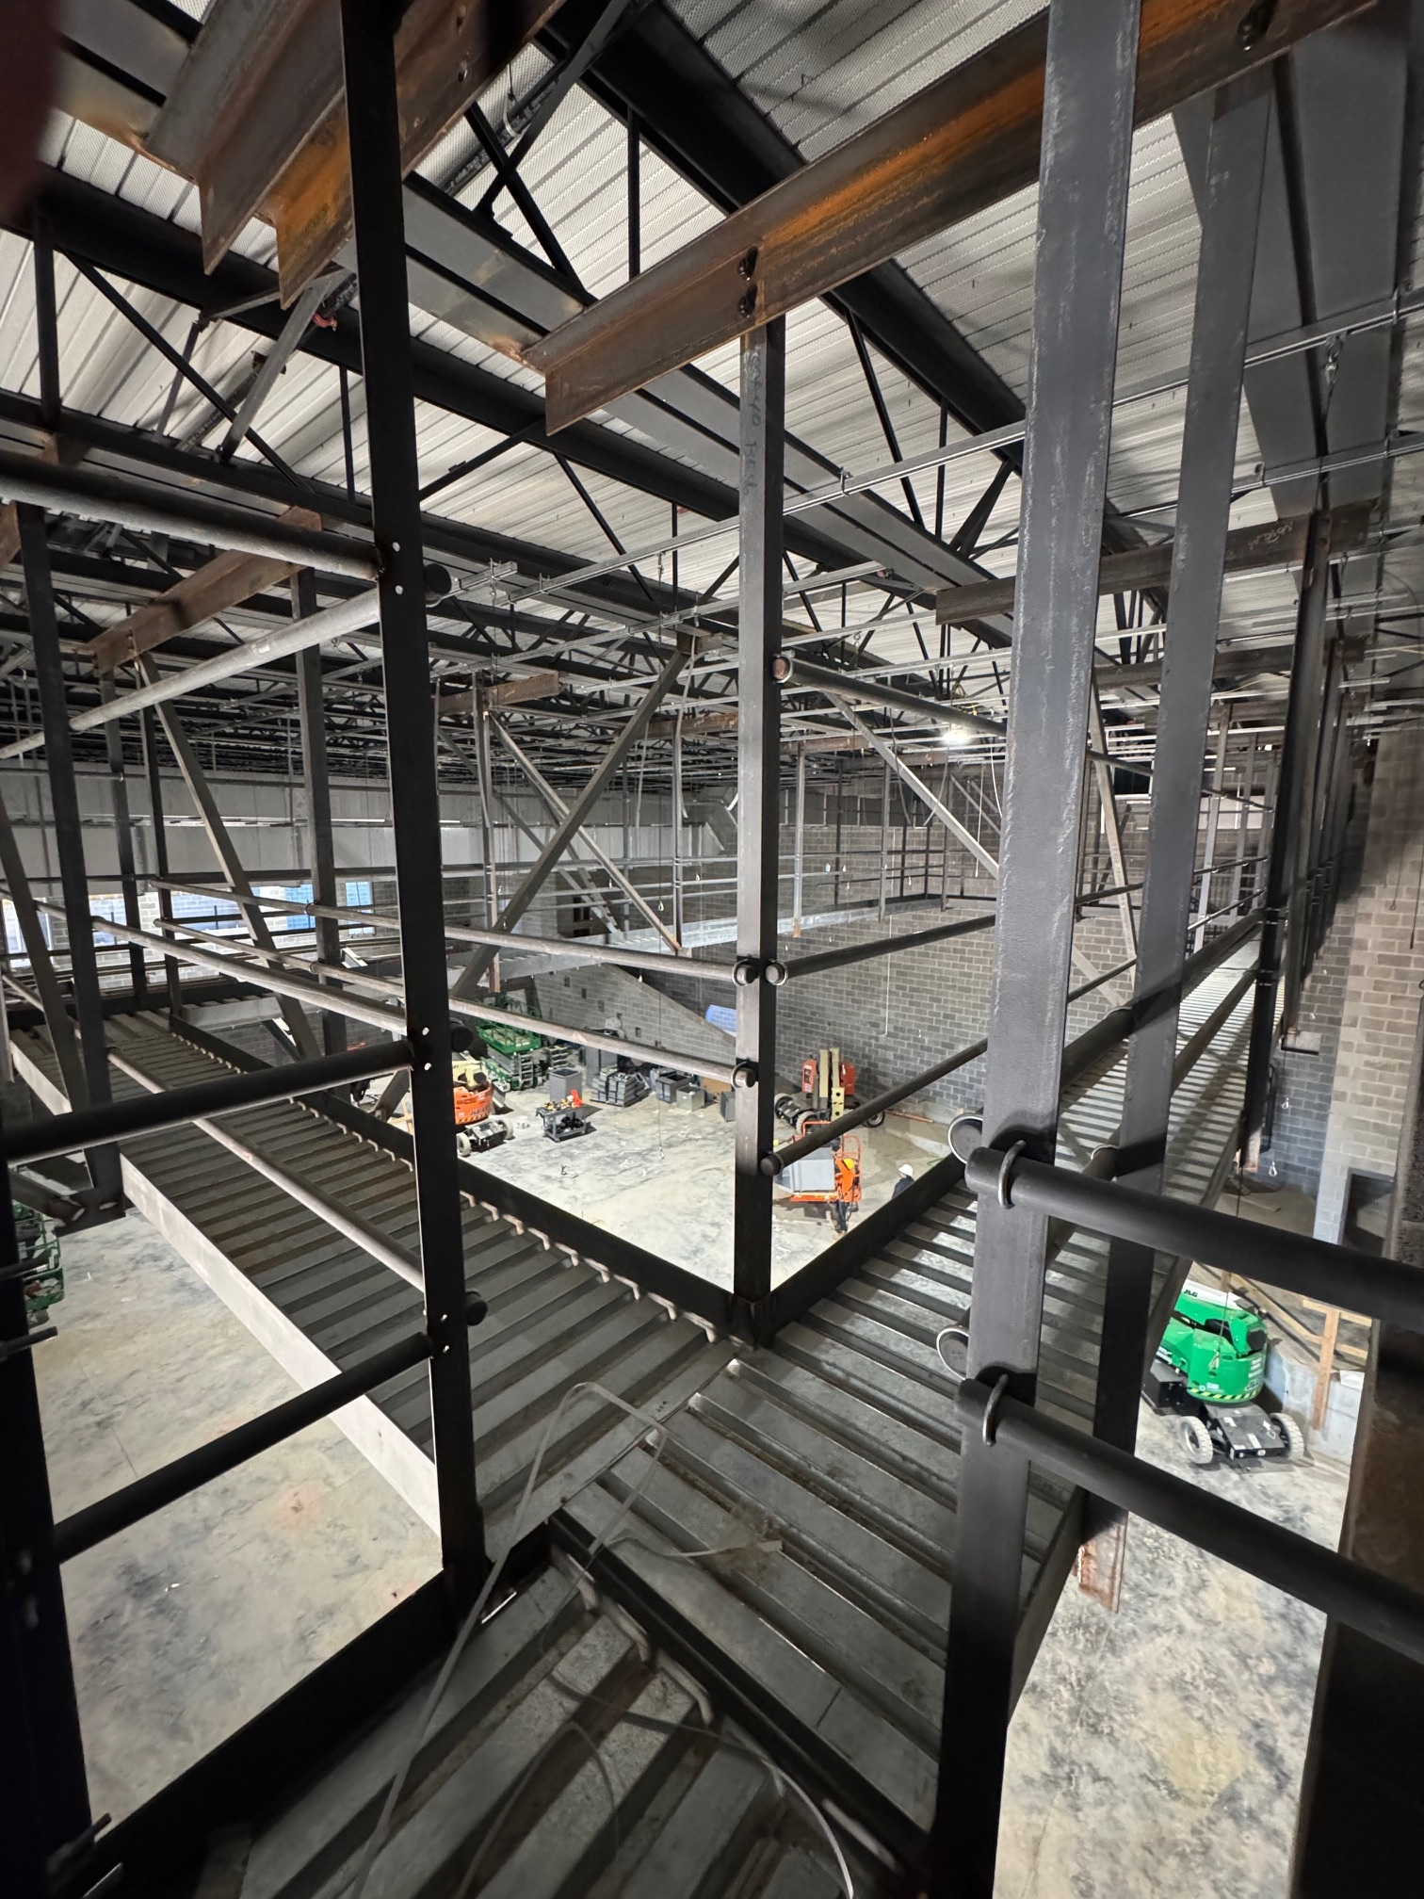
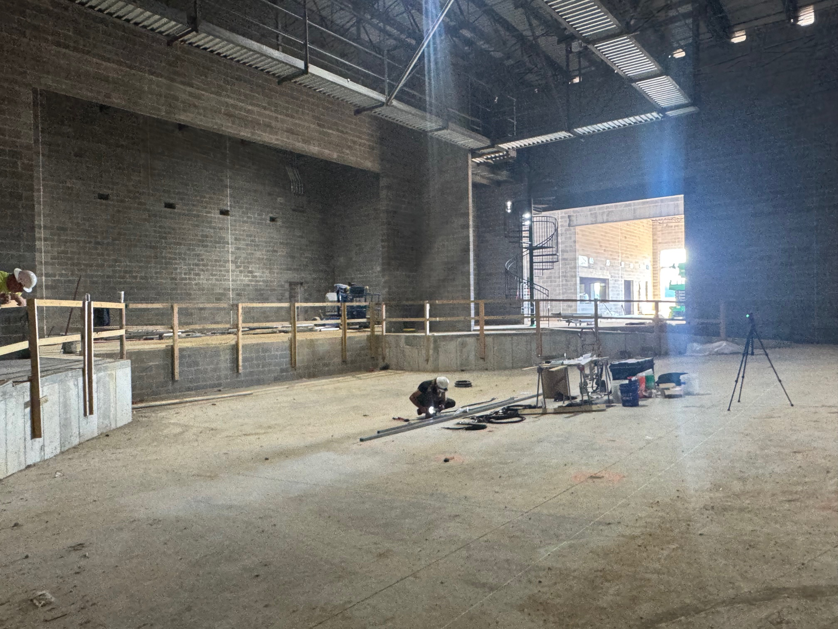
Bullitt East High School - Construction

Slide 12
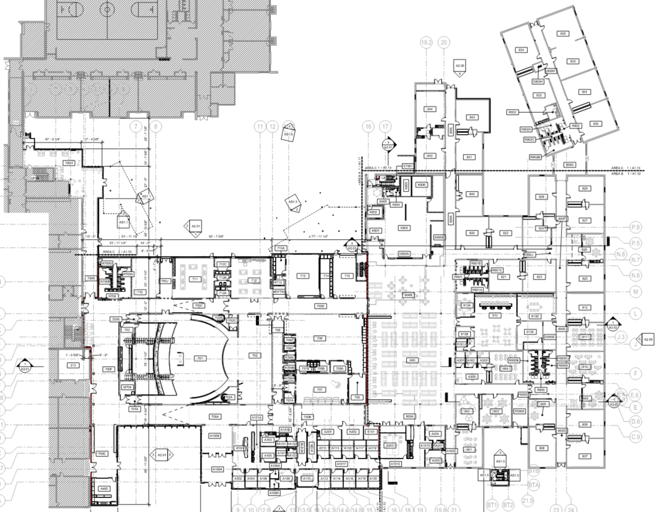
Area B
Construction Timeframe:
Anticipated Completion - May 2026
Furniture Delivery - June 2026.
Area C - Continuing
Area A
Bullitt East High School Construction

Slide 13

Phase 2 Athletics
NBHS Physical Science Center

Slide 14
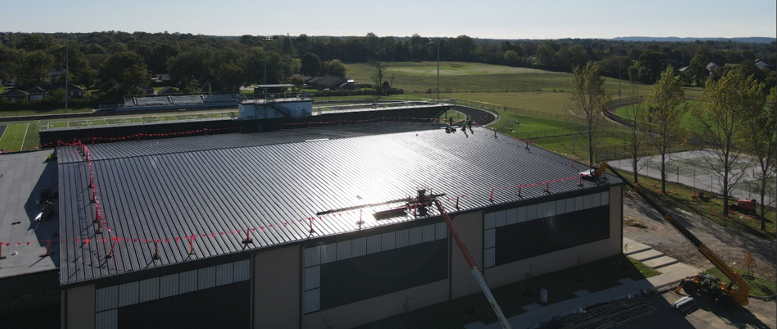
Phase 2 Athletics
NBHS Physical Science Center

Slide 15
Board Consent Items - Bid Package No. 2 - North Bullitt Physical Science Center
Change Order 22 - Chain Link Fencing at Ballfield Condenser Units - $10,386.00 - BCPS Facilities requested chain link fencing be added around each exterior condenser unit at the concession buildings at all three high schools. Work can occur with trades currently contracted to perform work and avoid the cost of additional mobilization.
Change Order 23 - Interior Framing and Finishing - $3,508.00 - Framing and gypsum wall board is being added at the soccer coach's office and men’s locker room to enclose the area below the stair landing to finish out the space and allow for sprinkler piping to be hidden from view. Also, a floor finish was not specified at the elevator cab, this change order covers the cost of material and install of that finish.
Phase 2 Athletics
NBHS Physical Science Center

