Slide 1
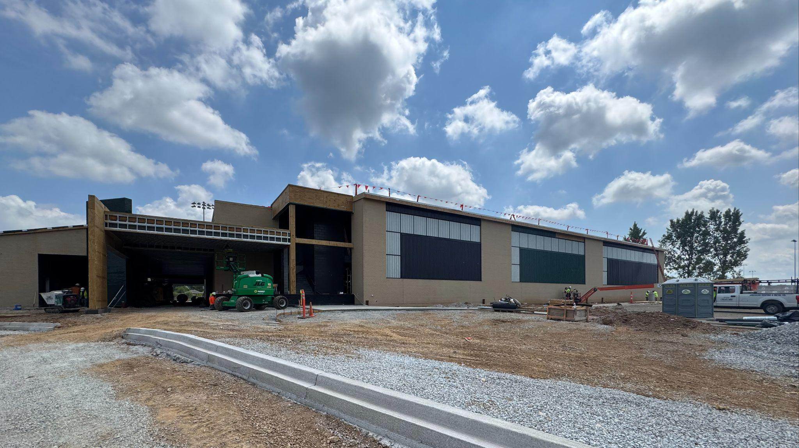



August 25th - Design and Construction Update

Slide 2
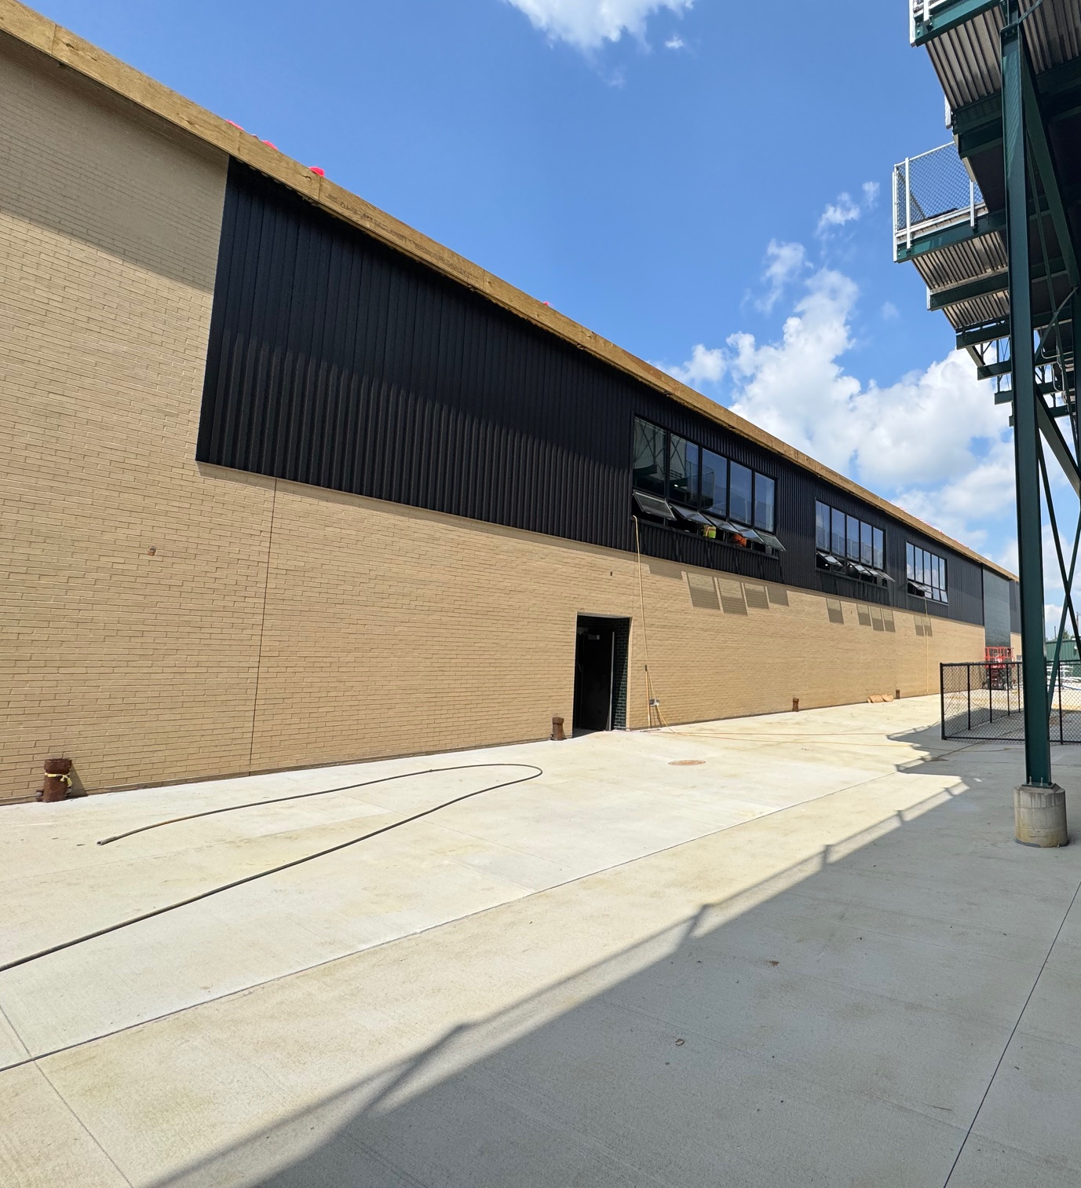
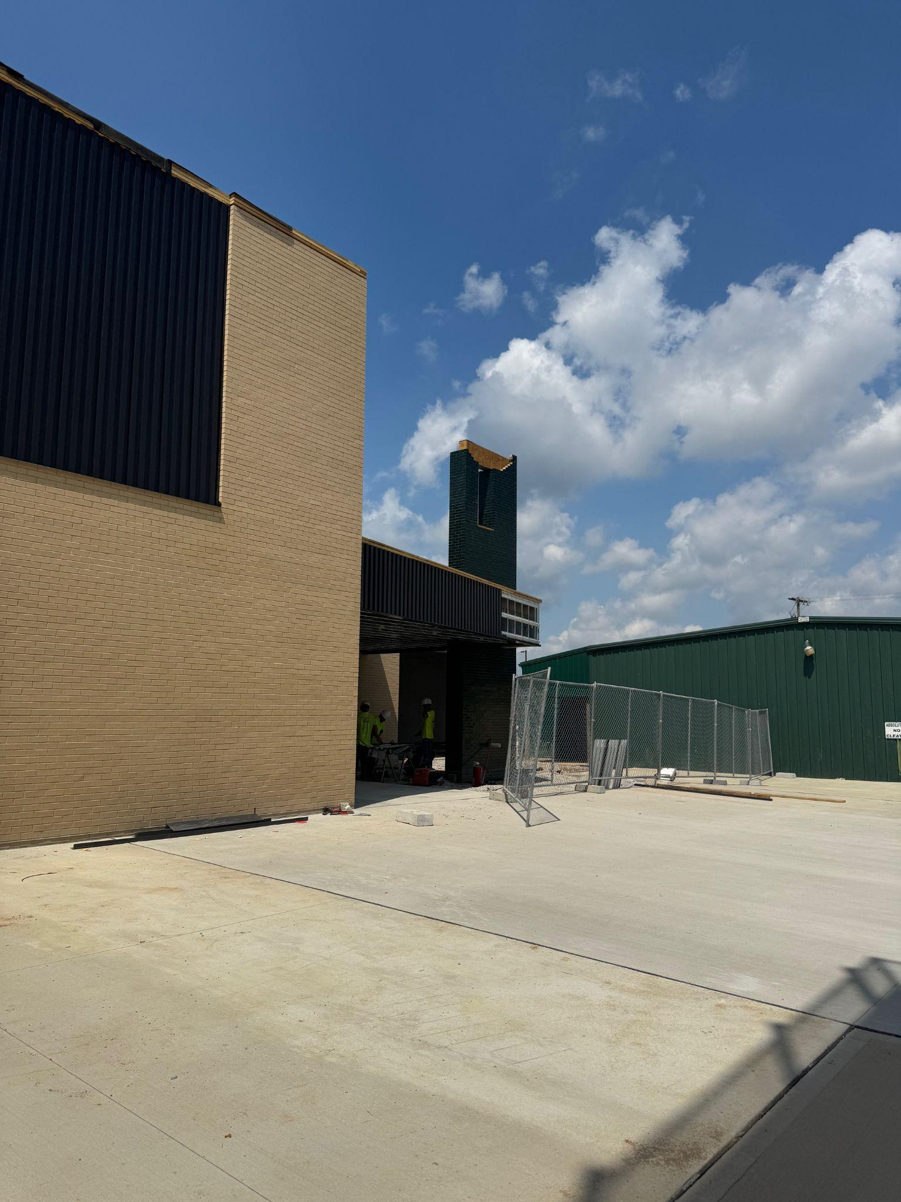
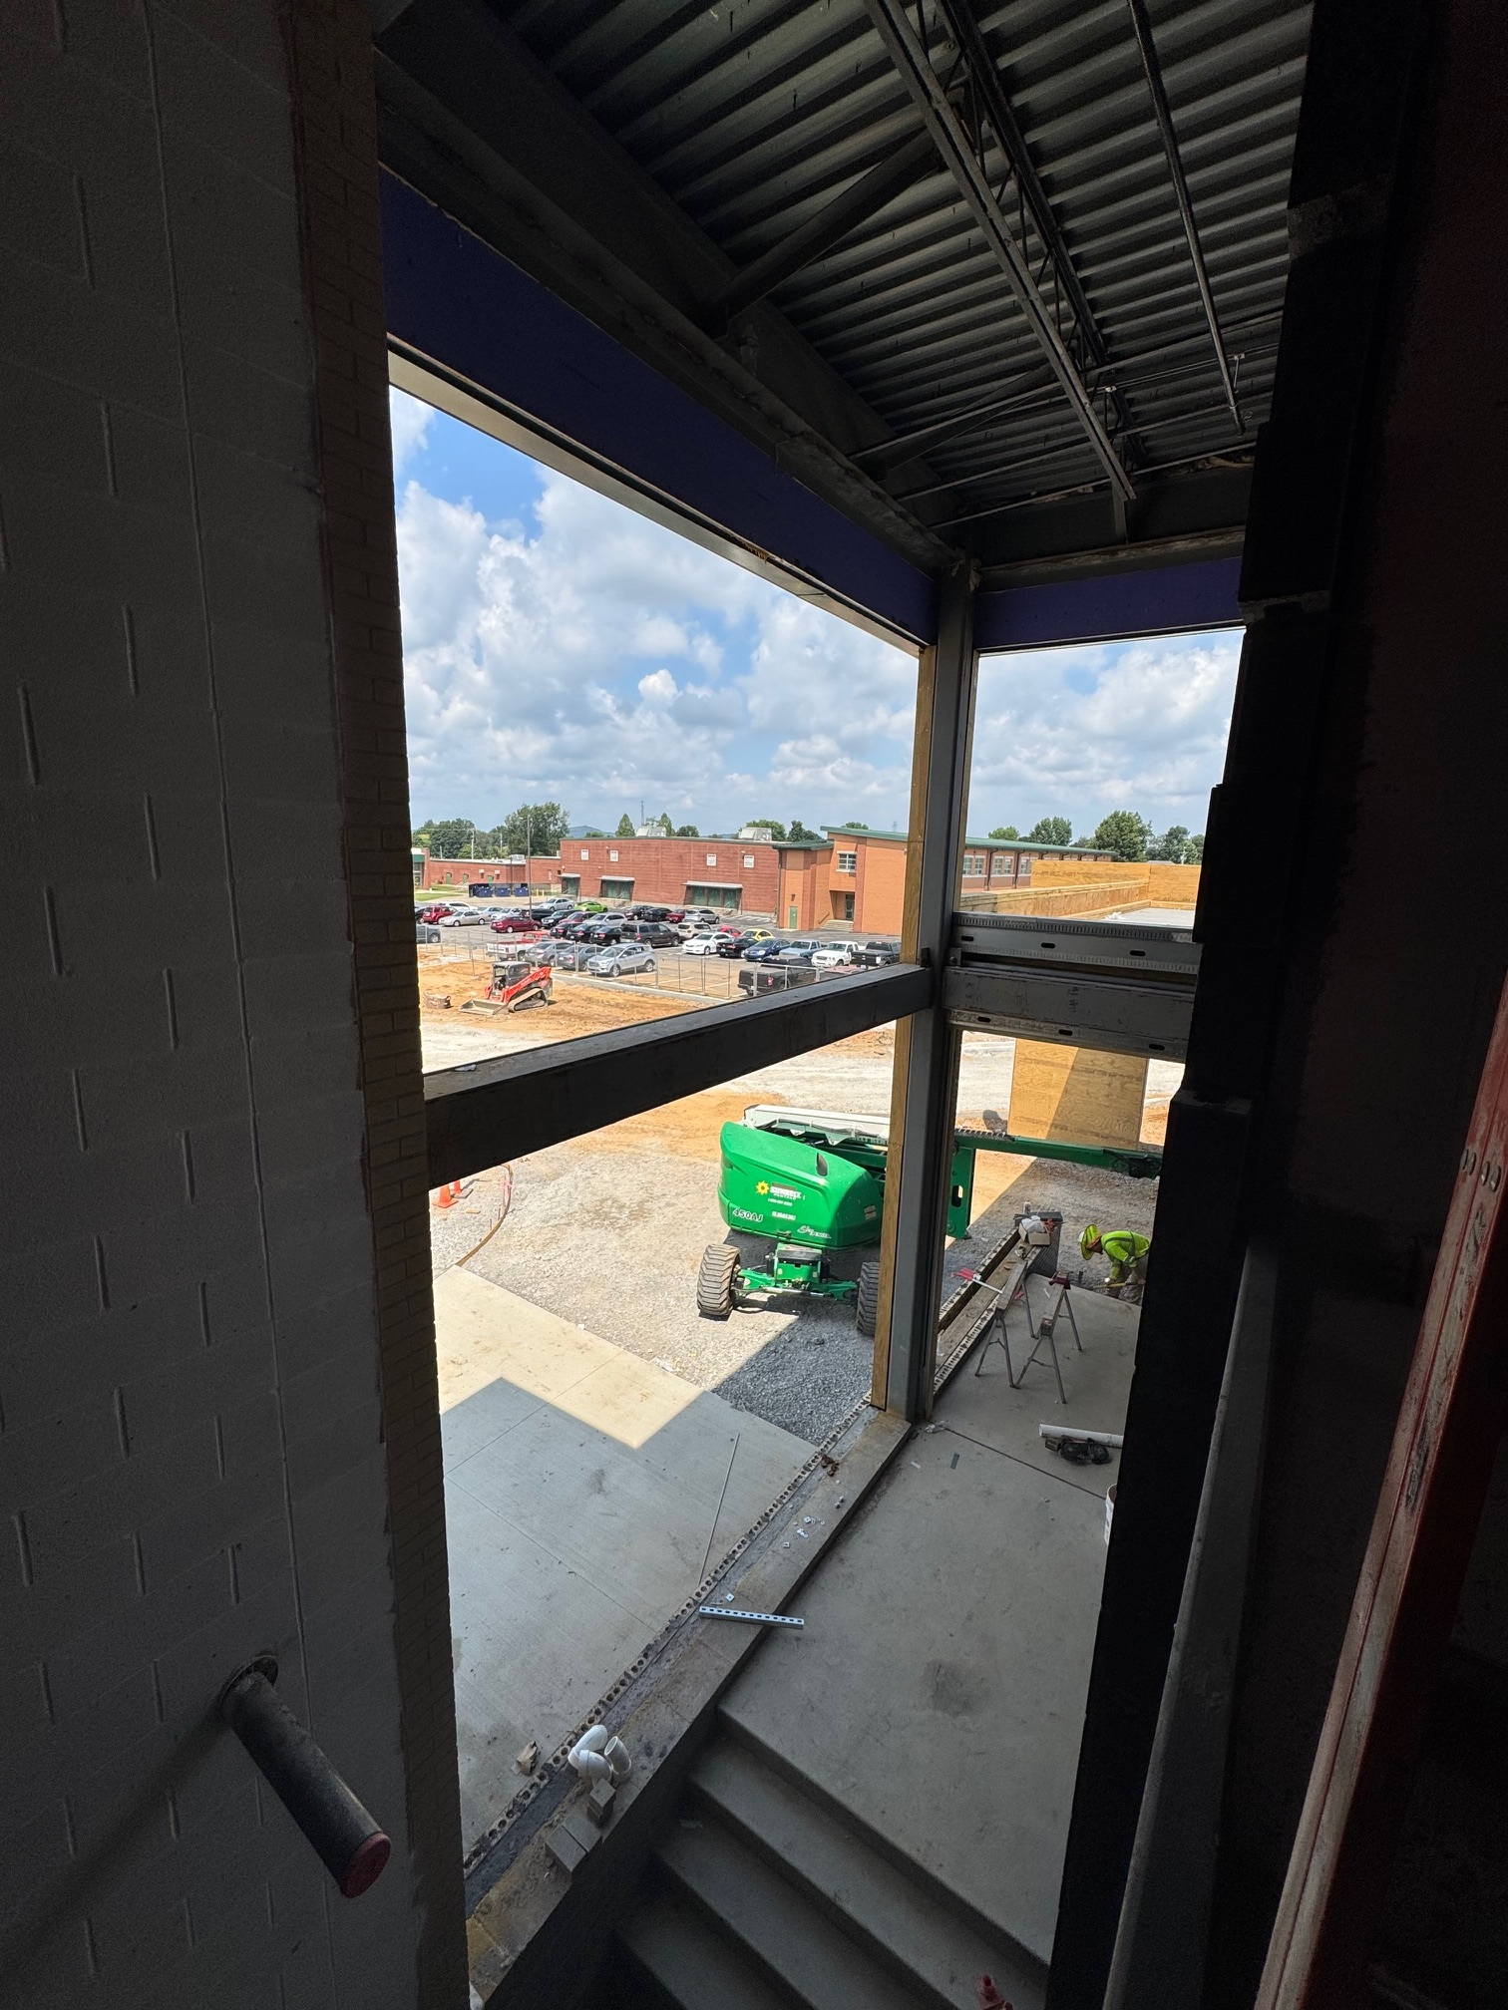

Phase 2 Athletics
NBHS Physical Science Center

Slide 3
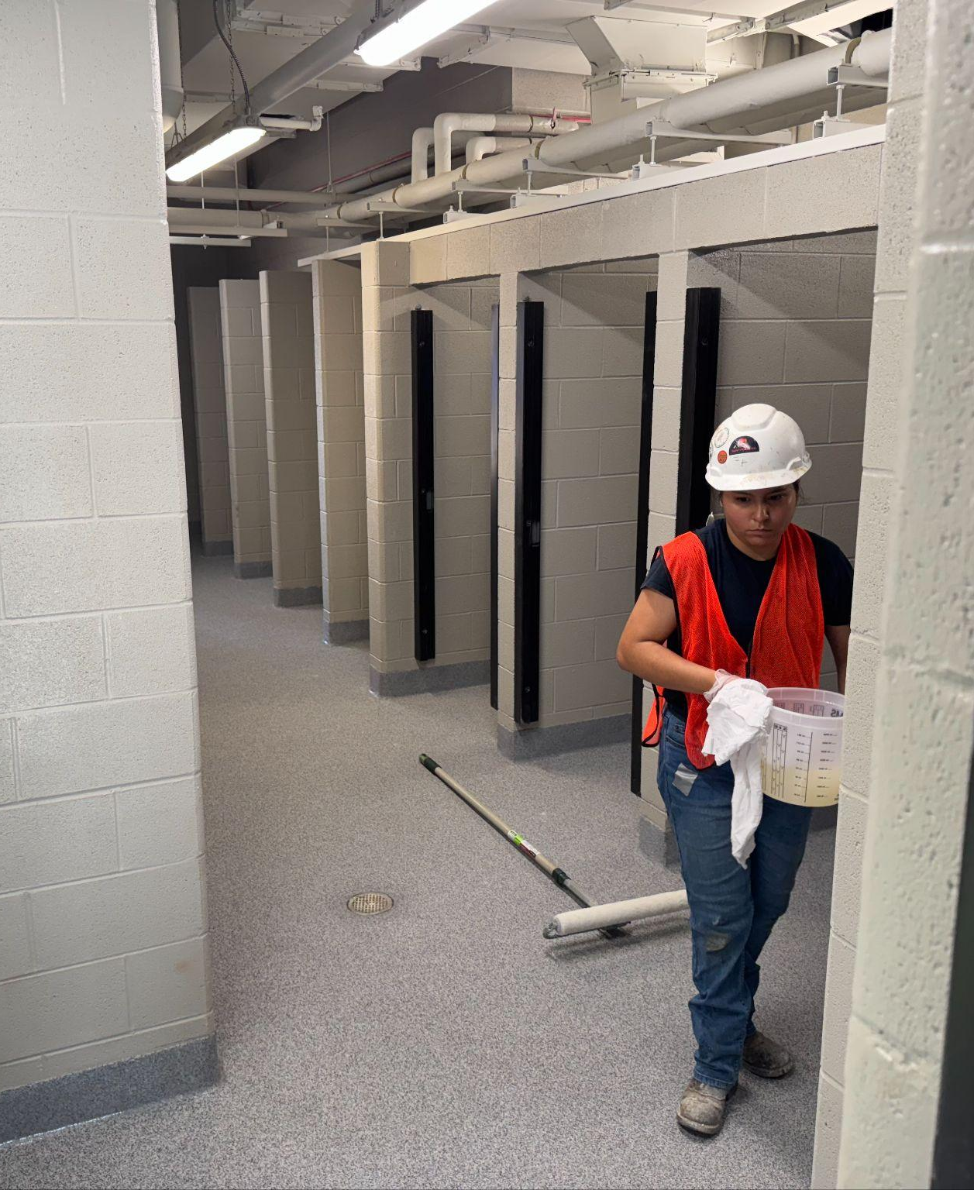
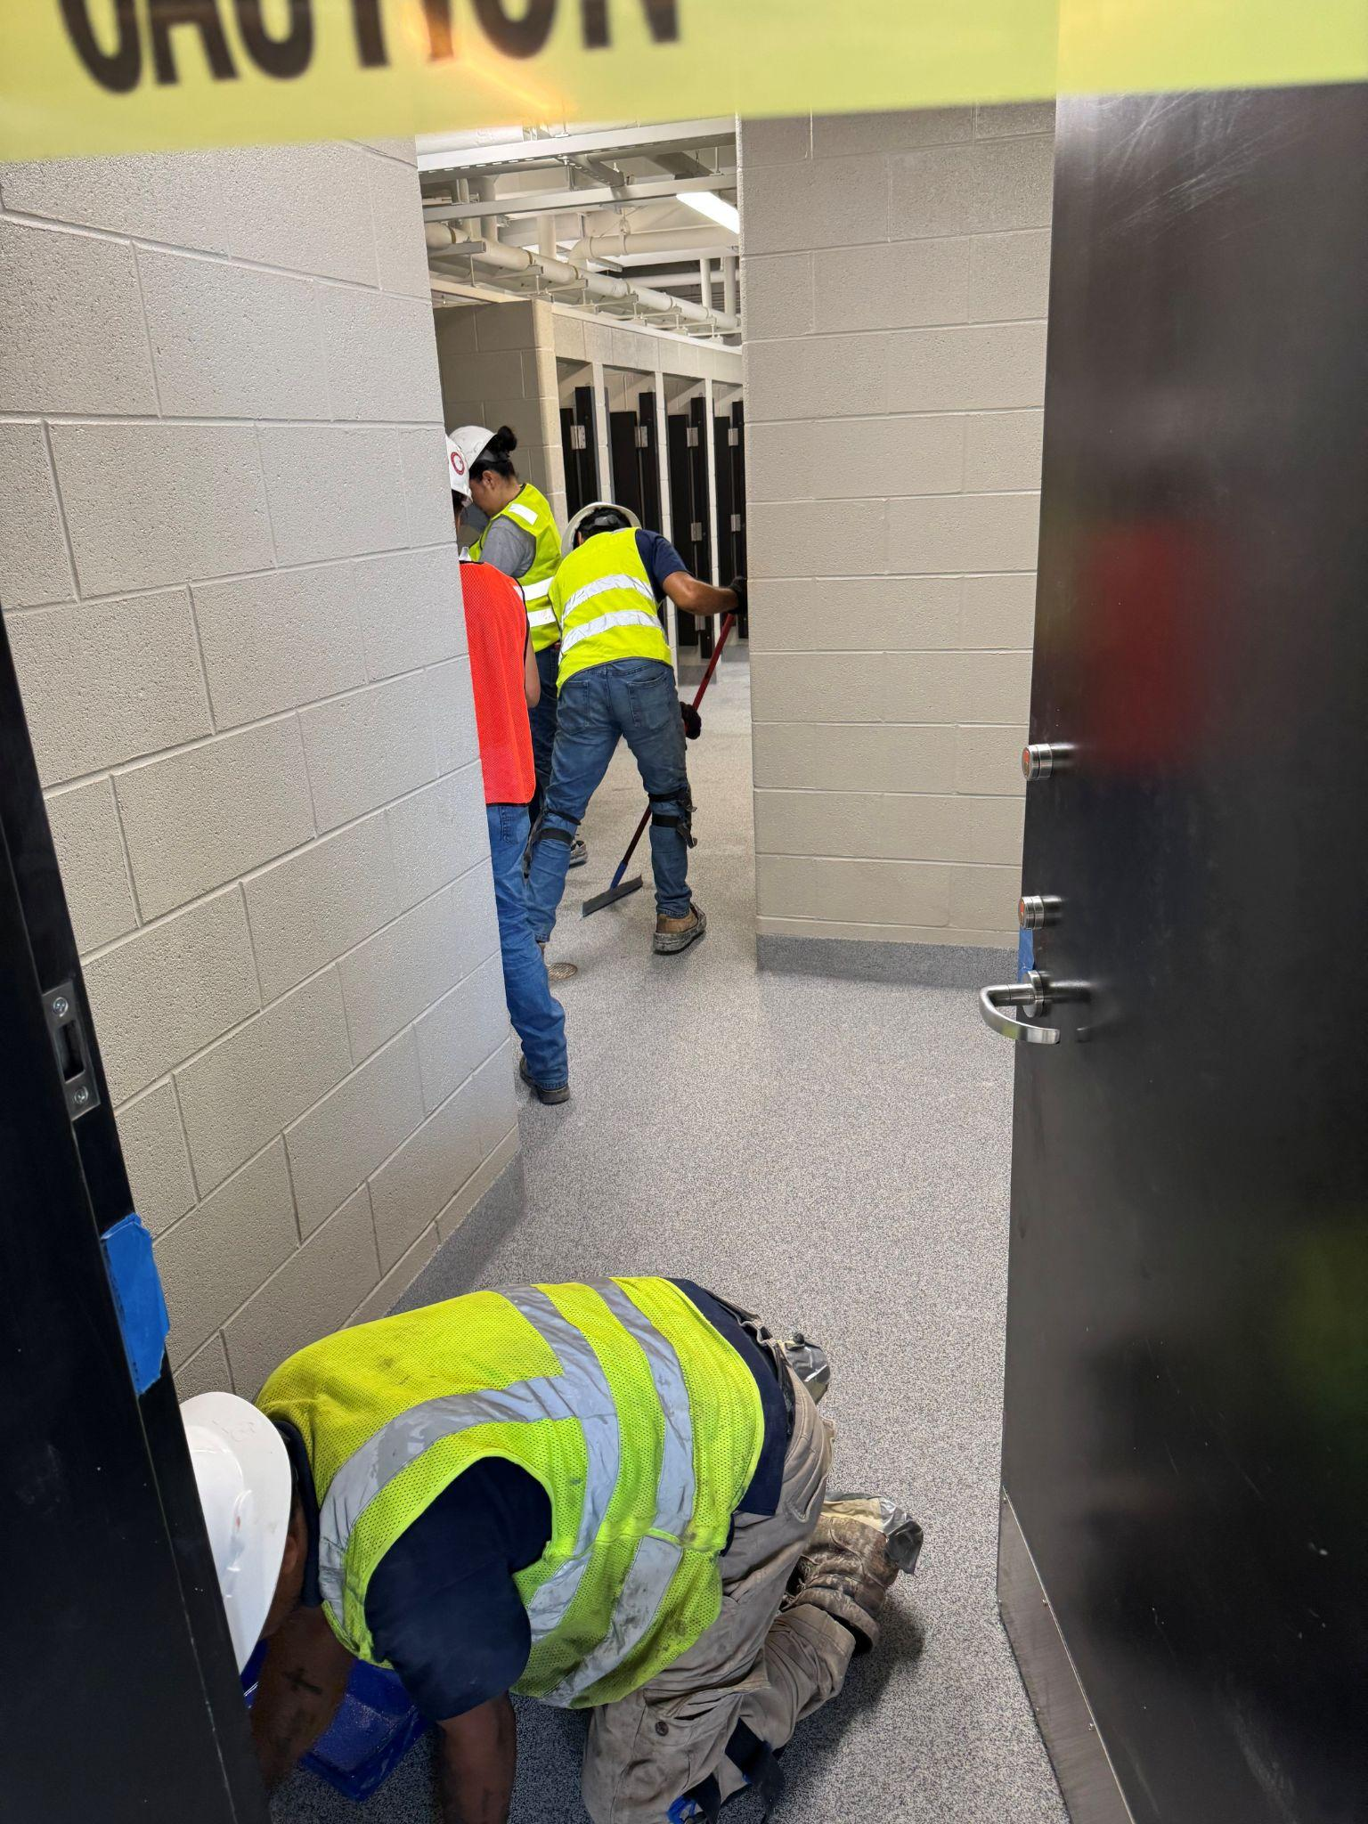
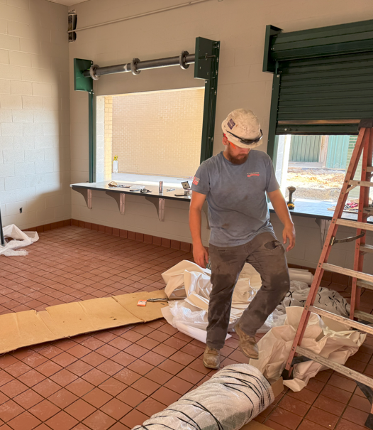
Phase 2 Athletics
NBHS Physical Science Center

Slide 4
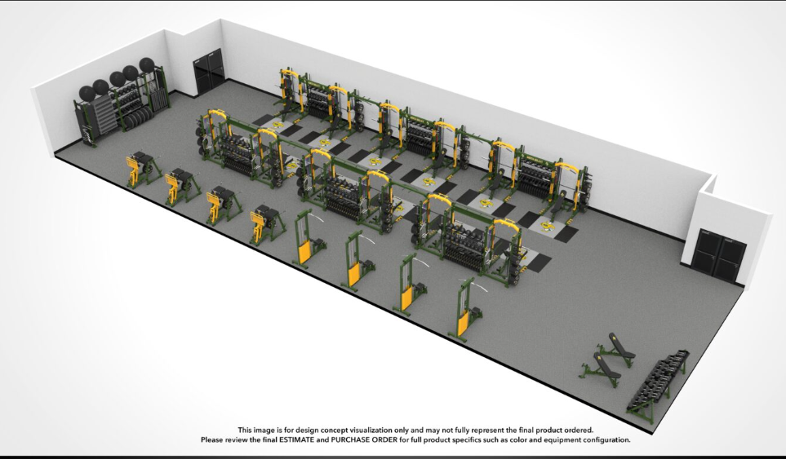
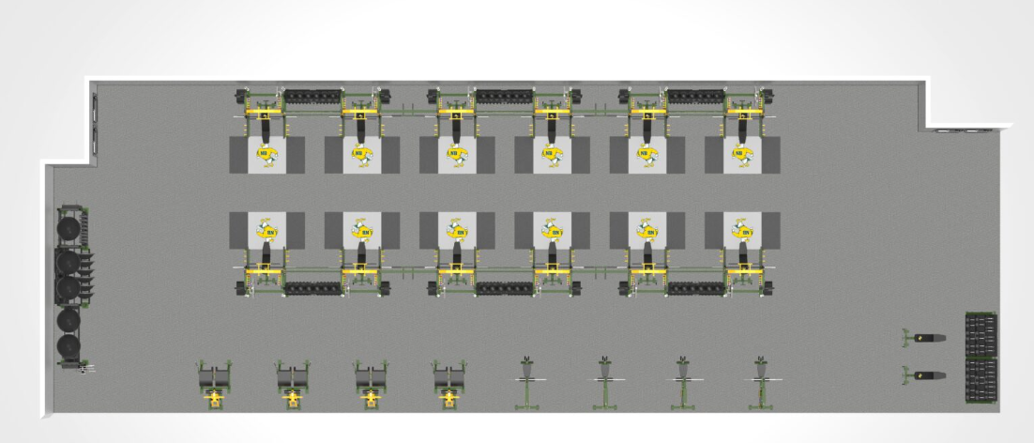
Board Consent Items - Bid Package No. 2 - North Bullitt Physical Science Center
Change Order 13 - Omitted Weight Room Flooring
$29,758.00 Credit - Weight room flooring is being omitted and replaced with an outside vendor’s flooring.
This change order deducts the cost of installation of the resilient flooring originally specified and documented. There is a separate change order for the omission of flooring materials attached to this change order.
NBHS Athletics and BCPS Facilities has been working with Direct Fitness for provision of the flooring with logos.
A PO in the amount of $74,904.60 has been issued directly to Direct Fitness Solutions for provision of branded weight room flooring and installation.
Phase 2 Athletics
NBHS Physical Science Center

Slide 5
Board Consent Items - Bid Package No. 2 - North Bullitt Physical Science Center
Change Order 14 – Laundry Room Revisions -
$68,063 (+$9,362 + $2,901.13) = $80,326.13 - BCPS Facilities requested the laundry room be revised to accommodate commercial laundry equipment instead of the residential grade laundry equipment originally documented. This change order also includes the cost of the commercial washer and dryer.
Change Order 15 - Added Nailer Board
$3,243 - Additional wood blocking is required at the roof parapet cap to maintain a proper flashing height above the modified bitumen roof. This change was reviewed by Garland (the roof warranty holder) and agreed with the change.
Phase 2 Athletics
NBHS Physical Science Center

Slide 6
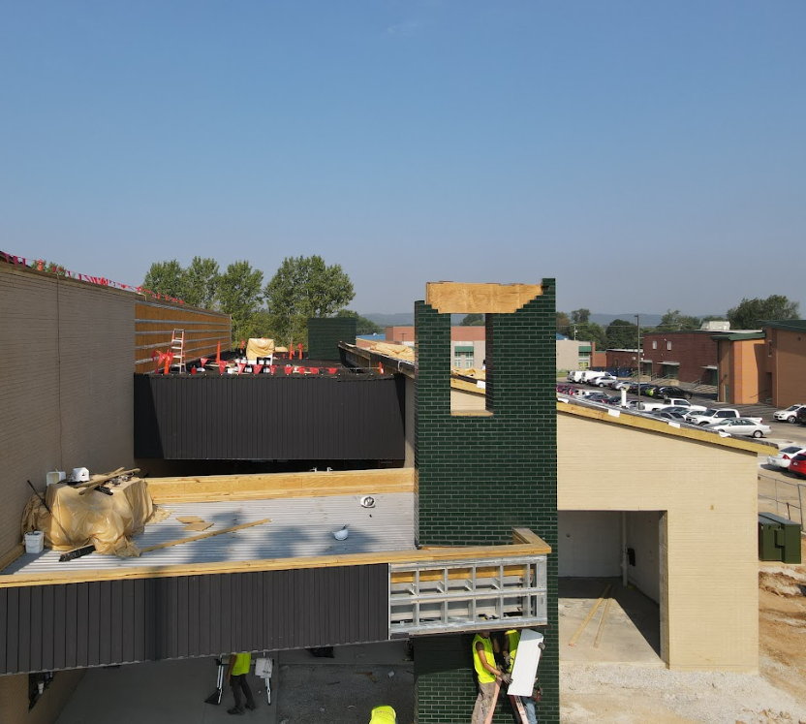
Board Consent Items - Bid Package No. 2 - North Bullitt Physical Science Center
Change Order 16 - BCHS New Parking Lot Numbering
$2,000 - BCHS Administration requested the Contractor number the parking spaces to allow them to assign them to students on the first day of school.
Schiller DPO Change Order - Added Locker Locks
$9,245 - BCPS Facilities requested combination locks on all lockers inside the Physical Science Center in lieu of padlock hasps. This request was made before lockers were fabricated.
Phase 2 Athletics
NBHS Physical Science Center

Slide 7
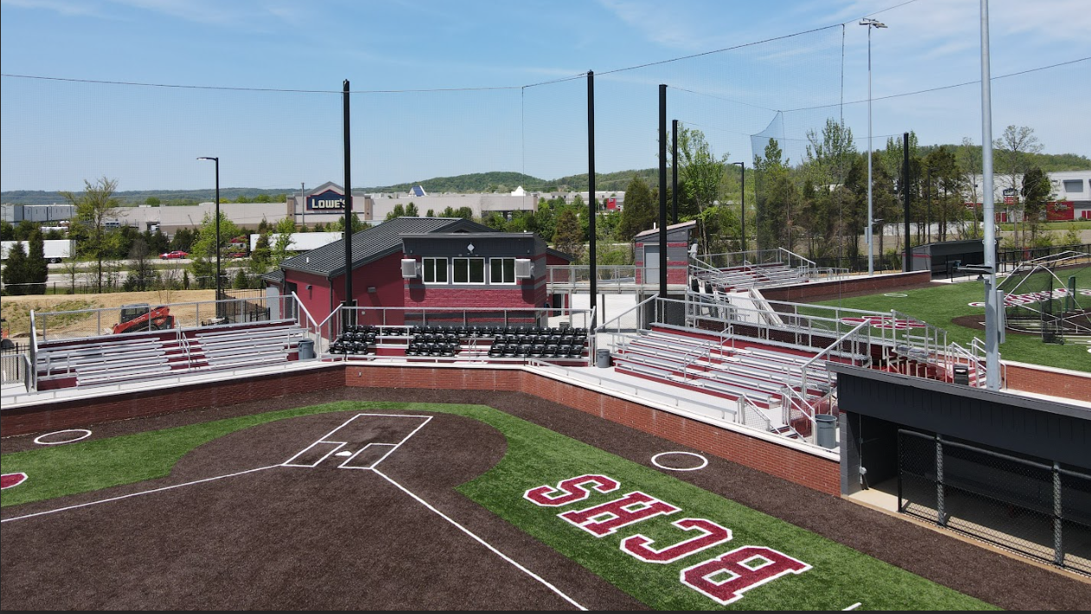
Phase 2 Athletics
Baseball and Softball

Slide 8
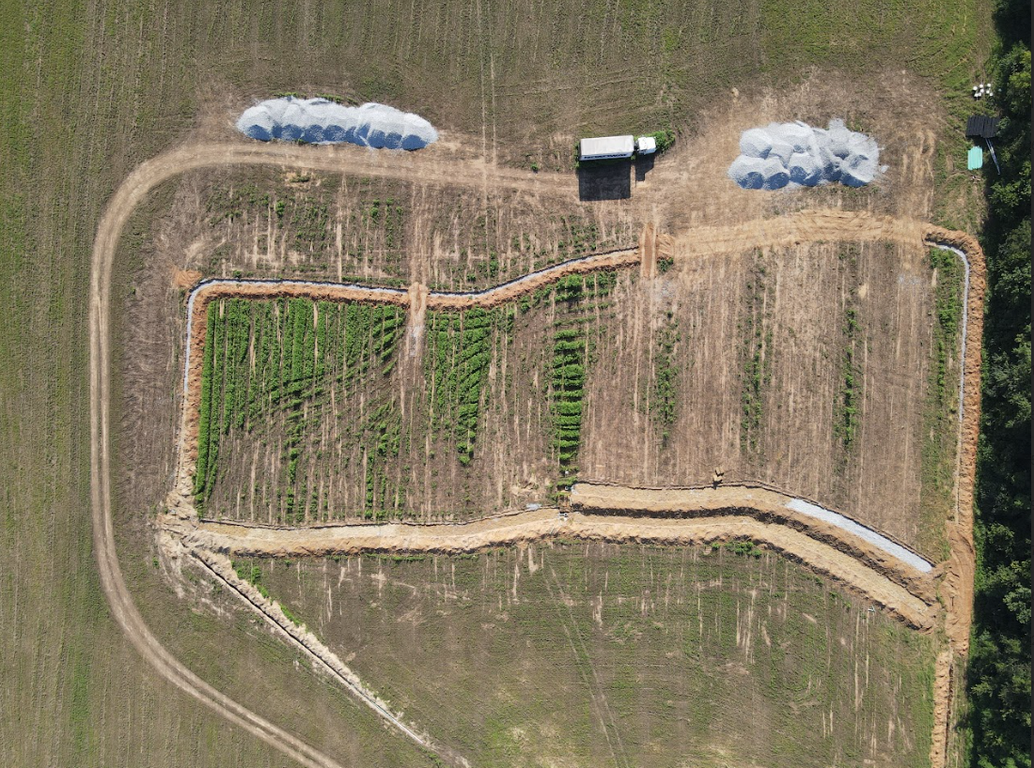
Board Consent Items - Bid Package No. 1 - Baseball and Softball
Final Punch Inspections
Inspections occurred on 8-6-2025 and correction work is happening now.
Septic Field
Lateral field installation will be completed at the end of the week. Remaining work is the electrical work at the tank pump.
Change Order 29 - Ferguson DPO Swap -
This Change Order transfers $50,000 to the GC contract and removes the same amount of material costs from the DPO for two sewage ejector pumps.
Phase 2 Athletics
Baseball and Softball

Slide 9
Board Consent Items - Bid Package No. 1 - Baseball and Softball
Change Order 30 - Miscellaneous Site Revisions, Inspector Comments and Soil Remediation
$ 48,499.00 - This change order includes several revisions across all three sites to capture miscellaneous revisions required by local inspectors, code review and final site completion. Change Order Requests included are:
COR 64 - NBHS - Added Silt Fence at Septic Field - $913.00 - Requirement of City for stormwater control around the septic field construction.
COR 65 - BCHS - Overage over Soil Allowance - $24,732 - Work to remediate soils below the new parking lot exceeded the Allowance for unsuitable soils meant for the baseball/softball field project. This overage accounts for work beyond the allowance and was verified by BCPS third party special inspector, S&ME.
COR 68 - BEHS Berm - $13,333 - BCPS Leadership requested the topsoil stockpile be reshaped at the outfield of the softball field to buffer the field from neighboring properties and provide a spectator viewing area.
COR 69 - BEHS Clubhouse Ramp - $9,521 - The City of Mt Washington's building inspector cited the building for not having an accessible means of entry/egress into the clubhouse and required provision of a ramp and handrails before a final Certificate of Occupancy would be issued.
Phase 2 Athletics
Baseball and Softball

Slide 10
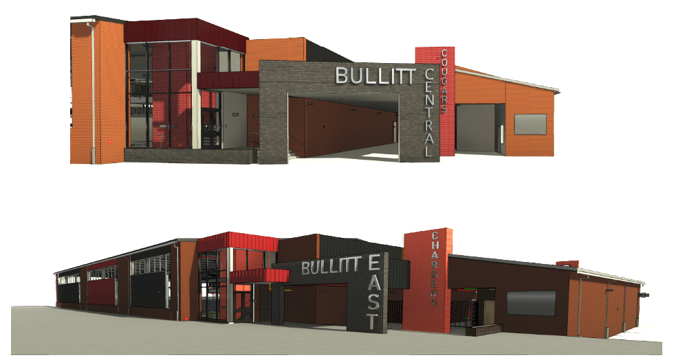
Phase 3 Athletics - Physical Science Centers
Bullitt Central and Bullitt East

Slide 11
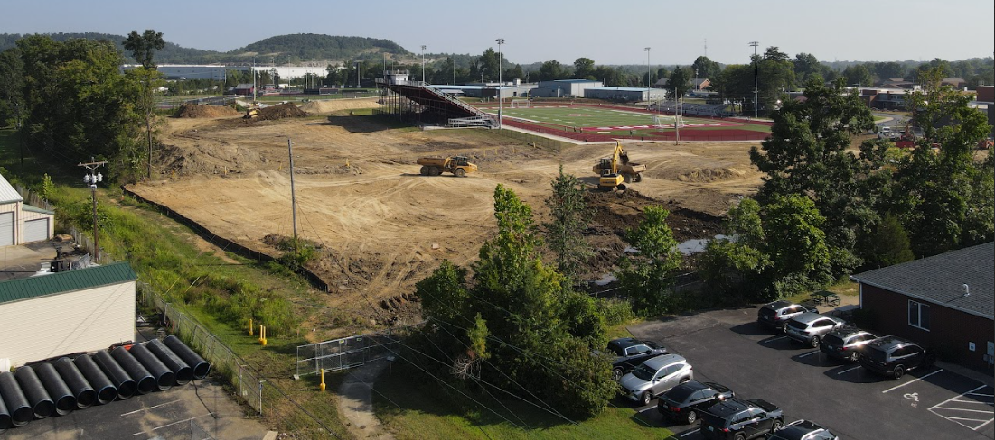
Phase 3 Athletics - Physical Science Centers
Construction

Slide 12
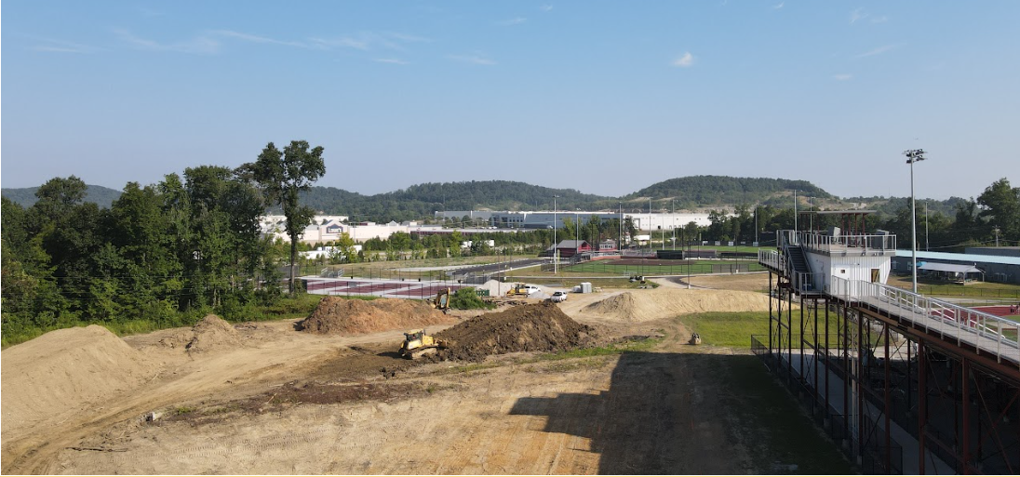
Phase 3 Athletics - Physical Science Centers
Construction

Slide 13
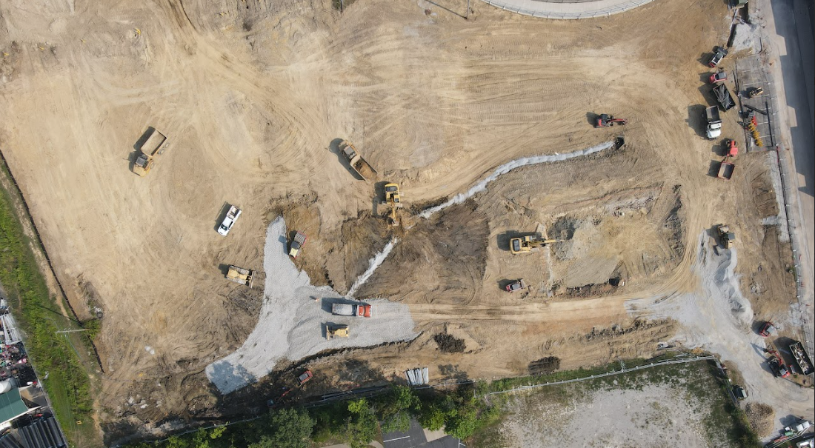
Phase 3 Athletics - Physical Science Centers
Construction

Slide 14
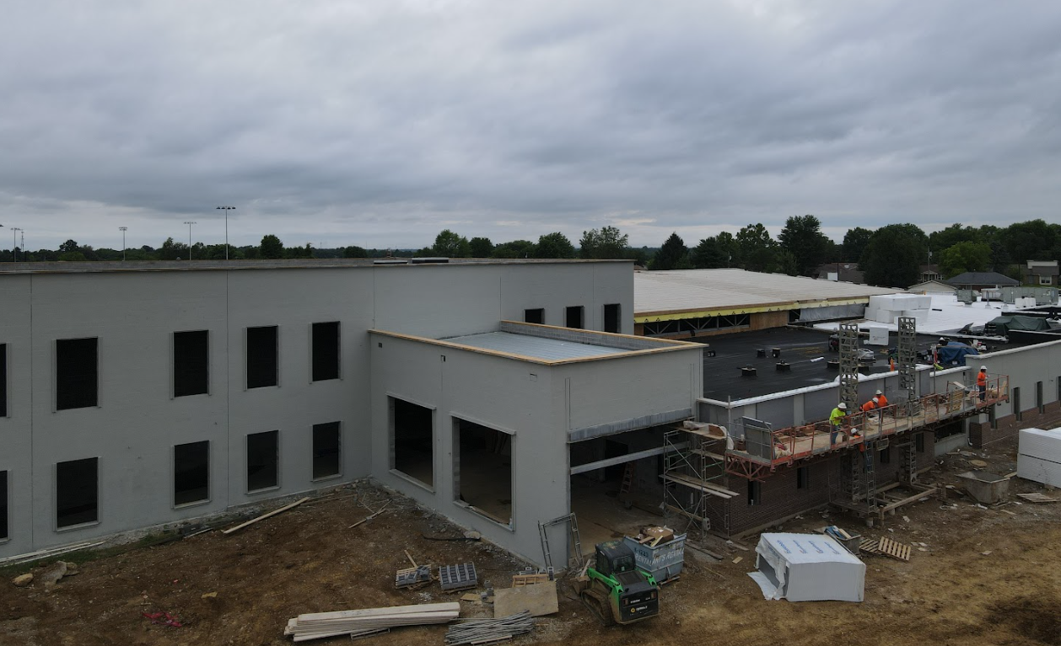

Bullitt East High School - Construction

Slide 15
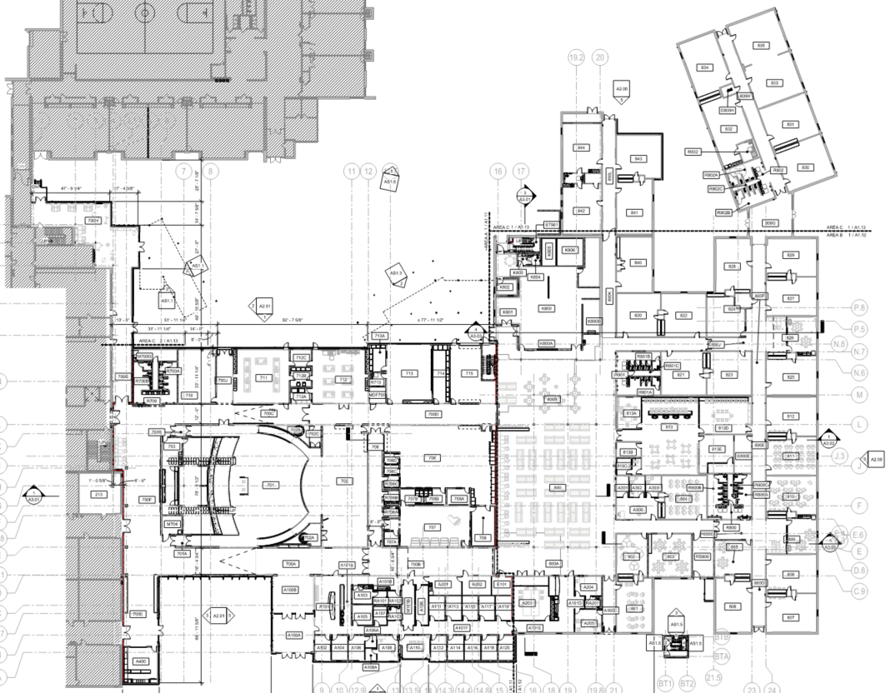
Area B
Construction Timeframe:
Anticipated Completion - May 2026
Furniture Delivery - June 2026.
Area C - SUMMER
Area A
Connection Work
Bullitt East High School Construction

Slide 16
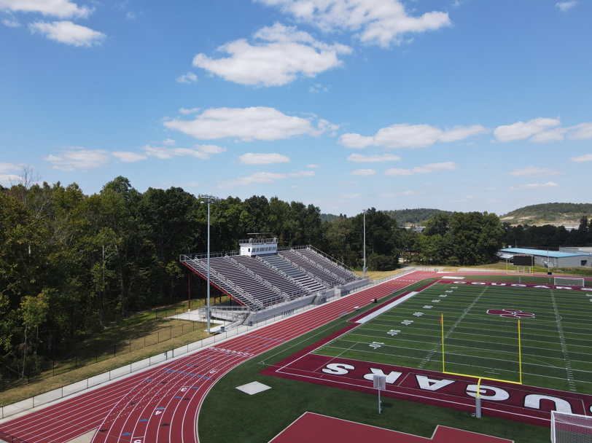
Board Consent Items - High School Football Stadiums
BG-4 - Calhoun Construction - Closeout Document
BG-4 - Vine & Branch (Toadvine) Bleacher COOP - Closeout Document
FOOTBALL STADIUM - CLOSEOUT

Slide 17
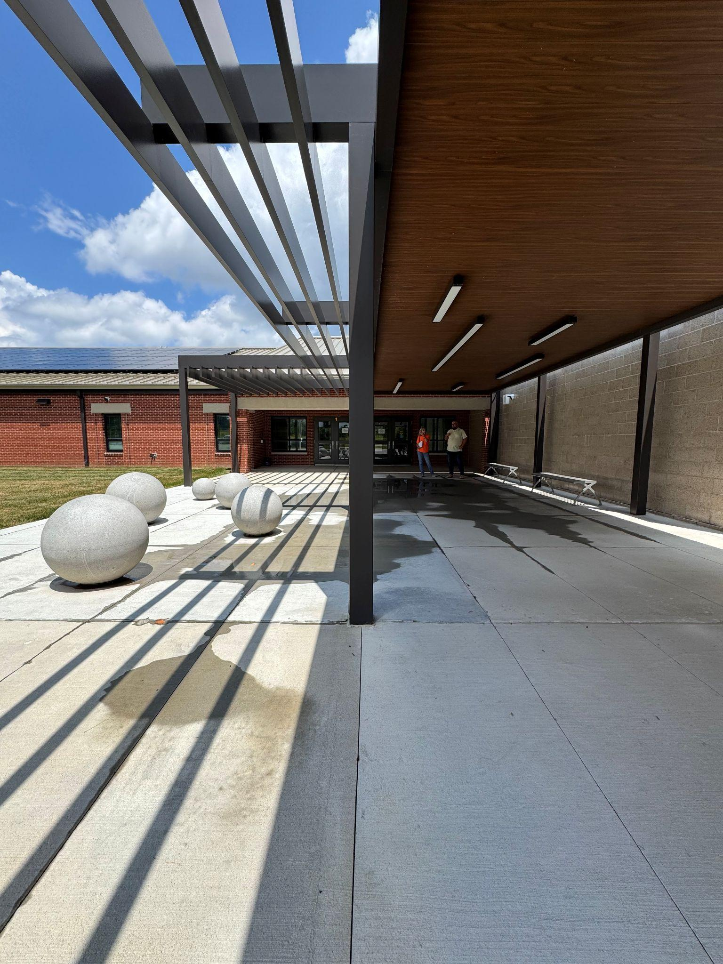

Board Consent Items - Bernheim Middle School
Bernheim - Change Order #37 - Front Entrance Modifications - $42,436.80
Due to standing water below the front entrance canopy, BCPS Facilities requested the addition of a cover to close the gap between the cafeteria wall and front entrance canopy. After the design team reviewed the elevations of the concrete slab and how water can flow away from the walkway, it was determined a trench drain should also be installed to deal with ponding water. Both solutions were priced and reviewed with BCPS Facilities, and both are desired to mitigate any ponding or potential ice issues in winter.
Door Hardware Materials Adds - Schiller - $421.62
Bernheim Administration requested additional door hardware materials.
Bernheim Middle School Construction

