Slide 1
Mercer County
Athletics – Phase 2:
August 19th, 2025

Slide 2
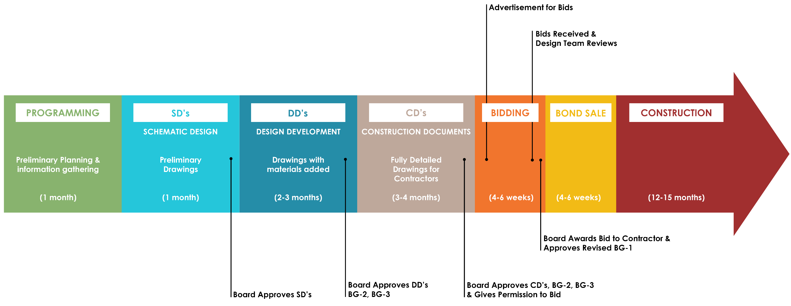
Design Process Overview:
Current Phase: Programming

Slide 3
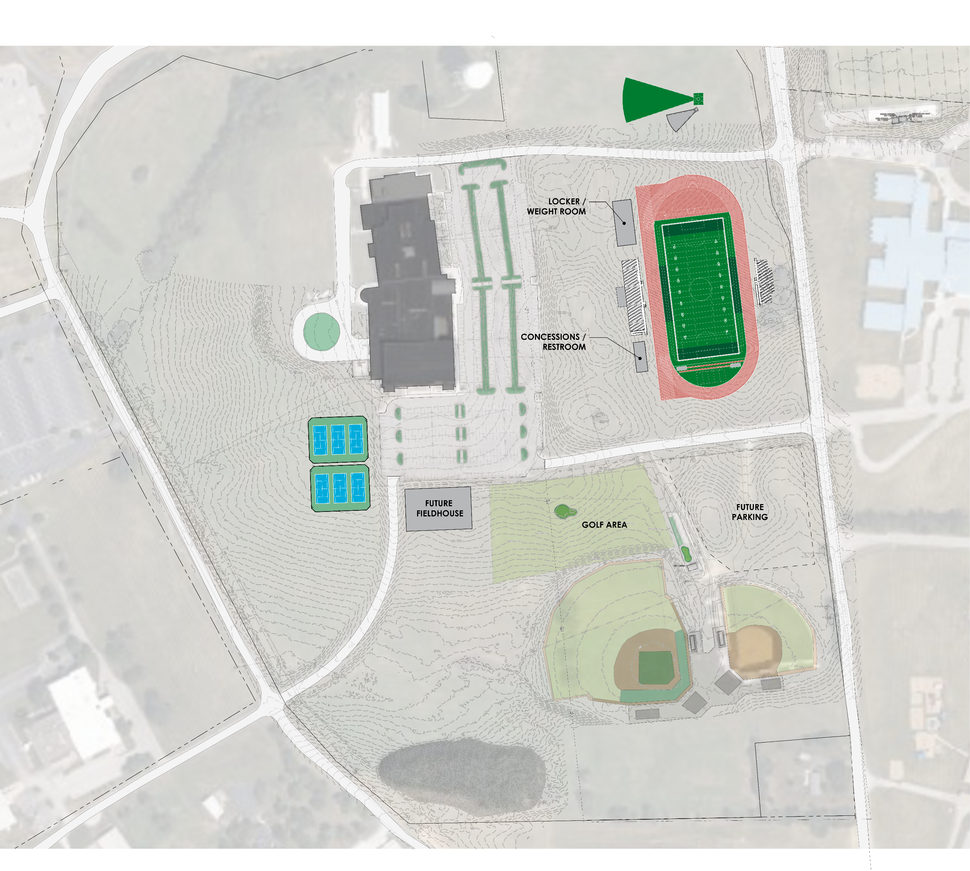
Option 1 – Front of School:
Pros:
Cost:
Most cost-effective option
Location:
Ideal solar orientation for field and bleachers
Access:
Direct procession from front of school
Adjacency to existing and future parking
Grading/Retaining:
Least amount cut/fill; minimal site walls
Utility:
Existing power/water/sanitary along Moberly Road
Cons:
Location:
School is visibly behind stadium
Shot-put and discus on opposite side of access road

Slide 4
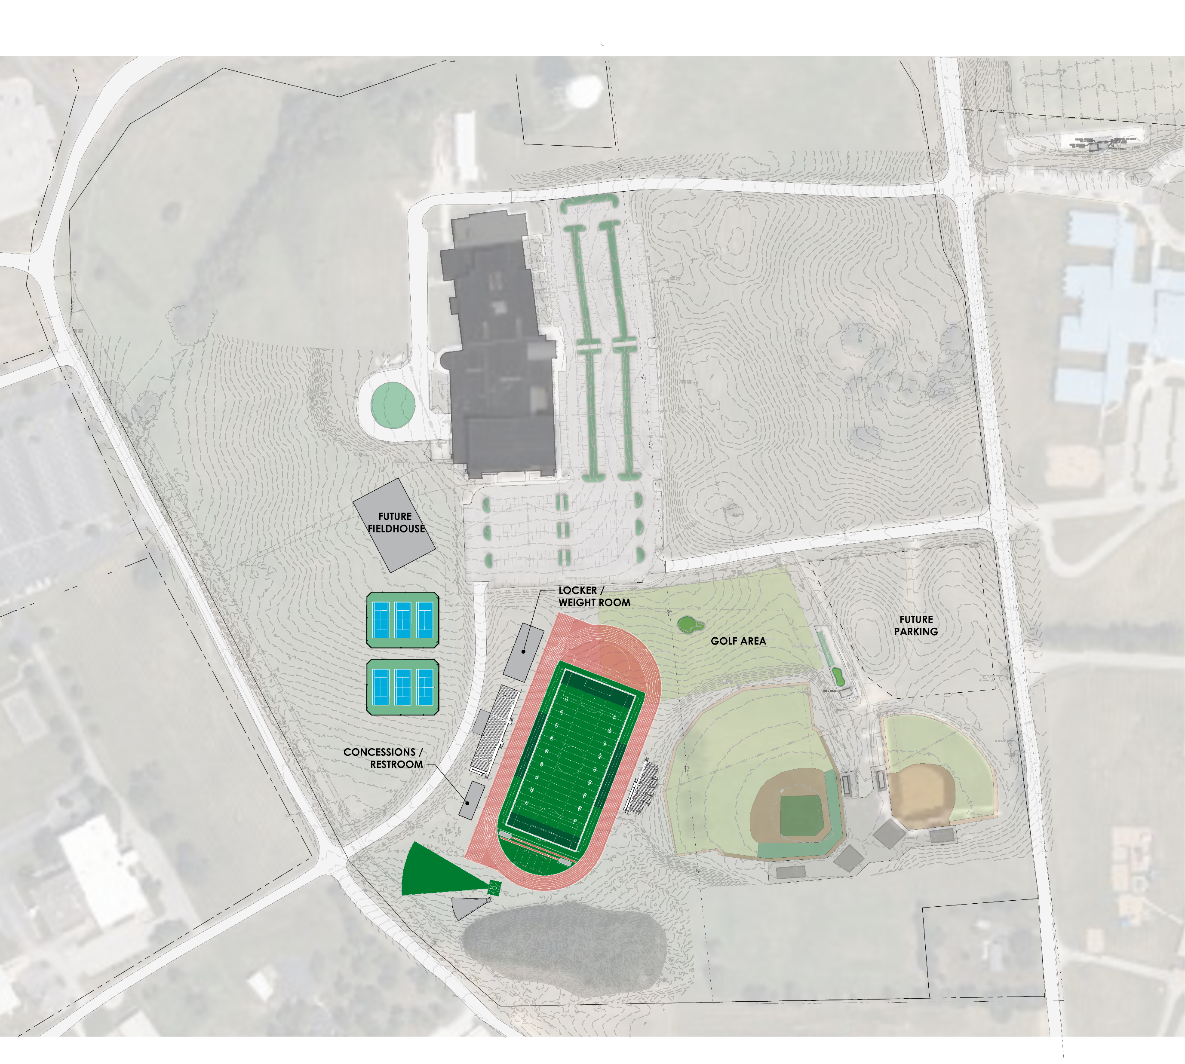
Option 2 – Adjacent to Baseball / Softball:
Pros:
Location:
Not located in front of school
Access:
Adjacency to existing parking
Utility:
3-Phase power and natural gas located along Industry road available
Cons:
Grading/Retaining:
28’ grade change
Massive fill and retaining walls needed
Location:
Located adjacent to existing golf range
Impacts existing road location
Non-Ideal solar orientation of field and bleachers
Utility:
Future fieldhouse located on top of existing water main
Greater sanitary pump distance than option 1

Slide 5
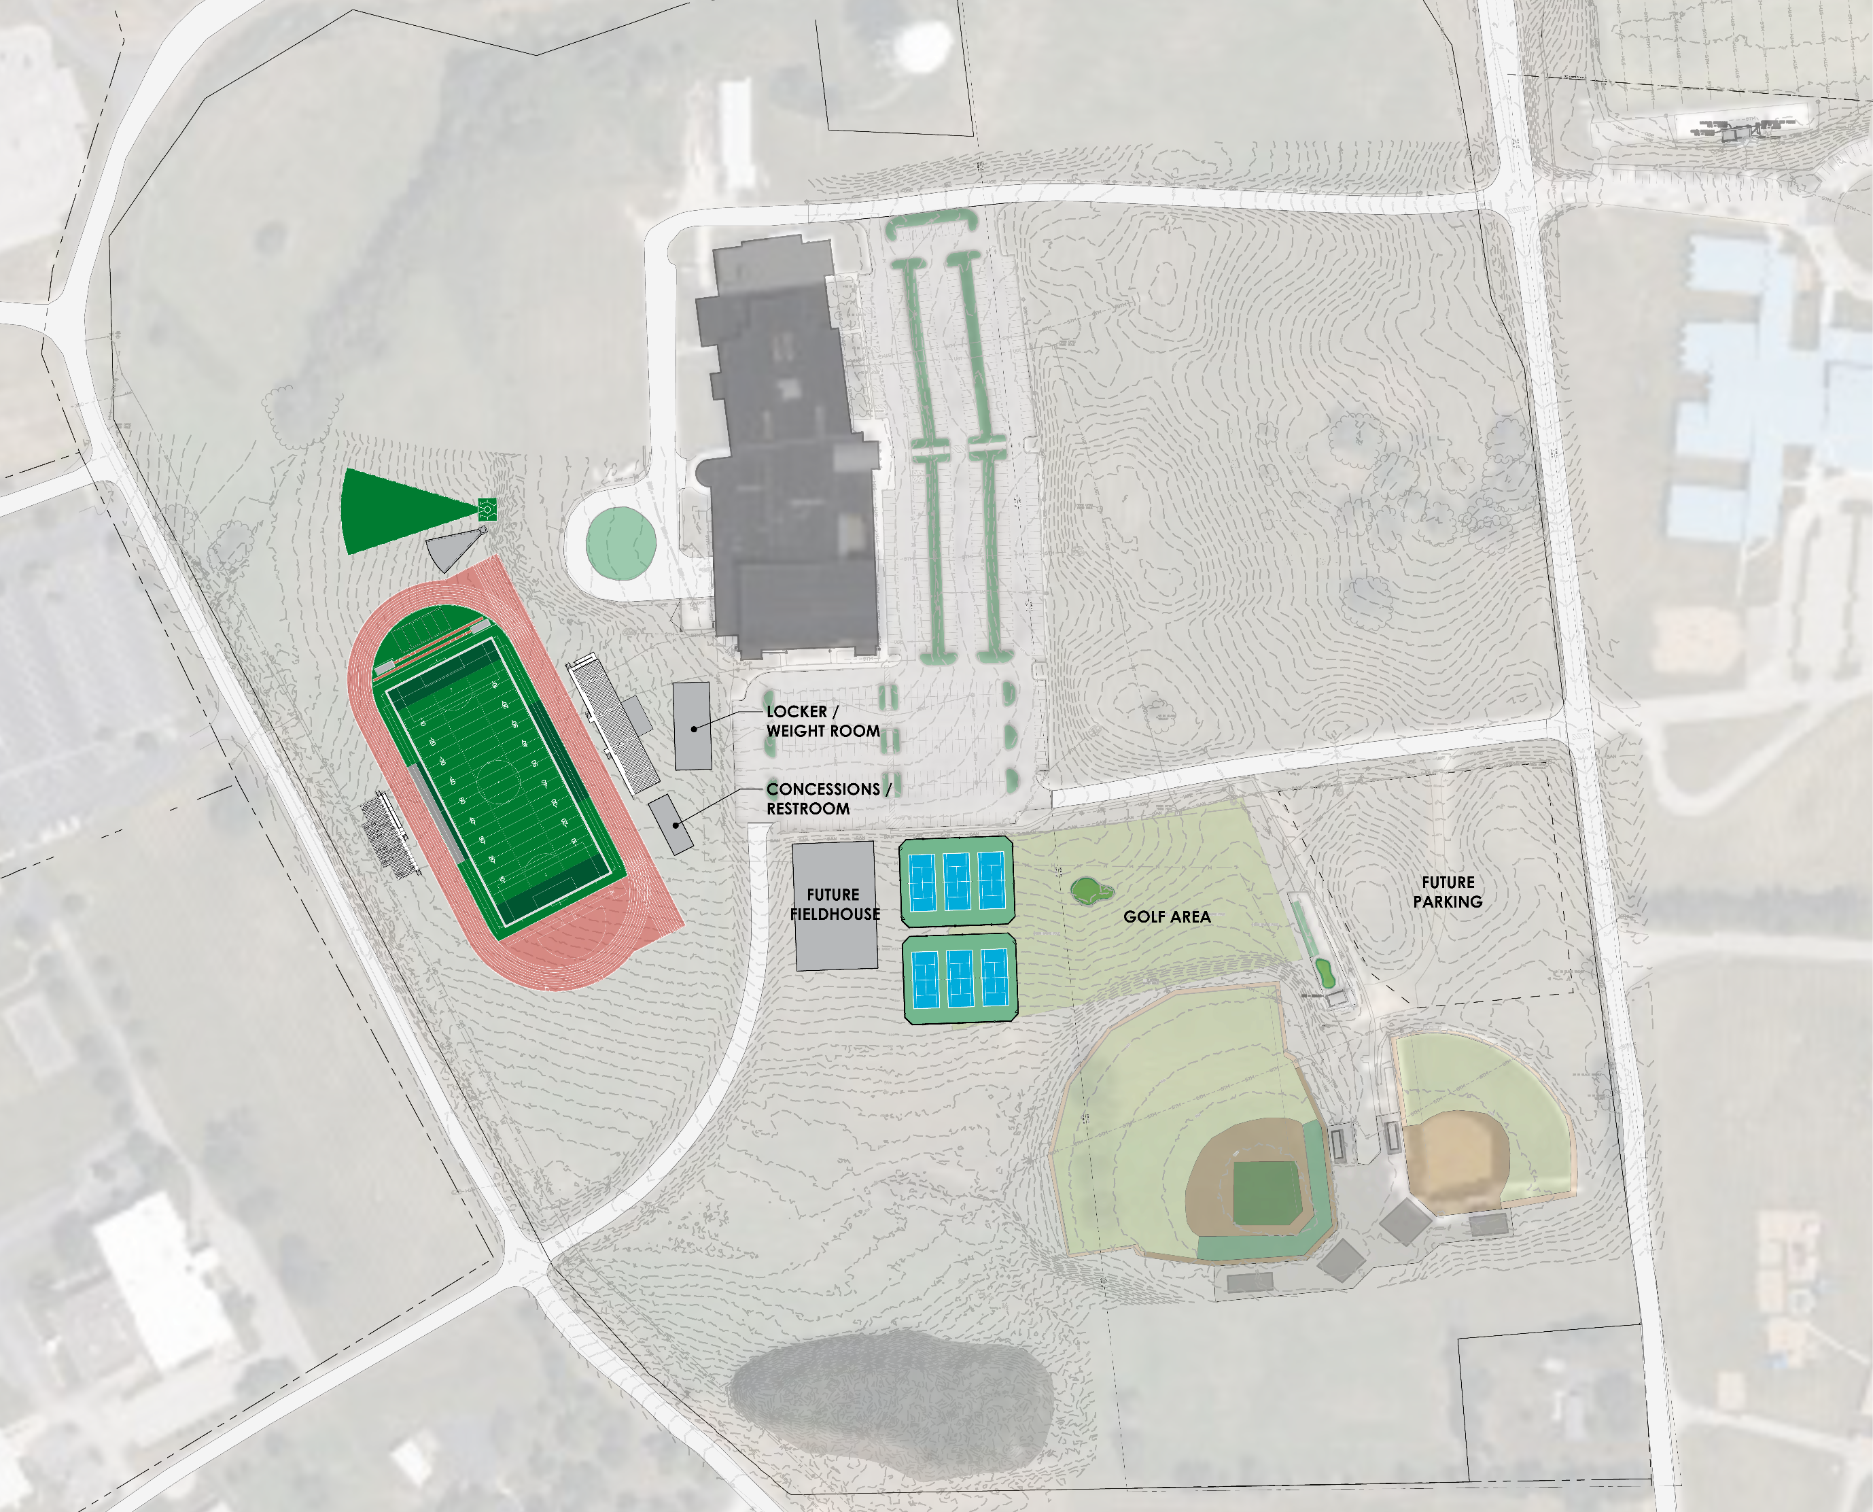
Option 3 – Back of School:
Pros:
Location:
Not located in front of school
Access:
Adjacency to existing parking (furthest of the 3 options)
Utility:
3-Phase power and natural gas located along Industry road available
Cons:
Grading/Retaining:
34’ grade change
Massive fill and retaining needed
Location:
Impacts existing road location
Bad solar orientation of field and bleachers
Utility:
Stadium located on top of existing water main and vault
Greater sanitary pump distance than option 1

Slide 6
Questions?

