Slide 1


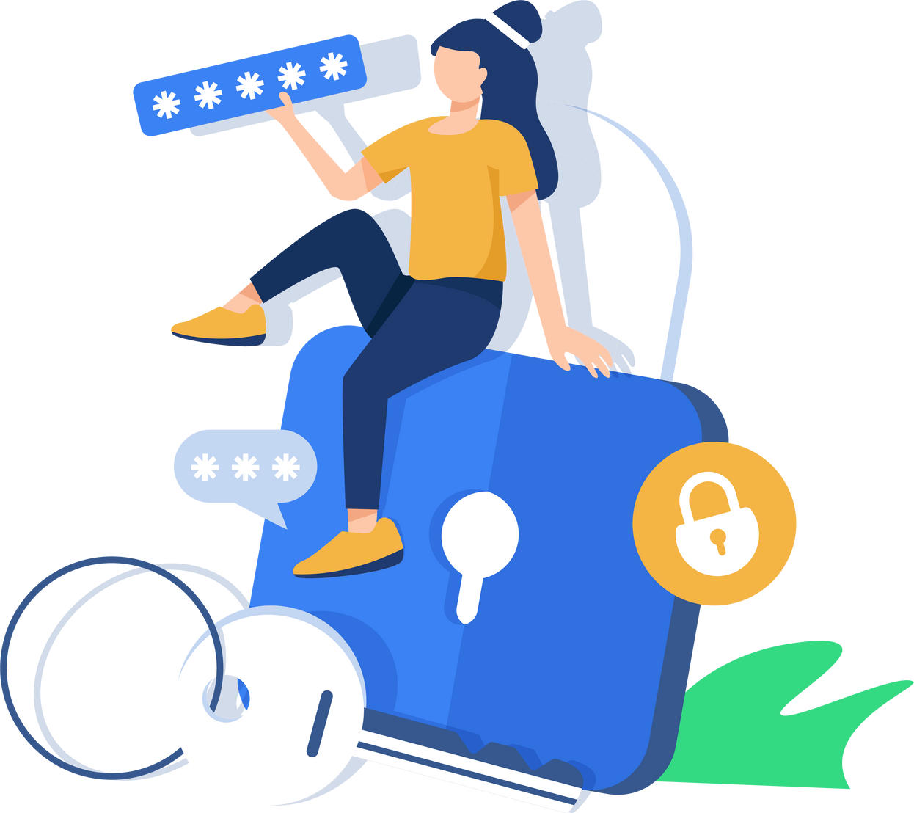



DATA SECURITY & BREACH NOTIFICATION BEST PRACTICES
SAFEGUARDING YOUR IDENTITY

Slide 2



DATA SECURITY COMPLIANCE & GETTING ERATE FUNDING
In accordance with state and federal law, this presentation is to inform you of how our district goes about data security reporting and notifying the proper personnel in the event of a data breach*.
Current and Relevant Federal Legislation includes The Family Rights and Privacy Act (FERPA), the Children’s Online Privacy Protection Act (COPPA), the Children’s Internet Protection Act (CIPA). Our district must be CIPA compliant in order to receive Erate funding.
*A data breach is defined as unauthorized access of personally identifiable information or PII.

Slide 3
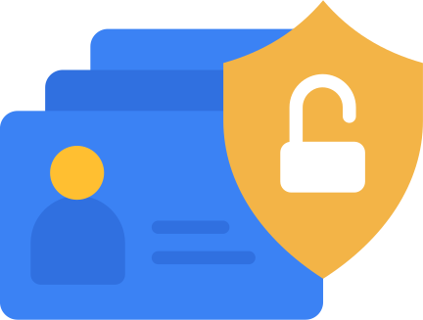

Data Security in KY:
Things we should all Know
702 KAR 1:170 is a regulation that establishes the requirements and standards for school district data security and breach investigation procedures and practices in Kentucky.
01
THIS DIRECTLY RELATES TO KRS 61.931, 932, & 933
03
THIS IS IF THEIR INFORMATION IS BREACHED UNKNOWINGLY
02
WE MUST NOTIFY THE AFFECTED INDIVIDUAL(S) IMMEDIATELY
04
WITHIN 72 HOURS, THIS HAS TO BE REPORTED TO KDE & KY AG, ETC.
*We complete the FAC-001 form and send that to CommonwealthBreachNotification@ky.gov
This distribution list includes KDE, KY AG, State Police, Dept. of Library and Archives, & State Office of Technology

Slide 4




DATA PROTECTION STRATEGIES IN BCPS
Effective data protection strategies are essential for safeguarding sensitive information and maintaining compliance. Effective data protection strategies are essential for safeguarding sensitive information and maintaining compliance.
DATA LOSS PREVENTION IN GOOGLE
ACCESS PERMISSIONS & 2FA
CISA VULNERABILITY SCANS
COMING SOON: RAPID IDENTITY*
*Rapid Identity will provide several security factors for all users including SafeID, SheildID, and 2FA.
They are also a Secure By Design Pledge Signer on the CISA website.

Slide 5
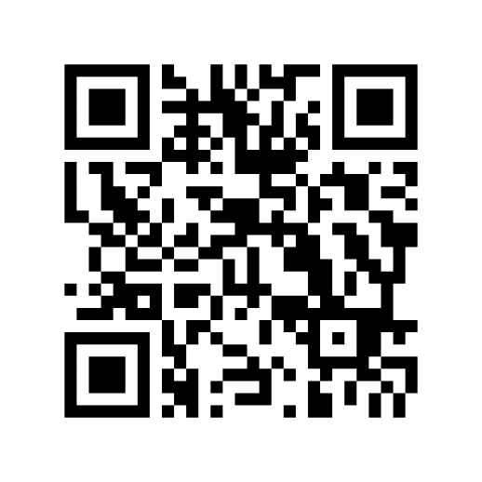
Scan the QR code to visit CISA’s Secure by Design Pledge page

Slide 6

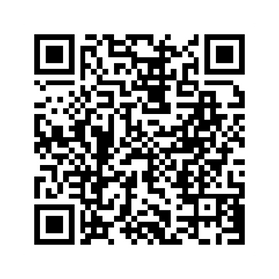
THE IMPORTANCE OF CISA’S VULNERABILITY SCAN
CISA (Cybersecurity and Infrastructure Security Agency) vulnerability scans assess internet-accessible systems for security weaknesses and potential vulnerabilities. They identify and report on issues like unpatched software, misconfigurations, and other flaws that could be exploited by malicious actors. These scans help organizations proactively improve their security posture and reduce their risk of cyber attacks.
IDENTIFYNG VULNERABILITIES
PROVIDES REGULAR REPORTS
SCANS PUBLIC FACING IP ADDRESSES
CONTINUOUS MONITORING
*takes you to CISA’s Cybersecurity Site

Slide 7
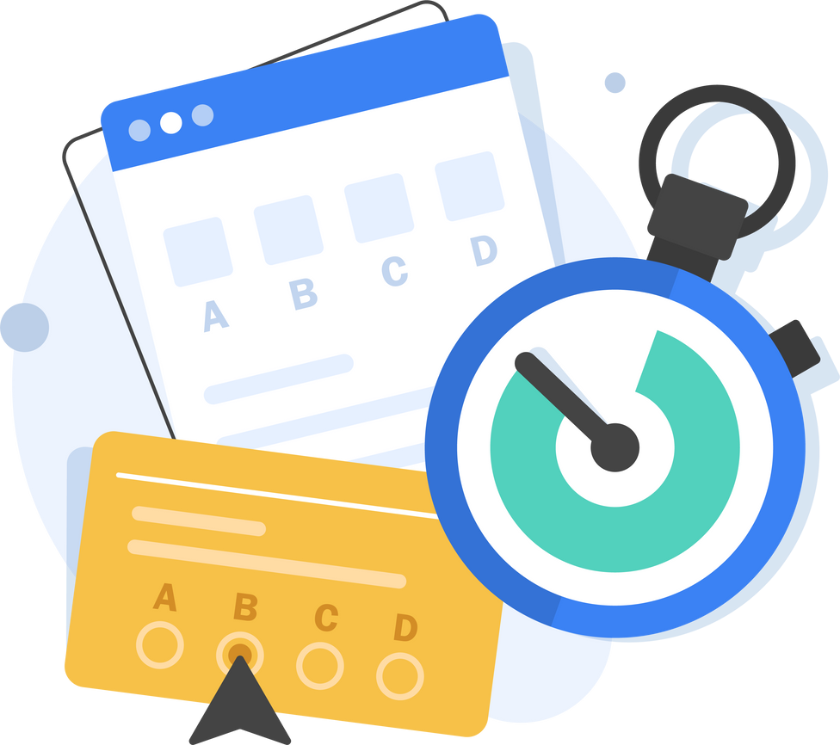
GOGUARDIAN ADMIN
CIPA Compliance
In addition to having GoGuardian Teacher so that teachers can monitor student activity, the state has moved to GoGuardian Admin for filtering services at the district level. It analyzes web activity and applies predefined rules to block or allow content based on categories. It uses a combination of web filtering and content filtering, and administrators can customize these rules to meet their specific needs. This allows for a safer learning environment while still providing access to appropriate educational materials.

Slide 8


QUESTIONS?

