Slide 1

Bullitt County Public Schools
2025-26 School Tax Rates
August 11, 2025

Slide 2
Proposed 2025-26 School Tax Rates
Kentucky school districts must determine local school tax rates annually. The BCPS Leadership Team is recommending the Bullitt County Board of Education adopt the following reduced tax rates for 2025-26:
75.7
75.7
47.7
Real Property
Personal Property
Motor Vehicle
Reduced from 75.9 - Applied to land and buildings
Reduced from 75.9 - Applied to business equipment
Unchanged rate - Applied to registered vehicles

Slide 3
What is the source of our funding?
SEEK Funding
Property Taxes
Permissive Taxes
Support Education Excellence in Kentucky - State formula-based funding
Real estate and tangible property (rates the board sets yearly)
3% utility tax on telephone, electric, water, natural gas, cable television
Other Local Revenues
Grants
Interest on deposits, indirect cost transfers, etc.
Federal (Special Education, Title I), State (ESS, GT, Preschool), Local (Bullitt County Foundation)

Slide 4
Understanding SEEK Revenue Timeline
SEEK is a formula-driven allocation of state-provided funds to local school districts based on student attendance—AADA (Adjusted Average Daily Attendance).
Forecast
Final
April or May
March
Initial planning estimates
Actual funding amounts confirmed
1
2
3
Tentative
September
Preliminary figures based on enrollment
This timeline creates planning challenges as we must set tax rates before final SEEK amounts are known.

Slide 5



The SEEK Funding Challenge
The Inverse Relationship
Enrollment & State Funding
If enrollment and state per pupil funding remain constant:
Remains constant
Increased local property assessment values result in decreased state SEEK support
Property Assessment
For every $1 million increase in assessment, we lose approximately $3,000 in SEEK funding
Increases
State SEEK Support
This creates a funding gap that must be addressed through local revenue sources while keeping tax rates as low as possible.
DECLINES

Slide 6

SEEK Funding Trends
As our community grows and property values increase, state funding through SEEK decreases proportionally, requiring careful local tax planning.

Slide 7
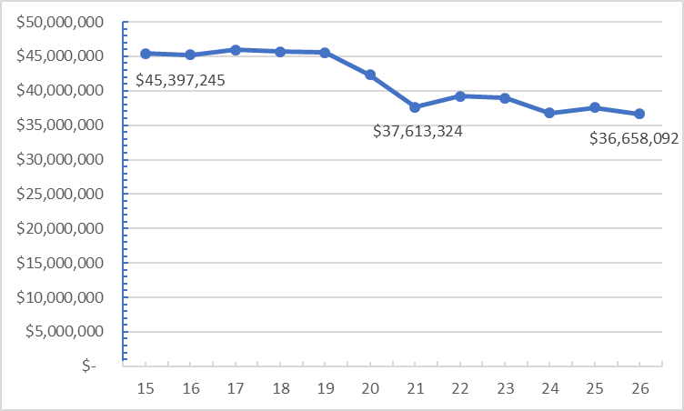
SEEK Funding Trends

Slide 8

Property Tax Assessment Growth
Bullitt County continues to experience significant growth in property values, which benefits our community but creates funding challenges for our schools due to the inverse relationship with state funding.
While proposing a tax rate reduction from 75.9 to 75.7, we must still ensure adequate funding for educational services.

Slide 9
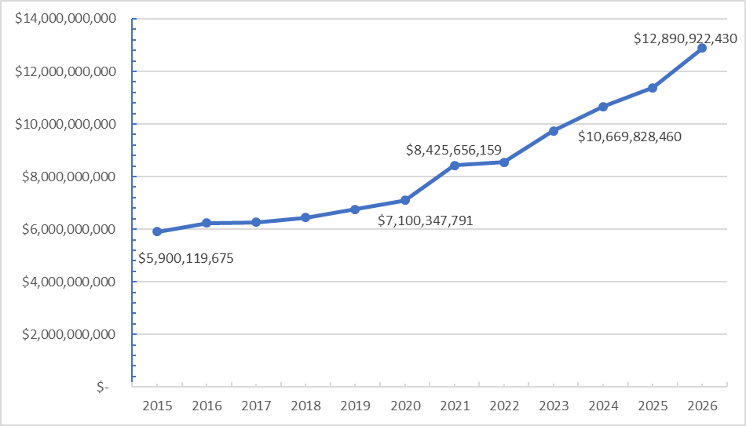
Property Tax Assessment Growth

Slide 10








The Inverse Relationship Explained
Property Values Rise
SEEK Formula Adjusts
Bullitt County experiences growth in property assessments
State calculates we need less support
Local Revenue Needed
State Funding Decreases
District must rely more on local sources
SEEK allocation is reduced
Despite reducing our tax rate from 75.9 to 75.7, the total revenue may increase due to higher property values, helping offset the reduction in state funding.

Slide 11
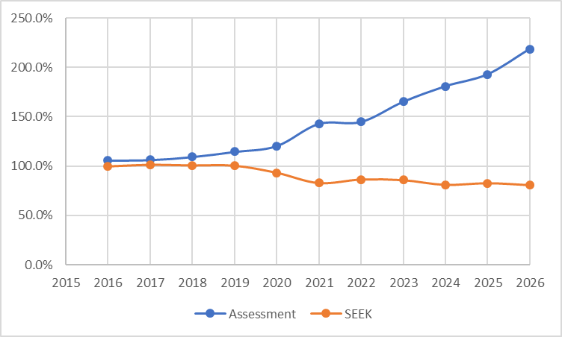
The Inverse Relationship Explained

Slide 12
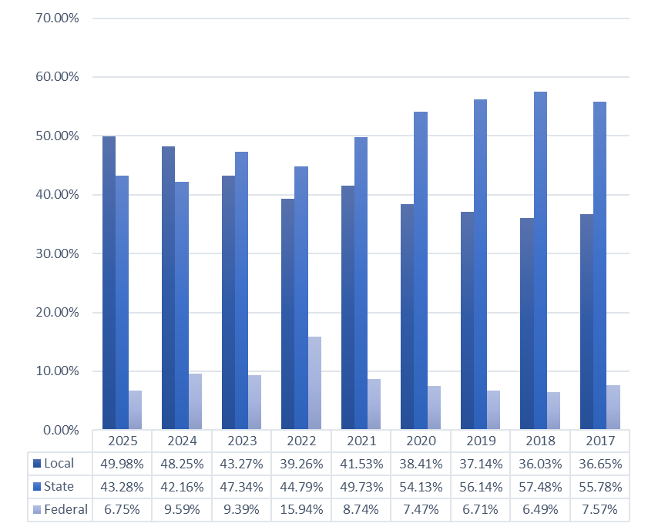
District Funding Sources Overview

Slide 13

Impact of Assessment Growth on SEEK Funding
Assessment History & SEEK Loss
FY 2020: $7.1B assessment (Loss: $1.0M in SEEK)
FY 2021: $8.4B assessment (Loss: $4.0M in SEEK)
FY 2022: $8.5B assessment (Loss: $0.3M in SEEK)
FY 2023: $9.7B assessment (Loss: $3.6M in SEEK)
FY 2024: $10.7B assessment (Loss: $2.8M in SEEK)
FY 2025: $11.4B assessment (Loss: $2.1M in SEEK)
FY 2026: $12.9B assessment (Loss: $4.5M in SEEK)
State grants are also trending down, increasing our reliance on local tax dollars even with our proposed rate reduction from 75.9¢ to 75.7¢.

Slide 14
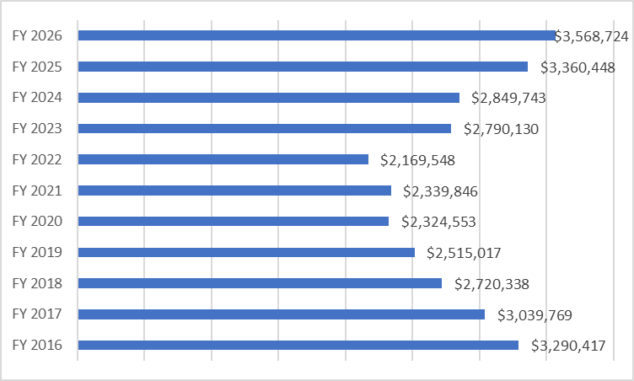
State Grant Trends
The graph illustrates the trend in state grant funding. Combined with reduced SEEK funding, this highlights the importance of sustainable local revenue sources despite our effort to reduce the tax rate to 75.7.

Slide 15
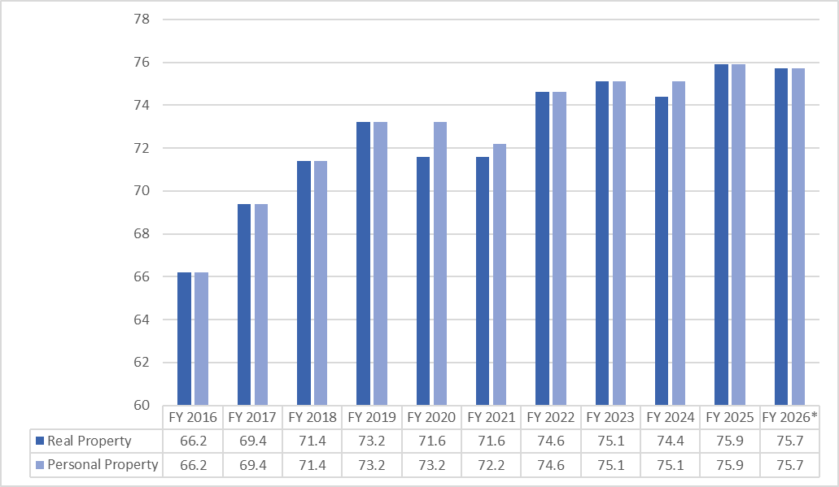
Bullitt County Tax Rate History
*Proposed rate

Slide 16
Financial Impact of Proposed Tax Rate
Description
Proposed Rate (75.7)
Potential Revenue
$10,684,709.44
Building Fund
$1,730,922.93
Projected Uncollectable
$320,541.28
Cost of Collections
$235,063.61
SEEK Budget Adjustment
$1,692,044.00
Realistic Estimate of Additional Revenue
$6,706,137.62
Even with the tax rate reduction from 75.9 to 75.7, increased property values will generate additional revenue to offset state funding reductions and support essential educational services.

Slide 17

Proposed Use of Additional Funds
School Safety
Educational Enhancements
SROs (School Resource Officers)
Sustain BVLA (Bullitt Virtual Learning Academy)
Life safety upgrades (Audio Enhancement)
Maintain Chromebook leases
Support preschool program
Weapons detection systems (high schools)
Facilities & Staff
Begin high school gym floor replacements
Sustain district salary increases
Additional step to salary scale

Slide 18
Summary: 2025-26 Tax Rate Proposal
Tax Rate Reduction
Real Estate
Personal Property
Motor Vehicle
75.7
75.7
47.7
Reduced from 75.9
Reduced from 75.9
(Unchanged)
The proposed tax rate balances fiscal responsibility with the need to provide quality education for Bullitt County students as state funding continues to decline.

