Slide 1
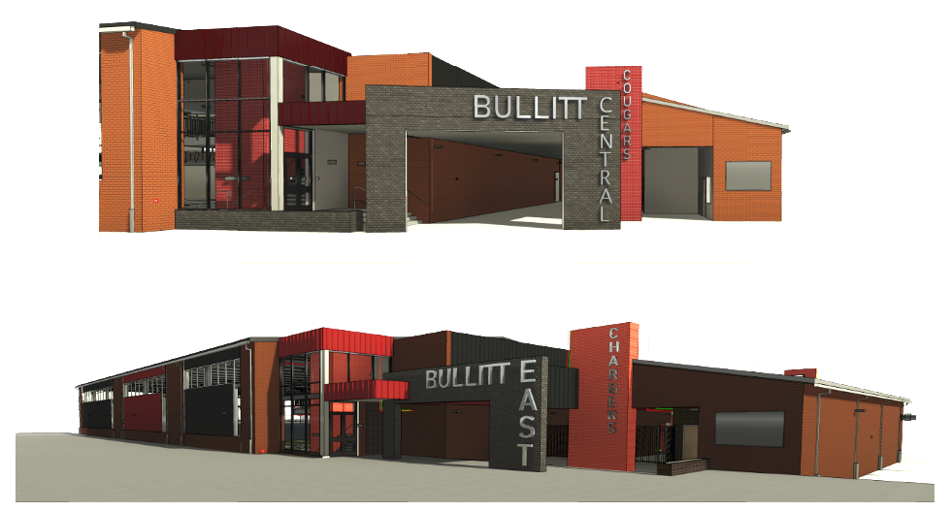


June 16th - Design and Construction Update

Slide 2
Physical Science Centers Bullitt Central & Bullitt East
Special Board Meeting - Award of Contract: June 19, 2025, Thursday
Award of Bid Package No. 1 – General Construction Contract BP1 – Bullitt Central Physical Science Center
Award of Bid Package No. 3 – Technology Contract BP3 – Bullitt Central Physical Science Center
Award of Bid Package No. 1 – General Construction Contract BP1 – Bullitt East Physical Science Center
Award of Bid Package No. 3 – Technology Contract BP3 – Bullitt East Physical Science Center
Special Inspections – Award of Contract Bullitt East and Bullitt Central Physical Science Center
July 28th Board Meeting
Award of Bid Package No. 2 – Controls Contract BP2 – Bullitt Central Physical Science Center
Award of Bid Package No. 2 – Controls Contract BP2 – Bullitt East Physical Science Center
Third Party System Commissioning Services and Test and Balance
Phase 3 Athletics - Physical Science Centers
BID RESULTS

Slide 3
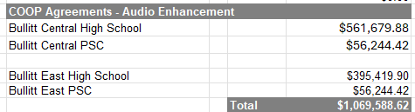
Physical Science Centers Bullitt Central & Bullitt East
COOP Agreement – Audio Enhancement – Intercom and Life Safety Upgrades at Bullitt Central and Bullitt East Campuses
Phase 3 Athletics - Physical Science Centers
BID RESULTS

Slide 4
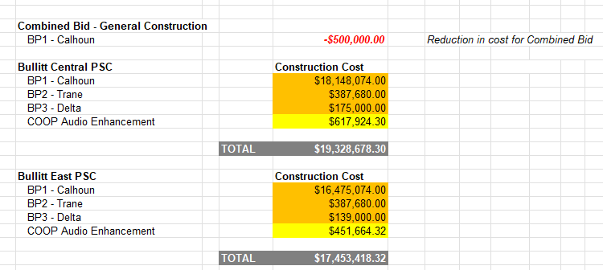
Phase 3 Athletics - Physical Science Centers
Speculative BG-1

Slide 5
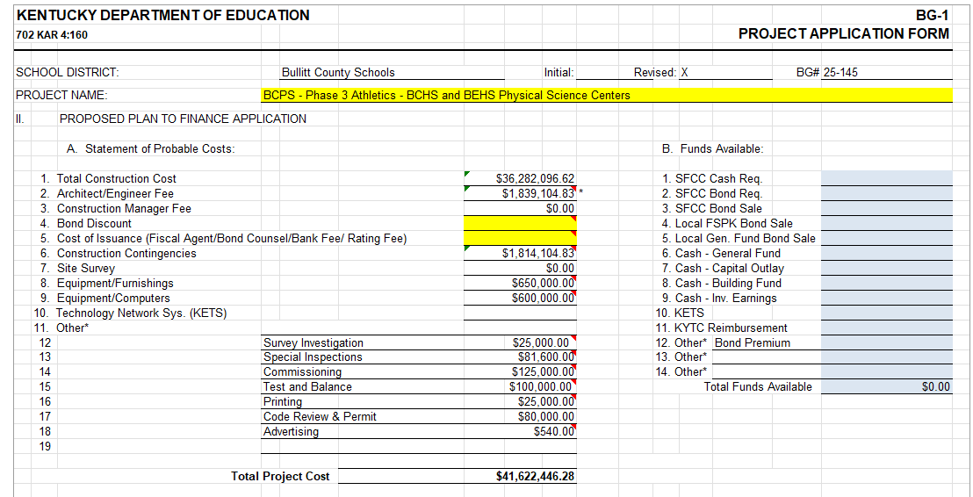
Speculative BG-1

Slide 6
Change Orders - Reviewed 6/16/2025 - Formal Approval at 6/19/2025 Meeting
Change Order 07 – Access Controls and Projection Screen Changes
Change Order 08 – Structural and Wall Changes
Change Order 25 – Batting Cage Installation
Change Order 26 – Bullitt East Site Revisions
Change Order 27 – North Bullitt Site Revisions
Change Order 28 – Bullitt Central Site Revisions
BP4 - Football Press Box AV Revisions Phase II Athletics
BG-4 - New Old Mill Elementary - Close Out BP1 - Redlee Construction
Construction Change Orders - Formal Approval

Slide 7
Change Orders - Reviewed 6/16/2025 - Formal Approval at 6/19/2025 Meeting
BP4 - Football Press Box AV Revisions Phase II Athletics
$29,951.92 - BCPS Technology Department requested additional Audio-Visual work at the three high school stadium press boxes. Work includes additional speakers, power at bleacher skirts, and data drops at stadium in general.
BG-4 - New Old Mill Elementary - Close Out BP1 - Redlee Construction
Contractual and FACPAC close out of the General Construction Bid Package.
Construction Change Orders - Formal Approval

