Slide 1
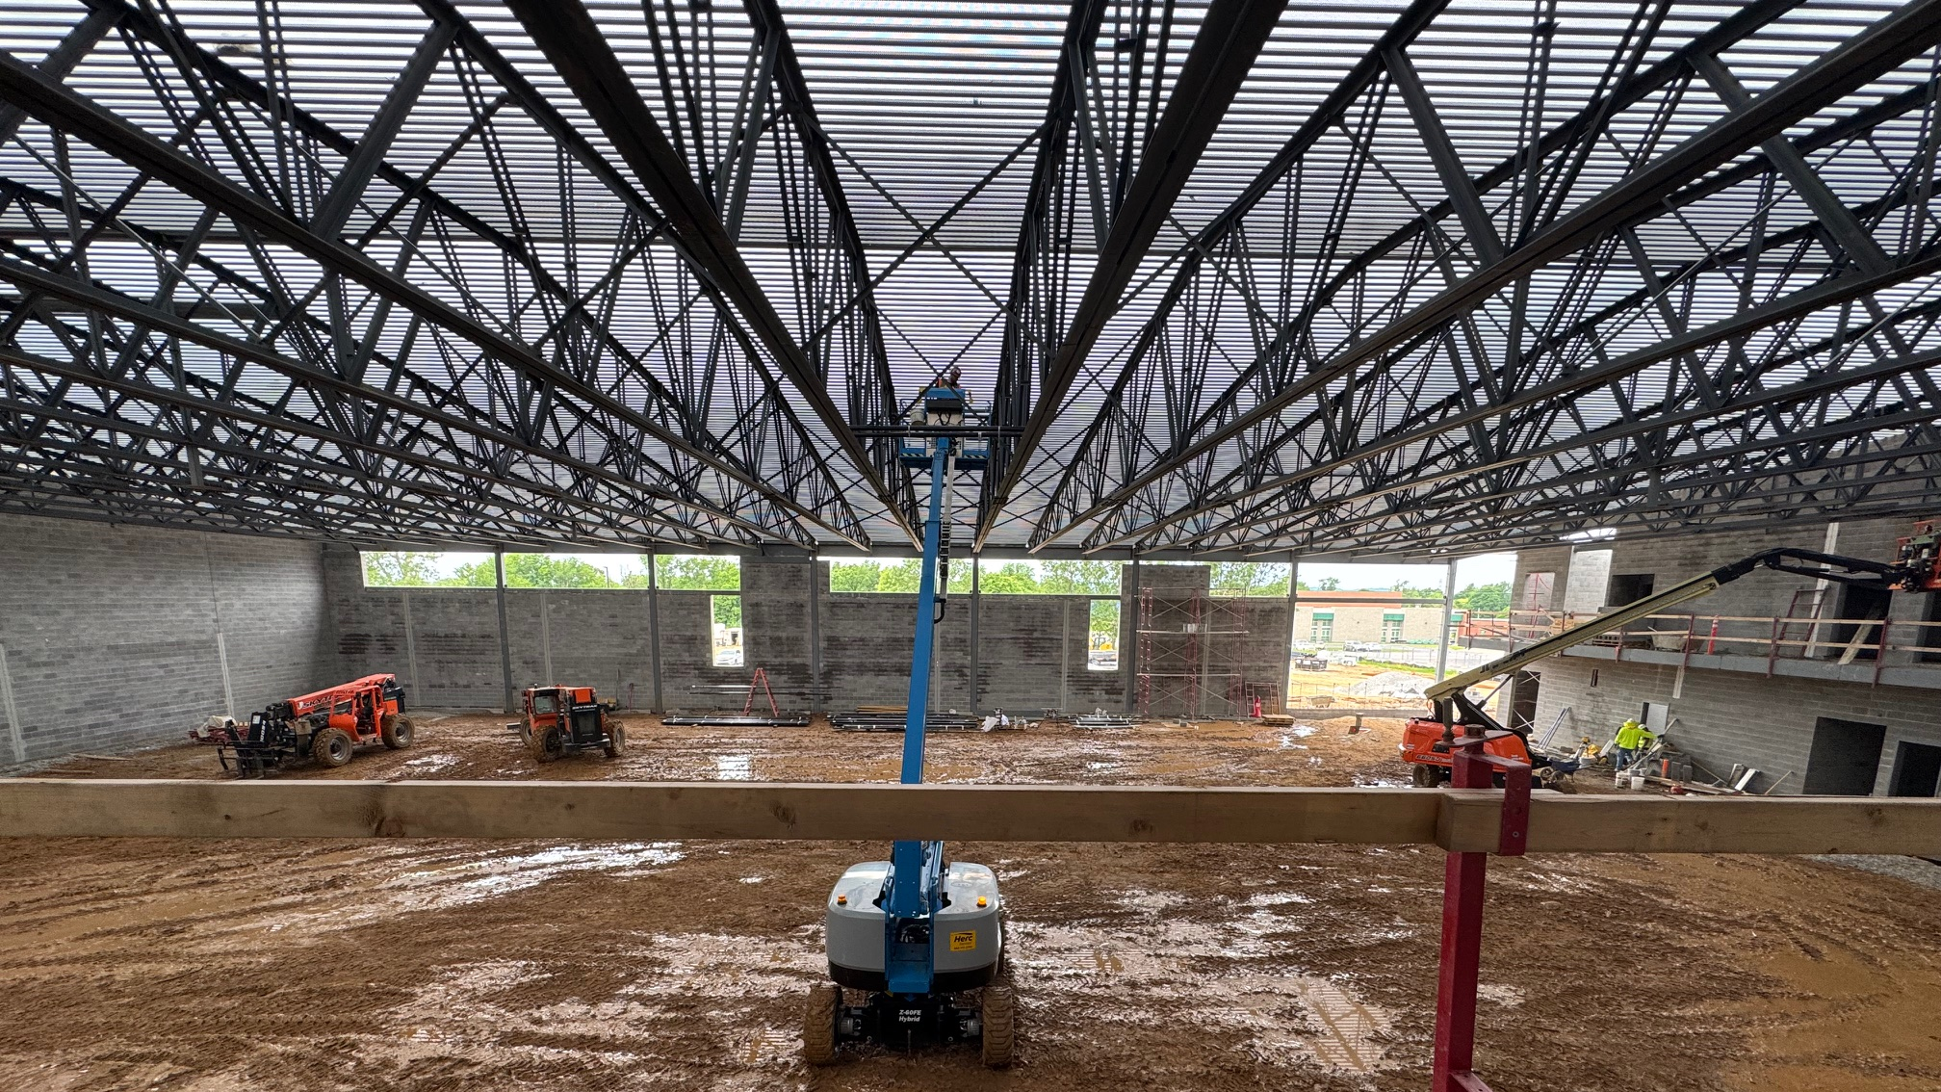



June 16th - Design and Construction Update

Slide 2
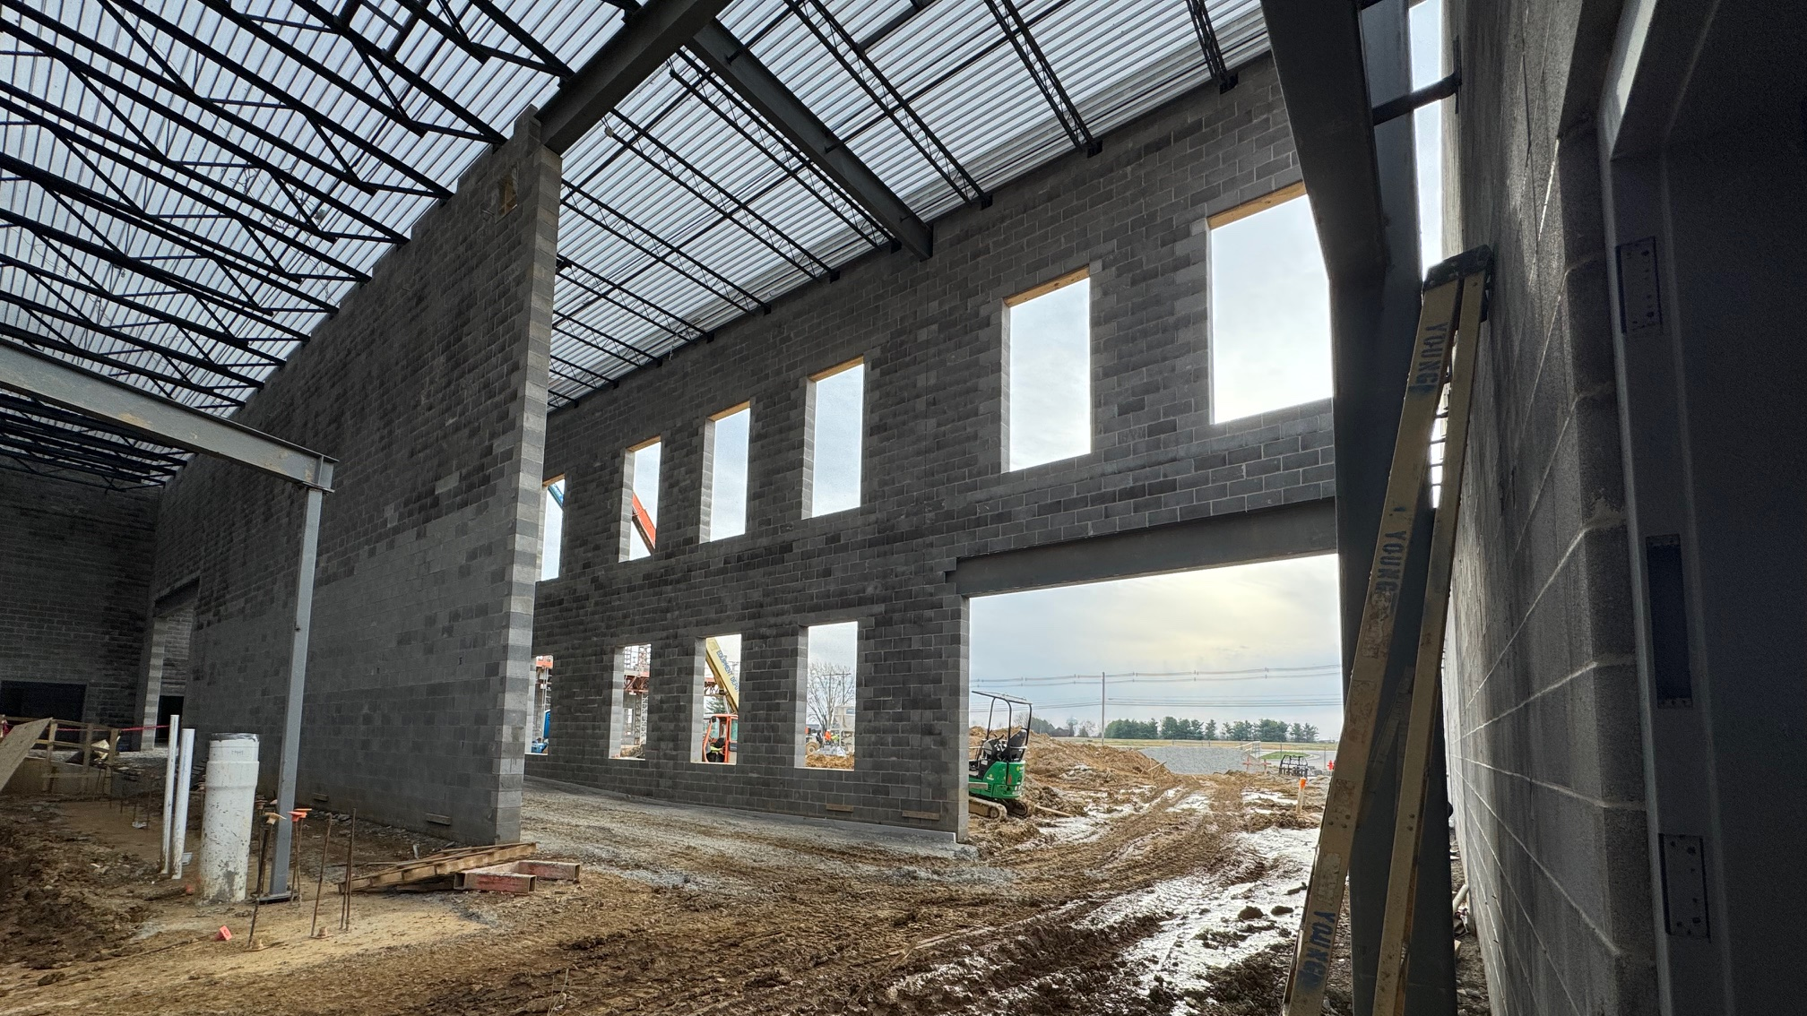

Bullitt East High School - Construction

Slide 3
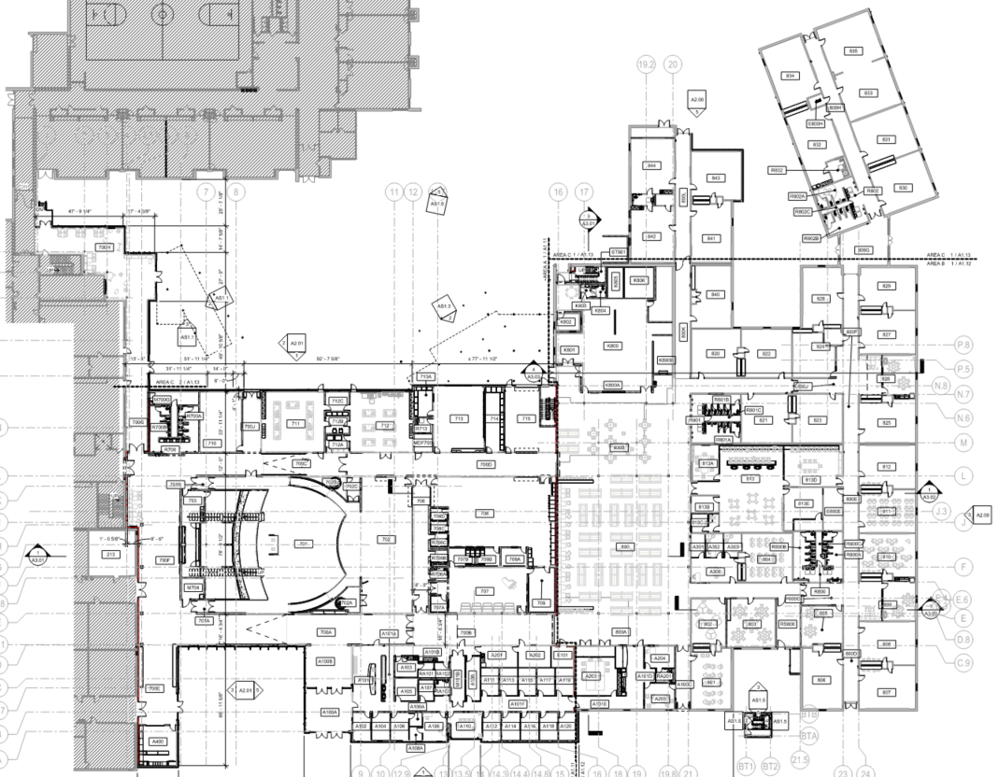
Area B
Construction Timeframe:
Anticipated Completion - May 2026
Furniture Delivery - June 2026.
Area C - SUMMER
Area A
SUMMER
Bullitt East High School Construction

Slide 4
Board Consent Items
No Change Orders this month.
Bullitt East High School Construction

Slide 5
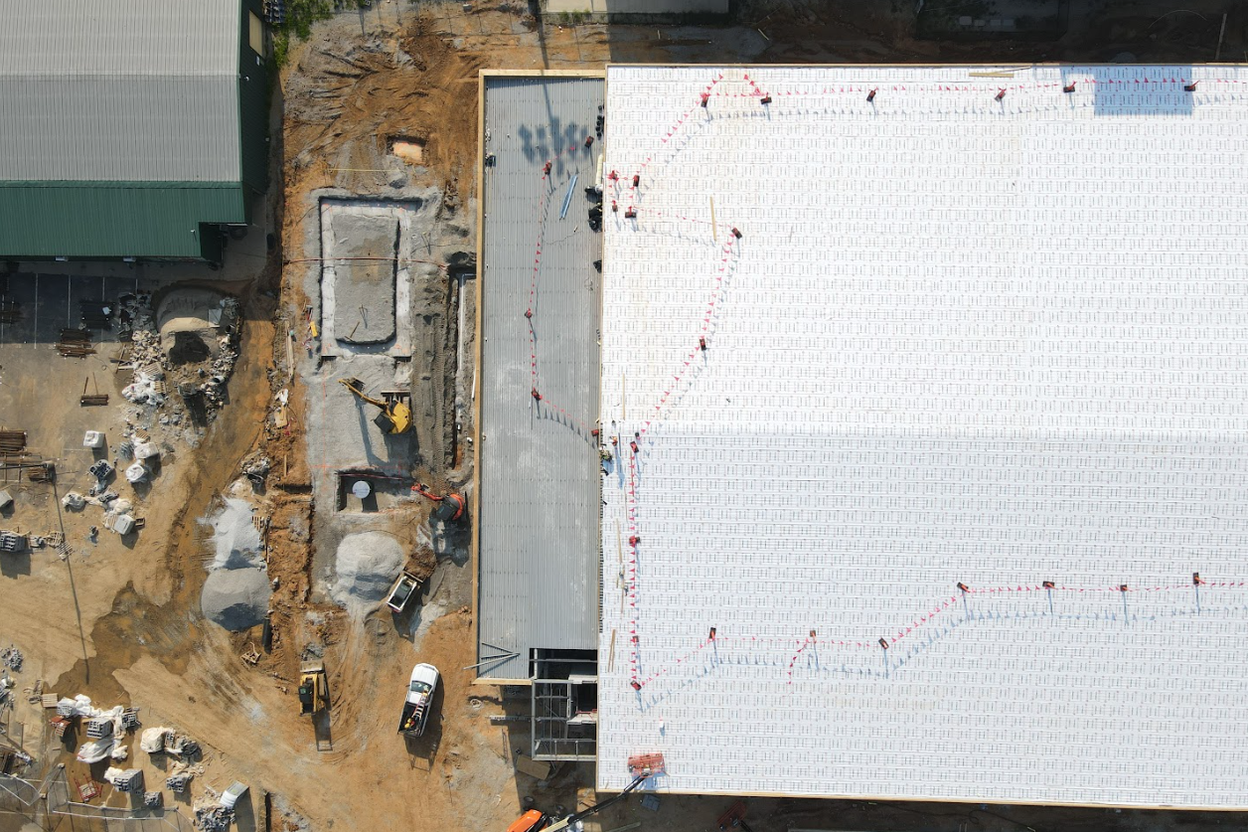
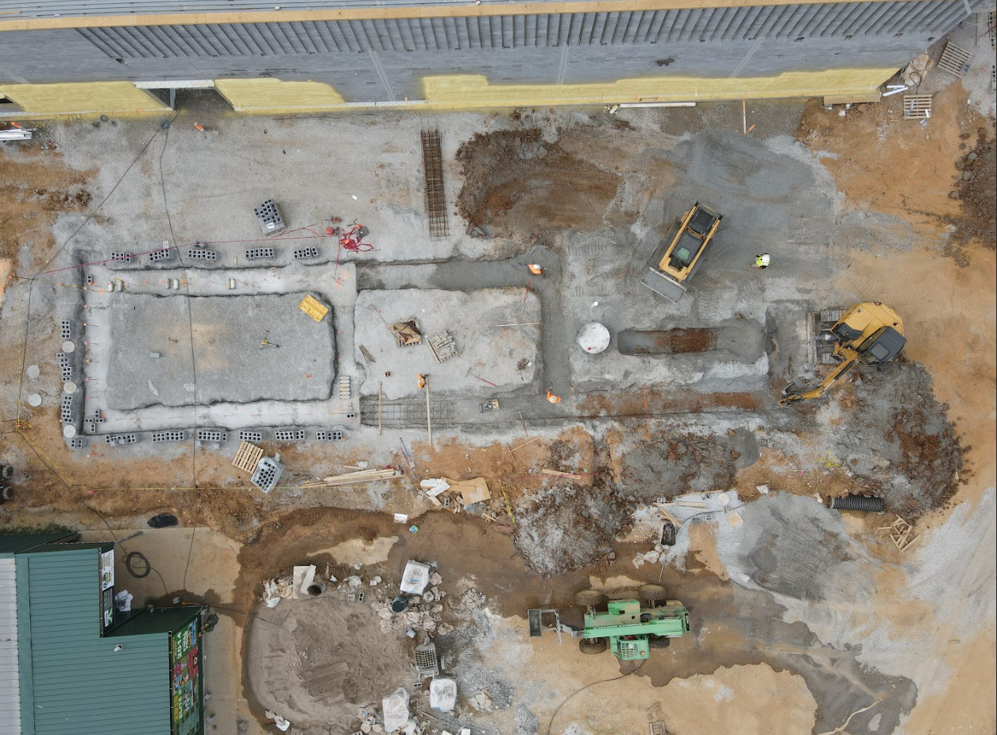

Phase 2 Athletics
NBHS Physical Science Center

Slide 6
Board Consent Items - Bid Package No. 2 - North Bullitt Physical Science Center
Change Order 07 – Access Controls and Projection Screen Changes
$14,480.00 - BCPS Facilities requested the addition of Door Access Controls at the Weight Room and Two PE Locker Rooms. There is a separate Change Order to the Schiller DPO for the added Door Hardware that will be prepared for the July Board Meeting. Submitted Cost of Hardware is $12,147.59.
BCPS Technology requested the projection screen be modified to work better with the projector they will provide under a separate purchase order.
Change Order 08 – Structural and Wall Changes
$3,765.00 - Work included in this Change Order includes the following: A masonry credit for a reduction in the locker base height; Masonry infill at a louver that was adjusted in size based on submitted equipment; Increase in foundation size to support a stair beam; Provision of added lintels to address RFI #33.
Phase 2 Athletics
NBHS Physical Science Center

Slide 7
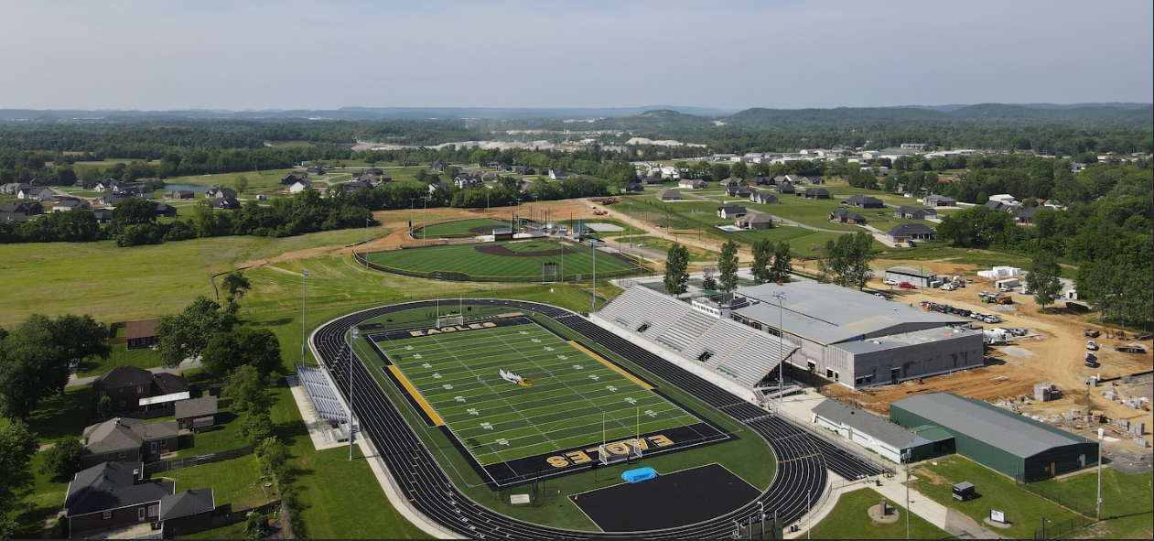
Phase 2 Athletics
Baseball and Softball

Slide 8
Board Consent Items - Bid Package No. 1 - Baseball and Softball
Change Order 25 – Batting Cage Installation
$7,811.00 - BCPS Facilities asked the Contractor to install the batting tunnel overhead netting at North Bullitt and Bullitt East. This cost is for installation, only. The cost of equipment will be carried under a direct purchase order with Sportfield Specialties. Cost of Equipment (Covered by Direct Purchase Order): $31,820
Change Order 26 – Bullitt East Site Revisions
$38,920.00 - Work was added to provide a concrete finish at the retaining wall next to the softball field, additional sidewalks next to the baseball field and Rip Rap at an existing drainage/retention area next to the Football Field. As a result of the added flatwork, storm piping was modified to accommodate site drainage.
Phase 2 Athletics
Baseball and Softball

Slide 9
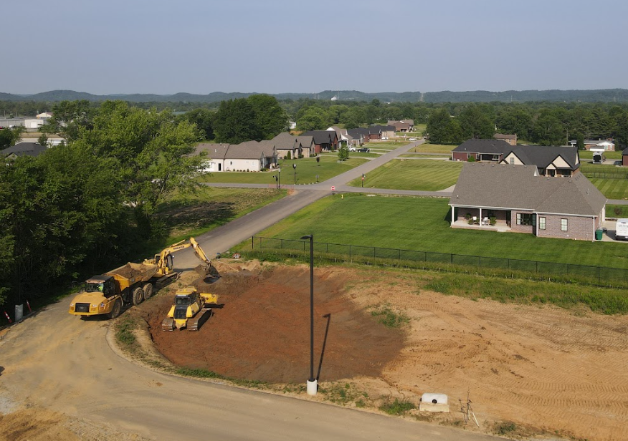
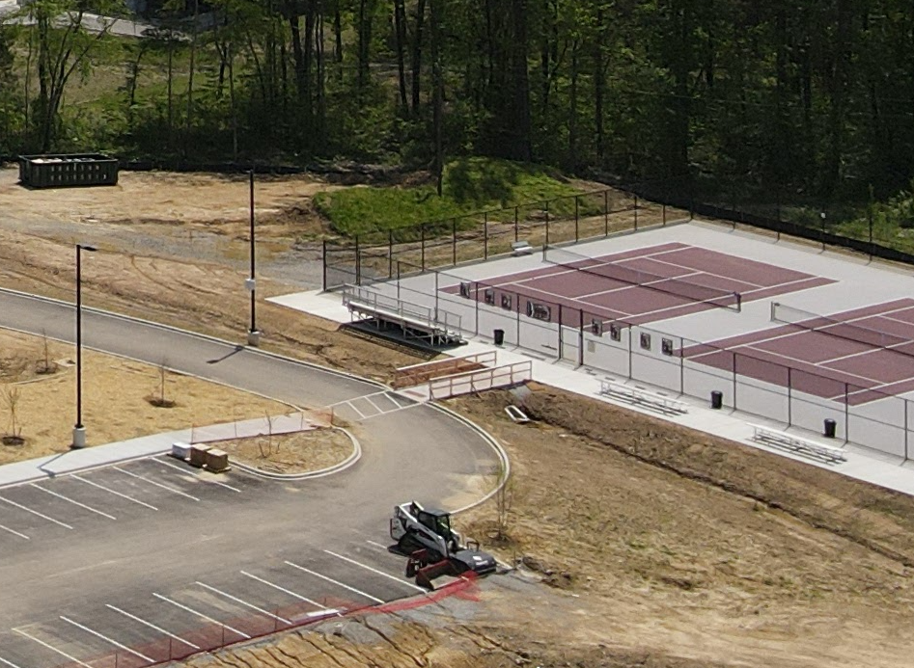
Board Consent Items - Bid Package No. 1 - Baseball & Softball
Change Order 27 – North Bullitt Site Revisions
$6,665.00 - A headwall and replacement pipe are being added at the detention basin at the access road to Robin Way to hold the storm pipe in place and properly drain the basin to the ditch. Contract Unit prices were utilized for this Change Order.
Change Order 28 – Bullitt Central Site Revisions
$9,560.00 - The building inspector for the City of Shepherdsville required a guardrail be added at the sidewalk leading to the tennis courts due to the slope of the surround grade. The guardrail will be plate mounted to the existing concrete sidewalk and will be made of aluminum to avoid the need for painting to protect it from rust. This is a code requirement by the building inspector.
Phase 2 Athletics
Baseball and Softball

Slide 10
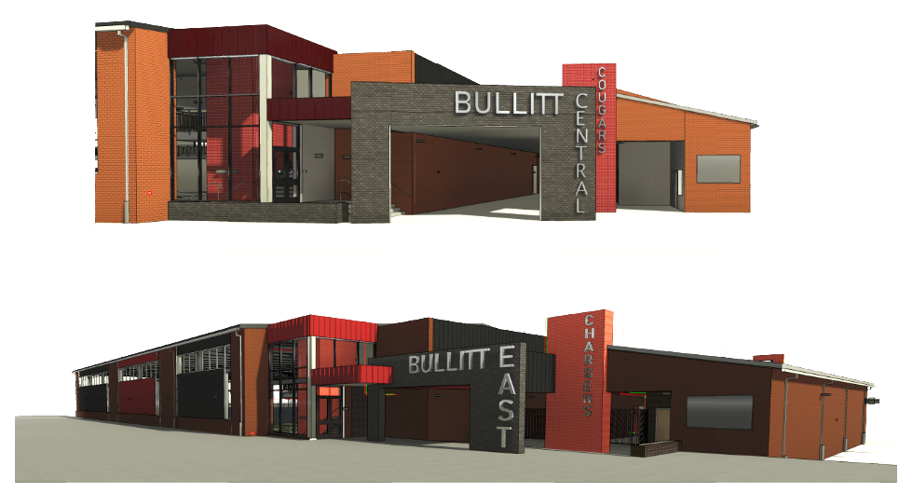
Phase 3 Athletics - Physical Science Centers
Bullitt Central and Bullitt East

Slide 11
Physical Science Centers Bullitt Central & Bullitt East
Special Board Meeting - Award of Contract: June 19, 2025, Thursday
Award of Bid Package No. 1 – General Construction Contract BP1 – Bullitt Central Physical Science Center
Award of Bid Package No. 2 – Controls Contract BP2 – Bullitt Central Physical Science Center
Award of Bid Package No. 3 – Technology Contract BP3 – Bullitt Central Physical Science Center
Award of Bid Package No. 1 – General Construction Contract BP1 – Bullitt East Physical Science Center
Award of Bid Package No. 2 – Controls Contract BP2 – Bullitt East Physical Science Center
Award of Bid Package No. 3 – Technology Contract BP3 – Bullitt East Physical Science Center
Special Inspections – Award of Contract Bullitt East and Bullitt Central Physical Science Centers
COOP Agreement – Audio Enhancement – Intercom and Life Safety Upgrades at Bullitt Central and Bullitt East Campus –
Pending Proposal Receipt from Audio Enhancement
Phase 3 Athletics - Physical Science Centers
Schematic Design and Design Development Submission

Slide 12
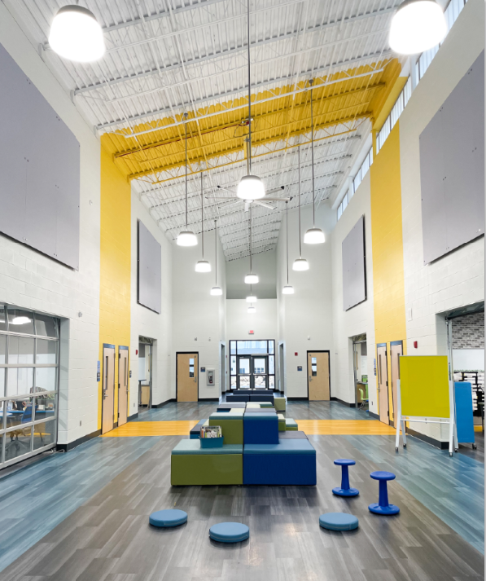

Board Consent Items - Old Mill Elementary - Close-Out Documentation
Close Out - Redlee Construction:
  Material DPO Reconciliation Credits –
    DPO 24 Credit - Sherwin Williams - $626.07 - PO 21904039
    DPO 29 Credit - Core and Main - $764.11 - PO 21904011
    DPO 30 Credit - Old Castle - $4,489.00
DPO Credit Total = $5,879.18
Final paperwork to be complete is a BG-4 for the Redlee Contract.
Old Mill Elementary School - Close Out - KDE

