Slide 1
BCES
May 2025

Slide 2
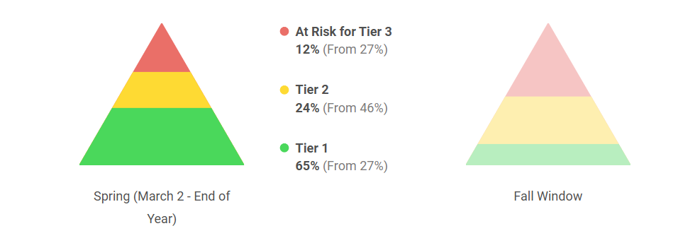
Reading Data from Fall to Spring

Slide 3
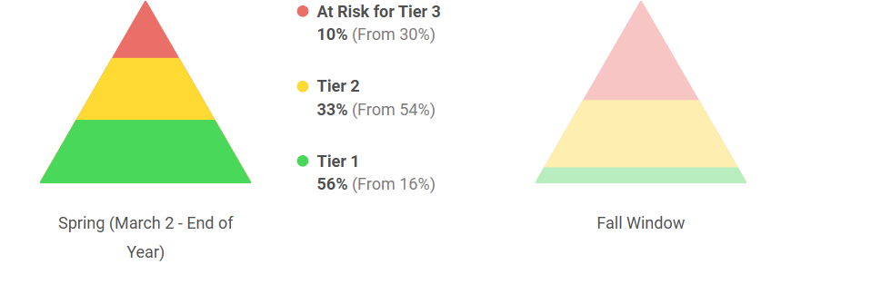
Math Data from Fall to Spring

Slide 4
Celebrations
Treasure Day: May 16
Battle of the Castles and Good Faith Effort: May 19
Color Run: May 20
Field Day: May 20
K Graduation and 5th Grade Farewell: May 21

Slide 5
BCMS

Slide 6
Middle School Celebrations
May 20: 6th and 7th Grade Awards 11:00am
May 21: 8th Grade Completion Ceremony / Awards 1:45pm
May 22: Last Day of School for Students
May 23: High School Graduation

Slide 8
BCHS

Slide 9
BCHS Highlight Dates
01 - Senior Signing Day - 10:00 A.M.
03 - BCHS Prom @ Churchill’s 8 pm -12 am
05-09 Teacher Appreciation Week
07 - Senior Awards @ 7:00 PM - Singleton Gym
08 - KSA - 10th (Makeup) & 11th - Testing
08 - AP Statistics Exam 8am
08 - AP World History Exam 12pm
09 - KSA - 11th Grade
09 - AP US History Exam 8am
09 - Application deadline for June National ACT
10 - Senior Trip to Cincinnati
10 - JAG Bed Building Project
12 - AP Music Theory Exam 12pm
13 - Underclassmen Awards (11th Grade at 9:30 AM, 9th & 10th Grades at 10:30 AM)
14 - AP English Language Composition Exam 8am
16 - AP Psychology Exam 12pm
16 - Senior Grades Due - See Fontanez for Questions
15-18 - BC Thespians present Hadestown: Teen Edition
19-23 - Graduation Practice (Senior Exams & Grades should be resolved by the 16th.)
19 - Final Exams - 1st & 2nd Periods - Grades 9-11
19 - Field Day - 10:00 A.M. - Blankenship will share details
20 - Final Exams - 3rd, 5th, 7th Periods - Grades 9-11
20- AP US History Makeup Exam 12pm
21 - Final Exams - 4th & 6th Periods - Grades 9-11
21 - AP Biology Makeup Exam 12 pm
21 - Chromebook (and charger) Collection - Information Coming
22 - Last Day of School
22 - Senior Walk
22 - Senior Breakfast - Silver Creek Baptist Church - 11:00 A.M.
22 - Senior Salute
22 - Junior/Senior Water War
23 - Closing Day
23 - Graduation at Phelps Stokes Chapel (Tentative Location) - 7:30 PM
26 - Memorial Day (no school)
27 - Staff Work Day

