Slide 1

Attendance and Enrollment
April 2025 Review
DPP- Kyle French Created 4/16/25

Slide 2
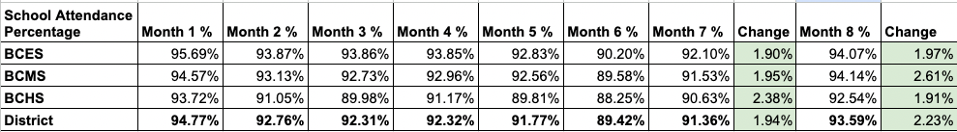
Attendance Rates
Section
Section
12
Pre School Attendance | YTD-89.32% Month- 89.28%

Slide 3
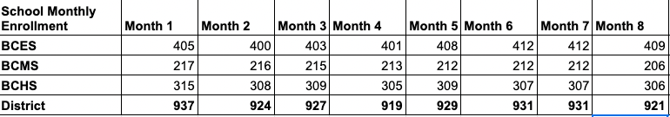
Enrollment Rates
Section
Section
12

