Slide 1
BCES February Board Report
Counselor Week Appreciation-
Mr. Craig Dollins
Upcoming Events:
2/18/25- First and Second Grade Music Concert @6:00
2/21/25- Club Day
3/3-3/7/25- Reading across America Week

Slide 2
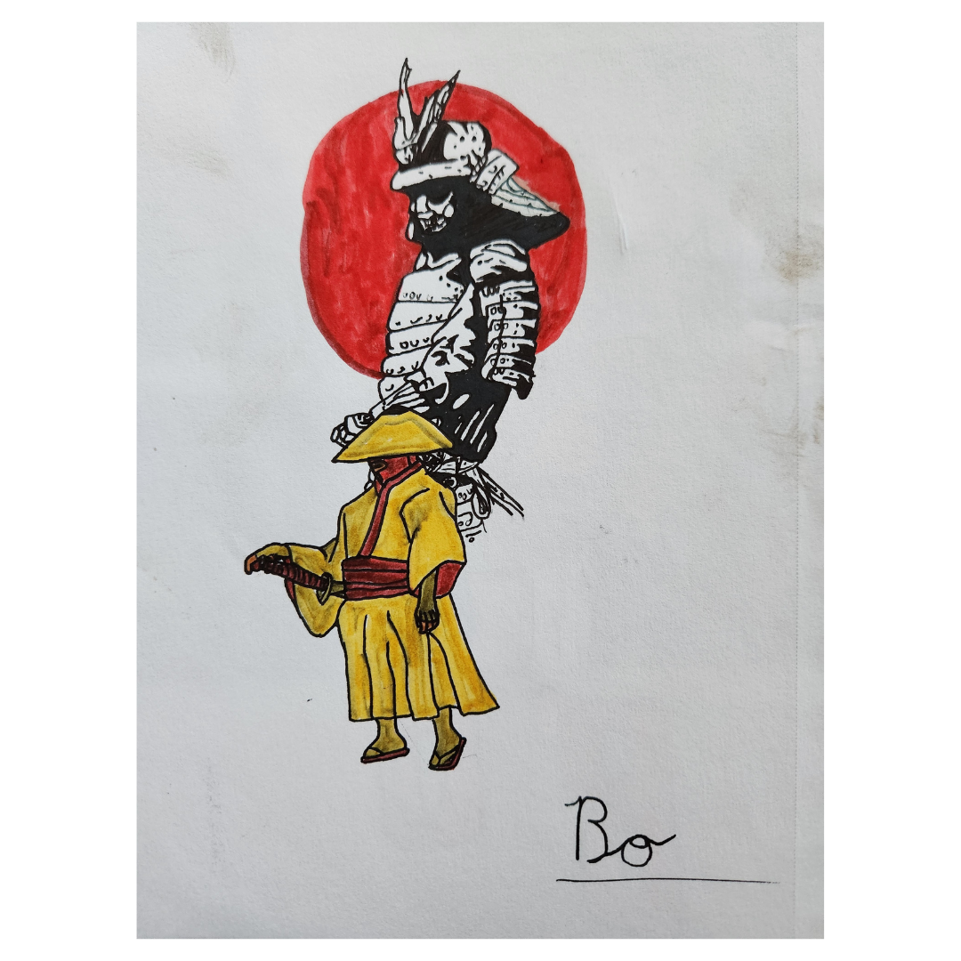
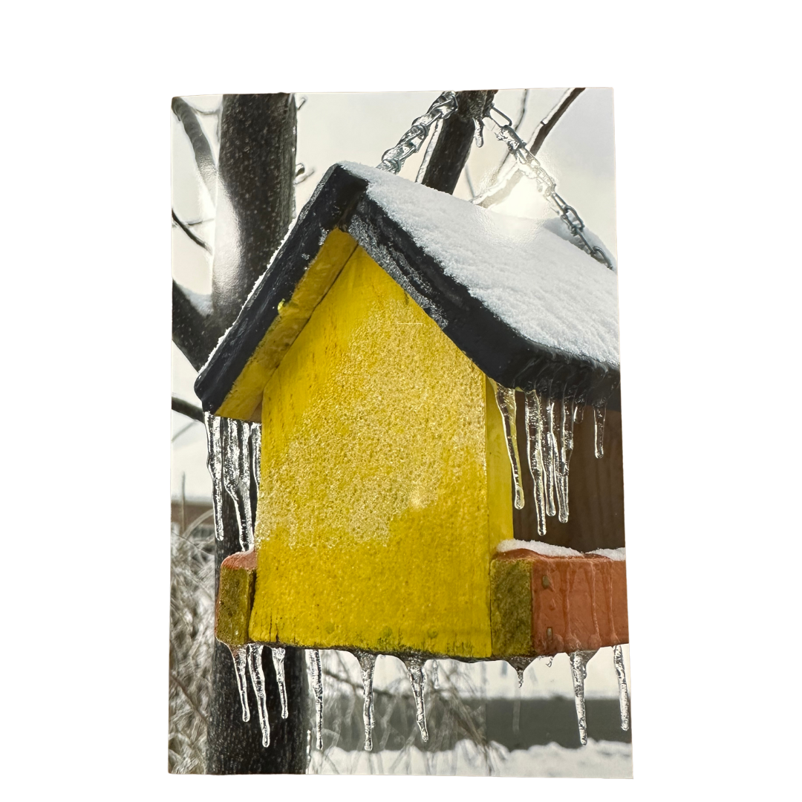
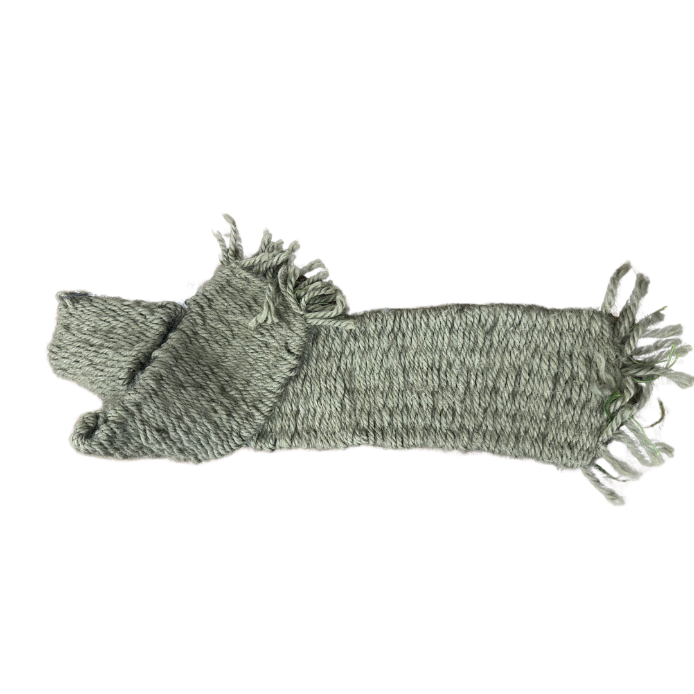
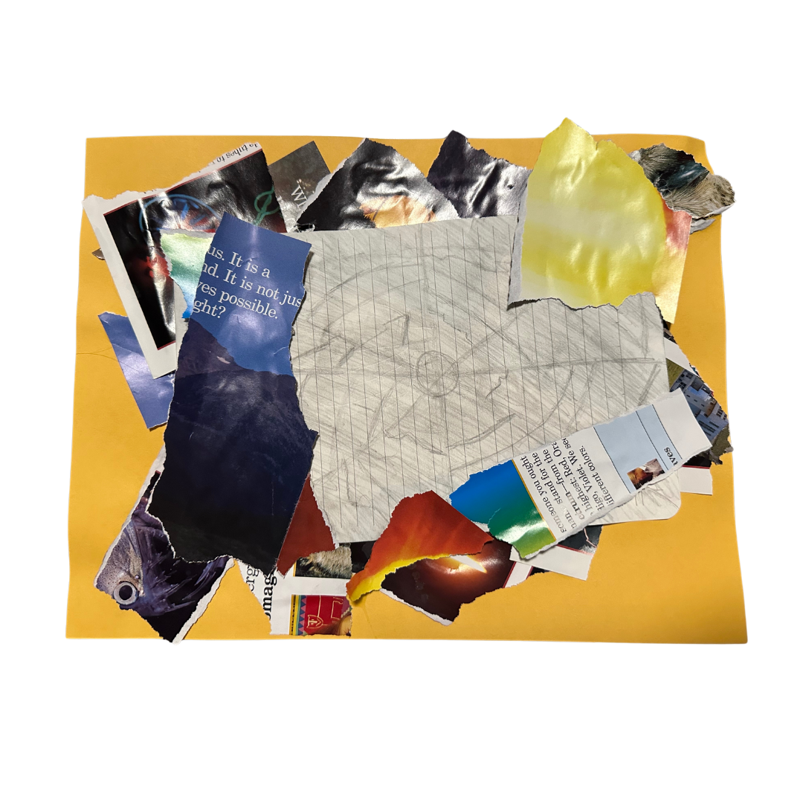
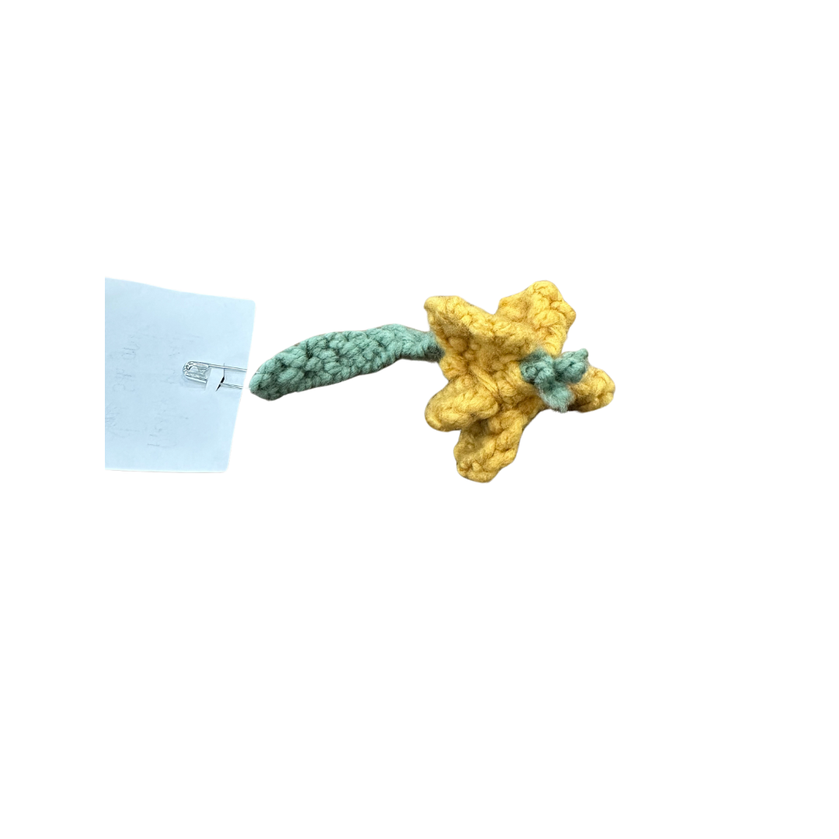
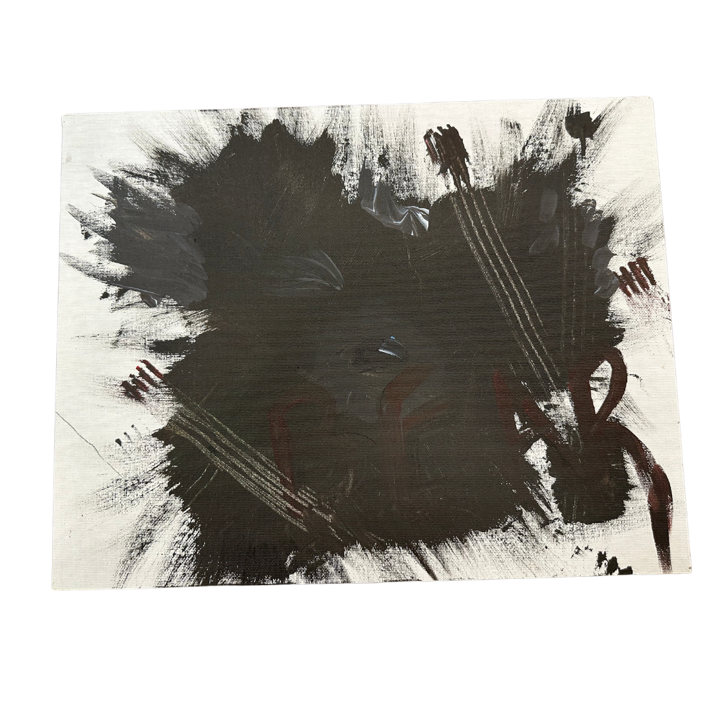
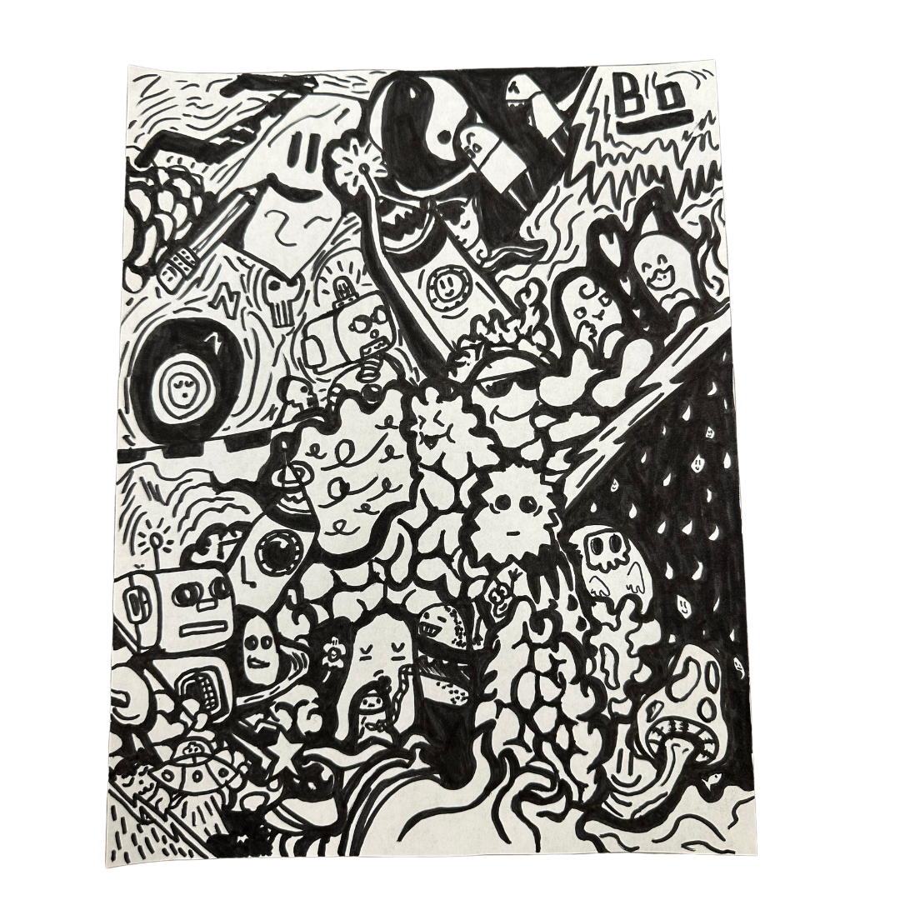
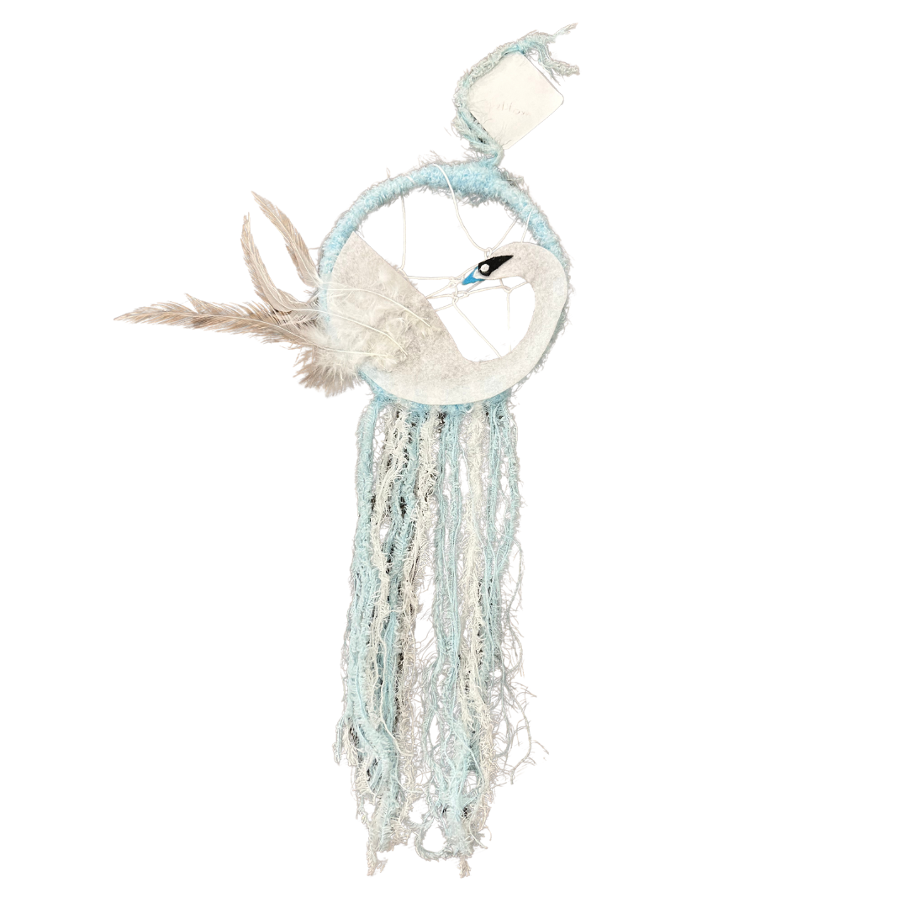
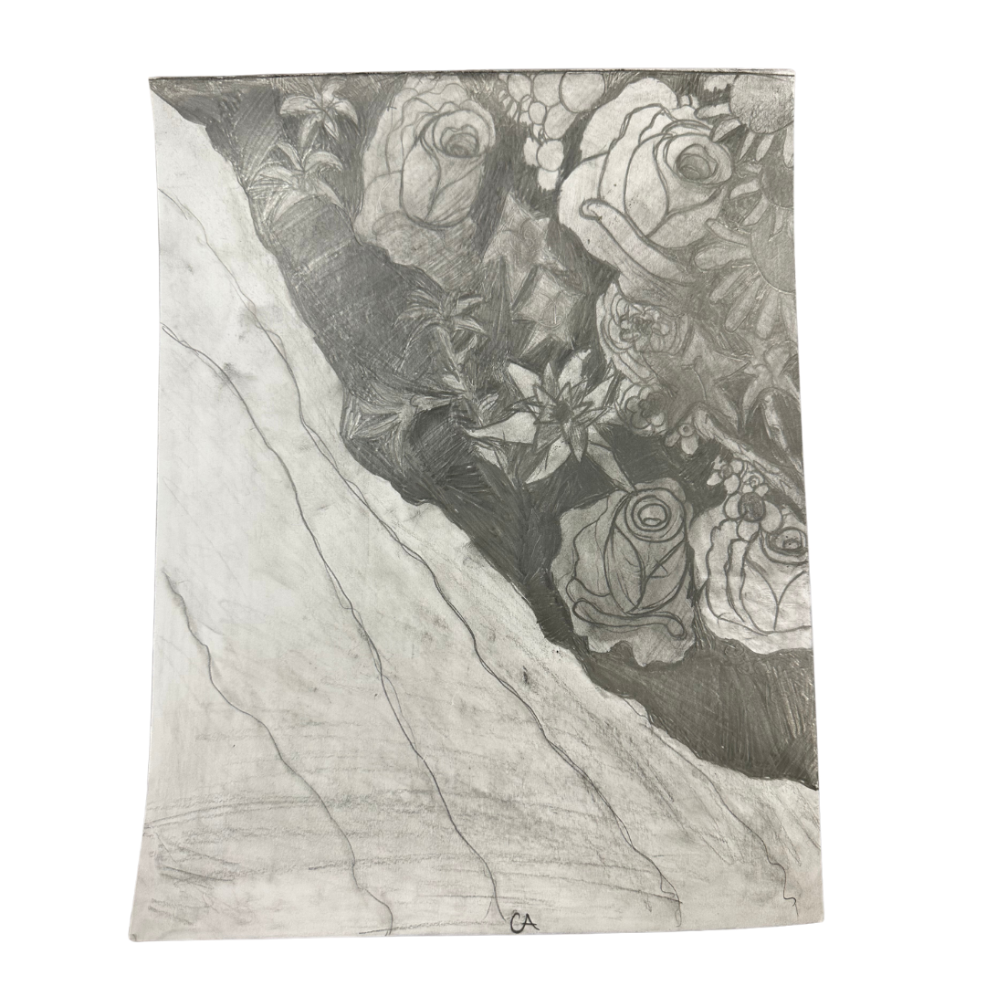
Spot Light: Art- All State Competition

Slide 3
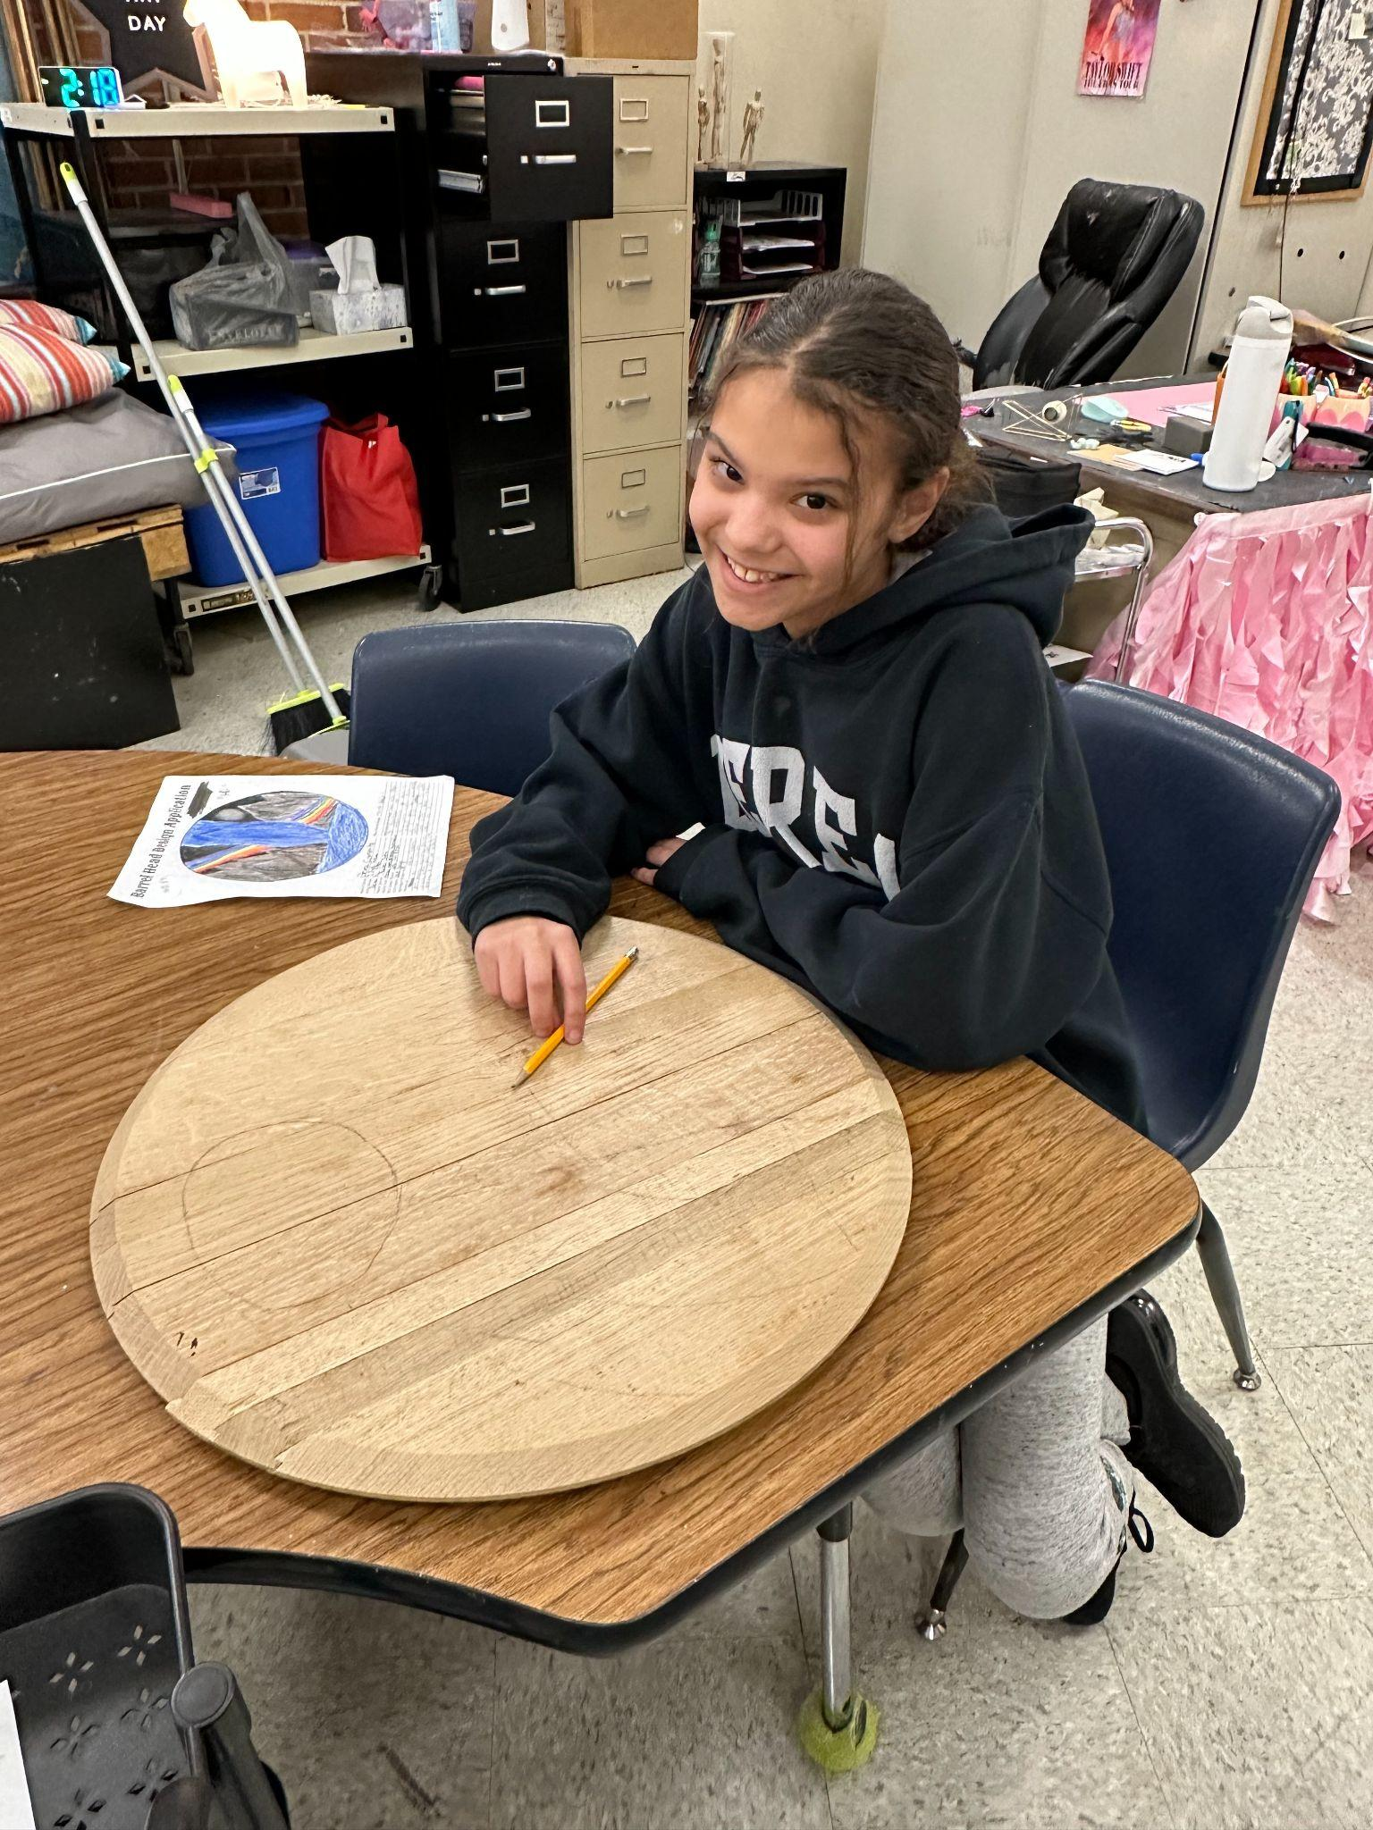
National Art Conference
Maya was chosen to be one out of 30 students (K-12) in Kentucky to represent an areA of Kentucky on their barrel painting in March.
Cumberland Falls Moon Bow
Maya Richardson

