Slide 1


Slide 2



Slide 3


HCHS CTE Construction Project

Slide 4
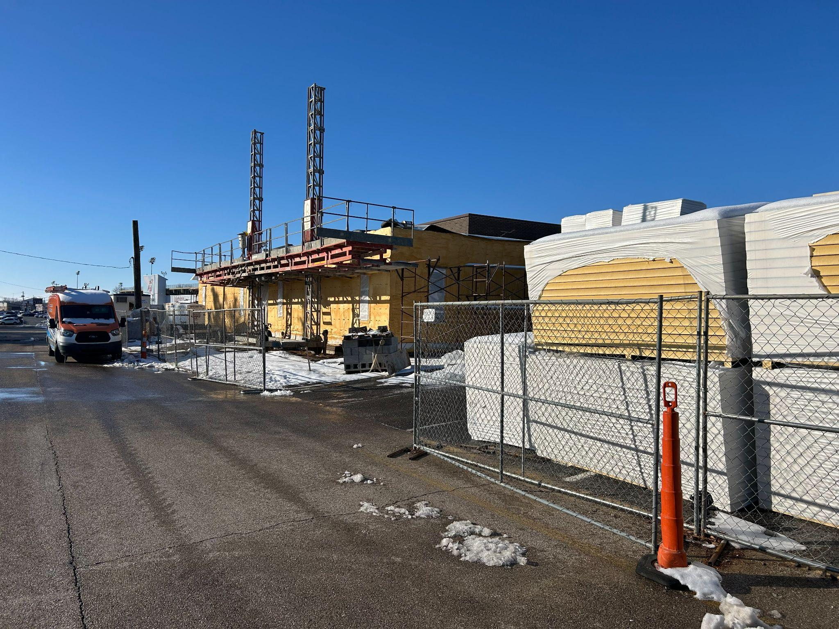

Notes:
Outside exterior of the two new health science classrooms

Slide 5
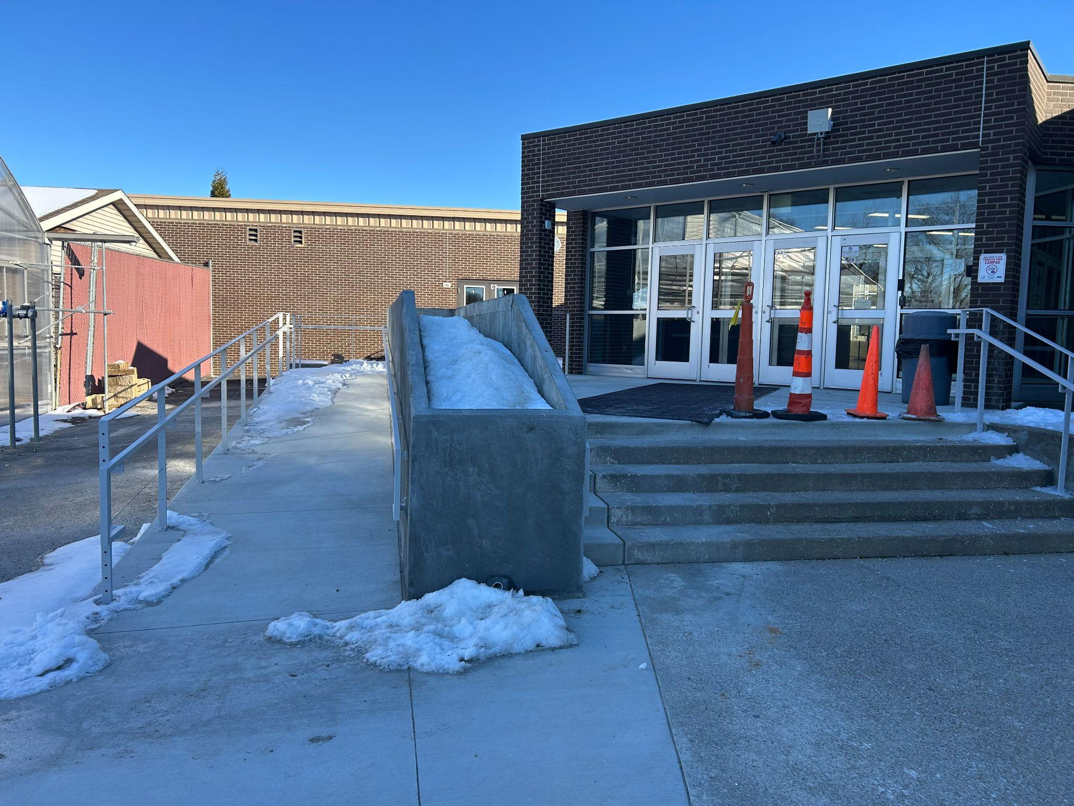
Notes:
New ADA accessible south entrance

Slide 6
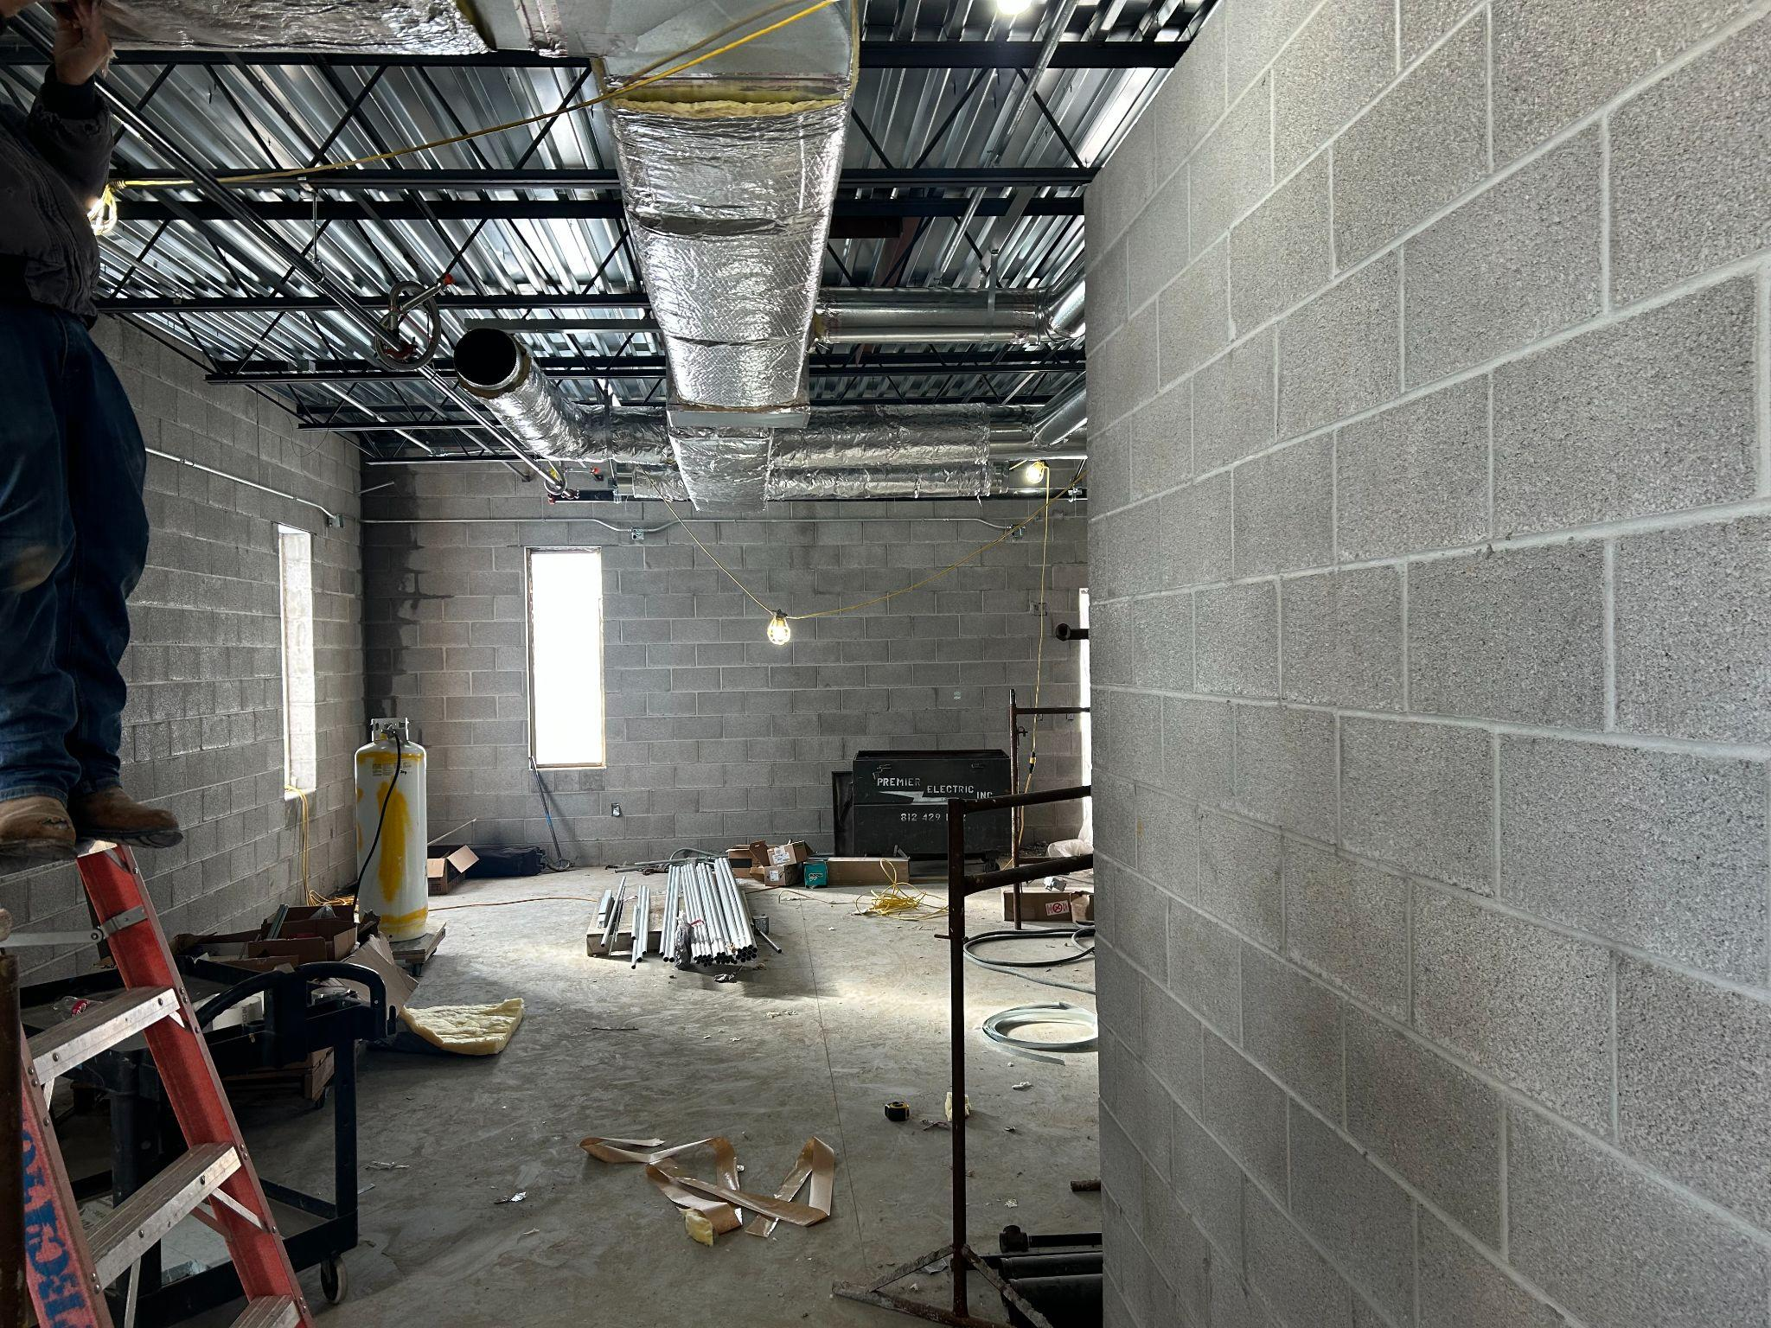
Notes:
Inside the new south side Health Science Classroom

Slide 7
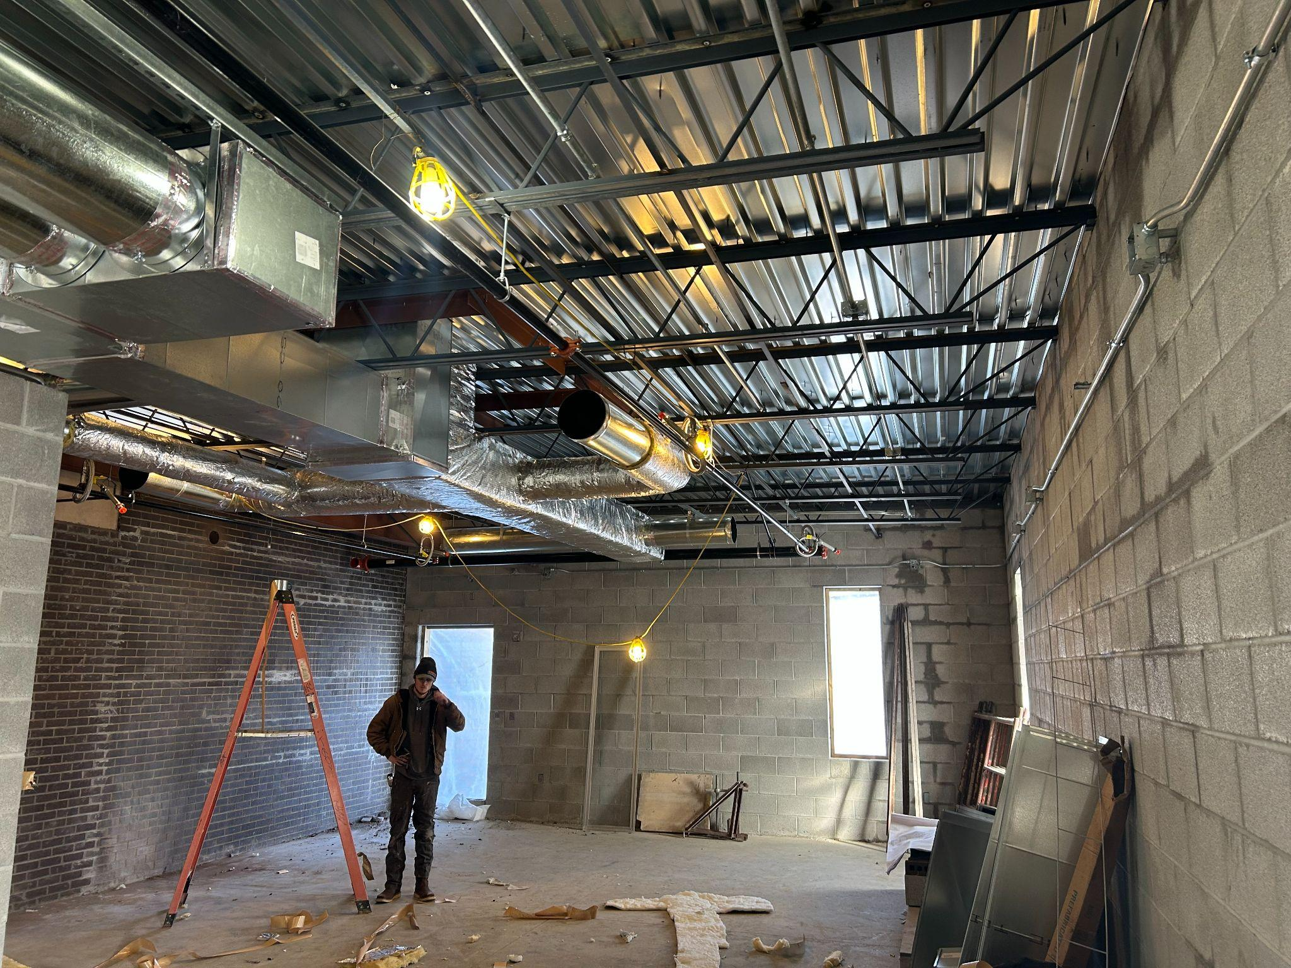
Notes:
Inside new north side health science classroom. Also the person standing in the photo is a graduate of The Central Academy and is working for Perfection Heating and Air. Nic Schneider

Slide 8
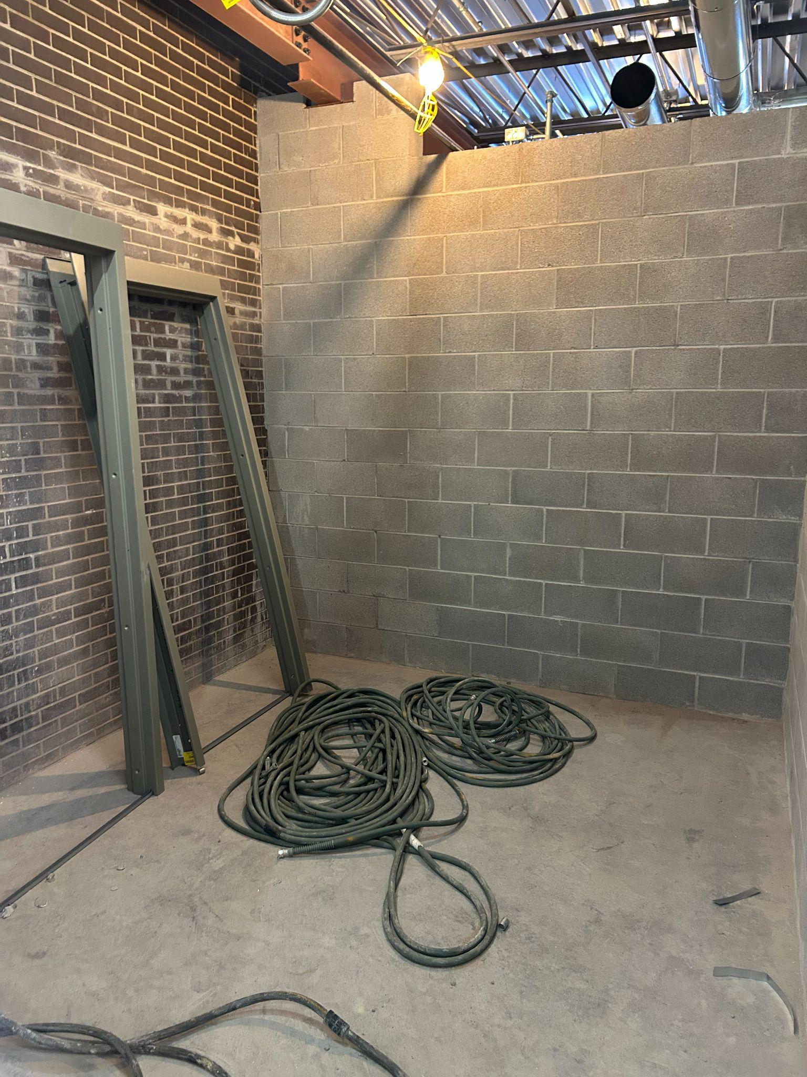
Notes:
Office #1 for Health Science teacher

Slide 9
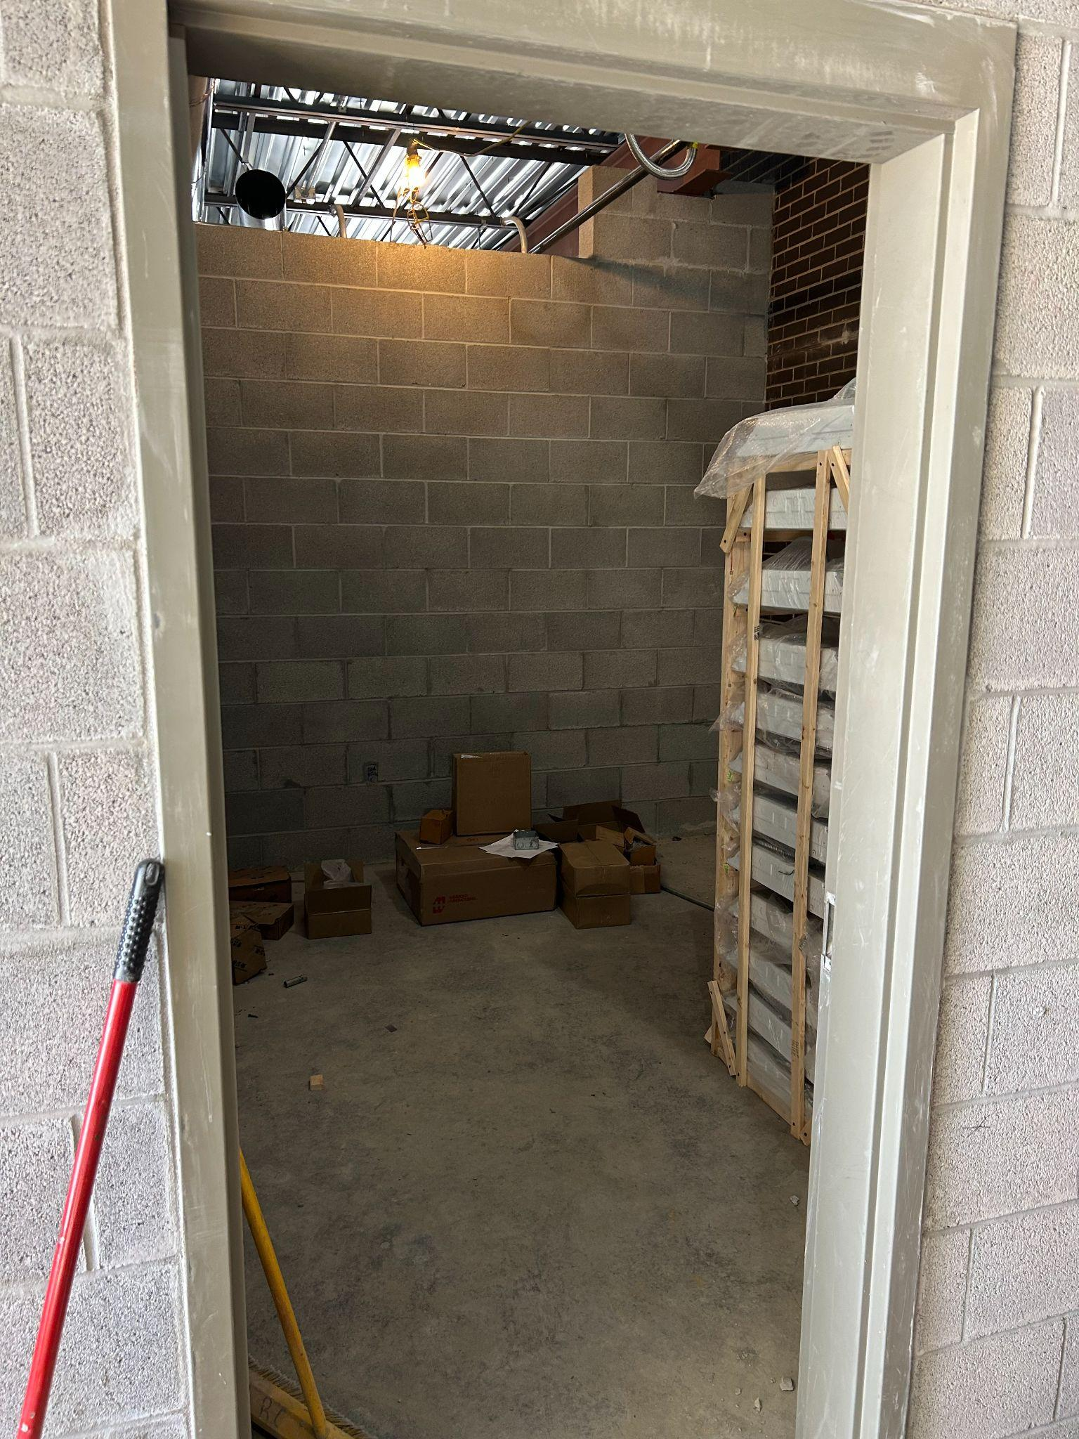
Notes:
Office #2 for Health Science teachers

Slide 10
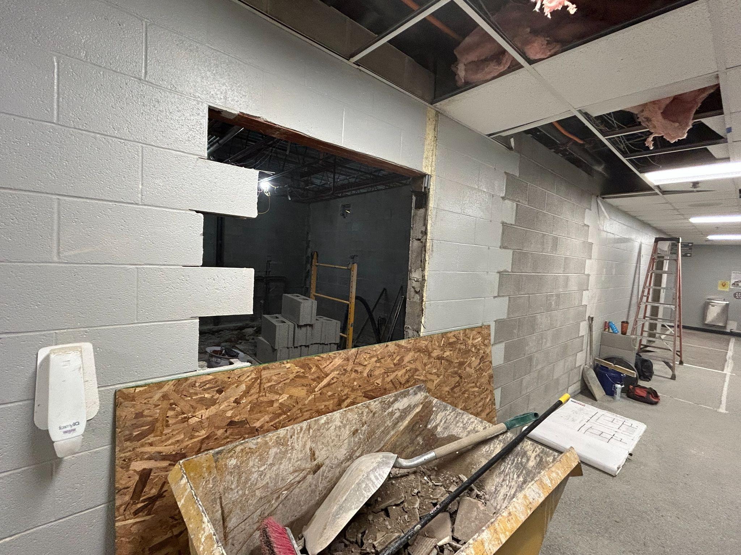
Notes:
CTE Hallway renovation to the student restrooms

Slide 11
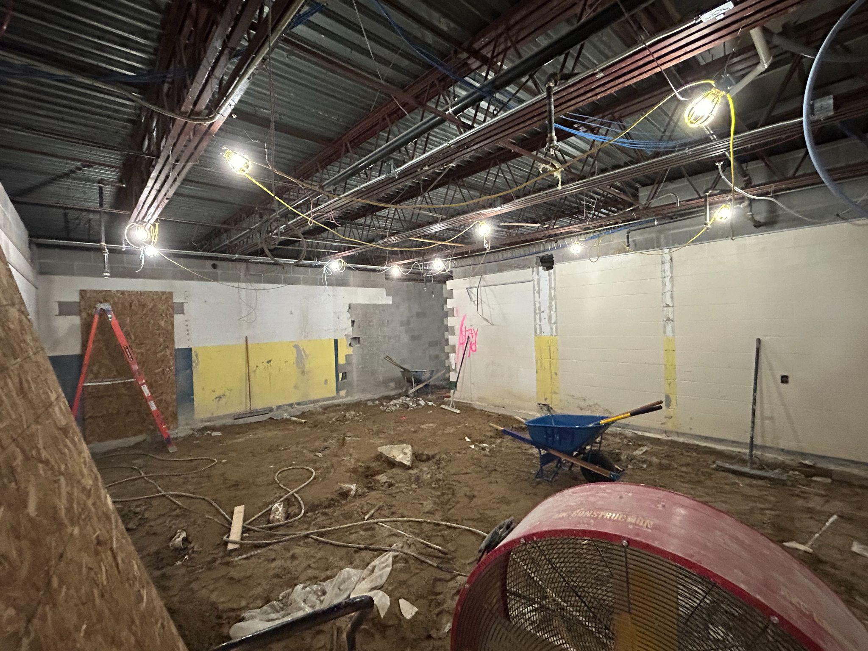
Notes:
Current state of restroom renovation

