Slide 1
Terrace metrics
2024

Slide 2
Indicators assessed
RESILIENCY
Positive School Experiences
Global Satisfaction
Hope
Grit
Resiliency
Personal Standards
Leadership
RISK
Anxiety
Bullying Others
Getting Bullied
Ostracism
Depression
Trauma
Self-criticism
School Violence
Drugs/Alcohol

Slide 3
RESILIENCY SURVEY SUMMARY OF RESULTS SOUTHGATE INDEPENDENT SCHOOLS
• Thirty-five percent of students were placed in the optimal or satisfactory resiliency/wellness categories, a 5% increase from a year ago
--Sixteen percent of students were in the “may need assistance” category, which is consistent from last year
• Most Average resiliency scores were at or higher than a year ago
--Global satisfaction and grit were the largest exceptions
--The positive social connections average score was slightly more favorable than a year ago
• In comparison to the Fall 2022 semester, slightly less 6th-8th grade students reported elevated anxiety and depression
--More 3rd-5th graders reported elevated levels of anxiety than a year ago

Slide 4
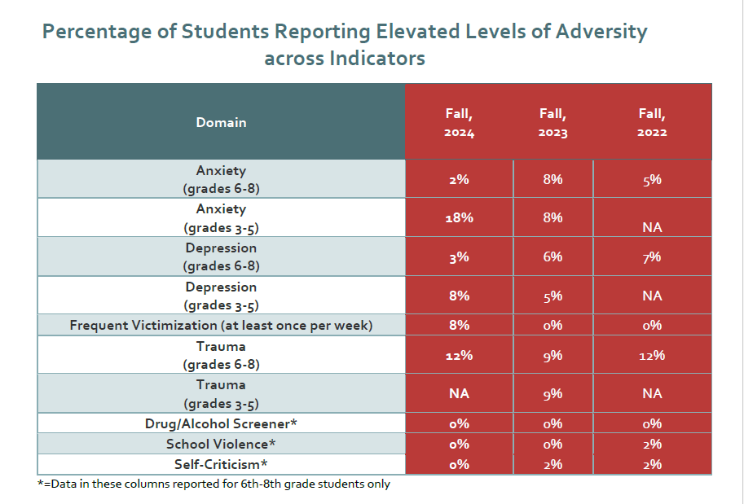

Slide 5
Strategies for Improvement
13 students flagged “Priority 1” (3 referred to Ms. Weber, 3 referred to Miss Emily, 3 referred to Mr. Ray, 3 referred to parent/doctor, 1 referred to Mrs. Melville)
Weekly mentoring with school staff
Administer mock QSCS survey during Dec. MAP assessment
Bullying education and reporting measures?
Social/emotional learning embedded in curriculum at all grade levels
Terrace Metrics tiered intervention tools
Trauma-informed assessment walkthrough and updated district trauma plan

