Slide 1
2024 Kentucky Summative Assessment KSA
Dawson Springs Elementary School

Slide 2
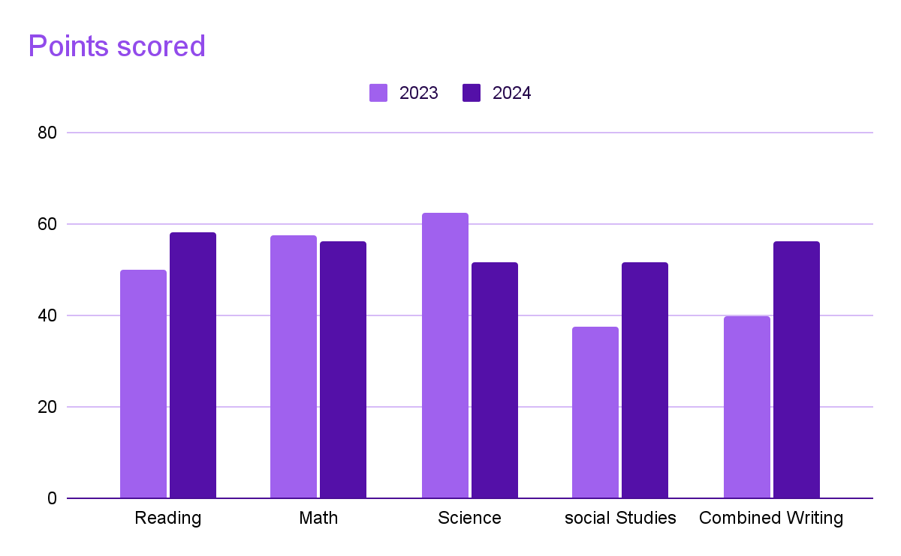
Dawson Springs Elementary School
 | 2023 | 2024
Reading | 49.8 | 58
Math | 57.4 | 56.3
Science | 62.5 | 51.6
Social Studies | 37.5 | 51.3
Combined Writing | 39.8 | 56.3

Slide 3
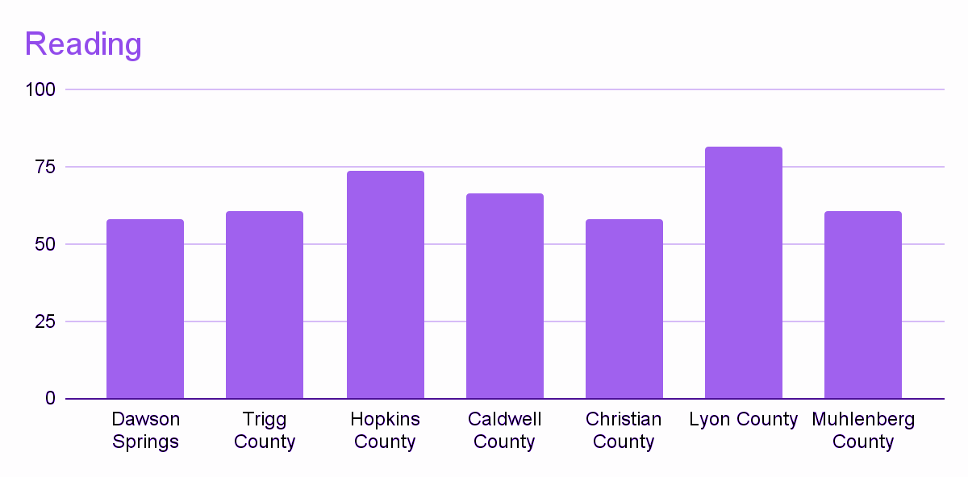
Reading

Slide 4
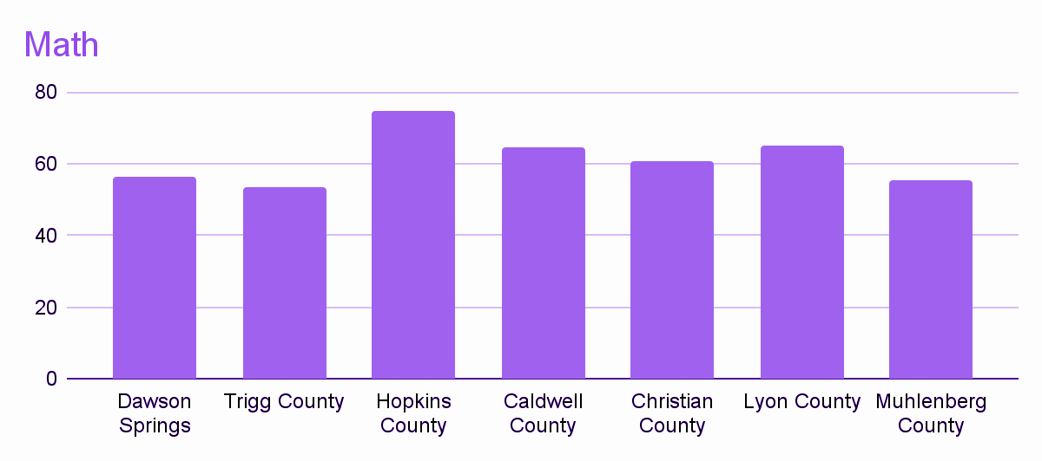
Math

Slide 5
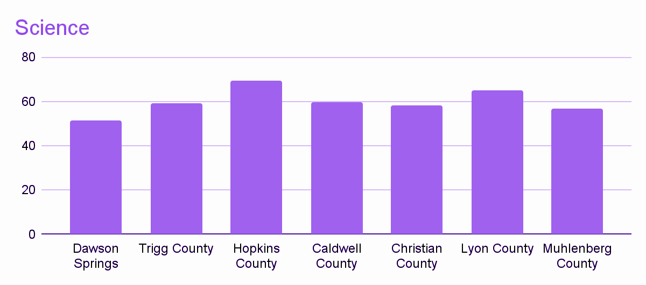
Science

Slide 6
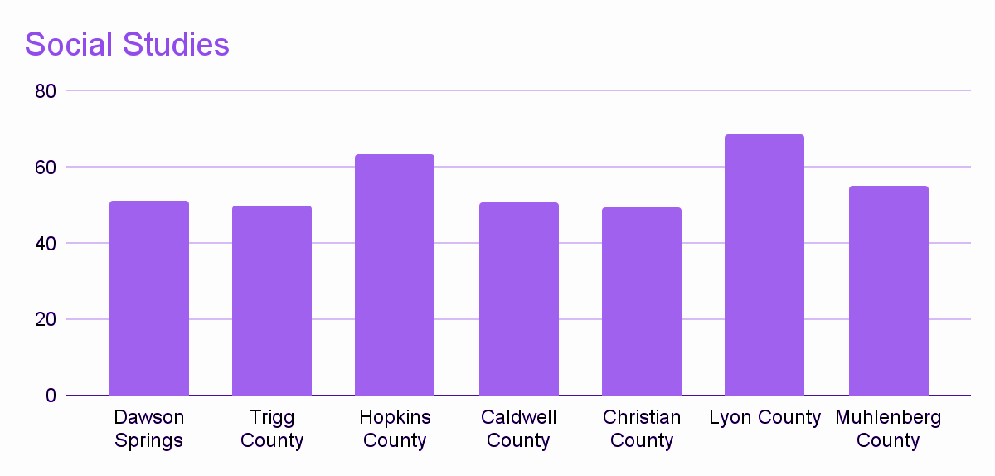
Social Studies

Slide 7
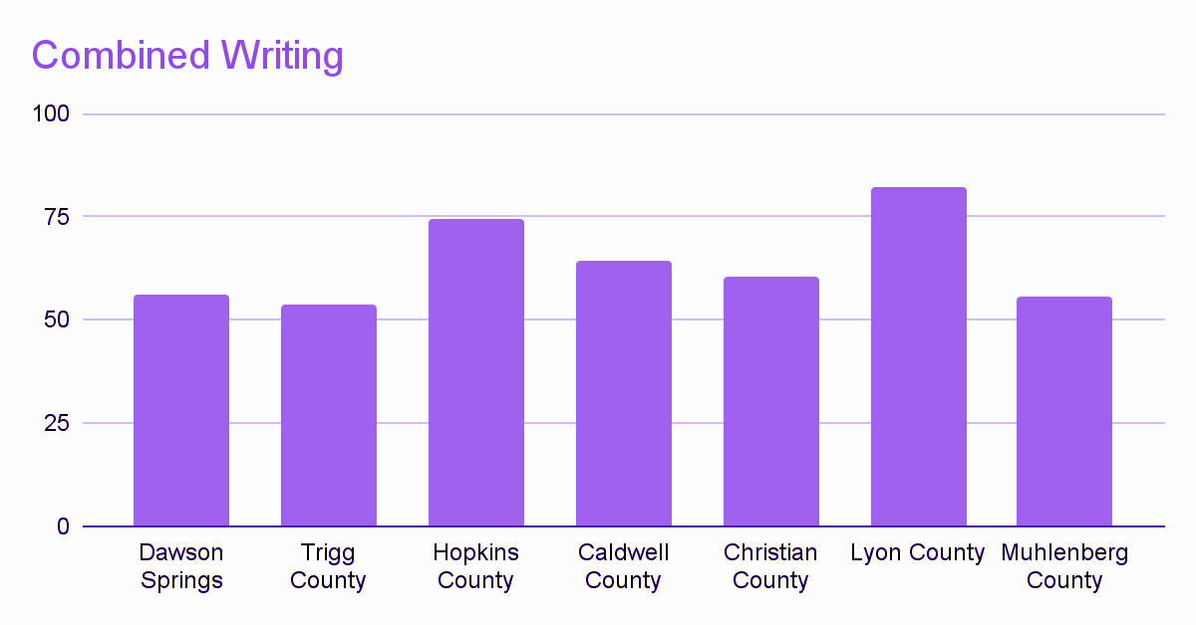
Combined Writing

