Slide 1

Board Spotlight October 2024
Notes:
Title Slide 02

Slide 2



Tackling attendance is a top priority across the state
Notes:
Divider Slide 02

Slide 3

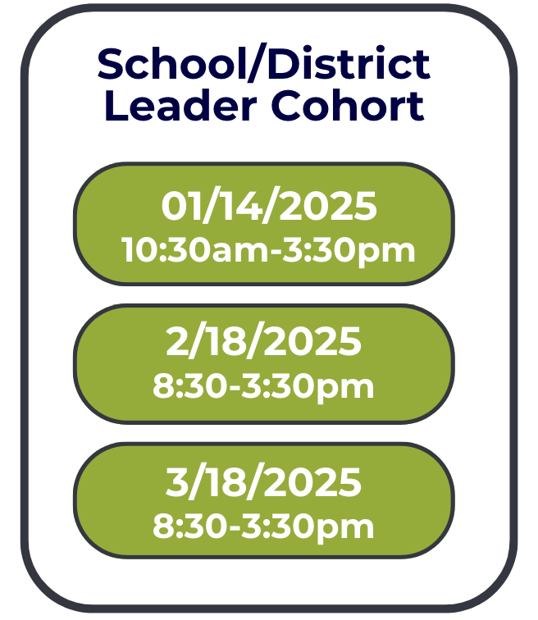


Slide 4
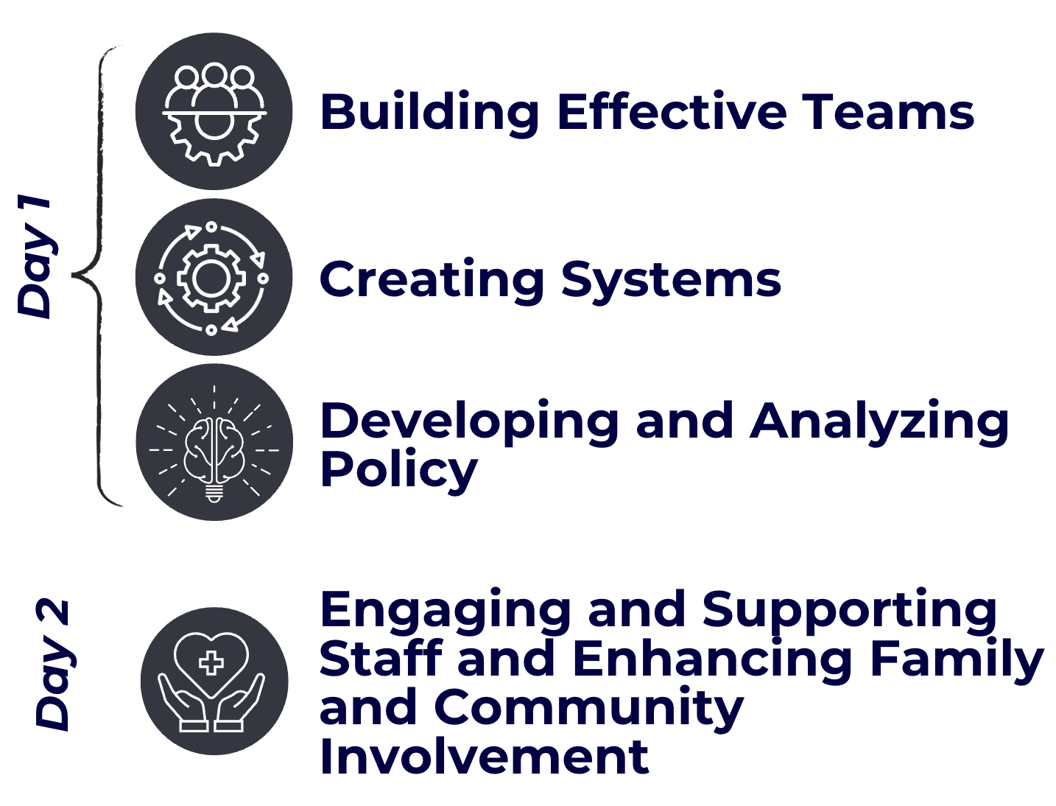


Day 1 and Day 2 Breakdown
*designed for District and School Leaders

Slide 5



Day 3 Breakdown
*designed for leadership teams and teachers
Notes:
Divider Slide 02

Slide 6
Example teams for trainings
District DPP
Building Level Administrator
FRYSC
Counselor
School Social Worker
Teacher Leader(Day 3 only)

Slide 7

CONTINUOUS SUPPORT
NKCES Team will provide coaching support for school and district teams between cohort meetings as needed.

Slide 8

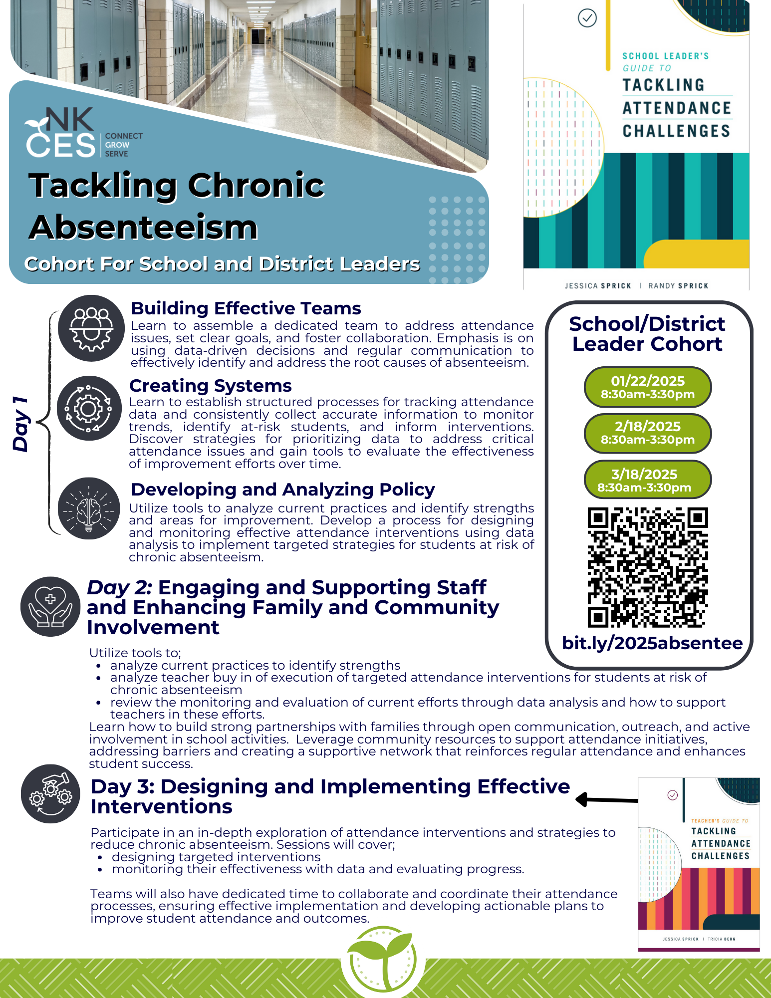
Register
Here

