Slide 1

Glenn O. Swing Elementary School
2024-2025 Presentation to the CIPS Board of Education
Principal - Ellen Peach
Assistant Principal - Karissa Storey

Slide 2
School Data Snapshot
Data Source | 2022-2023 | 2023-2024 | 2024-2025
K Readiness | 30% Ready | 49% Ready | No Data
3rd Grade Reading | 21- 22 KSA: 53% P/D EOY Benchmark: 71% | 22-23 KSA: 66% P/D EOY Benchmark: 72% | 23-24 KSA: No Data EOY Goal: 80%
ADA | 94.2% | 94.5% | Goal: 95.5%
New Staff | 16% | 18% | 17%
<5 Years Experience | 52% | 46% | 42%
Family Engagement | EOY - 95% | EOY - 95% | Goal: 97%

Slide 3
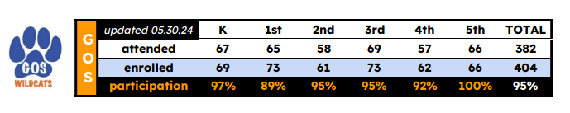
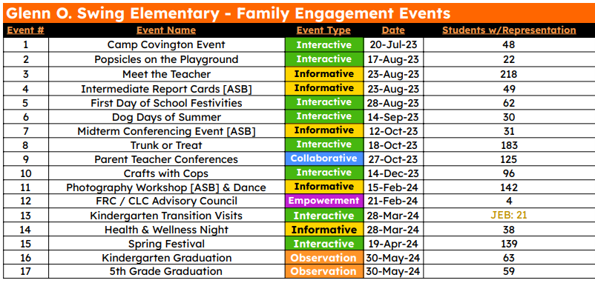
School Data Snapshot

Slide 4
What We Do Best!
Our Systems
Some of our systems include MTSS, PLCs, data analysis process, feedback loop for formative assessments, walkthroughs/coaching
All staff work collaboratively to meet student needs - wrap around approach

Slide 5
School Focuses
Through our Plan, Do, Study, Act (PDSA), we have targeted three growth areas:
1: Active Participation - Teachers will create more opportunities for ALL students in the class to proactively engage throughout the lesson. Administrators will discuss, provide examples of and model active engagement strategies to get more students engaged in their classroom during instruction. We will use unit planning, walkthrough observation feedback and focus visit results (ELEOT tool) to measure our progress.
2: Student Work Analysis Follow-Up Plan - During student work analysis sessions, teachers will develop clear actions on what and how they will teach areas of concern found, with follow up coaching and support from administration.
3: Foundational Skills and Vocabulary Instruction - Implementation of systematic foundational skills and vocabulary instruction in order to fill missing gaps and work towards 80%+ benchmark and improved reading comprehension.

Slide 6
Come to GOS!
Selling GOS in 30 seconds:
Here at GOS, we ensure every student is ‘Respectful, Responsible and Ready to Learn’! Glenn O. Swing has been rated a ‘blue’ school by Kentucky Department of Education, we are in the top 7% of schools in the state and we are the number 1 school in Kenton County. Our teachers and staff strive daily to hold every student to the highest expectations, both academically and behaviorally. By working collaboratively, our GOS team ensures the success of the whole child and we do not stop until your child reaches his or her fullest potential. We treat our students as our own, and we would be happy to have you join the Wildcat Family!

Slide 7
Promoting GOS in the Community
-Open House
-Monthly Family Nights
-Adopt-a-Class
-Service Learning Projects
-Friends of Peaselburg Neighborhood Association
-Pointe Benton Lane Social Committee
-Center for Great Neighborhoods
-Scripps Howard Foundation/WCPO
-Social Media - School website, Facebook, Instagram

Slide 8
School Culture
-Attendance: Letters home explaining attendance process, collaboration between school and district attendance team, weekly incentive for classes with highest attendance percentage, monthly incentive for students who meet attendance goals
-Impact Survey Data: Shared and analyzed data with staff and determined next steps as a team. Received feedback from all staff on next steps in lowest 4 areas.
-QSCS Data: Shared/analyzed data with staff, progress monitoring areas of concern, analyzed SRSS scores, tier I taught by classroom teachers, and more classroom guidance and small groups

Slide 9
PLCs and Collaboration
-Vertical and grade level teams make up PLCs
-PLCs meet daily to analyze student work and data - formative and summative
-Create action plans to address areas of weakness identified in analysis sessions
-Collaborate on unit plan development
-Provide feedback on formative and summative assessments before administering them
-Set team goals for assessments
-Teachers observe peers to learn instructional strategies from one another
-Admin attend all PLC meetings and monitor student growth throughout the process

Slide 10
Teacher Retention
-New(er) Staff:
-Developed a more robust and formal mentor system
-Mentorship over first three years
-Veteran Staff:
-Leadership opportunities
-Autonomy
-PLC process retains our staff - protected time, admin/teacher side-by-side approach, and collaboration

Slide 11
Professional Development
-Staff has positive feedback on professional development this year
-Positives:
-Tailored to our specific needs
-Teacher Planning Days and Equivalency Days have played a crucial role in
planning process
-More staff choice with PD Academy and flex hours
-Monitored through walkthroughs, lesson plan checks, and student work analysis

Slide 12
Curriculum Development
-Prior to the School Year
-New staff attendance training on UPOs and the unit planning process
-Teachers attended sessions at the PD Academy focused on the curriculum for their content
area
-During the School Year
-Daily planning time is given to allow teachers to collaborate with peers in unit planning
-Monthly planning by district
-Admin and teachers plan side-by-side to support teachers’ work
-Unit plans are written following CIPS district curriculum/UPOs and EDI format
-Unit plans are submitted through the Google Drive
-Admin feedback meetings are held every Wednesday morning
-Feedback is given by administrators- using tiered system
-Teachers make revisions as needed

Slide 13
Technology
-1:1 technology for all students- iPads
-Tech programs and platforms being used:
-Xtramath
-Amplify- science
-Google Classroom- digital ICNs
-Mastery Connect- flashbacks and unit assessments
-Digital texts through myView and other literacy platforms
-SAVAAS in all content areas
-Rollout continues to go very smoothly and incorporation of tech into all classrooms is natural
-Monitored through student work analysis sessions and assessment/flashback
analysis sessions

