Slide 1
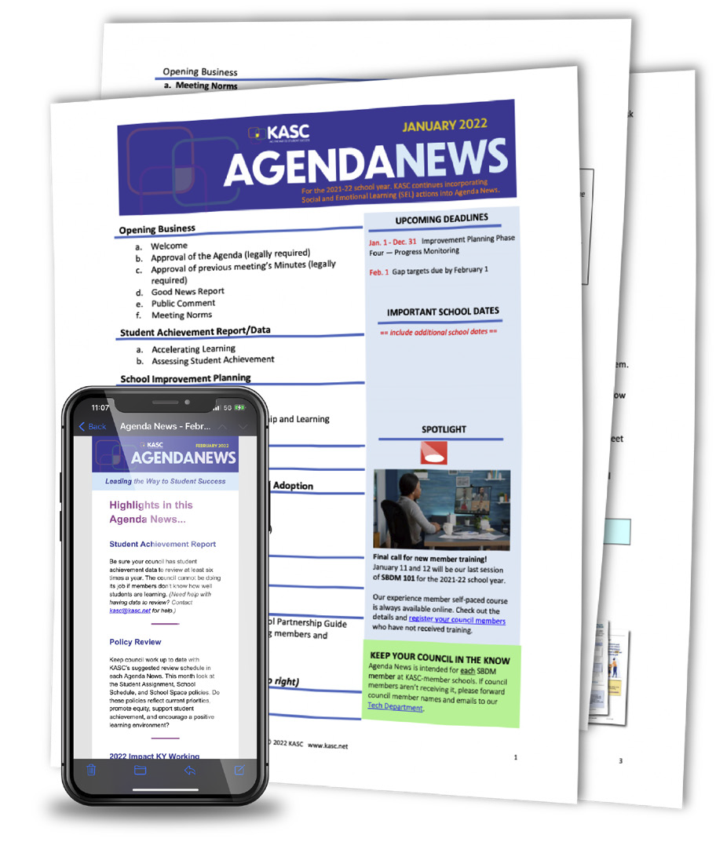


Kentucky Association of School Councils

Slide 2
4400+
640+
60+
Members across Kentucky
Schools
District Members

Slide 3

96/123
Member Schools
78%

Slide 4

We Are…
Efficient
Effective
Evidence Based
Simplify state requirements
Provide sample policies
Develop time-saving tools
Answer questions quickly
Provide step-by-step guidance
Facilitate professional learning
Create instructional products
Stay current on research
Align everything we provide with best practices
Provide customized support and coaching

Slide 5



Our WHY
KASC believes in the unlimited potential of human beings.
People, with support and caring, can accomplish anything.

Slide 6
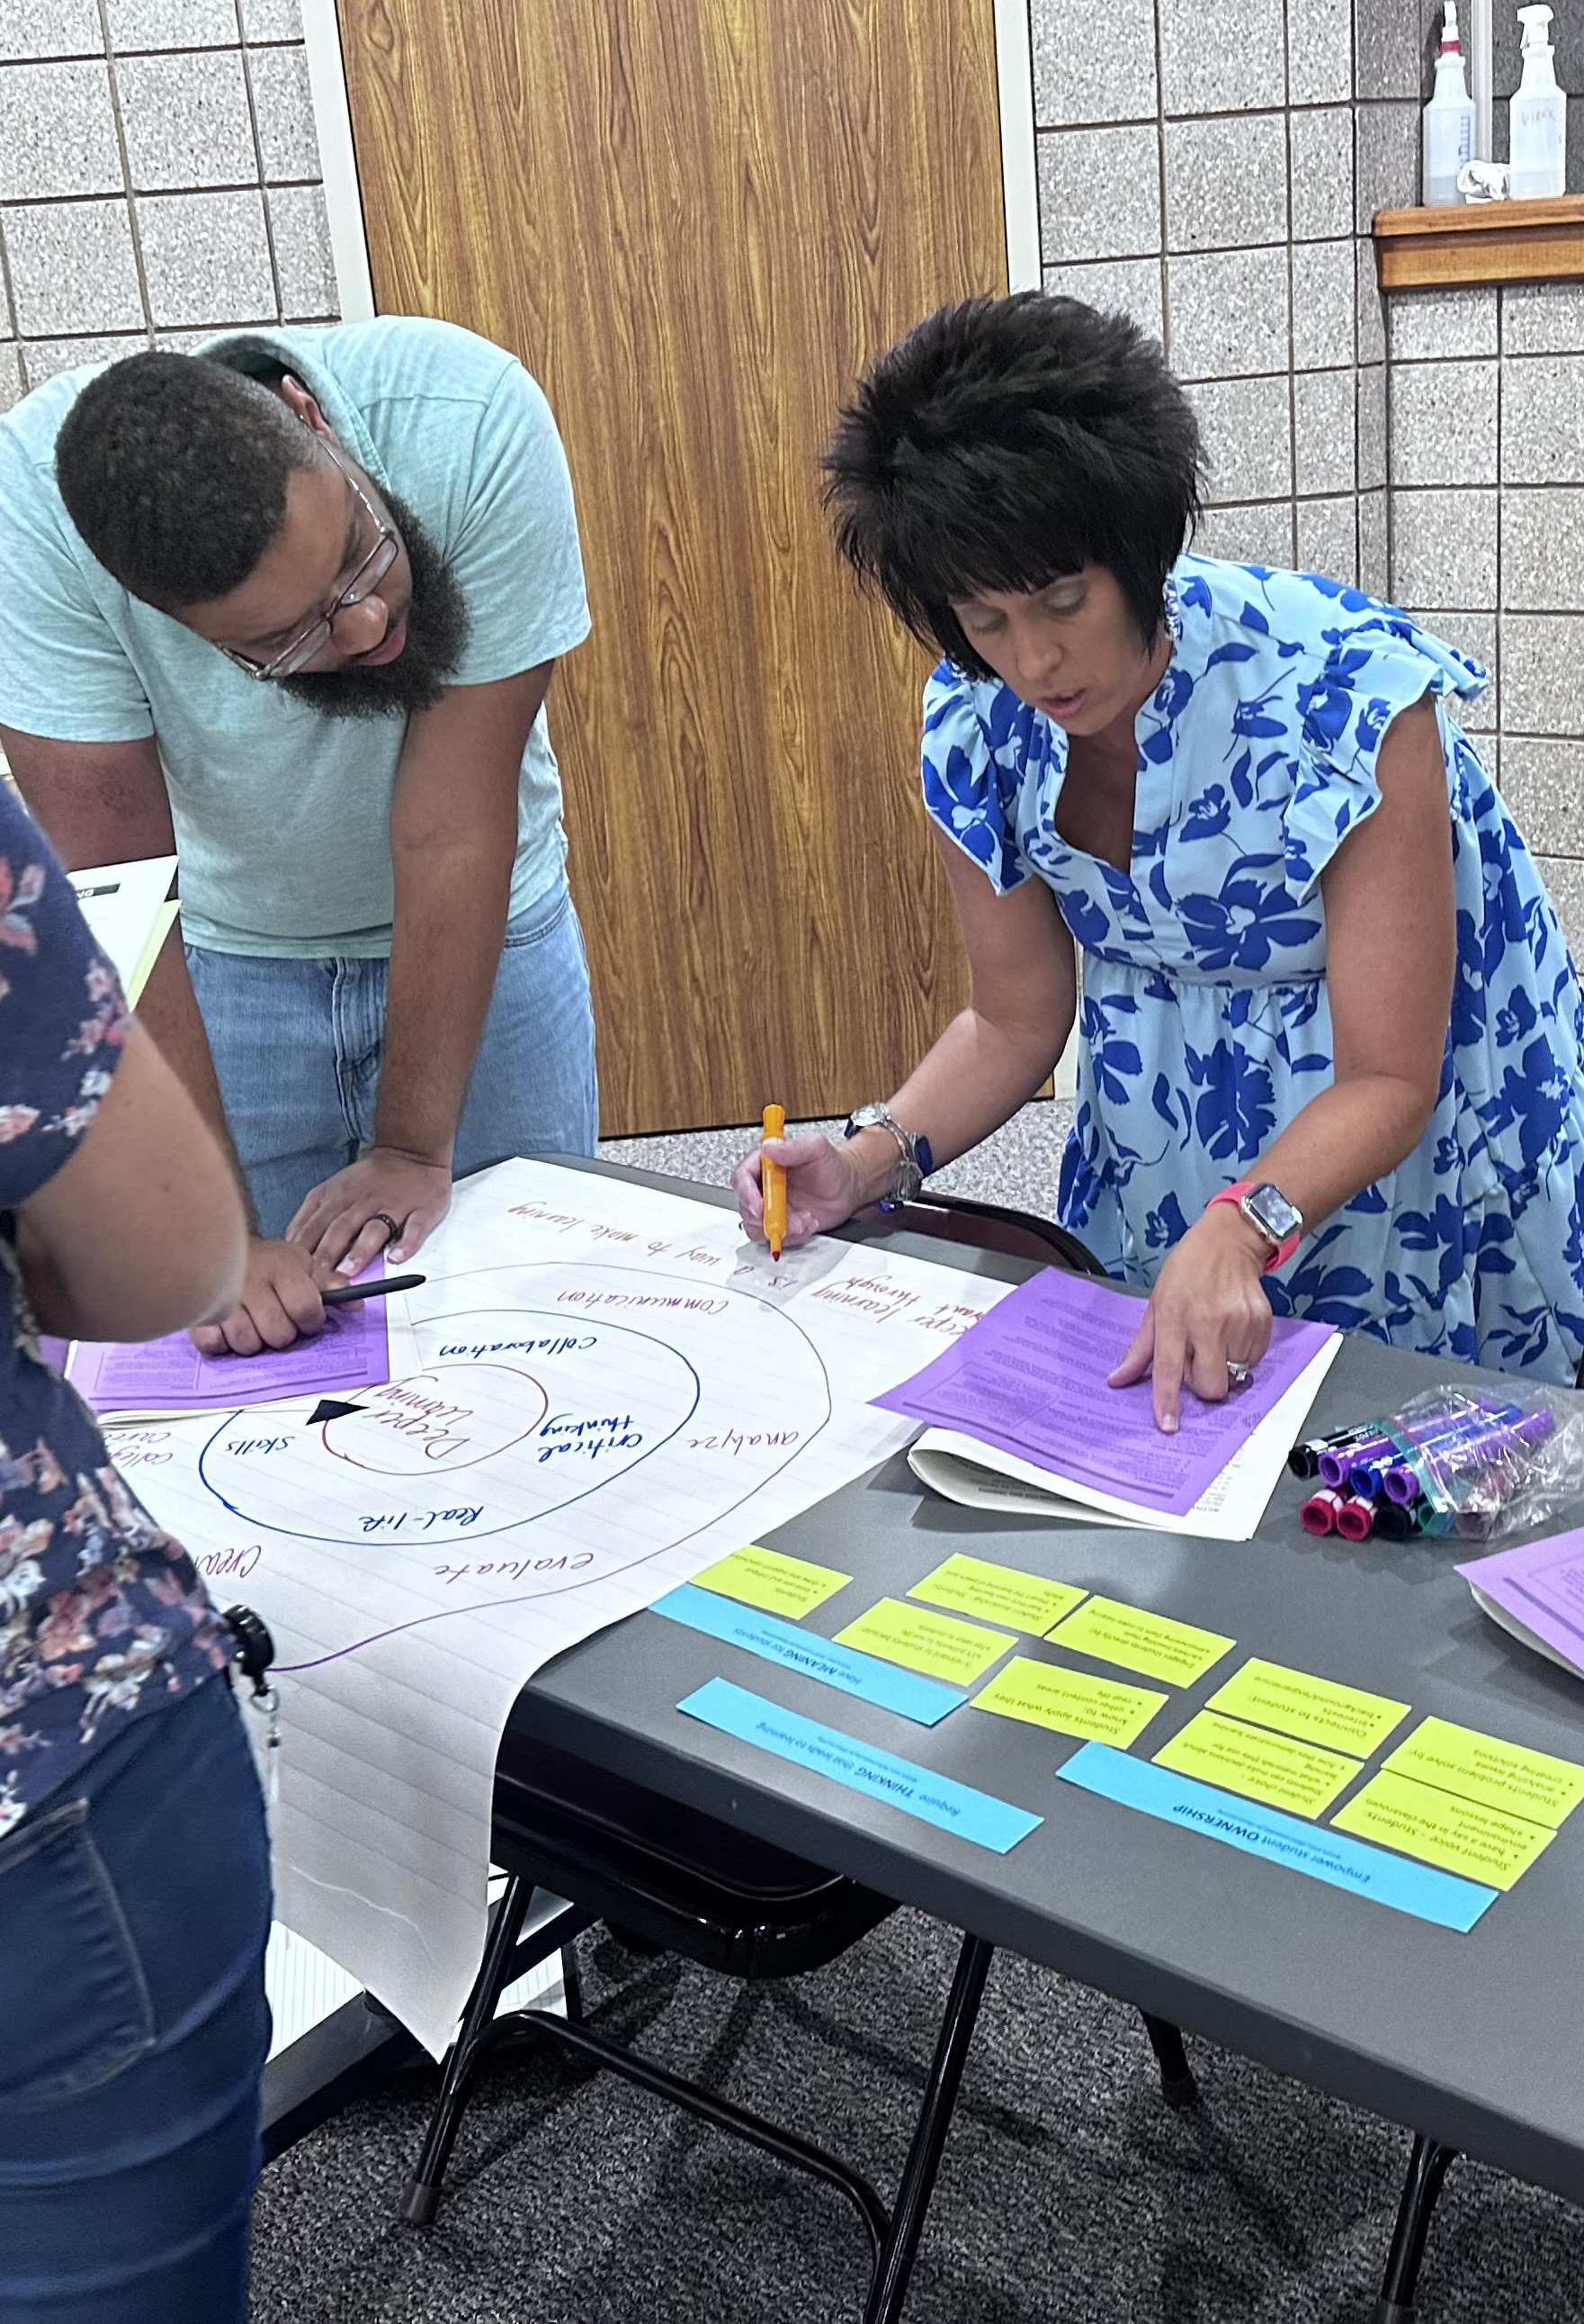
KASC Membership Includes:
Practical tools and resources focused on student achievement and improvement.
Quick answers to questions and expert legal advice.
Big discounts on products, training, and more.
An inside track on new resources and requirements.
A strong voice on issues facing councils and schools.

Slide 7
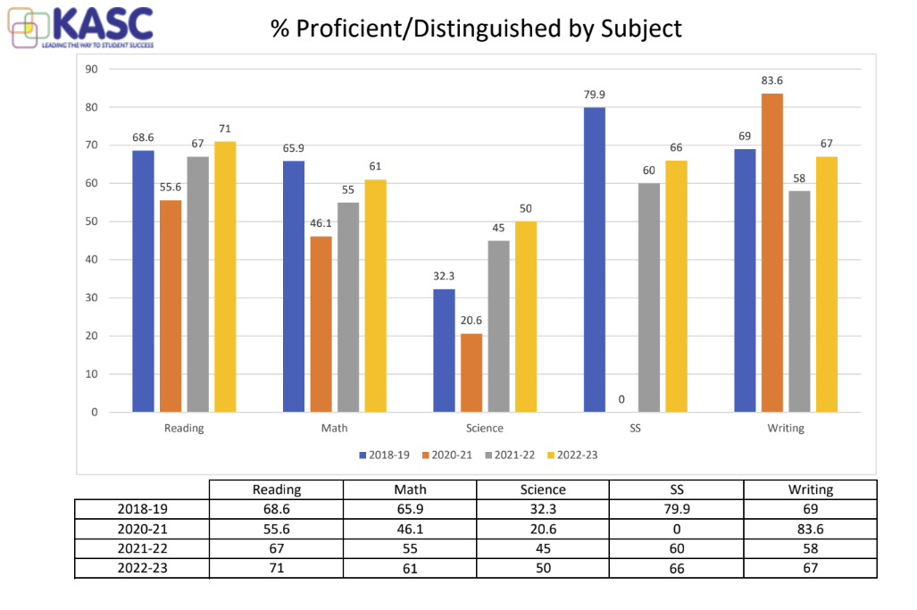
KASC’s Test Score Graphing Service is valuable.
Provides subject area percentages for Proficient / Distinguished across four years. The School Report Cards are one year each.
It comes with the 39-page Leadership Guide for Studying Your Scores.
It shows trends for P/D and for Novice % by subject across four years.
% P/D and Novice are broken down by group per subject across four years .

Slide 8

Released Later than Usual

