Slide 1
Optimizing the Direction of Care:
A Secondary Insurance Claims Analysis
Yuri Hosokawa PhD, ATC
Vice President of Education
Vice President of Communication
Korey Stringer Institute

Slide 2
Conflict of Interest
This project is funded by the National Football League (NFL) and the National Athletic Trainers’ Association (NATA)
Korey Stringer Institute has the following entities as corporate sponsors:
  University of Connecticut Foundation
  NFL
  Gatoarde
  Camelbak
  Kestrel
  MISSION
  NATA
  heartsmart.com

Slide 3
Research Question/ Hypotheses
Preventable (unnecessary) number of secondary insurance claims are observed in schools with no athletic training service.
  Any difference between full time vs. part time vs. no service?
There are differences in:
  Types of medical services rendered
  Injured body part

Slide 4

Methods
Data from two secondary athletics insurance companies
  Claims data with details on the medical service provided
  Company A: August, 2010- July, 2015 (i.e., 5 academic years)
  Company B: August, 2012- July, 2014 (i.e., 2 academic years)
Athletic training service data from ATLAS
  Data from what was reported by May 15th, 2017

Slide 5
Methods
Athletic related insurance claims
  Injuries that are due to secondary school organized athletic events in grades 9 through 12
  Removed if:
    Physical education
    Recreational activity
    Recess
    Other non-athletic injuries

Slide 6
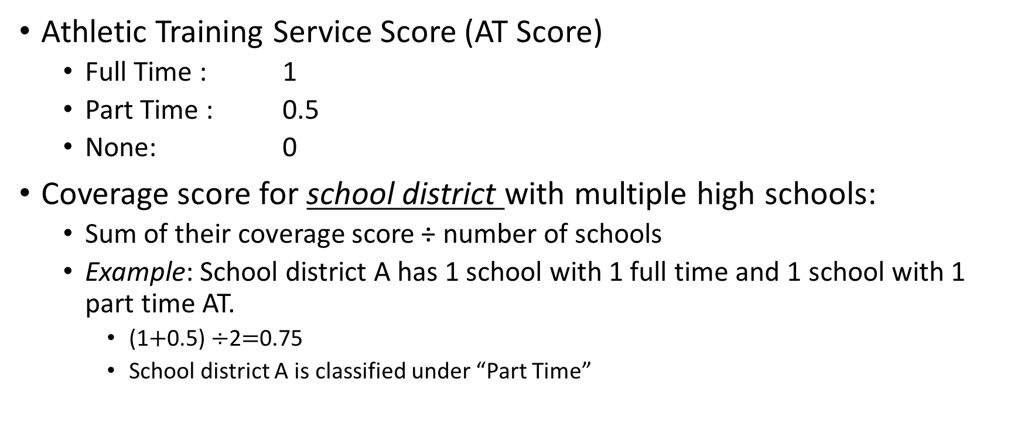
Methods
Athletic Training Service Score (AT Score)
  Full Time : 1
  Part Time : 0.5
  None: 0
Coverage score for school district with multiple high schools:
  Sum of their coverage score ÷ number of schools
  Example: School district A has 1 school with 1 full time and 1 school with 1 part time AT.
    (1$+$0.5) $÷$2$=$0.75
    School district A is classified under “Part Time”

Slide 7
Methods
A two-way ANOVA was used to compare the five-year average data by athletic training service (FULL, PART, NONE).
Post-hoc analyses using Tukey correction were conducted for comparisons
  Statistical significance was set a priori (p<0.05)
  Mean differences (MD), 95% confidence intervals (CI) were also calculated (MD, [95%CI], p value)

Slide 8
Sampling
Table. Policy holder by athletic training service
Secondary insurance service data
n=217,856

Slide 9
Sampling: 22 states
Table. Policy holder by state

Slide 10
Analysis by Body Part
HEAD
UPPER EXTREMITY
LOWER EXTREMITY
GENERAL BODY
Head
Face
Neck
Elbow
Finger
Forearm
Hand
Shoulder
Thumb
Upper arm
Wrist
Achilles tendon
Ankle
Foot
Groin
Hip
Knee
Lower Leg
Thigh
Cardiac
Dehydration
Exertional heat illness
Respiratory
TRUNK
Abdomen
Lumbar/ Lumbar spine
Pelvis
Sternum
Thoracic/ Thoracic spine
UNSPECIFIED
All other claims with no injured body part data

Slide 11
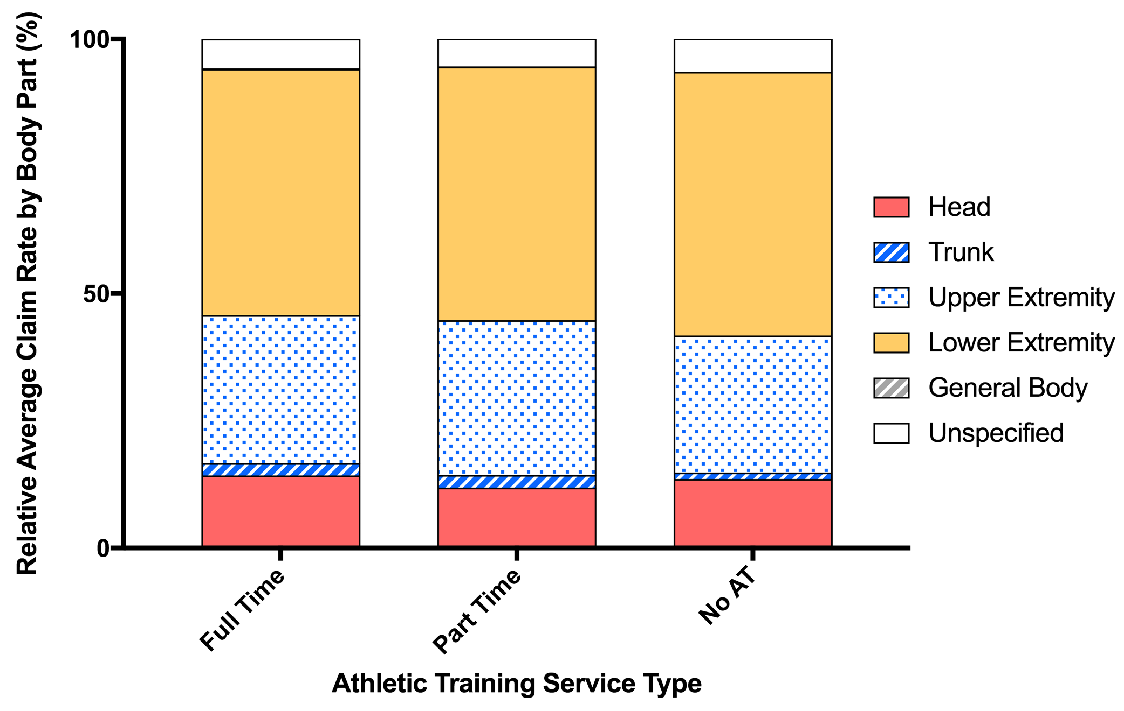
Injured Body Part
Relative average claim rate (%)
Notes:
No difference across AT service type. The order of commonly injured body part was the same across FULL, PART, and NONE: lower extremity, upper extremity, head, unspecified, trunk, and general body from the highest to the lowest.

Slide 12
Analysis by Service
Ambulance
Anesthesia
Dental injury
Diagnostic/image/lab tests
Emergency room
Equipment/supplies
Injection
Prescription
Outpatient
Physician
Rehabilitation/treatment
Specialist consultation
Surgery
ACUTE CARE
DIAGNOSIS AND MANAGEMENT
Ambulance
Emergency room
Diagnostic/image/lab tests
Rehabilitation/treatment
SURGICAL PROCEDURE
PHYSICIAN AND SPECIALIST VISIT
Anesthesia
Injection
Surgery
Dental injury
Equipment/supplies
Prescription
Outpatient
Physician
Specialist consultation

Slide 13
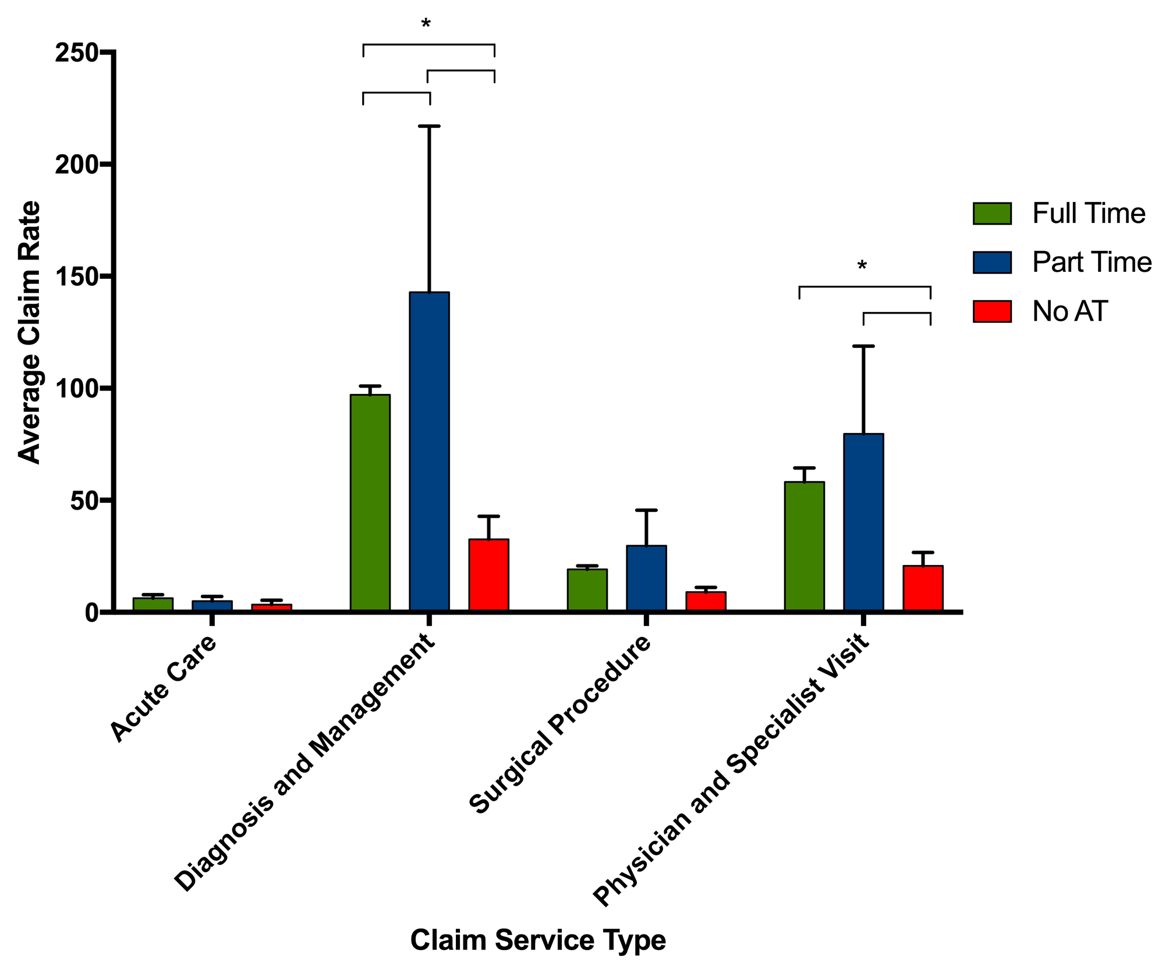
Analysis by Service
Average Claim Rate
Diagnosis and management
PART had the highest average claim rate
  vs. FULL (45.9, [15.1, 76.7], p=0.002)
  vs. NONE (110.4, [79.6, 141.2], p<0.001)
FULL had greater average claim rate than NONE
  (64.5, [33.7, 95.3], p<0.001)
Notes:
No difference in average claim rate of acute care and surgical procedure

Slide 14
Analysis by Service
Average Claim Rate
Physician and specialist visit
PART had the highest average claim
  vs. NONE (58.8, [28.0, 89.6], p<0.001)
FULL had a greater average claim rate than NONE
  (37.4, [6.6, 68.2], p=0.014)
Notes:
No difference in average claim rate of acute care and surgical procedure

Slide 15
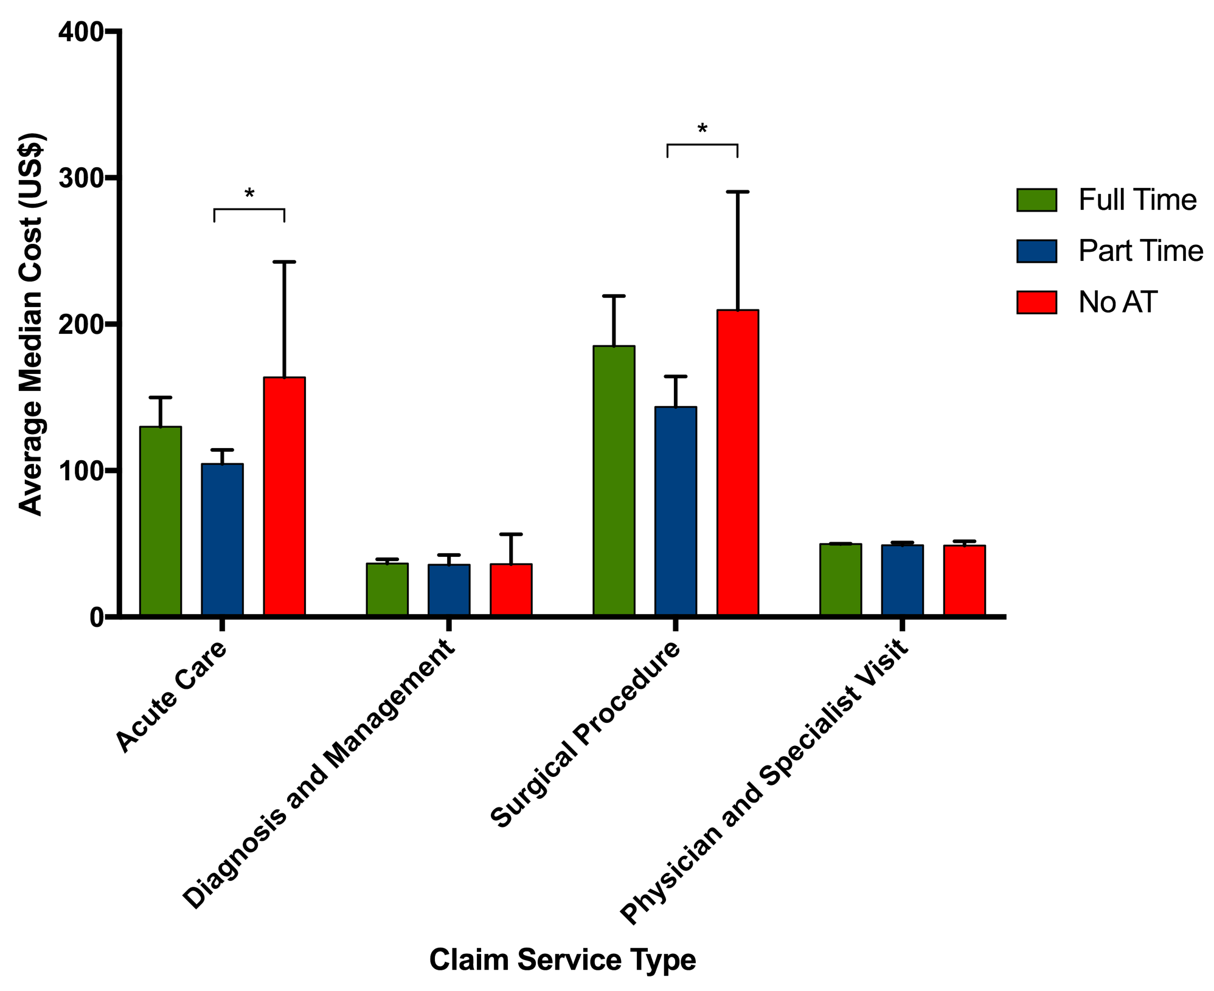
Analysis by Service
Median Claim Cost
Acute care
NONE had the highest median claim cost
  vs. PART (58.9, [14.9, 103], p=0.006)
Notes:
No difference in median claim cost of diagnosis and management and physician and specialist visit

Slide 16
Analysis by Service
Median Claim Cost
Surgical procedure
NONE had the highest median claim cost
  vs. PART (66.2, [22.1, 110], p=0.002).
Notes:
No difference in median claim cost of diagnosis and management and physician and specialist visit

Slide 17
Limitations
Limited representations of schools with part and no athletic trainers
Limited national representations
  22 states represented but 81% of the data were from four states:
    Pennsylvania (31%)
    New Jersey (29%)
    Connecticut (11%)
    South Carolina (10%)

Slide 18
Limitations
Not all types of injuries happen at constant rate for all schools
  Our analysis is the average of five academic years
No information on primary insurance claims
Analysis per policy holder (school district) not by individual school

Slide 19
Conclusions
Part time athletic training services resulted in a greater number of claims
  Diagnosis and management
  Physician and specialist visits

Slide 20
Conclusions
The direction of care student athletes receive after injury may be influenced by their access to athletic training services.
Further investigation should obtain data on:
  Severity of injury
  Diagnosis
  Improved geographical representation of FULL, PART, and NONE

