Slide 1
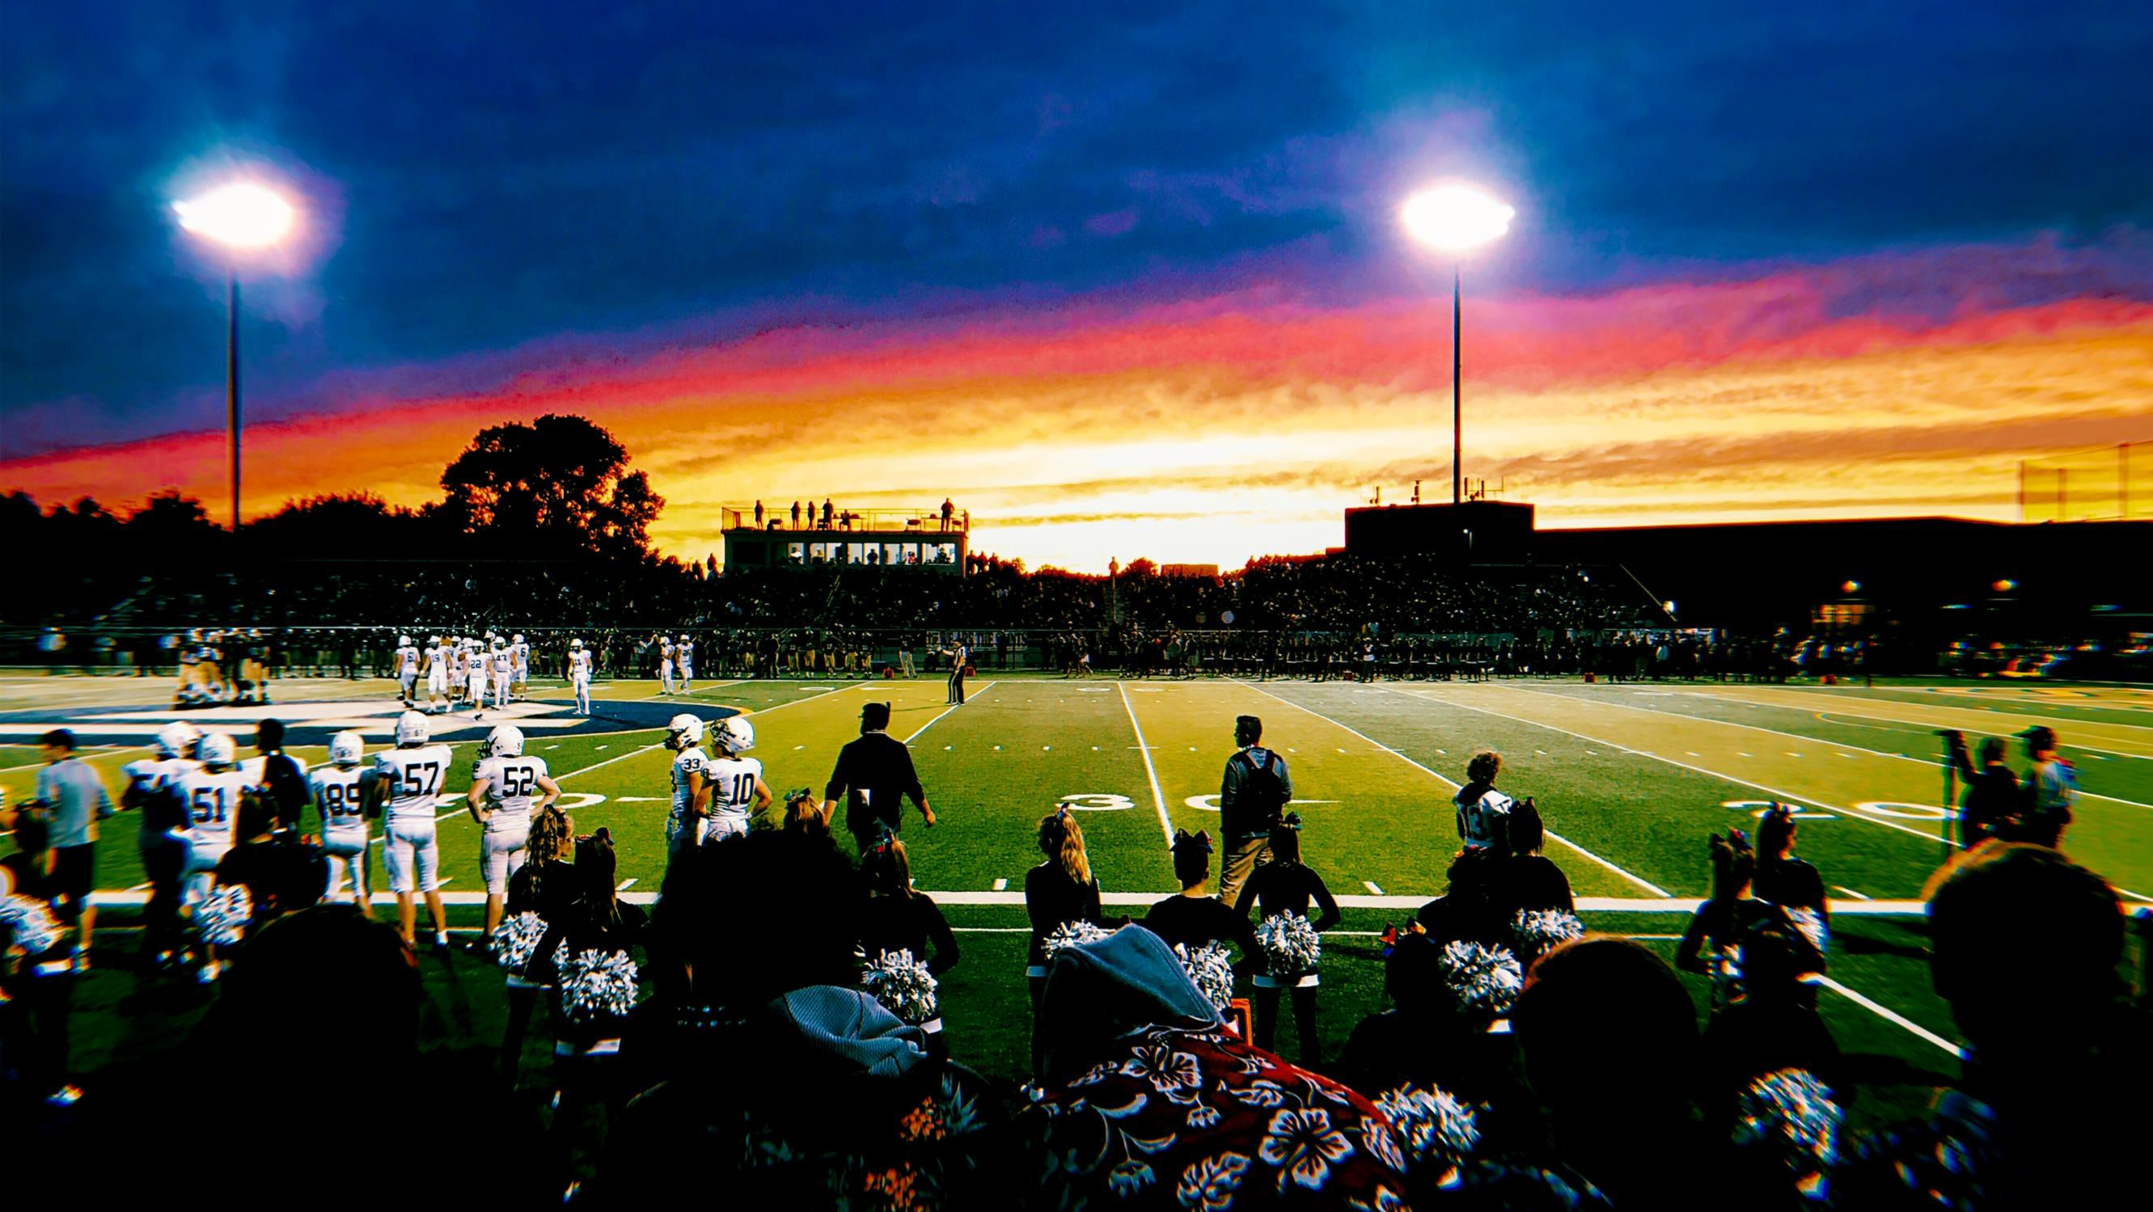


NFHS Network KHSAA

Slide 2
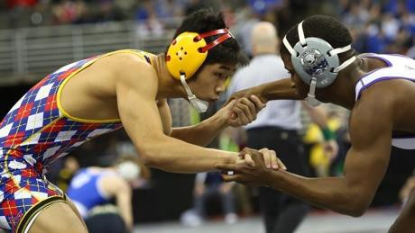





TOTAL LIVE KENTUCKY BROADCASTS

Slide 3









TOP 5 PRODUCING SCHOOLS:
Bishop Brossart High School Frederick Douglass High School North Laurel High School Owensboro High School
Trinity High School

Slide 4

TOTAL SCHOOL REVENUE FOR
SCHOOLS

Slide 5





KHSAA Schools on the NFHS Network
254
151
SCHOOLS not on the NFHS Network
118
SCHOOLS WITH PIXELLOTS
44%
PERCENT OF SCHOOLS
PIXELLOT CAMERAS

Slide 6
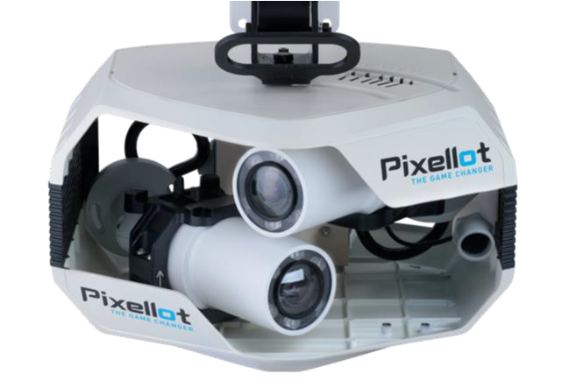



OFFER
For Main Gym and Field
upfront or ongoing, including equipment, software, installation, and maintenance
starts right away

Slide 7
How we help expand your audience
We do the Marketing
Our Marketing Automation Platform is the engine behind what we do – we market every single broadcast
Event specific designs, with your logos, are created by our systems
Messaging is pushed out on a daily schedule – including game time reminders when your broadcast starts
Extensive
We send communications to fans that follow your school on the NFHS Network
We promote your home games AND your away games
We reach an audience outside of your direct school community
Multifaceted
Our marketing includes automated emails, push notifications, social media, paid ads, etc.
We leverage partnerships with companies you might work with (MaxPreps, VNN, BigTeams, + many more)

Slide 8
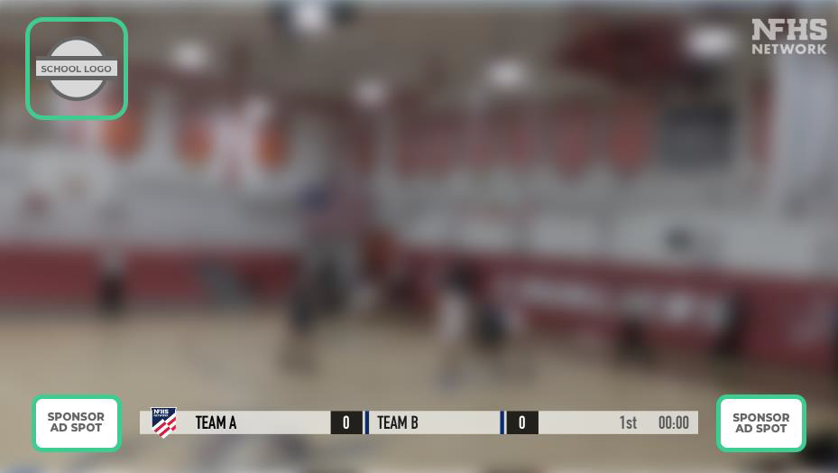
Advertising Opportunities for Schools
Advertising Options
School landing page banners
Watermarks in broadcast
Announcer Reads
Coming Soon this year:
  Rotating Watermarks
  Pre-roll and Mid-Roll Video
  Automated action-based graphics
“This touchdown brough to you by…”

Slide 9
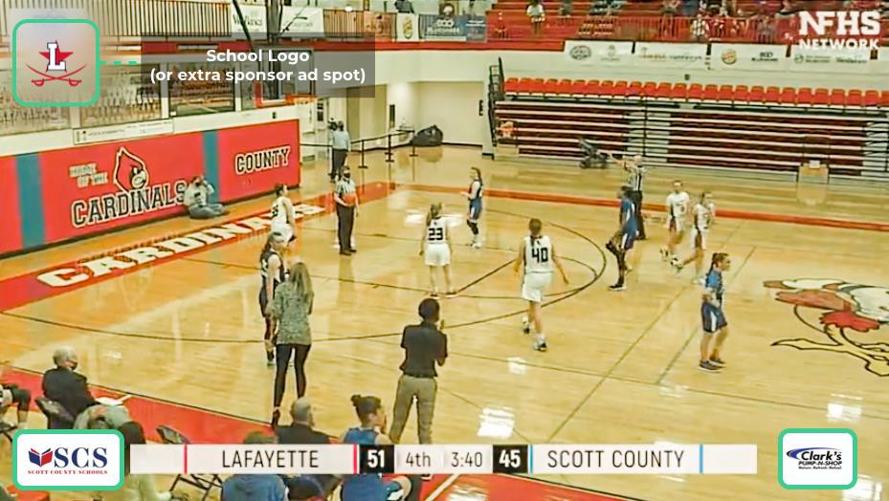
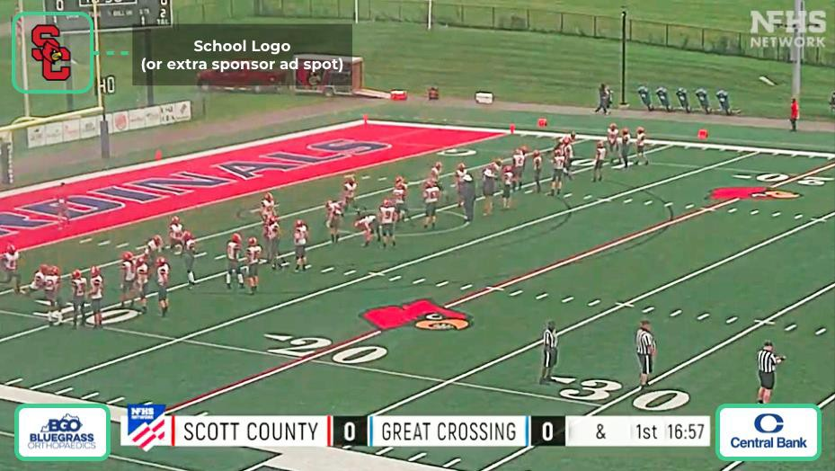
Pixellot Ad Placement Examples

Slide 10
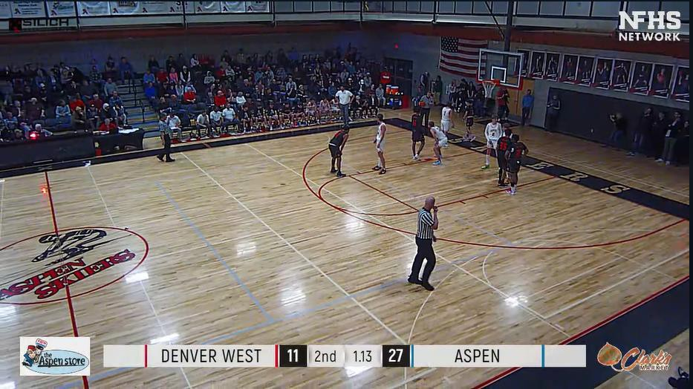
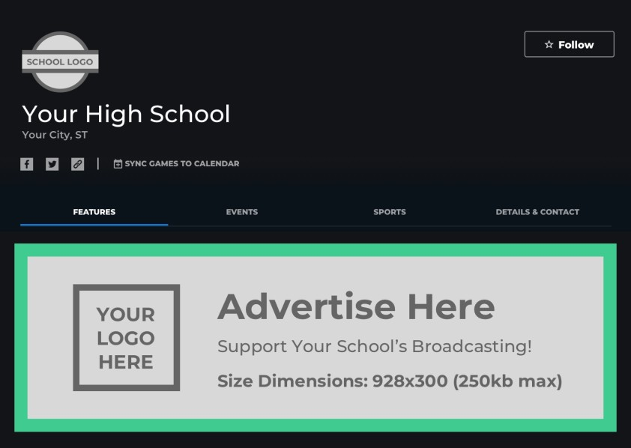
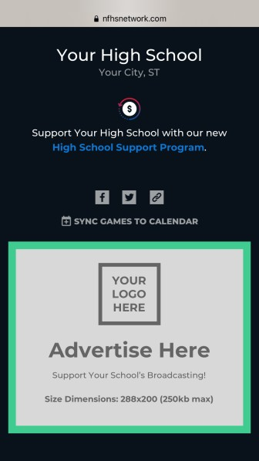
Pixellot Ad Placement Examples
NFHS Network – Advertising Opportunities
Watermarks in broadcast
Website
Mobile App

Slide 11
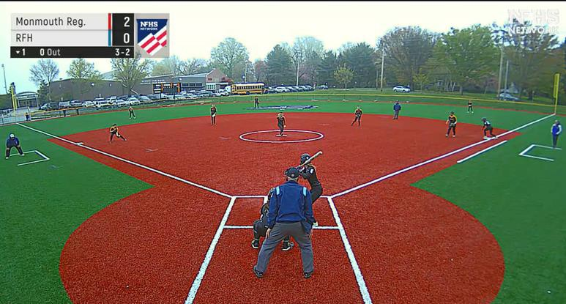
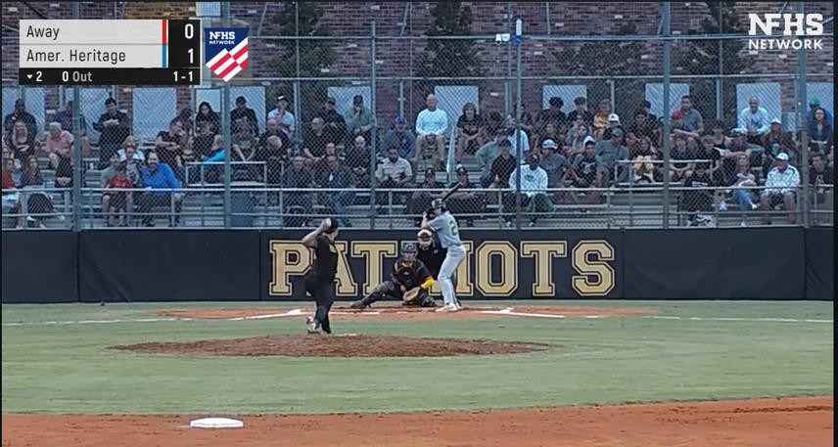
New Baseball/Softball Systems
NFHS Network
Designed specifically for baseball and softball
Second angle available for baseball

Slide 12

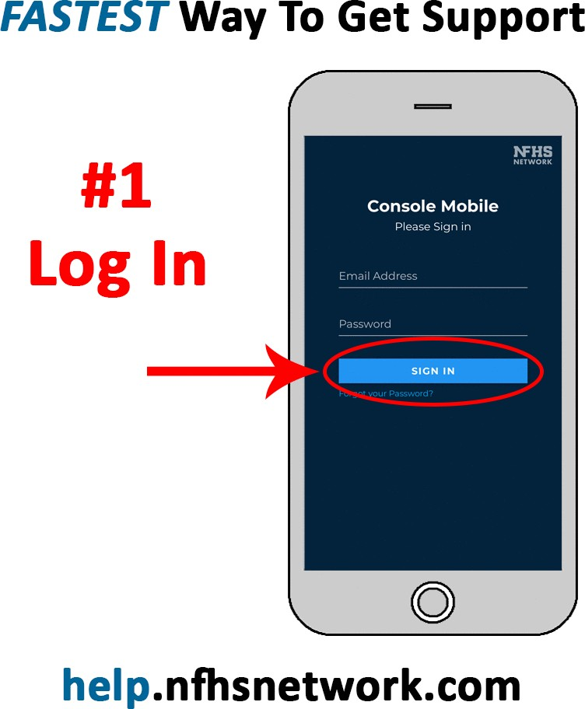
Console Mobile
Submit Support Tickets Monitor Pixellot Systems Run Test Broadcasts Change Event Times Start/Stop Broadcasts
44% of support tickets via mobile console (national average)

Slide 13
Customer Service
NFHS Network
NFHS Network subscribers (viewers) having trouble watching a broadcast or need assistance with their accounts should email customer service at:
customerservice@nfhsnetwork.com

Slide 14
Ready to Join the NFHS Network?
NFHS Network
Schools interested in joining the NFHS Network and receiving
2 free Pixellot units + free installation should contact:

Slide 15


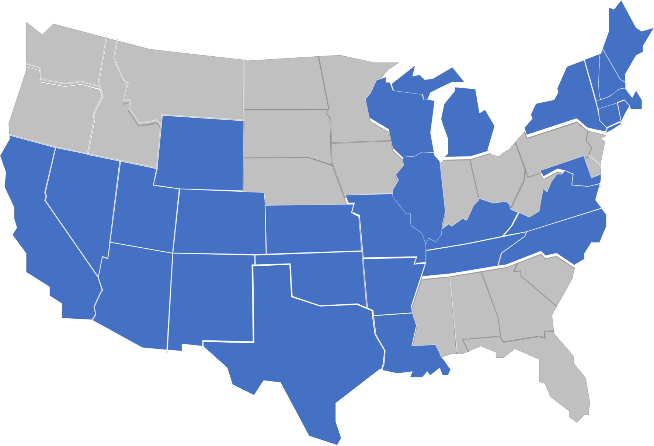
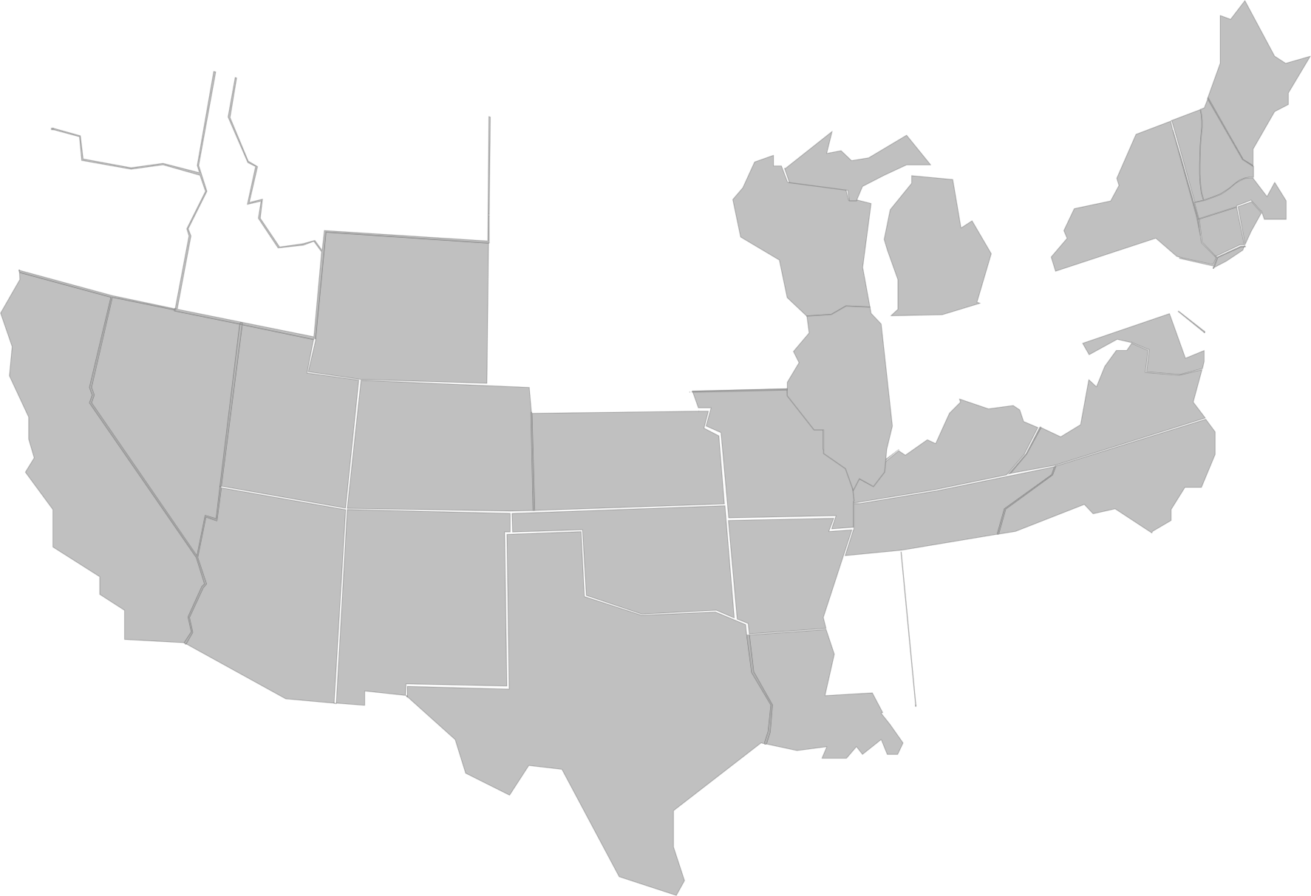
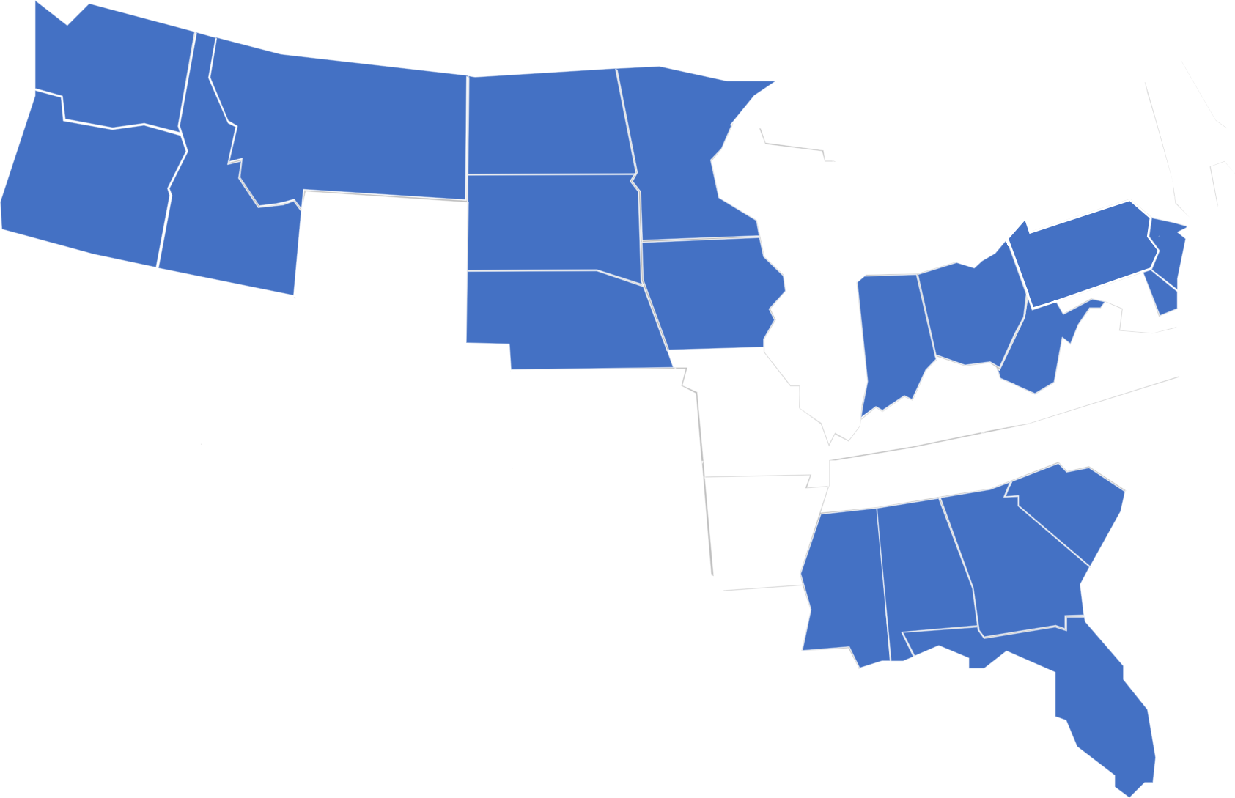



OUR NETWORK

