Slide 1


SCHOOL BROADCAST PROGRAM

Slide 2
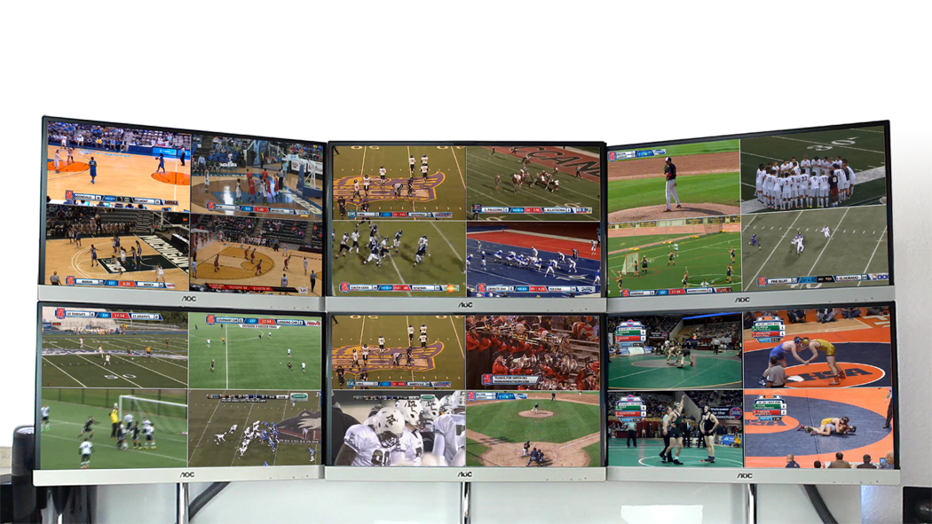
The Largest Broadcaster of High School Sports

Slide 3

The #1 impediment to Schools taking part is the issue of manpower – many schools have no one to run the program.
Even when schools do have an established broadcast program with plenty of participating students, there are simply too many events – they can’t cover them all.
We now have a solution for both…

Slide 4
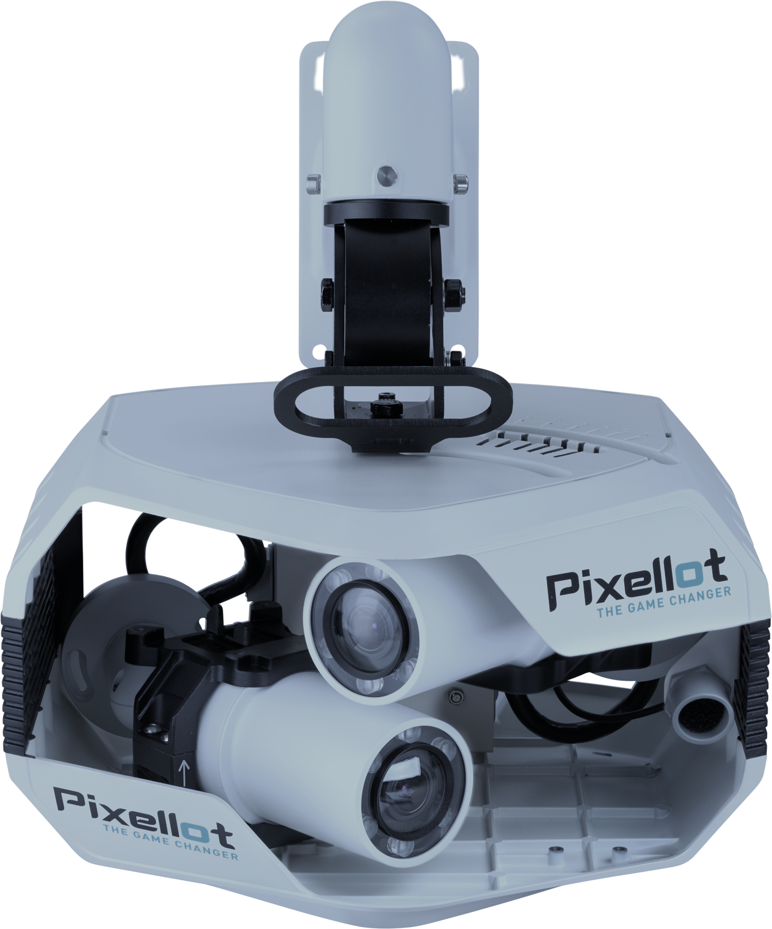

AUTOMATED
SPORT PRODUCTION

Slide 5

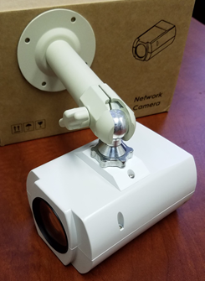
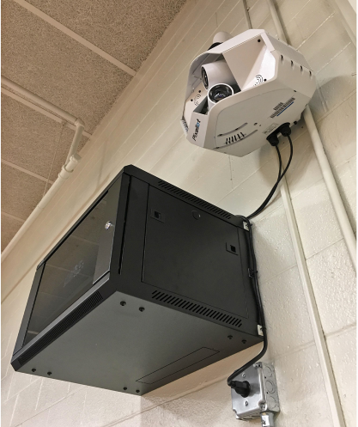
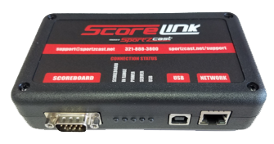

HARDWARE OVERVIEW
Pixellot is a system designed for automated event production
No people required.
Video Equipment
Camera head with weatherproof HD cameras
Video Processing Computer for creating the automated production
Scoring Devices
Automatically integrate score data into your broadcast with one of these devices:
OCR camera
(indoor venues)
Mount and point at scoreboard
Sportzcast
(outdoor venues)
Plug into scoreboard controller

Slide 6
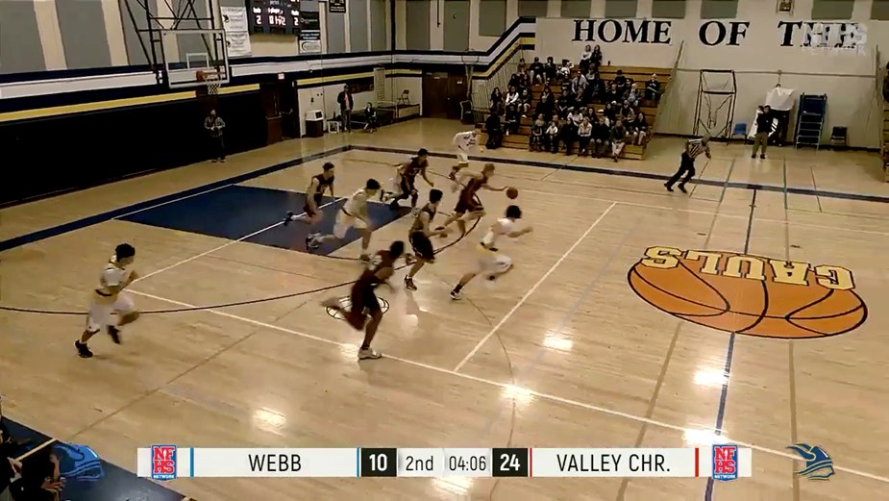
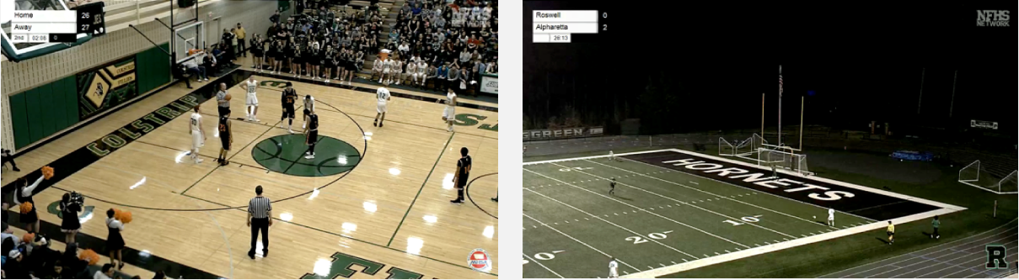
AUTOMATED PRODUCTION
Auto-tracking feature enables cameras to follow the action
No camera operator required
Scorebug graphic with real-time data pulled from scoreboard
Integrates with coaching software
Click here for Basketball example clip
Click here for Soccer example clip

Slide 7

PIXELLOT GAME FILM UPLOAD
Coaches receive automated email after each game with link to download game film* – game film can then be easily and quickly uploaded into coaching software
*Football game film is already split into individual clips for easier breakdown in coaching software
SCHOOL LOGO
(or extra sponsor ad spot)

Slide 8
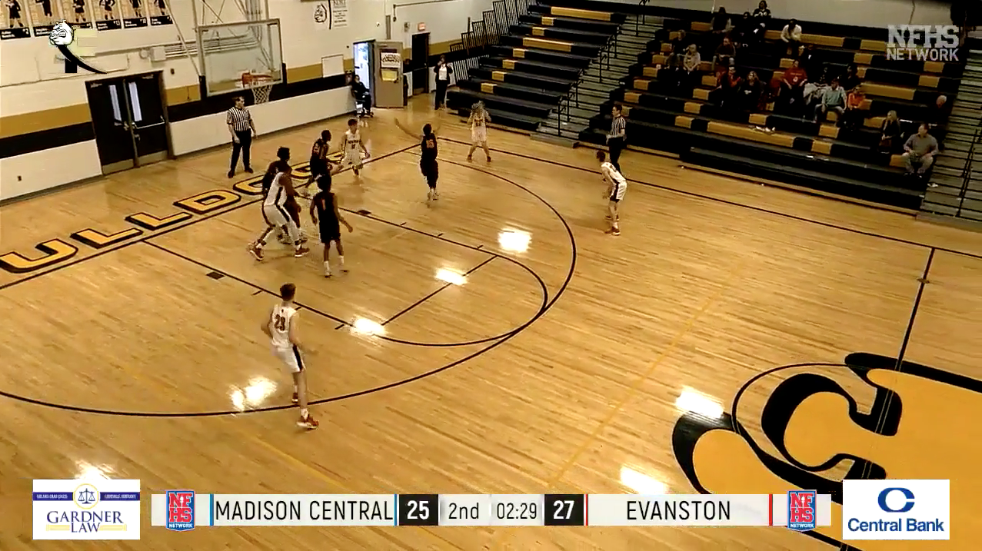
PIXELLOT AD SPOTS
Up to 3 spots for advertising (2 sponsor spots and 1 spot for your school logo or extra ad)
Change graphics out every athletic season
Sell sponsor spots to help pay for your Pixellot unit(s)
Sponsor receives ad space in every game
SCHOOL LOGO
(or extra sponsor ad spot)
SCHOOL LOGO
(or extra sponsor ad spot)
SPONSOR AD SPOTS
SPONSOR AD SPOTS

Slide 9

FINANCIAL MODEL
One-time fee for Pixellot equipment package (Pixellot system + all accessories)
ZERO recurring costs for system
Installation not included
Previous Pricing:
SPECIAL 2-for-1 DEAL:
$5,000 for
1 Unit
$5,000 for
2 Units
For more information contact:
Stephen Christensen: Stephen.Christensen@nfhsnetwork.com
503-380-5637

