Slide 1


Alternative Programs 2021-2022
Kim Stevenson, Director of Alternative Programs

Slide 2
Alternative Programs consist of:
Bluegrass Learning Academy - Kim Stevenson/Richard Rorie
Christian County Day Treatment - Chris Gilkey
Cumberland Hall Hospital - Chris Gilkey
Virtual Learning Academy - Arnelle Wesley
Bullying
District Discipline
Juvenile Court Liaison (MOU’s, Citation and Arrest)
PBIS/Trauma Informed Care
Racial Equity - Mancell Elam
Restraint and Seclusions
School Based Therapist
School Counselors Interventions
Threat/Suicide Screeners

Slide 3

Students served and Graduated in 2021-2022
Bluegrass Learning Academy
330 students served (46 graduated)
Christian County Day Treatment
33 students served (2 seniors and 2 graduated)
Cumberland Hall
588 students served
Virtual Learning Academy
415 students served (38 graduated)

Slide 4

Number of Threat/Suicide Screeners and Bullying Forms
2020-2021
Threat Screeners - 25
Suicide Screeners - 97
Bullying Reports - 18
2021-2022
Threat Screeners - 234
Suicide Screeners - 278
Bullying Reports - 53

Slide 5
Mental Health Services (School Based Therapist, Pennyroyal Mental Health and Mt. Comprehensive
School Based Therapist served 550 students
(Brooke Burkhead, Cassie Dougherty, Stacy Jones, and Brandy Westerfield)
Pennyroyal Mental Health Center served 199 students
Mt. Comprehensive Counseling served 408 students
Total number served - 1,157 students

Slide 6
Number of MOU’s, Citations, and Arrest
Memorandum of Understanding served - 354 students
Citations served - 70 students
Arrest - 12 students

Slide 7
Discipline Data
Total referrals - 8,537
In School Suspension referrals - 3,871
Out of School Suspension referrals - 1,918
Bluegrass Learning Academy referrals - 245

Slide 8
Discipline Data
The top 5 infractions were (high to low)
1. Disruptive Behavior (2,070)
2. Failure to Follow (1,358)
3. Biting/Hitting/Kicking (576)
4. Fighting (490)
4. Disorderly Conduct (484)
The largest number of infractions happened in the month of March (1,487) and the next highest was September (1,217)
The top 5 number of events from locations (high to low) were:
1. Classroom (5,284)
2. Bus (993)
3. Hallway (748)
4. Cafeteria (287)
5. Restroom (285)

Slide 9
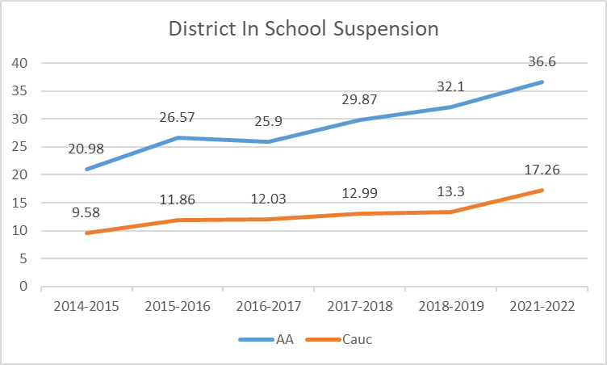
Risk score for ISS was 2.09

Slide 10
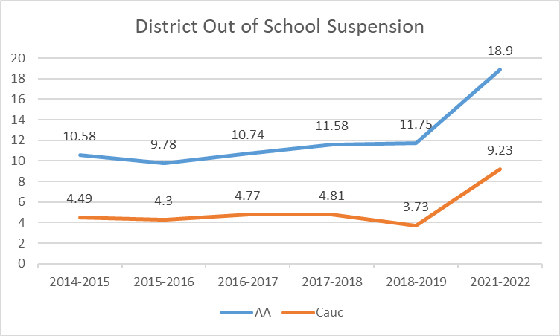
Risk score for OSS was 2.04

Slide 11

Senate Bill 1 relating to School Counselors
2019 - General Assembly passed Senate Bill 1(School Safety and Resilience Act) which in part states that schools will increase supports for mental health and school counselors will have 80% of their services directly working with students
CCPS has adopted the American School Counselor Framework provided by the American School Counselor Association and Kentucky Department of Education

Slide 12


School Counselors will:
Set 2 goals in the categories of behavior, attendance and academics based on school data in these areas (they work with their administrator on the goals)
Be the PBIS Coach for Tier II and III
Meet with each student in the building to build relationships
Complete mini lessons based on their top 5 behavior infractions (minimum of two a month)
Meet with every student that is in ISS to begin interventions to change the behavior - meet with every student coming back from OSS to rebuild the connection
Assist with any classroom management strategies
Develop monthly calendar on their time and discuss with administrator
Develop small groups based on data
Short-term counseling for students - long term will be School Based Therapist
Develop training for teachers on trauma informed care and mental health needs

Slide 13


Next Steps for SY 22-23
CCPS will be using the Multi-Tiered System of Support model that increases support based on each student’s needs, recognizing that behavior, social and emotional challenges can impact their academic success.
PBIS, Social Emotional Learning, and Trauma Informed Care for students and staff

