Slide 1

Finance Plan for
High School Project
Baird Public Finance
November 2021
Robert W. Baird & Co. Incorporated is providing this information to you for discussion purposes only in seeking to serve as a financial advisor or municipal advisor to you on a possible issuance of municipal securities. Baird is a municipal advisor registered with the Securities and Exchange Commission and the Municipal Securities Rulemaking Board (“MSRB”). A financial advisor or municipal advisor is subject to a fiduciary duty, including a duty of care and a duty of loyalty, and is required to act solely in the best interests of the client. See “Important Disclosures” contained herein.

Slide 2
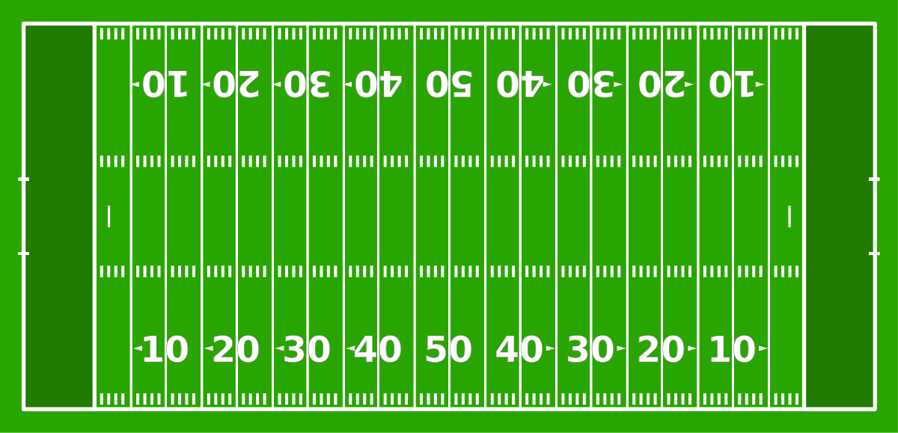
Objectives of the
Finance Plan
Fits within the current budget
Funds a complete project
Meets key timeline dates
1

Slide 3


Created a Fiscally Responsible and
Solid Finance Plan
Fits within the District’s current budget
  Utilizes current financial resources available
    Does not hinge on a new nickel tax/Building Fund tax
  Meet cash flow needs and existing debt obligations
    Reduces the up-front General Fund contribution
    Includes a General Fund bond payment
  Reviewed with Kentucky
  Department of
  Education
Christian’s low tax rate compared to peers
Avg. 65.44
(1) Source: KDE 2020-21 Local District Tax Levies report
2

Slide 4
Developed a Plan to Maximize
Bonding Capacity
Funds a complete project
  Includes main campus with athletic complex and all support facilities
    General Fund bond allows for more flexibility and funding of these projects
  Increase bonding capacity
    25-year bond issue with General Fund bond ($50 million vs. $75+ million)
3

Slide 5
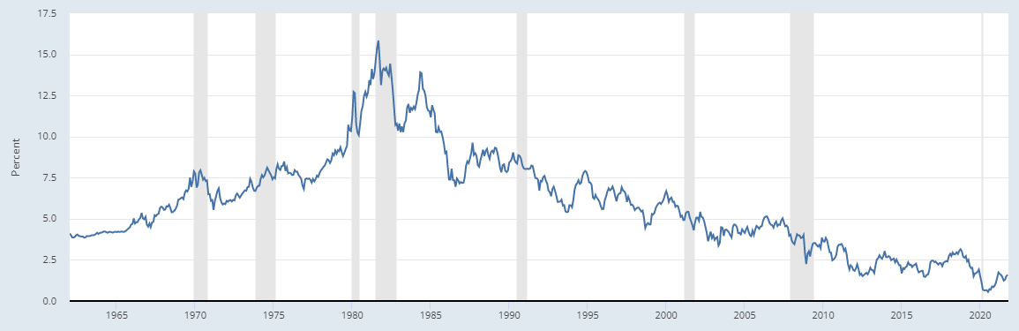
Mobilized Quickly and Strategically
Meets key timeline dates
  Targeting an opening date of August 2024
    26 months of construction
  CCPS awarded $10 million Local Area Vocational Education Center (LAVEC) grant
    Bids must be awarded for the project to begin by September 1, 2022
  Take advantage of the very low interest rate environment
    As of today, projecting a fixed rate of ≈2.5%
10-Year Treasury⁽¹⁾
(1) Source: Federal Reserve as of October 20, 2021
4

Slide 6





In Lockstep with KDE on the
Approval Process
September
October
November
December
January
February
March
April
May
June
July
August
September
9/22: KDE toured site with CCPS team
9/27: meeting with KDE and CCPS teams to review finance plan and preliminary design
Construction bids received
9/1/22:
Deadline for
$10 million grant
KDE Review
2021
2022
BG1s submitted to KDE
All documents (BG1s, design schematics, bid packages, finance plan, etc.) have to be submitted, reviewed and approved by KDE
Continuous communication between all parties
5

Slide 7
Next Step to Formalize the
Finance Plan
Current BG1
Source | Amount
SFCC Bond Sale | $3,300,000
Local FSPK Bond Sale | 67,000,000
Cash - Building Fund | 671,141
Cash - Capital Outlay | 475,988
Cash - Investment Earnings | 98,258
Cash - General Fund | 7,000,000
Residual Construction Funds | 460,734
ARP/ ESSER III | 25,562,893
CTE SFCC Grant | 10,000,000
Total | $114,569,014
KDE has requested the project be split into two BG1s
  Land and site work
  Main campus building
1
2
Land and Site Work
Main Campus Building
6

Slide 8

Moving Towards the
Goal Line
TOUCHDOWN
TOUCHDOWN
RED ZONE
(9/1/2022)
Action Items at the November 4th Board Meeting:
  Land purchase
  BG1s
  General Fund Bond Resolution
  Reimbursement Resolution
7

Slide 9
Important Disclosures
Robert W. Baird & Co. Incorporated (“Baird”) is providing you with the information contained herein and/or accompanying materials (the “Materials”) for discussion purposes only in seeking to serve as a financial advisor or municipal advisor to you on a possible issuance of municipal securities. Baird is a municipal advisor registered with the Securities and Exchange Commission and the Municipal Securities Rulemaking Board (“MSRB”).
If Baird is hired as financial advisor in connection with an issuance of municipal securities, Baird will provide municipal advisory services with respect to the issuance of municipal securities, including advice, recommendations and other assistance regarding the structure, timing, terms and other similar matters concerning the particular issuance of municipal securities for which you may be considering. As such, Baird will serve as a fiduciary and act solely in your best interest. Baird’s fiduciary duties as your financial advisor will include the duty of care and the duty of loyalty. Under MSRB Rule G-23, if Baird is hired as financial advisor with respect to an issuance of municipal securities, Baird will not be able to serve as underwriter or placement agent for that issuance.
Should you want Baird serve in a different capacity, such as underwriter or placement agent, you should notify Baird of such decision immediately and Baird will provide additional disclosures to you which will describe the role of underwriter or placement agent and explain any actual or potential conflicts of interest inherent in that role.
The Materials do not include any proposals, recommendations or suggestions that you take or refrain from taking any action with regard to an issuance of municipal securities and are not intended to be and should not be construed as ''advice'' within the meaning of Section 15B of the Securities Exchange Act of 1934 or Rule 15Ba1-1 thereunder. The Materials are intended to provide information of a factual, objective or educational nature, as well as general information about Baird (including its Public Finance unit) and its experience, qualifications and capabilities.
Any information or estimates contained in the Materials are based on publicly available data, including information about recent transactions believed to be comparable, and Baird’s experience, and are subject to change without notice. Interested parties are advised to contact Baird for more information.
If you have any questions or concerns about the above disclosures, please contact Baird Public Finance.
IRS Circular 230 Disclosure: To ensure compliance with requirements imposed by the IRS, we inform you that the Materials do not constitute tax advice and shall not be used for the purpose of (i) avoiding tax penalties or (ii) promoting, marketing or recommending to another party any transaction or matter addressed herein.
8

