Slide 1
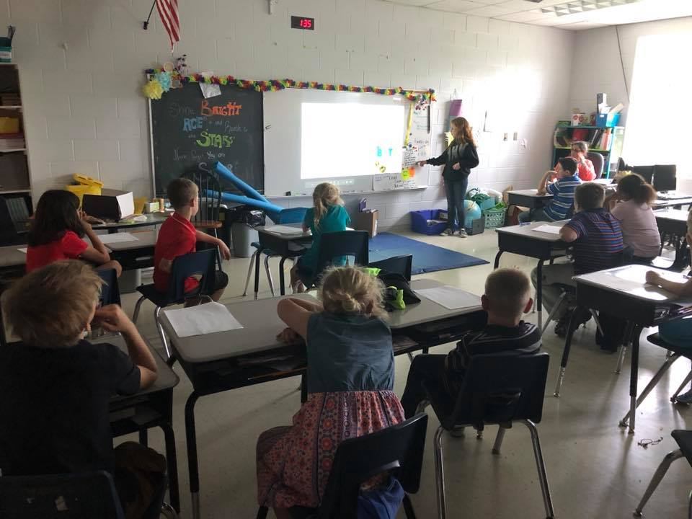



Slide 2

Our facilities received the U.S. EPA’s ENERGY STAR signifying superior energy performance!

Slide 3
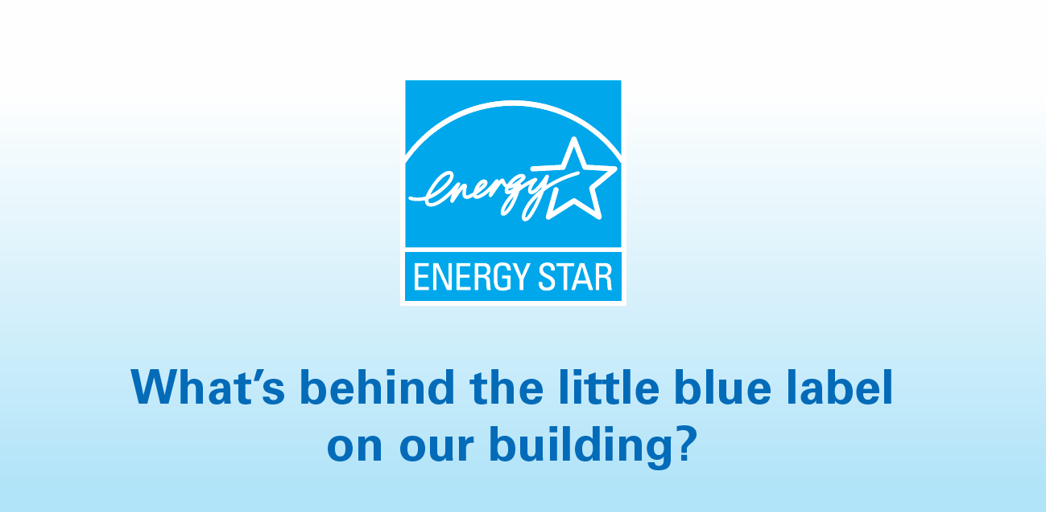

Slide 4
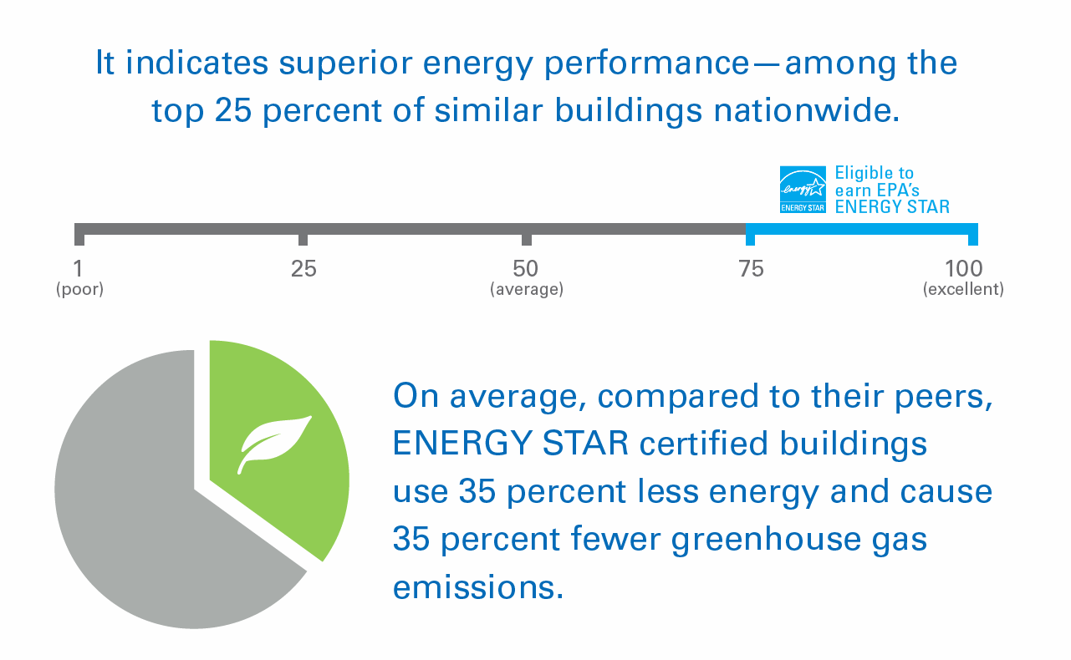

Slide 5

Bloomfield Middle – Perfect 100
Cox’s Creek – Perfect 100
Foster Heights – Perfect 100
Thomas Nelson – Perfect 100
Bloomfield Elementary – 99
Old Kentucky Home – 99
Boston School – 97
Nelson County High – 95
New Haven School – 92
Central Office – 91
Horizons Academy – 80

Slide 6

Benefits
  38% usage reduction
  Savings $$$
  Community
  Property value
  Federal leases
  Future mandates
LESS money in the outlets
MORE money in the students

Slide 7
The Numbers
  ’07-’08 = $ 210,460.00 avoided
  ‘16-’17 = $768,889.00 avoided
  Total avoided usage = 38.7 %
  Total avoided costs = $6,082,253.00!

Slide 8


