Slide 1

























































Where We Were: 2015-16 District Planning (CDIP) and JCPS Budget Processes
CDIP Process
2015-16 CDIP
CABINET:
Individually draft current work plan by V2020 Strategy
PPE:
Initiate CDIP process in response to data
PPE:
Integrate CDIP components from Cabinet
PPE:
Finalize CDIP
PPE:
Submit CDIP to KDE
2014-15 Data
CCR & Grad Data published
Board:
KPREP data
Review/
ACT
administration
KPREP
administration
published
approve
CDIP
Budget Process
FINANCE:
Additional requests reviewed and approved
Board: Review/ approve
additional requests
Board:
Review/approve Budget Requests
FINANCE:
Initiate Budget Request Process based on anticipated needs
FINANCE:
Review budget request submissions
CABINET:
Select requests for approval
FINANCE:
Additional requests reviewed and approved
2015-16 Additional Funding Approvals
2016-17 Budget Planning and Requests

Slide 2






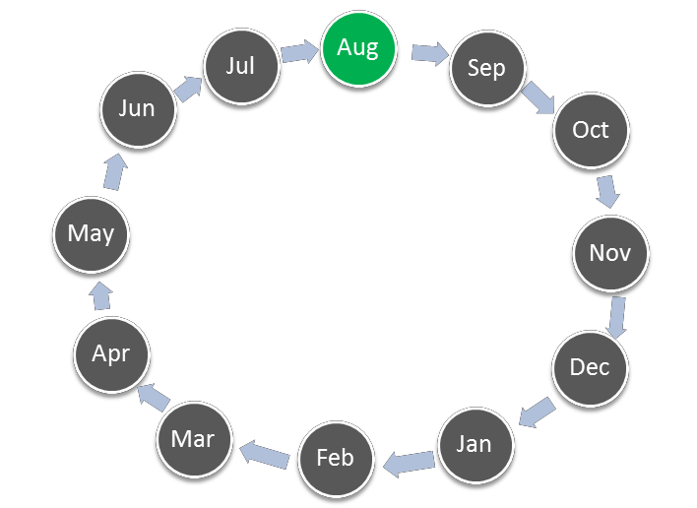
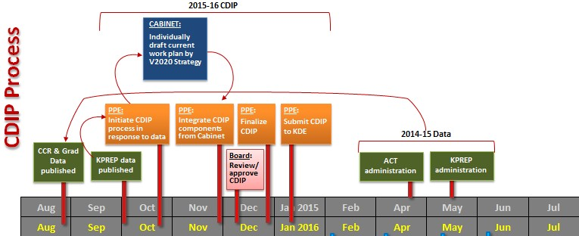






















Where We Moved: 2016-17 Continuous Improvement Planning and Funding Processes
PPE:
Program/budget
evaluation
FINANCE:
Program/budget evaluation
2016
Board: Review/approve Budget Requests
2017-18 Strategy and Budget Planning linked to V2020
FINANCE:
Discuss funding projections
Collect cost center projections
PPE:
Discuss funding
projections
Train on process and support planning
2017
CABINET:
Select requests for approval
FINANCE:
Review budget request submissions
FINANCE:
PPE:
Review budget request submissions
Evaluation support
PPE:
Initiate Budget Request Process
Planning, research support
Initiate Budget Request Process
Funding options support

Slide 3
2017-2018: Sequence of Events for Flexible Allocation Budget Process
Timeframe | Event
October 2016 | The Budget Request Process team (Planning and Evaluation and Finance) recommended that the Superintendent and Cabinet identify priority areas so that cost center heads could determine whether to submit a request and tailor requests to these priorities.
End-of November 2016 | Finance was tasked with asking cost center heads to estimate any projected funding needs with no restrictions on requests.
Early December 2016 | Supervisors reviewed budget requests and gave some initial feedback to cost center heads on how to modify those asks.
Mid-December 2016 | The Budget Request Process team provided training for cost center heads based on the recommended process and provided guidance on how to make submissions.
End-of January 2017 | Cost center heads submitted budget requests. No priorities were set in advance of the opening of this process by the Superintendent and Cabinet.
Mid-February 2017 | The Budget Request Process team began to review submitted requests to identify common areas of need. This review process was based on an established scoring rubric focused on alignment with Vision 2020, demonstrated need, and clarity in objectives and planning.
End-of February 2017 | Before the Budget Request Process team completed their review, the Superintendent convened Cabinet and Assistant Superintendents to identify broad priority areas of need.
Early March 2017 | The Budget Request Process team shifted their focus from reviewing most submitted requests to reviewing only high cost items aligned with the three broad areas of need. Reviewers still followed the scoring rubric and also considered evidence of previous program efficacy (for existing programs). In addition, Planning and Evaluation staff examined the submissions from an equity lens (e.g., priority vs non-priority schools; other programs already in place at schools). These analyses were shared with the Superintendent to inform Cabinet’s review and selection of requested funds.
Mid-March 2017 | The Superintendent ultimately decided to divide the flexible funds between school- initiated programs and district-initiated programs with a greater proportion of funds directed to district programs. Additionally, Academics received a larger portion of the overall allocation with most funds directed to schools. Cabinet members and Assistant Superintendents then were asked to prioritize submissions made by their cost center heads within that allocated amount. The three areas of need identified by Cabinet did guide some of these selections.
Late March 2017 | Final award decisions were communicated to cost center heads.
Mid-April | The Board received notification of the final list of selected funding requests.
Late March 2017 | Due to the change in review process, Planning and Evaluation recommended conducting a final review of selected submissions to identify any proposals with significant misalignment between their goals and targets or between their requested staffing and students served (i.e., unreasonable number of students served by a single staff member). As a result, cost center heads were required to adjust these points of misalignment in their proposals before funds were released for their selected proposals.

Slide 4
































Where We’re Going: 2017-18 Continuous Improvement Planning and Funding Processes
PPE:
Program/budget evaluation
THIS MAY CHANGE!!
FINANCE:
Program/budget evaluation
2017
CCR & Grad Data publishe
d
KPREP data
published
2018-19 Strategy and Budget Planning linked to V2020
CABINET:
Cross-functionally draft current work plan by V2020 Strategy
PPE:
Initiate CDIP process
CABINET:
Identify priority work to further implement V2020 and align funding
FINANCE:
Communicate priorities to cost center heads
PPE:
Communicate priorities to cost center heads
Board: Review/approve Budget Requests
PPE:
Submit CDIP to KDE Jan 1 BUT feel free to keep working on it.
2018
FINANCE:
Initiate Budget Request Process based on funding priorities
Funding options support
CABINET:
Select requests for approval
FINANCE:
Review budget request submissions
PPE:
Review budget request submissions
Evaluation support
PPE:
Initiate Budget Request Process based on funding priorities
Planning, research support

Slide 5
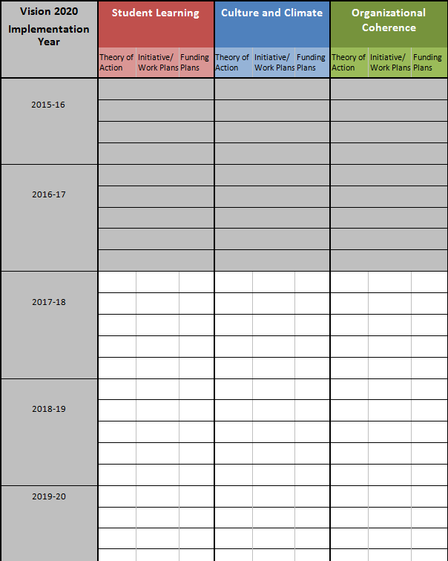
Where We’re Going: Strategic Work and Funding Planning

Slide 6




















































Vision 2020: Core Processes
Strategic Planning Processes
Board Strategy Update
Stocktake
JCBOE
Goal Report
Mid- Year Review
Strategy
Assessments
Oct
Strategy Assessments
Sep
Nov
Aug
Dec
Goal
Report
Board Strategy Update
Board Strategy Update
Goal
Report
Jul
Jan
Jun
Feb
Strategy Assessments
May
Mar
Strategy Assessments
Apr
JCBOE
Annual
Review
Goal
Report
Stocktake
Board Strategy Update

