Slide 1

TELL Kentucky 2013
Ann Maddock
Senior Advisor
Kentucky Board of Education
June 5, 2013

Slide 2
Before We Begin….
As a result of the extensive, collaborative work across the state since the 2011 TELL Survey, the following initiatives were implemented and incorporate TELL data:
  Kentucky Professional Growth and Effectiveness System
  Consolidated District Improvement Plan (CDIP)
  Consolidated School Improvement Plans (CSIP)
  Kentucky Learning Forward (Standards Implementation)
  Additional stakeholder efforts include:
  The Kentucky Department of Education asked every KDE office to incorporate the use of the 2011 TELL data into their discussions with respective stakeholder groups.
  The TELL Kentucky Partners incorporated the use of the TELL data in a variety of ways with their constituents.

Slide 3
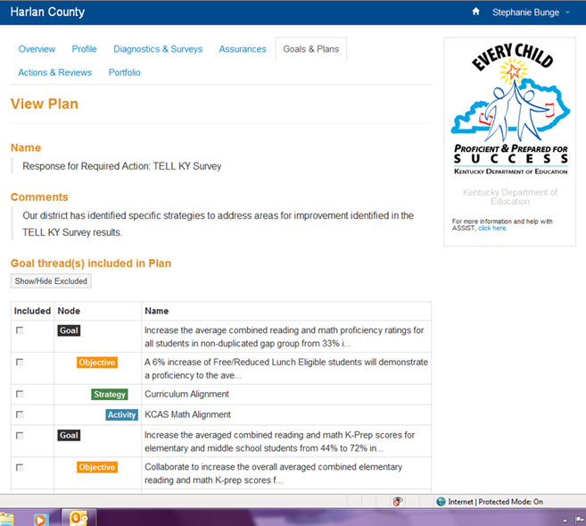
TELL Data is a Required Component in the Statewide ASSIST System

Slide 4
About TELL Kentucky 2013
The 2013 TELL Kentucky Survey was an online, anonymous survey of all licensed school-based educators in the state to assess teaching conditions which research has shown are important to teacher retention and student achievement.
The survey was administered March 4-29, 2013. Educators were able to access the survey via www.tellkentucky.org, 24 hours/day during the survey window using their individual, anonymous access code. A Help Desk was available to provide assistance.
The same questions were used as in 2011, plus one additional question: “At this school, we utilize the results from the 2011 TELL Kentucky Survey as a tool for school improvement.”

Slide 5
School, District and State Results
www.tellkentucky.org

Slide 6
Ninety percent of schools (1,296/1,441) met or exceeded the 50 percent response rate (and at least 5 respondents) threshold required to receive an individual school-level data report!
All results may be viewed online www.tellkentucky.org.
Notes:
1,245 SCHOOLS IN 2011

Slide 7
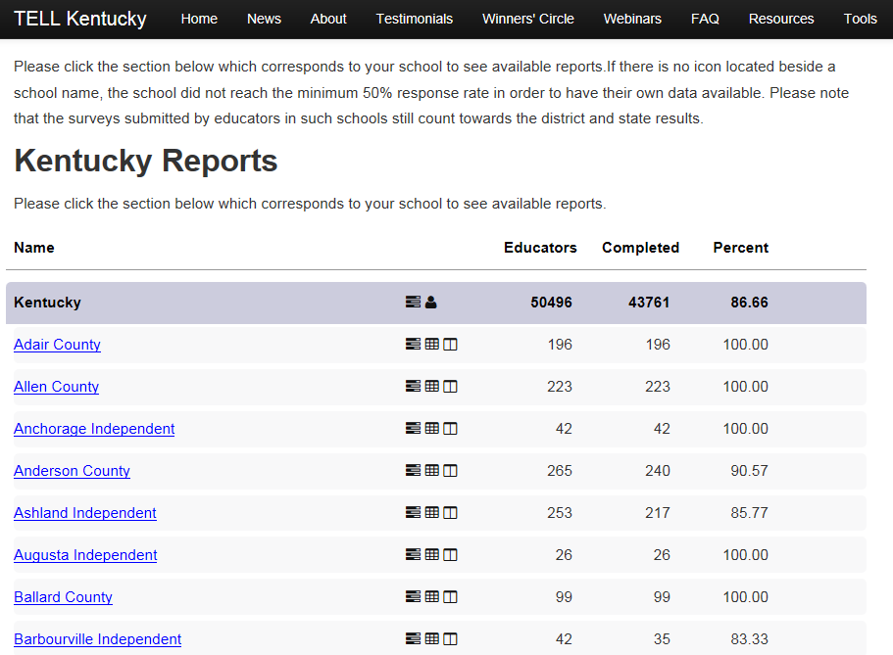
State Results Icons
# Educators
# Completed
% Completed
District Results Icons

Slide 8

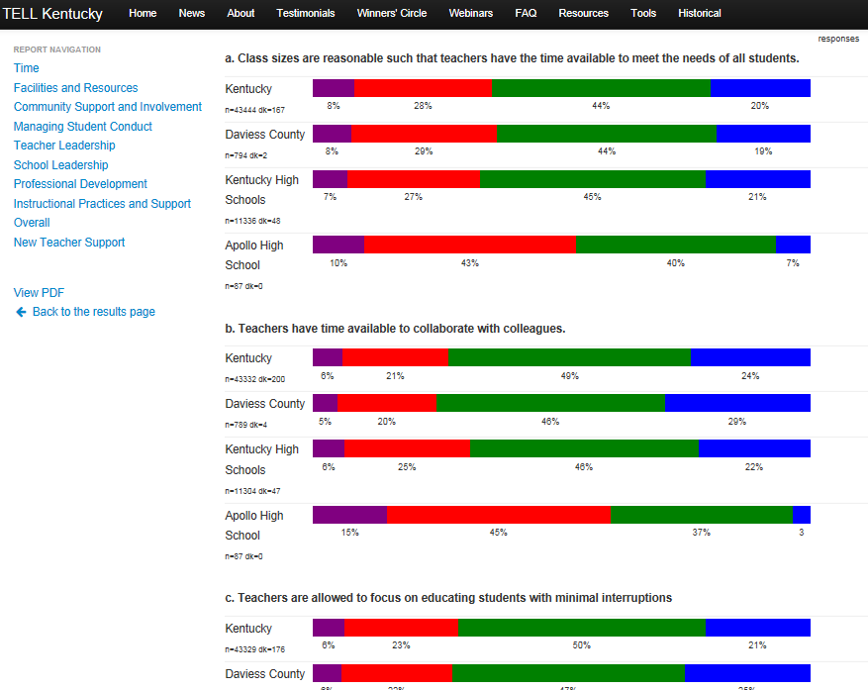
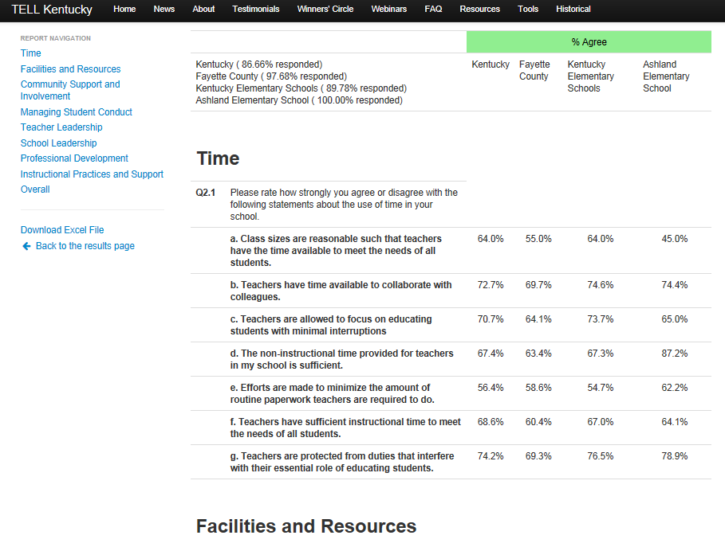
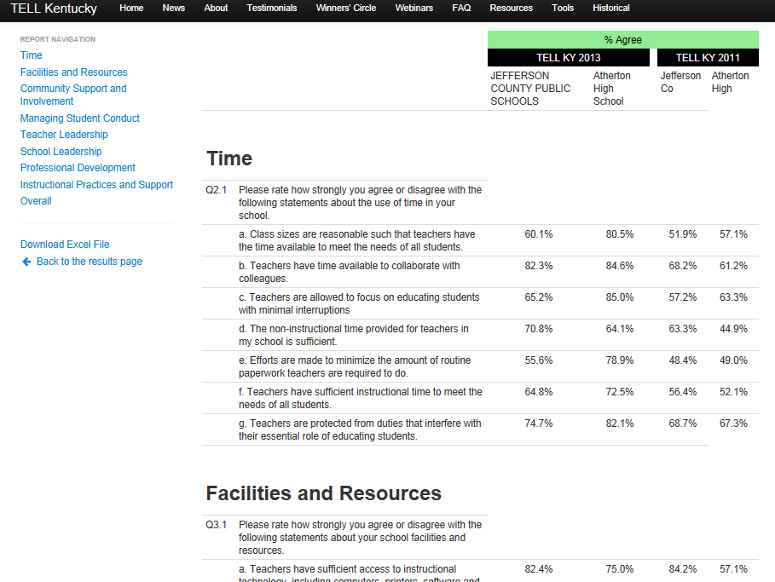
Three icons provide access to the results for the state, districts and schools.
Detailed
Summary
Comparison to 2011

Slide 9
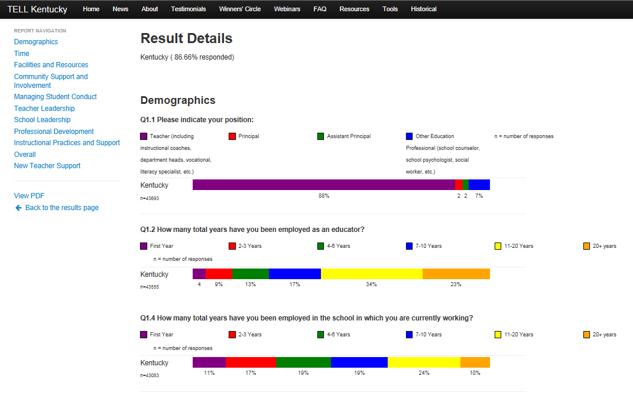
State Results (detailed view):
    Each question is listed with color coded bar results; when you scroll over the color, the actual information pops up.
    The Menu on the left side provides easy access to the main sections of the survey.

Slide 10
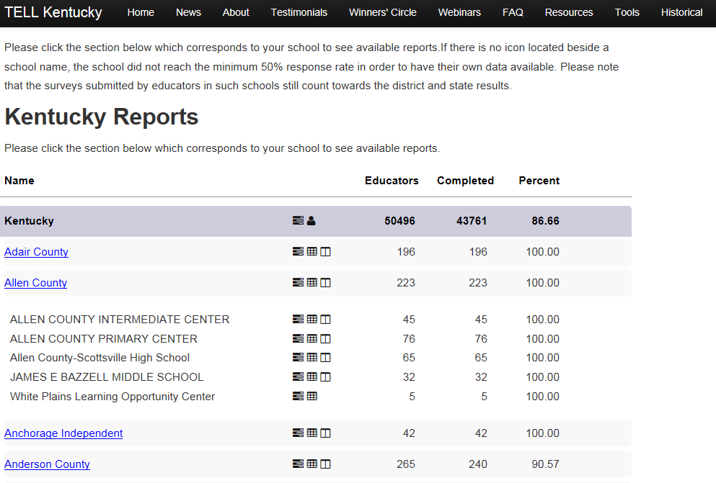
How to access school results
Schools in each district, followed by icons for reports, #educators, #responses, and % completed

Slide 11
Detailed School Results
COUNTY NAME
download
SCHOOL EXAMPLE
state
district
COUNTY NAME
like type
school
SCHOOL EXAMPLE
COUNTY NAME

Slide 12
Summary School Results
COUNTY
COUNTY NAME
School name
School name

Slide 13
Comparison to 2011 School Results
COUNTY NAME
School name
COUNTY NAME
School name

Slide 14
Preliminary Findings
www.tellkentucky.org

Slide 15
Increasing Participation in TELL Kentucky
Percentage of Licensed, School-Based Educators

Slide 16
About the 2013 Kentucky Respondents
Respondents | 2013 | 2011
Teachers | 88.3% | 88.9%
Principals | 2.5% | 2.5%
Assistant Principals | 2.0% | 1.8%
Other* | 7.1% | 6.8%
Total Response Rate | 43,761 (86.7%) | 42,025 (80.3%)
*Other includes school counselors, school psychologists, social workers, etc.

Slide 17
Respondents by School Level
School Type | 2013 |  |  | 2011
 | Headcount | Responded | % Responded | Headcount | Responded | % Responded
Elementary | 25,407 | 22,880 | 90.1 | 25,622 | 22,129 | 86.4
Middle | 9,548 | 8,189 | 85.8 | 10,082 | 8,071 | 80.1
High | 13,826 | 11,408 | 82.5 | 14,713 | 10,341 | 70.3
Other | 1,719 | 1,284 | 74.7 | 1,932 | 1,484 | 76.8
  90% of schools reached threshold in both iterations.

Slide 18
Please note that in the following Tables, the numbers shown represent the ‘Rate of Agreement’ which is the sum of the ‘Strongly Agree’ and ‘Agree’.

Slide 19
Composite Rate of Agreement by Construct
Rate of Agreement

Slide 20
Time Showed Most Increase in Rate of Agreement
+5.9
Rate of Agreement
Notes:
However, this is the lowest RA of the constructs

Slide 21
Time Items with Increased Agreement
Survey Item | 2013 | 2011 | 2013-2011
The non-instructional time provided for teachers in my school is sufficient. | 67.4 | 60.6 | 6.8
Teachers have time available to collaborate with colleagues. | 72.7 | 66.0 | 6.7
Teachers have sufficient instructional time to meet the needs of all students. | 68.6 | 62.6 | 6.0
Efforts are made to minimize the amount of routine paperwork teachers are required to do. | 56.4 | 50.5 | 5.9
Teachers are allowed to focus on educating students with minimal interruptions. | 70.7 | 65.1 | 5.6
Teachers are protected from duties that interfere with their essential role of educating students. | 74.2 | 68.9 | 5.3
Class sizes are reasonable such that teachers have the time available to meet the needs of all students. | 64.0 | 58.8 | 5.2

Slide 22
Instructional Practices Showed Highest Rates of Agreement; Second in Growth
85.9
+5.1
Rate of Agreement
80.8
Notes:
And grew the second most, behind Time

Slide 23
Instructional Practices and Supports Items with Increased Agreement
Survey Item | 2013 | 2011 | 2013-2011
Teachers have autonomy to make decisions about instructional delivery (i.e., pacing, materials and pedagogy). | 83.5 | 77.3 | 6.2
Teachers are assigned classes that maximize their likelihood of success with students. | 74.1 | 67.9 | 6.2
The curriculum taught in this school is aligned with Common Core Standards. | 97.7 | 92.0 | 5.7
Teachers work in professional learning communities to develop and align instructional practices. | 89.9 | 84.6 | 5.3

Slide 24
Instructional Practices and Supports Items with Increased Agreement
Survey Item | 2013 | 2011 | 2013-2011
Provided supports (i.e., instructional coaching, professional learning communities, etc.) translate to improvements in instructional practices by teachers. | 86.2 | 82.4 | 3.8
Local assessment data are available in time to impact instructional practices. | 88.5 | 85.6 | 2.9
Teachers use assessment data to inform their instruction. | 94.4 | 92.0 | 2.2
Teachers are encouraged to try new things to improve instruction. | 93.6 | 91.7 | 1.9
State assessment data are available in time to impact instructional practices. | 64.4 | 64.0 | 0.4

Slide 25
Educators Report More Agreement with Items Related to School Councils
Survey Item | 2013 | 2011 | 2013-2011
The school council makes decisions that positively impact school staffing and schedules. | 85.8 | 81.6 | 4.2
Parents on the school council are representative of the diversity within the school community. | 83.7 | 79.7 | 4.0
Overall, the school council provides effective leadership in this school. | 87.5 | 83.7 | 3.8
The school council makes decisions that positively impact instruction (i.e., curriculum, instructional practices, etc.). | 88.8 | 86.1 | 2.7
Teachers on the school council are representative of the faculty (i.e., experience, subject/grade, etc.) | 90.6 | 88.1 | 2.5

Slide 26
Teacher Leadership: Increased Agreement with Decision Making and School Improvement Processes
Survey Item | 2013 | 2011 | 2013-2011
Teachers are relied upon to make decisions about educational issues. | 83.5 | 79.7 | 3.8
The faculty has an effective process for making group decisions to solve problems. | 74.8 | 68.9 | 5.9
Teachers have an appropriate level of influence on decision making in this school. | 66.6 | 62.1 | 4.5
In this school we take steps to solve problems. | 82.7 | 78.5 | 4.2
Teachers are trusted to make sound professional decisions about instruction. | 84.9 | 81.0 | 3.9
Notes:
These are from teacher leadership and show a nice increase there as well.

Slide 27
Increased Agreement with School Leadership Items
Survey Item | 2013 | 2011 | 2013-2011
Teachers feel comfortable raising issues and concerns that are important to them. | 72.1 | 67.6 | 4.5
The school improvement team provides effective leadership at this school. | 83.7 | 79.2 | 4.5
The school leadership consistently supports teachers. | 79.6 | 75.3 | 4.3
There is an atmosphere of trust and mutual respect in this school. | 74.5 | 70.4 | 4.1
The faculty are recognized for accomplishments. | 80.7 | 77.0 | 3.7
The faculty and leadership have a shared vision. | 83.6 | 80.2 | 3.4
Notes:
School leadership third highest construct; grew third most – all questions increased in RA

Slide 28
Increased Agreement with School Leadership Items
Survey Item | 2013 | 2011 | 2013-2011
Teacher performance is assessed objectively. | 90.0 | 87.4 | 2.6
Teachers receive feedback that can help them improve teaching. | 86.6 | 84.4 | 2.2
The procedures for teacher evaluation are consistent. | 89.7 | 87.6 | 2.1
Teachers are held to high professional standards for delivering instruction. | 94.1 | 92.3 | 1.8
Notes:
School leadership third highest construct; grew third most – all questions increased in RA

Slide 29
Only Two Questions Where Rates of Agreement Decreased: Technology
Survey Item | 2013 | 2011 | 2013-2011
The reliability and speed of Internet connections in this school are sufficient to support instructional practices. | 75.6 | 81.7 | -6.1
Teachers have access to reliable communication technology, including phones, faxes and email. | 94.0 | 94.5 | -0.5

Slide 30
Induction Support for New Teachers
Overall, there are positive findings; however, these numbers should be noted:
Nineteen percent of the 5,452 novice teachers responding to TELL were not assigned a mentor; 2 out of 10 did not attend any orientation and one-quarter did not have access to professional learning communities.
Of new teachers assigned a mentor, the following percentages never worked with their mentor on:
  14% - analyzing student work
  13% - reviewing results of student assessments
  12% - developing lesson plans or aligned lessons with state and local curriculum
In the coming months NTC will provide a Brief that highlights more of the New Teacher findings.

Slide 31
Immediate Employment Plans
Q10.1 Which of the following best describes your immediate professional plans? (Select one.)

Slide 32
Questions Related to State Standards
Survey Item | 2013 Rate of Agreement
The curriculum taught in this school is aligned with Common Core Standards. | 97%
Q8.2 In which of the following areas (if any) do you need professional development to teach your students more effectively? Common Core | 50%
Q8.3 In the past 2 years have you had 10 clock hours or more of professional development in any of the following areas? Common Core Standards | 65%

Slide 33
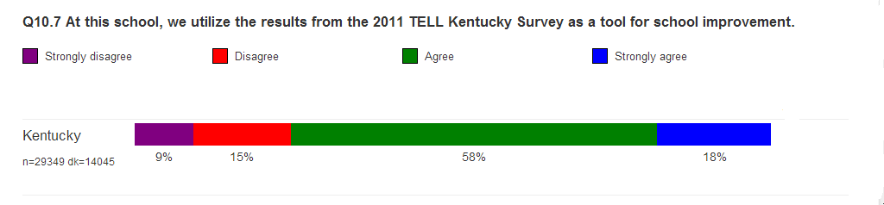
Use of 2011 TELL Survey Results
Since the release of the 2011 TELL Kentucky Survey results, the Kentucky Department of Education (KDE) and each of the TELL Kentucky Partners engaged in extensive outreach with stakeholders across the Commonwealth. The goals of outreach efforts were to emphasize the importance of the TELL data and to provide guidance in how to use the TELL data for improvement planning.

Slide 34
District 180
Since the 2011 TELL results were released, KDE has focused efforts on District 180 in order to utilize the findings when working with school leaders.
Preliminary results are very encouraging; for example:
  The Rates of Agreement in District 180 schools, as a group, increased overall and increased more than the state.
  Cohort 1 reports the highest Rates of Agreement overall.
  Cohort 2 reports the most increase in Rates of Agreement overall.
  The areas of most improvement for Cohorts 1 and 2 appear to be the two areas which also showed the greatest connection to student achievement in 2011: Community Engagement & Support and Managing Student Conduct for Cohort 1 and Community Engagement & Support and School Leadership for Cohort 2.
  Instructional Practices rates of agreement are almost equal to the state.
In the coming weeks, NTC will provide a detailed report on the findings in these schools.

Slide 35
District 180
Rate of Agreement

Slide 36
Summary

Slide 37
More educators took the TELL Kentucky Survey (86.7% in 2013; 80.3% in 2011).
Educators report:
  More agreement in the areas of Instructional Practices and Supports, School Leadership, and School Councils;
  More teacher engagement in decision making processes; and
  Highest increase in agreement with items related to Time, although the lowest area on the survey.
Only two questions declined in agreement from 2011 to 2013 and are related to technology.
Improvements in key areas assessed by the TELL Survey validate efforts made by state leaders to use the data since 2011. Areas include: Time, Instructional Practices & Support, Community Engagement & Support, Managing Student Conduct, and Leadership.

Slide 38
Supports & Next Steps

Slide 39

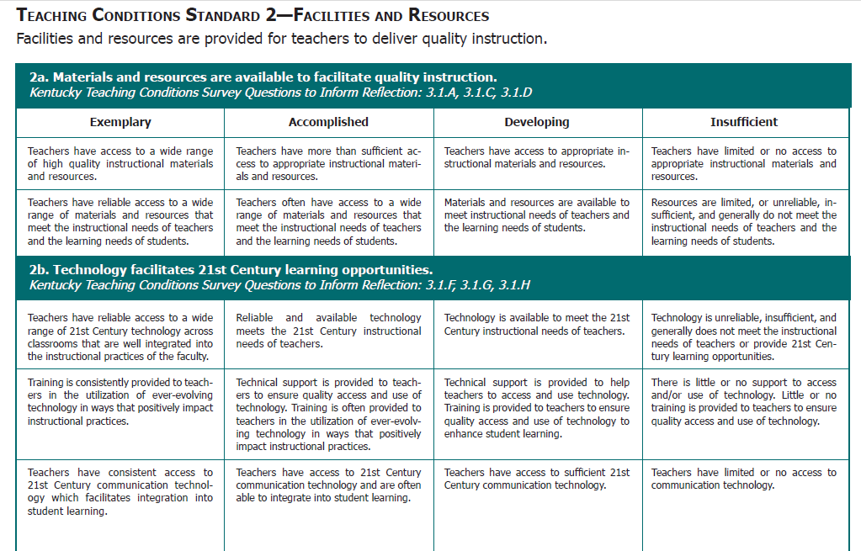
School and district leaders have been encouraged to review their data using the continuum in the Kentucky Standards for Teaching Conditions and begin plans on how to incorporate findings into the school improvement plan for next year!

Slide 40
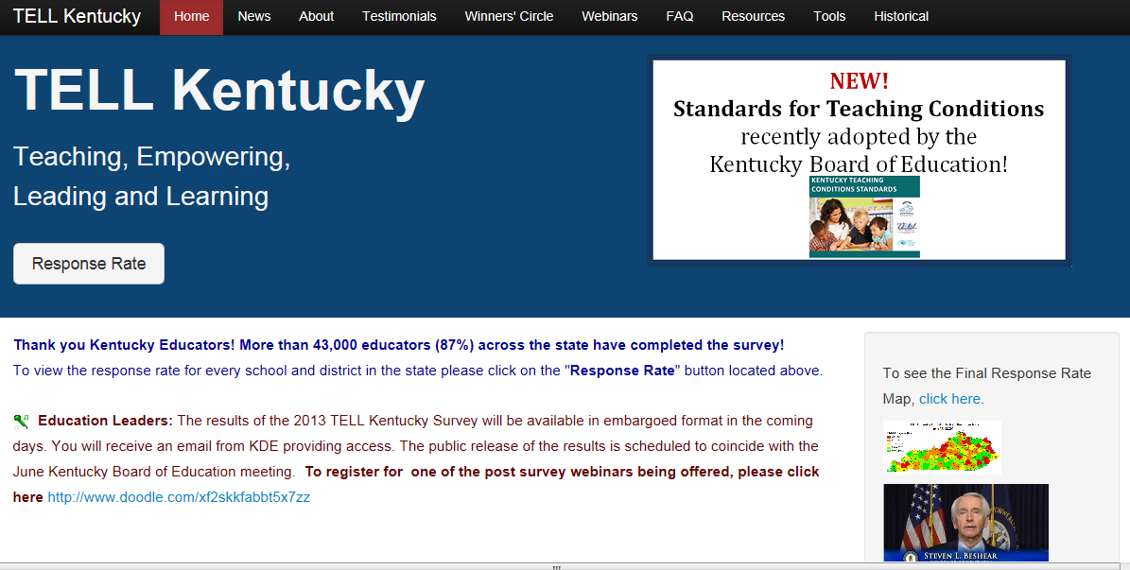



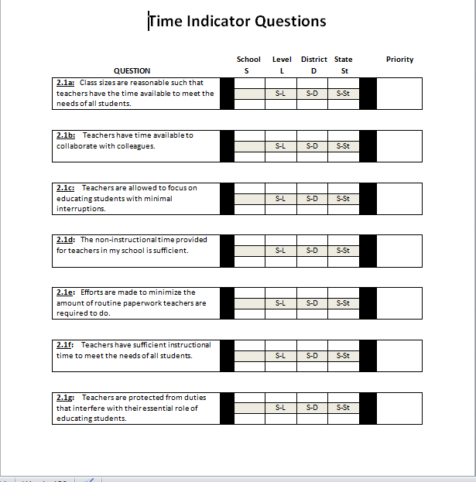

Tools for Using Your Data
School Boards
District Leaders
SBDM Councils
KEA District Leaders

Slide 41

The 2013 Winner’s Circle Awards will be announced in September.
In the coming months, NTC will release additional findings and reports which will be posted on the www.tellkentucky.org website. Reports will include connections to student achievement, teacher retention, findings by grade level, new teacher support and District 180.

Slide 42
Congratulations for a very successful TELL Kentucky year and for “Taking the Reins” and leading the way for other states across the nation!

Slide 43
Ann Maddock amaddock@newteachercenter.org
919.600.4945
For more information

