Slide 1
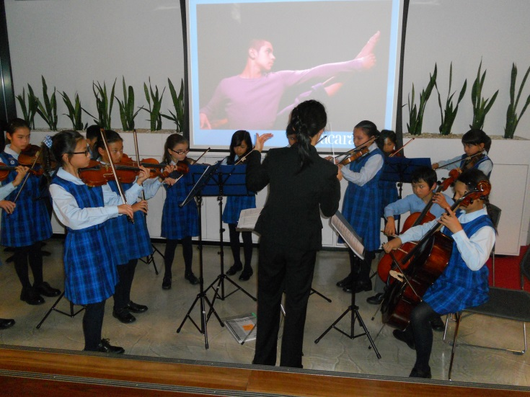
Global Education Leaders’ Program (GELP)
May 6-10, 2013
Sydney, Australia

Slide 2
What is Global Education Leaders’ Program (GELP)?
Community of key education system leaders
Policy-makers, thought-leaders and world-class consultants
Collaborating to transform education at local, national and international levels

Slide 3
What is Education 3.0?
Arose out of a set of key ideas which were explored in a series of Cisco white papers
Presented a compelling case for why the current education system, developed in the age of industrialization, is insufficient for the evolving and dynamic conditions of the 21st Century
Three Challenges:
  Globalization
  Demographics Shifts
  Technological Revolution

Slide 4
What is Education 3.0? (cont.)
Growing consensus that system transformation, not school improvement, is the necessary response
Transformational System to Occur
  Equitable access
  Holistic Approach – The System is Complex/Interdependent
  Transfer of Ownership from Teachers to Learners
  Technological Learning

Slide 5
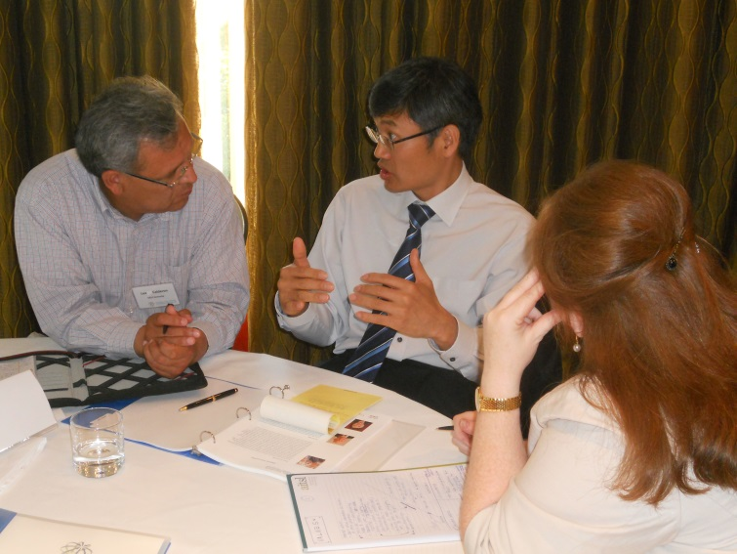
What is the goal of GELP?
To equip every learner with the skills, expertise and knowledge to survive and thrive in the 21st century

Slide 6
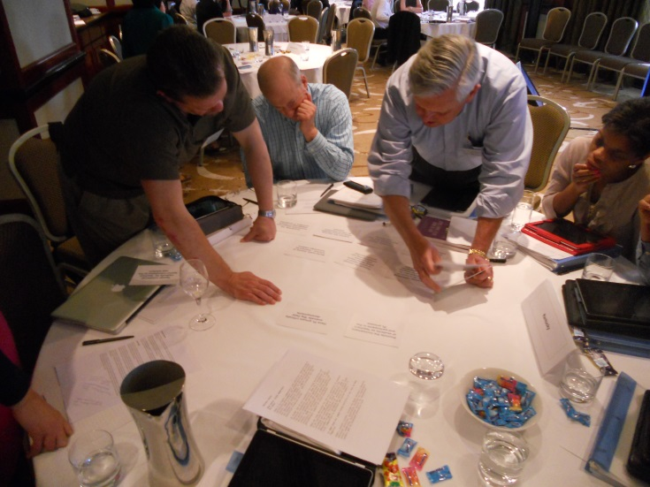
What are we doing?
Building a case for a transformational change for 21st century education
Need to be cognizant of culture, values for a 3.0 education learning and leadership
KY Roadmap Development: Districts of Innovation Initiative

Slide 7
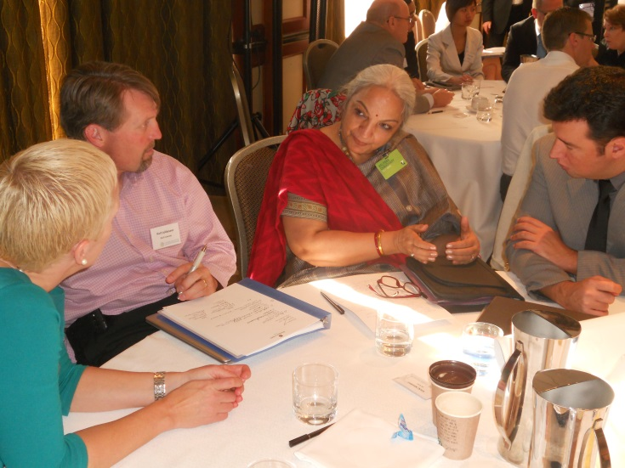
Who are the participating countries, jurisdictions?
Brazil
British Columbia, Canada
Chaoyang District, Beijing
Colorado, Kentucky & New York
Finland
India
New Zealand
South Korea
Victoria, Australia

Slide 8
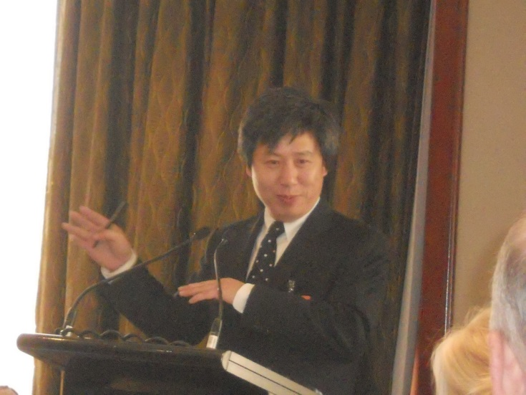
What did we do in Sydney?
Session led by Yong Zhao, Presidential Chair/Associate Dean, University of Oregon

Slide 9
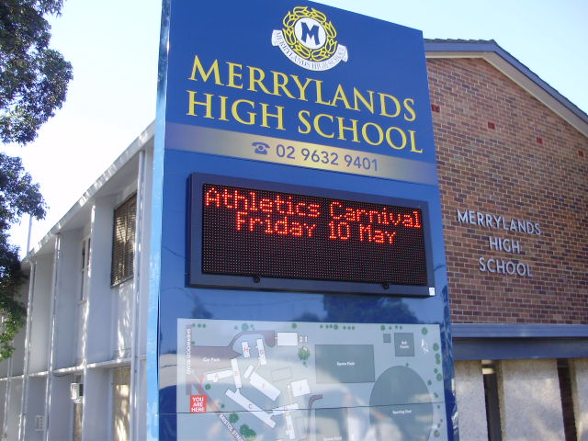
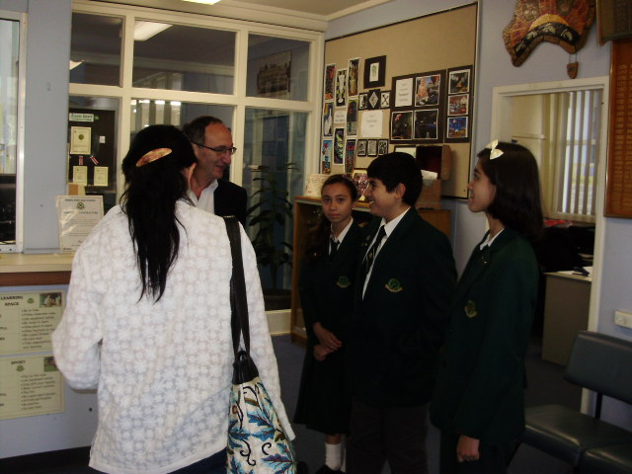
What did we do in Sydney? (cont.)
Schools Visits
  Campbelltown Performing Arts H.S. – 1,174 students, action learning is used, world’s most advance users of technology in the classroom
  Merrylands H.S. – students come from over 52 cultural backgrounds, 68% come from non-English- speaking backgrounds, technology based teaching and learning

Slide 10
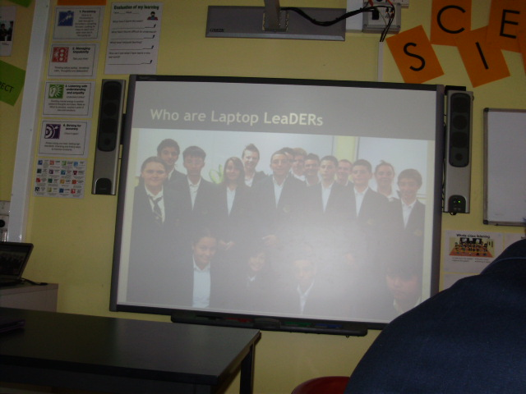
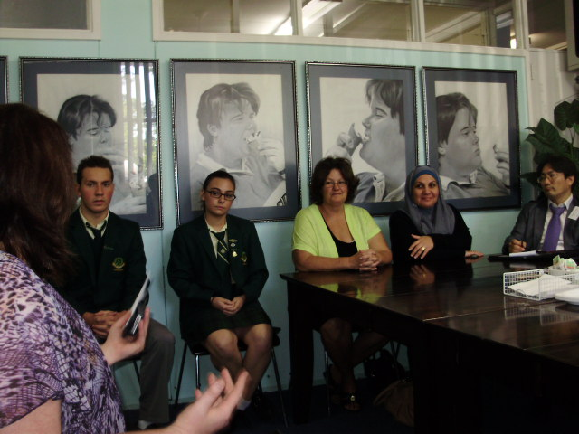
Schools Visits- Cont.
Northern Beaches Christian School – past years it has grown from 250 to more than 1,200 students. In 2005, the principal founded the Sydney Centre for Innovation. Internal innovation was encouraged but now includes the broader community – local, nationally and internationally

Slide 11
What did we do in Sydney? (cont.)
Implications of political leadership and education transformation
Tom Bentley, Deputy Chief of Staff to the Australian Prime Minister
Former high school graduates and current students shared their educational experiences

Slide 12
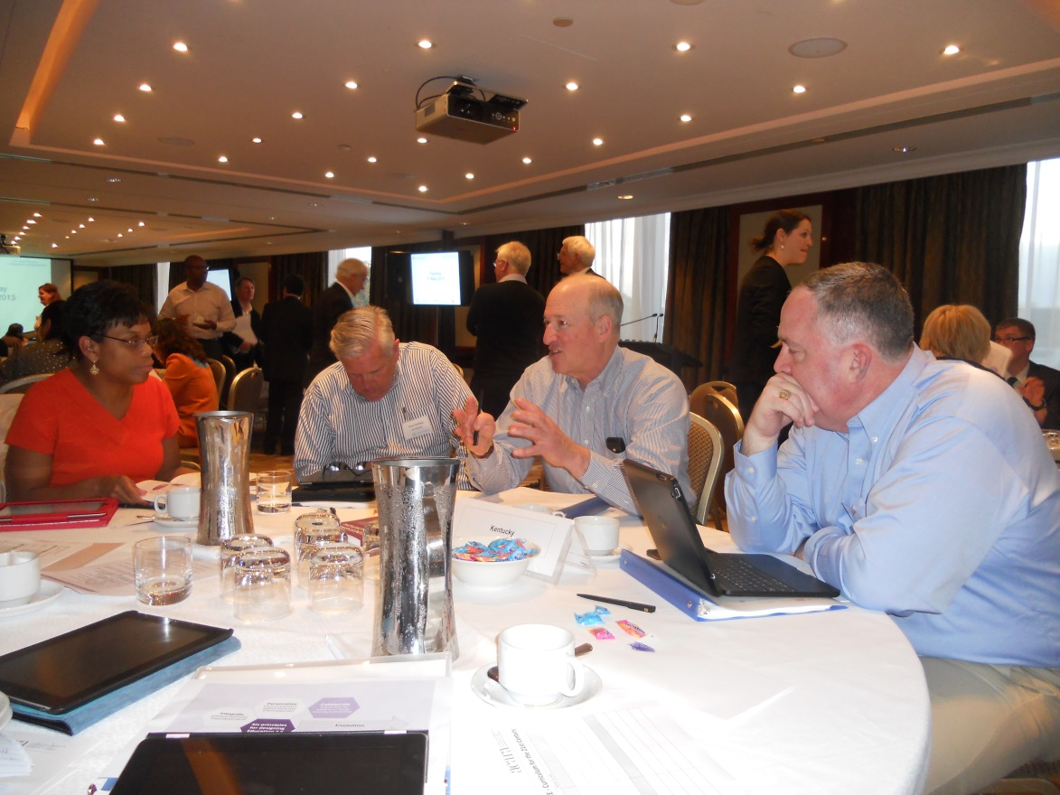
What did we do in Sydney? (cont.)
Cross Jurisdictional Workshops
Boardrooms and School Visits
Provided feedback to New South Wales Minister Adrian Piccoli

