Slide 1



Strategic Planning
Update

Slide 2


District/School Report Card
http://applications.education.ky.gov/SRC/

Slide 3
Stocktakes
A stocktake is a bi-annual update to the
Commissioner
Each of our four Delivery Plans reports bi-annually to the Commissioner via stocktakes

Slide 4
Stocktakes
The Gap stocktake occurred December 20, 2012.

Slide 5
Gap Progress Report
Strategy | Dec ’12 | Problems/Concerns
Best Practices and Sustainability |  | Schedule needs to be fully defined along with the relationship with the PEEK tool.
Consolidated Planning & Use of Data | 
Digital Learning | 
Individual Learning Plan Addendum | 
Professional Development for Gap Closure |  | Delay in schedule around three components: PD process, co-teaching and CCR student review.
Progress Monitoring |  | Scope is not fully defined. Strategy lead is working with an advisory group as well as existing enterprise data system leads to determine the next steps of this strategy.

Slide 6
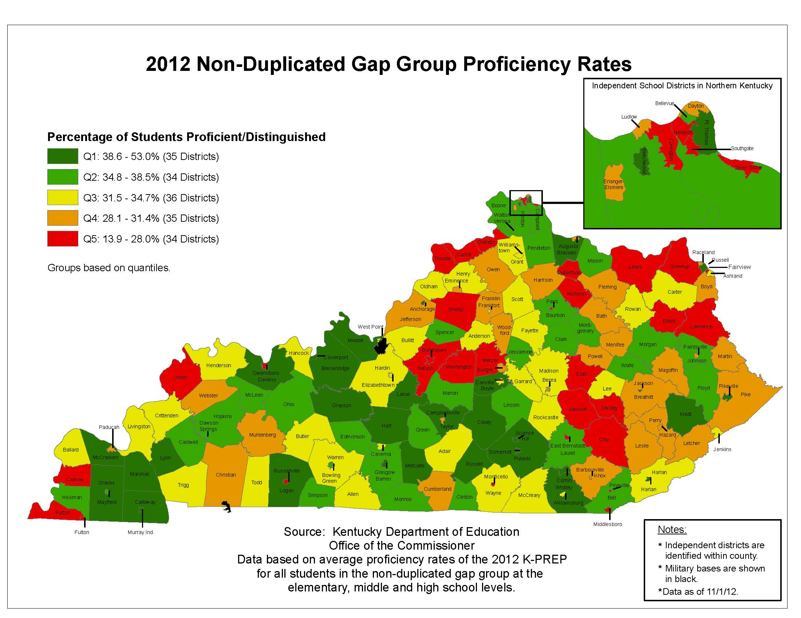

Slide 7
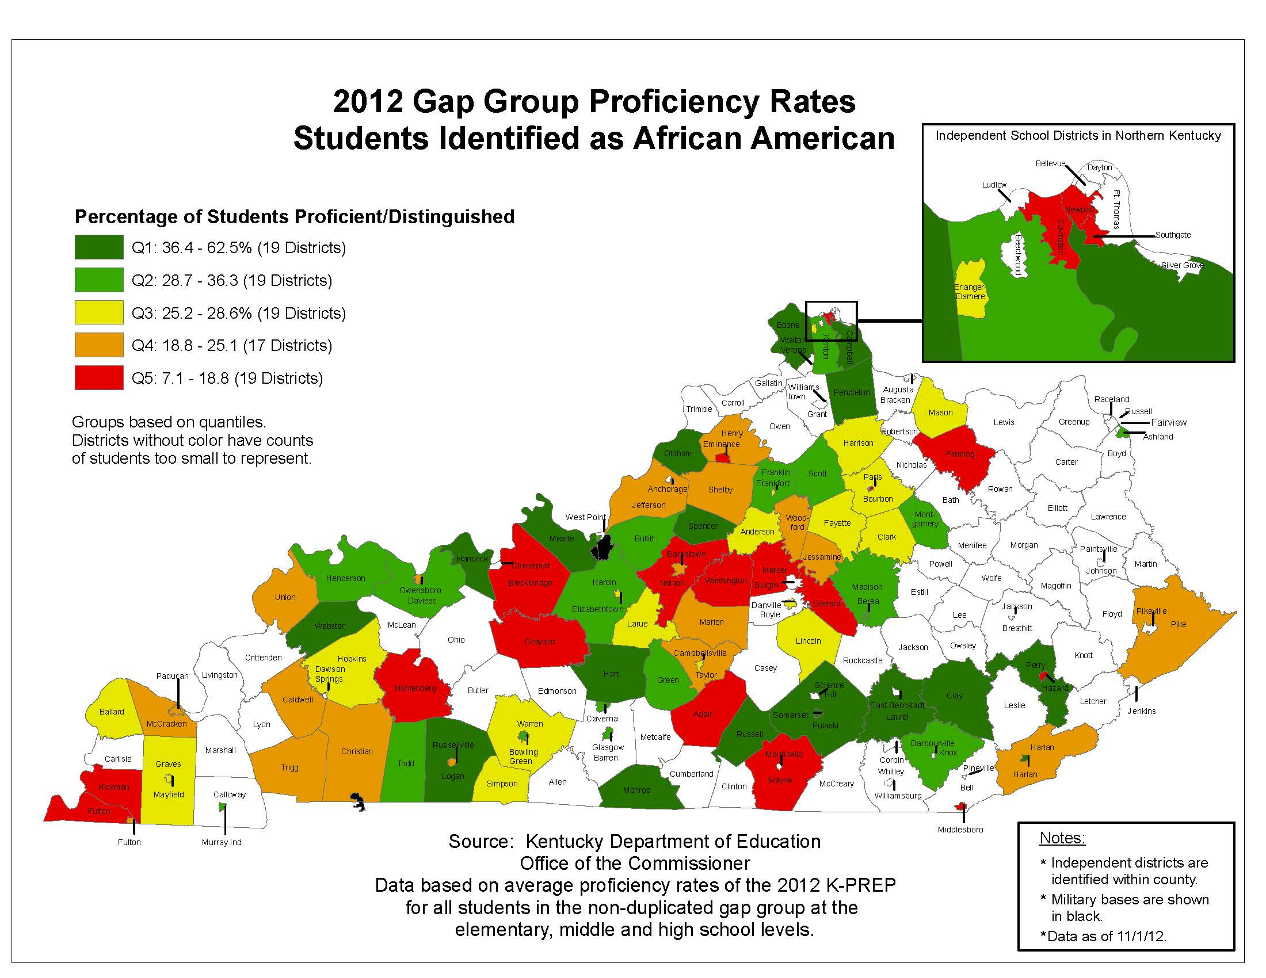

Slide 8
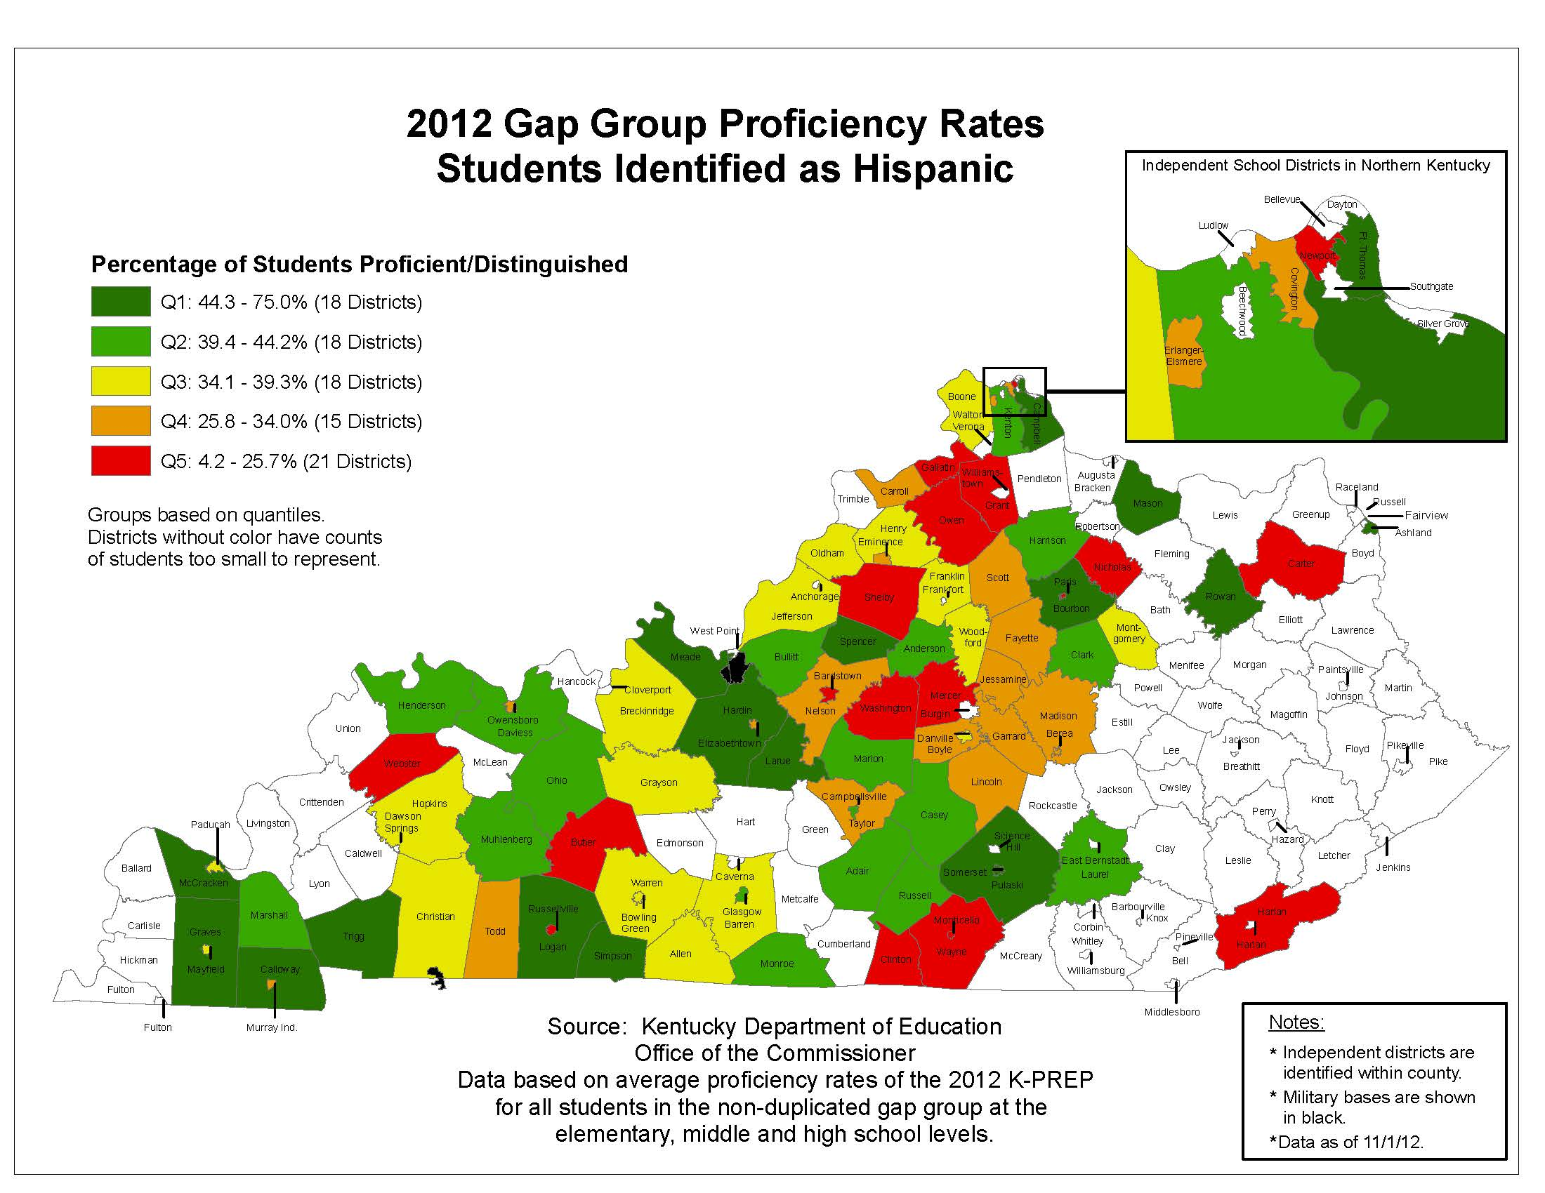

Slide 9
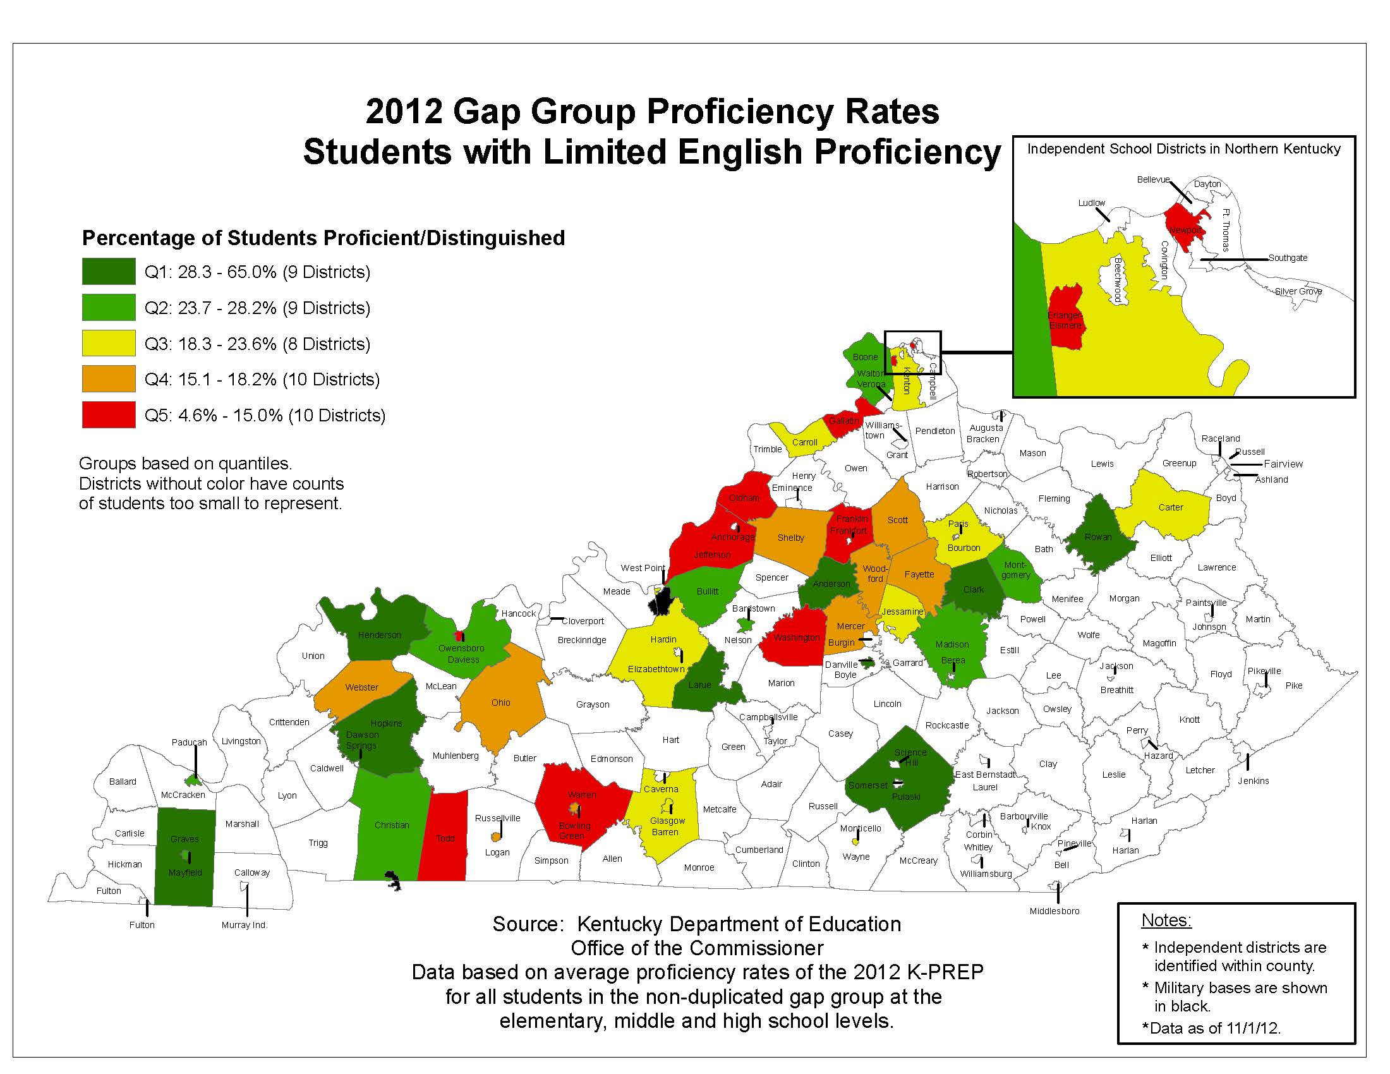

Slide 10


Slide 11
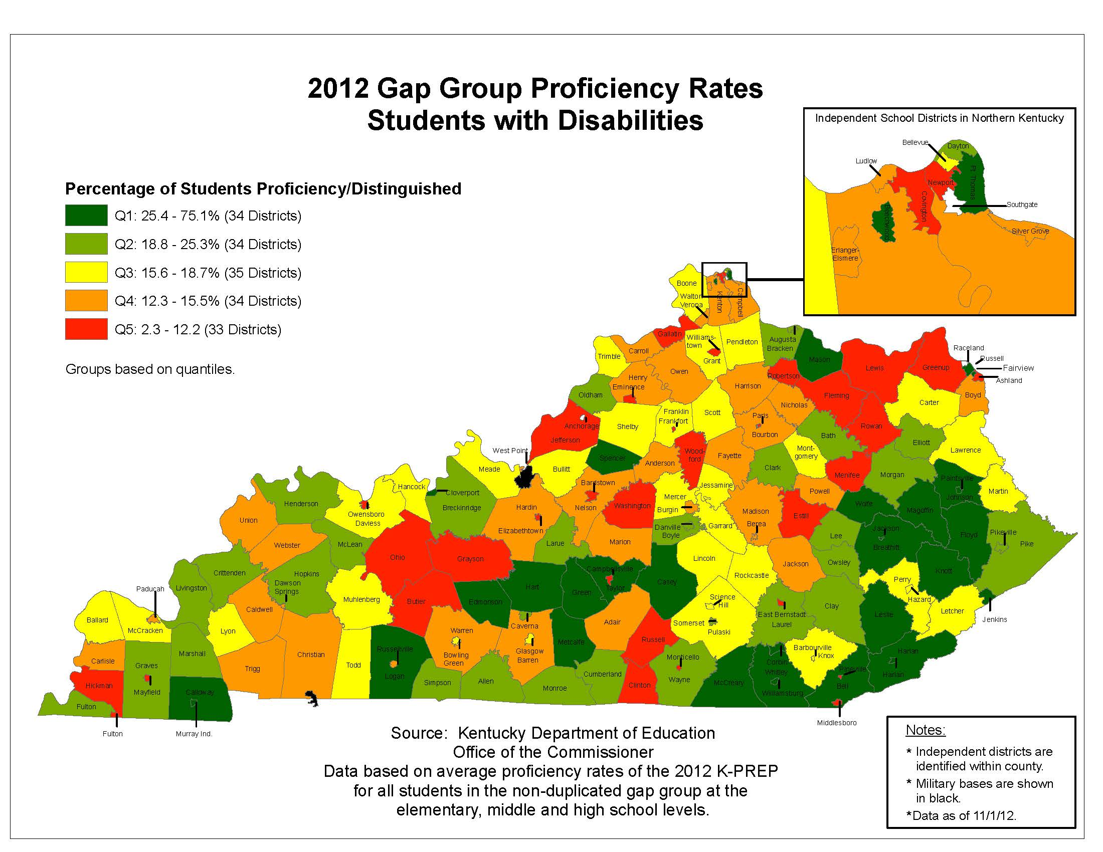

Slide 12
Stocktakes
The Next Generation Professionals stocktake occurred on January 22, 2012.

Slide 13
Next Generation Professionals Progress Report
Strategy | Jan ’13 | Problems/Concerns
Professional Growth & Effectiveness (Teachers) | 
Professional Growth & Effectiveness (Principals) |  | The strategy lead is working with the CDU in order to craft an analysis plan to determine whether there is a need for a statewide summative data collection system.
Educator Development Suite (EDS) | 
Human Capital Management |  | The scope is evolving rapidly for this strategy and the correct tasks are being identified. The strategy lead is working with the CDU in order to craft a research plan to help determine what questions need to be answered.
Professional Learning & Support |  | The budget to sustain this strategy still needs to be determined. The scope, schedule and tasks for this strategy need to be determined more fully. Professional Development statute has been proposed. The CDU will lead a session on Jan 29 to help define the scope.
TELL Kentucky and the Use of Data | 

Slide 14
The following measure is appropriate to support the Professional Growth and Effectiveness System (PGES).
Percentage of Respondents who agreed
Percentage of Respondents who disagreed
Observation N=275 | Student Growth N=253 | Student Growth received SGP N=138 | Reflective Practice N=246 | Professional Growth Plans N=238 | Student Voice N=200 | SV Tripod Participants N=58
Notes:
According to the PGES survey, participants have high levels of agreement that the PGES measures (with the exception of student voice) are appropriate measures of teacher effectiveness. With the student voice tool, participants who took part in the tripod survey were more likely to agree that the measure was appropriate to measure teacher effectiveness.

Slide 15
When discussing the following measures with my colleagues, the reactions I encountered were:
Percentage of Respondents who had positive responses from their colleagues
Percentage of Respondents who had negative responses from their colleagues
Observation N=231 | Student Growth Goals N=190 | Reflective Practice N=158 | Professional Growth Plans N=177 | Student Growth Percentiles (SGP) N=98 | SGP received scores N=85 | Student Voice N=96 | SV Tripod Participants N=46
Notes:
According to the PGES survey, the discussions about the PGES measures were very positive for PGPs and Reflective Practice. With the new tool, teachers are focusing on their own growth. The other measures are encountering less positive reactions from colleagues in field test schools. The most negative reactions are in the student voice tool; however, this is mitigated when looking at teachers who have participated in the tripod survey. The low N counts are due to the fact that not all teachers discussed the measures with colleagues.

Slide 16
Perceptions of Overall Professional Growth and Effectiveness System (PGES)
Percentage of Respondents who agreed
Percentage of Respondents who disagreed
I feel comfortable being assessed using the Professional Growth and Effectiveness System (PGES) framework. N=218 | My district currently has the infrastructure to train all its teachers in the proper use of the Professional Growth and Effectiveness System (PGES). N=215 | I have effectively communicated the purpose and expectations of the field test to my colleagues. N=218
Notes:
According to the PGES survey, nearly 70% feel comfortable being assessed by the PGES; however, less than half the participants feel that their district has the infrastructure to train all its teachers in the USE of PGES.

